Slide 1
Figures for TOG paper

Slide 2
RDT1
RDT2
Pr(hand | data) = P₁
Pr(!hand | data) = P₂
Pr(hand | data) = P₃
Pr(!hand | data) = P₄
Pr(hand | data) ≈ (P₁+P₃) / (P₁ + P₂ + P₃ + P₄)
Pr(!hand | data) ≈ (P₂+P₄) / (P₁ + P₂ + P₃ + P₄)

Slide 3
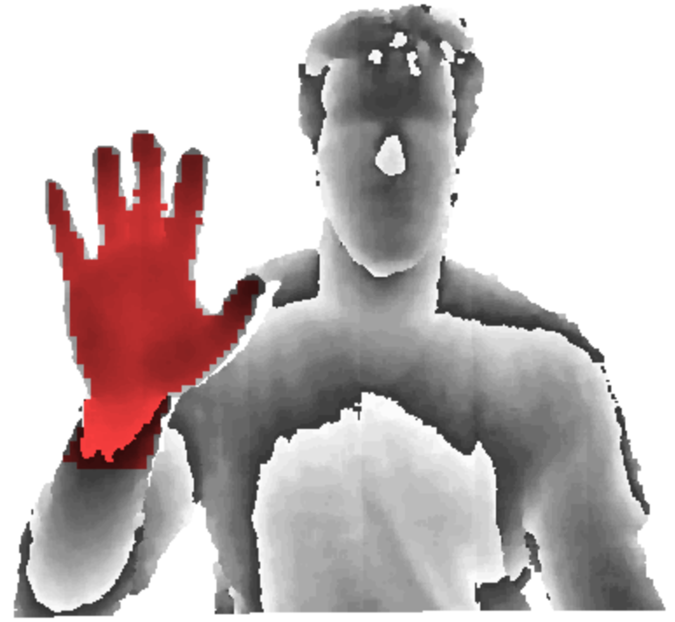

Target Labeling
Trained RDF Labeling

Slide 4
RDF image segmentation
Neural Network Feature Extraction
Real-Time Pose Recovery
Motion capture database

Slide 5
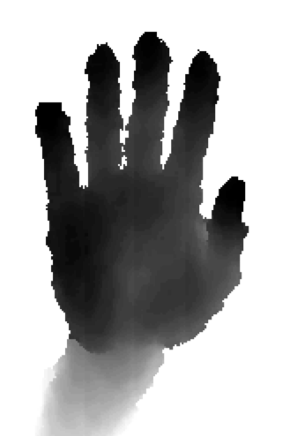
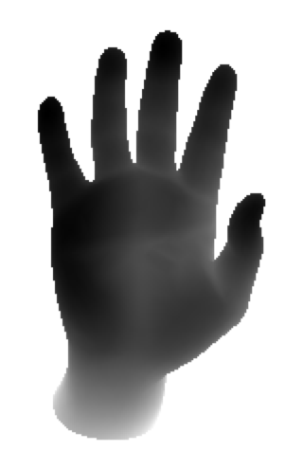
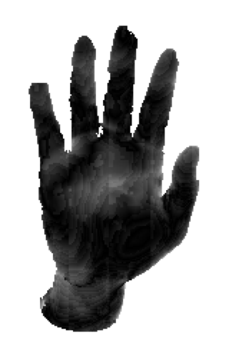
PrimeSense
synthetic
residue

Slide 6
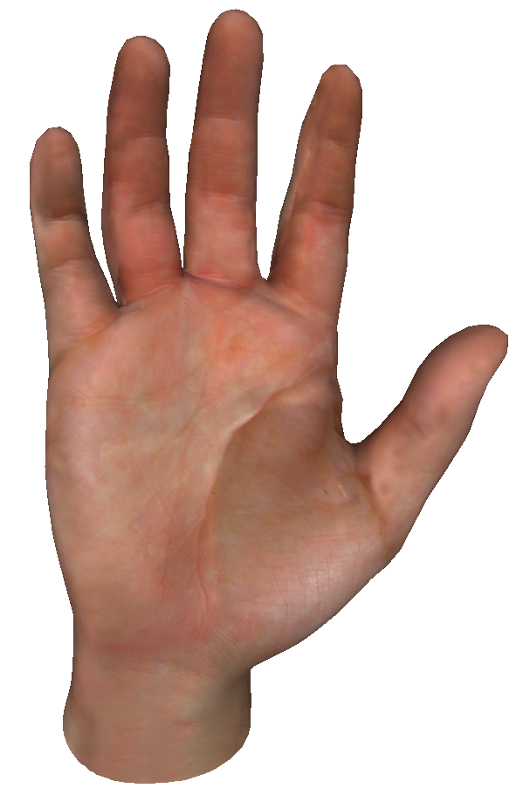
6 DOF
3 DOF
2 DOF
1 DOF

Slide 7
Render Hypothesis
Evaluate Fit
Adjust Hypothesis
Check Termination
PSO
search space coverage
Nelder-Mead
Fast local convergence

Slide 8
96x96
CNN Feature Detector 1
Image Preprocessing
48x48
CNN Feature Detector 2
2 stage Neural Network
CNN Feature Detector 3
24x24
concatenate
(1D vector)
heat-maps

Slide 9
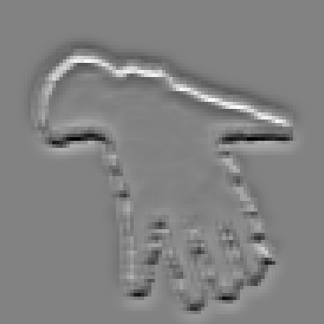
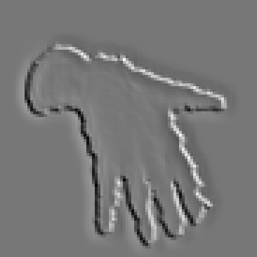
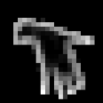
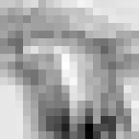

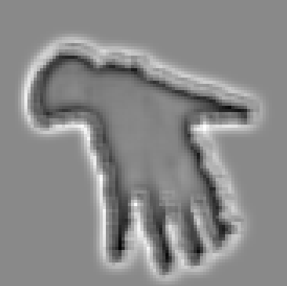
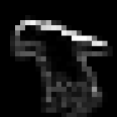
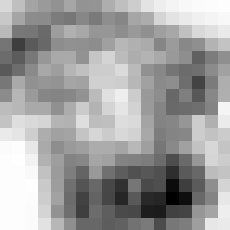
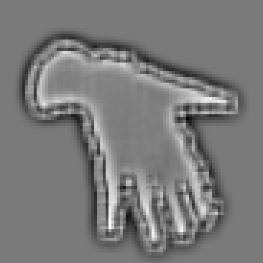
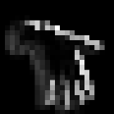
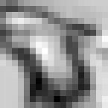

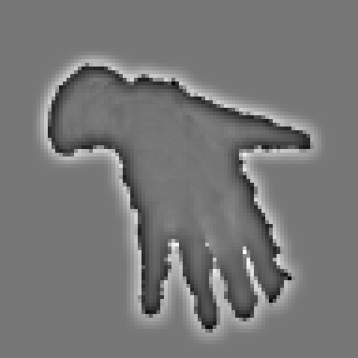
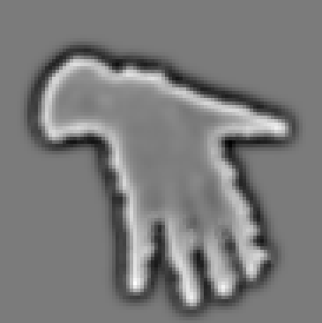
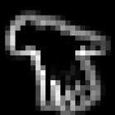
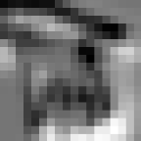

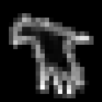
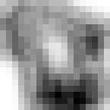

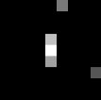
16x92x92
16x23x23
32x22x22
32x9x9
1x96x96
5x5 convolution
4x4 maxpool + ReLU
6x6 convolution
2x2 maxpool + ReLU

Slide 10





3x32x9x9
7776
14x18x18
Heat-maps
4536
4536
4536
resize
ReLU
resize
Neural Net
Neural Net

Slide 11
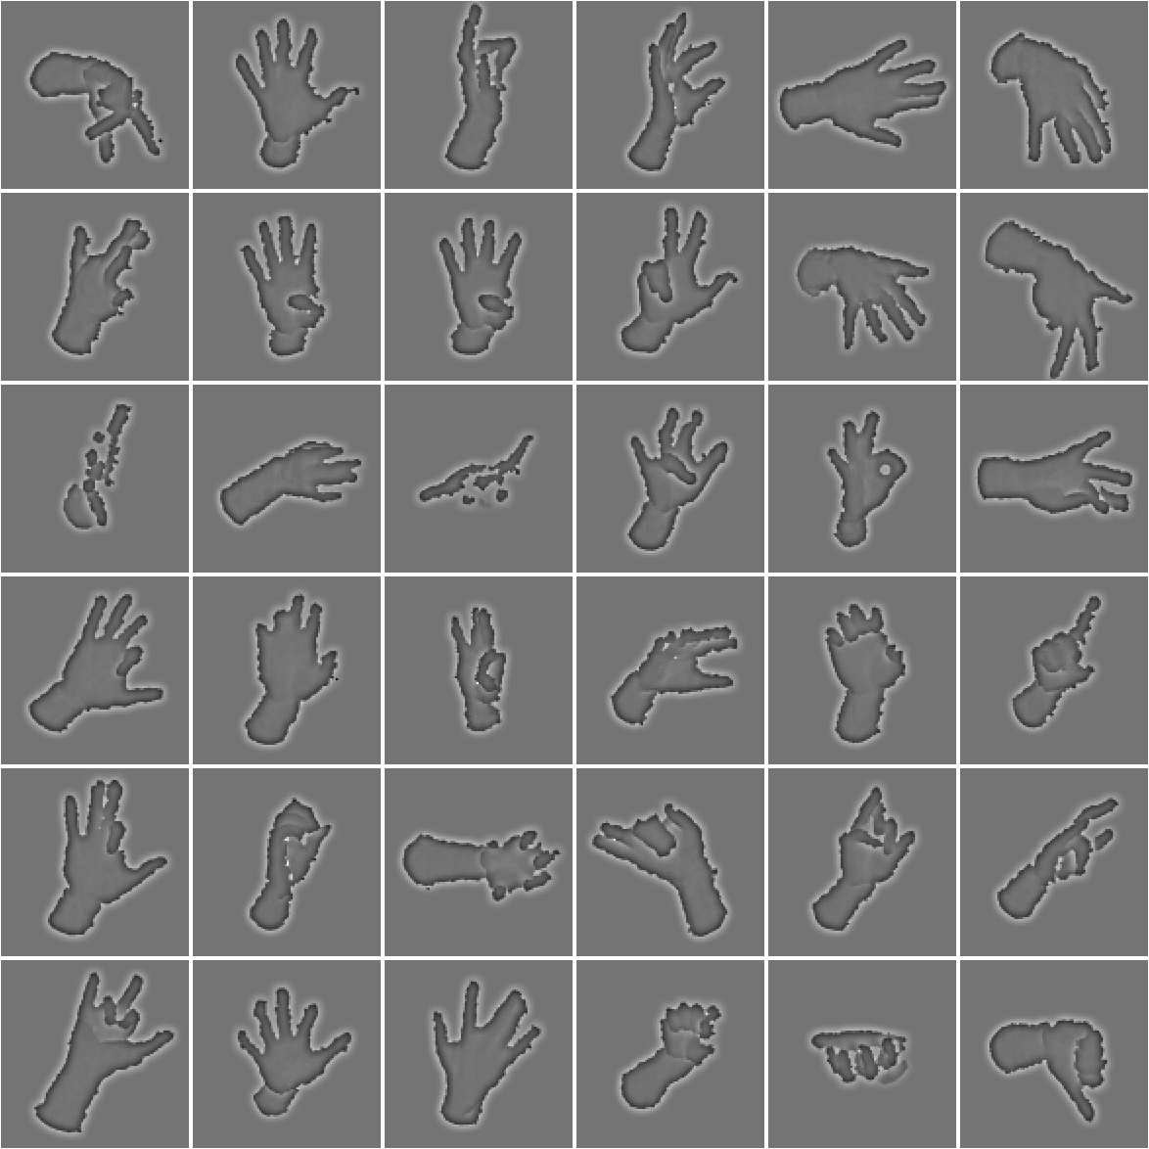

Slide 12
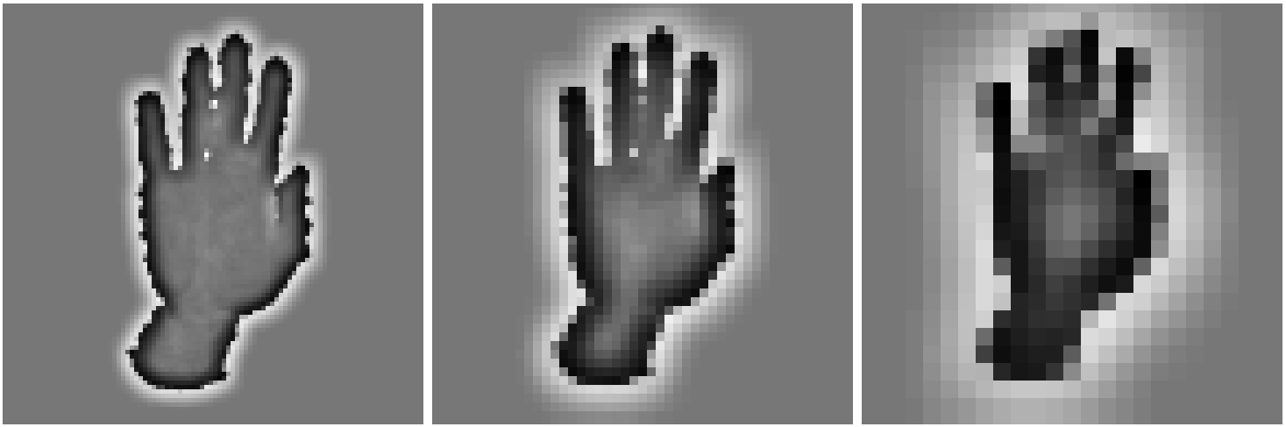
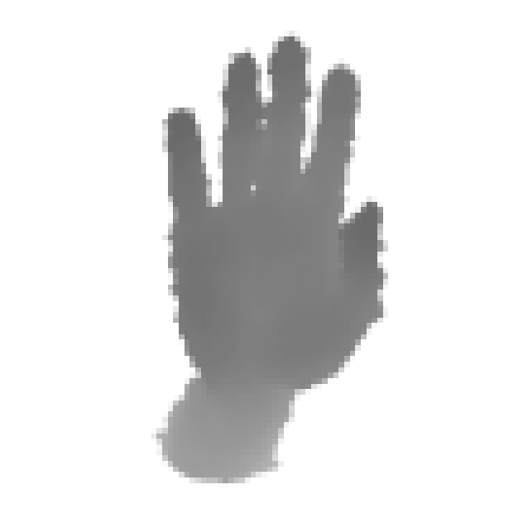
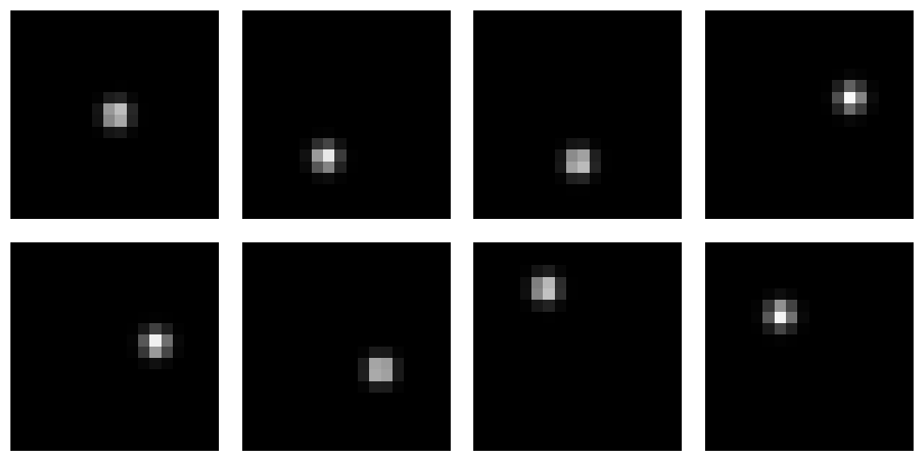
Note, brightness and contrast were adjusted

