Slide 1
Real-time Pose Recovery of Human Hands Using Convolutional Neural Networks
J. Tompson, M. Stein, K. Perlin

Slide 2
Real-time Pose Recovery of Human Hands Using Convolutional Neural Networks

Slide 3
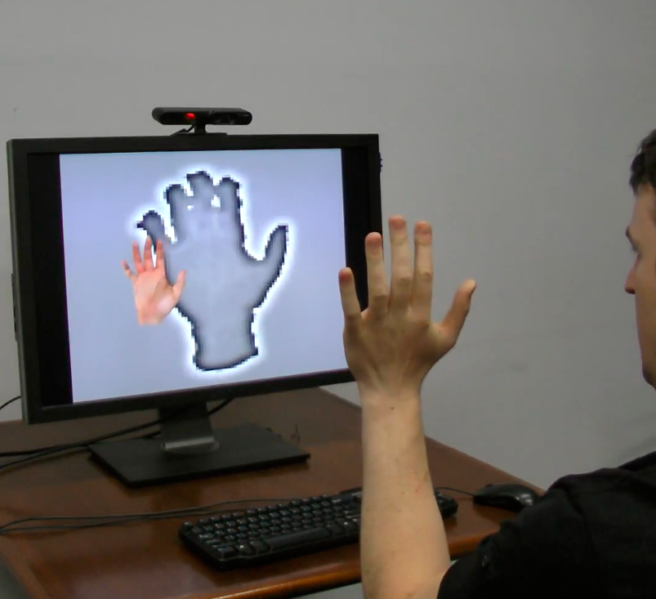
RDF Image Segmentation
Neural Network Feature Extraction
Real-Time Pose Recovery
Offline Database Generation

Slide 4
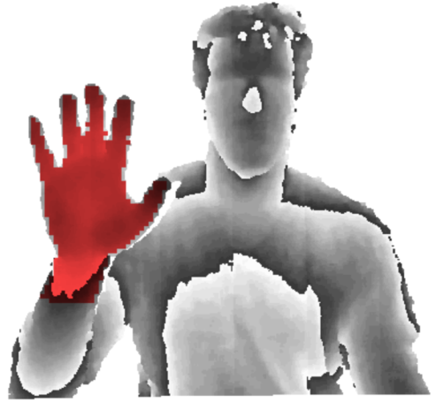
RDF Image Segmentation
Neural Network Feature Extraction
Real-Time Pose Recovery
Offline Database Generation

Slide 5
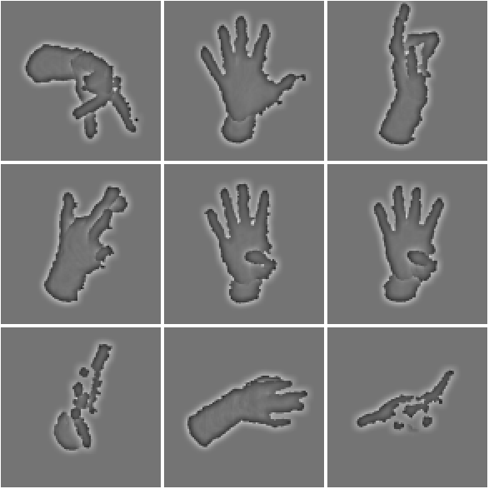
RDF Image Segmentation
Neural Network Feature Extraction
Real-Time Pose Recovery
Offline Database Generation

Slide 6
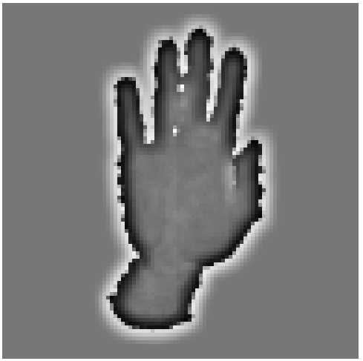
RDF Image Segmentation
Neural Network Feature Extraction
Real-Time Pose Recovery
Offline Database Generation

Slide 7
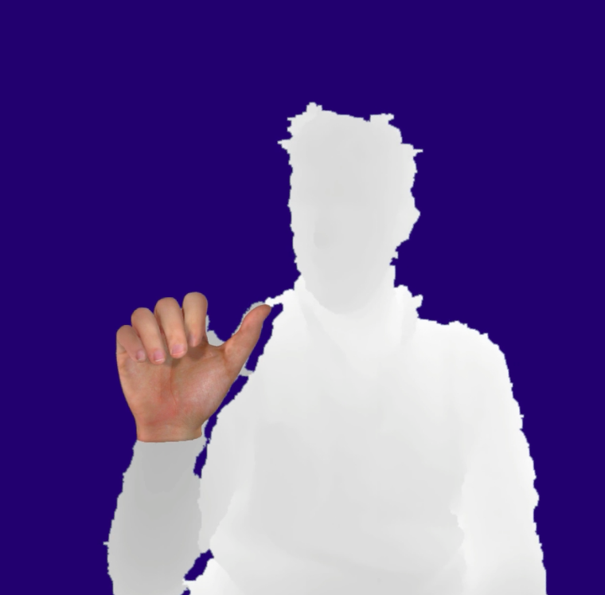
RDF Image Segmentation
Neural Network Feature Extraction
Real-Time Pose Recovery
Offline Database Generation

Slide 8
96x96
CNN Feature Detector 1
RDF Image Segmentation & Preprocessing
48x48
CNN Feature Detector 2
2 stage Neural Network
CNN Feature Detector 3
24x24
concatenate
(1D vector)
heat-maps

Slide 9
Dataset Creation

Slide 10
Real-time Pose Recovery

