Slide 1
Is ASP.NET Core Ready for Primetime?
Jonathan "J." Tower

Slide 2

Hi, I’m J.
Jonathan "J." Tower
Partner & Principal Consultant
Trailhead Technology Partners
trailheadtechnology.com
 Microsoft MVP in ASP.NET
 Telerik/Progress Developer Expert
✓ Organizer of Beer City Code
→ jtower@trailheadtechnology.com
✶ trailheadtechnology.com/blog
 jtowermi
github.com/jonathantower/aspnet-core-primetime

Slide 3


If You Give $200, So Will I!
bit.ly/stirtrek-water
“charity:water is a non-profit organization that provides clean and safe drinking water to people in developing nations. The organization was founded in 2006 and has helped fund 22,936 projects in 24 countries, benefiting over 4.6 million people.” - Wikipedia
“4/4 Stars” - CharityNavigator.org

Slide 4
Is ASP.NET Core Ready for Primetime?
Jonathan "J." Tower

Slide 5
Yup

Slide 6
Thank You! Questions?*
*Just kidding

Slide 7
Some History

Slide 8
History of ASP.NET Core
ASP.NET vNext May 2014
ASP.NET 5 Feb 2015
ASP.NET Core 1.0 January (released June) 2016
ASP.NET Core 1.1 November 2017
ASP.NET Core 2.0 August 2017
ASP.NET Core 2.1 May 2018
ASP.NET Core 2.2 December 2018
ASP.NET Core 3.0 2nd half 2019 (TBA at Build)
Notes:
vNext/5 – k / kre / kpn / kvm
1.0 RC1 – DNVM / DNX / DNU
1.0 RC2 – CLI
1.1 Killing off the project.json file
2.0 Razor pages, metapackages, .NET Standard 2.0
2.1 SignalR, Razor class libs (for Identity), APIController, ACtionResult<T>
2.2 Full OpenAPI (swagger) support
3.0 Razor components (for Blazor), gRPC

Slide 9
The Reasons ASP.NET Core is Ready for Prime-Time

Slide 10
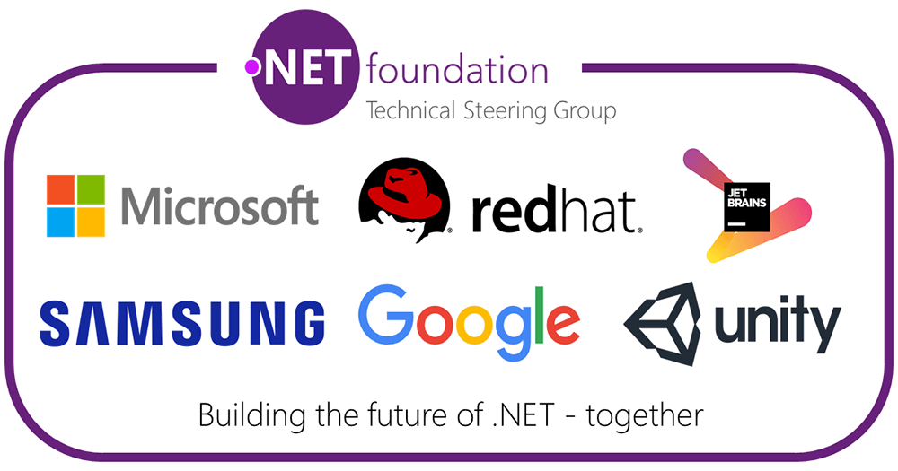

Open-Source

Slide 11

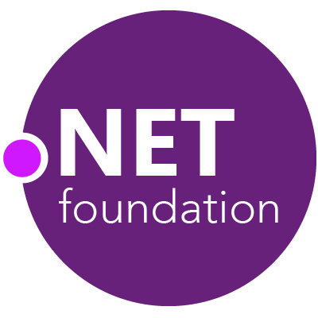
Steeltoe
.NET Core
Microsoft Web Protection Library
MSBuild
DotNetNuke
ASP.NET AJAX Control Toolkit
ASP.NET Core
SourceLink
Microsoft Azure WebJobs SDK
Salesforce Toolkits for .NET
nUnit
MVVM Light Toolkit
IronPython
Mailkit
WorldWide Telescope
Nancy
Open XML SDK
.NET SDK for Hadoop
MvvmCross
MEF
JSON.NET
Mimekit
xUnit
ASP.NET Web Pages
NuGet
IdentityManager
Couchbase Lite for .NET
ML.NET
iOS
macOS
Entity Framework
.NET ECOSYSTEM
WCF
ILMerge
Xamarin.Mobile
ASP.NET SignalR
Infer.NET
.NET Micro Framework
Open Live Writer
Mono
Xamarin.Auth
Xamarin SDK
Orchard CMS
OWIN Authentication Middleware
ProtoBuild
IdentityServer
Microsoft Azure SDK for .NET
.NET Compiler Platform ("Roslyn")
Prism
ASP.NET Web API
Cake
Orleans
Kudu
Cecil
LLILC
Umbraco
System.Drawing
ASP.NET MVC
Notes:
The .NET Foundation is our center of gravity for open development and collaboration around the .NET ecosystem. The .NET Foundation has over 50 projects and hundreds of repos under its stewardship. Open Source Software foundations provide protection, support, services and best practices for helping each project be successful and to grow the ecosystem of people and software.

Slide 12
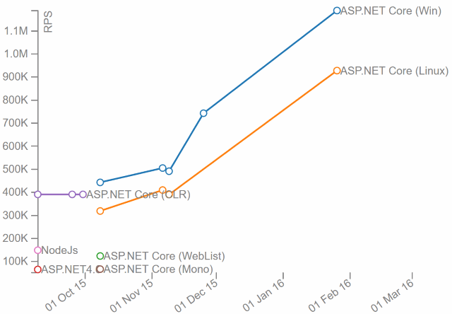
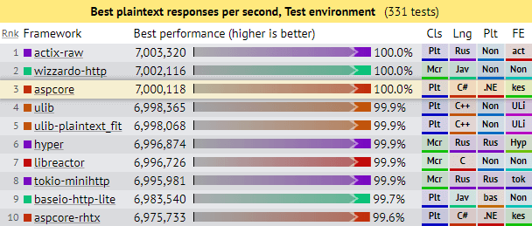
Performance

Slide 13
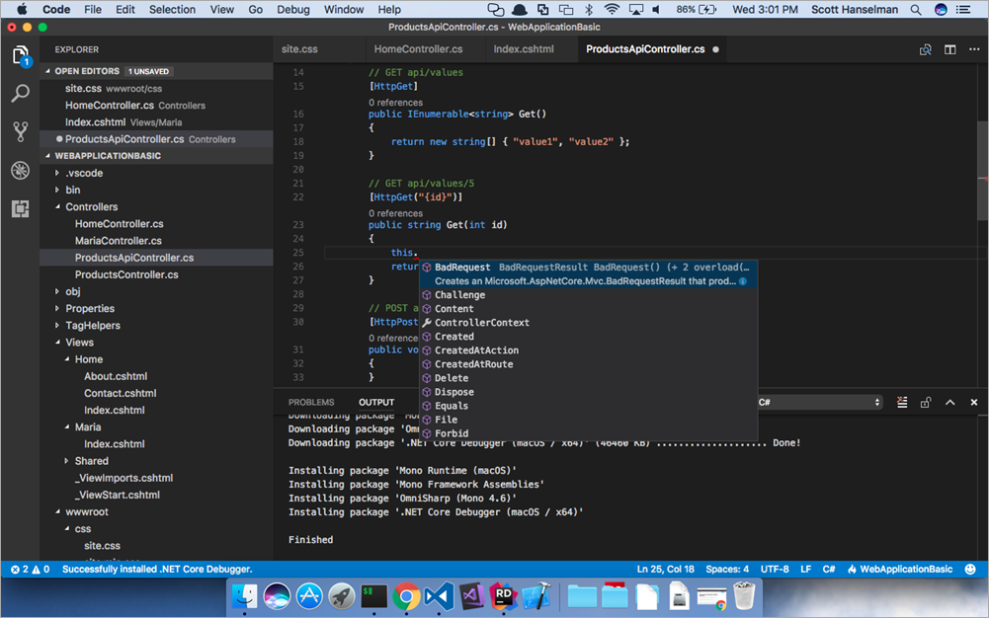
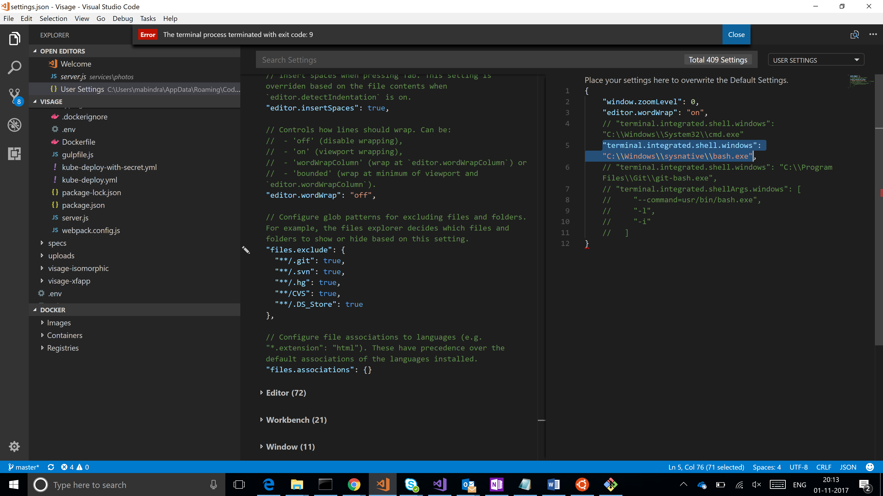
Cross-Platform Development

Slide 14






Cross-Platform Hosting

Slide 15



Containerization Support

Slide 16


JavaScript SPA Framework Support

Slide 17
Modularization
Everything is in Nuget packages
Only use what you need
No dependency on monolithic framework
Allows for each side-by-side deployment

Slide 18
.NET Standard 2.0 and Beyond
.NET Standard is for sharing code libraries
Replaced PCLs
250% more APIs than 1.6
.NET Standard 2.0 => .NET Framework 4.7.2
.NET Standard 2.0 => .NET Core 2.0

Slide 19
Unified MVC and Web API
One namespace, one set of framework classes
Single controller base class
Shared authentication stack
Same model-binding rules
[APIController] attribute
Auto model validation
Model binding inference
Other small differences

Slide 20
Dependency Injection
Dependency injection built-in
DI is already used by the framework
Simple lifetime options:
Singleton
Request (Scoped)
Transient
3rd party DI framework integrate easily

Slide 21
kestrel
Decouples ASP.NET Core from IIS
Cross platform
Built for speed
Limited features (port sharing)

Slide 22
Tag Helpers
Think of it as AngularJS directive for server-side programming

Slide 23
Razor Pages
Paged-based model built on ASP.NET Core MVC
More MVVM than MVC
Simpler, more easy to organize

Slide 24
Side-by-side Versioning
Framework-dependent vs self-contained
No worries about missing features
Deploy without fear of breaking old apps

Slide 25
Configuration
JSON based
Also supports XML, Azure key valut, command line, environment variables, environment files
Easier hierarchical support
IOptions<T>

Slide 26
Logging
Built-in and 3rd party providers
Console, Debug, EventSource, EventLog, TraceSource
AzureAppServices, ApplicationInsights
elmah, Log4net, NLog, Serilog, others…

Slide 27
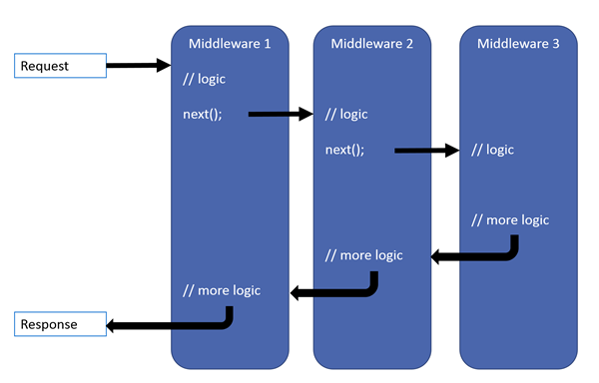
Middleware
A little like HTTPModules
Configured in code (not XML)
Easy control over the order

Slide 28
What’s Still Missing?

Slide 29
EF Core
Inheritance: Table per type (TPT)
Inheritance: Table per concrete class (TPC)
Many-to-many without join entity
Create model from database: VS wizard
Update model from database
Text-based query language (Entity SQL)
Change tracking: Proxies
Lifecycle hooks (events, interception)
Simple Logging (Database.Log)

Slide 30
Full HTTP/2 and HTTP/3 Support
HTTP/2 on Mac
HTTP/3 an

Slide 31
Distributed Caching

Slide 32
Web Forms

Slide 33
Summing Up

Slide 34
Low Risk, High Reward
Modern
Open source
Cross-platform
High performance
Stable since 2.0
Full-featured since .NET Standard 2.0
Side-by-side versioning

Slide 35
.NET Framework is D#@d
Supported for a very long time
Ubiquitous on Windows
Not cross-platform
Old, slow compared to Core
From BUILD: all new feature development will be done in .NET Core

Slide 36

New Development
"So you shouldn't feel pressured to move off .NET Framework, but just know that it's going to be much more highly targeted compatible fixes kind of going forward and we recommend that all new development that you start on .NET is on .NET Core if possible.“
Beth Massi Product Marketing Manager .NET Platform, Microsoft @bethmassi

Slide 37
Migrating from ASP.NET to ASP.NET Core
Somewhat migratable:
SPAs
MVC
Web API
Must be replaced:
Web Forms (Razor Pages?)

Slide 38
If You Give $200, So Will I!
bit.ly/stirtrek-water
“charity:water is a non-profit organization that provides clean and safe drinking water to people in developing nations. The organization was founded in 2006 and has helped fund 22,936 projects in 24 countries, benefiting over 4.6 million people.” - Wikipedia
“4/4 Stars” - CharityNavigator.org

Slide 39
Thank You! Questions?
Jonathan "J." Tower
Partner & Principal Consultant
Trailhead Technology Partners
trailheadtechnology.com
 Microsoft MVP in ASP.NET
 Telerik/Progress Developer Expert
✓ Organizer of Beer City Code
→ jtower@trailheadtechnology.com
✶ trailheadtechnology.com/blog
 jtowermi
github.com/jonathantower/aspnet-core-primetime

