Slide 1
Getting Started with ASP.NET Core
J. Tower, Trailhead Technology Partners
Created For Brilliance Audio

Slide 2

About Me
Jonathan "J." Tower
Principal Consultant & Partner
Trailhead Technology Partners
Microsoft MVP in ASP.NET
→ jtower@trailheadtechnology.com
✶ trailheadtechnology.com/blog
 jtowermi
trailheadtechnology.com

Slide 3
Introductions
What’s your name?
What is the focus of your job? What technologies do you use?
Why are you passionate about in software?
What have you heard/read about .NET Core and ASP.NET Core?
What do you want out of this training? Anything you’re hoping to avoid?

Slide 4
Schedule
Morning
Introduction
ASP.NET Core Basics
- Morning Break -
ASP.NET Core Basics (continued)
- 60-Minute Lunch Break -
Afternoon
MVC & Web API in Core
- Afternoon Break -
Advanced Topics

Slide 5
Questions
Please, interrupt with any questions
Make sur you get what you want out of the training
If it makes sense, let’s go off plan/try some new thing together

Slide 6
History of .NET

Slide 7
Early History of .NET
Replace Win32 APIs
Next Generation Windows Services (NGWS)
Anders Hejlsberg leaves Borland for Microsoft in 96
COOL: C-like Object Oriented Language
“.NET” because of its embrace of the internet

Slide 8
.NET vs Java
Engineered to be platform-agnostic
Cross-platform implementations available for other OSs
But, Microsoft never implemented full framework outside of Windows
Others did: Mono

Slide 9
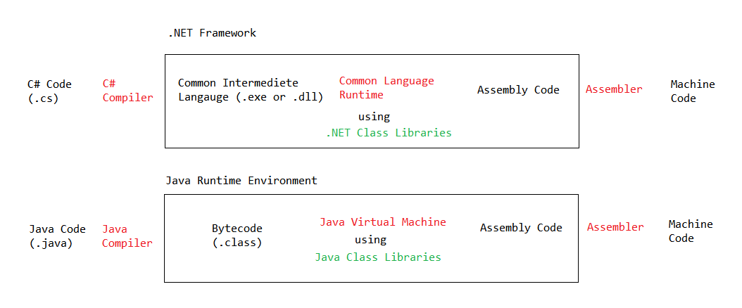
.NET vs Java

Slide 10
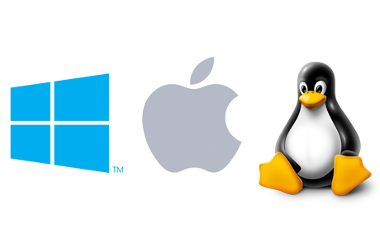
Cross-Platform .NET: A Promise 15 Years in the Making

Slide 11
History of ASP.NET

Slide 12
History of ASP.NET
Version | .NET / IDE Version | Key Features
1.0 | 1.0 and Visual Studio .NET | OO, event-driven web apps, viewstate, DLL class libraries
1.1 | 1.1 and Visual Studio .NET 2003 | ODBC
2.0 | 2.0 and Visual Studio 2005 | New controls, Themes, Skins, Master pages, Membership Services, Localization
3.5 | 3.5 and Visual Studio 2008 | ASP.NET AJAX, LINQ, MVC 1
4.0 | 4.0 and Visual Studio 2010 | Routing
4.5 | 4.5 and Visual Studio 2012 | Unobtrusive Validation, Async, HTML5, WebSocket
4.5.1 | 4.5.1 and Visual Studio 2013 | One ASP.NET, Scaffolding, Identity

Slide 13

A Fork in the Road
v1
v4.6

Slide 14
Wait, I Thought It Was ASP.NET 5
Well, about that…

Slide 15
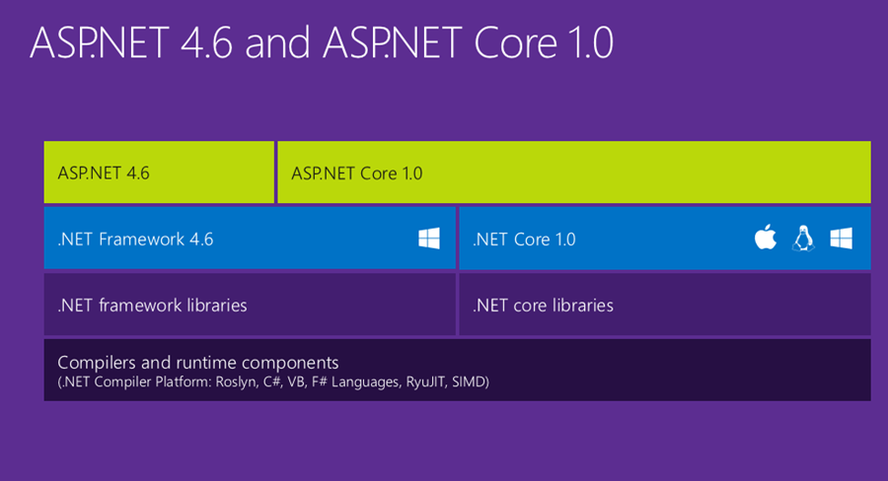
ASP.NET 5
Source: http://www.hanselman.com/blog/ASPNET5IsDeadIntroducingASPNETCore10AndNETCore10.aspx

Slide 16
Source: http://www.hanselman.com/blog/ASPNET5IsDeadIntroducingASPNETCore10AndNETCore10.aspx

Slide 17
ASP.NET 5, We Hardly Knew Ye
ASP.NET 5 now becomes ASP.NET Core .10
EF 7 becomes EF Core 1.0
Core 1.0 – because it’s new, different, and built for .NET Core
ASP.NET – because it’s still so familiar

Slide 18
.NET Core Roadmap
Release | Time frame*
1.0.1 | Sept 13, 2016
1.1 | Q4 2016 / Q1 2017
1.2 | Q1 2017 / Q2 2017
1.1
Replacing xproj/project.json
with .csproj/MSBuild
1.2
Bring back many of the missing APIs in .NET Core:
Networking
Serialization
Data
Much more

Slide 19
ASP.NET Core Roadmap
Release | Time frame*
1.1 | Q4 2016 / Q1 2017
1.2 | Q1 2017 / Q2 2017
1.1
WebSockets
URL Rewriting middleware
Response caching middleware
DI improvements for 3rd party containers
WebListener server (Windows only)
Middleware as MVC filters
ViewComponents as Tag Helpers
Improved Azure integration
App Service startup time improvements
App Service logging provider
Azure Key Vault provider
1.2
SignalR
View Pages (Views without MVC controllers)
Web API security
View precompilation
Future Work
Visual Basic support

Slide 20
DEMO: ASP.NET Core on Windows
Hello, World!

Slide 21
DEMO: ASP.NET Core on MacOS
Hello, Mac!

Slide 22
LAB: Setup and Installation
Windows
Visual Studio 2015 Update 3
VS 2015 Tooling Preview 2
https://www.microsoft.com/net/core#windows
MacOS
Homebrew
OpenSSL
.NET Core SDK
VS Code
https://www.microsoft.com/net/core#macos

Slide 23
Why ASP.NET Core?

Slide 24
Reasons for ASP.NET Core
Cross-Platform Deployment/Development
Unified stack for UIs and APIs
Support for moderns client-side frameworks
Light-weight and modular HTTP request pipeline
Self hosting
Side-by-side app versioning
Open source and community focused
Performance

Slide 25
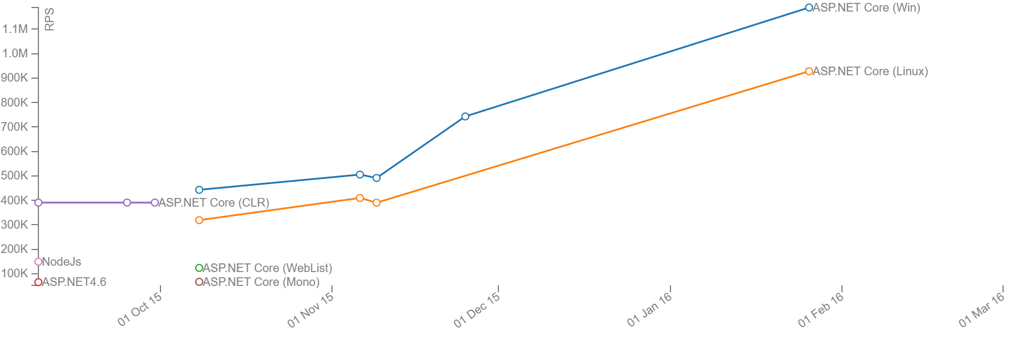
Perf!

Slide 26
New Project Templates

Slide 27
DEMO: New Project Templates
VS, File > New Project…
dotnet new
yeoman

Slide 28
Project & Solution Structure

Slide 29
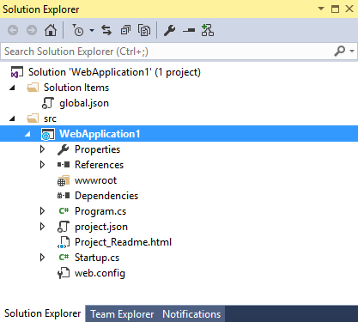
Project & Solution Structure
project.json File Maintain dependencies in your project (package.config)
Toolings support
Target frameworks
Assembly Information

Slide 30
ProjectName.xproj File
Contains Visual Studio-specific settings
Getting renamed back to .csproj
Future versions will see build settings moved to .csproj

Slide 31
project.json File
Contains all project build settings (name, assembly version, etc.)
Also contains NuGet dependencies
Getting phased out and/or renamed in future releases
Build-related settings moving back to .csproj
May be renamed to nuget.json and retain nuget dependencies

Slide 32
project.lock.json File
Generated by the .NET tooling when you restore the project's packages
Cache specific dependency graph
Regenerated when project.json editted
Don’t edit it or check it into source control
Edit project.json directly

Slide 33
wwwroot Folder
For static and generated files
Separates source code from distributed site
Better security
NOTE: To enable Static Files feature, add NuGet package and configure in Configure() method by adding app.UseStaticFiles().

Slide 34
Dependencies Section
Used to manage Bower and NPM tooling packages
For client-side packages (i.e. jQuery, Bootstrap, Angular, Lodash, etc).
bower.json file
package.json file
NOTE: Bower and NPM are not tied to ASP.NET Core, they are open source technologies which can be used in ASP.NET Core.

Slide 35
Program.cs File
The most important file in ASP.NET Core
Contains a Main() method like a console App
ASP.NET Core 1.0 applications are console applications with a well-defined entry point
Initiates, builds, and runs the server (IIS and Kestrel)
Define the root of the project here

Slide 36
Startup.cs
Second most important file
ConfigureServices() and Configure()
Configure middleware on the request pipeline
Configure Dependency Injection (DI)
Other start-up configuration

Slide 37
Startup.Startup (Contructor)
For loading app configuration

Slide 38
Startup.ConfigureServices()
Called first after contructor
Add services to ASP.NET here via DI
Add your own services via DI to
Service config often wrapped in extension methods

Slide 39
Startup.Configure()
Runs second after constructor
Configures the ASP.NET pipeline (default: empty)

Slide 40
Web.Config File
For IIS support
Simple HttpModule that passes requests on to Kestrel
<handlers> <add name="aspNetCore" path="*" verb="*" modules="AspNetCoreModule" resourceType="Unspecified"/> </handlers>

Slide 41
DEMO: gulpfile.js file
A “task runner” for front-end web development

Slide 42
gruntfile.js File
Another task run option
The community seems to be moving toward gulp and home-made

Slide 43
bundleconfig.json File

Slide 44
appsettings.json File
No more:
XML
System.Configuration namespace
<AppSettings> in web.config
<ConnectionStrings> in web.config
JSON-format by default (also support XML, INI, and custom)

Slide 45
appsettings.json File
var builder = new ConfigurationBuilder()
.SetBasePath(env.ContentRootPath)
.AddJsonFile("appsettings.json", optional: true, reloadOnChange: true)
.AddJsonFile($"appsettings.{env.EnvironmentName}.json", optional: true);
if (env.IsDevelopment()) builder.AddUserSecrets();
builder.AddEnvironmentVariables();
Configuration = builder.Build();

Slide 46
DEMO: Config Environment Variables

Slide 47
DEMO: User Secrets
Saved on Windows:
“%APPDATA%\microsoft\UserSecrets\<userSecretsId>\secrets.json”
In project.json
Set a “userSecretsId”
Add “Microsoft.Extensions.SecretManager.Tools”
Add “Microsoft.Extensions.Configuration.UserSecrets”
Command Line:
dotnet user-secrets list
dotnet user-secrets set key value
dotnet user-secrets remove key
dotnet user-secrets clear
Visual Studio Editor

Slide 48
DEMO: Add a Setting File

Slide 49
LAB: Add a Settings File to Project
Add a new settings file
Parse the setting into an object
Inject the setting object in a controller
Use the setting in the controller

Slide 50
Hosting ASP.NET Core

Slide 51
Hosting ASP.NET Core
Totally decoupled from web server environment
Supports:
IIS / IIS Express
Self-Hosting using Kestrel and WebListener HTTP servers
Third party implementations

Slide 52
Kestrel
Cross-platform web server
Based on libuv, a cross-platform asynchronous I/O library
Microsoft.AspNetCore.Server.Kestrel
Meant to be deployed behind a proxy (like IIS, Apache, or Nginx)

Slide 53
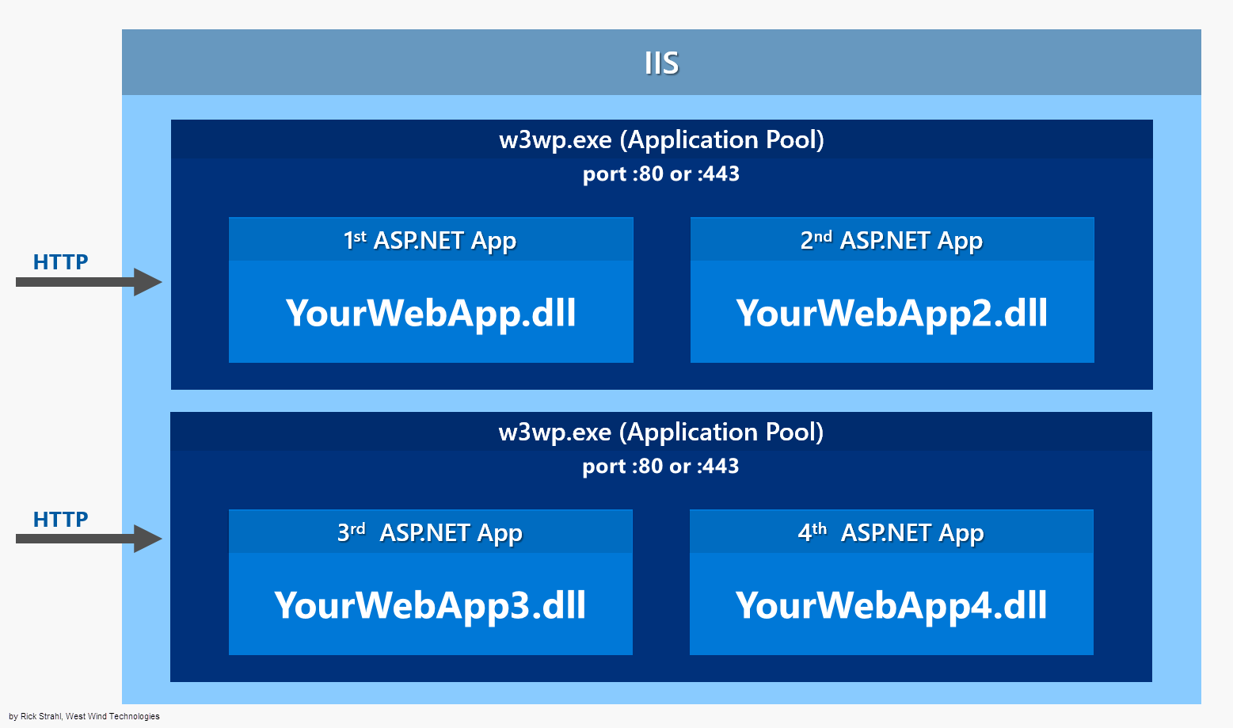
Classic ASP.NET Hosting
Photo credit: https://weblog.west-wind.com/posts/2016/Jun/06/Publishing-and-Running-ASPNET-Core-Applications-with-IIS

Slide 54
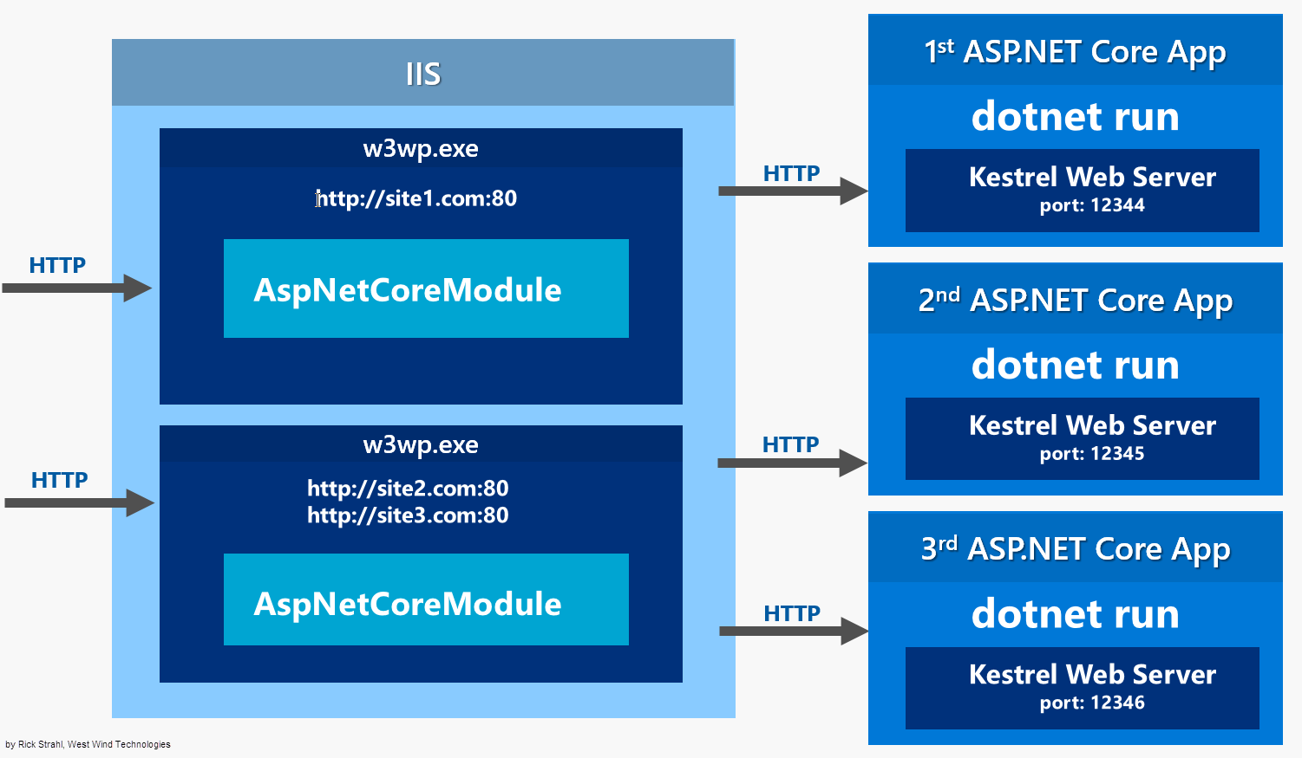
IIS and Kestrel
Photo credit: https://weblog.west-wind.com/posts/2016/Jun/29/First-Steps-Exploring-NET-Core-and-ASPNET-Core

Slide 55
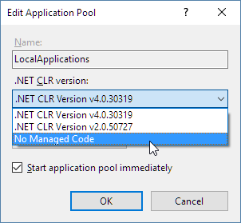
IIS / IISExpress
Windows-only
No need in dev environment

Slide 56
WebListener
Windows-only
Runs directly on Http.sys
Still in preview!

Slide 57
Dependency Injection

Slide 58
Dependency Injection Lifetimes
Transient
Transient lifetime services are created each time they are requested. This lifetime works best for lightweight, stateless services.
Scoped
Scoped lifetime services are created once per request.
Singleton
Singleton lifetime services are created the first time they are requested (or when ConfigureServices is run if you specify an instance there) and then every subsequent request will use the same instance. If your application requires singleton behavior, allowing the services container to manage the service’s lifetime is recommended instead of implementing the singleton design pattern and managing your object’s lifetime in the class yourself.

Slide 59
DEMO: Injecting a Service with DI

Slide 60
LAB: Create your own DI Service
Create a service that mimics sending and email
Create an interface for that service
Map the interface to the service instance
Inject an instance of your service into a controller
EXTRA: Try injecting different services for different environments

Slide 61
Package Management

Slide 62
DEMO: Loading packages
Server-Side/.NET
NuGet
Client-Side
NPM
Bower

Slide 63
Pipeline & Middleware

Slide 64
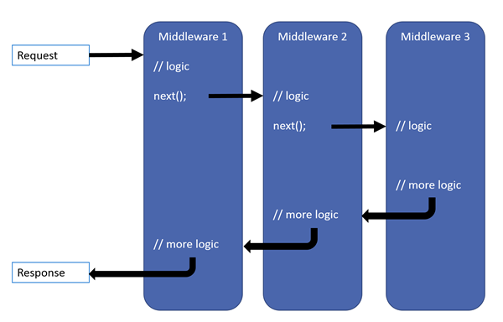
Pipeline & Middleware

Slide 65
Built-In Middleware
Middleware | Description
Authentication | Provides authentication support
CORS | Configures Cross-Origin Resource Sharing.
Routing | Define and constrain request routes.
Session | Provides support for managing user sessions.
Static Files | Provides support for serving static files, and directory browsing.

Slide 66
LAB: Create Custom Middleware

Slide 67
MVC & APIs

Slide 68
Setting up MVC
File > New Project, ASP.NET Core, Empty
Microsoft.AspNetCore.Mvc and Microsoft.AspNetCore.StaticFiles
services.AddMvc();
app.UseStaticFiles();
app.UseMvc(config =>
{
config.MapRoute("default", "{controller=Home}/{action=Index}/{id?}");
});
Add Controller and View

Slide 69
Setting up WebAPI
No additional steps!
Same references, base class, and pipeline as MVC

Slide 70
Unified Controllers
Shared routes and route table
Shared security pipeline
Web API no longer supports inferred verbs
API and View actions in the same controller
Return IActionResult for views and APIs (no need for IHttpActionResult for APIs)

Slide 71
Unified Controllers
MVC Controller
public MyController : System.Web.MVC.Controller { public IActionResult MyAction() {} }
Web API Controller
public MyController : System.Web.Http.ApiController { public IHttpActionResult MyAction() {} }
Unified Controller
public MyController : Microsoft.AspNet.Mvc.Controller { public IActionResult MyAction() {} }

Slide 72
DEMO: View API Controllers

Slide 73
LAB: Create View and API Controllers
Create an MVC view controller and view
Create a layout view
Test your view
Create an API controller that returns hard-coded data
Create another API action that returns an error
Test your API controller

Slide 74
Tag Helpers

Slide 75
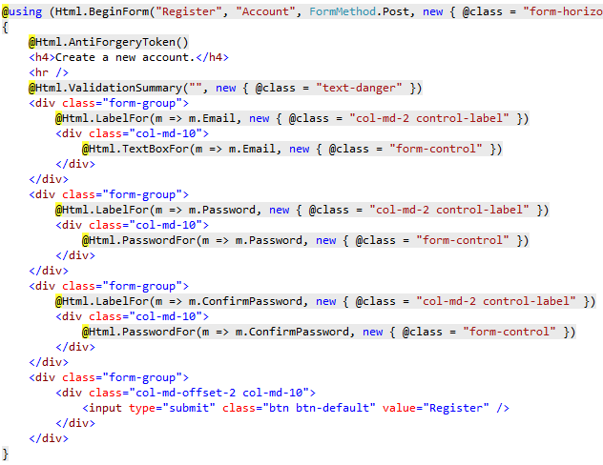
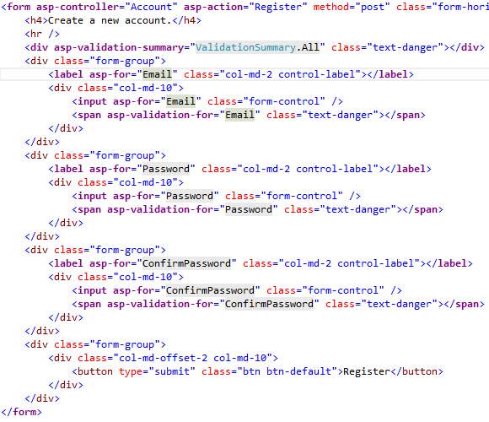
Tag Helpers
An HTML-friendly development experience

Slide 76
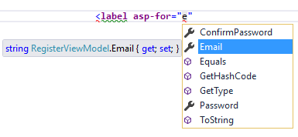
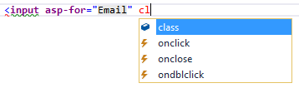
Tag Helpers
A rich IntelliSense environment for creating HTML and Razor markup

Slide 77
Tag Helpers
A way to make you more productive and able to produce more robust, reliable, and maintainable code using information only available on the server
<link rel="stylesheet" href="~/css/site.min.css" asp-append-version="true"/>
<link rel="stylesheet" href="/css/site.min.css?v=UdxKHVNJA5vb1EsG9O9uURFDfEE3j1E3DgwL6NiDGMc" />

Slide 78
DEMO: Some Build-In Tag Helpers
Environment
Form
Anchor
Cache
Image

Slide 79
DEMO: Custom Tag Helper

Slide 80
LAB: Custom Tag Helpers
Create a custom ProgressBar tag helper
Create a new ASP.NET Core project
Add bootstrap using Bower or NPM

Slide 81
View Components

Slide 82
View Components
Similar to partial views
Doesn’t use model binding
Avoids controller lifecycle (like action filters)
Not reachable via HTTP
Uses parameters and DI to get data

Slide 83
DEMO: View Components

Slide 84
Entity Framework Core 1.0

Slide 85
Entity Framework Core 1.0
Only available on .NET Core
Cross-Platform
In-memory provider
Modular (NuGet)
More async support
NOTE: Not (yet) feature compatible with EF 6.x

Slide 86
DEMO: EF Core Code-First & Migrations

Slide 87
LAB: EF Core Setup and Migration
Add references for EF tools and dependencies
Create a context and model classes
Configure your context as a service
Add a database migration
Update the database

Slide 88
Command-Line Interface (CLI)

Slide 89
.NET CLI
> dotnet new
> dotnet restore
> dotnet build
> dotnet publish
> dotnet run
> dotnet test
> dotnet pack

Slide 90
dotnet restore
Specify sources
Globally: C:\users\username\AppData\Roaming\NuGet\NuGet.config
Locally: NuGet.config or --configfile
Command Line: --source switch
Set package output directory
--packages new-location
Default: %userprofile%\.nuget\packages

Slide 91
dotnet build
Some important flags
--output
--framework
--runtime
--configuration

Slide 92
dotnet publish
Framework-dependent deployment (FDD)
"type": "platform"
> dotnet app.dll
Self-contained deployment (SCD)
//"type": "platform"
> app.exe

Slide 93
dotnet run
Run at development time
Run FDDs
Sample flags
--configuration
-- project /path/to/project.json

Slide 94
dotnet pack
> dotnet pack
--no-build
--version-suffix “20161217“
1.0.0-*
1.0.0-20161217

Slide 95
ASP.NET Identity

Slide 96
ASP.NET Identity
Install package Microsoft.AspNetCore.Identity.EntityFrameworkCore
services.AddIdentity<ApplicationUser, IdentityRole>()
.AddEntityFrameworkStores<ApplicationDbContext>()
.AddDefaultTokenProviders();
app.UseIdentity();

Slide 97
Deploying ASP.NET Core Applications

Slide 98
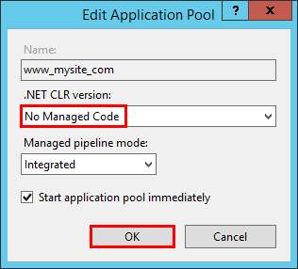
Deploying ASP.NET Core to IIS
Ensure .UseIISIntegration()
Install the .NET Core Windows Server Hosting bundle

Slide 99
Other Common Scenarios
Azure / AWS
https://docs.asp.net/en/latest/tutorials/publish-to-azure-webapp-using-vs
Docker
https://azure.microsoft.com/en-us/documentation/articles/vs-azure-tools-docker-hosting-web-apps-in-docker/
Linux with Nginx or Apache (or other)
https://docs.asp.net/en/latest/publishing/linuxproduction

Slide 100
Thank You!
Jonathan "J." Tower
Principal Consultant & Partner
Trailhead Technology Partners
Microsoft MVP in ASP.NET
→ jtower@trailheadtechnology.com
✶ trailheadtechnology.com/blog
 jtowermi
trailheadtechnology.com

