Slide 1
Creating a Chat Bot
With Azure Bot Service and LUIS
Jonathan "J." Tower

Slide 2

Hi, I’m J.
Jonathan "J." Tower
Partner & Principal Consultant
Trailhead Technology Partners
trailheadtechnology.com
 Microsoft MVP in ASP.NET
 Telerik/Progress Developer Expert
✓ Organizer of Beer City Code
→ jtower@trailheadtechnology.com
✶ trailheadtechnology.com/blog
 jtowermi

Slide 3


Slide 4


If You Give $100, So Will I!
bit.ly/lou-chatbot
“charity:water is a non-profit organization that provides clean and safe drinking water to people in developing nations. The organization was founded in 2006 and has helped fund 22,936 projects in 24 countries, benefiting over 4.6 million people.” - Wikipedia
“4/4 Stars” - CharityNavigator.org

Slide 5
Summary
Azure Bot Service
BotBuilder SDK
Developer Tools
Advanced Features
Language Understanding Service (LUIS)
And Of Course: DEMOS!

Slide 6
Azure Bot Service
The service that ties it all together

Slide 7
What are Azure Bot Services?
Create conversation interfaces
Exposed to multiple channels
Channel plumbing is hosted in Azure
Implemented as REST APIs or Azure Functions (serverless)
Language of your choice (C# and Node samples)
Implementation can be hosted anywhere

Slide 8

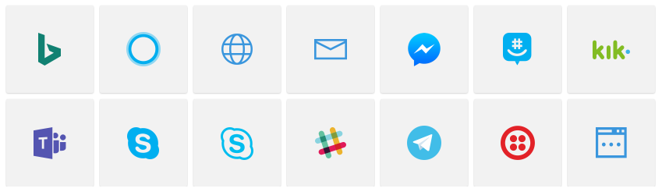



How Azure Bot Service Works
Bot Framework
User
Bot Service
Your REST Service (Or Azure Functions)
Channels

Slide 9
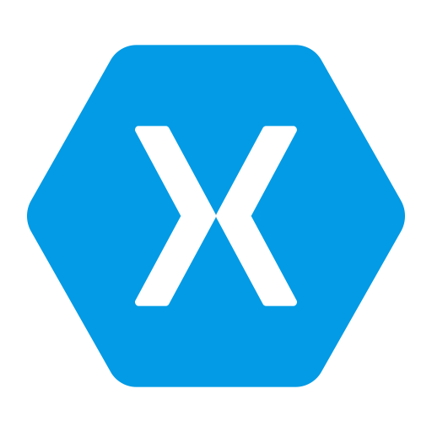




Xamarin: An Analogy
Xamarin
Single C# Codebase
User
Mono
Mobile App Platforms

Slide 10

Features
Support for any language
Supports App Service, Azure Function, or custom API (Bot Channels Registration)
Download Node and C# templates
Online Code Editor
Templates Available
Basic
Form
LUIS
Q&A
Proactive
CI/CD Setup
VSTS
Git
GitHub
Bitbucket
OneDrive
Dropbox

Slide 11
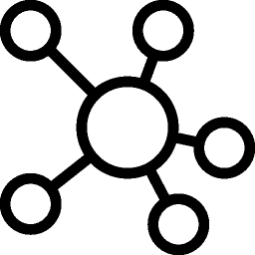
Channels
Standard
Bing
Cortana
Email
Facebook Messenger
GroupMe
Kik
Microsoft Teams
Skype
Skype for Business
Slack
Telegram
Twilio
Premium (Pay per 1000 msgs)
Direct Line
Web Chat

Slide 12

DEMO
Configure Channels

Slide 13
Pricing
$
 | FREE | S1
Standard Channels | Unlimited messages | Unlimited messages
Premium Channels (DirectLine & Web Chat) | 10,000 messages/month | $0.50 per 1,000 messages
+ Azure App Service / Azure Functions resources consumed
+ Other services consumed (Azure Storage, Bing Spellcheck, LUIS, App Insights, etc.)

Slide 14
BotBuilder SDK
Makes developing a chat bot easy

Slide 15
What is BotBuilder SDK
Simplifies the development of chat bots
Available for C# and Node
Open source at https://github.com/Microsoft/BotBuilder
NOTE: .NET Core 1.1 and 2.0 compatibility via Microsoft.Bot.Connector.AspNetCore
https://blog.botframework.com/2017/11/28/new-bot-connector-support-net-core-2-0/

Slide 16

Key Concepts
Connector
Activity
Dialog
FormFlow
State
Security

Slide 17

Connector
Provides a single REST API enabling communication across multiple channels
Facilitates communication between bot and user
Relays messages from bot to channel, from channel to bot

Slide 18

Activity
Activity objects passed between bot and channel
Message is most common activity type
Other activity types include
ConverstaionUpdateActivity
TypingActivity
EndOfConversationActivity
MessageReactionActivity
Etc.

Slide 19

Dialog
Dialogs model a conversation and manage flow
Dialogs can be composed of other dialogs
Context maintains the stack of dialogs that are active
Allows conversations to scale across computers

Slide 20

FormFlow
Form with fields
Walk the user through a flow

Slide 21

State
Stored in memory, SQL, CosmosDB, or Table Storage
Scoped to User, Conversation, or both
var sentGreeting = userData.GetProperty<bool>("SentGreeting");
userData.SetProperty("SentGreeting", true);

Slide 22

Security
[BotAuthentication] Attribute
Configure with provided AppId and Password
Ensures only the Bot Framework Connector can access your API endpoints

Slide 23
Developer Tools
These will help you develop your chat bot

Slide 24
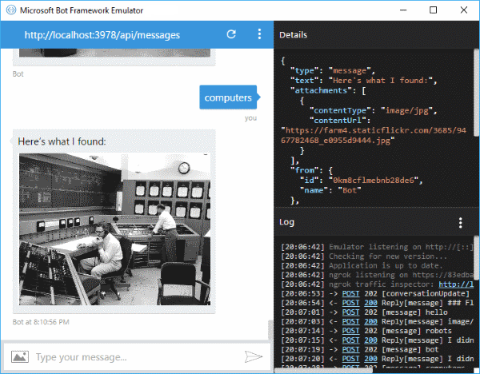
Bot Framework Emulator
Desktop application for testing and debugging bots, locally or remotely
Works on
Windows
Mac
Linux
https://emulator.botframework.com/

Slide 25
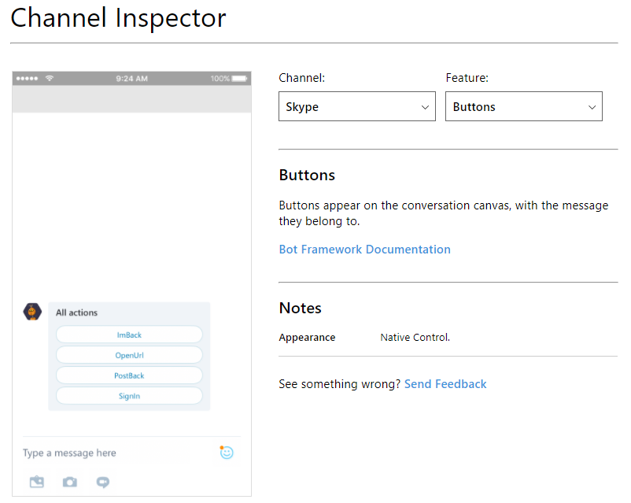
Channel Inspector
Web-based tool
Previews various chat bot features as they appear on different channels
https://docs.botframework.com/en-us/channel-inspector/channels/Skype

Slide 26
DEMO
Simple Chat Bot

Slide 27
Advanced Features
Some things you might want to look into more

Slide 28

Advanced Features
Accepting payments with Stripe
Sending Attachments
Suggested actions
Rich Cards

Slide 29
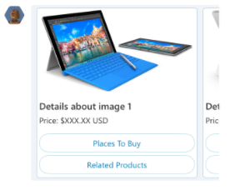
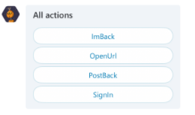
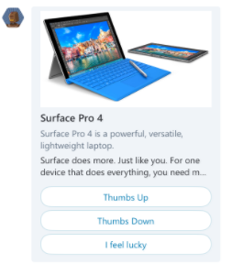
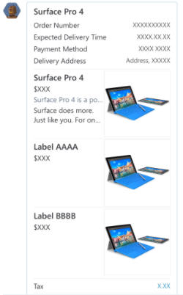
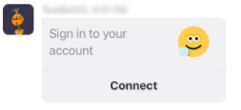
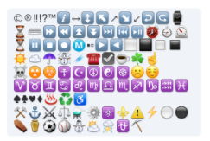
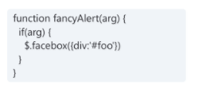
Rich Cards

Slide 30
DEMO
Rich Cards

Slide 31
LUIS
Language Understanding Service

Slide 32
What is Language Understanding Service (LUIS)?
Turns natural language (typed or spoken) into “user intent“
Implemented as REST API
Wrapped by Bot Framework SDK for .NET and Node
Currently supports 12 languages

Slide 33
Key Concepts
Model
Intents
Utterances
Entities
Notes:
Model is the combination of the other 3
Intents are things a user means, aka commands
Utterances is what the user actually says
Entities are pieces of data in the utterance, aka variables

Slide 34
DEMO
LUIS Model Setup

Slide 35
Building Models
Pre-build domains
Custom domains
Manually on LUIS web site (luis.ai)
With code via Authoring APIs

Slide 36
LUIS Pricing
$
Tier | SLA | Features | Unit | Price
Free | None |  | Transactions | 10,000 transactions free per month
Basic | 99.9% | Up to 50 tx / sec | Transactions | $1.50 per 1,000 transactions

Slide 37
Advanced Concepts & Features
Phrase Lists
Bing Spell Check API
Analytics (Application Insights)

Slide 38
DEMO
LUIS-Enabled Chat Bot

Slide 39
Recap
Azure Bot Service
BotBuilder SDK
Developer Tools
Advanced Features
Language Understanding Service (LUIS)
DEMOS!

Slide 41
If You Give $100, So Will I!
bit.ly/lou-chatbot
“charity:water is a non-profit organization that provides clean and safe drinking water to people in developing nations. The organization was founded in 2006 and has helped fund 22,936 projects in 24 countries, benefiting over 4.6 million people.” - Wikipedia
“4/4 Stars” - CharityNavigator.org

Slide 42
Thank You! Questions?
Jonathan "J." Tower
Partner & Principal Consultant
Trailhead Technology Partners
trailheadtechnology.com
 Microsoft MVP in ASP.NET
 Telerik/Progress Developer Expert
✓ Organizer of Beer City Code
→ jtower@trailheadtechnology.com
✶ trailheadtechnology.com/blog
 jtowermi
github.com/jonathantower/chatbot

