Slide 1
.NET Web APIs
Tips, Tricks, & Best Practices
Jonathan "J." Tower

Slide 2

Hi, I’m J.
Jonathan "J." Tower
Principal Consultant & Partner
Trailhead Technology Partners
trailheadtechnology.com
 Microsoft MVP in ASP.NET
 Telerik/Progress Developer Expert
✓ Organizer of Beer City Code
→ jtower@trailheadtechnology.com
✶ trailheadtechnology.com/blog
 jtowermi
github.com/jonathantower/dotnet-apis

Slide 3


If You Give $50, So Will I!
bit.ly/api-water
“charity:water is a non-profit organization that provides clean and safe drinking water to people in developing nations. The organization was founded in 2006 and has helped fund 22,936 projects in 24 countries, benefiting over 4.6 million people.” - Wikipedia
“4/4 Stars” - CharityNavigator.org

Slide 4

Overview
Quick Refresher on RESTful
Routing
Inputs and Outputs
Validation
Error Handling
Authentication
3rd Party tools
Performance tips

Slide 5

A Note about .NET Core…
ASP.NET and ASP.NET Core
Where is Web API in .NET Core?
Web API is dead; long live Web API!

Slide 6
RESTful Refresher

Slide 7
Representations
XML
<Person>
<ID>1</ID>
<Name>M Vaqqas</Name>
<Email>m.vaqqas@gmail.com</Email>
<Country>India</Country>
</Person>
JSON
{
"ID": "1",
"Name": "M Vaqqas",
"Email": "m.vaqqas@gmail.com",
"Country": "India"
}

Slide 8
Headers
Request
Accepts: application/json
Response
Content-Type: application/json
Both
Authorization

Slide 9
HTTP Methods
GET − Provides a read only access to a resource.
PUT − Used to create a new resource.
DELETE − Used to remove a resource.
POST − Used to update an existing resource or create a new resource.
OPTIONS − Used to get the supported operations on a resource.

Slide 10
URIs
GET http://www.example.com/customers
GET http://www.example.com/customers/33245
POST http://www.example.com/customers
PUT http://www.example.com/products/66432
DELETE http://www.example.com/products/66432

Slide 11
HTTP Response Codes
200 OK
201 Created
400 Bad Request
401 Unauthorized
403 Forbidden
404 Not Found
500 Internal Server Error

Slide 12
ASP.NET’s RESTful
ASP.NET
ASP.NET Core
ASP.NET Web API
ASP.NET MVC

Slide 13
Routing
Notes:
Differences .net and .net core
Attribute routing – route, routeprefix, combined in core, constraints
Global JSON settings

Slide 14
Differences: .NET & .NET Core
.NET – System.Web and System.Http
.NET Core - Merged

Slide 15
Routing Rules
routes.MapRoute(
name: "default",
template: "{controller=Home}/{action=Index}/{id?}");
routes.MapRoute(
name: "default",
template: "{controller=Home}/{action=Index}/{id:int}");
routes.MapRoute(
name: "us_english_products",
template: "en-US/Products/{id}",
defaults: new { controller = "Products", action = "Details" },
constraints: new { id = new IntRouteConstraint() },
dataTokens: new { locale = "en-US" });

Slide 16
Attribute Routing
todo
public class MyDemoController : Controller
{
[Route("")]
[Route("Home")]
[Route("Home/Index")]
public IActionResult MyIndex()
{
return View("Index");
}
[Route("Home/About")]
public IActionResult MyAbout()
{
return View("About");
}
}

Slide 17
Attribute Routing
todo
[Route("products")]
public class ProductsApiController : Controller
{
[HttpGet]
public IActionResult ListProducts() { ... }
[HttpGet("{id}")]
public ActionResult GetProduct(int id) { ... }
}

Slide 18
Global Config in .NET
var json = GlobalConfiguration.Configuration.Formatters.JsonFormatter; // format datetimes as UTC json.SerializerSettings.DateTimeZoneHandling = DateTimeZoneHandling.Utc // Used MS date format "\/Date(1356044400000+0100)\/" json.SerializerSettings.DateFormatHandling = DateFormatHandling.MicrosoftDateFormat; // camelCase JSON json.SerializerSettings.ContractResolver = new CamelCasePropertyNamesContractResolver();
// Indent JSON json.SerializerSettings.Formatting = Newtonsoft.Json.Formatting.Indented; // Ignore reference loops json.SerializerSettings.Re‌​ferenceLoopHandling = ReferenceLoopHandling.Ignore;

Slide 19
DTOs
Notes:
Dto vs model/entity
Mapping (automapper)

Slide 20
Mapping Models to DTOs
var config = new MapperConfiguration(cfg => cfg.CreateMap<Order, OrderDto>());
var mapper = config.CreateMapper();
OrderDto dto = mapper.Map<OrderDto>(order);

Slide 21
Parameters
Notes:
[FromBody] body
[FromUri] Querystring (get)
See https://docs.microsoft.com/en-us/aspnet/web-api/overview/formats-and-model-binding/parameter-binding-in-aspnet-web-api
TypeConverterss, Model Binders, Value Providers, HttpParameterBinding

Slide 22
Conventions
Mapping done by convention
Can be overridden

Slide 23
[FromBody]
[HttpPost]
public void Post(AddValueCommand command)
{
}
[HttpPost]
public void Post([FromBody]AddValueCommand command)
{
}

Slide 24
[FromUri]
public ValuesController : Controller
{
public IActionResults Get([FromUri]GeoPoint loc) { ... }
}
// http://localhost/api/values/?Latitude=47.678558&Longitude=-122.130989

Slide 25
Override Convention
public class BodyParameterBindingConvention : IActionModelConvention
{
public void Apply(ActionModel action)
{
if (action == null)
throw new ArgumentNullException(nameof(action));
foreach (var parameter in action.Parameters)
{
parameter.BindingInfo = parameter.BindingInfo ?? new BindingInfo();
parameter.BindingInfo.BindingSource = BindingSource.Body;
}
}
}

Slide 26
Override Convention
public void ConfigureServices(IServiceCollection services)
{
services.AddMvc(options =>
{
options.Conventions.Add(
new BodyParameterBindingConvention());
});
}

Slide 27
Responses
Notes:
void
Single object
List of objects
HttpActionResult (ActionResult in core)
HttpResponseMessage
Exception Helper methods in base class

Slide 28
Types of Responses
void
Single object
List of objects
HttpActionResult (ActionResult in core)
HttpResponseMessage – ASP.NET (not Core)
Exception
Helper methods in base class

Slide 29
Using IHttpActionResult (IActionResult)
Generic and allows for all kinds of different responses
200 – object results
401 – Unauthorized
400 – BadRequest with validation errors

Slide 30
Using Base Helper Methods
ViewResult
JsonResult
Ok
UnAuthroized
BadRequest
ContentResult
FileResults
…

Slide 31
Using Exceptions
ASP.NET HttpReponseMessage
ASP.NET Core – custom handler

Slide 32
Validation
Notes:
ModelState

Slide 33
Validation
using System.ComponentModel.DataAnnotations;
public class LoginDto
{
[Required]
public string Username { get; set; }
[Required]
[RegularExpression(@"^[a-zA-Z0-9]$",
ErrorMessage = "Non-alphanumeric characters are not allowed.")]
public string Password { get; set; }
}

Slide 34
Validation
public IActionResult Login([FromBody]LoginDto req)
{
if (!ModelState.IsValid) return BadRequest(ModelState);
if (req.Username != "jtower" || req.Password == "Password")
return Unauthorized();
return Ok();
}

Slide 35
Error Handling

Slide 36
Try…Catch
Catch “expected” errors in Try…Catch block
Return meaningful error message and HTTP code

Slide 37
Global Error Handling
Handle unexpected errors centrally
Log and alert sysadmin
Filter some exceptions (HTTP redirect, thread abort, etc…)

Slide 38
Global Error Handling
public class UnhandledExceptionLogger : ExceptionLogger
{
public override void Log(ExceptionLoggerContext context)
{
var exceptionString = context.Exception.ToString();
// log exceptionString
}
}
config.Services.Replace(typeof(IExceptionLogger),
new UnhandledExceptionLogger());

Slide 39
Global Error Handling
GlobalConfiguration.Configuration.IncludeErrorDetailPolicy
= IncludeErrorDetailPolicy.Always;

Slide 40
Authentication
Notes:
Indentity JWT
Custom – extract token from qs

Slide 41
DEMO: ASP.NET Identity

Slide 42
Demo: JSON Web Tokens (JWT)

Slide 43
3rd Party Tools
Notes:
Swagger/swashbuckle

Slide 44
Microsoft.AspNet.WebApi.Versioning & Microsoft.AspNetCore.Mvc.Versioning
[ApiVersion( "1.0" )] [Route( "api/v{version:apiVersion}/helloworld" )] public class PeopleController : ApiController
// api/helloworld?api-version=1.0

Slide 45
SDammann.WebApi.Versioning
config.Routes.MapHttpRoute(
name: "DefaultApi",
routeTemplate: "api/v{version}/{controller}/{id}",
defaults: new { id = RouteParameter.Optional }
);
ApiVersioning.Configure(config)
.ConfigureRequestVersionDetector<DefaultRouteKeyVersionDetector>();
// Namespace MyApi.Version1_1

Slide 46
Swashbuckle (Swagger)
// .NET
httpConfiguration
.EnableSwagger(c => c.SingleApiVersion("v1", "My API"))
.EnableSwaggerUi();
// .NET Core
services.AddMvc();
services.AddSwaggerGen(c =>
{
c.SwaggerDoc("v1", new Info { Title = "My API", Version = "v1" });
});

Slide 47
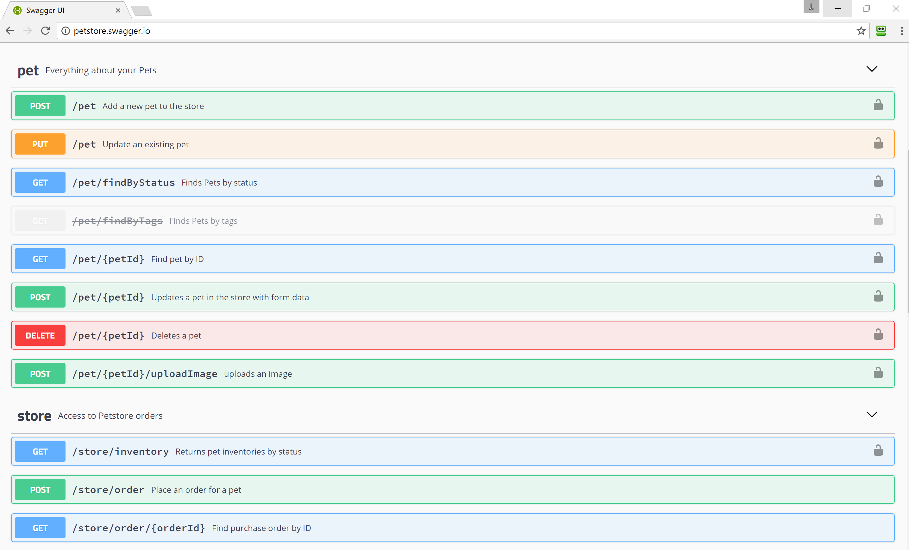

Slide 48
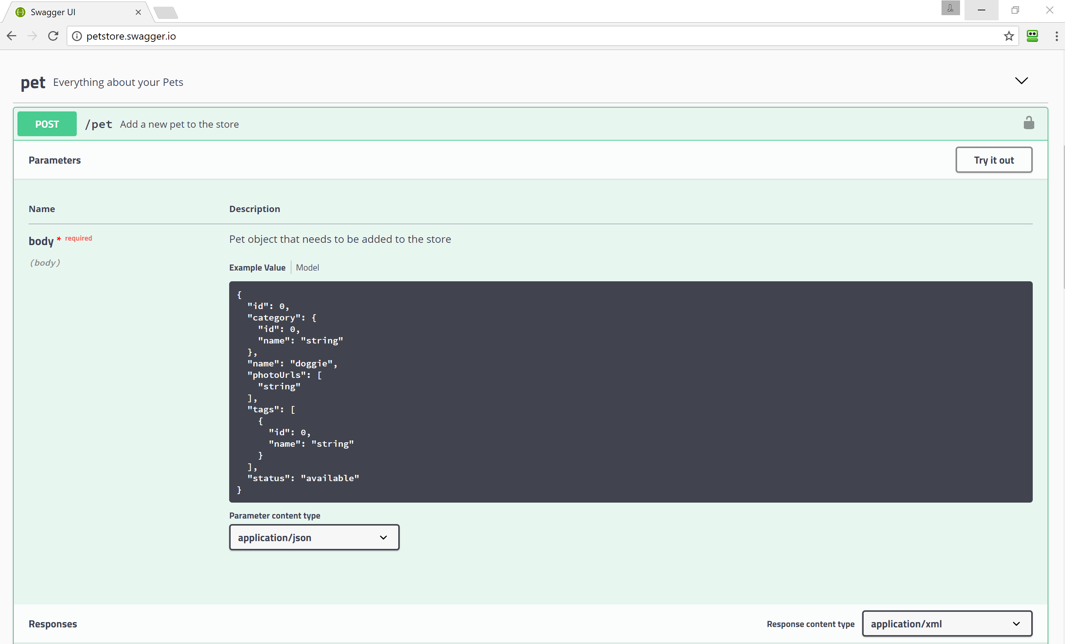

Slide 49
Performance
Notes:
async/await
Output caching
Raw ado.net or asnotracking()

Slide 50
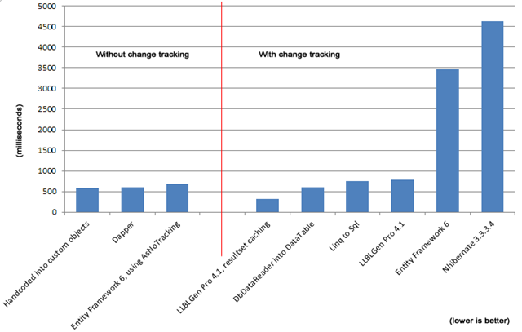
AsNoTracking()

Slide 51
Async/Await
Some tasks require waiting (database access, http calls)
More simultaneous requests!
Analogy: making breakfast

Slide 52
Caching
var key = "someKey";
MemoryCache memoryCache = MemoryCache.Default;
var item = memoryCache.Get(key);
if (item == null)
{
item = new { }; // todo – go get item
memoryCache.Add(key, value, DateTimeOffset.Now.AddMinutes(30));
}
return item;

Slide 53

Recap
Quick Refresher on RESTful
Routing
Inputs and Outputs
Validation
Error Handling
Authentication
3rd Party tools
Performance tips

Slide 54
Thank You! Questions?
Jonathan "J." Tower
Principal Consultant & Partner
Trailhead Technology Partners
trailheadtechnology.com
 Microsoft MVP in ASP.NET
 Telerik/Progress Developer Expert
✓ Organizer of Beer City Code
→ jtower@trailheadtechnology.com
✶ trailheadtechnology.com/blog
 jtowermi
github.com/jonathantower/dotnet-apis

Slide 55
If You Give $50, So Will I!
bit.ly/api-water
“charity:water is a non-profit organization that provides clean and safe drinking water to people in developing nations. The organization was founded in 2006 and has helped fund 22,936 projects in 24 countries, benefiting over 4.6 million people.” - Wikipedia
“4/4 Stars” - CharityNavigator.org

