Slide 1
.NET Web APIs
Tips, Tricks, & Best Practices
Jonathan "J." Tower

Slide 2

Hi, I’m J.
Jonathan "J." Tower
Principal Consultant & Partner
Trailhead Technology Partners
trailheadtechnology.com
 Microsoft MVP in ASP.NET
 Telerik/Progress Developer Expert
✓ Organizer of Beer City Code
→ jtower@trailheadtechnology.com
✶ trailheadtechnology.com/blog
 jtowermi
github.com/jonathantower/dotnet-apis

Slide 3


If You Give $50, So Will I!
bit.ly/api-water
“charity:water is a non-profit organization that provides clean and safe drinking water to people in developing nations. The organization was founded in 2006 and has helped fund 22,936 projects in 24 countries, benefiting over 4.6 million people.” - Wikipedia
“4/4 Stars” - CharityNavigator.org

Slide 4

Overview
Quick Refresher on RESTful
Routing
Inputs and Outputs
Validation
Error Handling
Authentication
A useful pattern
3rd Party tools
Performance tips

Slide 5
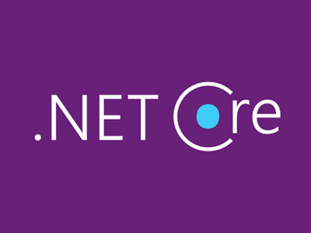
A Note about .NET Core…
ASP.NET and ASP.NET Core
Where is Web API in .NET Core?
Web API is dead; long live Web API!

Slide 6
RESTful Refresher

Slide 7
Representations
XML
<Person>
<ID>1</ID>
<Name>M Vaqqas</Name>
<Email>m.vaqqas@gmail.com</Email>
<Country>India</Country>
</Person>
JSON
{
"ID": "1",
"Name": "M Vaqqas",
"Email": "m.vaqqas@gmail.com",
"Country": "India"
}

Slide 8
Headers
Request
Accepts: application/json
Response
Content-Type: application/json
Both
Authorization

Slide 9
HTTP Methods
GET − Provides a read only access to a resource.
PUT − Used to create a new resource.
DELETE − Used to remove a resource.
POST − Used to update an existing resource or create a new resource.
OPTIONS − Used to get the supported operations on a resource.

Slide 10
URIs
GET http://www.example.com/customers
GET http://www.example.com/customers/33245
POST http://www.example.com/customers
PUT http://www.example.com/products/66432
DELETE http://www.example.com/products/66432

Slide 11
HTTP Response Codes
200 OK
201 Created
400 Bad Request
401 Unauthorized
403 Forbidden
404 Not Found
500 Internal Server Error

Slide 12
ASP.NET’s RESTful
ASP.NET
ASP.NET Core
ASP.NET Web API
ASP.NET MVC

Slide 13
Routing
Notes:
Differences .net and .net core
Attribute routing – route, routeprefix, combined in core, constraints
Global JSON settings

Slide 14
Differences: .NET & .NET Core
.NET – System.Web and System.Http
.NET Core - Merged

Slide 15
Global Config in .NET
var json = GlobalConfiguration.Configuration.Formatters.JsonFormatter; // format datetimes as UTC json.SerializerSettings.DateTimeZoneHandling = DateTimeZoneHandling.Utc // Used MS date format "\/Date(1356044400000+0100)\/" json.SerializerSettings.DateFormatHandling = DateFormatHandling.MicrosoftDateFormat; // camelCase JSON json.SerializerSettings.ContractResolver = new CamelCasePropertyNamesContractResolver();
// Indent JSON json.SerializerSettings.Formatting = Newtonsoft.Json.Formatting.Indented; // Ignore reference loops json.SerializerSettings.Re‌​ferenceLoopHandling = ReferenceLoopHandling.Ignore;

Slide 16
Routing Rules
todo

Slide 17
Attribute Routing
todo

Slide 18
DTOs
Notes:
Dto vs model/entity
Mapping (automapper)

Slide 19
DTOs vs Entities vs Models

Slide 20
Mapping Models to DTOs

Slide 21
Parameters
Notes:
[FromBody] body
[FromUri] Querystring (get)
See https://docs.microsoft.com/en-us/aspnet/web-api/overview/formats-and-model-binding/parameter-binding-in-aspnet-web-api
TypeConverterss, Model Binders, Value Providers, HttpParameterBinding

Slide 22
Conventions

Slide 23
[FromBody]

Slide 24
[FromUri]

Slide 25
TypeConverters, Model Binders, Value Providers, & HttpParameterBinding

Slide 26
Responses
Notes:
void
Single object
List of objects
HttpActionResult (ActionResult in core)
HttpResponseMessage
Exception Helper methods in base class

Slide 27
Types of Responses
void
Single object
List of objects
HttpActionResult (ActionResult in core)
HttpResponseMessage
Exception
Helper methods in base class

Slide 28
Using IHttpActionResult (IActionResult)

Slide 29
Using Base Helper Methods

Slide 30
Using HttpReponseMessage

Slide 31
Using Exceptions

Slide 32
Validation
Notes:
ModelState

Slide 33
Validation
using System.ComponentModel.DataAnnotations;
public class LoginDto
{
[Required]
public string Username { get; set; }
[Required]
[RegularExpression(@"^[a-zA-Z0-9]$",
ErrorMessage = "Non-alphanumeric characters are not allowed.")]
public string Password { get; set; }
}

Slide 34
Validation
public IActionResult Login([FromBody]LoginDto req)
{
if (!ModelState.IsValid) return BadRequest(ModelState);
if (req.Username != "jtower" || req.Password == "Password")
return Unauthorized();
return Ok();
}

Slide 35
Error Handling

Slide 36
Try…Catch
Catch “expected” errors in Try…Catch block
Return meaningful error message and HTTP code

Slide 37
Global Error Handling
Handle unexpected errors centrally
Log and alert sysadmin
Filter some exceptions (HTTP redirect, thread abort, etc…)

Slide 38
Global Error Handling
public class UnhandledExceptionLogger : ExceptionLogger
{
public override void Log(ExceptionLoggerContext context)
{
var exceptionString = context.Exception.ToString();
// log exceptionString
}
}
config.Services.Replace(typeof(IExceptionLogger),
new UnhandledExceptionLogger());

Slide 39
Global Error Handling
GlobalConfiguration.Configuration.IncludeErrorDetailPolicy
= IncludeErrorDetailPolicy.Always;

Slide 40
Authentication
Notes:
Indentity JWT
Custom – extract token from qs

Slide 41
DEMO: ASP.NET Identity

Slide 42
Demo: JSON Web Tokens (JWT)

Slide 43
A Useful Pattern

Slide 44
Two Pieces
Two Pieces:
Dependency Inject
Repositories

Slide 45
DEMO: Repository Pattern + DI

Slide 46
3rd Party Tools
Notes:
Swagger/swashbuckle

Slide 47
Microsoft.AspNet.WebApi.Versioning & Microsoft.AspNetCore.Mvc.Versioning
[ApiVersion( "1.0" )] [Route( "api/v{version:apiVersion}/helloworld" )] public class PeopleController : ApiController
// api/helloworld?api-version=1.0

Slide 48
SDammann.WebApi.Versioning
config.Routes.MapHttpRoute(
name: "DefaultApi",
routeTemplate: "api/v{version}/{controller}/{id}",
defaults: new { id = RouteParameter.Optional }
);
ApiVersioning.Configure(config)
.ConfigureRequestVersionDetector<DefaultRouteKeyVersionDetector>();
// Namespace MyApi.Version1_1

Slide 49
Swashbuckle (Swagger)
// .NET
httpConfiguration
.EnableSwagger(c => c.SingleApiVersion("v1", "My API"))
.EnableSwaggerUi();
// .NET Core
services.AddMvc();
services.AddSwaggerGen(c =>
{
c.SwaggerDoc("v1", new Info { Title = "My API", Version = "v1" });
});

Slide 50
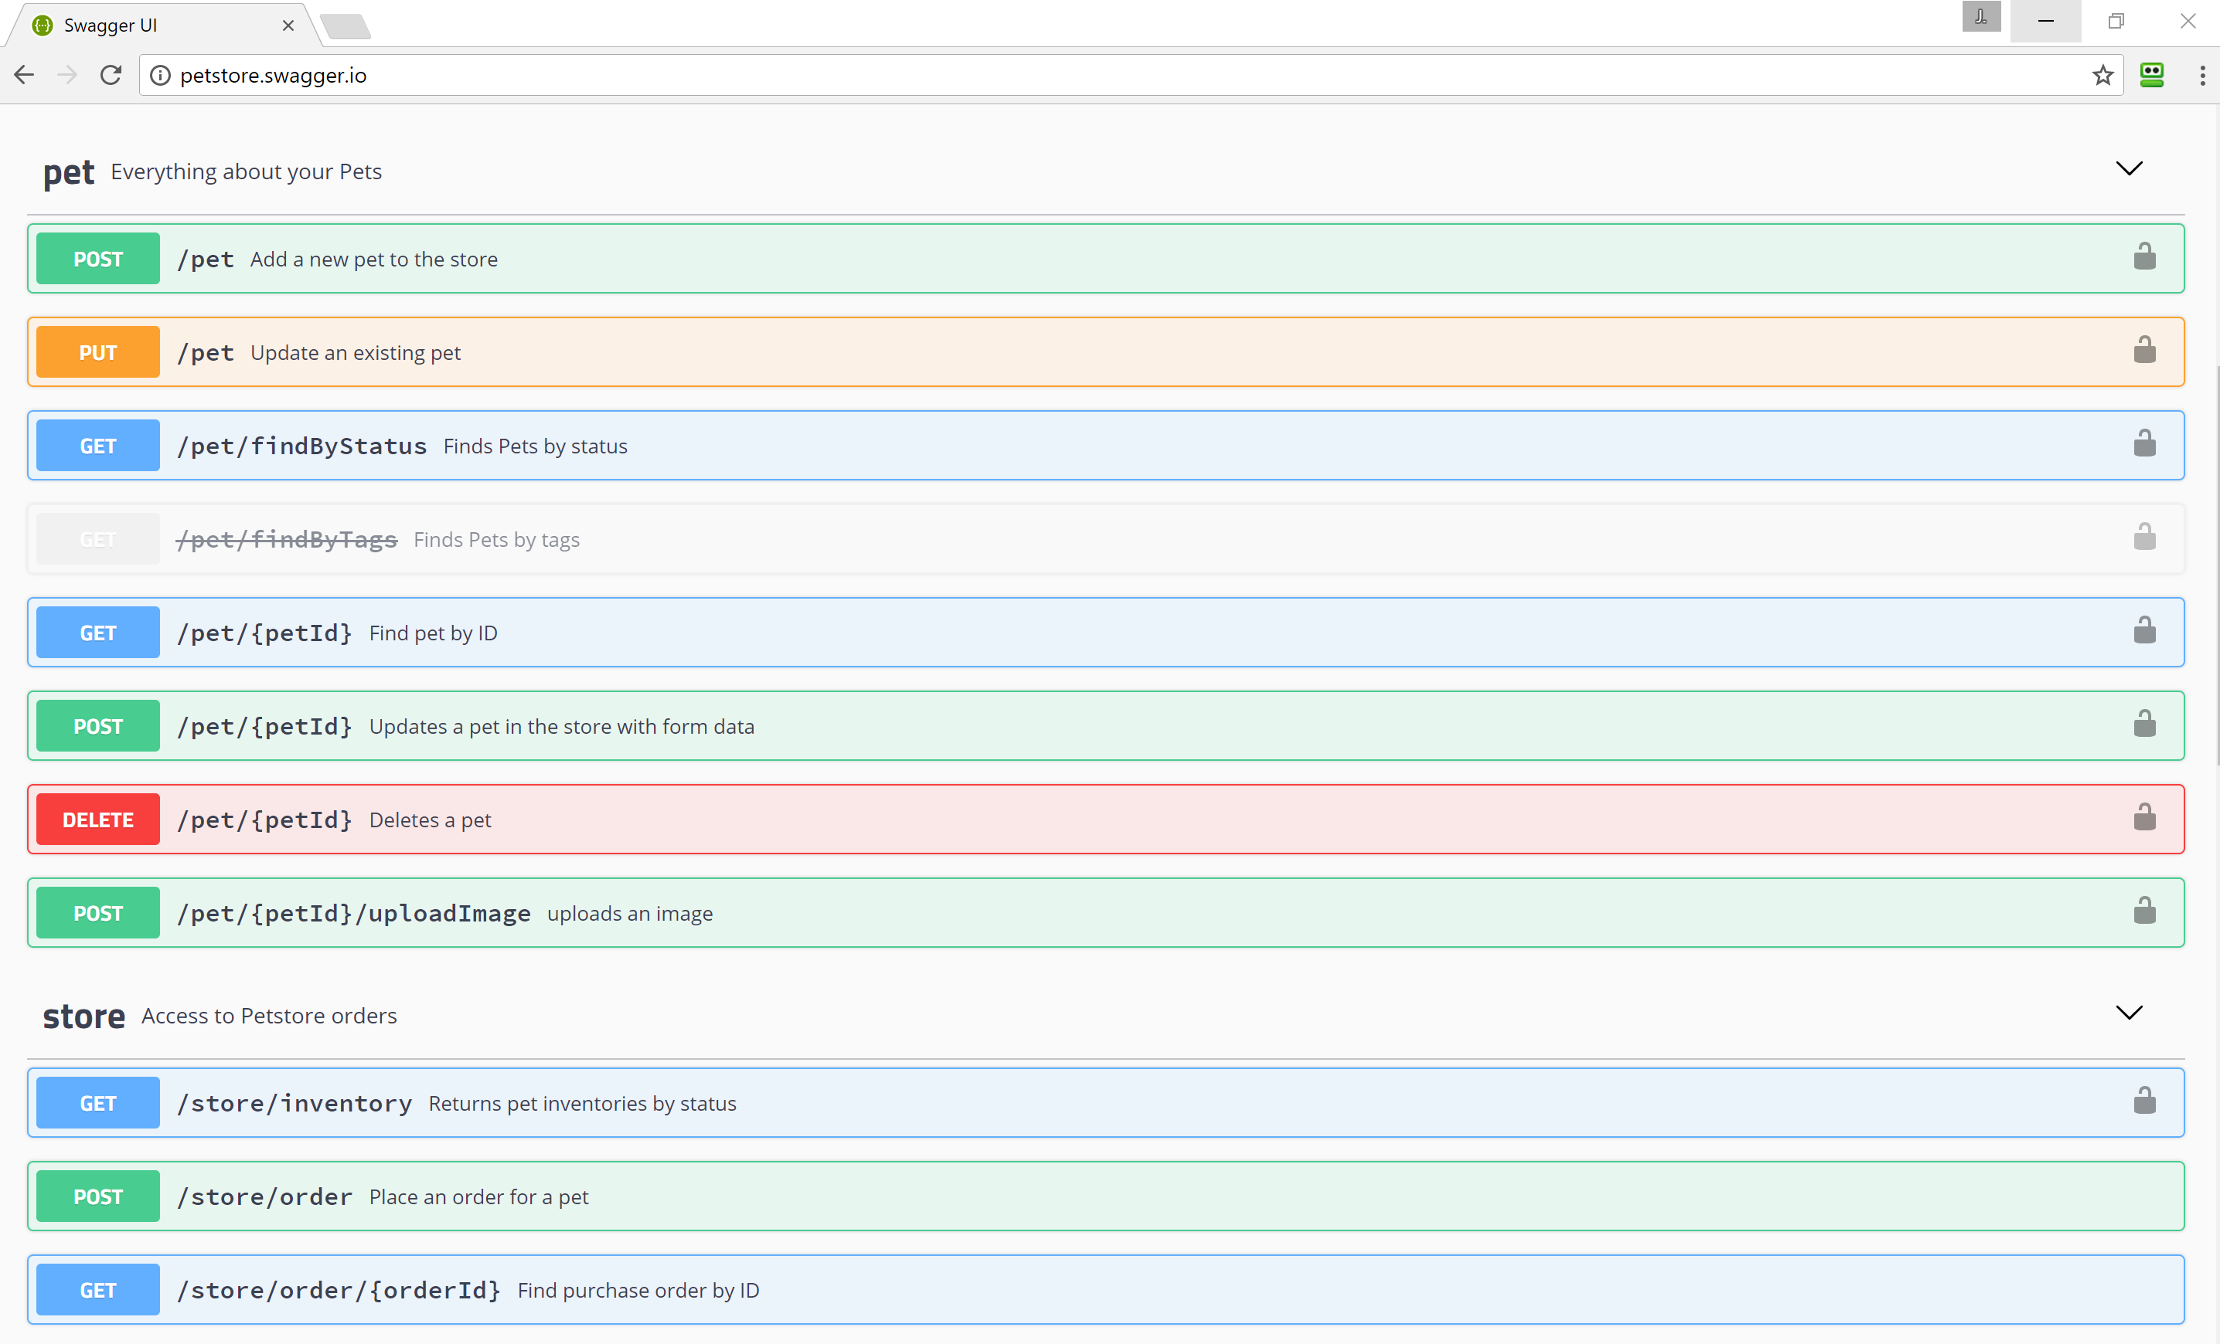

Slide 51
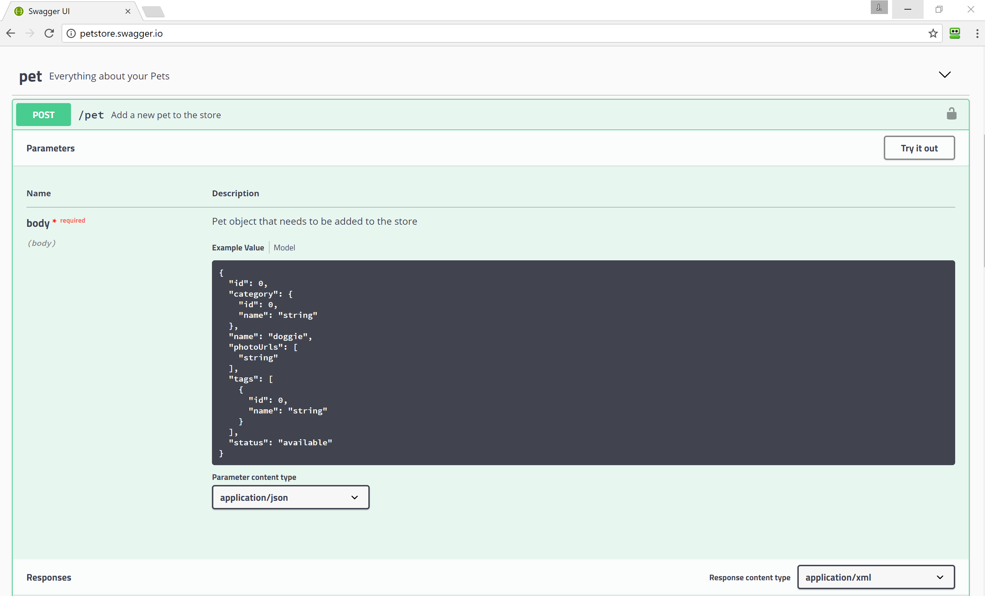

Slide 52
Performance
Notes:
async/await
Output caching
Raw ado.net or asnotracking()

Slide 53
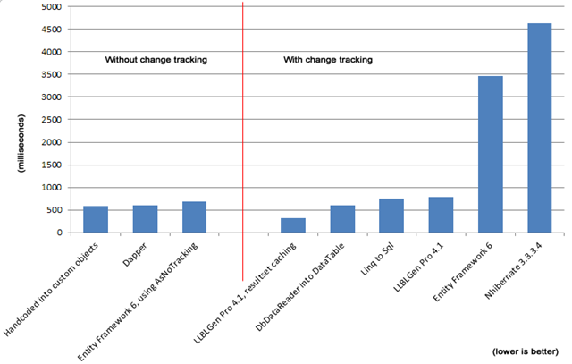
AsNoTracking()

Slide 54
Async/Await
Some tasks require waiting (database access, http calls)
More simultaneous requests!
Analogy: making breakfast

Slide 55
Caching
var key = "someKey";
MemoryCache memoryCache = MemoryCache.Default;
var item = memoryCache.Get(key);
if (item == null)
{
item = new { }; // todo – go get item
memoryCache.Add(key, value, DateTimeOffset.Now.AddMinutes(30));
}
return item;

Slide 56

Recap
Quick Refresher on RESTful
Routing
Inputs and Outputs
Validation
Error Handling
Authentication
A useful pattern
3rd Party tools
Performance tips

Slide 57
Thank You! Questions?
Jonathan "J." Tower
Principal Consultant & Partner
Trailhead Technology Partners
trailheadtechnology.com
 Microsoft MVP in ASP.NET
 Telerik/Progress Developer Expert
✓ Organizer of Beer City Code
→ jtower@trailheadtechnology.com
✶ trailheadtechnology.com/blog
 jtowermi
github.com/jonathantower/dotnet-apis

Slide 58
If You Give $50, So Will I!
bit.ly/api-water
“charity:water is a non-profit organization that provides clean and safe drinking water to people in developing nations. The organization was founded in 2006 and has helped fund 22,936 projects in 24 countries, benefiting over 4.6 million people.” - Wikipedia
“4/4 Stars” - CharityNavigator.org

