Slide 1
.NET Standard
Reuse All the Code
Jonathan "J." Tower

Slide 2

Hi, I’m J.
Jonathan "J." Tower
Principal Consultant & Partner
Trailhead Technology Partners
trailheadtechnology.com
 Microsoft MVP in ASP.NET
 Telerik/Progress Developer Expert
✓ Organizer of Beer City Code
→ jtower@trailheadtechnology.com
✶ trailheadtechnology.com/blog
 jtowermi
github.com/jonathantower/dotnet-standard

Slide 3


If You Give $245, So Will I!
bit.ly/gang-conf
“charity:water is a non-profit organization that provides clean and safe drinking water to people in developing nations. The organization was founded in 2006 and has helped fund 22,936 projects in 24 countries, benefiting over 4.6 million people.” - Wikipedia
“4/4 Stars” - CharityNavigator.org

Slide 4
Overview
What is the .NET Standard?
Why should I care?
DEMO: How to read Nuget listing
DEMO: Creating a .NET Standard library from scratch
Compare/Contrast with Portable Class Libraries (PCLs)
DEMO: Converting a PCL to .NET Standard
.NET Standard v2.0 & v2.1

Slide 5
What is .NET Standard?
The .NET Standard is a formal specification of .NET APIs
Intended to be available on all .NET runtimes/platforms
.NET Standard is a specification, not an implementation
Specification in code

Slide 6
.NET Standard?
NOT another name for non-Core version of .NET (.NET Framework)
Terminology:
Platform/Flavor
.NET Framework
.NET Core
.NET Standard
.NET

Slide 7
Goals of .NET Standard
Create and maintain consistency between the .NET platforms
Uniform set of APIs on all .NET platforms
Portable libraries across platforms
Reduce/eliminate conditional compilation
Notes:
Defines uniform set of BCL APIs for all .NET platforms to implement, independent of workload.
Enables developers to produce portable libraries that are usable across .NET runtimes, using this same set of APIs.
Reduces and hopefully eliminates conditional compilation of shared source due to .NET APIs, only for OS APIs.

Slide 8

The Standards Gap
A standard exists for .NET runtime implementations (ECMA 335)
No standard existed for .NET Base Class Library (BCL) implementations

Slide 9

.NET Standard Versioning: Additive
2.0
1.6
1.5
1.4
1.3

Slide 10

.NET Standard Versioning: Immutable
Notes:
Immutable. Once shipped, .NET Standard versions are frozen. New APIs will first become available in specific .NET platforms, such as .NET Core. If the .NET Standard review board believes the new APIs should be made available everywhere, they'll be added in a new .NET Standard version.

Slide 11
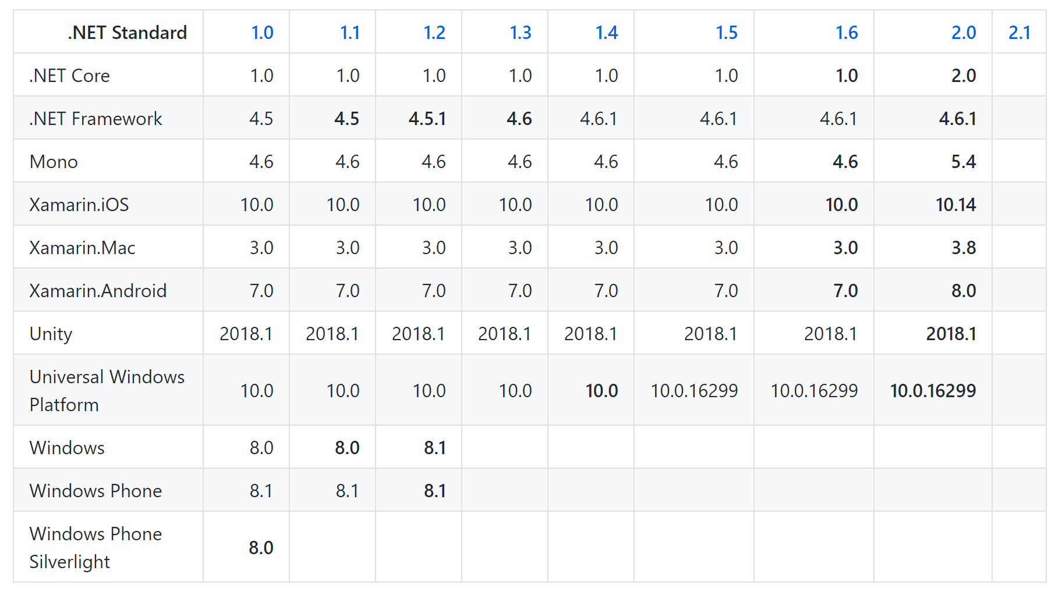
https://github.com/dotnet/standard/blob/master/docs/versions.md

Slide 12
What’s Included?
BCLs, but NOT FCLs
FCLs:
WPF
WCF
ASP.NET
WinForms
…
Notes:
Base class libraries, not framework class libraries

Slide 13
David Fowler’s “Developer Analogy”
// .NET Standard
interface INetStandard10
{
void Primitives();
void Reflection();
void Tasks();
void Collections();
void Linq();
}
interface INetStandard11 :
INetStandard10
{
void ConcurrentCollections();
void InteropServices();
}
interface INetStandard12 :
INetStandard11
{
void ThreadingTimer();
}
...

Slide 14
David Fowler’s “Developer Analogy”
// .NET Framework
interface INetFramework45 : INetStandard11
{
void FileSystem();
void Console();
void ThreadPool();
void Crypto();
void WebSockets();
void Process();
void Sockets();
void AppDomain();
void Xml();
void Drawing();
void SystemWeb();
void WPF();
void WindowsForms();
void WCF();
}
// Mono
interface IMono43 : INetFramework46
{
void MonoSpecificApi();
}
// Windows Universal Platform
interface IWindowsUniversalPlatform : INetStandard14
{
void GPS();
void Xaml();
}
// Xamarin
interface IXamarinIOS : INetStandard15
{
void AppleAPIs();
}
interface IXamarinAndroid : INetStandard15
{
void GoogleAPIs();
}
// .NET Core
interface INetCoreApp10 : INetStandard15 { }

Slide 15
David Fowler’s “Developer Analogy”
class Example
{
public void FuturePlatformApplication(ISomeFuturePlatform platform)
{
JsonNet(platform); //JSON.NET supports .NET Standard 1.0
}
public void JsonNet(INetStandard10 platform)
{
platform.Linq();
platform.Reflection();
platform.Collections();
}
}

Slide 16
David Fowler’s “Developer Analogy”
MORE: http://bit.ly/dev-analogy

Slide 17
Why Should I Care?

Slide 18
Two Reasons You Will Care
Consuming others’ x-platform libraries from Nuget
DEMO
Creating your own x-platform libraries
DEMO

Slide 19
.NET Standard vs Other Ways to Share

Slide 20
Other Ways to Share Code
Completely different implementation per target
Linked files in source control
#if defs
Portable Class Libraries (PCLs)

Slide 21
Portable Class Libraries (PCLs)

Slide 22
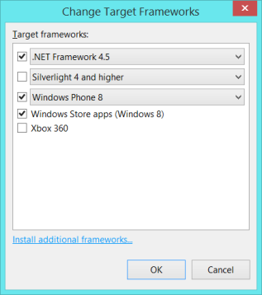
Problems with PCLs
Sheer number of permutations
Intersection of APIs, not union
Notes:
Async example

Slide 23
PCLs: Intersection of APIs
.NET Framework 4.5 BCL
Windows 8 BCL
Silverlight 5 BCL

Slide 24
PCLs: Intersection of APIs
.NET Framework 4.5 BCL
Windows 8 BCL
Silverlight 5 BCL
Profile47 portable-net45+sl50+win8

Slide 25
.NET FRAMEWORK
.NET CORE
XAMARIN
APP
MODELS
WPF
Windows Forms
UWP
iOS
Android
ASP.NET
ASP.NET Core
OS X
*
BASE
LIBRARIES
Base Class Library
Core Library
Mono Class Library
COMMON INFRASTRUCTURE
Compilers
Languages
Runtime components

Slide 26
.NET FRAMEWORK
.NET CORE
XAMARIN
APP
MODELS
My code
BASE
LIBRARIES
Implementation 3
Reference implementation
Implementation 2
Implementation 1
PCL reference assemblies
COMMON INFRASTRUCTURE
Compilers
Languages
Runtime components

Slide 27
.NET Standard

Slide 28
.NET FRAMEWORK
.NET CORE
XAMARIN
WPF
Windows Forms
UWP
iOS
Android
ASP.NET
ASP.NET Core
OS X
*
.NET STANDARD LIBRARY
One library to rule them all
COMMON INFRASTRUCTURE
Compilers
Languages
Runtime components

Slide 29
.NET FRAMEWORK
.NET CORE
XAMARIN
Reference implementations
Full implementations
My code
COMMON INFRASTRUCTURE
Compilers
Languages
Runtime components

Slide 30
.NET Standard: Curated Set of APIs
2.0
1.6
1.5
1.4
1.3
1.2
1.1

Slide 31

More APIs / Fewer Platforms

Slide 32
Comparison: .NET Standard to Portable Class Libraries
.NET Standard: sort of the next generation of PCLs
“Standard-based PCL” vs “profile-based PCL”
Soft reference through a go-between vs hard-coded reference
Notes:
.NET Standard can be thought of as the next generation of Portable Class Libraries (PCL). The .NET Standard improves on the experience of creating portable libraries by curating a standard BCL and establishing greater uniformity across .NET runtimes as a result. A library that targets .NET Standard is a PCL or a ".NET Standard-based PCL". Existing PCLs are "profile-based PCLs".

Slide 33
Comparison: .NET Standard to Portable Class Libraries
.NET Standard | PCLs
A curated set of APIs | Profiles are defined by intersections of existing platforms
Linearly versions | PCL profiles do not linearly version.
Agnostic to platform | PCL profiles represents Microsoft platforms
Notes:
NET Standard is a curated set of APIs, while PCL profiles are defined by intersections of existing platforms.
.NET Standard linearly versions, while PCL profiles do not.
while the .NET Standard is agnostic to platform.

Slide 34
PCL Compatibility
Microsoft.NETCore.Portable.Compatibility
Enable .NET Standard-based PCLs to reference profile-based PCLs.
Enable profile-based PCLs to be packaged as .NET Standard-based PCLs.

Slide 35
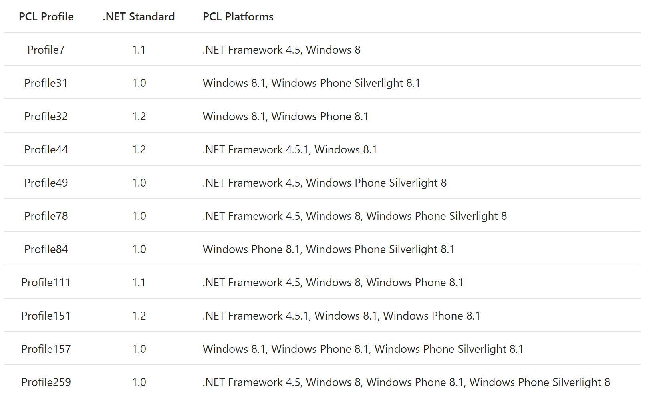

Slide 36
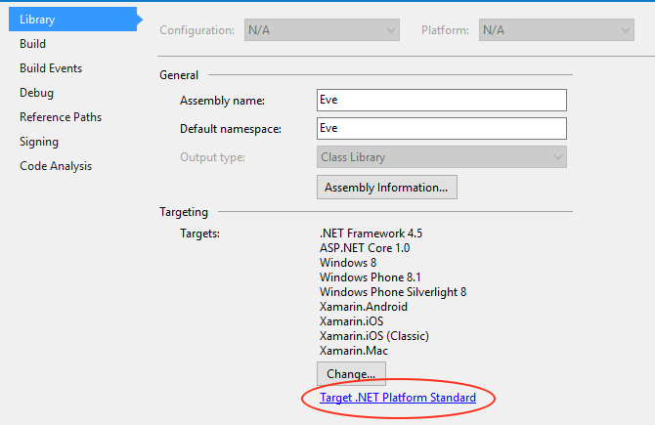
DEMO: PCL Conversion
Convert a PCL to .NET Standard
Removed in VS 2017 15.7.4

Slide 37
.NET Standard 2.0

Slide 38
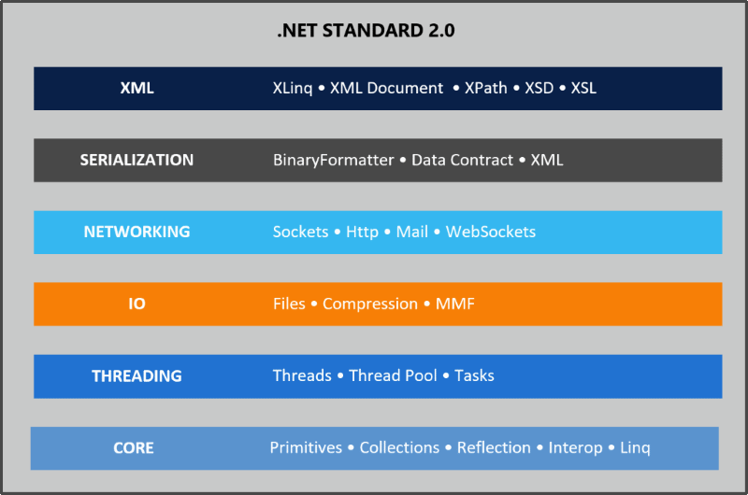
.NET Standard 1.6 -> 2.0
August 2017
With .NET Core 2.0
Huge!
20k new APIs
(or 149% increase)

Slide 39
.NET Standard 2.1

Slide 40
.NET Standard 2.1
3k new APIs
800 new members in .NET Core
Span<T> and foundational-APIs working with spans
Reflection emit
SIMD
ValueTask and ValueTask<T>
DbProviderFactories
System.HashCode
System.String overloads

Slide 41
.NET Standard 2.1
Currently 83% complete
Released with .NET Core 3.0 in 2019
.NET Standard 2.1 Support
.NET Core 3.0
Future versions of Xamarin, Mono, and Unity
Note: .NET Framework 4.8 remains on .NET Standard 2.0

Slide 42
Recap
What is the .NET Standard?
Why should I care?
DEMO: How to read Nuget listing
DEMO: Creating a .NET Standard library from scratch
Compare/Contrast with Portable Class Libraries (PCLs)
DEMO: Converting a PCL to .NET Standard
.NET Standard v2.0 & v2.1

Slide 43
Thank You! Questions?
Jonathan "J." Tower
Principal Consultant & Partner
Trailhead Technology Partners
trailheadtechnology.com
 Microsoft MVP in ASP.NET
 Telerik/Progress Developer Expert
✓ Organizer of Beer City Code
→ jtower@trailheadtechnology.com
✶ trailheadtechnology.com/blog
 jtowermi
github.com/jonathantower/dotnet-standard

Slide 44
If You Give $245, So Will I!
bit.ly/gang-conf
“charity:water is a non-profit organization that provides clean and safe drinking water to people in developing nations. The organization was founded in 2006 and has helped fund 22,936 projects in 24 countries, benefiting over 4.6 million people.” - Wikipedia
“4/4 Stars” - CharityNavigator.org

