Slide 1




Toward Automatic Hardware and Data Partitioning in HLS
n×[Int,Int]
Map(*, input)
Hardware Description
Language (HDL)
High-Level IR
High-Level
Synthesis (HLS)
Synthesis
FPGA
Cost Model
predict
*
Resource Usage:
Muls: m
Partitioned IR
*
m
Join(
Map(Map(*, _),
Split(input, m)))
*
*
(n/m)xm×[Int,Int]
Tzung-Han Juang, Jonathan Van der Cruysse, and Christophe Dubach McGill University – CDP ’24 – Tuesday November 12, 2024
Notes:
Merge title slide and slide 2

Slide 2
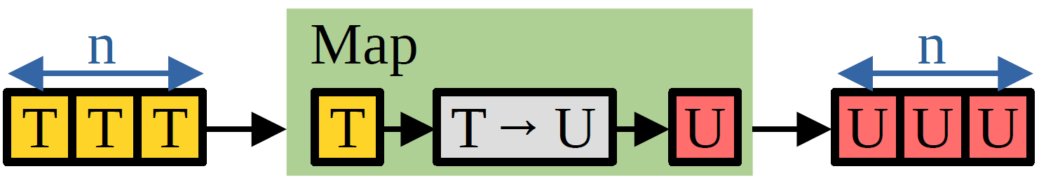
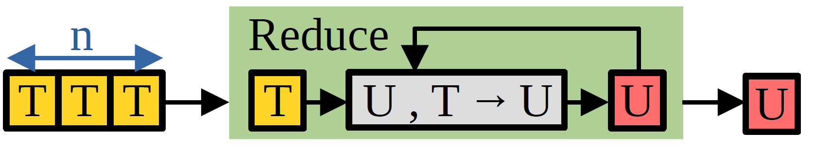
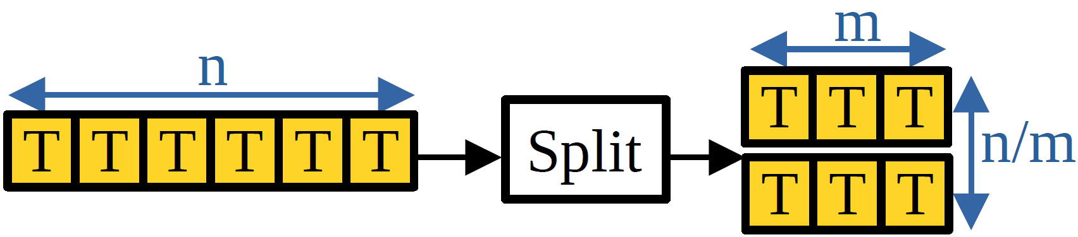
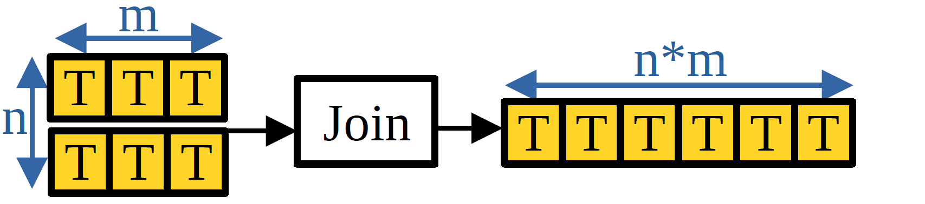
Functional Intermediate Representation (IR) [1]
Map(f: T→U, in: n×T): n×U
Reduce(f: (U,T)→U, in: n×T): U
Split(in: n×T, size: m): (n/m)×m×T
Join(in: n×m×T): (nm)×T
DotProd(in: nx[Int,Int]): Int = Reduce(+, Map(*, in))
[1]: Christof Schlaak et al. Memory-Aware Functional IR for Higher-Level Synthesis of Accelerators. . TACO 2022
Notes:
X in one color, y in another color
Increase zip, map, reduce font size, change to gray color

Slide 3
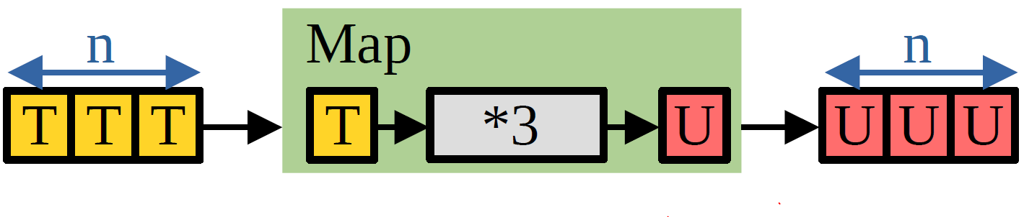
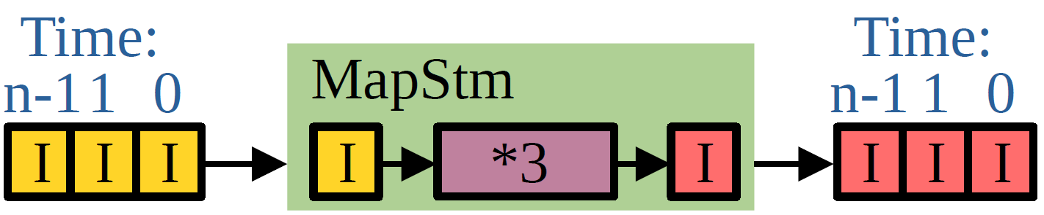
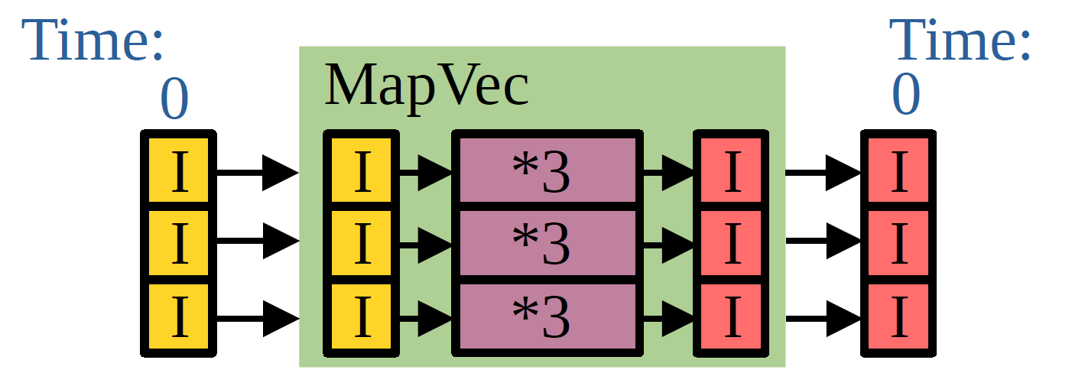
Lower Functional IR
Algo Level:
Map(*3, in: n×Int): n×Int
Lowering
Arch Level:
MapStm(*3, in: Stm[Int,n]): Stm[Int,n]
Optimizing
MapVec(*3, in: Vec[Int,n]): Vec[Int,n]
Lowering
HDL Level:
entity MapVec is port(input in std_logic_vector ...)
Notes:
X in one color, y in another color
Increase zip, map, reduce font size, change to gray color

Slide 4
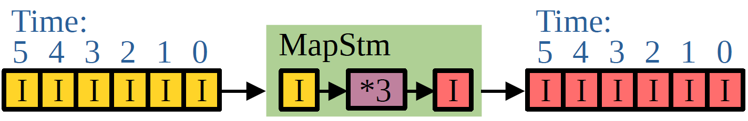
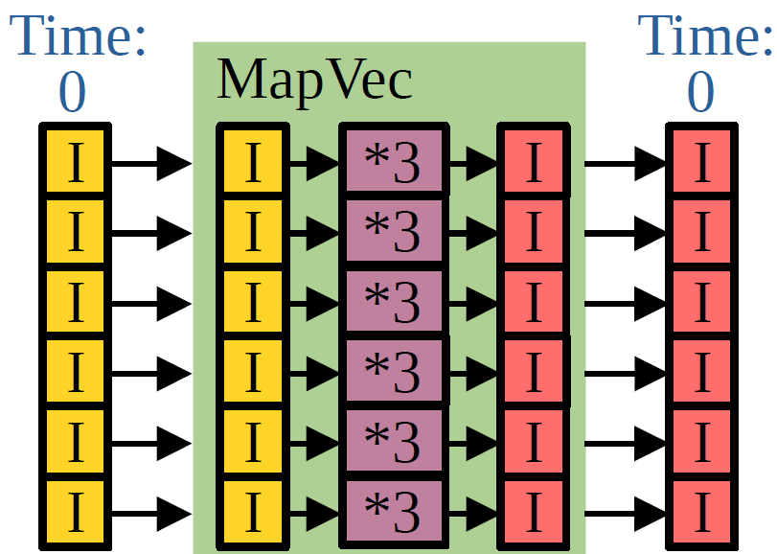
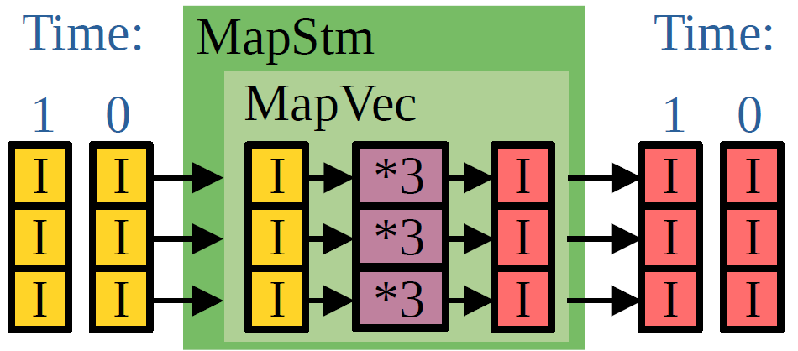
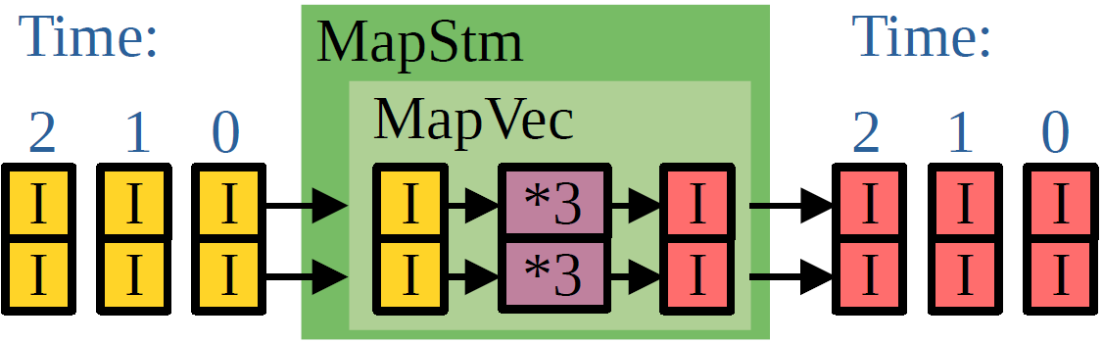
Motivation: Determining Partition Size
Original:
MapStm(*3, in: Stm[Int,6]): Stm[Int,6]
After Optimizing
2 cycles
3 resources
3 cycles
2 resources
1 cycle
6 resources
Notes:
X in one color, y in another color
Increase zip, map, reduce font size, change to gray color

Slide 5
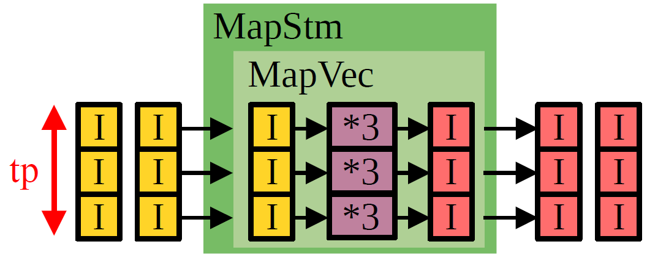
Preserve Tuning Parameters for Partitioning
Algo Level:
Map(*3, in: 6×Int): 6×Int
Express Partitioning
Join(Map(Map(*3, _), Split(in, tp)))
Lowering
Arch Level:
JoinStm(MapStm(MapStm(*3, _), SplitStm(in, tp)))
Optimizing
JoinStm(MapStm(Vec2Stm,
MapStm(MapVec(*3, _),
MapStm(Stm2Vec, SplitStm(in, tp)))))

Slide 6
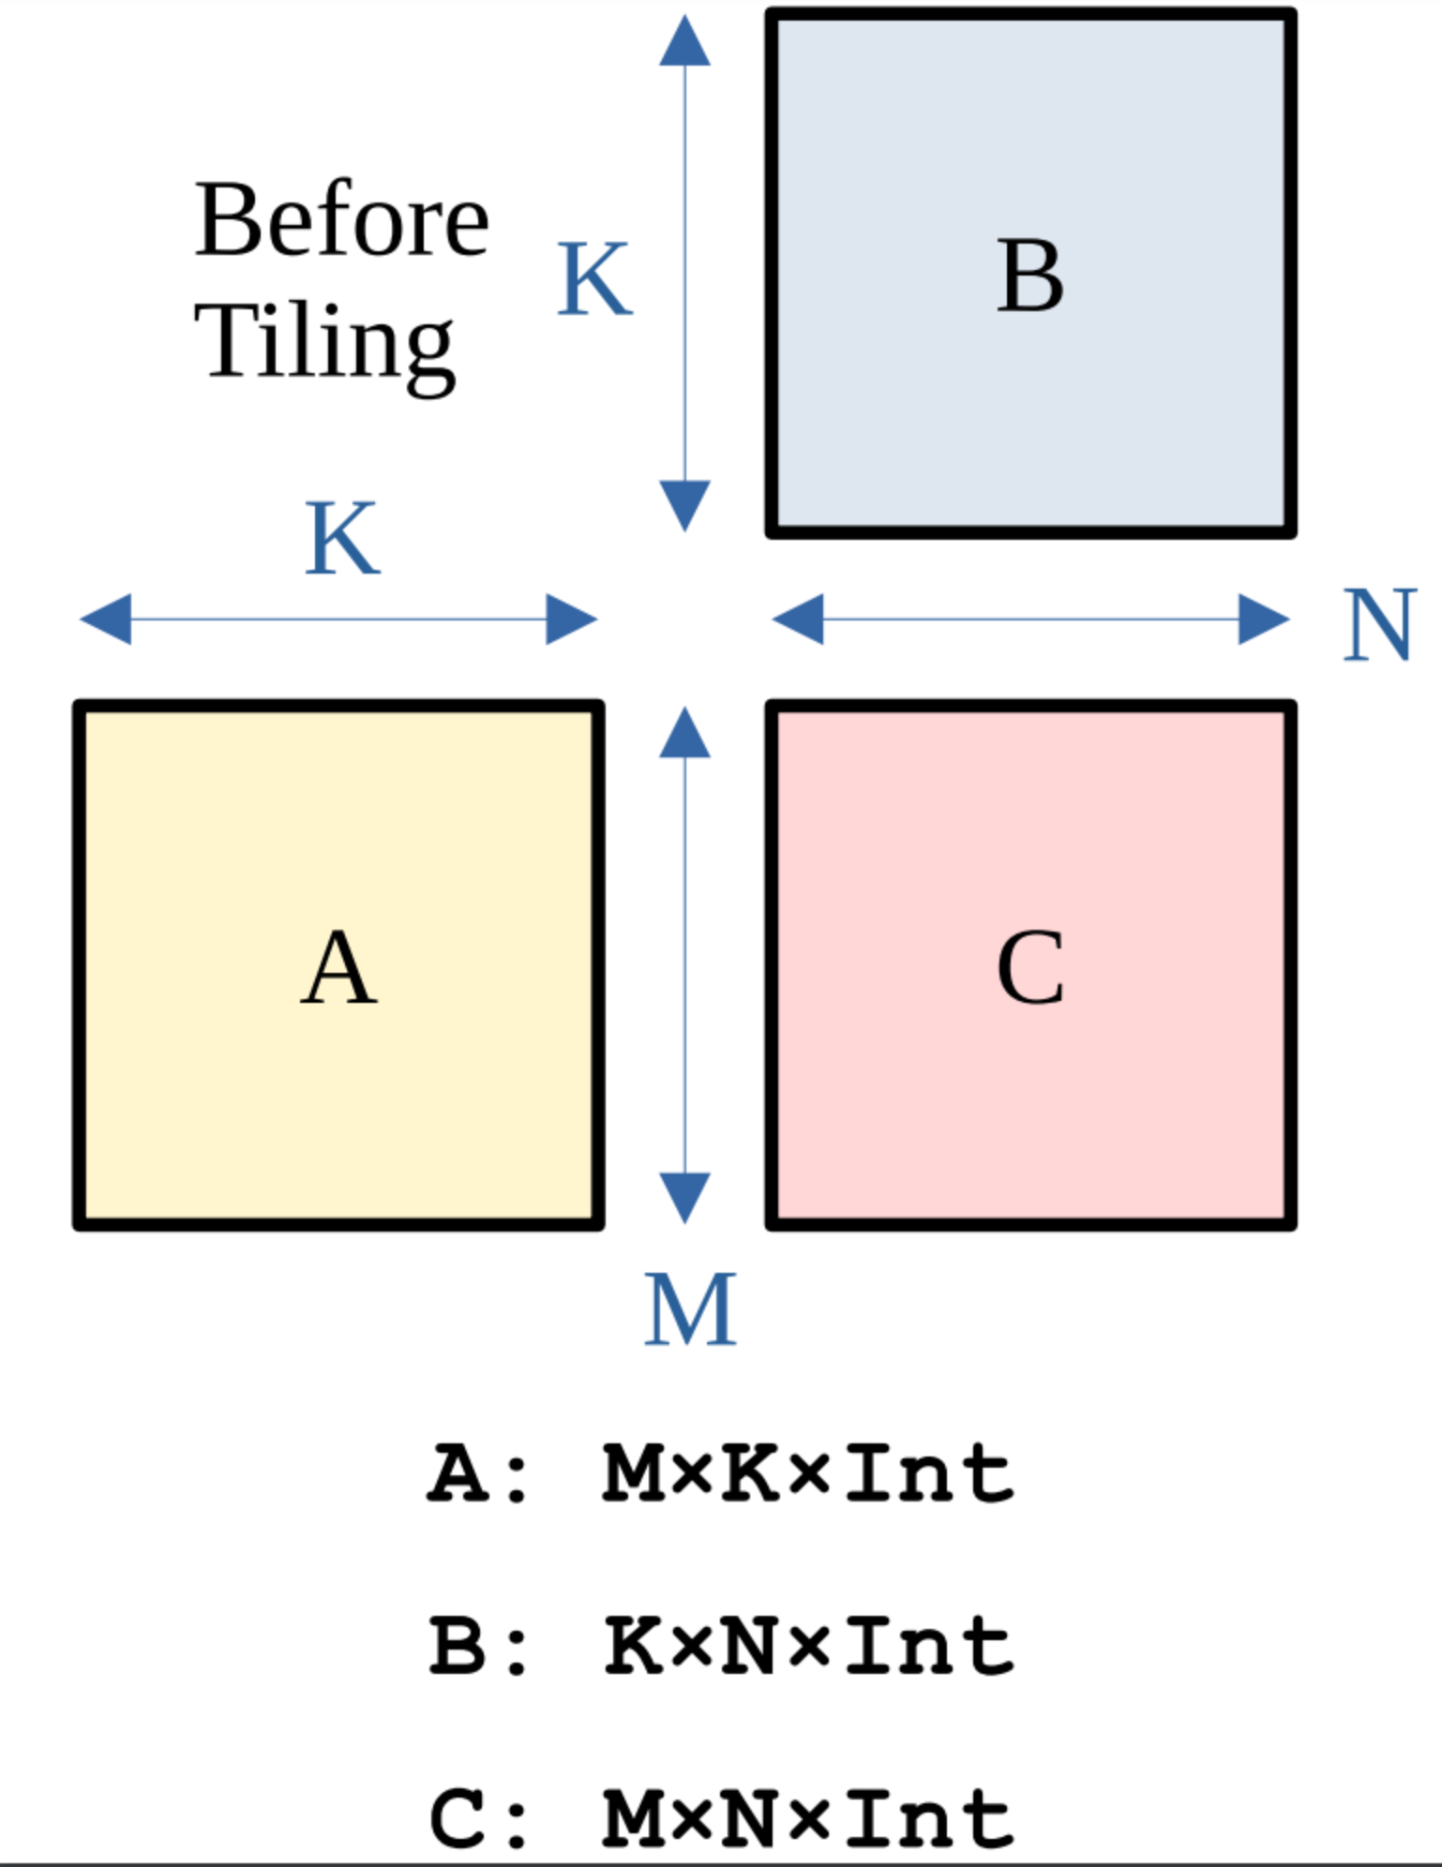
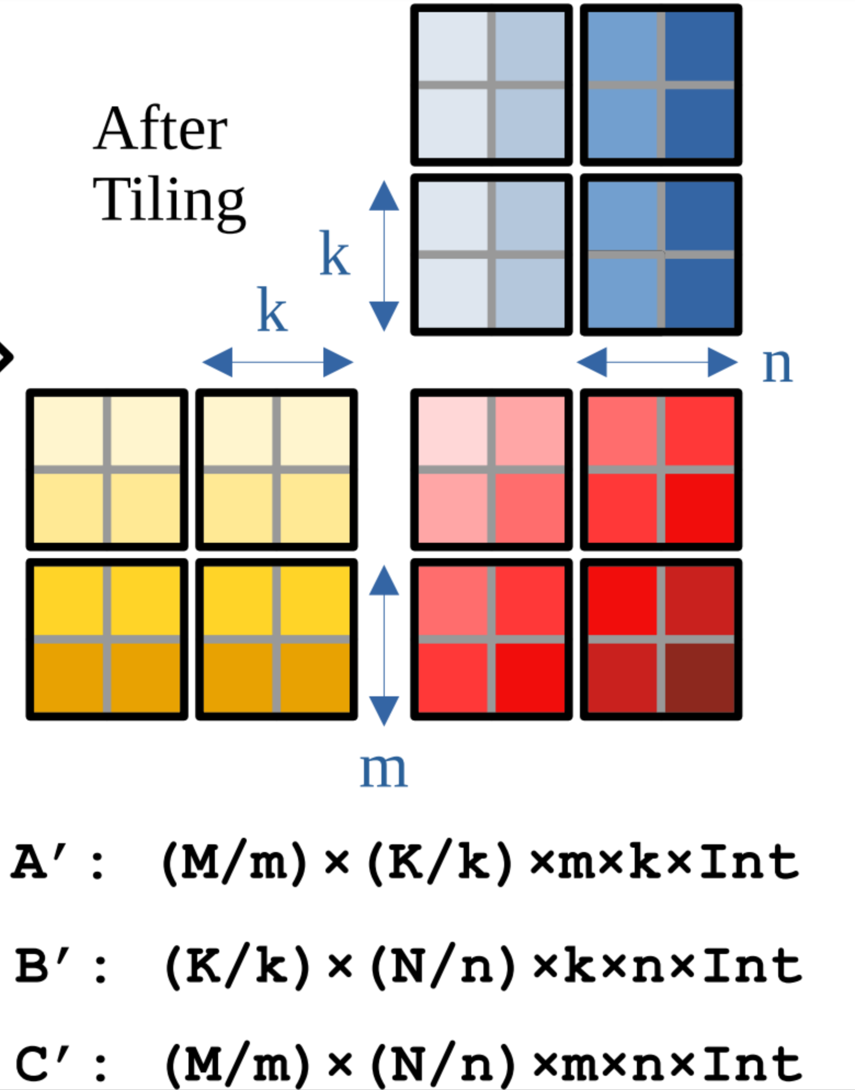
Insert Tuning Parameters
MatMul(A: MxKxInt, B: KxNxInt): MxNxInt =
Map(a -> Map(b -> DotProd(a, b), Transpose(B)), A)
Add Tuning Parameters: m, n, k
A’ = Transpose(Split(A, (m, k))): (M/m)x(K/k)xmxkxInt
B’ = Transpose(Split(B, (k, n))): (K/k)x(N/n)xkxnxInt
C’ = Map(a’ =>
Map(b’ =>
Reduce(+,
Map(tup =>
MatMul(tup.0: mxkxInt, tup.1: kxnxInt)
Zip(a’, b’)
)), Transpose(B’)
), A’): (M/m)x(N/n)xmxnxInt
Linked tuning parameter

Slide 7
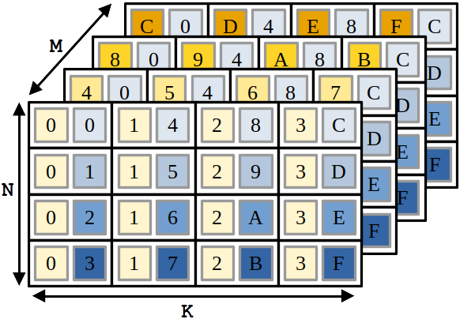
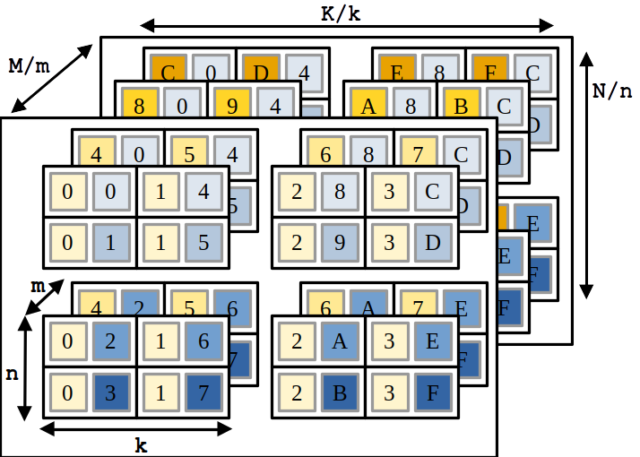
Partitioning with Single Input
MatMul(AB: MxNxKx[Int,Int]): MxNxInt
DCM(divideFunc, conquerFunc, mergeFunc, AB)
divided: (M/m)x(N/n)x(K/k)xmxnxk×[Int,Int]
= Transpose(Split(AB, (m, n, k)))
conquered: (M/m)x(N/n)x(K/k)xmxn×Int
= Map(Map(Map(MatMul(_), _), _), divided)
merged: (M/m)x(N/n)xmxn×Int
= Map(Map(Reduce(+, _), _), conquered)

Slide 8
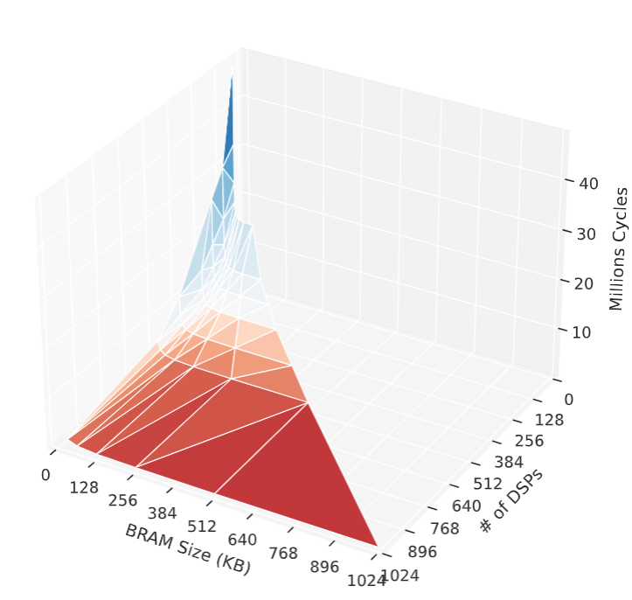
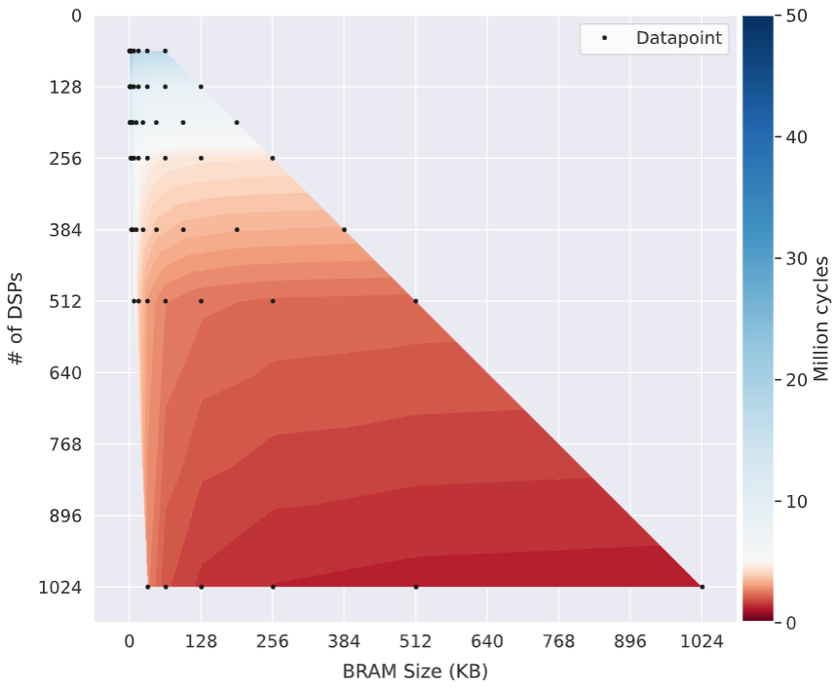
Exploration for Matrix Multiplication

Slide 9
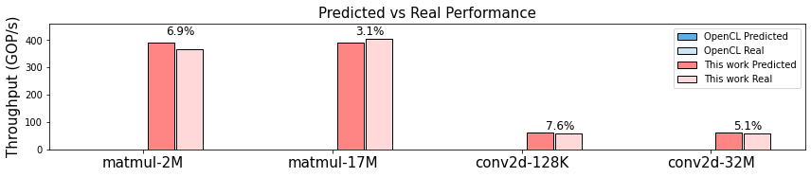
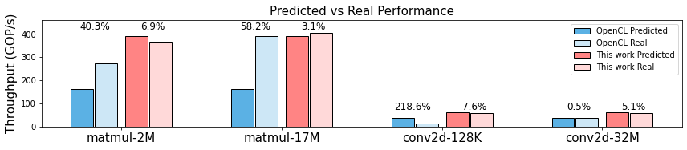
Performance Prediction against Intel OpenCL

Slide 10
From Semi-Automatic to Automatic Partitioning
Users’ interference
Hardware Description
Language (HDL)
High-Level IR
Partitioned IR
High-Level
Synthesis (HLS)
Divide-
Conquer-Merge
Cost Model
Preserve tuning parameters
Without users
Hardware Description
Language (HDL)
High-Level IR
High-Level
Synthesis (HLS)
Cost Model
Partitioning

Slide 11
Automatic Partitioning with Resource Sharing
MatVec(fWgt, Flatten(Conv(cWgt, In)))
cWgt
(64*3*3)×64×T
fWgt
(64*2*2)×64×T
In
(64*4*4)×T
Conv
Flatten
MatVec (64*2*2)×64×T
Slide2D
MatVec (64*3*3)x64xT
Pad
MatVec (64*3*3)×64×T
Lower
Pad

Slide 12
Resource Sharing
Ingredients:
Multi-level abstraction
Transformations
Decision-making mechanism
MatVec(fWgt, Flatten(Conv(cWgt, In)))
cWgt
(64*3*3)×64×T
fWgt
(64*2*2)×64×T
Slide2D
Invoke
In
(64*4*4)×T
MatVec (64*3*3)x64xT
Flatten
Pad
Invoke
MatVec (64*3*3)x64xT
MatVec (64*3*3)x64xT
[2]: Tzung-Han Juang et al. Let Coarse-Grained Resources Be Shared: Mapping Entire Neural Networks on FPGAs. TECS 2023

Slide 13
Overview
MatMul(A, b)
MatVecSk(A, b,
c,d -> Dot(c,d))
let dot = c,d -> Dot(c, d)
MatVecSk(A, b, dot)
DSL
Skeleton IR
Equality Saturation
Skeleton IR w/ shared funcs
High-Level
Synthesis (HLS)
Cost Model
Decision-making mechanism
Multi-level abstraction
Outlining Extractor
Transform Rules
Transformations

Slide 14
Ingredient #1: Skeleton IR
DSL
Skeleton IR
MatVec(A, b)
→
MatVecSk(A, b, c,d -> Dot(c, d))
Conv(Wgt, In)
→
ConvSk(Wgt, In, A,b -> MatVecSk(A, b, …))

Slide 15
Skeleton IR
ConvSk
Conv
cWgt
(64*3*3)×64×T
In
(64*4*4)×T
A,B ->
→
cWgt
(64*3*3)×64×T
In
(64*4*4)×T
MatVecSk
(64*3*3)x64xT
A (64*3*3)x64xT
b
64xT
c,d ->
Dot

Slide 16
Ingredient #2: Transformations
Conv
Tile
Width/height
Output channels
Input channels
Pad width/height
MatVec
Tile
Pad
Dot
Change parallelism

Slide 17
Transformations
DSL
Skeleton IR
MatVec(A, b)
→
MatVecSk(A, b, c,d -> Dot(c, d))
Conv(Wgt, In)
→
ConvSk(Wgt, In, A,B -> MatVecSk(A, B, …))
TiledMatVecSk(A, B, C,D -> MatVecSk(C, D, …))
PaddedMatVecSk(A, B, C,D -> MatVecSk(C, D, …))

Slide 18
Ingredient #3: Equality Saturation
Saturation
MatVec padding rule
E-Graph construction
Extraction
MatVecSk (64*2*2)×64×T
MatVecSk (64*2*2)×64×T
MatVec (64*2*2)×64×T
Padded MatVecSk
Flatten
fWgt
(64*2*2)×64×T
a,b ->
let mv = A,B ->
MatVecSk^{(64*3*3)x64xT}(...)
PaddedMatVecSk(
fWgt,
Flatten(ConvSk(
cWgt, In, mv)),
mv)
ConvSk
Conv
…
→
In
(64*4*4)×T
cWgt
(64*3*3)×64×T
A,B ->
MatVecSk (64*3*3)×64×T
Outline
…
…
…

Slide 19
Summary + Future Work
Automatic Partitioning
✔
✔
✔
✔
…
DSL
Skeleton IR
Equality Saturation
Skeleton IR w/ shared funcs
High-Level
Synthesis (HLS)
Cost Model
Outlining Extractor
Transform Rules
DSL
Divide-
Conquer-Merge
High-Level
Synthesis (HLS)
Evaluate
…
Semi-automatic Partitioning
Preserve Tuning
Parameters
Cost Model

Slide 20


Toward Automatic Hardware and Data Partitioning in HLS
Tzung-Han Juang
McGill University tzung-han.juang@mail.mcgill.ca
Jonathan Van der Cruysse
McGill University jonathan.vandercruysse@mail.mcgill.ca

Slide 21
Equality Saturation: Extraction and Outlining
Inline (cost 3)
cost(MatVecSk)
OR (cost 2) + cost(padding)
MatVecSk (64*2*2)×64×T
MatVec (64*2*2)×64×T
Padded MatVecSk
Transformation decision
Flatten
fWgt
(64*2*2)×64×T
a,b ->
Outlining decision
Solver
ConvSk
Conv
Inline (cost 2) OR
Latency: x
DSPs per use: y
RAM per use: z
Outline (cost 2)
Latency: x + (sharing overhead)
DSPs per use: 0
RAM per use: 0
Global DSPs: y
Global RAM: z
…
In
(64*4*4)×T
cWgt
(64*3*3)×64×T
A,B ->
Inline (cost 1)
Latency: x
DSP per use: y
RAM per use: z
MatVecSk (64*3*3)×64×T
…
…
…

Slide 22
MatVec Skeleton
MatVec(A, b) = map( (a, b’) -> Dot(a, b’), zip(A, repeat(B)))
MatVecSk(A, b, f) = map( f, zip(A, repeat(B)))

Slide 23
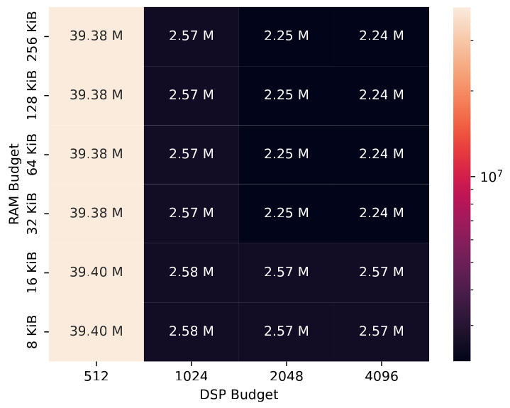
Latency (in steps) per resource budget, first 4 layer of VGG

Slide 24
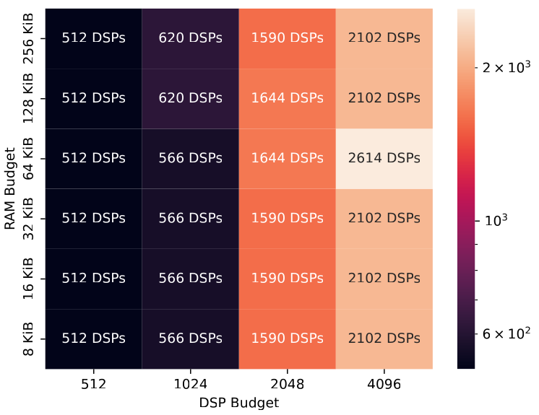
DSP use per resource budget, first 4 layer of VGG

Slide 25
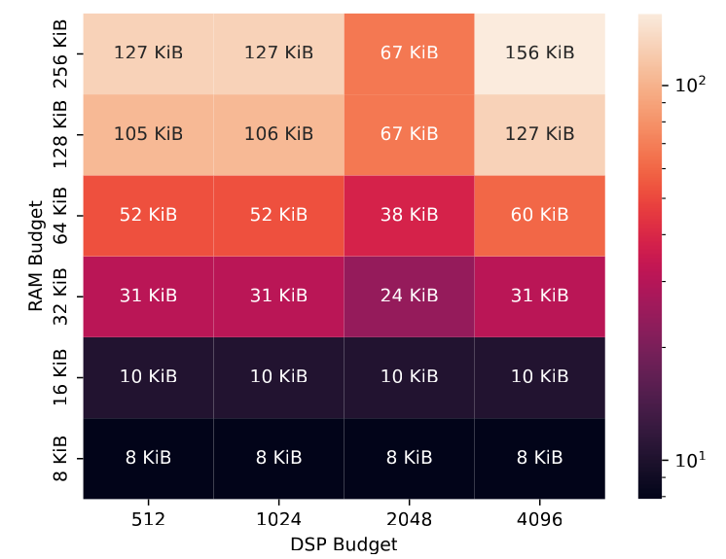
RAM use per resource budget, first 4 layer of VGG

