Slide 1


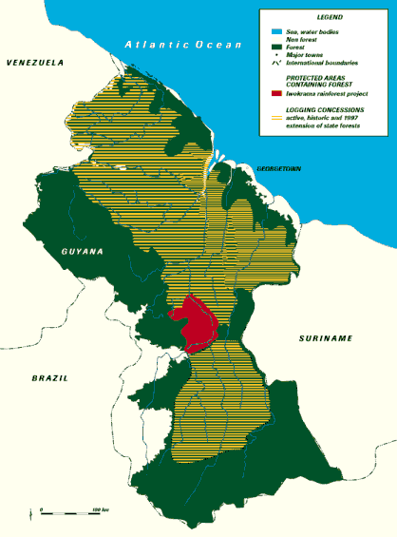
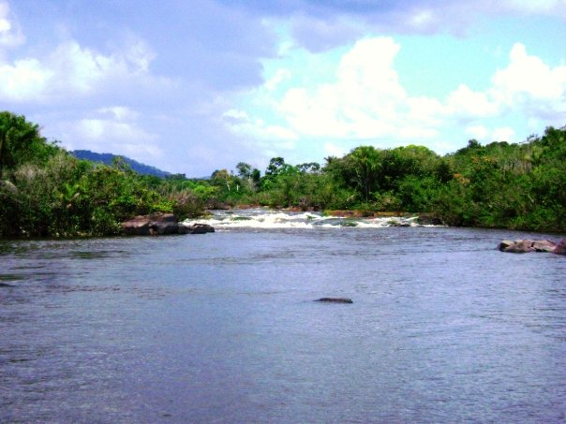
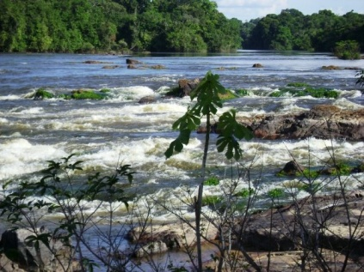
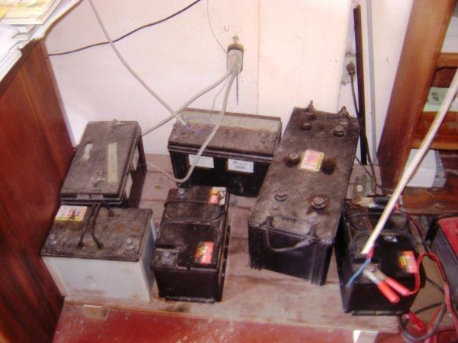
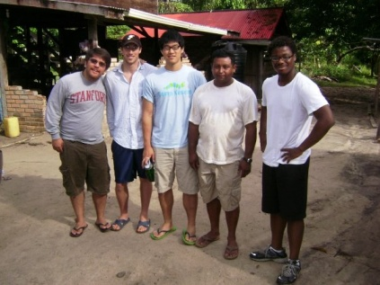
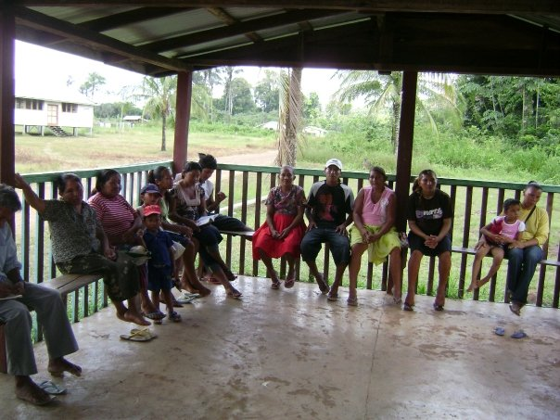
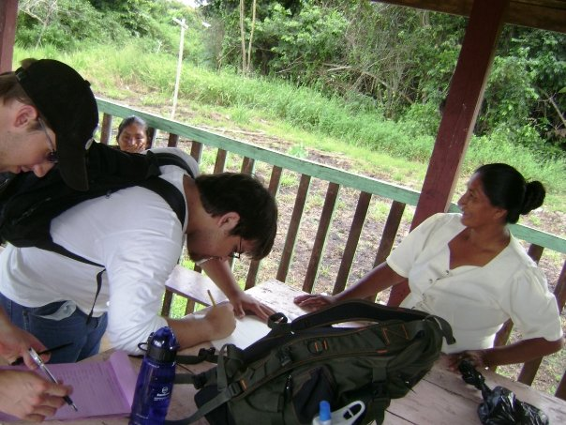
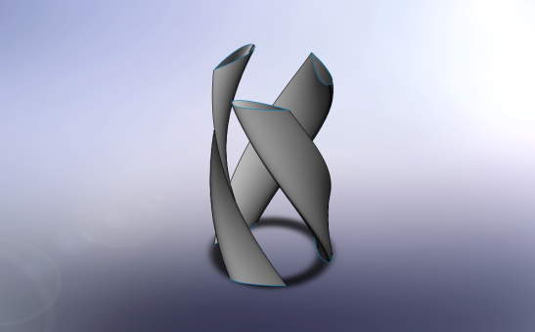
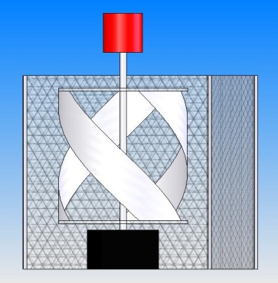
Global Problem
Now – 1.6 billion, 1/4 of the world’s population, lives without electricity
2030 – At current rural electrification rate, 1.4 billion will still not have electricity
Effects of No Electricity
People are trapped into poverty
Time is spent searching for biomass
Less time devoted to education and other income generating activities
Possible Solutions and Problems
Grid electrification
  Villages are difficult to reach
  Too costly for 2USD a day
  Currently impractical
Hydro Power
  Dependent on Location
  Designs must be water proof
  Often requires making a dam
Solar Power
  Expensive dollar per watt
  Maintenance/ Installation issues
  Dependent on sunlight
Wind Power
  Difficult to maintain and install
  Highly dependent on location
Fossil Fuels+ Generators
  Pollutes the environment
  Generators are difficult to repair
  Gas is expensive
Existing Infrastructure
Car Batteries
Charged in major cities by diesel generators
Delivered to families
Process is inefficient and costly
Trip Conclusions
Design too complicated
Turbine needs to be easily repairable
Materials must be locally available
Villagers mainly need lighting
Workers also need energy
EnGen should take advantage of solar energy
New Designs
Solar Concentrator
  Will use a Fresnel Lens to concentrate light on solar panels
  More portable than parabolic dish solar concentrator
  Will allow villagers to move the device between home and farm
Floating Waterwheel
  Waterwheel will take advantage of the rivers white water rapids
  This design will water in the wet or dry season
  Unlike Gorlov Turbines these will be easily repairable if broken
Electrical Component
  Charge Controllers and Inverters are available in Guyana
  Will use alternators instead of Permanent Magnet Generators
  Battery Banks will be made of Deep Cycle 12 volt batteries
Bringing Energy
to Off-Grid Communities
Community- Fairview
Located in Iwokrama Rainforest
Works closely Iwokrama NGO
Approximately 200 villagers
Most villagers are farmers
What We Learned
Immense potential for hydro and solar energy
Many villagers owned their own generators
They could not afford gas
Impressive understanding of electricity and renewable energy
Design not well suited for river
Original Turbine Design Details
35% Efficiency (NACA -0021)
Styrofoam Blades Coated in Fiberglass
Design Dimensions
  Radius- .75 meters
  Height- 1.25 meters
Brief Future Action Plan
November
  Order parts for new design
  Begin building new turbines
  Attempt to secure funding
December
  Finish building prototypes
  Test prototypes.
  Secure Funding for Trip
  Build any additional turbines
January
  Travel to Install
Original Turbine Design Failures
Was not designed for river depth during
rainy season
Permanent Magnetic Generators were
not readily available in Guyana
Blades too complicated to be fixed by
villagers
Initial Design and Thoughts
Gorlov Helical Turbine
River was under 10 feet deep
Rainy season was not very prevalent
Villagers had little access to energy
Team: Eric Beecher, Nicholas Hong, Jose Villalobos, Renaldo Webb

