Slide 1

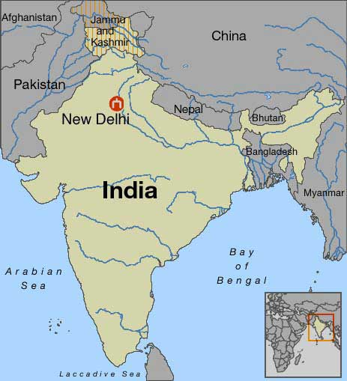
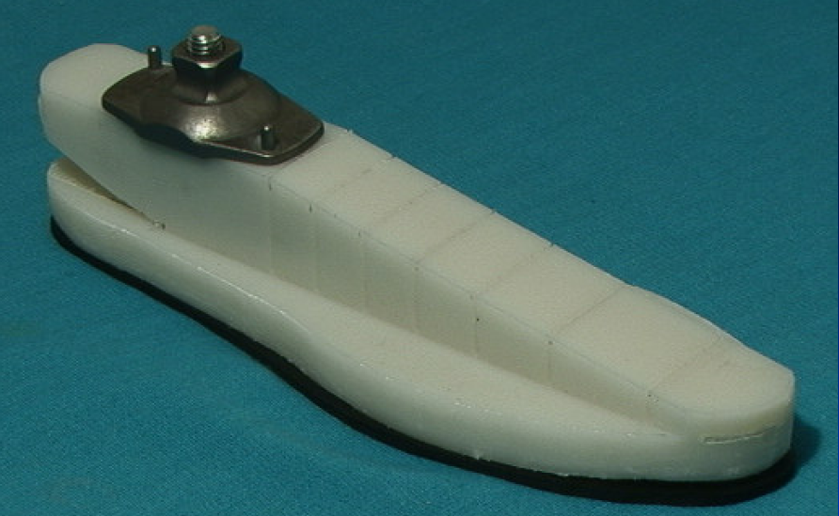
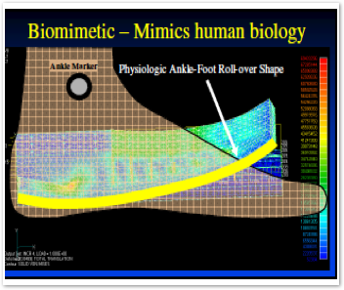
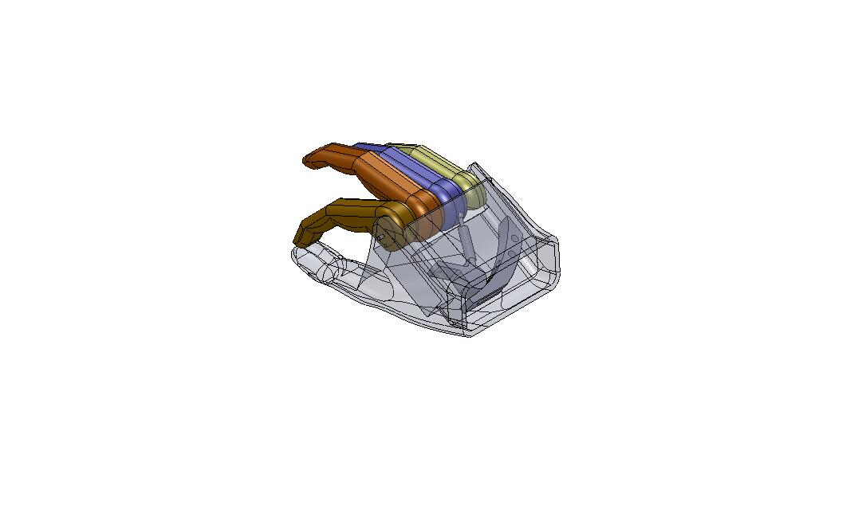
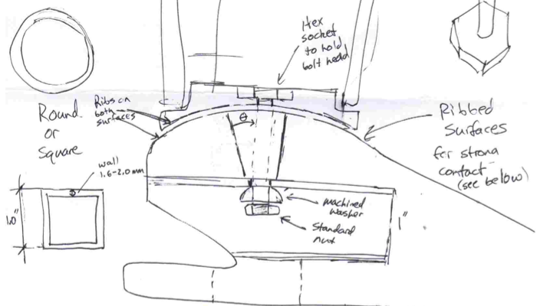
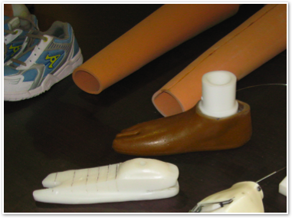
KEVIN FARINO
Graduating Class: Class of 2010
Major: Mechanical Engineering
Hometown: Medford. MA
Interests: MIT Ice Hockey, Snowboarding
SHAPE AND ROLL FOOT
Project:
The Shape and Roll technology was developed at the Northwestern University Prosthetics Research Laboratory and Rehabilitation Engineering Research Center in Chicago,IL headed by Doctor Andrew H. Hansen.
Project Description:
The Shape and Roll foot is a low-cost prosthetic foot that mimics the rollover shape of a natural gait. Cyclic testing and recently held trials have revealed some design issues that must be addressed before it can be deployed. This project will address these issues to make the foot more durable and less costly, as well as augment the functionality to allow both squatting and walking. The goal is to make it a practical device for use in the developing world in terms of functionality and manufacturability. Andrew Hansen and his Northwestern University team will assist in prototyping efforts and help with design iterations as necessary.
LOCATION
New Delhi, India
Capital of India
Average summer temperature is 99 deg. F
TRANS-RADIAL PROSTHESIS
Design Specifications
Redesign Existing Foot
Replace aluminum square tube with round tube
Create attachment to the Jaipur Foot exoskeletal HDPE
Mitigate the stiffness of the heel
Provide Squat/Walk Functionality
In India the appearance (or cosmesis) of the
prosthetic is almost as important as the function of
the device itself. As such, it becomes a huge
challenge to develop an inexpensive prosthetic that
meets the aesthetic and practical needs of amputees.
The goal of the variable mechanical advantage
(VaMA) hand is to provide an “all in one” prosthetic
device for work and social gatherings.
-Voluntary closing operation
-Manually operated via upper extremity harness
-Mechanical advantage operation
-Natural aesthetic design
-Can grab large objects, pinch, and grasp
-Estimated ~$30 cost per unit.
Alpha Prototype
-Mechanical operation was inspired by Professor Dan
Frey’s paper “A body powered prehensor with
variable mechanical advantage" P&O International,
1994, 18, 118-123
-Middle, ring, and pinky fingers move as one unit
-Index finger is coupled to the rest of the hand
Design Specifications
Alpha Prototype
The first prototype addresses the first three design specifications.
1. A convex dome was added to the top of the foot to allow adjustment, mainly in the sagittal plane.
2. The aluminum extrusion is necessary for support. The square tubing was replaced with round tubing because it is easier to obtain in India.
3. The attachment piece is modeled after the HDPE exoskeleton for a natural look. It sits on the dome of the foot with the outer edges contacting the surface to reduce the bending moment in the bolt. A bolt is inserted through the bottom of the foot to fasten the ankle and foot together.
ORGANIZATION
The projects were very well accepted by the organization. There is further work to be done, but by visiting the facilities and talking face to face with patients and the men who work in organization, I came back with a much deeper understanding of the circumstances I was designing for.
CHALLENGES
Although many people spoke English, the majority of the workers at the Jaipur Foot Organization did not. This made a challenge of all the little things. However our host was amazing and made sure we were well taken care of. Also, white people were not prevalent in India, so it was hard to get them to communicate their true feelings about the devices in use because they wanted to impress us.

