Slide 1
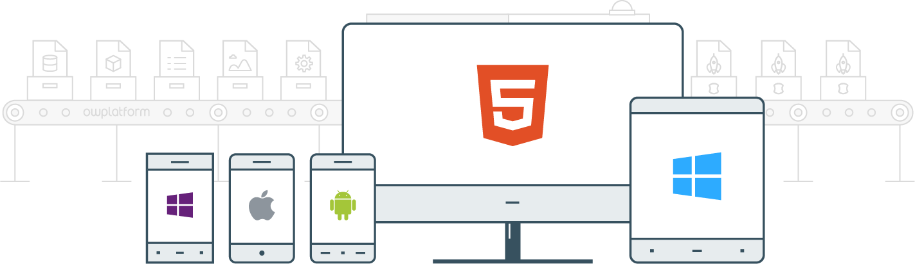

I
Course:
Become a Full-stack Developer
Become a Full-stack Developer
+972.52.530.7939
jwax@prodware.fr

Slide 2
Build your first Angular2+ App
Become a Full-stack Developer
+972.52.530.7939
jwax@prodware.fr

Slide 3
Angular2 – Your first App
Angular CLI (Command Line Interface)
  https://cli.angular.io/
  Prerequisites
    nodejs (6+) + npm
    https://nodejs.org/en/ (LTS version)
    Local Admin rights
  Getting Started
  https://angular.io/guide/quickstart
    Install angular-cli
    Create new angular project
    Run angular project
// install angular-cli
> npm install –g @angular/cli
// create new angular project
> ng new <yourappname>
> cd <yourappname>
// run angular project
yourappname> ng serve
Become a Full-stack Developer
+972.52.530.7939
jwax@prodware.fr

Slide 4
Angular2 – Your first App
Project Folder/Structure
// Angular Project Structure
.angular-cli.json
.editorconfig
.gitignore
e2e
karma.conf.js
package.json
protractor.conf.js
README.md
src
tsconfig.json
tslint.json
  Angular Style Guide
  https://angular.io/guide/styleguide
  Angular CLI uses Style Guide
Become a Full-stack Developer
+972.52.530.7939
jwax@prodware.fr

Slide 5
Angular2 – Your first App
ReadMe.md
# Jerusalapp
This project was generated with [Angular CLI](https://github.com/angular/angular-cli) version 1.4.7.
## Development server
Run `ng serve` for a dev server. Navigate to `http://localhost:4200/`. The app will automatically reload if you change any of the source files.
## Code scaffolding
Run `ng generate component component-name` to generate a new component. You can also use `ng generate directive|pipe|service|class|guard|interface|enum|module`.
## Build
Run `ng build` to build the project. The build artifacts will be stored in the `dist/` directory. Use the `-prod` flag for a production build.
## Running unit tests
Run `ng test` to execute the unit tests via [Karma](https://karma-runner.github.io).
## Running end-to-end tests
Run `ng e2e` to execute the end-to-end tests via [Protractor](http://www.protractortest.org/).
## Further help
To get more help on the Angular CLI use `ng help` or go check out the [Angular CLI README](https://github.com/angular/angular-cli/blob/master/README.md).
Become a Full-stack Developer
+972.52.530.7939
jwax@prodware.fr

Slide 6
Angular2 – Your first App
Running/Testing/Build your app
// Run your app
> ng serve
// Unit Test your app
> ng test
// End-To-End Test your app
> ng e2e
// Build your app
> ng build
  Nodejs + webpack – like iisexpress
  Test: karma, jasmine
  e2e: selenium/protractor
  Build: webpack (--eject option)
Become a Full-stack Developer
+972.52.530.7939
jwax@prodware.fr

Slide 7
Resources
Angular Official Site – http://angular.io
Angular CLI – http://cli.angular.io
https://www.ng-conf.org/ - Original Angular Conference
https://www.angularconnect.com/ - Angular Connect
https://thinkster.io/tutorials/learn-angular-2 - Free Course.
jwax@prodware.fr
Become a Full-stack Developer
+972.52.530.7939
jwax@prodware.fr

