Slide 1
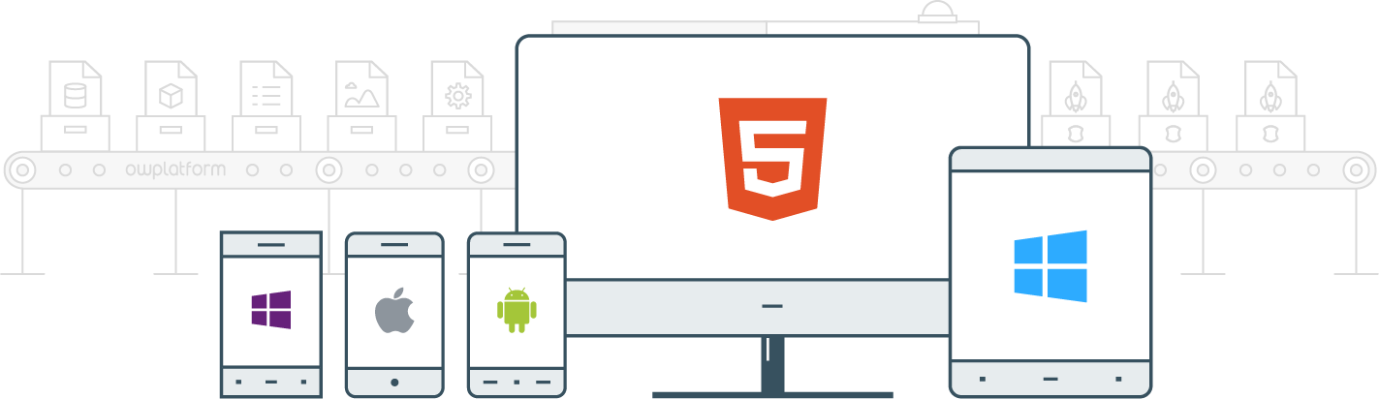

I
Course:
Become a Full-stack Developer
Become a Full-stack Developer
+972.52.530.7939
jwax@prodware.fr

Slide 2
Javascript Basics
Become a Full-stack Developer
+972.52.530.7939
jwax@prodware.fr

Slide 3
Javascript Basics
Javascript Types
  Null
  Undefined
  String
  Number (floats)
  Booleans
  Always boxed (reference types)
    Arrays
    Objects
    Regular Expression
    Functions
      Arguments (not an array)
var a = null;
a = b; ← b is undefined
var s = ‘foo’; or var s = “foo”;
var n = 1;
var isTrue = true;
Always boxed (reference type):
------------------------------------------
var arr = [1,2,3];
var obj = { };
function MyFunc(x){
return x + 1;
}
var f = function () {
return arguments[0] + arguments[1]
};
Become a Full-stack Developer
+972.52.530.7939
jwax@prodware.fr

Slide 4
Javascript Basics
Javascript - equality
  Always use === and !== (not ==)
  === checks value AND type
  Referential compare for boxed/by ref
  Structural compare for non-boxed/by val
  One possible use for ==
    Check null AND undefined
// == is misleading, because all these are true
null == undefined
false == 0
false == ’’
’’ == 0
true == 1
true == ’1’
’1’ == 1
// possible use for ==
(x == null)
Is like
(x === null || x === undefined)
Become a Full-stack Developer
+972.52.530.7939
jwax@prodware.fr

Slide 5
Javascript Basics
Javascript - Objects
  var obj = { };
  An object has properties:
    obj.propA = “shalom”
    obj[“propA”] = “shalom”
// Objects
var obj = { };
var obj = new Object();
// iterate over objects properties
for (var n in obj) {
if (obj.hasOwnProperty(n)) {
console.log(obj[n]);
}
}
Become a Full-stack Developer
+972.52.530.7939
jwax@prodware.fr

Slide 6
Javascript Basics
Javascript - Arrays
  var arr = [ ];
  An Array has elements:
    arr[0] = “shalom0”
    arr[1] = “shalom1”
  Array.push(…) – add element to array
  Array.pop(…) – remove last element
  Array map – an array with keys
    arr[“key1”] = “value1”
    arr[“key2”] = “value2”
// Arrays
var arr = [ ]; // empty
var arr = new Array ();
var arr = [1,2,3]; // array of numbers
arr.push(“one”, “two”); // add elements to arr
// array of objects
var arr = [ { name: “Yossi”}, { name: “Dana”} ]
// iterate over array elements
for (var i == 0; i <= arr.length; i++) {
console.log(arr[i][“name”]);
}
Become a Full-stack Developer
+972.52.530.7939
jwax@prodware.fr

Slide 7
Javascript Basics
Javascript “this”
// call a function alone – this is on global scope
Function foo(a){
var self = this;
}
foo(1);
  global (window in the browser)
  “this” depends on how the function is called.
  Set “this” explicitly – function binding:
    “apply”, “call”, “bind”
    Each framework handles this.
  Every function returns a value.
    undefined – if no return.
  Don’t forget var inside functions
// call a function on an object – this is the object
var x = { foo: function(a) { var self = this; } };
x.foo(1);
// call/apply/bind – set “this” to the calling function
var f = function () {return this};
f.call (100) // result is 100
// var in function – means local, otherwise global
var fn = function(){
var a = 1; // local
b = 2; // b is global
}
Become a Full-stack Developer
+972.52.530.7939
jwax@prodware.fr

Slide 8
Javascript Basics
Javascript - exceptions
  Try {} catch {} is available
  You can throw any type
    This does NOT include stack trace
  You can throw Error(…)
    This DOES include stack trace
  Always better to check for errors so they do not occur.
// throw simple type – no stack trace
try {
...
throw 3;
} catch (n) {
// n has no stack trace!
}
// throw Error – with stack trace
try {
...
throw new Error(3);
} catch (e) {
// e has a stack trace
}
Become a Full-stack Developer
+972.52.530.7939
jwax@prodware.fr

Slide 9
Javascript Basics
Javascript – utility libraries
  Utility libraries:
    Cross browser
    Optimize Performance
    Tested
  Underscorejs ( _ )
    Client side
  Lodash ( _ )
    Client side
    Server side (nodejs)
// underscore
_.each([1, 2, 3], alert);
var even = _.find([1, 2, 3, 4, 5, 6], function(num){ return num % 2 == 0; }); // result is: 2
var odds = _.reject([1, 2, 3, 4, 5, 6], function(num){ return num % 2 == 0; }); // result is: [1, 3, 5]
// lodash
var array = [1, 2, 3];
_(array).reverse().value()
// result is: [3, 2, 1]
Become a Full-stack Developer
+972.52.530.7939
jwax@prodware.fr

Slide 10
ES6 – What’s new highlights
Become a Full-stack Developer
+972.52.530.7939
jwax@prodware.fr

Slide 11
ES6 (JavaScript 2015) – What’s new?
let – block scoped variables
  var in javascript doesn’t do exactly what you think – not always scoped where it is declared.
  let – a new keyword you can use instead of var which properly scopes the variable.
  const – like let but cannot be assigned to (directly) in runtime – caution you can change it’s object’s/array’s properties…
// old - var
function varTest() {
var x = 1;
if (true) {
var x = 2; // same variable!
console.log(x); // 2
}
console.log(x); // 2
}
// ES6 – let
function letTest() {
let x = 1;
if (true) {
let x = 2; // different variable
console.log(x); // 2
}
console.log(x); // 1
}
https://developer.mozilla.org/en/docs/Web/JavaScript/Reference/Statements/let
Become a Full-stack Developer
+972.52.530.7939
jwax@prodware.fr

Slide 12
ES6 (JavaScript 2015) – What’s new?
Default Parameters
  It is now possible to default values for input parameters.
// old
function myFunc(message){
// old style input validation
var message = message || “”;
}
// ES6
function myFuncES6(message = “”){
}
http://es6-features.org/
Become a Full-stack Developer
+972.52.530.7939
jwax@prodware.fr

Slide 13
ES6 (JavaScript 2015) – What’s new?
Multi-line strings & Template Literals
  It is now possible to define multi-line strings easily using “back ticks”
// old – multi line string
var myString = “first line\n”
+”second line\n”
+”third line”;
// old concatenate strings
var name = “my name”;
var myConcatString = “hello Mr. “ + name;
// ES6 – using back ticks
var myStringES6 = `
first line
second line
third line.
`;
// ES6 – Template Literals
var name = “my name”;
var myTemplate = `hello Mr. ${name}`;
http://es6-features.org/
Become a Full-stack Developer
+972.52.530.7939
jwax@prodware.fr

Slide 14
ES6 (JavaScript 2015) – What’s new?
Arrow functions ()=>{ … }
  function(arguments) { expression } becomes (arguments) => { expression }
  Arrow functions are always anonymous
  lexically bind the this value
  and effectively turn function (arguments) { expression } into arguments => expression
  If using an expression after an arrow, the return is implicit, so no return is required
// old – bind, or var that = this…
function CounterES5() {
this.seconds = 0;
window.setInterval(function() {
this.seconds++;
}.bind(this), 1000); // or }.bind(this), 1000) and skip that = this
}
var counterA = new CounterES5();
window.setTimeout(function() {
ChromeSamples.log(counterA.seconds);
}, 1200);
// ES6 – arrow function handles this, lexical scope…
function CounterES6() {
this.seconds = 0;
window.setInterval(() => this.seconds++, 1000);
}
let counterB = new CounterES6();
window.setTimeout(() => ChromeSamples.log(counterB.seconds), 1200);
https://googlechrome.github.io/samples/arrows-es6/
Become a Full-stack Developer
+972.52.530.7939
jwax@prodware.fr

Slide 15
ES6 (JavaScript 2015) – What’s new?
Promises – built in
  promise = new Promise(function() {});
  Callbacks are functions, promises are objects
  Callbacks are passed as arguments, promises are returned
  Callbacks can represent multiple events, promises represent at most one
// ES6 – Promises
function asyncFunc() {
return new Promise(
function (resolve, reject) {
···
resolve(value); // success
···
reject(error); // failure
});
}
// call function
asyncFunc()
.then(value => { /* success */ })
.catch(error => { /* failure */ });
http://exploringjs.com/es6/ch_promises.html
Become a Full-stack Developer
+972.52.530.7939
jwax@prodware.fr

Slide 16
ES6 (JavaScript 2015) – What’s new?
Class
// ES6 – Promises
class Shape {
constructor (id, x, y) {
this.id = id;
this.move(x, y);
}
private set id (id) { this.id = id; }
get id () { return this.id;}
move (x, y) {
this.x = x;
this.y = y;
}
}
// inheritance
class Rectangle extends Shape {
constructor (id, x, y, width, height) {
super(id, x, y);
this.width = width;
this.height = height;
}
}
  Classes are 1st class citizens
  Constructor() function available
  public, private available
  extends – inheritance
  super – call super class
http://es6-features.org/#ClassDefinition
Become a Full-stack Developer
+972.52.530.7939
jwax@prodware.fr

Slide 17
ES6 (JavaScript 2015) – What’s new?
Modules
// ES6 – Modules
// lib/math.js
export function sum (x, y) { return x + y };
export var pi = 3.141593;
// someApp.js
import * as math from "lib/math";
console.log("2π = " + math.sum(math.pi, math.pi));
// otherApp.js
import { sum, pi } from "lib/math";
console.log("2π = " + sum(pi, pi));
  No global namespace pollution.
  export makes a function public
  import from lib/file some or all exports
http://es6-features.org/#ValueExportImport
Become a Full-stack Developer
+972.52.530.7939
jwax@prodware.fr

Slide 18
Javascript – Browser Support
Become a Full-stack Developer
+972.52.530.7939
jwax@prodware.fr

Slide 19
Javascript Browser Support
<no-script>
  An HTML element.
  Appers when ES/Javascript is OFF
  Can present HTML content.
// present content when javascript is OFF
<noscript>
<!-- anchor linking to external file -->
<a href="http://www.mozilla.com/">External Link</a>
</noscript>
<p>Rocks!</p>
// option 2
<body>
<div id="divMain" style="display: none">
This is content. </div>
<noscript> JS not enabled </noscript>
<script> document.getElementById("divMain").style.display = "block";
</script>
</body>
https://developer.mozilla.org/en/docs/Web/HTML/Element/noscript
Browser shims
  Some browser lack full ES5 support.
  Shims help us “fill the gap”
    Es5-shim.js
// IE9 – add ES5 missing features, objects
<!--[if lt IE 9]>
<script src="es5shim.min.js">
</script>
<![endif]-->
Become a Full-stack Developer
+972.52.530.7939
jwax@prodware.fr

Slide 20
Javascript/EcmaScript/TypeScript
Become a Full-stack Developer
+972.52.530.7939
jwax@prodware.fr

Slide 21
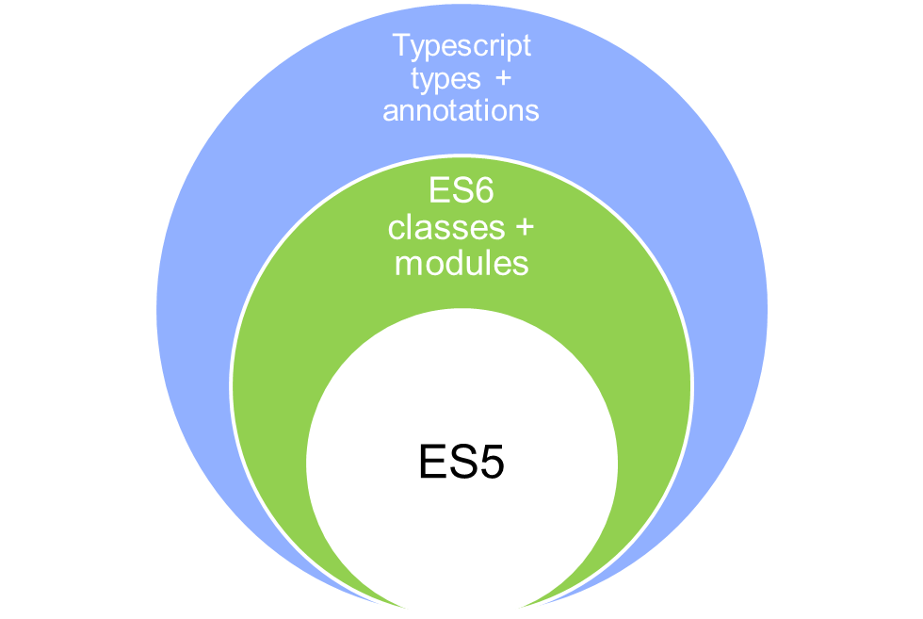
Javascript/EcmaScript/TypeScript
How Javascript, EcmaScript and TypeScript complement each other
  ES5 (JavaScript 2015) – Supported on Modern Browsers
  ES6 adds classes + modules…
  TypeScript adds types + annotations….
“TypeScript is a typed superset of JavaScript that compiles to plain JavaScript.” http://www.typescriptlang.org/
Become a Full-stack Developer
+972.52.530.7939
jwax@prodware.fr

Slide 22
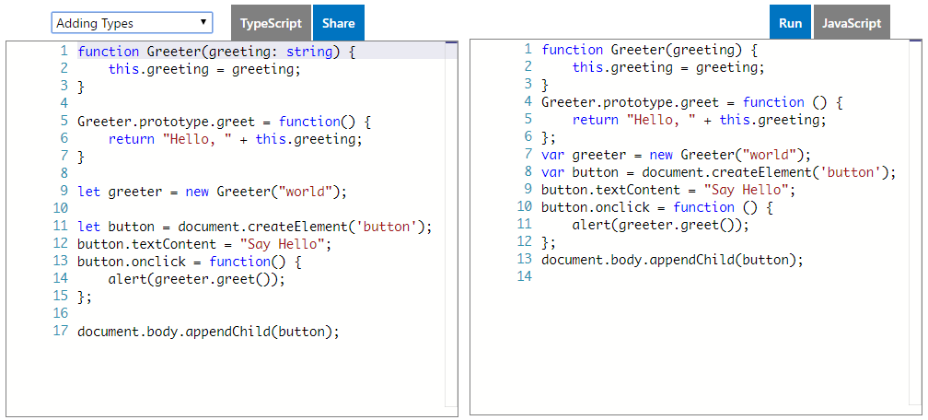
TypeScript
TypeScript – Playground
  https://www.typescriptlang.org/play/index.html
    Types
    Classes
    Inheritance
    Generics
    Unions and Type Guards
Become a Full-stack Developer
+972.52.530.7939
jwax@prodware.fr

Slide 23
TypeScript
TypeScript – Development Environment
  https://git-scm.com/
  https://nodejs.org/ (stable release 4.x)
  Upgrade npm to version 3.x
  Install typescript
  Install typings
// update npm to npm 3
> npm install –g npm
// install typescript
> npm install –g typescript
// install typings
> npm install –g typings
Become a Full-stack Developer
+972.52.530.7939
jwax@prodware.fr

Slide 24
TypeScript
TypeScript – Editors and IDE’s
  https://code.visualstudio.com – VS Code
    Fast Editor
    Debugger
    Git Integration
    Javascript support
    Typescript support
    Multi-Platform support (Win,OSX,Linux)
  https://www.jetbrains.com/webstorm/
    Full IDE
  Visual Studio 2015
  Atom (GitHub)
  And more…
Become a Full-stack Developer
+972.52.530.7939
jwax@prodware.fr

Slide 25
TypeScript
Lets write some TypeScript
  Create a Project Folder
  Cd into the folder
  Create TypeScript config file
  Open VSCode
// TypeScript compiler – create config file
> mkdir typescript
> cd typescript
> tsc --init
> code .
  Add playground.ts file
  Run twc –w (watch)
  In VSCode open playground.ts and js side-by-side
// run TypeScript compilter in watch mode
> tsc -w
Become a Full-stack Developer
+972.52.530.7939
jwax@prodware.fr

Slide 26
TypeScript – using a library
lodah
  Initialize project for npm (node modules)
  Install lodash (locally) to the project
  Install lodash typings (for intellisense…)
  Import lodash and us it.
// initialize npm for this project
> npm --init
// install and save to package.json
> npm install lodash --save
// install lodash typings
> typings install lodash --save
// import lodash to use in code
> import * as _ from "lodash";
function a (){
_.padStart("Hello TypeScript!", 20, " ");
}
Become a Full-stack Developer
+972.52.530.7939
jwax@prodware.fr

Slide 27
TypeScript
Types
  Set types for vars
  Set Type on input parameter
  Set Type on function return value
  https://www.typescriptlang.org/docs/handbook/basic-types.html
// string Type
let myString : string;
let myNum : number;
myNum = “hello” // error
// function Type on input parameter
Function myFunc(name: string){ }
myFunc(1) // error
// function Type on return value
Function myFunc(name: string) : string { }
let result: number;
result = myFunc(“one”) // error
Become a Full-stack Developer
+972.52.530.7939
jwax@prodware.fr

Slide 28
Resources
Free Javascript Books: http://jsbooks.revolunet.com/
JS DOM/HTML: http://domenlightenment.com/
Javascript - Cheat Sheet http://overapi.com/javascript/
DOM – Cheat Sheet http://overapi.com/html-dom/
TypeScript - https://www.typescriptlang.org/
jwax@prodware.fr
Become a Full-stack Developer
+972.52.530.7939
jwax@prodware.fr

