Slide 1
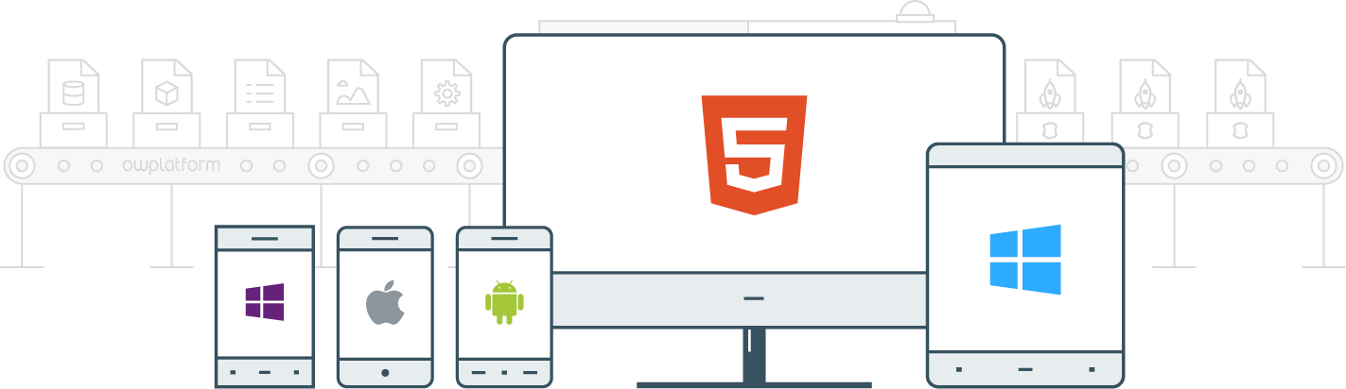

I
Course:
Become a Full-stack Developer
Become a Full-stack Developer
+972.52.530.7939
jwax@prodware.fr

Slide 2
Angular Modules-Components-Directives-Routing
Become a Full-stack Developer
+972.52.530.7939
jwax@prodware.fr

Slide 3
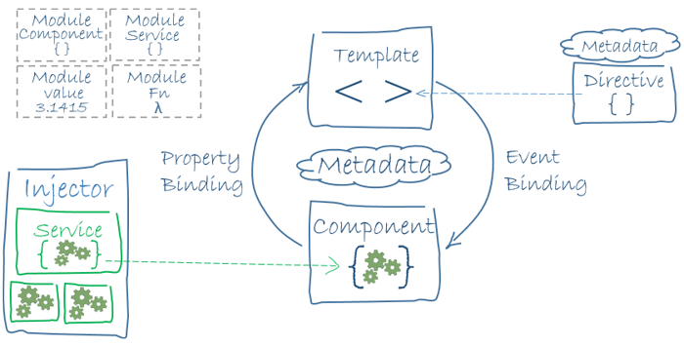
Angular – Architecture
Angular’s Building Blocks
NgModule
Directives
Components (Directive + Template)
Templates
Pipes
Services (logic)
Metadata – tell Angular what a class is for.
// xxx
> xxx
https://angular.io/guide/architecture
Become a Full-stack Developer
+972.52.530.7939
jwax@prodware.fr

Slide 4
Angular – Bootstrapping your application
Initialize the App
Browser – loads main.ts/js
AppModule – loaded by bootstrapModule
Environment (production, …)
import { enableProdMode } from '@angular/core';
import { platformBrowserDynamic } from '@angular/platform-browser-dynamic';
import { AppModule } from './app/app.module';
import { environment } from './environments/environment';
if (environment.production) {
enableProdMode();
}
platformBrowserDynamic().bootstrapModule(AppModule)
.catch(err => console.log(err));
https://angular.io/guide/bootstrapping
Become a Full-stack Developer
+972.52.530.7939
jwax@prodware.fr

Slide 5
Angular – NgModule(s)
App.module
https://angular.io/guide/ngmodule
Modules represent parts of our application that can be combined
Angular app needs at least one module (usually: AppModule)
App.module (AppModule) is bootstrapped
Imports – Modules
Declarations – Components, Directives, Pipes
Bootstrap – the 1st component loaded by this module
import { BrowserModule } from '@angular/platform-browser';
import { NgModule } from '@angular/core';
import { AppComponent } from './app.component';
@NgModule({
declarations: [AppComponent],
imports: [BrowserModule],
providers: [],
bootstrap: [AppComponent]
})
export class AppModule { }
Become a Full-stack Developer
+972.52.530.7939
jwax@prodware.fr

Slide 6
Angular – Directives
Angular Elements & Attributes for DOM Manipulation
Attribute Directives (NgStyle)
Structural Directives (NgFor, NgIf)
Components (Directives + Templates)
Prefix to diff from html tags (don’t use ng – that’s reserved for Angular)
Import directive file
Add to Component declarations
@Hostlistener for mouse events
<p myHighlight>Highlight me!</p>
https://angular.io/generated/live-examples/attribute-directives/eplnkr.html
import { Directive, ElementRef, Input } from '@angular/core';
@Directive({ selector: '[myHighlight]' })
export class HighlightDirective {
constructor(el: ElementRef) {
el.nativeElement.style.backgroundColor = 'yellow';
}
}
https://angular.io/guide/attribute-directives
Become a Full-stack Developer
+972.52.530.7939
jwax@prodware.fr

Slide 7
Angular – Structural Directives
Angular Elements & Attributes for DOM Manipulation
Structural Directives (NgFor, NgIf, NgSwitch)
https://angular.io/guide/structural-directives#unless
<div *ngIf="hero" >{{hero.name}}</div>
<ul>
<li *ngFor="let hero of heroes">{{hero.name}}</li>
</ul>
<div [ngSwitch]="hero?.emotion">
<happy-hero *ngSwitchCase="'happy'" [hero]="hero"></happy-hero>
<sad-hero *ngSwitchCase="'sad'" [hero]="hero"></sad-hero>
<confused-hero *ngSwitchCase="'confused’” [hero]="hero"></confused-hero>
<unknown-hero *ngSwitchDefault [hero]="hero"></unknown-hero>
</div>
https://angular.io/guide/structural-directives
Become a Full-stack Developer
+972.52.530.7939
jwax@prodware.fr

Slide 8
Angular – Pipes
Display value transformations (Format a Date…)
Pipe gets input and transforms it into output
DatePipe
UpperCasePipe / LowerCasePipe
CurrencyPipe
PercentPipe
https://angular.io/api?type=pipe
import { Component } from '@angular/core';
@Component({
selector: 'hero-birthday',
template: `<p>The hero's birthday is {{ birthday | date }}</p>`
})
export class HeroBirthdayComponent {
birthday = new Date(1988, 3, 15); // April 15, 1988
}
https://angular.io/guide/pipes
Become a Full-stack Developer
+972.52.530.7939
jwax@prodware.fr

Slide 9
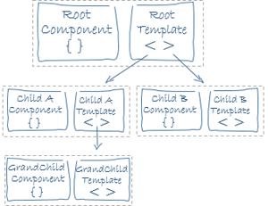
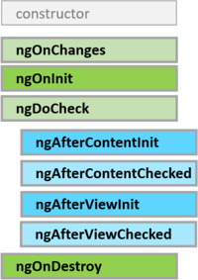
Angular – Component(s)
Angular’s Web Component
Component = Directive + Template
https://angular.io/guide/lifecycle-hooks
https://angular.io/guide/architecture
Become a Full-stack Developer
+972.52.530.7939
jwax@prodware.fr

Slide 10
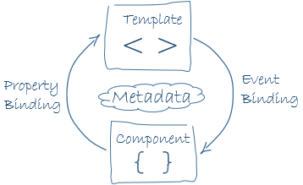
Angular – Component Templates
Angular’s Web Component
import { Component } from '@angular/core';
import { Hero } from './hero';
@Component({
selector: 'my-app',
template: `
<h1>{{title}}</h1>
<h2>My favorite hero is: {{myHero.name}}</h2>
<p>Heroes:</p>
<ul>
<li *ngFor="let hero of heroes">
{{ hero.name }}
</li>
</ul>
<p *ngIf="heroes.length > 3">There are many heroes!</p>
`
})
export class AppComponent {
title = 'Tour of Heroes';
heroes = [
new Hero(1, 'Windstorm'),
new Hero(13, 'Bombasto'),
new Hero(15, 'Magneta'),
new Hero(20, 'Tornado')
];
myHero = this.heroes[0];
}
Component = Directive + Template
Class = Component’s Context
Template = Component’s View
{{ }} binding expression
https://angular.io/guide/architecture
Become a Full-stack Developer
+972.52.530.7939
jwax@prodware.fr

Slide 11
Angular – Routing
const appRoutes: Routes = [
{ path: 'crisis-center', component: CrisisListComponent },
{ path: 'hero/:id', component: HeroDetailComponent },
{
path: 'heroes',
component: HeroListComponent,
data: { title: 'Heroes List' }
},
{ path: '',
redirectTo: '/heroes',
pathMatch: 'full'
},
{ path: '**', component: PageNotFoundComponent }
];
@NgModule({
imports: [
RouterModule.forRoot(
appRoutes,
{ enableTracing: true } // <-- debugging purposes only
)
// other imports here
],
...
})
export class AppModule { }
in-browser routing
<base href=“/”>
<router-outlet></router-outlet>
routerLink
RouterEvents
https://angular.io/generated/live-examples/router/eplnkr.html
Become a Full-stack Developer
+972.52.530.7939
jwax@prodware.fr

Slide 12
Resources
Angular Official Doc (architecture) - https://angular.io/guide/architecture
jwax@prodware.fr
Become a Full-stack Developer
+972.52.530.7939
jwax@prodware.fr

