Slide 1
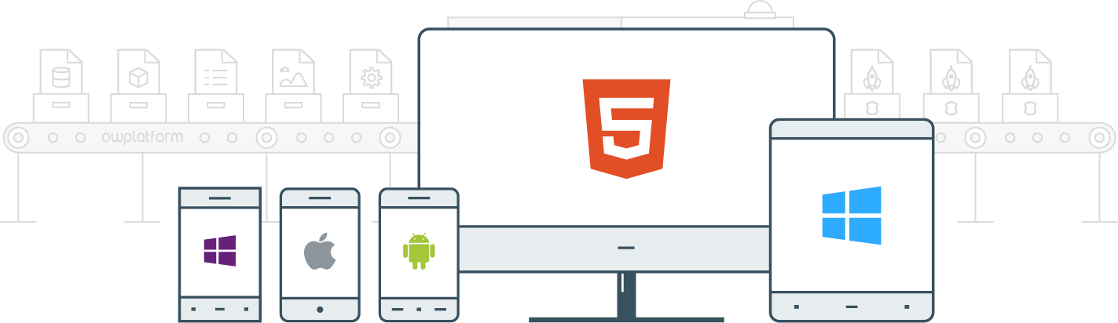

I
Course:
Become a Full-stack Developer
Become a Full-stack Developer
+972.52.530.7939
jwax@prodware.fr

Slide 2
Angular 2
Services, Observables & Forms
Become a Full-stack Developer
+972.52.530.7939
jwax@prodware.fr

Slide 3
Angular2 – Services
Angular Service, a Singleton Class for encapsulating and sharing logic.
Create a new class as an Injectable
Edit the data.service.ts
// angular-cli generate a service called data
> ng g service “data”
@Injectable
Import from @angular/core
@Injectable Annotation (Typescript) tells angular how this class behaves
Angular-cli (ng) named it DataService.
// An Angular 2 Service (Injectable)
import { Injectable } from '@angular/core';
@Injectable()export class DataService {
constructor() { }
}
Become a Full-stack Developer
+972.52.530.7939
jwax@prodware.fr

Slide 4
Angular2 – Services
How to use a Service/Injectable?
A Service lifetime is related to the Module
A Service behaves like a Singleton shared within its module.
App Service? Add to App Module
// app.module.ts - Import and Declare Service in Module
import { DataService } from './data.service';
@NgModule({
providers: [DataService]
})
Edit app.module.ts
Import data.service
Add it to ngModule’s providers.
Inject the Service into Component
// list.component.ts
// Inject Service into Component constructor
import { DataService } from ’../data.service';
…
constructor(private dataService: DataService) {
}
To use the Service in a Component
Inject it into the constructor
Become a Full-stack Developer
+972.52.530.7939
jwax@prodware.fr

Slide 5
Angular2 – Observables
Observables and rxjs help us handle streams of events
Using Observables to structure our data is called Reactive Programming.
Reactive Programming = Working with asynchronous streams of data
Rxjs provides tools to work with Observables like:
Observables are based on the Observer Design Pattern https://en.wikipedia.org/wiki/Observer_pattern
Static Operators
Instance Operators
Become a Full-stack Developer
+972.52.530.7939
jwax@prodware.fr

Slide 6
Angular2 – Observables
HTTP – Angular Service – returns an Observable.
Edit data.service.ts
Import HTTP from angular
inject HTTP service into data.service
// data.service.ts
import { Http } from '@angular/http';
…
constructor(private http: Http) { }
…
Return an Observable from data service
Subscribe to HTTP’s Observable
And return your own Observable
Note: map is an rxjs operator
// data.service.ts
getDataObservable(): Observable<Item[]> {
return this.http.get(environment.dataUrl)
.map(response => response.json()) .map(items => items.map(item => {
return new Item(item.id, item.name);
}));
}
Become a Full-stack Developer
+972.52.530.7939
jwax@prodware.fr

Slide 7
Angular2 – Observables
How to subscribe Observers to an Observable?
We need to subscribe to the Observable
We need to provide Observers (functions) to get/catch the Observer’s
Events
Errors
Completed
// list.component.ts
…
ngOnInit() {
this.dataService
.getDataObservable()
.subscribe(
list => this.list = list,
error => console.error("Error", error),
() => console.log('Done')
);
}
…
List component subscriber
List… success/events Observer
Error… error Observer
() … completed Observer
Become a Full-stack Developer
+972.52.530.7939
jwax@prodware.fr

Slide 8
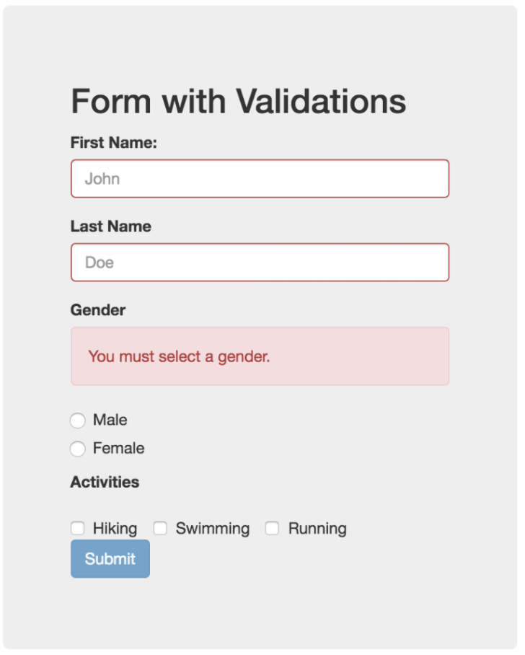
Angular 2 – Forms
What does a Form need to do?
Provide the user with the ability to Edit Values
Offer facilities to handle Input Validation
Present visual queues when values are required, invalid, wrong etc…
Perform complex validation between fields – form level validation
Handle the state of the form: Read, Edit, New…
And more…
https://scotch.io/tutorials/angular-2-form-validation
Become a Full-stack Developer
+972.52.530.7939
jwax@prodware.fr

Slide 9
Angular 2 – Forms
Adding Angular Form Module(s) to our application.
Import FormsModule
And/Or Import ReactiveFormsModule
Add them to your App Module’s imports – this makes all Angular Form feature available.
import { FormsModule, ReactiveFormsModule } from '@angular/forms';
// farther down...
@NgModule({
declarations: […],
imports: [
BrowserModule,
FormsModule,
ReactiveFormsModule
],
bootstrap: [ … ]
})
class AppModule {}
Become a Full-stack Developer
+972.52.530.7939
jwax@prodware.fr

Slide 10
Angular 2 – Forms
Angular Form Controls
AbstractControl – a Base Class for all form controls
FormControls – represents a single field and its state
// code.
…
let firstname = new FormControl(“firstname”);
let val = firstname.value;
firstname.errors; // a key/value string map of errors
firstname.valid; // all validation passed
firstname.dirty; // touched by user
…
// HTML/View – attach firstname control from code with the input field on the HTML/View
…
<input type=“text” [formControl]=”firstname” … />
…
Become a Full-stack Developer
+972.52.530.7939
jwax@prodware.fr

Slide 11
Angular 2 – Forms
Angular Form Groups
AbstractControl – a Base Class for all form controls
FormGroups – a collection of fields with its own state
// code.
…
let addressForm = new FormGroup({
street: new FormControl(“street”),
city: new FormControl(“city”),
zip: new FormControl(“zip”)
});
…
// Because FormGroup & FormControl are AbstractControls – we can check values/validity easily at any level
…
addressForm.value; // a key, value string map of form values
addressForm.valid; // if all formcontrols in formgroup are valid – formgroup is valid
…
Become a Full-stack Developer
+972.52.530.7939
jwax@prodware.fr

Slide 12
Angular 2 – Forms
FormsModule – ngForm + ngModel
ngForm – ”attaches” itself to any <form> element (it’s selector) and adds form features.
Adds a FormGroup named “ngForm”
Adds an (onSubmit) output/event to the form.
#f means we want to create a local variable in the HTML then we can reference it.
ngModel
Create a FormControl (under parent FormGroup) using input’s name.
Add one-way binding between <input> and FormControl
// Simple Form Template (using bootstrap css 4)
<form #f="ngForm" (ngSubmit)="onSubmit(f.value)" >
<div class="form-group row">
<label for="example-text-input" class="col-xs-2 col-form-label">Text</label>
<div class="col-xs-10">
<input class="form-control" type="text" name=”street” ngModel>
</div>
</div>
</form>
Become a Full-stack Developer
+972.52.530.7939
jwax@prodware.fr

Slide 13
Angular 2 – Forms
Form Logic (code-behind/controller)
Angular’s ngForm directive uses the Components class as it’s controller.
(ngSubmit) binds the form’s submit event to a function on the controller.
We create an onSubmit(form: any) function to be called by the ngSubmit event.
We pass the form (object or its value) to the onSubmit function.
// Simple Form’s controller/class
export class MyComponent(){
onSubmit(form: any){
console.log(form);
}
}
Become a Full-stack Developer
+972.52.530.7939
jwax@prodware.fr

Slide 14
Angular 2 – Forms
Reactive Forms with FormBuilder – Angular’s Form factory
FormBuilder – is an Angular Module for building forms by code.
Provides more flexibility to configure the FormGroups and FormControls
It DOES NOT build the HTML (see Dynamic Forms for how to do it)
Import FormBuilder into Component
Inject it via Component’s constructor
Create your form groups and controls MODEL.
// Reactive Form using FormBuilder
export class MyComponent(){
addressForm: FormGroup;
constructor(fb: FormBuilder){
this.addressForm = fb.group({
‘street’: [‘123 ABC Street’]
});
}
onSubmit(form: any){
console.log(form);
}
}
Become a Full-stack Developer
+972.52.530.7939
jwax@prodware.fr

Slide 15
Angular 2 – Forms
ReactiveFormsModule - ngForm
ngForm – ”attaches” itself to any <form> element (it’s selector) and adds form features.
Adds a FormGroup named “ngForm”
Adds an (onSubmit) output/event to the form.
// Simple Form Template (using bootstrap css 4)
<form [formGroup]=”addressForm" (ngSubmit)="onSubmit(addressForm)">
<div class="form-group row">
<label for="example-text-input" class="col-xs-2 col-form-label">Text</label>
<div class="col-xs-10">
<input class="form-control" type="text" name=”street”
[formControl]=”addressForm.controls[‘street’]”>
</div>
</div>
</form>
Become a Full-stack Developer
+972.52.530.7939
jwax@prodware.fr

Slide 16
Angular 2 – Forms
Validators
Import the Validators module
Assign Validator(s) to FormControl(s)
*ngIf + Validator(s) state in HTML to visually represent validation issues
Present Message and/or Change Style when Invalid
// Code: add validator to FormControl - ReactiveFormModule
constructor(fb: FormBuilder){
this.addressForm = fb.group({
‘street’: [ ‘’, Validators.required ]
});
}
// View: use Validator state to present visual queues to the user
<input type="text" [formControl]=”addressForm.controls[‘street']">
<div *ngIf="!addressForm.controls[‘street'].valid" class=”error">Invalid</div> <div *ngIf="addressForm.controls[‘street'].hasError('required')" class=”error">Required</div>
Become a Full-stack Developer
+972.52.530.7939
jwax@prodware.fr

Slide 17
Angular 2 – Forms
Custom Validators
Custom Validators behave like built-in validators
Input is a FormControl
Output is a collection of key,value pairs (StringMap<string, boolean>)
Key = error type, Value = true if Invalid
// Validator Class – First name MUST begin with capital letter
function firstnameValidator(control: FormControl): {
[s: string]: boolean } {
if (control.value[0] !== control.value[0].toUpperCase()) {
return { firstnameInvalid: true};
}
}
// Use Custom Validator – Validators.compose…
constructor(fb: FormBuilder){
this.addressForm = fb.group({
‘firstname’: [ ‘’, Validators.compose([Validators.required, firstnameValidator]) ]
});
}
Become a Full-stack Developer
+972.52.530.7939
jwax@prodware.fr

Slide 18
Angular 2 – Forms
Form Observers – Watching for changes
Observers – notify us when FormGroup or FormControl change state.
Subscribe to FormGroup/Control EventEmitters by using control.valueChanges
// Subscribing to Form Observers to listen for FormControl and FormGroup changes – using Observables
constructor(fb: FormBuilder) {
this.addressForm = fb.group({
’street': ['', Validators.required]
});
this.street = this.addressForm.controls[’street'];
// subscribe to FormControl events/changes
this.street.valueChanges.subscribe(
(value: string) => { console.log(’field changed:', value); } );
// subscribe to Form/FormGroup events/changes
this.addressForm.valueChanges.subscribe(
(form: any) => { console.log('form changed:', form); } ); }
Become a Full-stack Developer
+972.52.530.7939
jwax@prodware.fr

Slide 19
Angular 2 – Forms
Two-way data binding – USE WITH CARE
Two-way data binding can be useful, especially with Forms – but not required (use it sparingly)
[(ngModel)] – signifies that a field is an input + output which means two-way data bound
[formControl] – still needed to link between form control and the input field.
// HTML – using two-way data binding
<h2> Your name is: {{firstname}} </h2>
<label for=”firstname">First Name</label>
<input type="text" id=”firstname"
[formControl]=”addressForm.get(’firstname')"
[(ngModel)]=”firstname">
https://blog.thoughtram.io/angular/2016/10/13/two-way-data-binding-in-angular-2.html
Become a Full-stack Developer
+972.52.530.7939
jwax@prodware.fr

Slide 20
Resources
Injectable (Service)
Tutorial: https://angular.io/docs/ts/latest/tutorial/toh-pt4.html
Dependency Injection: https://angular.io/docs/ts/latest/guide/dependency-injection.html
Understanding Injectable: https://blog.thoughtram.io/angular/2015/09/17/resolve-service-dependencies-in-angular-2.html
Observables
Intro to Reactive Programming: https://gist.github.com/staltz/868e7e9bc2a7b8c1f754
Learning Observables: https://www.youtube.com/watch?v=KOOT7BArVHQ
Search using Observables: https://blog.thoughtram.io/angular/2016/01/06/taking-advantage-of-observables-in-angular2.html
http with observables: https://scotch.io/tutorials/angular-2-http-requests-with-observables
Forms
Forms: https://angular.io/docs/ts/latest/guide/forms.html
Reactive-Forms: https://toddmotto.com/angular-2-forms-reactive
Validation: https://scotch.io/tutorials/angular-2-form-validation
jwax@prodware.fr
Become a Full-stack Developer
+972.52.530.7939
jwax@prodware.fr

