Slide 1
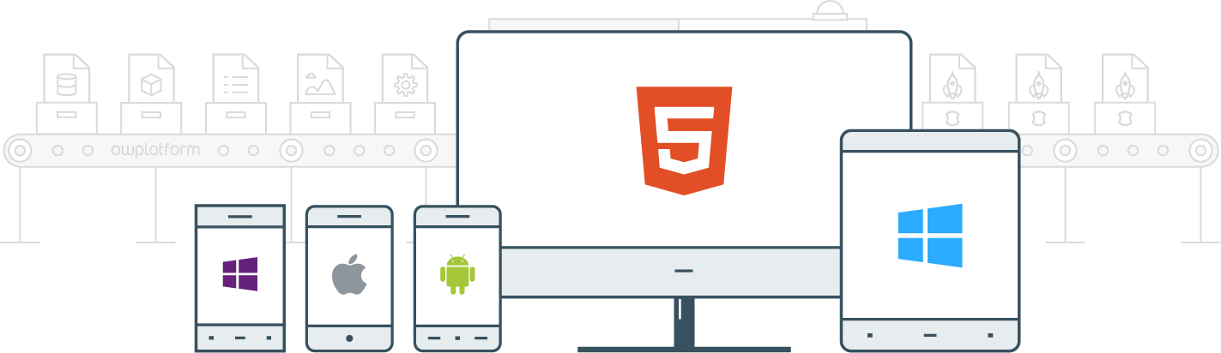

I
Course:
Become a Full-stack Developer
Become a Full-stack Developer
+972.52.530.7939
jwax@prodware.fr

Slide 2
Angular 2
Routing, Unit Testing
Become a Full-stack Developer
+972.52.530.7939
jwax@prodware.fr

Slide 3
Angular2 – Routing
Routing – a way to separate an app into area and control access to them
Angular 2 uses Component based Routing
Url/location based navigation in the client application.
Control navigation in and between areas of the application.
Handle application state changes
Loading of Modules on-demand
http://<base-url>/#/signin
Sample Application Components:
Public
Sign-in
Register
Private
List module
Detail module
About module
Sample Application Routes:
/
/signin
/register
/home
/list
/detail/1
/about
Become a Full-stack Developer
+972.52.530.7939
jwax@prodware.fr

Slide 4
Angular2 – Routing
Routing Components
Routes – configuration of routes
RouterOutlet – placeholder for a route
RouterLink – link to a route
// import Routing components
Import { Routes, RouterModule } for ‘@angular/router’;
// app.module.ts – Create routes configuration
const routes: Routes = [
{ path: ‘’, redirectTo: ‘signin’, pathMatch: ‘full’ },
{ path: ‘signin’, component: SignInComponent },
{ path: ‘home’, redirectTo: ‘list’ },
{ path: ‘list’, component: ListComponent }
];
path – relative url to this route.
component – the component to load when this route is active
redirectTo – rediret to a different route/path
Become a Full-stack Developer
+972.52.530.7939
jwax@prodware.fr

Slide 5
Angular2 – Routing
Load Routes into Module
In App Module – Import RouterModule
Install Routes with RouterModule.forRoot(routes)
// app.module.ts – Import and Install Routes
@NgModule({
imports: [ RouterModule.forRoot(routes) ],
providers: [
{ provide: LocationStrategy, useClass: HashLocationStrategy ]
]
})
Location Strategy
Hash: supported in all Browsers (default)
HTML5: newer browsers – no # in url
Become a Full-stack Developer
+972.52.530.7939
jwax@prodware.fr

Slide 6
Angular2 – Routing
RouterOutlet, RouterLink – when to load route component.
RouterOutlet
// Component with RouterLinks and RouterOutlet
@Component({
selector: ’sample-app',
template: `
<div>
<nav>
<a>Navigation:</a>
<ul>
<li><a [routerLink]="[’signin']">Sign-In</a></li>
<li><a [routerLink]="[’home']">Home</a></li>
<li><a [routerLink]="[’about']">About</a></li>
</ul>
</nav>
<router-outlet></router-outlet>
</div> `
}) class SampleApp { }
Where to load Component?
HTML Element to set layout
RouterLink
Which route to load?
NO page reload
Base url
Required by Router
{ provide: APP_BASE_HREF, useValue: '/' } - if no access to index
// index.html
<base href=“/”>
Become a Full-stack Developer
+972.52.530.7939
jwax@prodware.fr

Slide 7
Angular2 – Routing
Route Parameters
How do we navigate to a specific record?
How do pass parameters to a Route and It’s Component?
// route with parameters
/detail/12345
// Configuration route with parameter
const routes: Routes = [
…
{ path: ‘detail/:id’, component: DetailComponent }
];
Parameter – how can we use it in a Component
Become a Full-stack Developer
+972.52.530.7939
jwax@prodware.fr

Slide 8
Angular2 – Routing
ActivateRoute – using Route Parameters in a Component.
ActivateRoute
// Component using route parameter
import { ActivatedRoute } from '@angular/router';
export class DetailComponent() {
id: string;
constructor(private route: ActivateRoute){
route.params.subscribe(
params => this.id = params[‘id’];
);
}
}
An Angular Injectable
Access to Active Route
route.params
Observable – route changes
Subscribe to params.
Become a Full-stack Developer
+972.52.530.7939
jwax@prodware.fr

Slide 9
Angular2 – Routing
Router Hooks – responding to routing events.
Router Hooks
CanActivate to prevent navigation to a route
CanActivateChild to prevent navigation to a child route
CanDeactivate to prevent navigation away from the current route
Resolve to pre-fetch data before activating a route
CanLoad to prevent asynchronous routing
Guard Class
Middleware class that can be hooked into routes to “decide” how to response to a router hook
// Guard Class
@Injectable() export class AuthenticationGuard implements CanActivate {
constructor(private authService: AuthService) {}
canActivate(): boolean { return this.authService.isLoggedIn();
}
}
https://angular.io/docs/ts/latest/guide/router.html
Become a Full-stack Developer
+972.52.530.7939
jwax@prodware.fr

Slide 10
Angular2 – Routing
Route – configured to use Guard Class
How do we set Guard class to hook into route?
Add canActivate to the route we want to guard.
// Configuration route with parameter
const routes: Routes = [
…
{ path: ‘detail/:id’, component: DetailComponent, canActivate: [AuthenticationGuard] }
];
If Guard class returns true – the routing will activate, otherwise it will not.
Become a Full-stack Developer
+972.52.530.7939
jwax@prodware.fr

Slide 11
Angular2 – Routing
Nested/Child Routes – routes per sub-system/module
“Parent”/App Routes:
children: ChildRoutes
// app.module.ts
import { routes as childRoutes } from 'components/ProductsComponent';
const routes: Routes = [ { path: '', redirectTo: 'home', pathMatch: 'full' },
{ path: 'home', component: HomeComponent },
{ path: 'products', component: ProductsComponent, children: childRoutes }
];
Module/Child Routes:
In Module – define child routes (internal to the module)
Register child routes – in child module
// feature.module.ts
export const childRoutes: Routes = [ { path: '', redirectTo: 'main', pathMatch: 'full' },
{ path: 'main', component: MainComponent },
{ path: ’help', component: HelpComponent }
]
Become a Full-stack Developer
+972.52.530.7939
jwax@prodware.fr

Slide 12
Angular2 – Routing
Routing Module – organize your routes
// app.routes.ts
import { NgModule } from '@angular/core';
import { Routes, RouterModule } from '@angular/router'; import { ComponentA } from './componentA.ts';
import { ComponentB} from './componentB.ts';
const routes: Routes = [
{ path: '', pathMatch: 'full', redirectTo: ’compA' },
{ path: ’compA', component: ComponentA },
{ path: ’compB', component: ComponentB }
];
@NgModule({
imports: [
RouterModule.forRoot(routes)],
exports: [
RouterModule],
})
export class AppRoutingModule { }
export const routingComponents = [ComponentA, ComponentB];
app.routes.ts
App routing Module
export routing Module
export Components
Become a Full-stack Developer
+972.52.530.7939
jwax@prodware.fr

Slide 13
Angular2 – Routing
Routing Module – import and use
Import from app.routes
Add routing Module to “imports”
Add routing Components to “declarations”
// app.module.ts - import and use Routing Module
import { AppRoutingModule, routingComponents } from './app.routes';
@NgModule({
imports: [
AppRoutingModule
],
declarations: [
…
routingComponents
],
…
https://johnpapa.net/introducing-angular-modules-routing-module/
Become a Full-stack Developer
+972.52.530.7939
jwax@prodware.fr

Slide 14
Angular2 – Unit Testing
Testing Tools
jasmine – a behavior driven unit test library – set and check expectation about your code.
describe : what you are testing “component a”
it: should do something “add 2 numbers”
expect: (like assert) an expected condition – if fails appears as test error.
Karma – a test runner
Runs jasmine test and collects results
Runs in one or more browsers
Can run in headless browser – faster
// Sample unit test - using jasmine
describe(’Utils',
() => { it(’sums two numbers',
()=>{
var utils = new Utils();
expect(utils.sum(1, 1)).toEqual(2);
});
});
https://karma-runner.github.io/1.0/index.html
https://jasmine.github.io/2.4/introduction.html
Become a Full-stack Developer
+972.52.530.7939
jwax@prodware.fr

Slide 15
Angular2 – Unit Testing
Angular-cli – testing setup
angular-cli.json
“test” section – karma/test runner
“e2e” section – protractor/e2e runner
// angular-cli.json
"e2e": {
"protractor": {
"config": "./protractor.conf.js"
}
},
"test": {
"karma": {
"config": "./karma.conf.js"
}
}
https://jasmine.github.io/2.4/introduction.html
Become a Full-stack Developer
+972.52.530.7939
jwax@prodware.fr

Slide 16
Angular2 – Unit Testing
angular-cli – karma.config.js
// karma.config.js
// https://karma-runner.github.io/0.13/config/configuration-file.html
module.exports = function (config) {
config.set({
basePath: '',
frameworks: ['jasmine', 'angular-cli'],
plugins: [
require('karma-jasmine'),
require('karma-chrome-launcher'),
require('karma-remap-istanbul'),
require('angular-cli/plugins/karma')
],
files: [
{ pattern: './src/test.ts', watched: false }
],
preprocessors: [],
reporters: [],
logLevel: config.LOG_INFO,
browsers: [‘Chrome’]
…
Karma config.js (see link for details)
Config is just a Module.
Defines the environment for tests
Sets how test results are reported
Selects what browsers to run
logLevel
And more…
Become a Full-stack Developer
+972.52.530.7939
jwax@prodware.fr

Slide 17
Angular2 – Unit Testing
Test: app.component.ts
// app.component.spec.ts
import { TestBed, async } from '@angular/core/testing';
import { AppComponent } from './app.component';
import { Modules } from '@angular/platform-browser';
…
describe('AppComponent', () => {
beforeEach(() => {
TestBed.configureTestingModule({
declarations: [ AppComponent,… ],
imports: [ BrowserModule, … ],
providers: [ … ] });
TestBed.compileComponents();
});
it('should create the app', async(() => {
const fixture = TestBed.createComponent(AppComponent);
const app = fixture.debugElement.componentInstance;
expect(app).toBeTruthy();
});
);
@angular/core/testing
Test Dependencies
imports
providers
Etc…
Test Setup
describe
beforeEach
Tests
describe
It
Test Assertions
expect...
Become a Full-stack Developer
+972.52.530.7939
jwax@prodware.fr

Slide 18
Angular2 – Unit Testing
Test: Isolate your Subject Under Test
Tip!
Unit test – should be fast
Unit tests – isolate the subject under test SUT
Stubs
A Test class representing an actual class – for isolation
Mocking
Mock an external dependency
Use Mock during Unit Tests
Mock and Real Class – same signature
Set expectations
Monitor usage (calls, counters…)
// stub
var stubClass = { doA: function() { return ‘a’; } };
// mock – monitor expect
class myMock(){
methodCalls = 0;
methodA(){
this.methodCalls ++;
}
}
Become a Full-stack Developer
+972.52.530.7939
jwax@prodware.fr

Slide 19
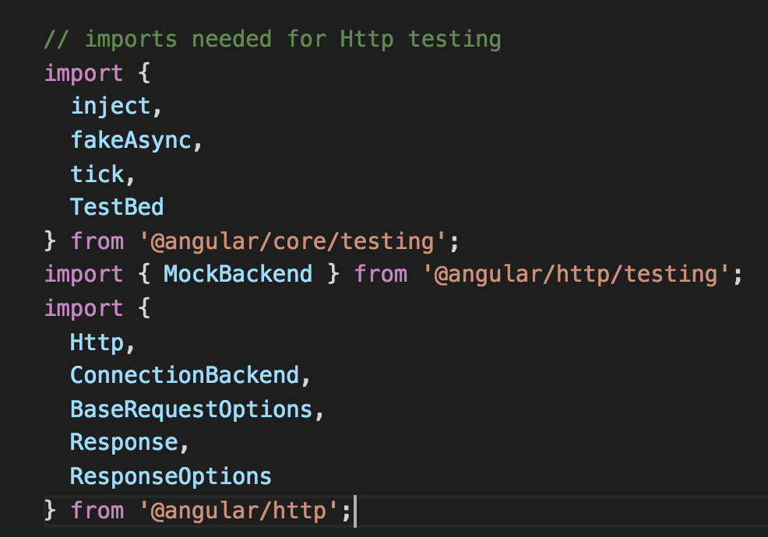
Angular2 – Unit Testing
Test: a service using Http
A service using Http
Http requests are slow
Dependency on Service/Server
Offline/no server ?
Should we test Http?
Http MockBackend
Angular’s Http Mock
Import Angular Test modules
Become a Full-stack Developer
+972.52.530.7939
jwax@prodware.fr

Slide 20
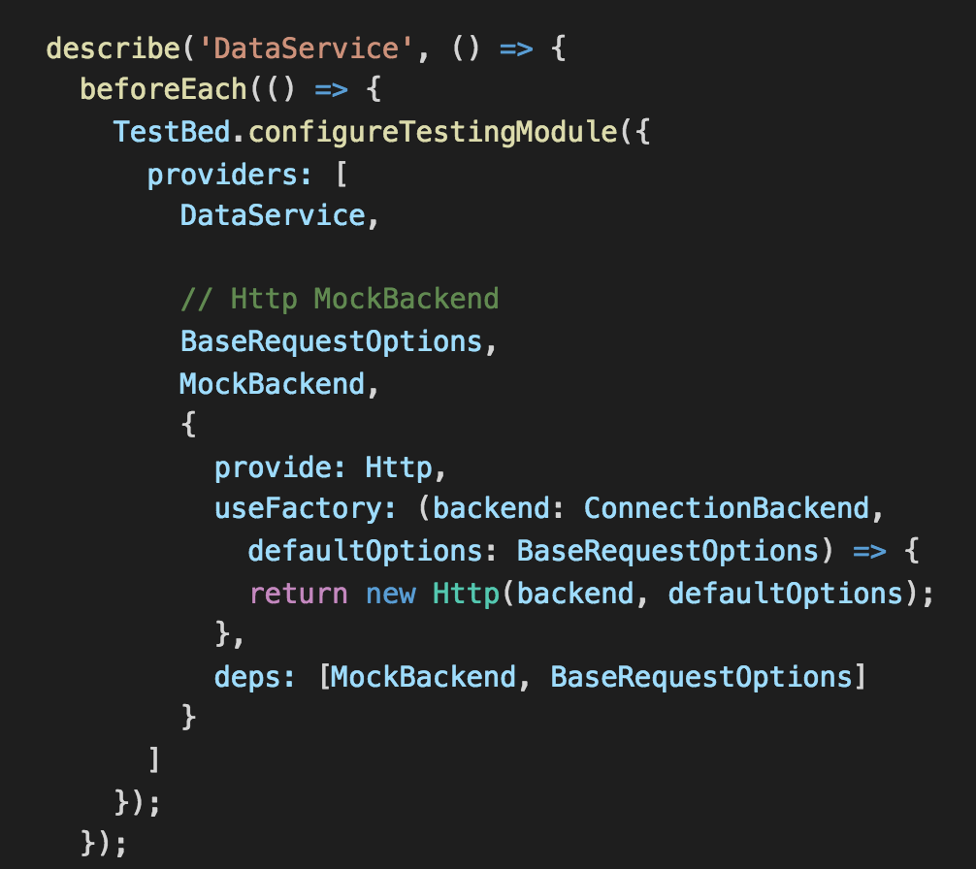
Angular2 – Unit Testing
Test: a service using Http
Setup Http Mockbackend
useFactory – instead of Http
deps – injected to factory
Become a Full-stack Developer
+972.52.530.7939
jwax@prodware.fr

Slide 21
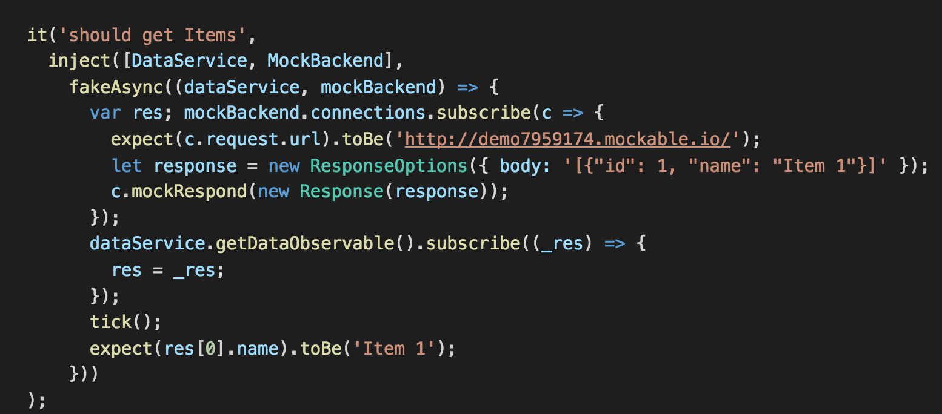
Angular2 – Unit Testing
Test: a service using Http
Setup Expectations
Http MockBackend – confirms expectations
Uses Observable to “subscribe” to connections/requests
Become a Full-stack Developer
+972.52.530.7939
jwax@prodware.fr

Slide 22
Resources
Angular 2 Router
https://angular.io/docs/ts/latest/guide/router.html
https://vsavkin.com/angular-2-router-d9e30599f9ea#.okmzglxkq
https://blog.thoughtram.io/angular/2016/06/14/routing-in-angular-2-revisited.html
Unit Testing
https://angular.io/docs/ts/latest/guide/testing.html
Jasmin: https://jasmine.github.io/
Karma: https://karma-runner.github.io/1.0/index.html
jwax@prodware.fr
Become a Full-stack Developer
+972.52.530.7939
jwax@prodware.fr

