Slide 1

Ethical Use of AI in Higher Education
Classical Argument Presentation
Jonathan Williams
Notes:
Introduce the topic and purpose: Argue that AI should be used in higher education, but only with clear ethical guidelines and transparency.
Preview the structure: background → position/thesis → three proof points → ethical safeguards → counterargument and refutation → conclusion.
Note: Any AI assistance used to draft wording or organize slides is cited on the References slide in alignment with the APUS Generative AI policy (American Public University System, 2024).

Slide 2
Statement of Background: Why this matters
AI tools are already embedded in higher education (writing support, tutoring, analytics).
Benefits are real, but risks include bias, privacy issues, and academic misuse.
The key question is not AI or no AI, it’s really, how do we use it responsibly?
(UNESCO, 2023; EDUCAUSE, 2023)
Notes:
Generative AI and other AI-enabled systems are now common in campus life. Students and faculty are using them whether institutions plan for it or not.
Problem: Without guardrails, AI can amplify inequity (bias), compromise privacy, and create confusion about academic integrity.
Rejecting AI entirely is unrealistic; the practical issue is building policies and practices that maximize learning benefits while minimizing harm.
Citations support that AI is rapidly affecting education and that guidance documents emphasize both opportunities and risks (UNESCO, 2023; EDUCAUSE, 2023).

Slide 3
Position
Higher education should adopt AI to improve learning and access, but only under transparent policies and ethical guidelines that protect students and academic integrity.
My claim: The responsible-use model is stronger than either full adoption with no guardrails or total rejection.
Roadmap: personalization → accessibility → supplemental support → safeguards → refutation.
(American Public University System, 2024; UNESCO, 2023)
Notes:
State the thesis clearly so the audience knows exactly what the argument is.
Emphasize both/and: AI adoption with responsible controls.
Explain what the responsible-use model means in the presentation: clear rules for use, transparency when AI assists work, privacy protections, bias awareness, and accessibility.
Connect to institutional expectations: APUS policy requires transparent citation/attribution of AI-generated wording or ideas (American Public University System, 2024), and UNESCO outlines ethical guidance for education and research (UNESCO, 2023).

Slide 4
Proof 1: Accessibility and inclusion
AI-powered supports can improve access for students with disabilities and language barriers.
Examples: Captioning, text-to-speech/speech-to-text, translation, and reading supports.
Accessibility must be designed in, not added later (align tools with accessibility standards).
(W3C, 2023; UNESCO, 2023)
Notes:
Explain why accessibility is a core benefit: AI can reduce barriers to participation, especially for students who rely on assistive technology or who are multilingual.
Give examples: automatic captions help Deaf/Hard-of-Hearing students; text-to-speech helps students with print disabilities; translation can support English-language learners.
Tie to standards: WCAG 2.2 provides widely used accessibility guidelines for digital content. Institutions should evaluate AI tools against these standards to avoid excluding users (W3C, 2023).
Connect to ethics: UNESCO stresses that equity and inclusion should guide AI adoption; accessibility is one practical way to operationalize that principle (UNESCO, 2023).

Slide 5
Proof 2: AI as support; not a replacement
AI can provide extra practice, feedback, and study support outside class hours.
This can free instructors to focus on mentoring, discussion, and higher-order learning.
Institutions should treat AI outputs as assistive suggestions requiring human judgment.
(EDUCAUSE, 2023; UNESCO, 2023)
Notes:
Clarify the role: The strongest case is AI as an assistant, helping with repetitive feedback and practice, while faculty focus on what humans do best (context, ethics, nuance, mentorship.
Example: AI can generate practice quizzes or explain a concept in multiple ways; faculty still verify accuracy and align to course outcomes.
Important caution: AI can be wrong or overly confident. Students must be taught to verify sources and treat outputs as drafts or suggestions.
EDUCAUSE highlights practical realities and limitations of generative AI in education, reinforcing the need for human oversight (EDUCAUSE, 2023). UNESCO similarly emphasizes responsible integration (UNESCO, 2023).

Slide 6
Proof 3: Ethical guardrails make adoption safer
Clear policies define allowed vs. prohibited AI use (and require attribution).
Privacy with data governance: minimize exposure to sensitive data; evaluate vendors.
Bias and fairness checks: monitor for disproportionate harm to certain groups.
Health/ethics guidance shows why governance matters for high-stakes decisions.
(American Public University System, 2024; UNESCO, 2023; World Health Organization, 2022)
Notes:
This slide answers: 'What kinds of ethical guidelines?' and 'What is misuse vs. responsible use?’
I start with policy: APUS requires transparent attribution/citation of AI-generated wording or ideas and holds students responsible for accuracy and originality (American Public University System, 2024).
Misuse examples: Submitting AI text as if it were original work; using AI to bypass learning objectives; feeding private student data into tools without permission.
Responsible use examples: Using AI for brainstorming, grammar, practice questions, or outlining, then verifying facts, citing use, and ensuring the final work reflects the student’s own learning.
Governance: Institutions need data rules (what can be uploaded, retention, vendor contracts), plus bias monitoring.
WHO’s ethics and governance framework for AI illustrates why oversight matters, especially when AI influences decisions affecting people’s wellbeing (World Health Organization, 2022).

Slide 7
Refutation: Strongest counterargument and response
Counterargument:
AI encourages cheating and weakens critical thinking.
Response:
The risk is real, but it’s managed through design and policy.
Teach AI literacy: verification, source checking, and limits.
Use assessment strategies that require process (drafts, reflections, oral defense).
Require disclosure/citation of AI assistance (transparency).
(American Public University System, 2024; UNESCO, 2023; EDUCAUSE, 2023)
Notes:
Present the opposition fairly: many worry AI makes it easier to outsource thinking and submit work that isn’t the student’s.
Acknowledge: this is a legitimate concern, ignoring it would weaken credibility.
Refute by showing mitigation: the presence of risk does not mean we must reject the tool; it means we must redesign instruction and policy.
Concrete strategies: require drafts and annotated bibliographies, incorporate in-class writing, include short oral explanations, and ask students to document how they used AI.
Tied directly to policy: APUS requires citation/attribution for AI-generated content and can request disclosure of the extent of AI use (American Public University System, 2024).
Support with guidance: UNESCO and EDUCAUSE discuss balancing learning benefits with integrity protections (UNESCO, 2023; EDUCAUSE, 2023).

Slide 8
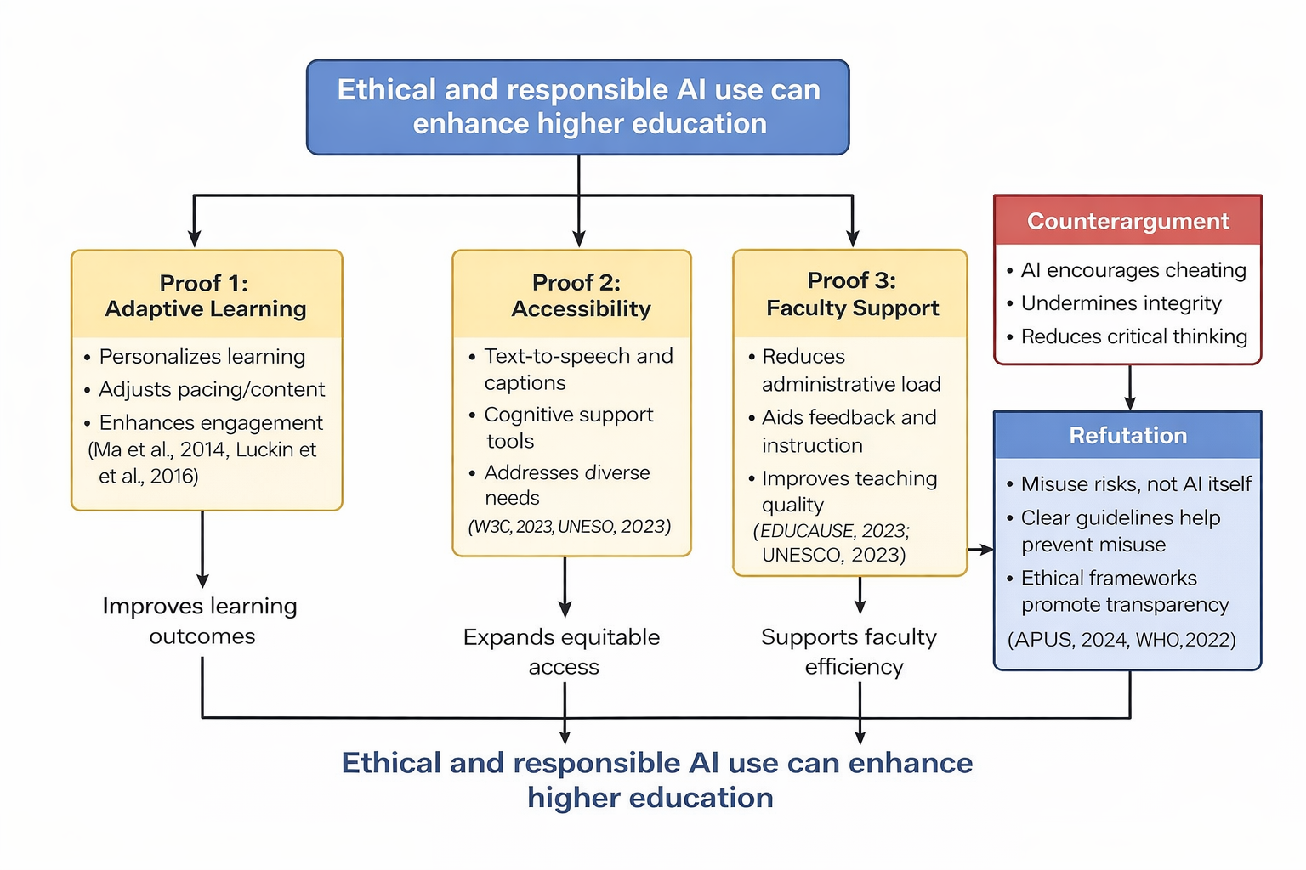
How the argument fits together
(CoPilot 2026)
Notes:
Walk the audience through the map:
1) Thesis at the top: adopt AI in higher education with ethical guidelines.
2) Three main supports: personalization (adaptive systems), accessibility, and supplemental academic support.
3) Guardrails slide shows what must exist for adoption to be responsible: policy, privacy, bias checks, and transparency.
4) Counterargument connects directly to refutation: cheating/critical thinking concerns are addressed with AI literacy plus assessment design plus disclosure requirements.
This slide keeps the presentation cohesive and to show that the conclusion follows logically from the premises.

Slide 9
Conclusion: Responsible AI in Higher Education
Responsible AI strengthens higher education
Ethical use is more effective than outright rejection
Continuous evaluation using critical thinking standards is essential
Notes:
This slide summarizes the argument presented throughout the presentation. Responsible and ethical use of AI can enhance teaching, learning, and accessibility in higher education. Rather than banning AI due to potential risks, institutions should emphasize ethical frameworks, transparency, and accountability. Ethical AI use preserves academic integrity while allowing innovation. Finally, ongoing evaluation using strong critical thinking standards ensures that AI remains a supportive tool rather than a substitute for human judgment.

Slide 10

References
American Public University System. (2024). Generative AI policy. https://www.apu.apus.edu/student-handbook/academic-integrity/generative-artificial-intelligence-policy/
EDUCAUSE. (2023, November 7). 7 things you should know about generative AI. https://library.educause.edu/resources/2023/11/7-things-you-should-know-about-generative-ai
UNESCO. (2023). Guidance for generative AI in education and research. https://www.unesco.org/en/articles/guidance-generative-ai-education-and-research
World Health Organization. (2022). Ethics and governance of artificial intelligence for health. https://www.who.int/publications/i/item/9789240029200
World Wide Web Consortium (W3C). (2023). Web Content Accessibility Guidelines (WCAG) 2.2. https://www.w3.org/TR/WCAG22/
OpenAI. (2026). Microsoft CoPilot [Large language model]. Used for credible source research and diagram assistance.
Notes:
These sources are traceable (with working URLs/DOIs) and cited in the slides/notes where used.
AI-use transparency: CoPilot was used to help create a visual diagram on slide 9 and source research.

