Slide 1
Intercultural Communication
By: Daniel, Thanh, Jonathan and Ewald

Slide 2
Story Time

Slide 3
Intercultural Communication
Googled Definition:
Intercultural communication is the verbal and nonverbal interaction between people from different cultural backgrounds.

Slide 4
Culture: What is it?
Dictionary Definition:
The ideas, customs, and social behaviour of a particular people or society.

Slide 5
aspects
Time
Individualism VS Collectivism (I vs C)
Fate and Personal Responsibility
Power Distance
Non-verbal

Slide 6
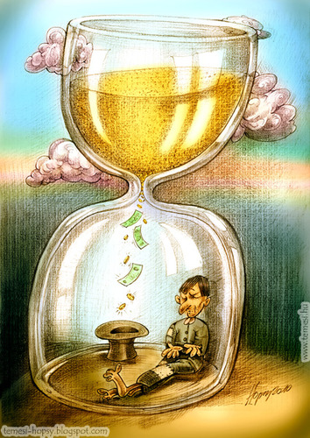
“Time is money!”

Slide 7

Time
Two different perceptions of time:
Monochronic
Polychronic

Slide 8
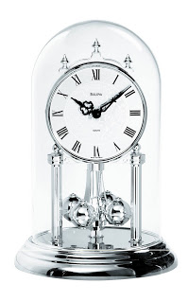
Monochronic
Does things one at a time
Fixed schedule
Low context
E.g. Americans

Slide 9
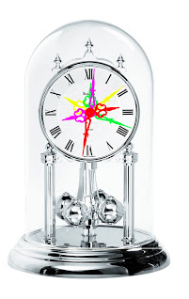
Polychronic
Does many things at a time
No restrictions
High context
E.g. Spanish

Slide 10
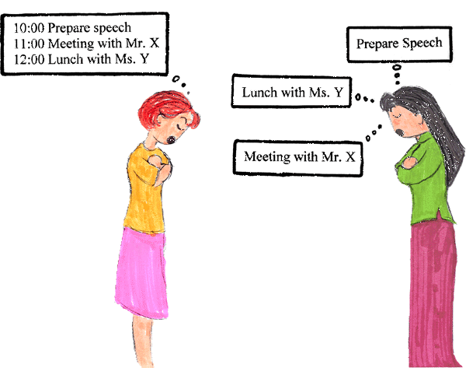
Monochronic vs. Polychronic
“What should I be doing right now, when and where next do I need to be?”
“What am I doing now and how is it going?”

Slide 11
Monochronic vs. Polychronic
Conflict when two perceptions of time clash!
It did happen in the early 1990s
Notes:
Thank you, Daniel, for talking about how different cultures perceive time.
I’m Thanh and I will show you what can go wrong if you do not put in efforts to understand different perceptions of time.
As Daniel said, countries like the USA or Canada are countries that strictly focus on given agenda, while some others like India or Spain follow lax schedules and engage in multitasking.
*click for animation*
Now, what would happen if two groups with opposite perceptions of time have a meeting? And it did happen in the early 1990s in Canada.
The people of the First Nations in Canada, or Canadian Indians, who followed polychronism, had their first meeting with the representatives of the Canadian government, who were monochronic.
> Next slide

Slide 12
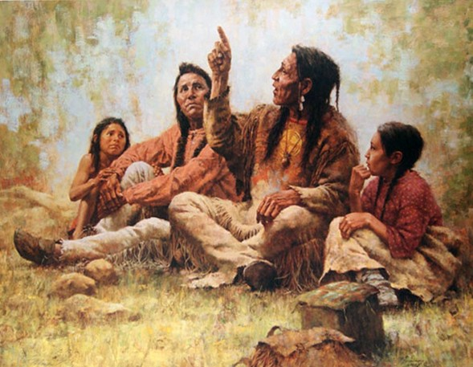

POLYCHRONISM | MONOCHRONISM
First Nations (Canadian Indian) | Canadian government representatives
Notes:
In this negotiation over claimed land, the First Nations started by telling stories of their people and past generations.
They spoke of the spirit of the land, they recited tales of their traditions. And they spoke in a circular way, adding their feelings and ideas.
When it came to the government representatives’ turn to speak, they presented charts, numbers, figures and focused on the present about their intentions, all in an objective and linear way.
> Next slide

Slide 13
Monochronic vs. Polychronic
The result was inevitable
However, we can avoid making the same mistake
Notes:
It is not hard to figure out how the meeting turned out. Both sides were very frustrated and did not come to a conclusion.
They all knew that “there was something wrong”. It was the cultural barrier, in this case, the difference in the perception of time.
You can avoid making the same mistake by knowing which culture you and your conversational partner belong to.
> Next slide

Slide 14

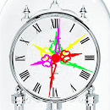
The Singaporean time
Monochronism
Polychronism
Singapore
Notes:
So, the question is, as a Singaporean, where are you standing on the time scale? Are you polychronic or monochronic?
*click for animation*
While Singaporeans used to be polychronic,
*click for animation*
there has been a change towards monochronism due to the modern work culture.
Therefore, you should expect to encounter people from both types of culture in your work and know how to properly deal with them.
> Next slide

Slide 15
What to do?
With monochronic people | With polychronic people
Be punctual Follow given agenda Let them know if you will be late | Be patient Set your standards Account for delays
Notes:
For example, when you have a meeting with someone from the monochronic culture, always arrive early so that you have some extra minutes for preparation. Or you will have to contact the other person beforehand to let them know you are arriving late.
On the other hand, you might want to train your patience if you work with a “polychron”. If you need them to appear in a meeting, set your standards on what time you expect them to turn up; or you can go one step ahead and plan a buffer time in your schedule to account for the delays.
>Next slide

Slide 16
What to do?
Don’t assume!
Notes:
The best way to avoid miscommunication is to stop making assumptions!
Don’t assume that people follow your view of time. Also, be sympathetic.
If you are a monochronic person, you might think polychronic people lack discipline and responsibility. But remember that they spend more time on preparation and do more work at the same time to build a strong relationship with others.
And if you are polychronic and think that the “monochrons” are strict people who don’t care about others, please remind yourself that their life is devoted to work performance.
> Next slide

Slide 17
Perception of time ⇕ Cultural representations
Monochronism | Polychronism
Individualism | Collectivism
Notes:
From what I pointed out just now, you can see that monochronism is usually associated with individualism, where individuals view themselves as independent and are motivated by their own needs.
In contrast, polychronic culture is usually associated with collectivism, where individuals view themselves as part of one or more collectives and are driven by the benefits of the collectives instead of their own ambitions.
> Next slide

Slide 18
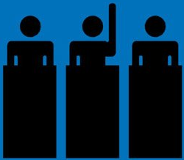
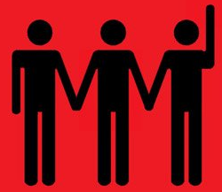
Individualism vs. Collectivism
Individualism
Collectivism
S’pore
Notes:
Are Singaporeans individualists or collectivists?
While economic development has been pushing Singaporeans to become more individualistic,
*click for animation*
Singapore remains one of the most collective countries in the world.
> Next slide

Slide 19
Singapore is collective!
Notes:
As the contrast between the two cultural representations is one of the main reasons behind intercultural miscommunication, expect a lot of efforts to achieve mutual understanding with individualists, especially when you work with people from Western countries, where individualism is often emphasized.
> Next slide

Slide 20
More aspects
Fate & Personal Responsibility
Power Distance
Indulgence
Perception of time
Uncertainty Avoidance
Notes:
The difference in individualism and collectivism leads to many aspects of intercultural communication but I will not hog up all the time and talk about them.
> Next slide

Slide 21
More aspects
Fate & Personal Responsibility
Power Distance
Notes:
Instead, Jonathan will expand on two particular aspects which are responsibility and power distance.
Before I conclude my part, please remember no matter which culture you are from, avoiding making assumptions is the best way to achieve mutual understanding between different cultures.
Jonathan, please.
# Pass to Jonathan
# Jonathan’s slides start here

Slide 22
FATE & PERSONAL RESPONSIBILITY
Two extents:
degree to which we feel ourselves the masters of our lives (Free Will View)
degree to which we see ourselves as subject to things outside our control (Fatalistic view)
Free Will
Fatalistic
Notes:
Ok so what is Fate & Personal Responsibility?
Fate & Personal responsibility In Short refers to the way people view their lives.
****CLICK Typically there are two types of views
****CLICK
The first is having a freewill view where people believe their outcome in life is dependent on their them choosing their actions.
****CLICK
And the second is having a fatalistic view, where people believe that the future is simply determined by fate and is unchangeable.
To explain these two viewpoints more clearly, let me give you a scenario
****CLICK

Slide 23
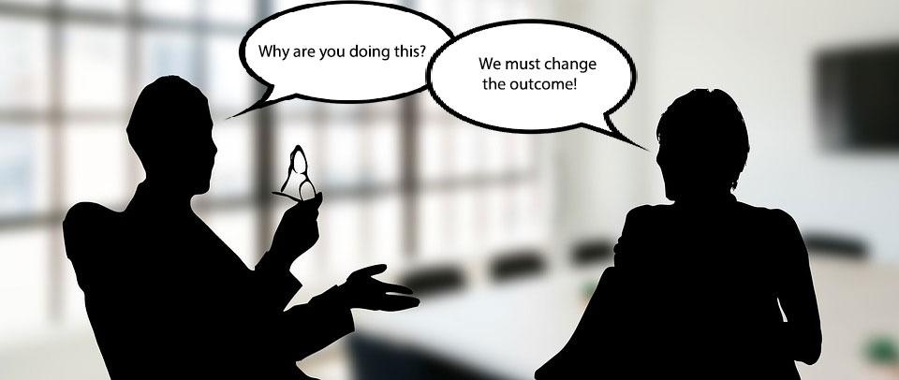
FATE & PERSONAL RESPONSIBILITY
Scenario: Team Project
Team Members: Will and Fate
Notes:
let's say you’re in a project group,
where all of you work extremely hard for a report
then at the end you get an average grade.
One of your team member, let's call him Will,
having a more freewill view,
believes that the report is worth more and
wants to confront the grader.
****CLICK
Whereas another team member,
let's call him Fate,
having a more fatalistic view
disapproves the idea
and feels that they should accept it and not cause trouble.
****CLICK
Both of them then start to argue.
This is because they have a misunderstanding about each other's point of view.
And it is not healthy in the long run.

Slide 24

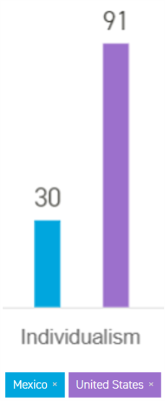
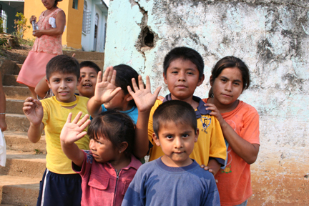
FATE & PERSONAL RESPONSIBILITY
Cultural examples:
Mexico
America
Notes:
One fatalistic culture is the Mexican culture.Having a legacy of poverty,
people are likely to see struggles as inevitable or unavoidable.
****CLICK
On the contrary, one freewill culture is the American culture,
where children grow up in a positive environment
and are taught to overcome setbacks and failure.
Therefore, getting a good understanding of someone elses cultural background and how they grew up
will help to prevent misunderstanding and unnecessary conflict.
Alright, I hope now you have got a good overview of how fate & personal responsibility differ from culture to culture and also different people.
Let me now move onto the second aspect of culture, Power-Distance.

Slide 25
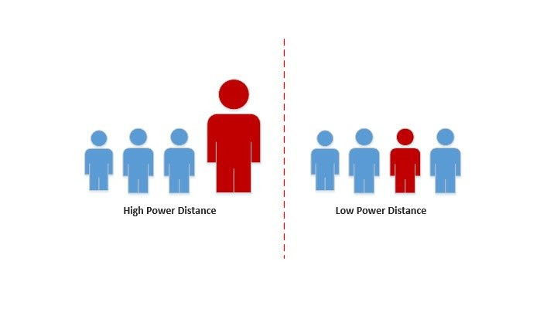
POWER DISTANCE
Extent to which lower ranking individuals of a society accepts that power is distributed unequally.
High Power Distance
Believe in high power and authority
Low Power Distance
Low inequality of power distribution
Notes:
***Power distance is the extent to which lower ranking individuals of a society accepts that power is distributed unequally.
***There are two types cultures,
a high power distance culture and a low power distance culture.
***Cultures having high-power distance cultivate a mindset
that people are not all equal,
some higher ranking than others.
In these cultures, leaders are expected to make difficult decisions
and subordinates will simply comply.
***On the other hand, People from a low-power distance culture,
believe in the opposite.
Leaders and subordinates will openly work towards resolving any dispute by stating their own points of view.
One example would be America, where people are relatively independent and more open to stating their own points of view.
Talking about being independent, Power-distance is also highly associated with individualism and collectivism.

Slide 26
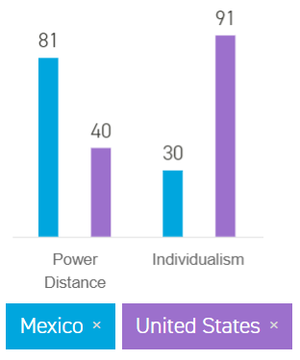
POWER DISTANCE
Association to Individualism and collectivism
Individualism
Low Power Distance
Collectivism
High Power Distance
Notes:
It is normally seen that in an individualistic culture like America is low-power distance.
***CLICK
Whereas a collectivistic culture like Mexico is of high power distance

Slide 27
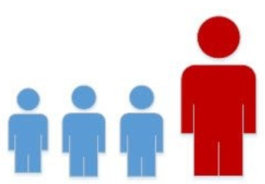
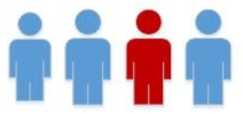
POWER DISTANCE IN SG
Low Power Distance
High Power Distance
Singapore
Notes:
As mentioned by Thanh, Singapore is a collective country.
So does that mean Singapore is a High power distance culture?
**CLICK
Indeed. Singapore is a generally a high-power distance society where people conform to a hierarchy.

Slide 28
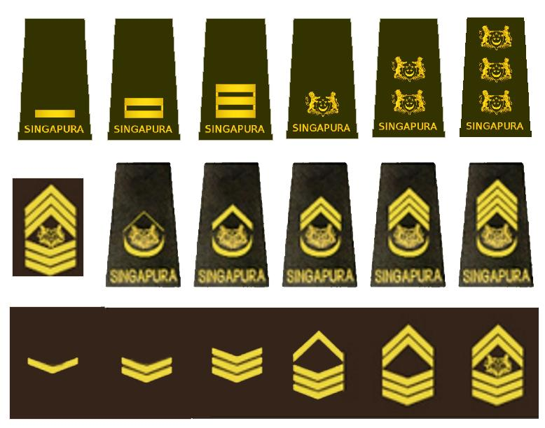
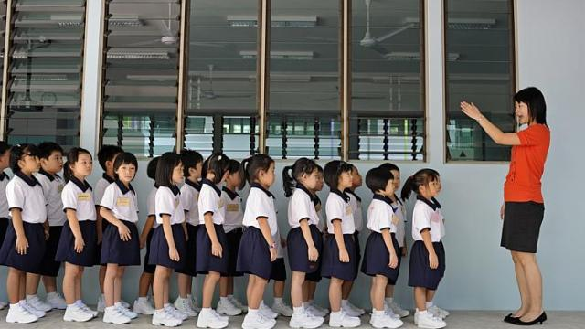
POWER DISTANCE
Singapore - High Power Distance
Notes:
Take the Singapore education system for example
***CLICK
where most students are taught to follow the teachers instructions since young growing with a high power distance mindset.
***CLICK
Another prominent example is Singapore's national service. Just by looking at the ranks, you can tell there power is consolidated at the top.
Therefore, it is very important in intercultural communication to know who you are working with,
if you’re working with people from a high power distance culture, the boss may just always be right.
One suggestion is to go through the right channels if you have any disputes with you boss.
On the other hand, in a low-power distance culture, your boss may expect you state your opinions and voice out issues instead of just being a subordinate.

Slide 29
INTERCULTURAL COMMUNICATION
Fate & Personal Responsibility
Understand others points of view
Power Distance
Know what power distance culture you are in.
Notes:
Alright, I hope now you have got a good overview of Fate & Personal Responsibility and Power-Distance.
Now let me pass on the time to the Ewald who is going to talk to you about the differences in nonverbal communication,, summarising today’s presentation.

Slide 30
Nonverbal Communication

Slide 31
Body Language

Slide 32
Greetings
Handshakes
make or break first meeting
duration and no. of shakes varies quite a bit!
Other customs

Slide 33
Gestures
Unintentionally offensive hand gestures
Signals
Italians vs. British
talking with the arms and hands

Slide 34
Proxemics

Slide 35
Personal space
North Americans
accustomed to large spaces
cold, lack interest, condescending?
Europeans
used to having less space
pushy, aggressive, disrespectful?

Slide 36
Personal space
Neither is intentionally upsetting - these are cultural differences!

Slide 37
Line-waiting
English and Americans –
“first come, first served”
Parisians –
le resquillage :
aggressive line jumping in marketplace
Armenians –
okay to save spots for others
(chope seat?)

Slide 38
Summary
View of Time
Individualism and Collectivism
Fate & Personal Responsibility
Power-Distance
Nonverbal communication

Slide 39
Learn and respect
Do discuss expectations
Don’t impose our cultural values onto others
Do due diligence in learning
Don’t assume what’s common to us is acceptable to others

Slide 40
THANK YOU!
Q&A

