Slide 1

Abstract Slide 1
The Future of Deep Learning
Neural Networks
Presented By: Jonathan Yulan(he/him)
Queens College

Slide 2

Abstract Slide 5
What is Deep Learning?
Let us begin by defining what is Data Science?
Artificial Intelligence is considered Deep Learning?
Deep vs Shallow Machine Learning?
Notes:
Data Science is a vast subject matter; One can almost think of it as a large Dataset that includes different features.
The features being: Statistics, Data Analytics and finally Machine Learning…Each of these features plays an important role in the art of Data Science
Artificial Intelligence has been conceptually been around since the late 1970s. Albeit a concept that has been around for quite some time, in today’s age has become quite complex.
An expert system has been around for quite a bit, and has been implemented in games such as checkers, and chess.
A series of if and else cases programmed by a subject matter expert could be considered Artificial Intelligence; Artificial Intelligence is not what constitutes as shallow or deep machine learning
What is the difference between shallow and deep machine learning? The differentiation has to do with the sophistication amongst the models
Linear regression, logistic regression, and decision trees are all models that fall under shallow machine learning
Random Forest using boosting and bagging and pasting techniques also known as ensemble techniques fall under a more sophisticated umbrella of deep machine learning
The model that I will be discussing and giving you a short demonstration of is known as a Neural Network and can be classified as the most sophisticated deep machine learning technique we have

Slide 3
Abstract Slide 5
Different Applications of Neural Networks
Types of Neural Networks
Multi Level Perception Neural Network
Sequential Neural Networks
Convolution Neural Networks
Recurrent Neural Network
Long – Short Term Memory Model
What can they be used for?
Regression and Classification
Computer Vision
Sequence, Text, Natural Language Processing
Time Series

Slide 4
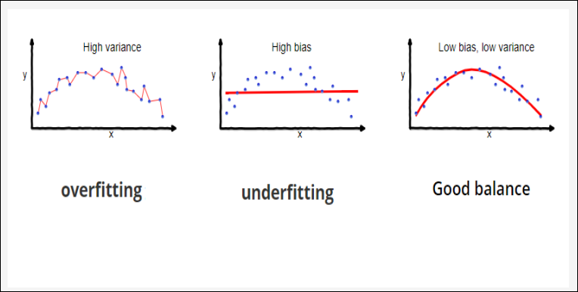
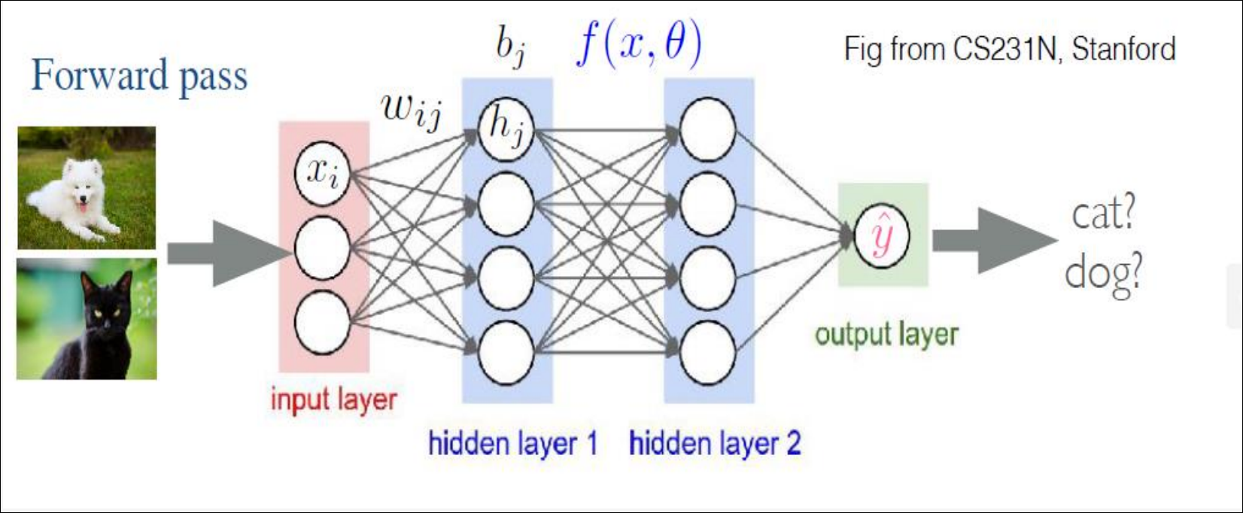
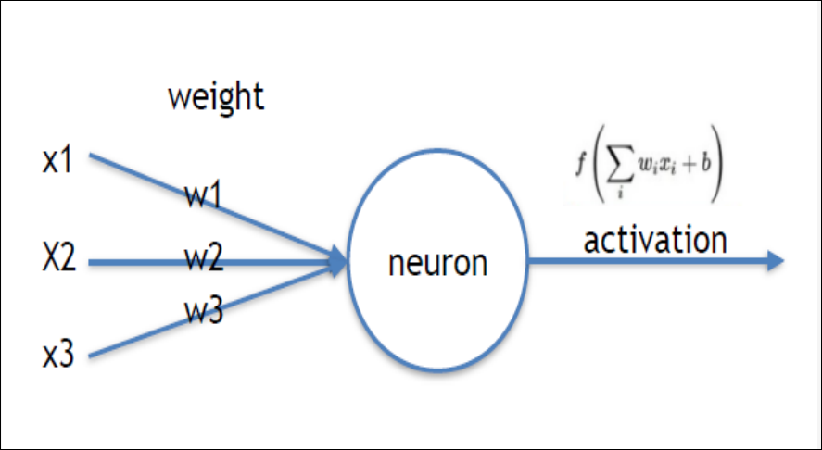
Abstract Slide 1
Theoretical View of Neural Network
Notes:
Shuffle our data
We run through our training data divided by this concept by batch size
We split into different partitions
Then for each of those specific partitions we get a prediction
We get the error
Use that error to calculate that gradient
And then use that gradient to update our model and then continue
This is essentially two for loops using the number of EPOCHS and the relationship to the batch size

Slide 5
Abstract Slide 1
How to build a Neural Network?
Decisions? Decisions? Decisions?
1. Decide on the Topology of the Neural Network
2. Choosing the Activation function for each layer
3. Choosing the Loss function for the problem we are trying to solve
4. Choosing the Optimizer function
How do we build a Neural Network?
The easiest and most intuitive way is to use an API called KERAS, developed by Facebook that works w/TensorFlow.
Notes:
Topology
- It is up to the programmer to decide how to build the layers that build the neural network. The number of nodes, and the selection of the connection.
- Fully connected network versus a spare connected neural network
- Sequential or Recurrent NN
- The connections between the neurons can serve different networks
- Many consider the topology of the neuron networks to be the most important decision you must make when theoretically building the neural network model
Activation Function
works on each layer, on each label
- how the connection is built from the independent to the dependent features
- ‘relu’, ‘sigmoid’ activation functions (Rectified Linear Unit)
- the dependency from the dependent variable to the independent variable
- the dot product is use in matrix multiplication which is used linearly to get the relationship between the linear dependency between dependent and independent variables
Loss Function
- classical machine learning for regression the loss function is the same thing
- Mean squared error for regression
- For classification we want to focus on maximum likelihood function
- Different cost functions need to be minimized
- gradient descent for the best fit parameter
- there are different variations of the gradient descent function
Right Optimizer
- Adam(Adaptive Moment Estimation) (primarily used in the industry)
- RMSProp(Root Mean Square Propagation)
- Optimizer is primarily reliant on the learning rate and the gradient. This is based on the gradient descent
- we are essentially trying to get the momentum and learning rate from our model
- then we subtract this from the model’s coefficient in order to have the model have a tighter more efficient fit
- this can cause issues such as if the learning rate being too small the model will take forever to converge (computationally expensive)
- if the learning rate is too high, this will mean a high momentum causing the model to oscillate and never come to an end
We want to make informed decisions to build a proper neural network.

Slide 6
Abstract Slide 5
Steps and Components of A Neural Network
Topology
Sequential, Recurrent NN
Number of Layers & Nodes
The Connections
Optimizer
Adam
RMSProp
Activation Functions
Softmax
Sigmoid
Loss Functions
Cross Entropy
MSE
Steps
Load
Define
Compile
Fit
Evaluate using performance metrics
Cross Validation to enhance
Re-Evaluate using out-of-sample data
Finalize
Notes:
Recurrent network some how takes the step back; these types of Neural Networks almost have some idea of history using a ‘feedback loop’
You must define everything first, and then you call compile everything before doing the work. We will see this in action in a little bit
Very similar process to shallow machine learning models
Load the data, define the data, compile the data, and fit the data albeit the way the neural network learns is utilizing back propagation to decide what or what not to change to lower the error
Adam stands for the Adaptive Moment Estimation
RMSProp is the Root Mean Square Propagation

Slide 7
Abstract Slide 1
Pros & Cons of Neural Networks
Pros
Do not need to know the feature space or our independent variables
-Fairly easy to code
No Feature Engineering Necessary
Black Box
Cons
Difficult to understand
Need a complete dataset
Needs a large dataset, usually computationally intensive
The hidden layers are magic
Notes:
15 input layers => 15 features
Dense just means that everything is fully connected
Hidden Layer created with the
Last layer is dependent on what you are trying to ouput
‘relu’ is one of the most common activation (Rectified Linear Unit)

Slide 8
Abstract Slide 1
Now on to our Demo ….
Let's run a convoluted Neural Network to help us with a classification problem. Where we will be classifying a dataset full of pictures of dogs and cats. Let us take a look at the actual process of building a neural network.

