Slide 1

Dynamic Customer Verification Overview
April 2016

Slide 2
Agenda
Introduction
DCV Phases and Sample Flow
How DCV Works?
Features of DCV
DCV Implementation Approach
Future Consideration
Q & A
Appendix: DCV Design

Slide 3
Introduction
Static Customer Verification Question
Question (such as MMN, DOB, and SIN) becomes less effective over time as more data becomes publicly available.
Dynamic Customer Verification Question
The DCV engine utilizes multiple data sources from CIS, SOL, KT and KS databases to generate challenge questions that only the customer or applicant would know based on their relationship with Scotiabank.
DCV Key Items
Provide a simplified and efficient Customer experience by enhancing the authentication process;
Reduce/Minimize account takeover fraud;

Slide 4
DCV Phases
Phase | Flow | Brief Description
Phase I (Nov. 2014) | Digital Channel Activate and Reset Password Flow for Scotia Card | Framework, Twelve Questions Profile question: Last Name? Postal Code? Home Phone Number? Date of Birth? CVV2? Dynamic questions: Scotiabank products? Payees? Mortgage Questions?
Phase II (Mar. 2015) | Digital Channel Activate and Reset Password Flow for Credit Card | Framework Enhancement; Four More Questions Which ScotiaCards do you have? Which Credit Cards do you have? Employer? Recent transactions?
Phase II ( Nov. 2015) | Digital Channel MFA Lockout Reset flow | MFA lockout purpose introduced
Phase III(Mar. 2016) | Digital Channel Activate and Recovery flow for Scotia Card, Credit Card, SPL and Hollis Wealth | Framework Enhancement; Fourteen More Questions Two more CC Questions, Four SPL questions, Four Hollis Wealth questions, Four IP Questions
 | SOL Access Code Reset Flow
Future Release | Digital Channel Activate and Recovery flow for Mortgage, IP, Saving, iTrade, Loan, and Master Card(ICE) only customer | Much More Questions
 | Scotia Card, Credit Card Activation, Verify by VISA flow etc.
 | Call Centre, IVR authentication flow

Slide 5
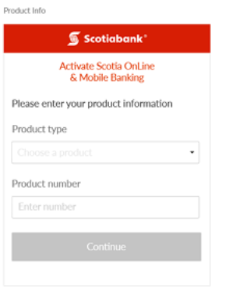
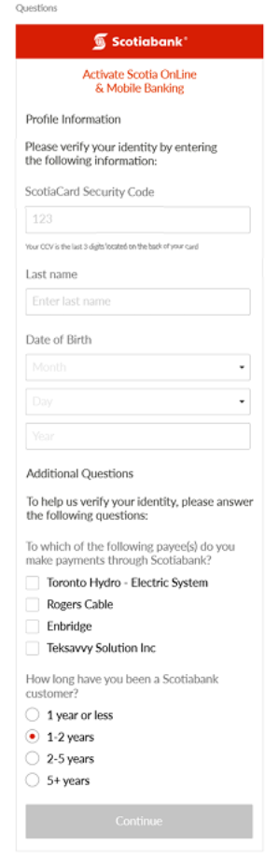
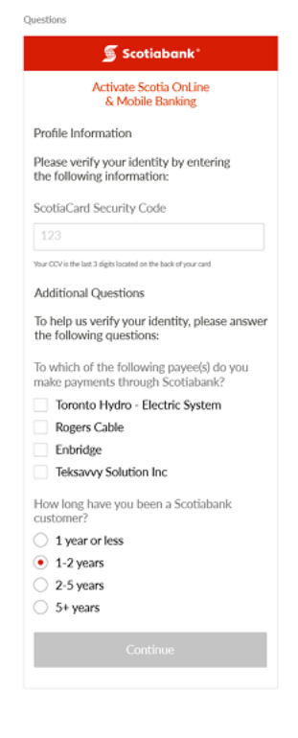

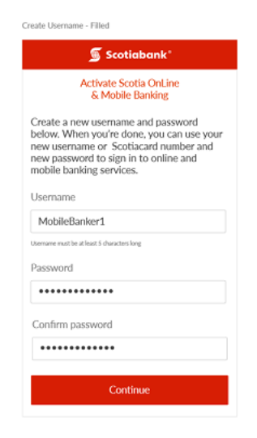
Sample Flow
DCV

Slide 6
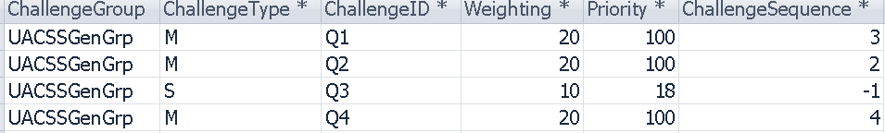
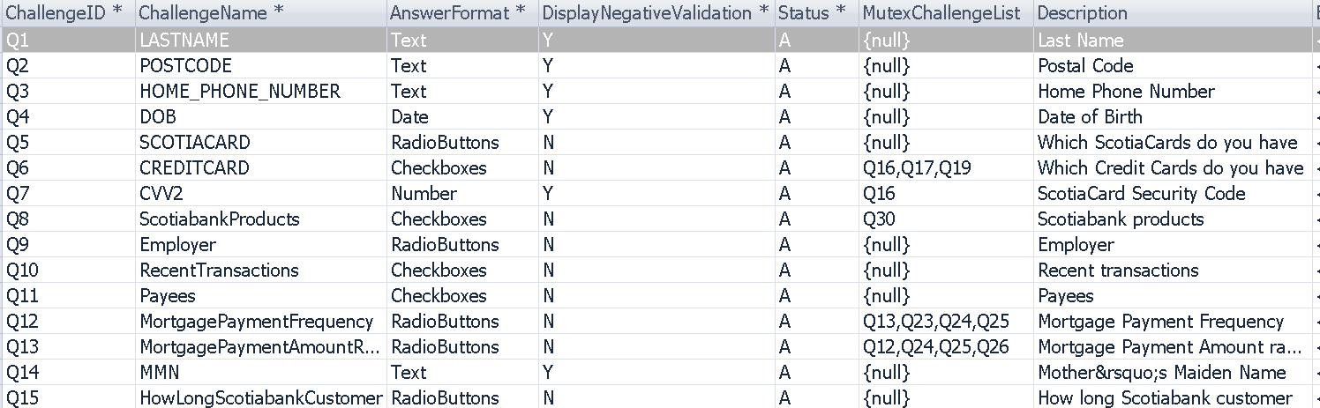
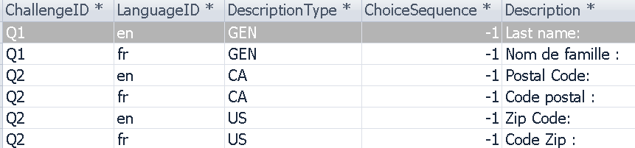
How DCV Works: DB Configuration
ChallengeSet: DCV Purpose
ChallengeGroup
Challenge: Fifty Questions
ChallengeDescription: en/fr

Slide 7
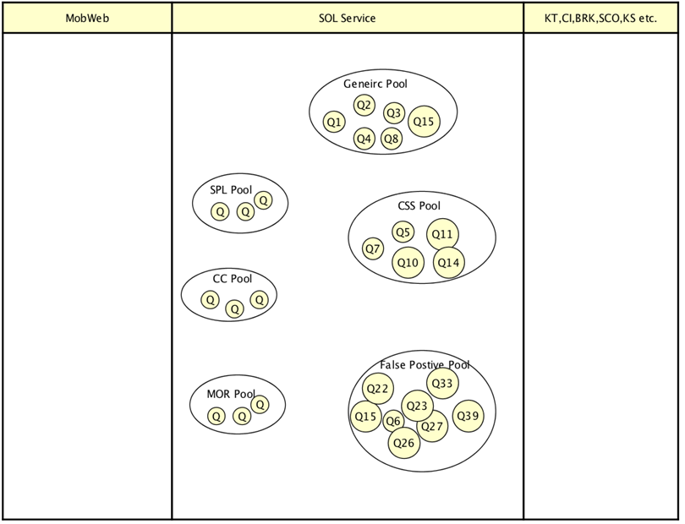









How DCV Works: Challenge Selection Flow
Pecking order on Challenge Group and Challenge

Slide 8
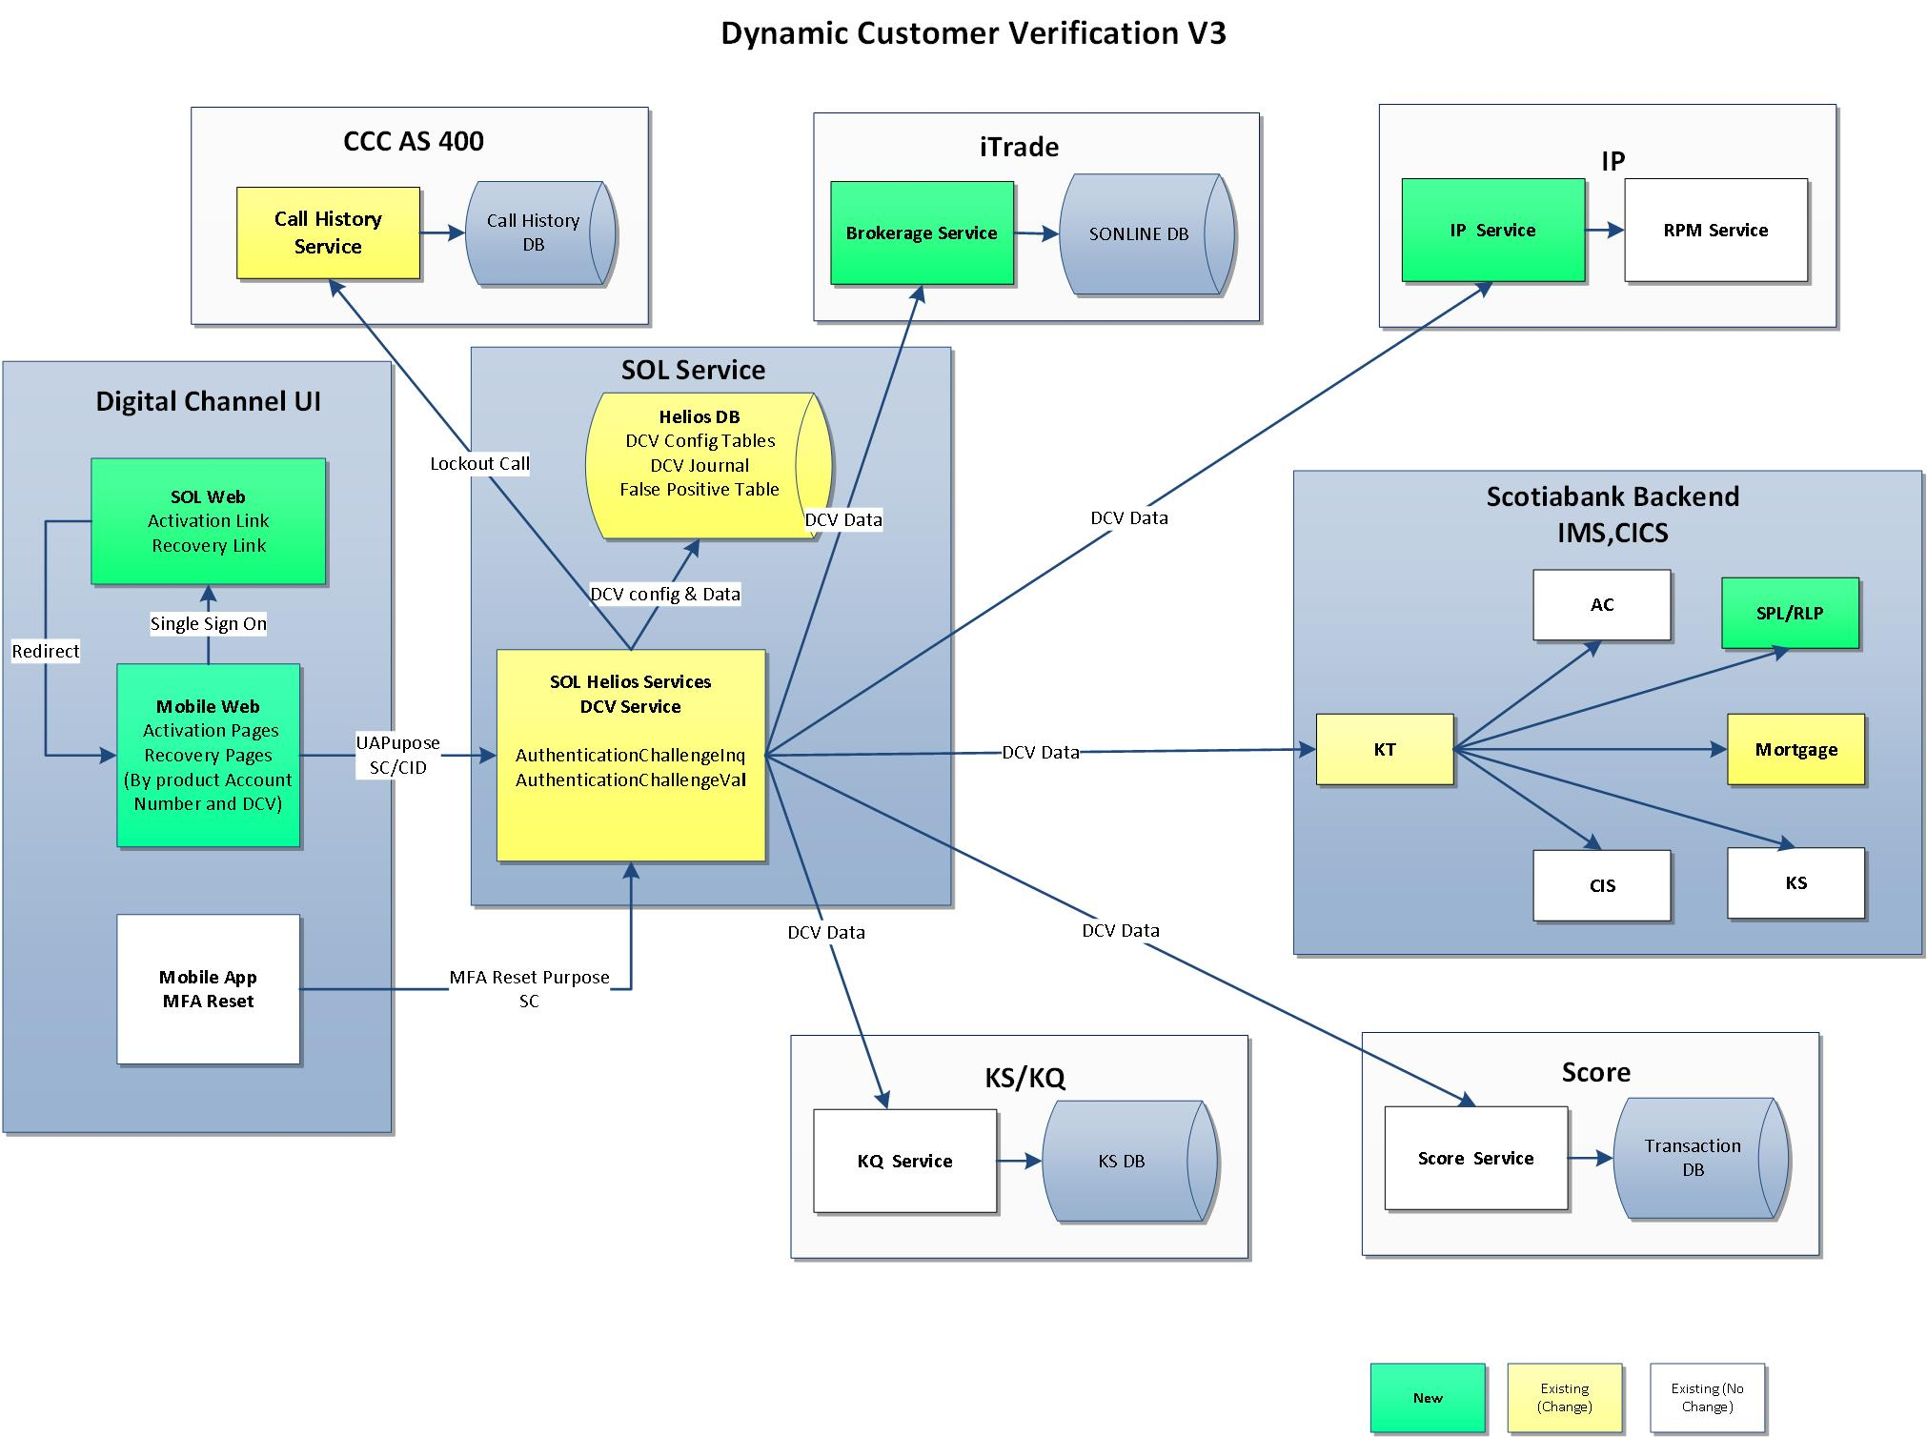
How DCV Works: Challenge Data Checking
DCV Inq: Challenge Quality Checking
DCV Val: Challenge Answer Checking

Slide 9
DCV Functional Feature
Dynamic Challenge
Weight and score will be applied based on Challenge Group;
Questions will be selected based on question pecking order (weight);
Valid question up to date information must be available ;
Answer Validation
Validate answers from the same source ;
Apply scoring rules to identify successful pass or fail of authentication;
Challenge Set Cache
Same questions will be present in 30 days if customer abends the flow;
DCV Lockout
Based on authentication purpose, customer will be lockout after a number of tries;
Lockout reset web service is available
Dynamic Authentication Session Report
DCV report can be used for question quality checking and investigation;
Notes:
3rd generation
Architecture is composed of a combination of internally developed components, purchased software, and open source technology, with the foundation being java technology running on IBM WebSphere. UI framework is based on JSF technology, utilizing XHTML templates, Rich Faces, AJAX, JSON and Spring. Services tier framework is based on Spring, leveraging industry standard technology including JAX-WS, and JAX-RS to deliver a swiss army knife of connector technology to allow us to interface to the numerous backend book of record systems.

Slide 10
DCV System Feature
Usability
SOAP WebService: Used in digital channel and can be extend to multiple channels;
Two Operations: AuthenticationChallengeInq & AuthenticationChallengeVal;
Extensibility
DCV framework supports more new questions being added to the service by DB configuration and development;
Maintainability
All challenge set, question weight, score, description etc are configured in DB;
Questions can be deactivate by utility script ;
Security
DDOS Prevention: If DCV questions are recovered from DB Cache within 10 minutes, skip host calls for data quality checking;
Notes:
3rd generation
Architecture is composed of a combination of internally developed components, purchased software, and open source technology, with the foundation being java technology running on IBM WebSphere. UI framework is based on JSF technology, utilizing XHTML templates, Rich Faces, AJAX, JSON and Spring. Services tier framework is based on Spring, leveraging industry standard technology including JAX-WS, and JAX-RS to deliver a swiss army knife of connector technology to allow us to interface to the numerous backend book of record systems.

Slide 11
DCV Implementation Approach
Approach
Leverage on implementation experience from digital channel;
Phased Approach, with selected pilot customers and lessons learned applied for remaining customers;
Discovery & Analysis
Configuration & Application Change
Testing & Validation
Implementation
Evaluation existing
Challenge Pool
Define challenge
group and pecking order
Define scoring rule
Define lockout rule
Apply DB config change
Develop new challenge
with downstream system
Develop API for false
positive answers
Validate new purpose
Review DCV journal
report
Define pilot strategy
Implementation
regression testing
Notes:
3rd generation
Architecture is composed of a combination of internally developed components, purchased software, and open source technology, with the foundation being java technology running on IBM WebSphere. UI framework is based on JSF technology, utilizing XHTML templates, Rich Faces, AJAX, JSON and Spring. Services tier framework is based on Spring, leveraging industry standard technology including JAX-WS, and JAX-RS to deliver a swiss army knife of connector technology to allow us to interface to the numerous backend book of record systems.

Slide 12
Future Consideration
Cloud
DCV redesign to deploy in cloud.
Exposing DCVJournal service, XMLCache service etc.
Restful API
Adding restful API support for DCV service
Performance Tuning
More tuning can be done through performance analysis, code optimization and caching strategy etc.
Notes:
3rd generation
Architecture is composed of a combination of internally developed components, purchased software, and open source technology, with the foundation being java technology running on IBM WebSphere. UI framework is based on JSF technology, utilizing XHTML templates, Rich Faces, AJAX, JSON and Spring. Services tier framework is based on Spring, leveraging industry standard technology including JAX-WS, and JAX-RS to deliver a swiss army knife of connector technology to allow us to interface to the numerous backend book of record systems.

Slide 13
Q & A
Questions?

Slide 14
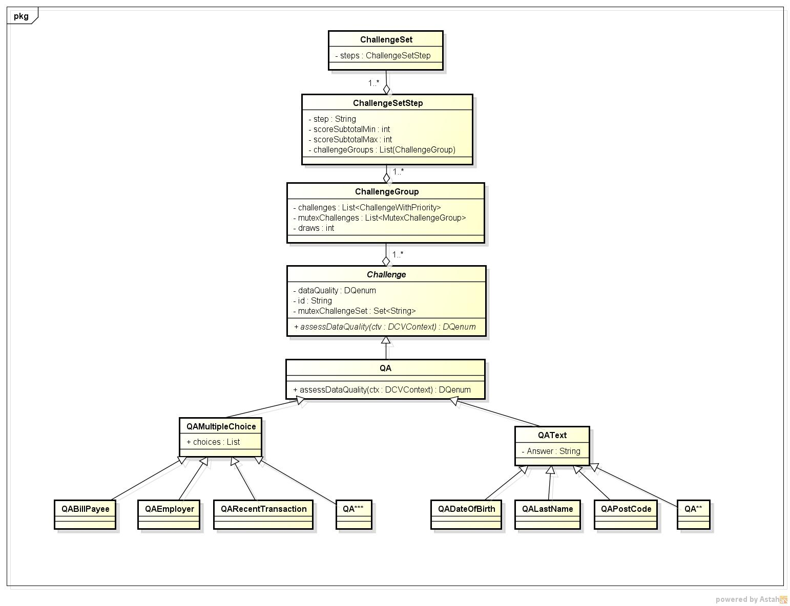
Design: Data Model
Notes:
3rd generation
Architecture is composed of a combination of internally developed components, purchased software, and open source technology, with the foundation being java technology running on IBM WebSphere. UI framework is based on JSF technology, utilizing XHTML templates, Rich Faces, AJAX, JSON and Spring. Services tier framework is based on Spring, leveraging industry standard technology including JAX-WS, and JAX-RS to deliver a swiss army knife of connector technology to allow us to interface to the numerous backend book of record systems.

Slide 15
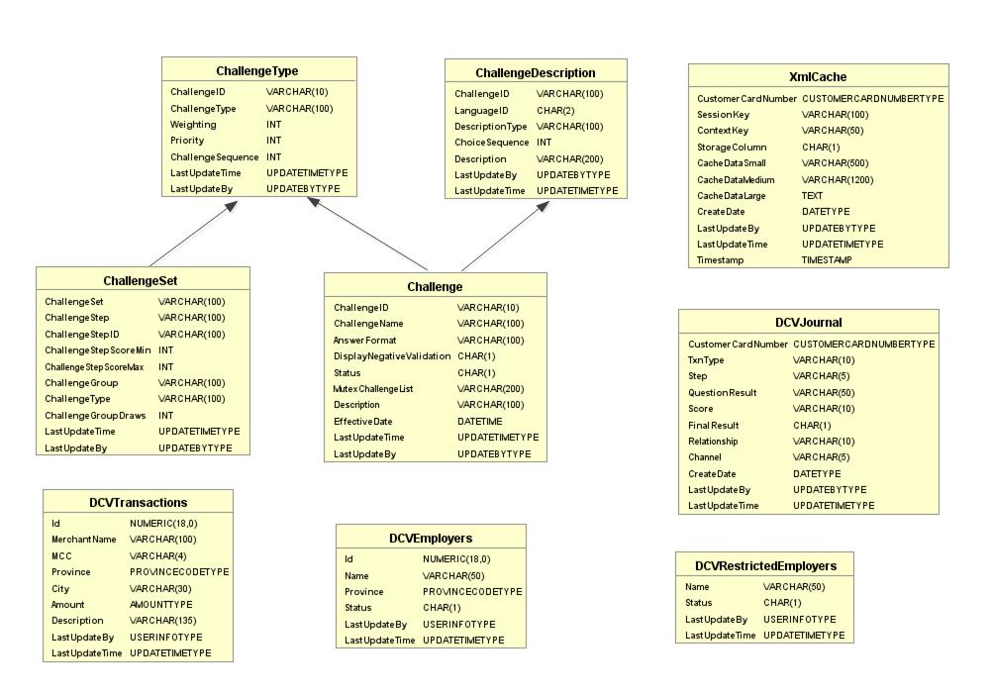
Design: Table Schema
Notes:
3rd generation
Architecture is composed of a combination of internally developed components, purchased software, and open source technology, with the foundation being java technology running on IBM WebSphere. UI framework is based on JSF technology, utilizing XHTML templates, Rich Faces, AJAX, JSON and Spring. Services tier framework is based on Spring, leveraging industry standard technology including JAX-WS, and JAX-RS to deliver a swiss army knife of connector technology to allow us to interface to the numerous backend book of record systems.

Slide 16
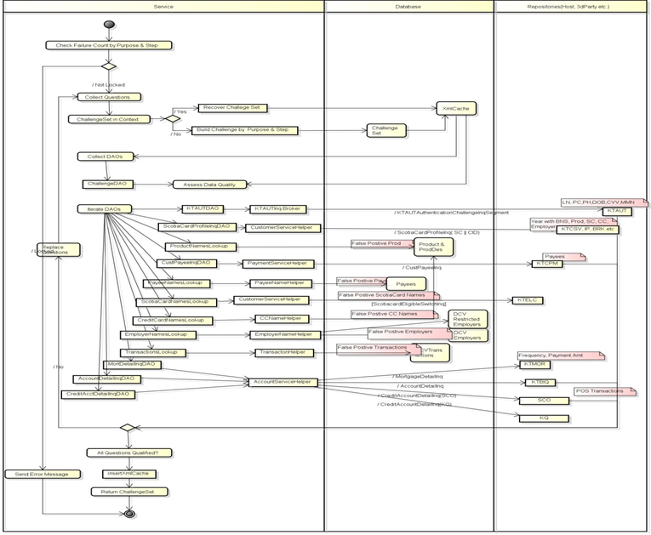
Design: Activity Diagram
Notes:
3rd generation
Architecture is composed of a combination of internally developed components, purchased software, and open source technology, with the foundation being java technology running on IBM WebSphere. UI framework is based on JSF technology, utilizing XHTML templates, Rich Faces, AJAX, JSON and Spring. Services tier framework is based on Spring, leveraging industry standard technology including JAX-WS, and JAX-RS to deliver a swiss army knife of connector technology to allow us to interface to the numerous backend book of record systems.

Slide 17
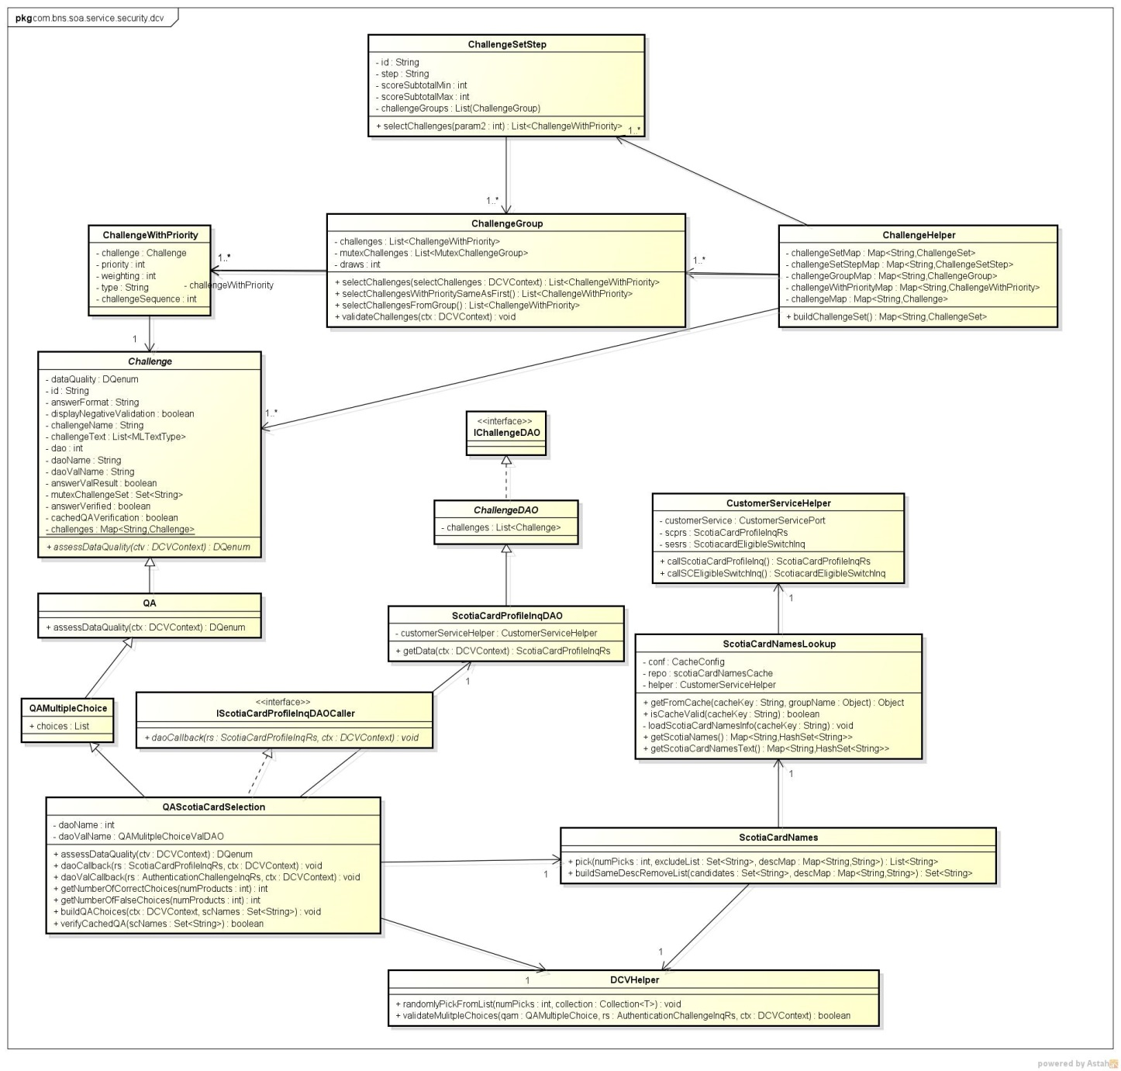
Design: Class Diagram
Notes:
3rd generation
Architecture is composed of a combination of internally developed components, purchased software, and open source technology, with the foundation being java technology running on IBM WebSphere. UI framework is based on JSF technology, utilizing XHTML templates, Rich Faces, AJAX, JSON and Spring. Services tier framework is based on Spring, leveraging industry standard technology including JAX-WS, and JAX-RS to deliver a swiss army knife of connector technology to allow us to interface to the numerous backend book of record systems.

