Slide 1


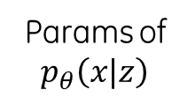



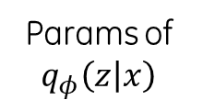






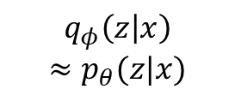
Latent space
Input
Encoder
Decoder
Reconstruction
Params of $q_{φ}\left(z | x\right)$
Params of $p_{θ}\left(x|z\right)$
$$x∈ℝ^{d}$$
$$q_{φ}\left(z | x\right)$$
$$≈p_{θ}(z|x)$$
$$p_{θ}\left(x|z\right)$$
$$\hat{x}∈ℝ^{d}$$
Sample $z$
Sample
$z∈ℝ^{p}$ with prior$p_{θ}\left(z\right)$
$$z$$
$$\sim p_{θ}\left(z\right)$$
$$p_{θ}\left(z|x\right)$$
$$p_{θ}\left(x|z\right)$$
$$x$$
$$\sim p_{θ}\left(x\right)$$

Slide 2
Regularization

