Slide 1
Numerical simulations & Deep Learning: applications to x-ray breast imaging
Zhijin Li
21 Dec 2018

Slide 2
About me
2013: MSc & Engineering degrees in applied maths – Supélec
2017: PhD in applied maths & medical imaging - Ecole Normale Supérieure Paris-Saclay
Currently: Research Scientist - Women’s Health Applied Research - GE Healthcare
Advanced clinical applications for 2D & 3D mammography
Design & implementation of simulation components for virtualized clinical trials
Research & implementation of supervised & unsupervised Deep Learning for x-ray breast imaging

Slide 3
Agenda
Introduction to x-ray breast imaging
Numerical simulations for virtual clinical trials
Virtual clinical trials
Stochastic solid breast texture model
Modeling clinical task & decision-making through model observers
Deep Learning for mammography classification
Clinical context
Challenges & approaches
Towards 3D mammography classification

Slide 4

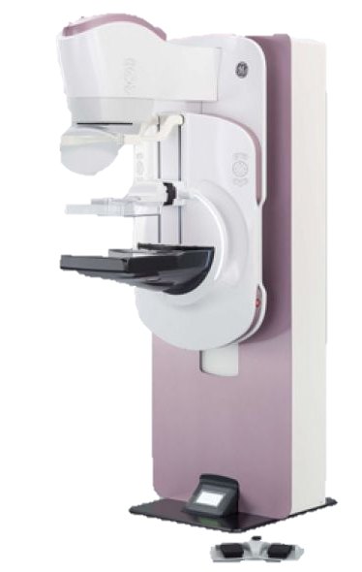
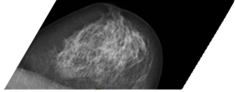
X-ray breast imaging
Worldwide breast cancer accounts for 25.2% of all female cancers and 16% of cancer deaths in adult women *
2D full field digital mammography (FFDM): the standard for population-based breast cancer screening
(Fibro)glandular tissue
Adipose tissue
* Estimated world-wide cancer statistics, WHO 2012

Slide 5
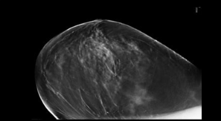
X-ray breast imaging
Worldwide breast cancer accounts for 25.2% of all female cancers and 16% of cancer deaths in adult women *
TOWARDS…
3D Digital breast tomosynthesis (DBT): Today investigational for screening
z
z
…
Reconstruction
* Estimated world-wide cancer statistics, WHO 2012

Slide 6
Numerical simulations for virtual clinical trials
Virtual clinical trials
Stochastic 3D breast tissue model
Modeling clinical task & decision-making through model observers

Slide 7




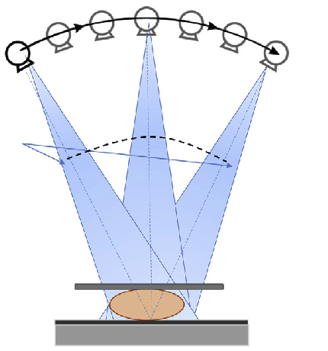

Virtual clinical trials
Clinical trials
Golden-standard to obtain clinical claims for imaging technology from regulatory agencies
Typically costly & long processes. Can incur extra x-ray dose to patients.
Patients
Imaging system
Radiologist & image review
Statistical analysis
Virtual clinical trials (VCT)
Replace clinical trial components in-part with numerical simulations
More cost-effective alternative
$$λ=w^{T}g$$
Numerical breast model
Numerical x-ray system
Model observer
Statistical analysis

Slide 8
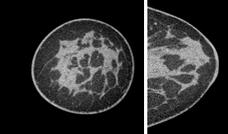
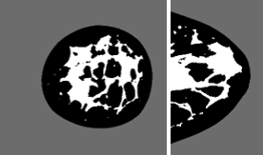
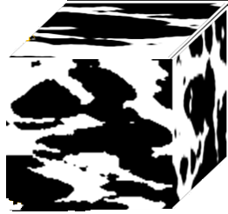
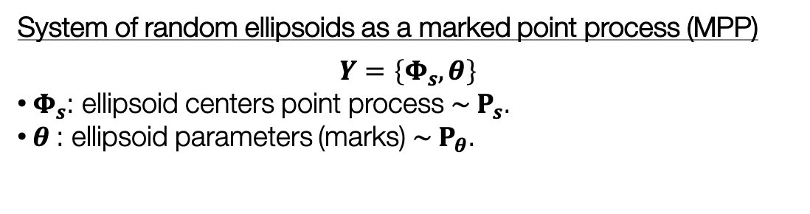
Stochastic 3D breast tissue model
Overview
Adipose compartments
Fibro-glandular tissue
Local adipose compartments
Can be modeled as a system of random ellipsoids
Clinical breast CT data
(courtesy of Prof. John Boone UCDMC)
System of random ellipsoids as a marked point process (MPP)
$$Y=\left\{Φ_{s},θ\right\}$$
$Φ_{s}$: ellipsoid centers point process $\sim P_{s}$.
$θ$: ellipsoid parameters (marks) $\sim P_{θ}$.

Slide 9
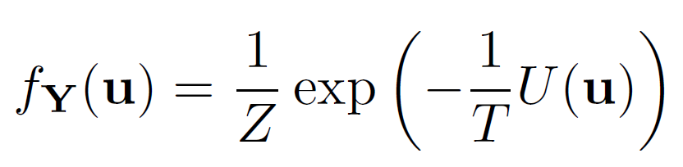

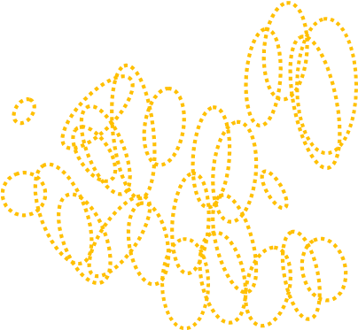
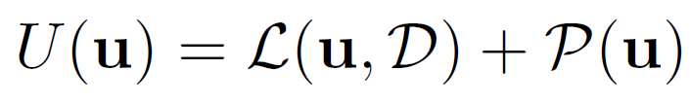
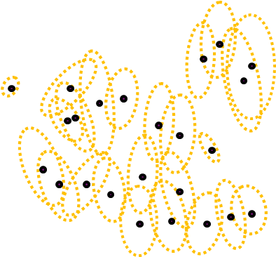
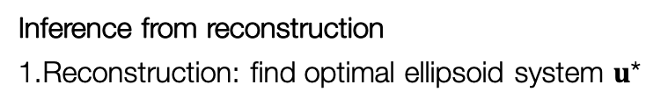
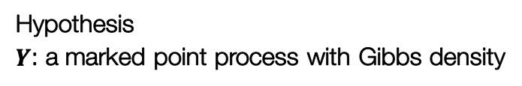


Stochastic 3D breast tissue model
Learning model parameters from segmented clinical breast CT data
Inference from reconstruction
Reconstruction: find optimal ellipsoid system $u$*
Hypothesis
$Y$: a marked point process with Gibbs density
With energy
The data term
How a configuration of ellipsoids deviates from input data
The prior term
Constraint on the overlap percentage btw ellipsoids
Inference: estimate $P_{s}$, $P_{θ}$ from $u$*
The optimal ellipsoidal configuration $u$*

Slide 10
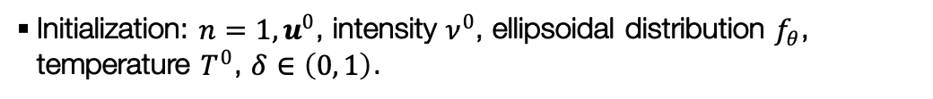
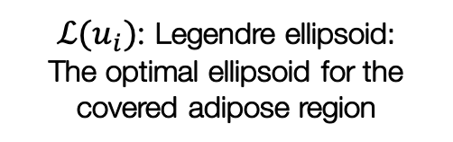
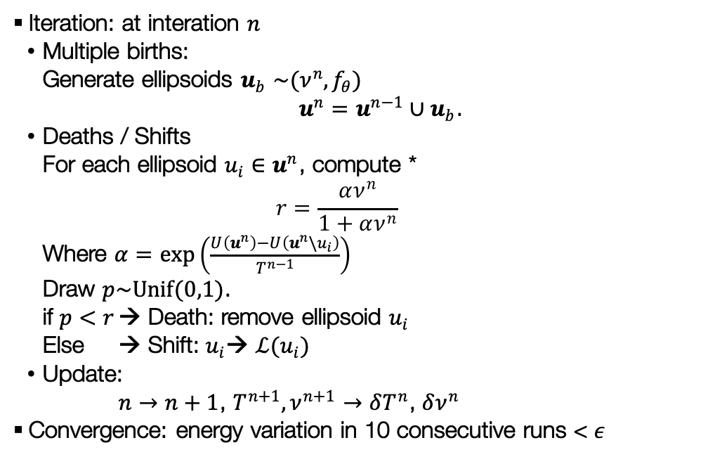
Stochastic 3D breast tissue model
Reconstruction: Multiple births, deaths & shifts
Initialization: $n=1,u^{0}$, intensity $ν^{0}$, ellipsoidal distribution $f_{θ}$, temperature $T^{0}$, $δ∈\left(0, 1\right)$.
Iteration: at interation $n$
Multiple births:
Generate ellipsoids $u_{b}$ ${\sim (ν^{n},f}_{θ})$
$u^{n}=u^{n−1}∪u_{b}$.
Deaths / Shifts
For each ellipsoid ${u_{i}∈u}^{n}$, compute *
$$r=\frac{αν^{n}}{1+αν^{n}}$$
Where $α=\exp\left(\frac{U\left(u^{n}\right)−U\left(u^{n}\backslash u_{i}\right)}{T^{n−1}}\right)$
Draw $p\sim Unif(0,1)$.
if $p<r$ → Death: remove ellipsoid $u_{i}$
Else → Shift: $u_{i}$→ $ℒ(u_{i})$
Update:
$n→n+1$, $T^{n+1},ν^{n+1}→δT^{n}$, $δν^{n}$
Convergence: energy variation in 10 consecutive runs < $ε$
$ℒ(u_{i})$: Legendre ellipsoid:
The optimal ellipsoid for the covered adipose region

Slide 11
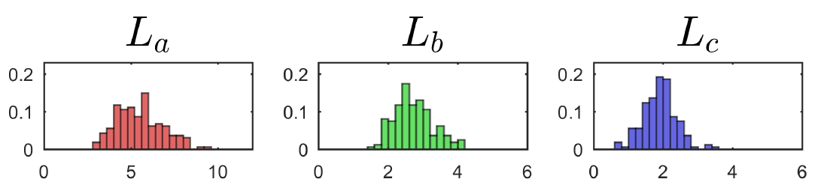
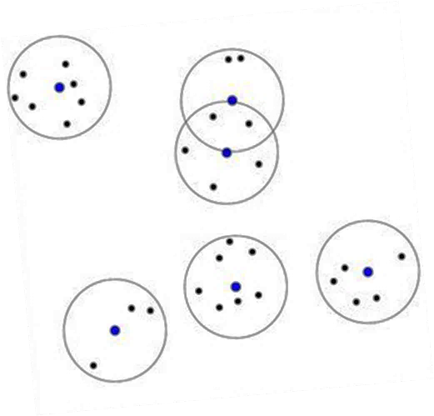
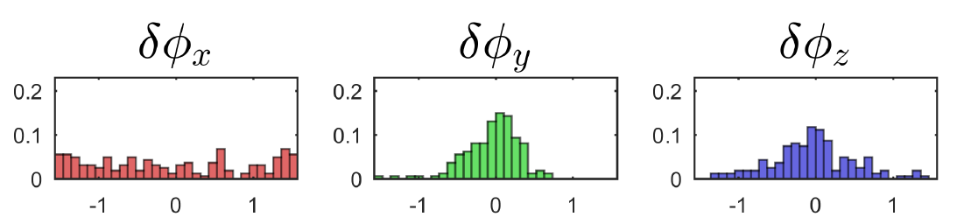
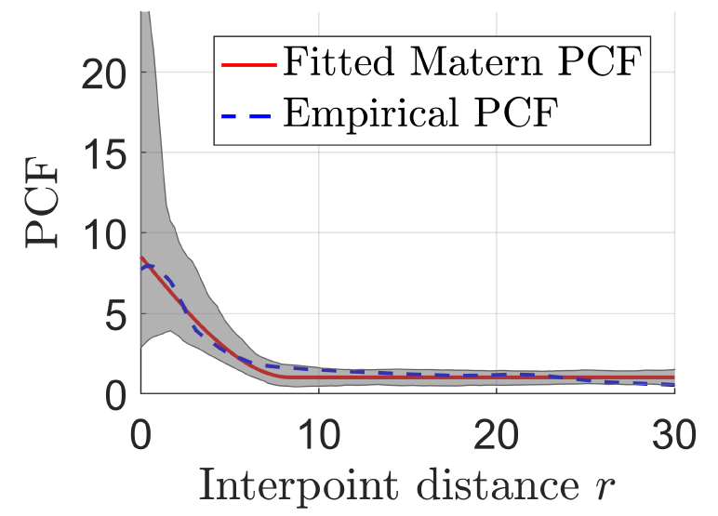
Stochastic 3D breast tissue model
Inference: $P_{s}$ → minimum contrast estimator, $P_{θ}$ → maximum likelihood
Axis lengths
Gaussian
Gaussian
Gaussian
Orientation angles
Uniform
Gaussian
Gaussian
Fitted to Gaussian / Uniform distributions using maximum likelihood estimator

Slide 12
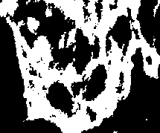
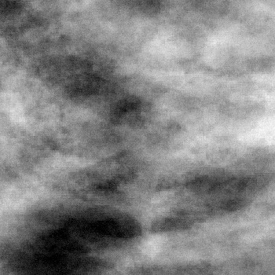
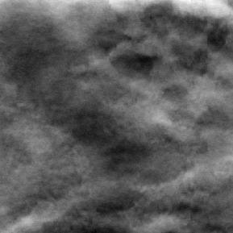
Stochastic 3D breast tissue model
Image size:
3.5 cm x 3.5 cm
Example results
Volume slices
Mammograms
DBT recon. slices
Simulations
Ground truth (from breast CT)
Notes:
Here is a slice from a volume simulated from the model representing an adipose breast. Here is the mammogram created from the same volume. And here is the DBT reconstructed slice created from the same volume. Here we also have other three sets of simulations representing three breasts with different densities.
The simulated images exhibit high visual realism. Also, we notice the improved morphological variation in simulated images. This is can be mainly attributed to the newly inferred medium scale parameters.

Slide 13
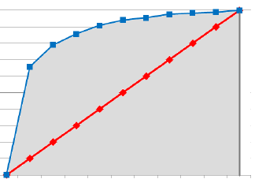
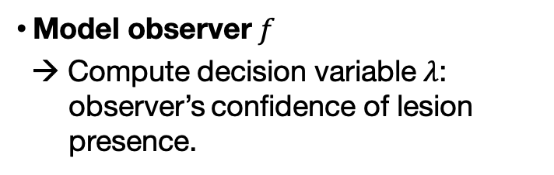
Modeling radiologist clinical tasks
Overview
Image $g$
Decision variable
$λ=f($ images, template, internal noise $)$
Threshold
Decision outcome $D$
Figure-of -merit
Area under the ROC curve (AUC)
Model observer $f$
→ Compute decision variable $λ$: observer’s confidence of lesion presence.
Threshold
$$p$$
Lesion
absent
Lesion
present
Decision Variable $λ$

Slide 14
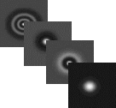
Modeling radiologist clinical tasks
Channelized Hotelling Observer (CHO)
Channelization: extract information sensitive to human visual system from image
.
Computation of decision variable $λ$: based on linear discriminative analysis
$$λ=w^{T}g$$

Slide 15
Example VCT application
Comparison of microcalcification detectability in FFDM vs DBT

Slide 16
Deep Learning for mammography classification
Clinical context
Challenges & approaches

Slide 17
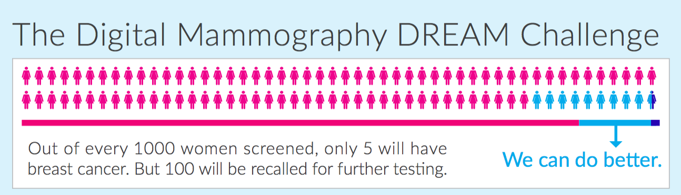
Deep Learning for mammography classification
Clinical context: screening mammography

Slide 18
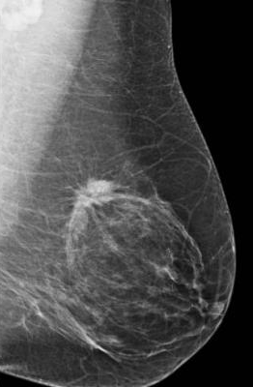
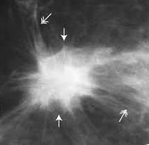
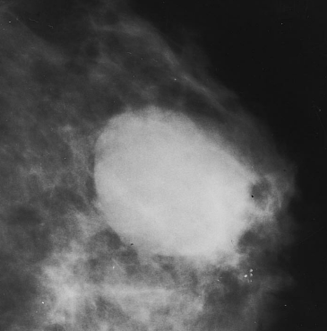
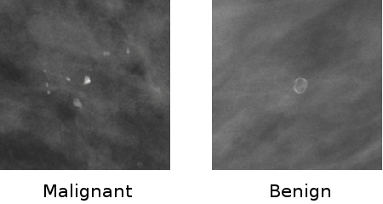
Deep Learning for mammography classification
Challenges
Typical findings in mammograms
Malignant mass
Benign mass
Malignant calc
Benign calc
Proportion of finding region
Area of findings much smaller than area of normal tissue
Insufficiency & heterogeneity of datasets
Annotated high quality data is expensive to collect
Data acquired from different mammography systems
Imbalance of training datasets
Screening mammograms are mostly normal
Imbalance in finding types

Slide 19
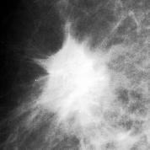
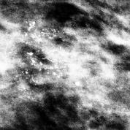
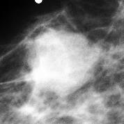
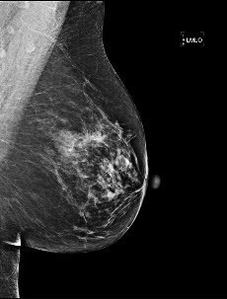
Deep Learning for mammography classification
Proportion of finding region: patch-based training technique
DDSM pre-training stage
5-class classification
Skip connection: addition of feature maps
GAP
Global average pool: each feature map → its average
Conv + BN+ Relu
Pooling
Fully connected
Background
DDSM ROIs
Conv Block
Conv Block
Conv Block
Benign calc
…
GAP
Malignant calc
Benign mass
Malignant mass
DREAM fine-tuning stage
Binary classification
Flat
Flattening: feature maps → 1 vector
Flat
Freezed
Trainable
Conv + BN+ Relu
Pooling
Conv + BN+ Relu
Conv + BN+ Relu
Fully connected
Conv Block
Conv Block
Conv Block
Flat
Cancer
DREAM FFDM
…
vs
GAP
Normal
Transferred
Compare w/ vs w/o GAP
2 New layers

Slide 20
Deep Learning for mammography classification
Proportion of finding region: visualization of heatmaps
DDSM pre-training stage
5-class classification
Skip connection: addition of feature maps
GAP
Global average pool: each feature map → its average
Conv + BN+ Relu
Pooling
Fully connected
Background
DDSM ROIs
Conv Block
Conv Block
Conv Block
Benign calc
…
GAP
Malignant calc
Benign mass
Malignant mass
DREAM fine-tuning stage
Binary classification
Flat
Flattening: feature maps → 1 vector
Flat
Freezed
Trainable
Conv + BN+ Relu
Pooling
Conv + BN+ Relu
Conv + BN+ Relu
Fully connected
Conv Block
Conv Block
Conv Block
Flat
Cancer
DREAM FFDM
…
vs
GAP
Normal
Transferred
Compare w/ vs w/o GAP
2 New layers

Slide 21
Deep Learning for mammography classification
Insufficiency & heterogeneity of datasets: fine-tuning on different dataset

Slide 22
Deep Learning for mammography classification
Insufficiency & heterogeneity of datasets: domain adaptation

Slide 23
Deep Learning for mammography classification
Imbalance of training datasets: artificial data balancing / augmentation
Augmentation: cannot resize
Microcalcs & masses: quite invariant to rotations & flipping

