Slide 1

SUPPLIER EVALUATION REPORT
Air France-KLM
Aviation / Airlines | 97.96M Passengers | Euronext: AF
€31.5B Revenue | 574 Aircraft | 87.8% Load Factor | Founded 2004
Confidential | March 2026 | Manu Forti Intelligence

Slide 2
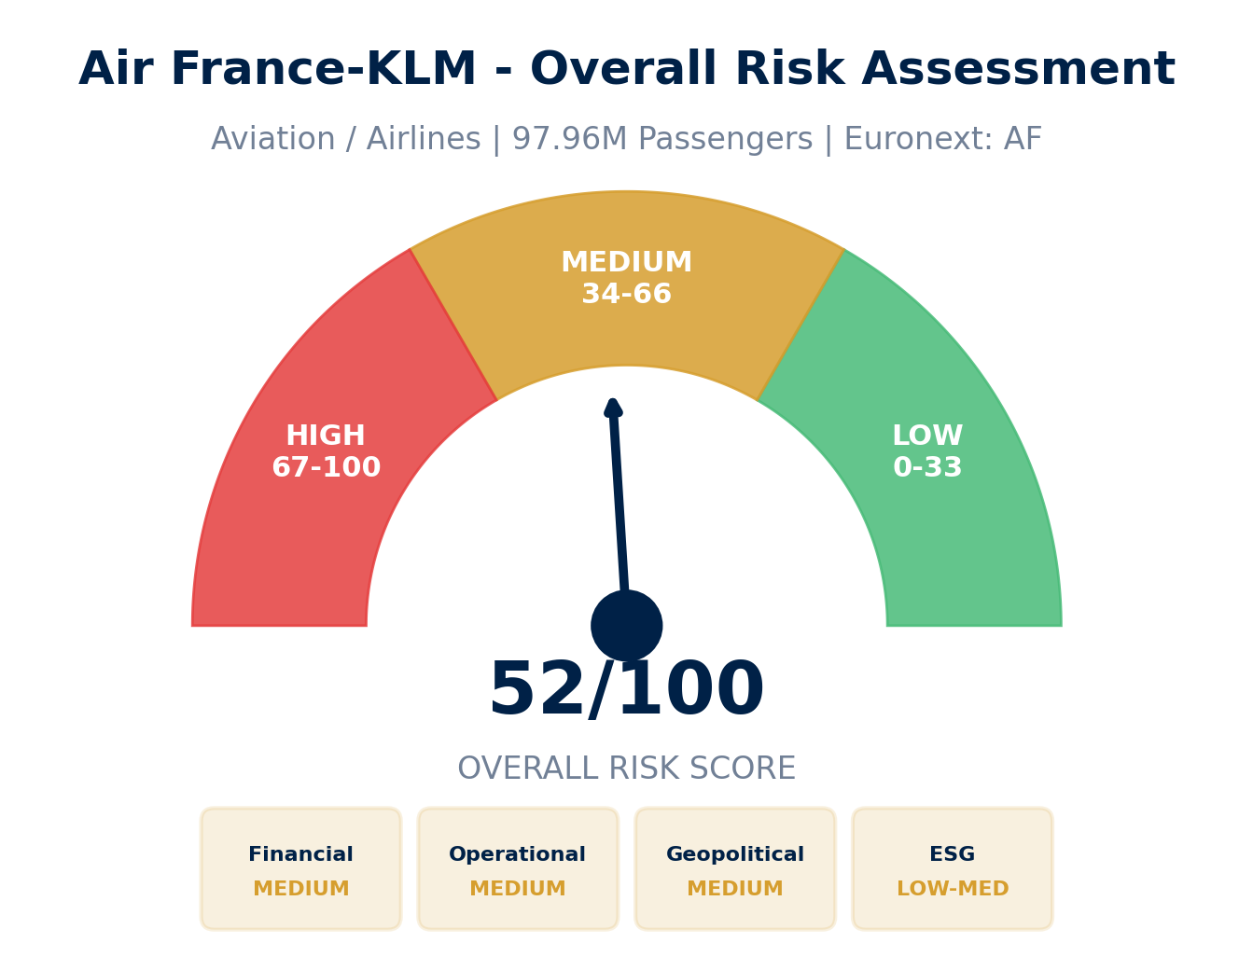
EXECUTIVE SUMMARY
Air France-KLM — Risk & Suitability Overview
SUPPLIER SNAPSHOT
Supplier:
Air France-KLM Group
Type:
Public Company
Sector:
Aviation / Airlines
HQ:
Paris / Amsterdam
Founded:
2004 (merger)
Employees:
75,000+
Revenue:
€31.5B (2024)
Passengers:
97.96M
Fleet:
574 aircraft
Exchange:
Euronext: AF
Key Findings
• Global #4 airline group with strong European hub positions
• Post-COVID recovery: 9.7% revenue CAGR, improving profitability
• Risk: Labor disputes and fuel price volatility
• ESG leader in Sustainable Aviation Fuel (SAF) adoption
Source: Manu Forti Intelligence | Confidential | March 2026

Slide 3
RECOMMENDATION
Decision Summary & Commercial Conditions
⚠ RECOMMENDATION: APPROVE WITH CONDITIONS
Air France-KLM is recovering from COVID-19 with improving financials but faces labor and fuel price risks. Recommended with monitoring conditions.
Commercial Conditions
Due Diligence
Enhanced Due Diligence (Mandatory)
• Payment: Standard airline terms (7-14 days)
• Monitor quarterly financial results
• Performance: On-time performance clauses
• Track labor negotiation progress
• Force Majeure: Include strike/labor dispute coverage
• Review fuel hedge positions
• Price Adjustment: Fuel surcharge pass-through
• Assess route network stability
• Capacity: Seasonal flexibility provisions
• Validate SAF procurement strategy
Overall Risk Summary - MEDIUM (52/100)
Financial:
MEDIUM
Post-COVID recovery ongoing
Operational:
MEDIUM
Labor disputes, fleet complexity
Geopolitical:
MEDIUM
Fuel prices, route stability
ESG:
LOW-MED
SAF leader, labor concerns
Source: Manu Forti Intelligence | Confidential | March 2026

Slide 4
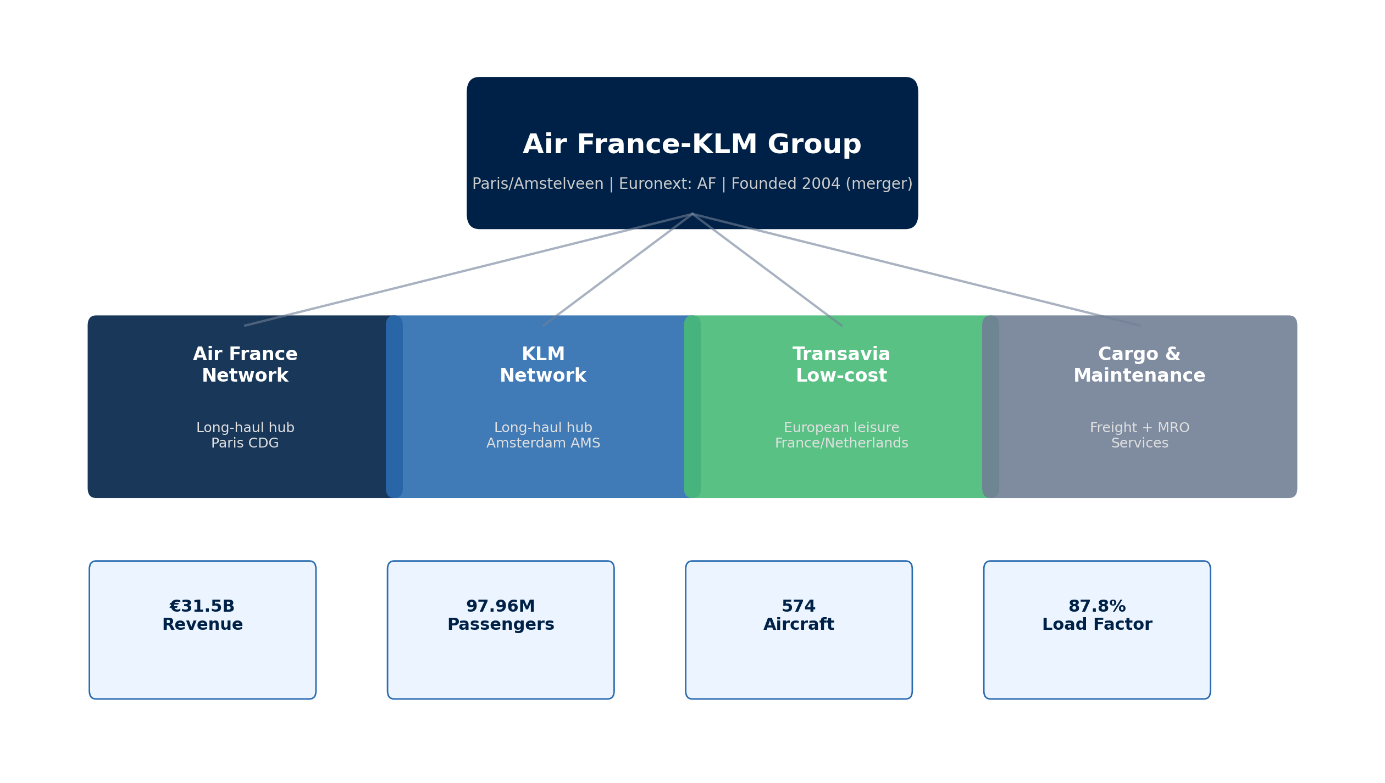
SUPPLIER PROFILE
Corporate Structure & Global Footprint
Company Overview
Leadership & Operations
• Air France-KLM is a leading European airline group formed
• CEO: Ben Smith (appointed September 2018)
by the 2004 merger of Air France and KLM.
Former COO at Air Canada
• Operates dual hubs: Paris CDG (Air France) and
• Chairman: Anne-Marie Couderc
Amsterdam AMS (KLM).
• HQ: Paris (Air France) / Amsterdam (KLM)
• Serves 195+ destinations in 90+ countries.
• Stock: Euronext: AF | Market Cap: ~€3B
Source: Manu Forti Intelligence | Confidential | March 2026

Slide 5
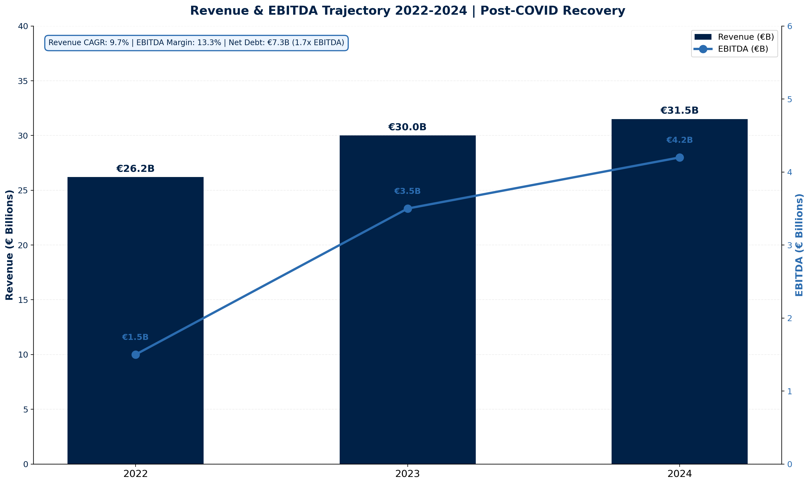
FINANCIAL HEALTH
Revenue & EBITDA Trajectory 2022-2024 | Euronext: AF
Financial Highlights
Revenue (2024):
€31.5B
Revenue YoY:
2023 Revenue:
+4.8%
€30.0B
EBITDA (2024):
€4.2B
EBITDA Margin:
13.3%
Net Profit:
€489M
3-Year CAGR:
9.7%
Net Debt:
€7.3B
Debt/EBITDA:
1.7x
Load Factor:
87.8%
Passengers:
97.96M
Financial Risk: MEDIUM ⚠
Exposure Guidance
• Post-COVID recovery ongoing but fragile
• Net debt elevated at 1.7x EBITDA
• Labor cost pressures from negotiations
• Monitor quarterly financial reports closely
Source: Manu Forti Intelligence | Confidential | March 2026

Slide 6
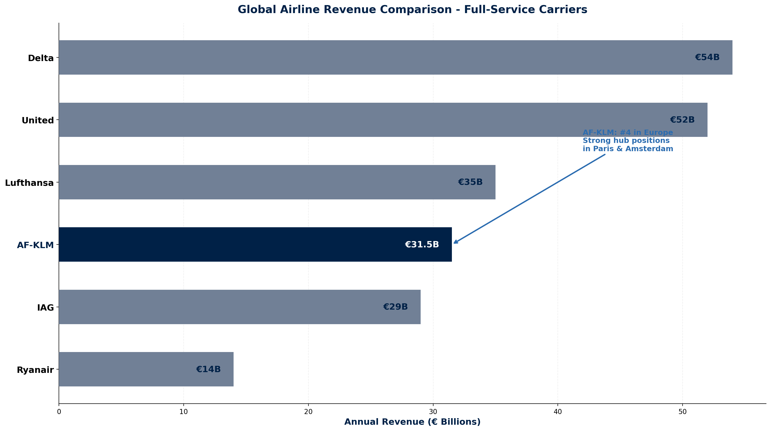
MARKET POSITION
Global Airline Revenue Comparison - Full-Service Carriers
COMPETITIVE CONTEXT
Air France-KLM ranks #4 among European
full-service carriers by revenue.
Key Strengths:
• Dual hub strategy (CDG + AMS)
• Strong long-haul network
• SkyTeam alliance membership
• Premium brand positioning
Key Challenges:
• Labor costs vs low-cost competitors
• State ownership complexity
• Fleet renewal requirements
Source: Manu Forti Intelligence | Confidential | March 2026

Slide 7
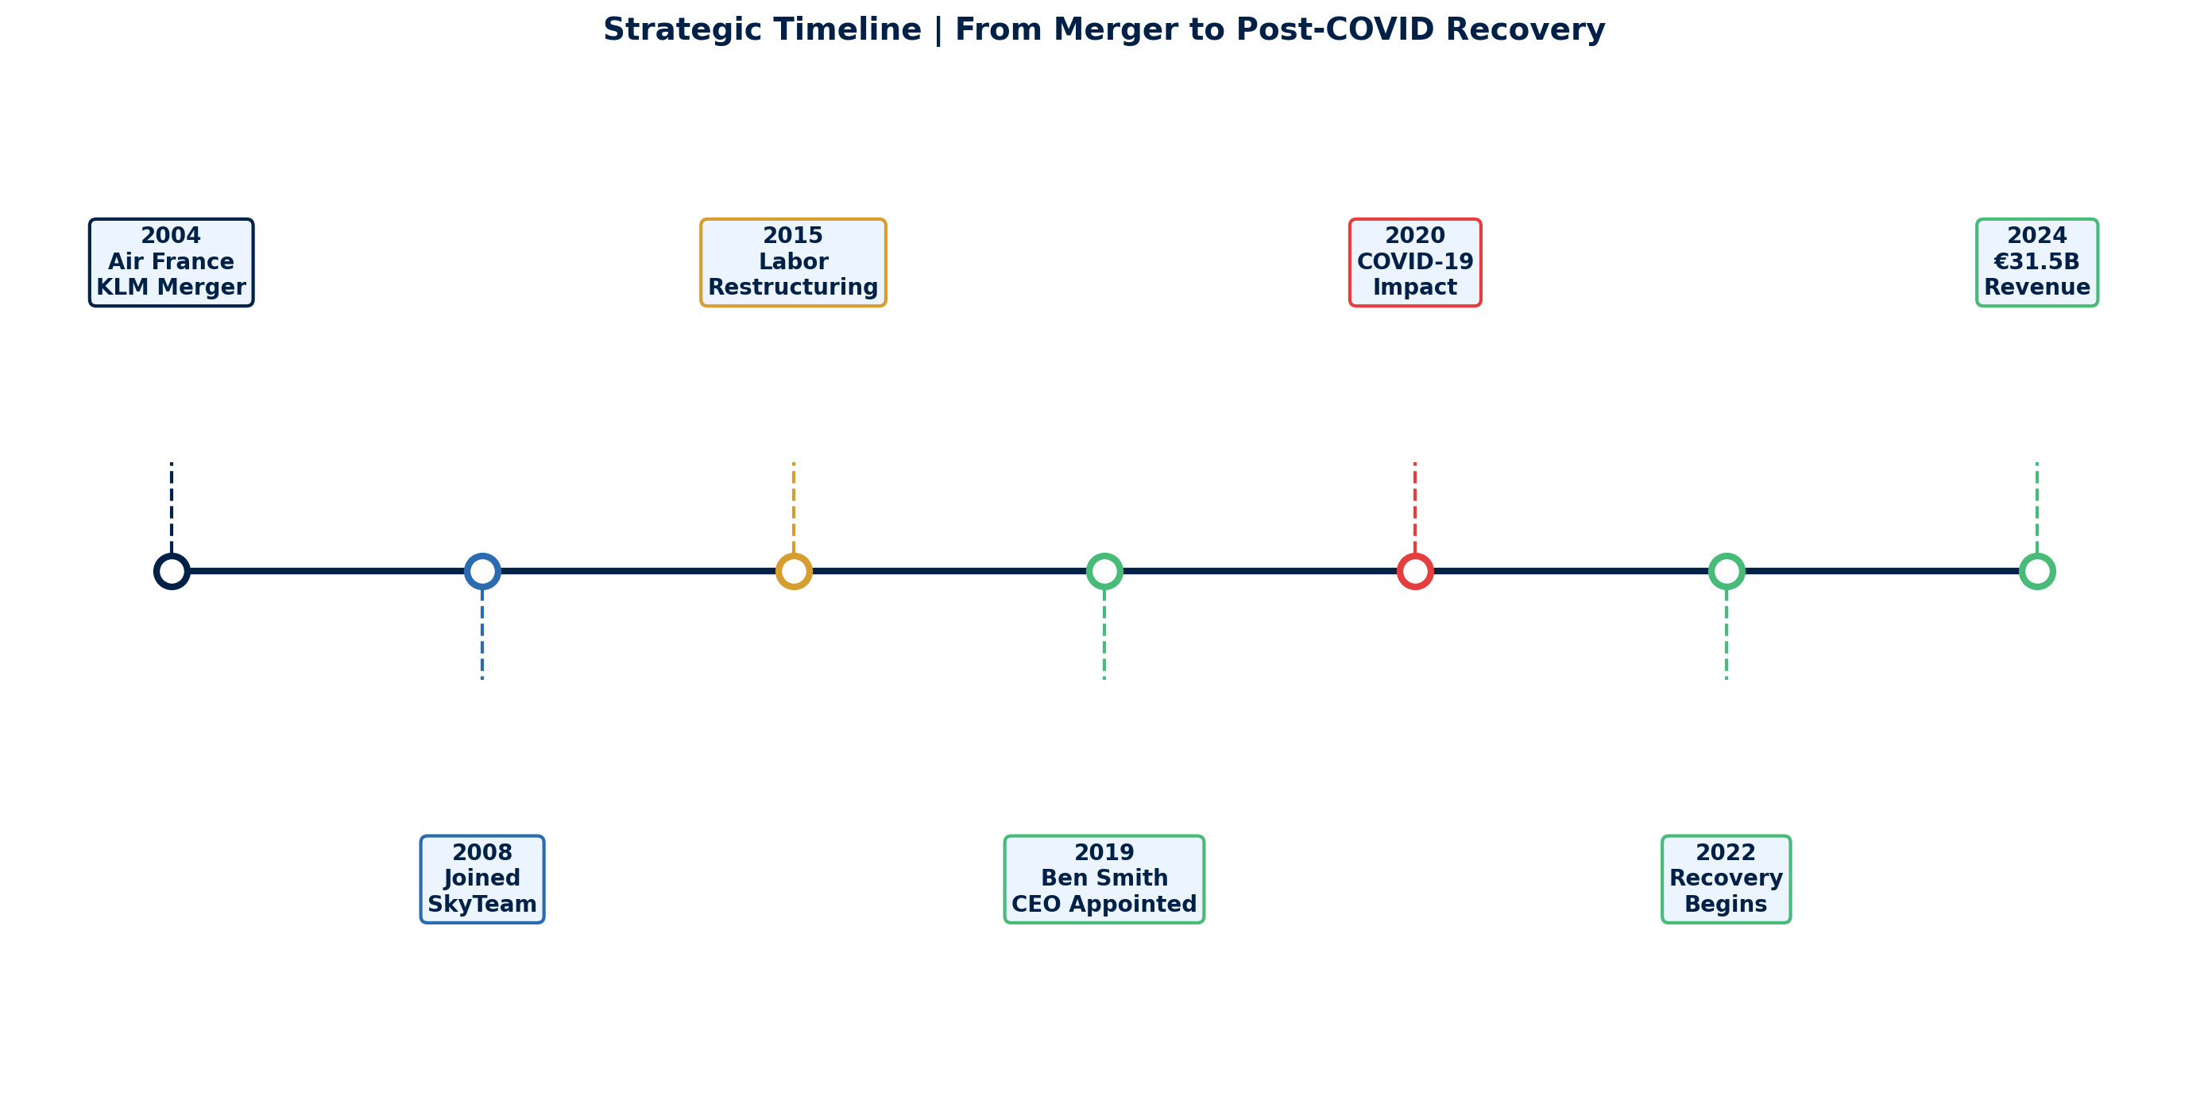
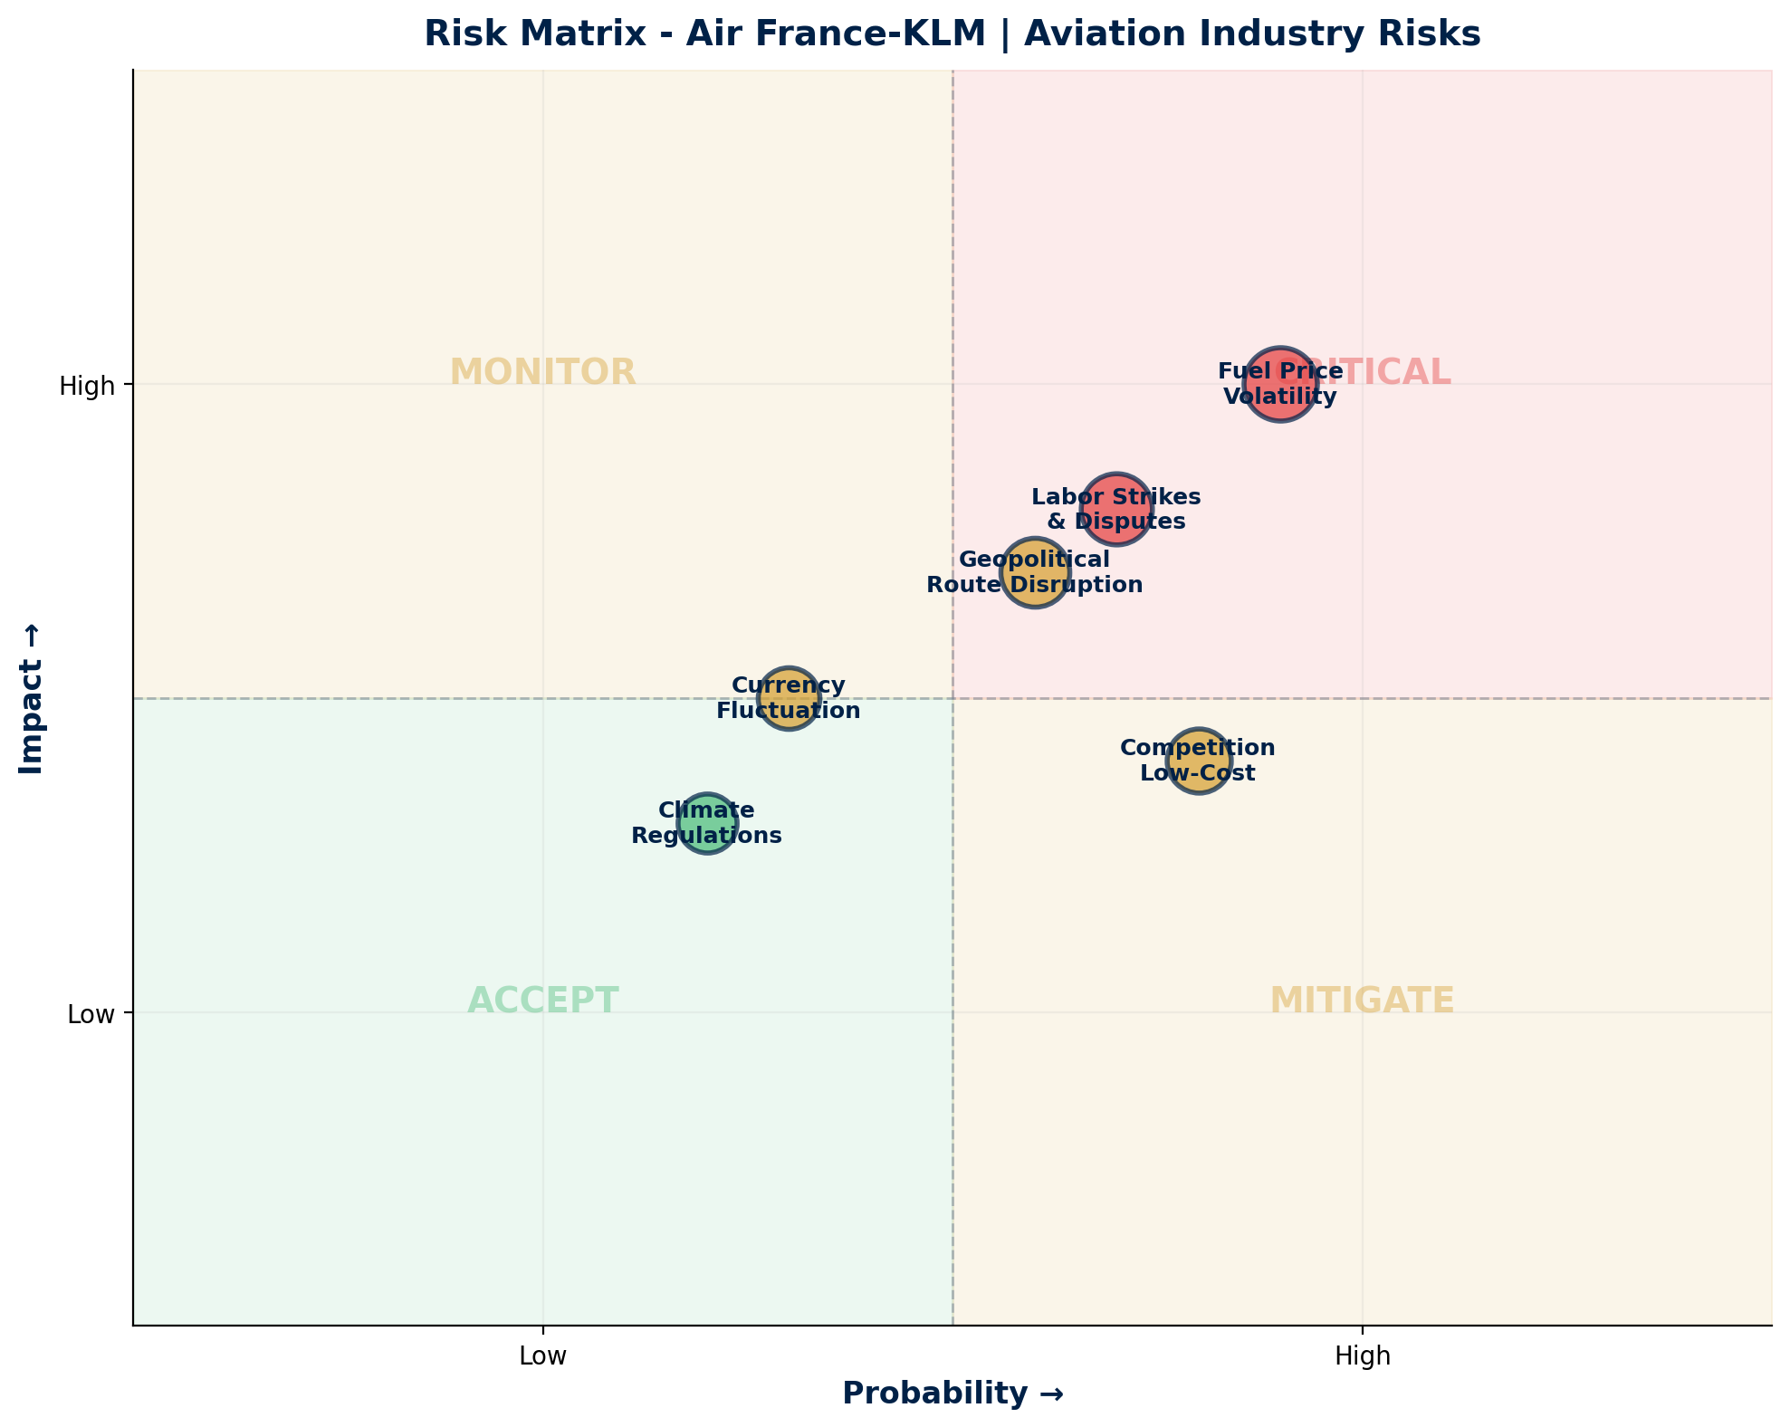
OPERATIONAL CAPABILITY + RISK ASSESSMENT
Strategic Timeline & Risk Matrix
Risk Summary Table
Fuel Price Volatility
Operational
HIGH
Major cost driver, volatile pricing
Labor Strikes & Disputes
Social
HIGH
2024 strikes disrupted operations
Geopolitical Route Risk
Geopolitical
MEDIUM
Middle East, Russia-Ukraine impact
Competition from Low-Cost
Commercial
MEDIUM
Ryanair, EasyJet pressure
Currency Fluctuation
Financial
MEDIUM
USD/EUR exposure on fuel
Climate Regulations
ESG
MEDIUM
SAF mandates, carbon taxes
Source: Manu Forti Intelligence | Confidential | March 2026

Slide 8
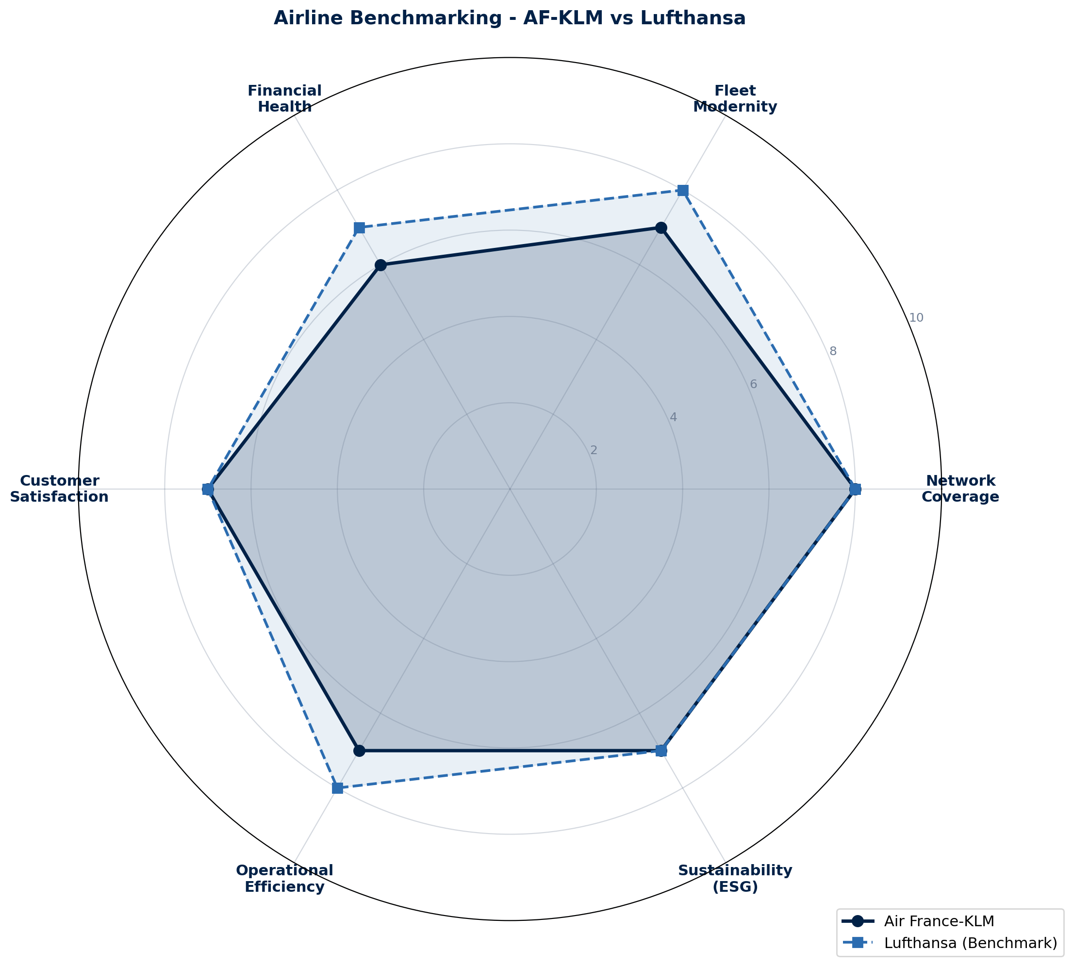
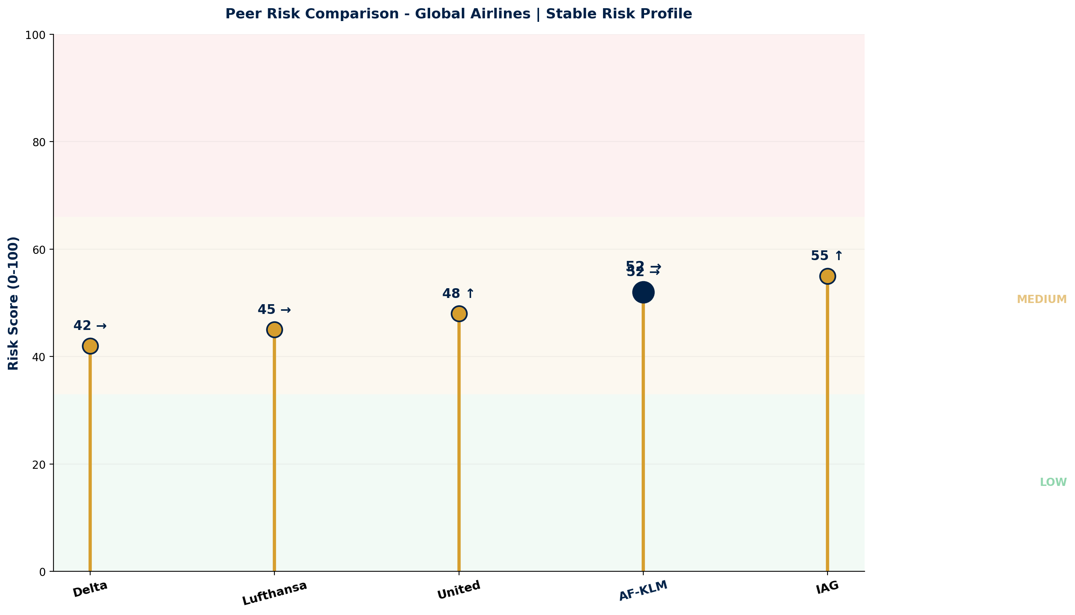
COMMERCIAL INTELLIGENCE + PEER RISK
Benchmarking & Competitive Analysis
Negotiation Leverage Assessment
Commercial Terms
• Buyer power: MODERATE (consolidated industry)
• Pricing: Competitive vs Lufthansa/IAG
• Corporate contracts: Volume = leverage
• Payment: 7-14 days (industry standard)
• Long-term agreements: Favorable terms
• Flexibility: Seasonal adjustments
• Fuel pass-through: Standard practice
• Loyalty: Flying Blue program benefits
Source: Manu Forti Intelligence | Confidential | March 2026

Slide 9
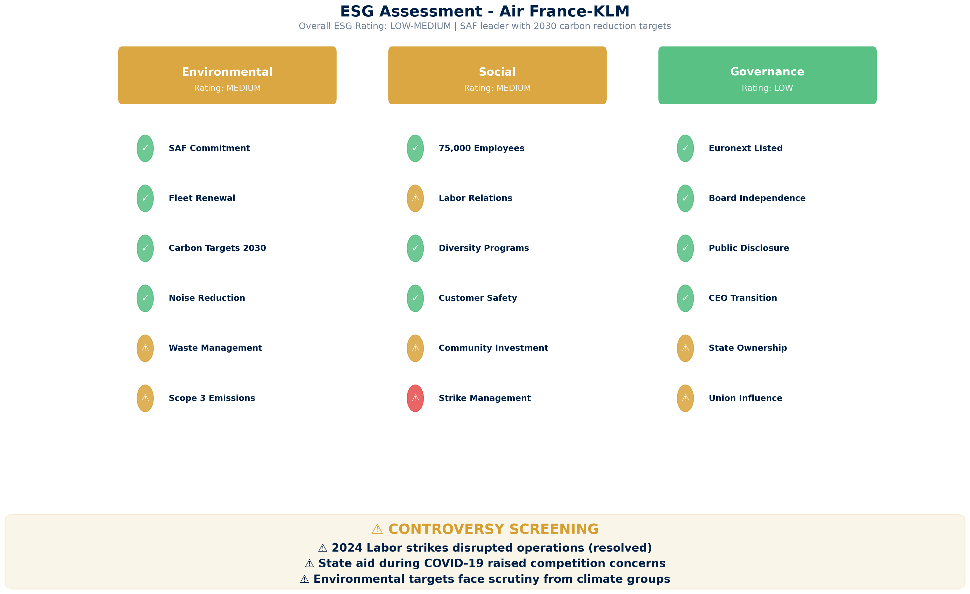
ESG ASSESSMENT
Environmental, Social & Governance Review
Source: Manu Forti Intelligence | Confidential | March 2026

