Slide 1

SUPPLIER EVALUATION REPORT
BN Engenharia
Construction / Engineering | São Paulo, Brazil | Founded 1975
R$750M Revenue | 152+ Projects | 201-500 Employees | Top 25 Brazil
Confidential | March 2026 | Manu Forti Intelligence

Slide 2
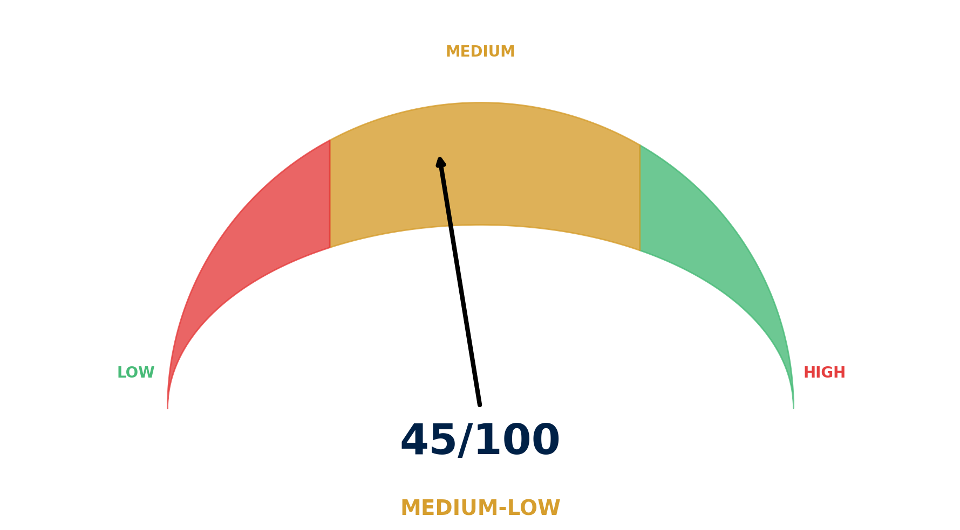
EXECUTIVE SUMMARY
BN Engenharia — Risk & Suitability Overview
SUPPLIER SNAPSHOT
Supplier:
BN Engenharia S.A.
Type:
Private Company
Sector:
Construction / Engineering
HQ:
São Paulo, Brazil
Founded:
March 1975
Employees:
201-500
Revenue:
R$750M (2024)
Parent:
Bueno Netto Group
Projects:
152+ delivered
Ranking:
Top 25 Brazil
Key Findings
• 50-year track record in Brazilian construction market
• Strong diversification: corporate, healthcare, renewable energy
• Revenue growth: 9% CAGR (2022-2024) reaching R$750M
• Entering infrastructure sector (sanitation, transmission lines)
Source: Manu Forti Intelligence | Confidential | March 2026

Slide 3
RECOMMENDATION
Decision Summary & Commercial Conditions
✓ RECOMMENDATION: APPROVE
BN Engenharia demonstrates solid financial performance, 50-year track record, and strong technical capabilities. Medium-low risk profile supports approval.
Commercial Conditions
Enhanced Due Diligence (Mandatory)
• Payment: Milestone-based with retention (5-10%)
• Verify current project portfolio and capacity
• Performance: Liquidated damages for delays
• Review financial statements (private company)
• Insurance: Contractor all-risk policy required
• Validate AQUA-HQE certifications
• Warranty: 5-year structural guarantee
• Assess infrastructure project experience
• Local Content: Brazilian labor and materials
• Confirm key personnel availability
Overall Risk Summary - MEDIUM-LOW (45/100)
Financial:
MEDIUM
Private company, limited disclosure
Operational:
LOW
50-year track record, 152+ projects
Geopolitical:
MEDIUM
Brazil economic volatility
ESG:
LOW-MED
Strong environmental focus
Source: Manu Forti Intelligence | Confidential | March 2026

Slide 4
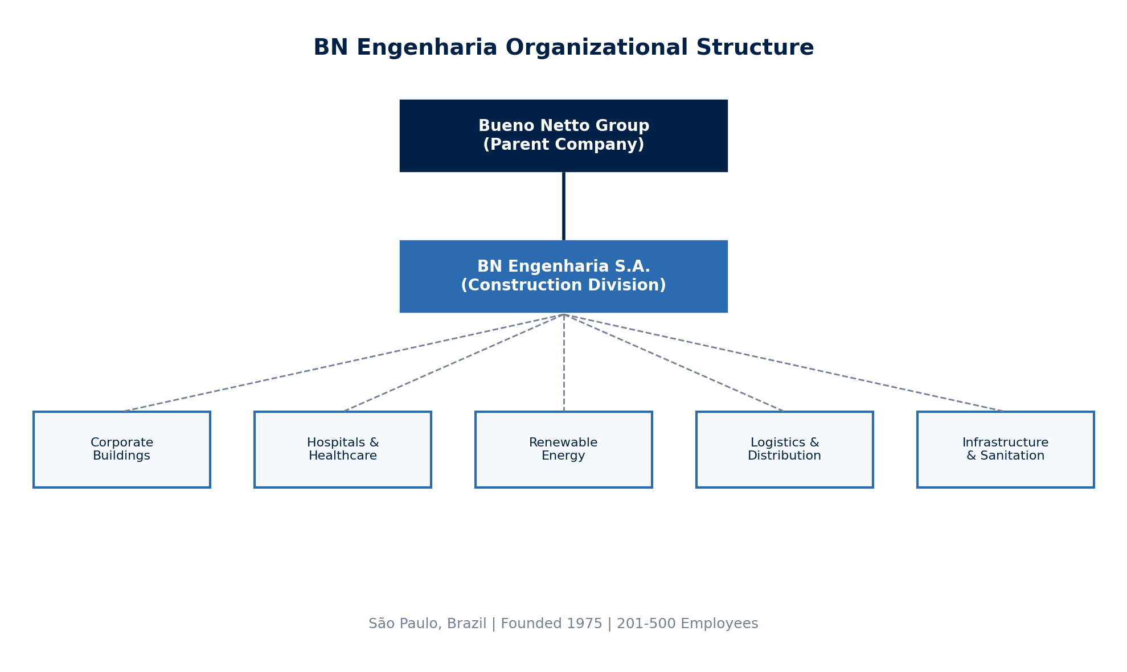
SUPPLIER PROFILE
Corporate Structure & Global Footprint
Company Overview
Leadership & Operations
• BN Engenharia is a leading Brazilian construction company
• CEO: João Antonio Mattei (General Director)
founded in 1975 under the Bueno Netto Group.
• Structure: Family-managed with partner-led decisions
• Specializes in corporate buildings, hospitals, renewable
• HQ: Avenida Doutor Cardoso De Melo, São Paulo
energy, logistics centers, and infrastructure.
• Employees: 201-500 | Projects: 152+ delivered
• Ranks among top 25 construction companies in Brazil.
Source: Manu Forti Intelligence | Confidential | March 2026

Slide 5
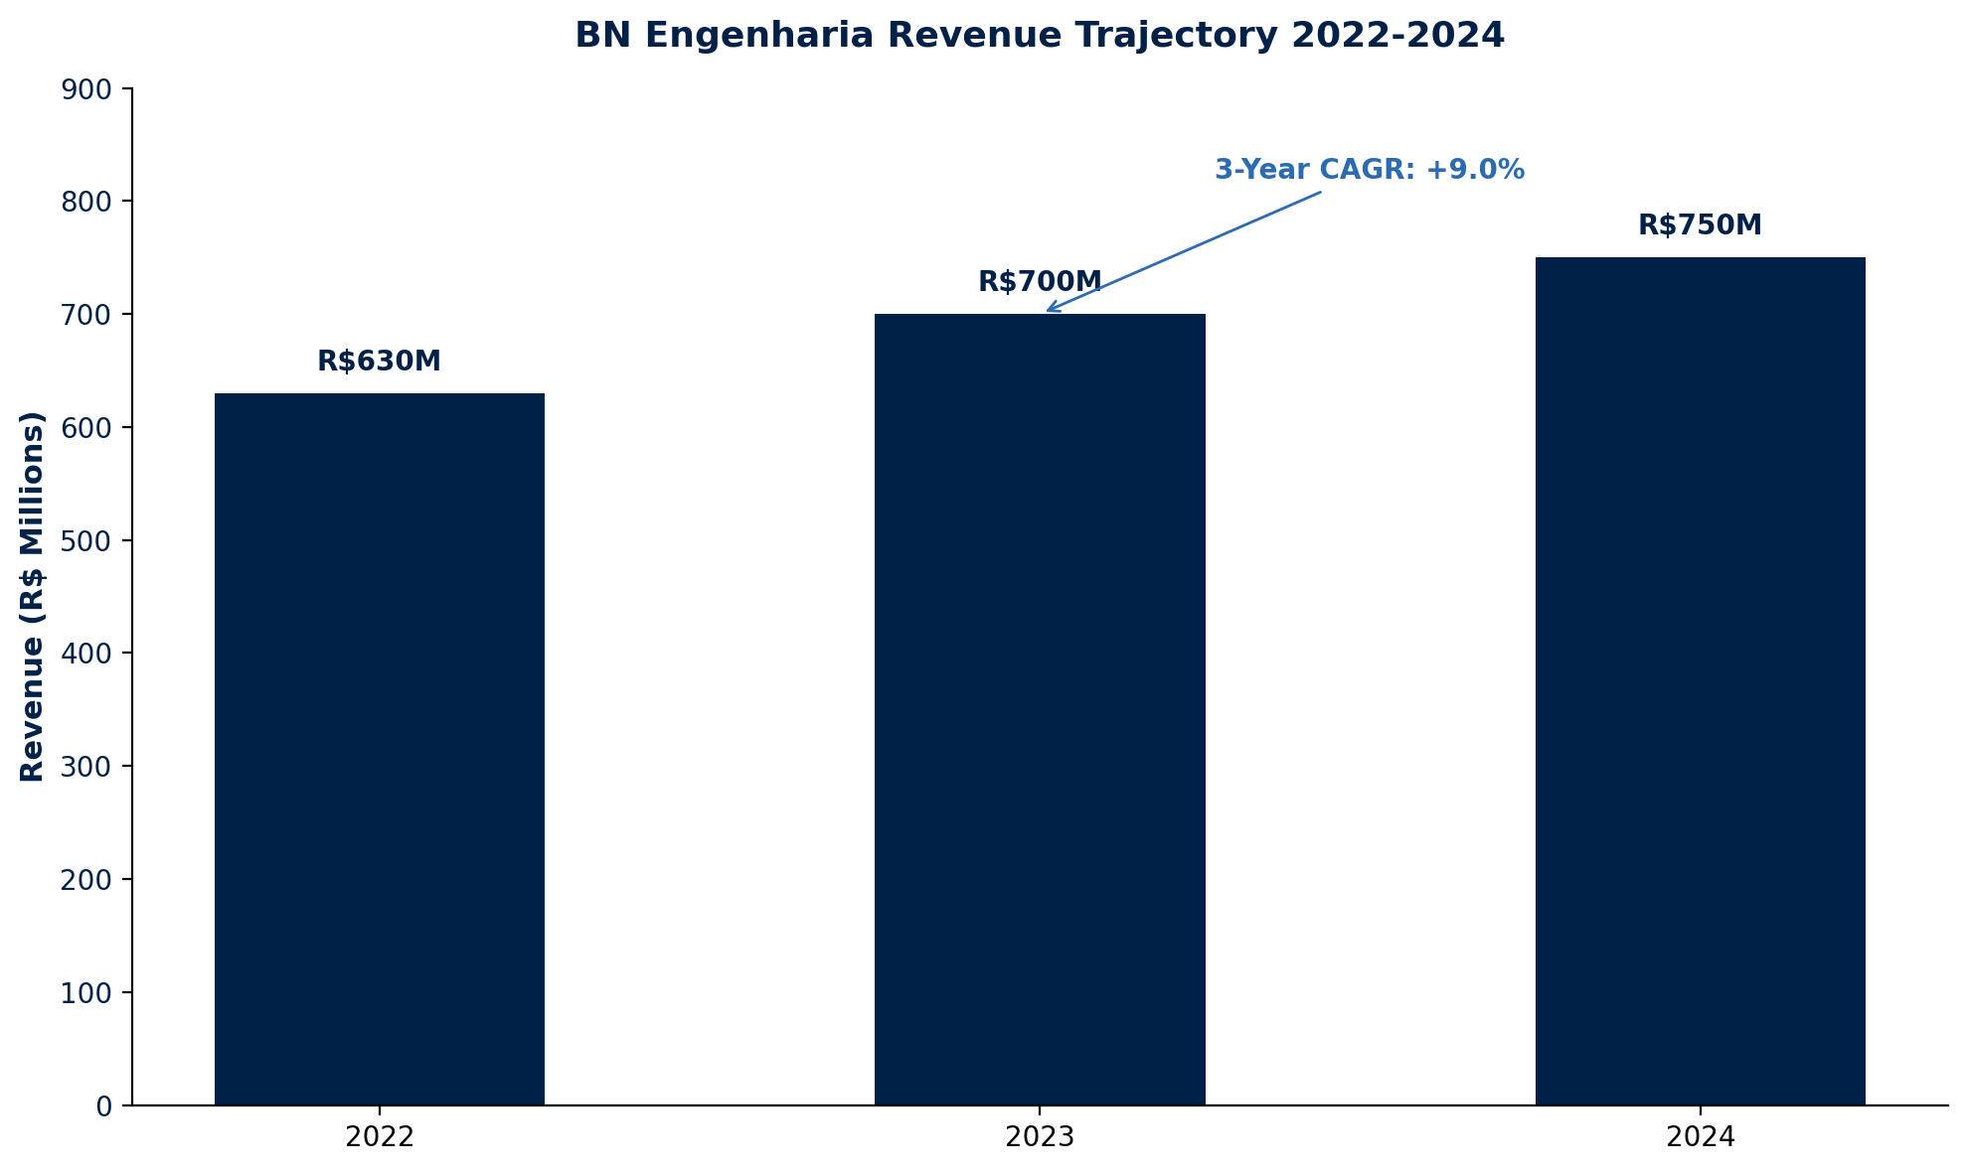
FINANCIAL HEALTH
Revenue Trajectory 2022-2024 | Private Company
Financial Highlights
2024 Revenue:
R$750M
2023 Revenue:
R$700M
Revenue Growth:
+7.1% YoY
3-Year CAGR:
+9.0%
2022 Revenue:
R$630M
Order Book:
Strong pipeline
Ownership:
Bueno Netto Group
Company Type:
Private (S.A.)
Employees:
201-500
Projects:
152+ delivered
Financial Risk: MEDIUM ⚠
Exposure Guidance
• Private company with limited financial disclosure
• Strong revenue growth trajectory (9% CAGR)
• Part of established Bueno Netto Group
• Request financial statements for major contracts
Source: Manu Forti Intelligence | Confidential | March 2026

Slide 6
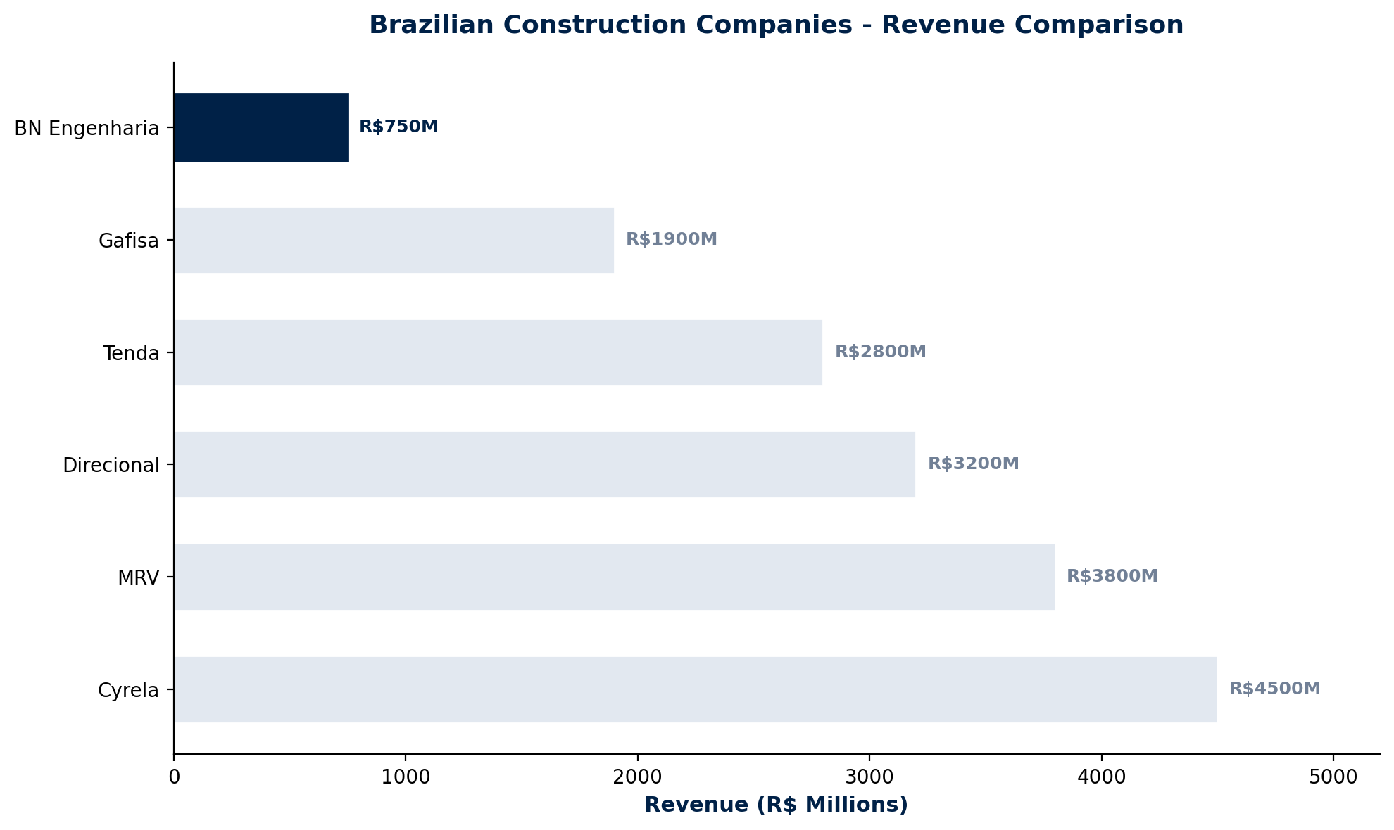
MARKET POSITION
Brazilian Construction Sector Comparison
COMPETITIVE CONTEXT
BN Engenharia is a mid-tier player in the
Brazilian construction market with R$750M
revenue, significantly smaller than major
publicly traded competitors.
Key Strengths:
• Specialized expertise (healthcare, solar)
• Agility from family-managed structure
• 50-year reputation and relationships
• Diversified across multiple segments
Key Challenges:
• Scale vs major competitors
• Limited financial transparency
• Geographic concentration (Brazil)
Source: Manu Forti Intelligence | Confidential | March 2026

Slide 7
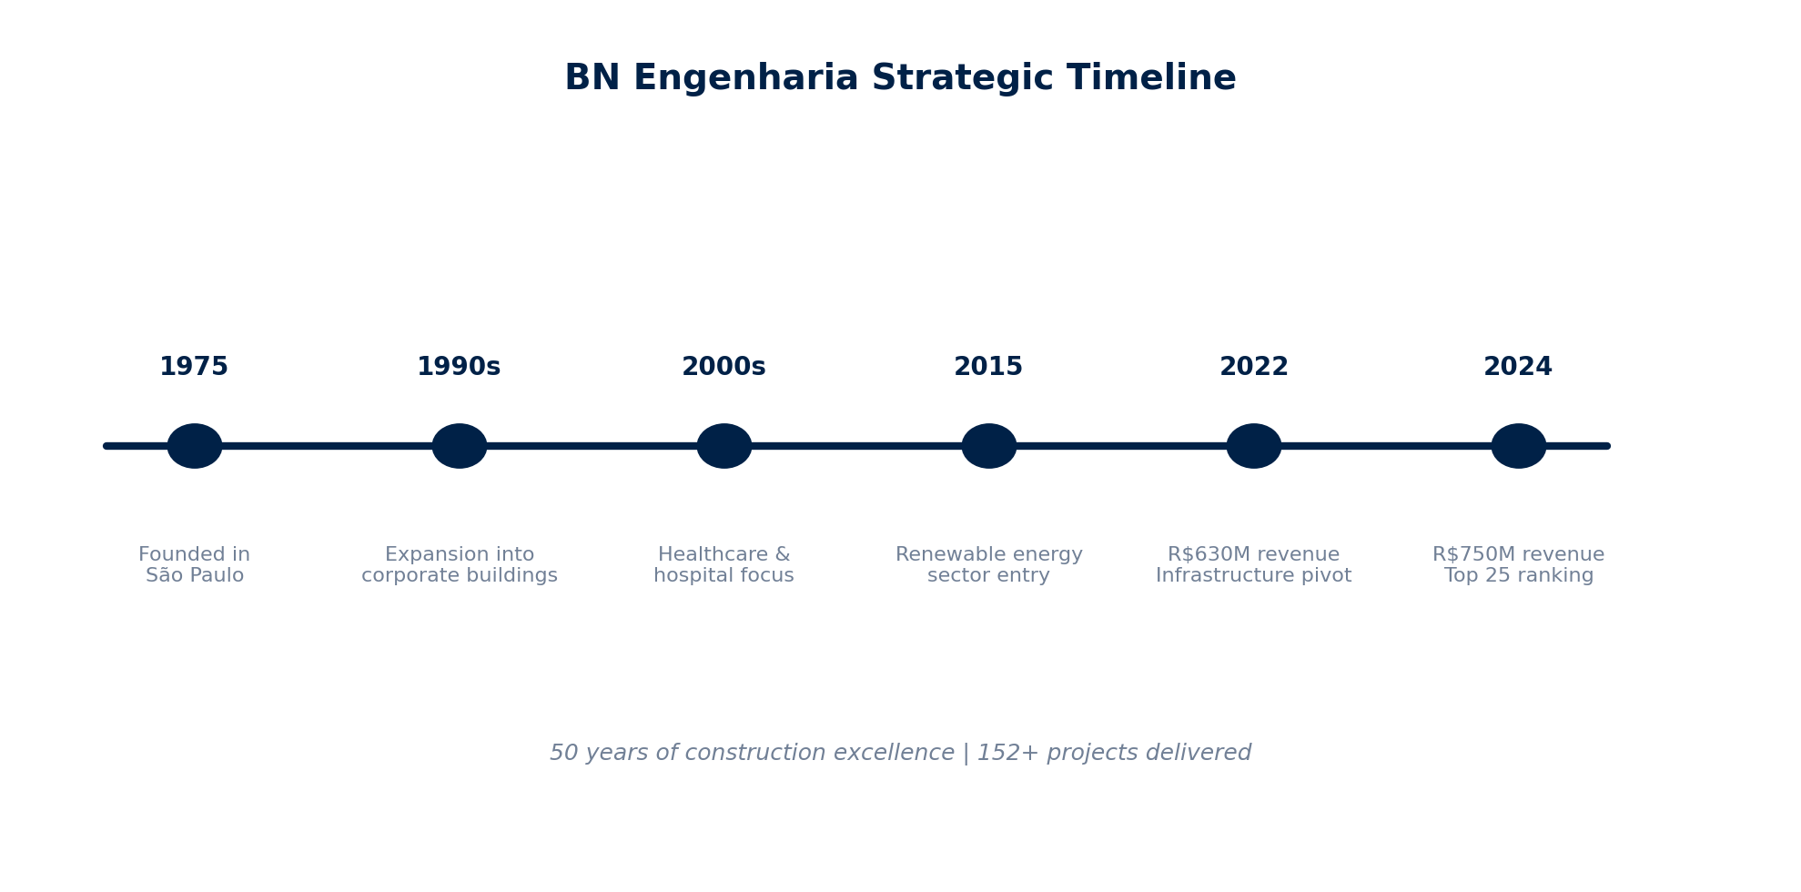
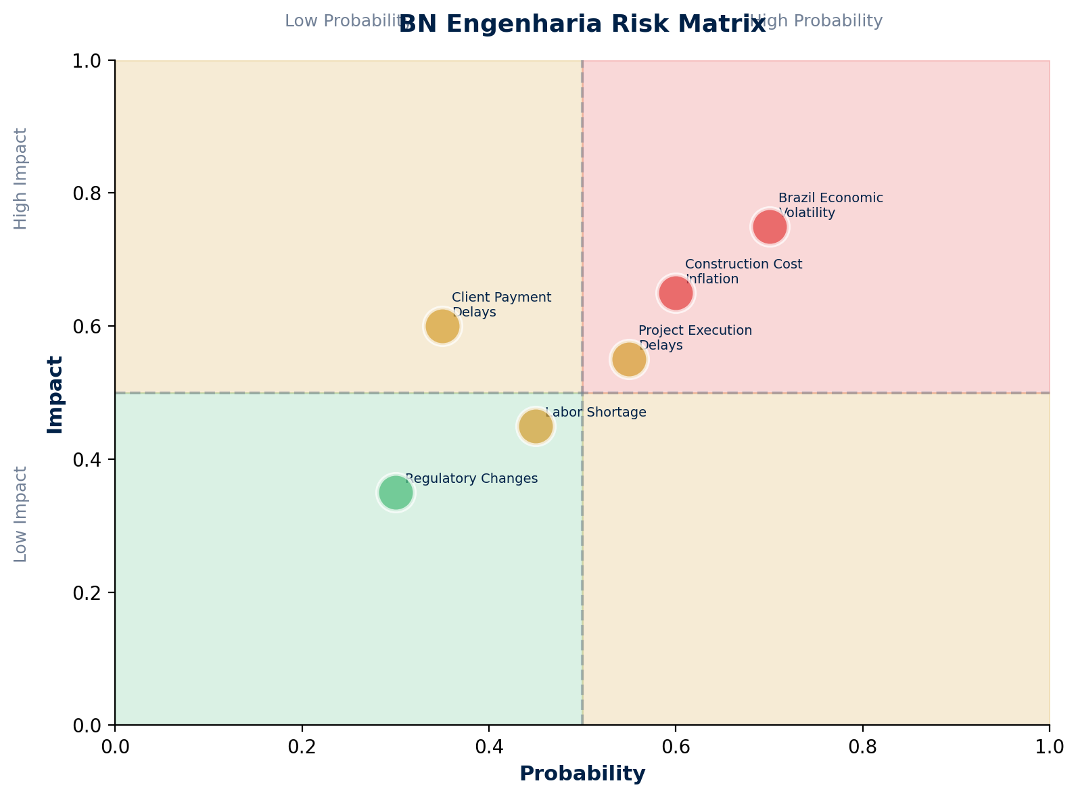
OPERATIONAL CAPABILITY + RISK ASSESSMENT
Strategic Timeline & Risk Matrix
Risk Summary Table
Brazil Economic Volatility
Geopolitical
HIGH
Interest rates, inflation impact
Construction Cost Inflation
Operational
HIGH
Material and labor cost increases
Project Execution Delays
Operational
MEDIUM
Weather, permitting, subcontractor issues
Client Payment Delays
Financial
MEDIUM
Cash flow impact from late payments
Labor Shortage
Social
MEDIUM
Skilled construction worker availability
Regulatory Changes
Geopolitical
LOW
Building codes, environmental rules
Source: Manu Forti Intelligence | Confidential | March 2026

Slide 8
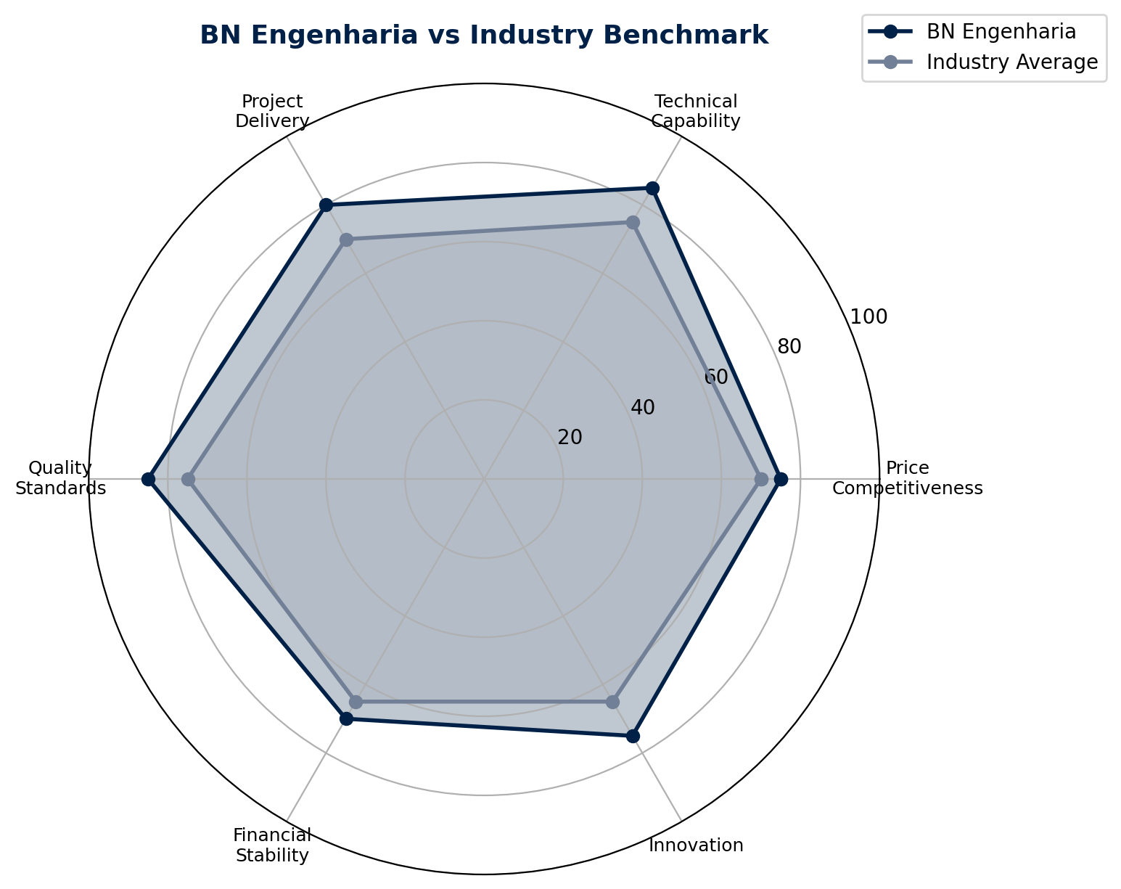
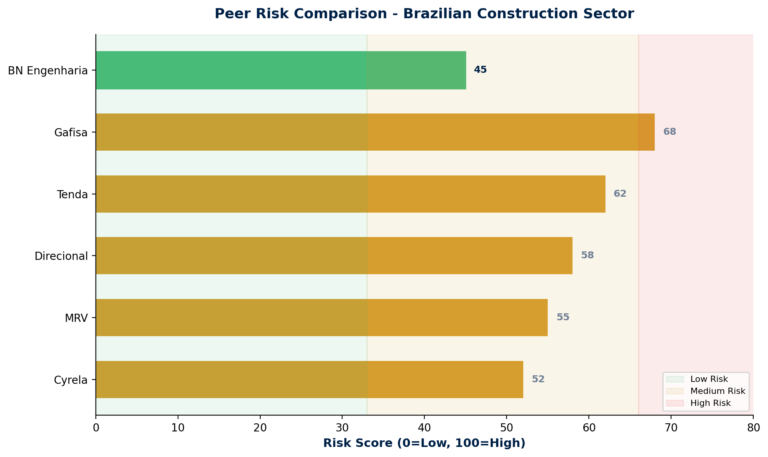
COMMERCIAL INTELLIGENCE + PEER RISK
Benchmarking & Competitive Analysis
Negotiation Leverage Assessment
Commercial Terms
• Buyer power: MODERATE (specialized expertise)
• Pricing: Competitive vs larger players
• Volume leverage: Limited at R$750M scale
• Payment: Milestone-based standard
• Alternative suppliers: Available (Cyrela, MRV)
• Flexibility: Good for specialized projects
• Long-term agreements: Favorable terms possible
• Quality: AQUA-HQE certified projects
Source: Manu Forti Intelligence | Confidential | March 2026

Slide 9
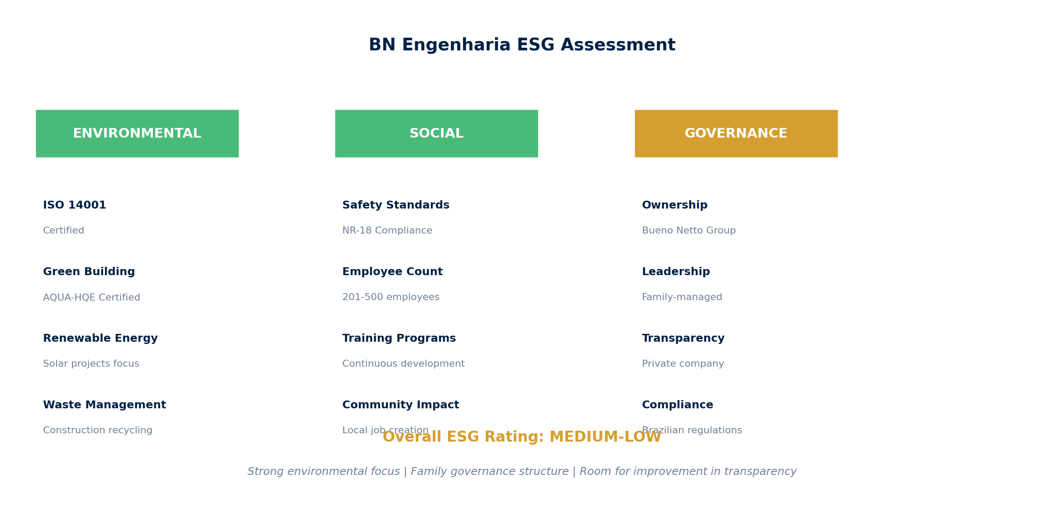
ESG ASSESSMENT
Environmental, Social & Governance Review
Source: Manu Forti Intelligence | Confidential | March 2026

