Slide 1

SUPPLIER EVALUATION REPORT
ControlPartner AS
Industrial Automation | SCADA Systems | Water/Wastewater
NOK 57.3M Revenue | 40-46 Employees | Norway | Uniwater Subsidiary
Confidential | March 2026 | Manu Forti Intelligence

Slide 2
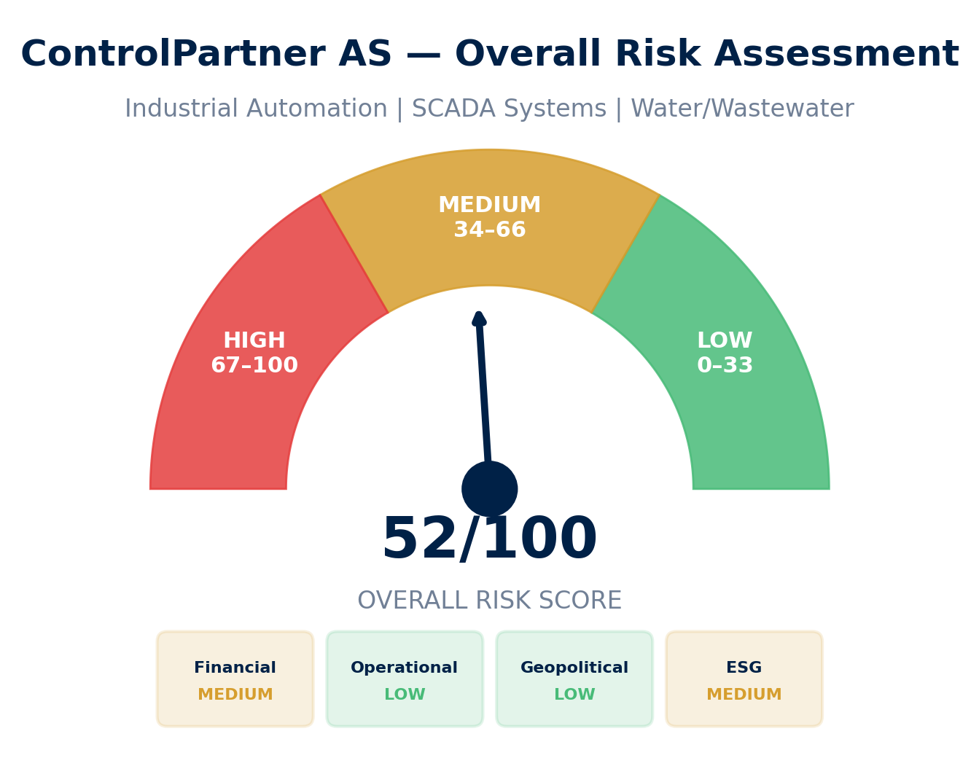
EXECUTIVE SUMMARY
ControlPartner AS — Risk & Suitability Overview
SUPPLIER SNAPSHOT
Supplier:
ControlPartner AS
Type:
Private (Uniwater subsidiary)
Sector:
Industrial Automation / SCADA
HQ:
Porsgrunn, Norway
Founded:
2015
Revenue:
NOK 57.3M (2023)
EBITDA:
NOK 5.2M (9.1% margin)
Order Book:
N/A (private)
Employees:
40-46
Parent:
Uniwater AB (Sweden)
Key Findings
• Niche Norwegian automation specialist with steady 2021-2023 growth trajectory
• Acquired by Uniwater AB in October 2025 — now part of Nordic water tech group
• Limited public financial data as private subsidiary — governance integration ongoing
• ESG flag: MEDIUM rating due to limited disclosure and recent ownership change
Source: Manu Forti Intelligence | Confidential | March 2026

Slide 3
RECOMMENDATION
Decision Summary & Commercial Conditions
⚠ RECOMMENDATION: CONDITIONAL APPROVAL — ENHANCED DUE DILIGENCE REQUIRED
ControlPartner is a technically capable Norwegian automation specialist with water/wastewater expertise. However, significant data limitations due to private subsidiary status and recent Uniwater acquisition (October 2025) require enhanced due diligence before engagement.
Commercial Conditions
• Payment: Letter of Credit required (no open account)
• Performance bonds: 15% of contract value (above standard)
• Force-majeure: Explicit geopolitical/sanctions clause
• Uniwater parent guarantee for contracts >NOK 5M
• Local entity contracting preferred
Enhanced Due Diligence (Mandatory)
• Request 2024 financials post-Uniwater acquisition
• Verify Uniwater AB creditworthiness and governance
• Supply chain audit: Norwegian labour standards
• Confirm key personnel retention post-acquisition
• Request latest ISO certifications
• Annual financial disclosure as contract condition
Overall Risk Summary — MEDIUM (52/100)
Financial: MEDIUM
Operational: LOW
Geopolitical: LOW
ESG: MEDIUM
Private; limited disclosure; Uniwater backing
Proven SCADA expertise; Norwegian standards
Norwegian-based; stable jurisdiction
Limited public disclosure; recent acquisition
Source: Manu Forti Intelligence | Confidential | March 2026

Slide 4
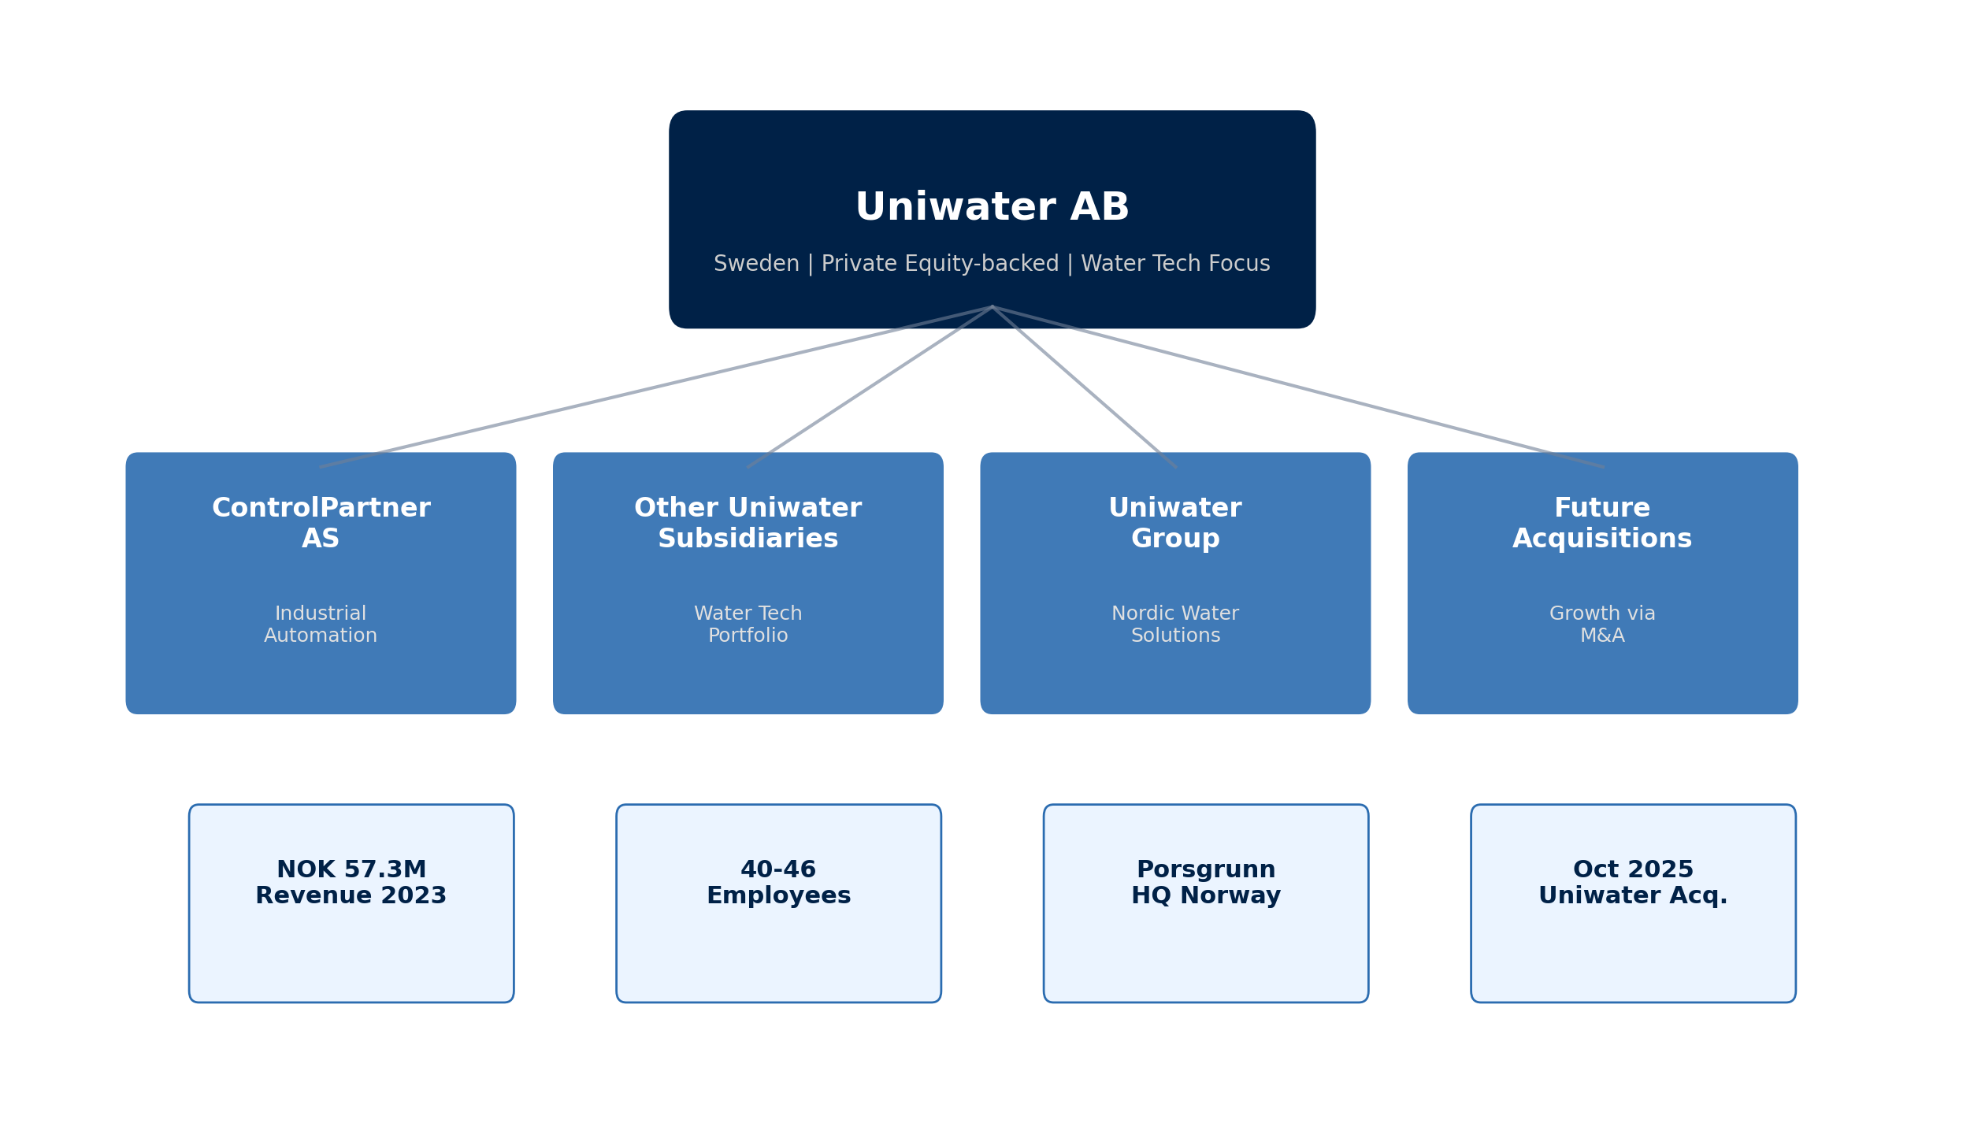
SUPPLIER PROFILE
Corporate Structure & Global Footprint
Company Overview
• ControlPartner AS is a Norwegian industrial
• automation company founded in 2015 in
• Porsgrunn. Specializes in SCADA systems,
• process control, and automation solutions
• for water/wastewater and industrial clients.
•
• Acquired by Uniwater AB (Sweden) in
• October 2025 — 5th Uniwater acquisition
• in 2025. Now part of Nordic water tech group.
Leadership
• Management team retained post-acquisition
• Uniwater integration ongoing
•
• Key: Norwegian operations with Swedish
• parent company oversight
•
• HQ: Porsgrunn, NO | Founded: 2015
Source: Manu Forti Intelligence | Confidential | March 2026

Slide 5
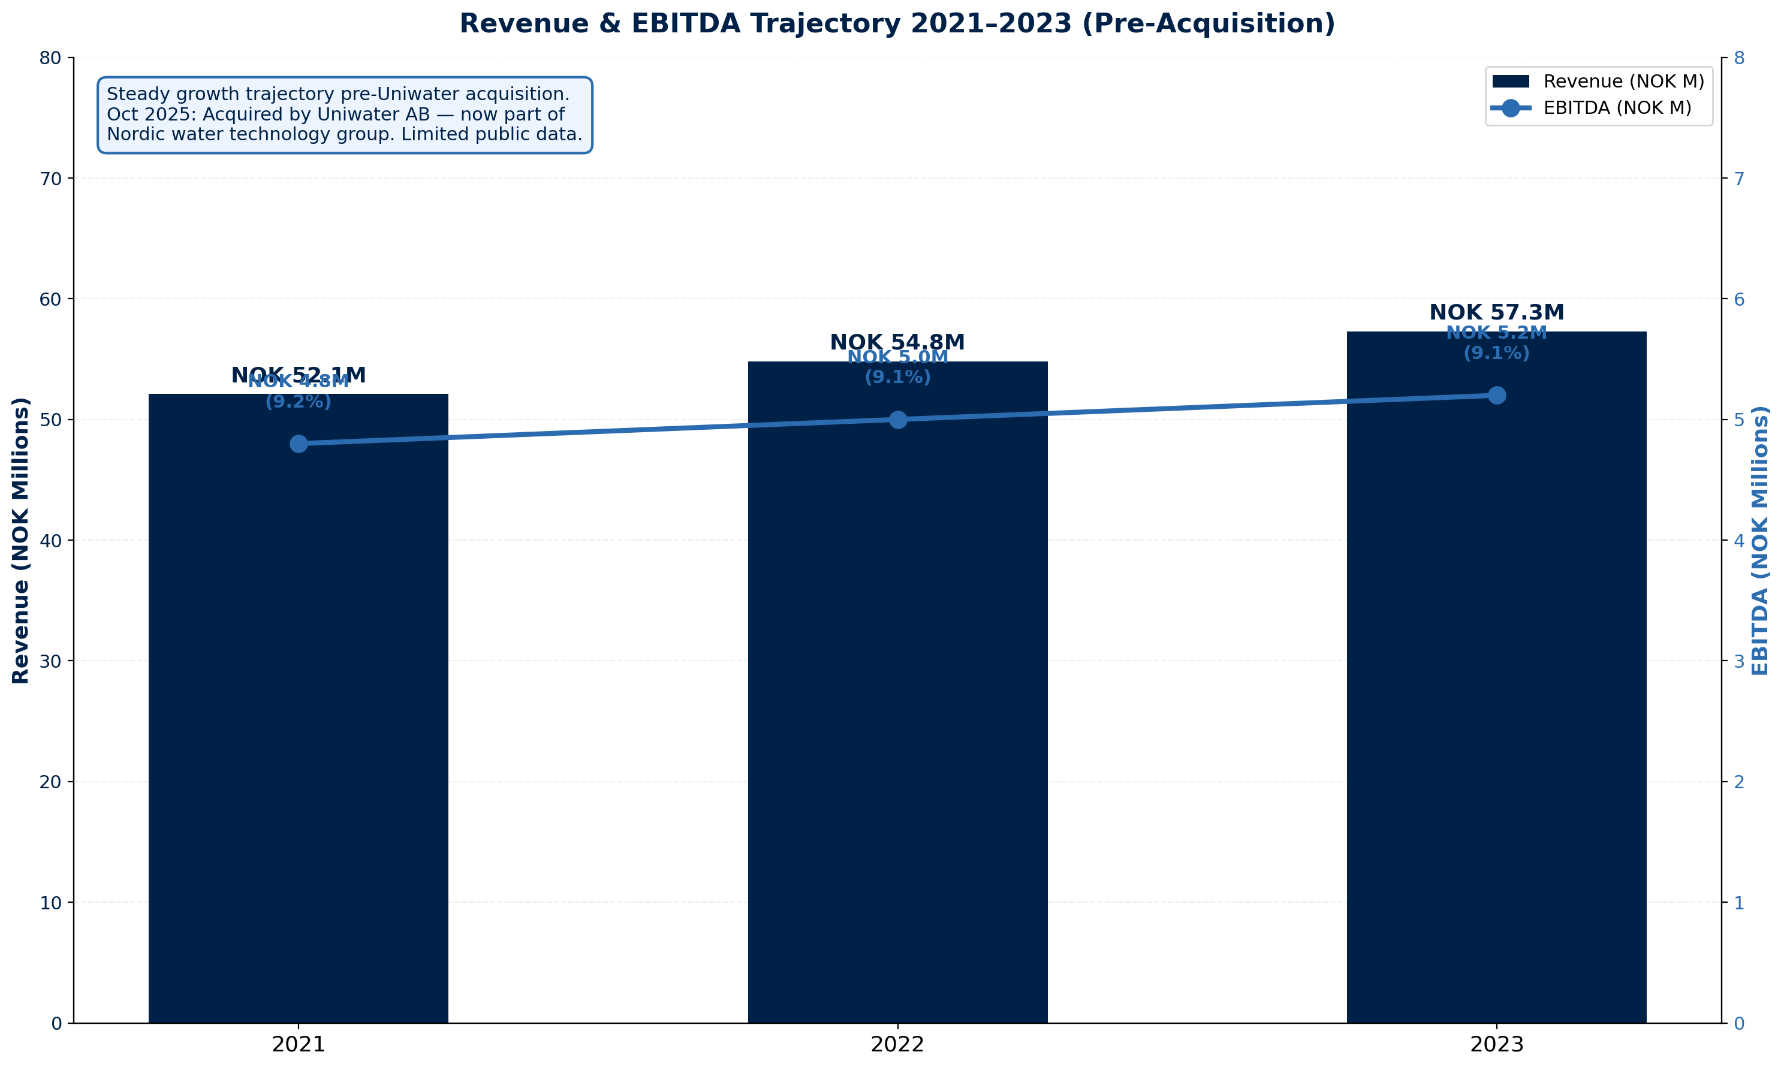
FINANCIAL HEALTH
Revenue & EBITDA Trajectory 2021–2023 (Pre-Acquisition) | Limited Post-Acquisition Data
Financial Highlights
2023 Revenue:
NOK 57.3M (+4.6% YoY)
2023 EBITDA:
NOK 5.2M (9.1% margin)
2023 Operating:
NOK 5.2M (pre-acquisition)
3yr Revenue CAGR:
+5.0% (2021–2023)
Order Book:
N/A (private subsidiary)
Gross Debt:
N/A (Uniwater consolidated)
Net Cash Position:
N/A (no disclosure)
Debt / EBITDA:
N/A (no data)
Financial Risk: MEDIUM ⚠
Exposure Guidance
• Private subsidiary — limited financial disclosure
• Uniwater AB backing provides parent support
• Letter of Credit mandatory; no open account
• Request 2024 audited financials before award
Source: Manu Forti Intelligence | Confidential | March 2026

Slide 6
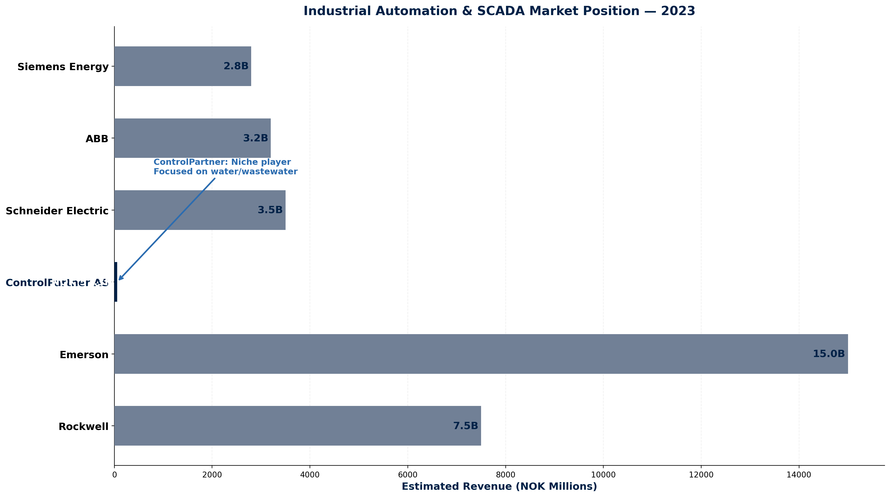
MARKET POSITION
Industrial Automation & SCADA Market Position — 2023
Competitive Landscape
• ControlPartner is a niche player in the
• Norwegian industrial automation market.
• Competes with global giants through
• specialization in water/wastewater SCADA
• and local Norwegian expertise.
ControlPartner Competitive Advantages
• Water/wastewater SCADA specialization
• Norwegian market knowledge and relationships
• Local service and support capability
• Integration with Nordic water infrastructure
• Uniwater group synergies (post-acquisition)
• Agile compared to global competitors
Key Competitors
• ABB — Switzerland — NOK 3.2B Norway — Global automation leader
• Siemens Energy — Germany — NOK 2.8B Norway — Diversified industrial
• Schneider Electric — France — NOK 3.5B Norway — Energy management
• Emerson — USA — NOK 15B global — Process automation
Source: Manu Forti Intelligence | Confidential | March 2026

Slide 7
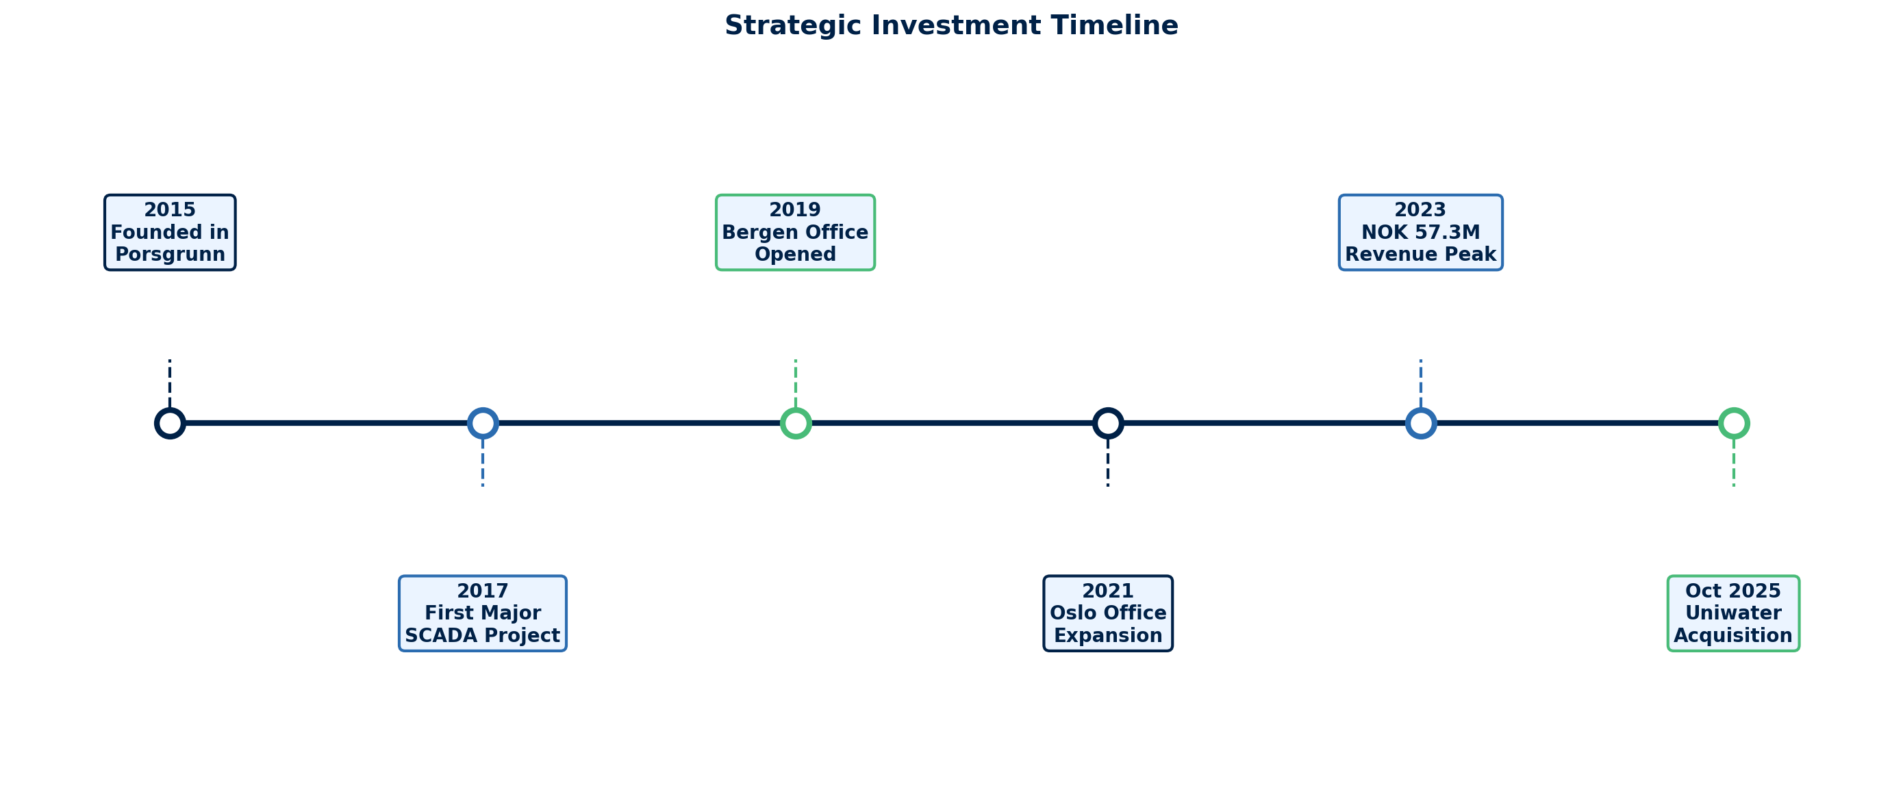
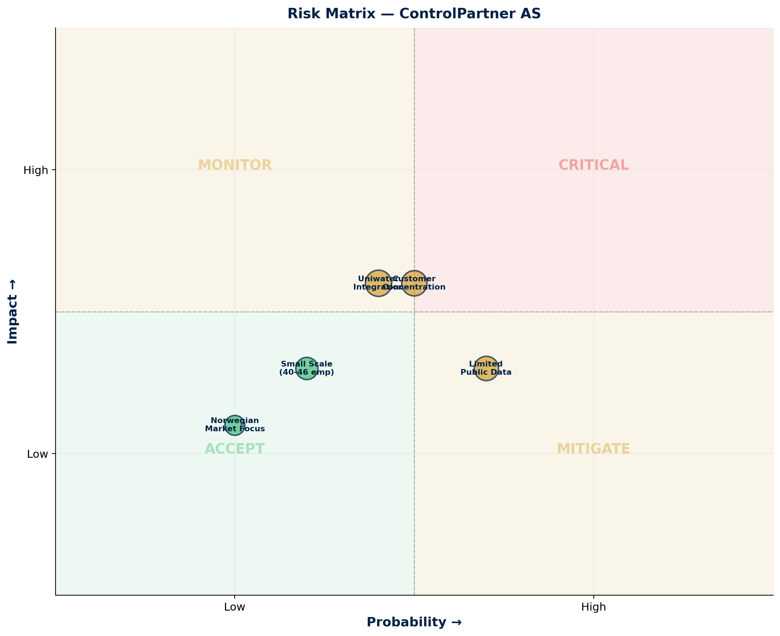
OPERATIONAL CAPABILITY & RISK ASSESSMENT
Milestones & Strategic Investment | Risk Matrix | Capability Summary
Risk Summary
Key Capabilities
• SCADA system design and implementation
• Process control and automation
• Water/wastewater sector expertise
• Norwegian regulatory compliance
Financial:
🟡 MEDIUM
Private; limited disclosure; Uniwater backing
Geopolitical:
🟢 LOW
Norway-based; stable jurisdiction
Uniwater Integration:
🟡 MEDIUM
Recent acquisition; governance alignment
Customer Concentration:
🟡 MEDIUM
Niche market; limited diversification
Delivery:
🟢 LOW
Proven execution; Norwegian standards
Source: Manu Forti Intelligence | Confidential | March 2026

Slide 8
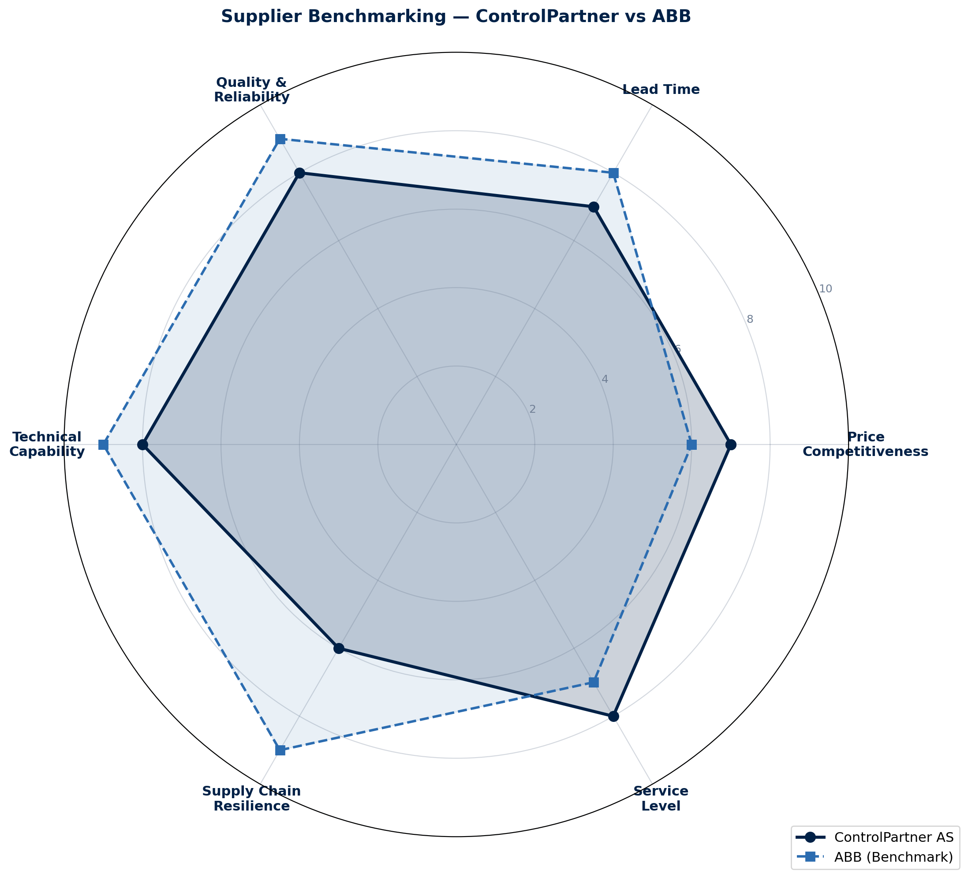
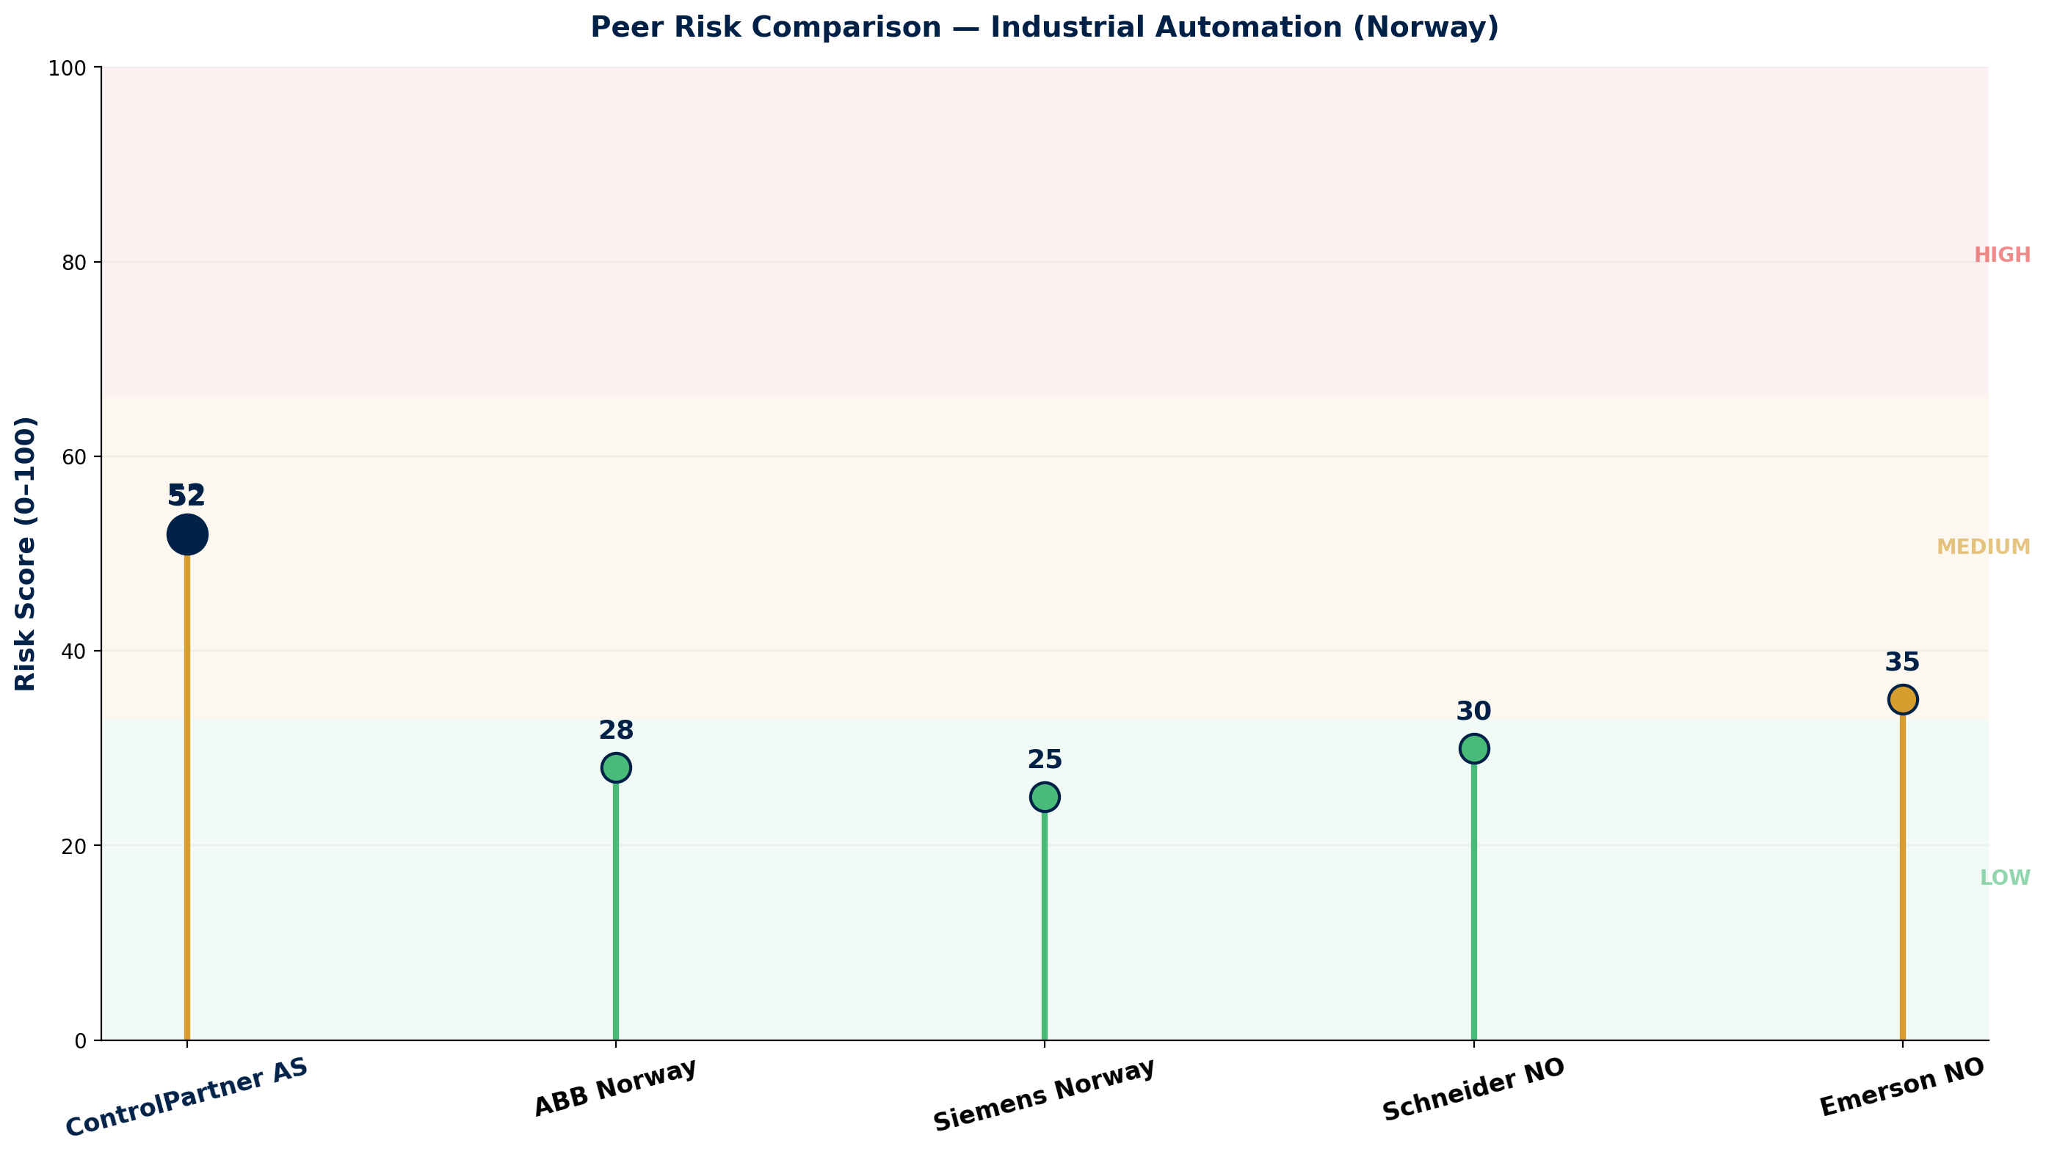
COMMERCIAL INTELLIGENCE & PEER RISK COMPARISON
Benchmarking Radar | Peer Risk Profile | Commercial Terms
Commercial Terms & Negotiation
• Pricing: Competitive vs global players on local projects
• Lead time: 4–8 weeks for standard SCADA components
• Payment: Letter of Credit mandatory — no open account
• Leverage: Multi-year service agreements for discount
Key Watch Points
• ⚠ Request 2024 financials post-Uniwater acquisition
• ⚠ Confirm key personnel retention post-acquisition
• ⚠ Verify Uniwater AB creditworthiness
• ⚠ Monitor integration progress with parent company
Source: Manu Forti Intelligence | Confidential | March 2026

Slide 9
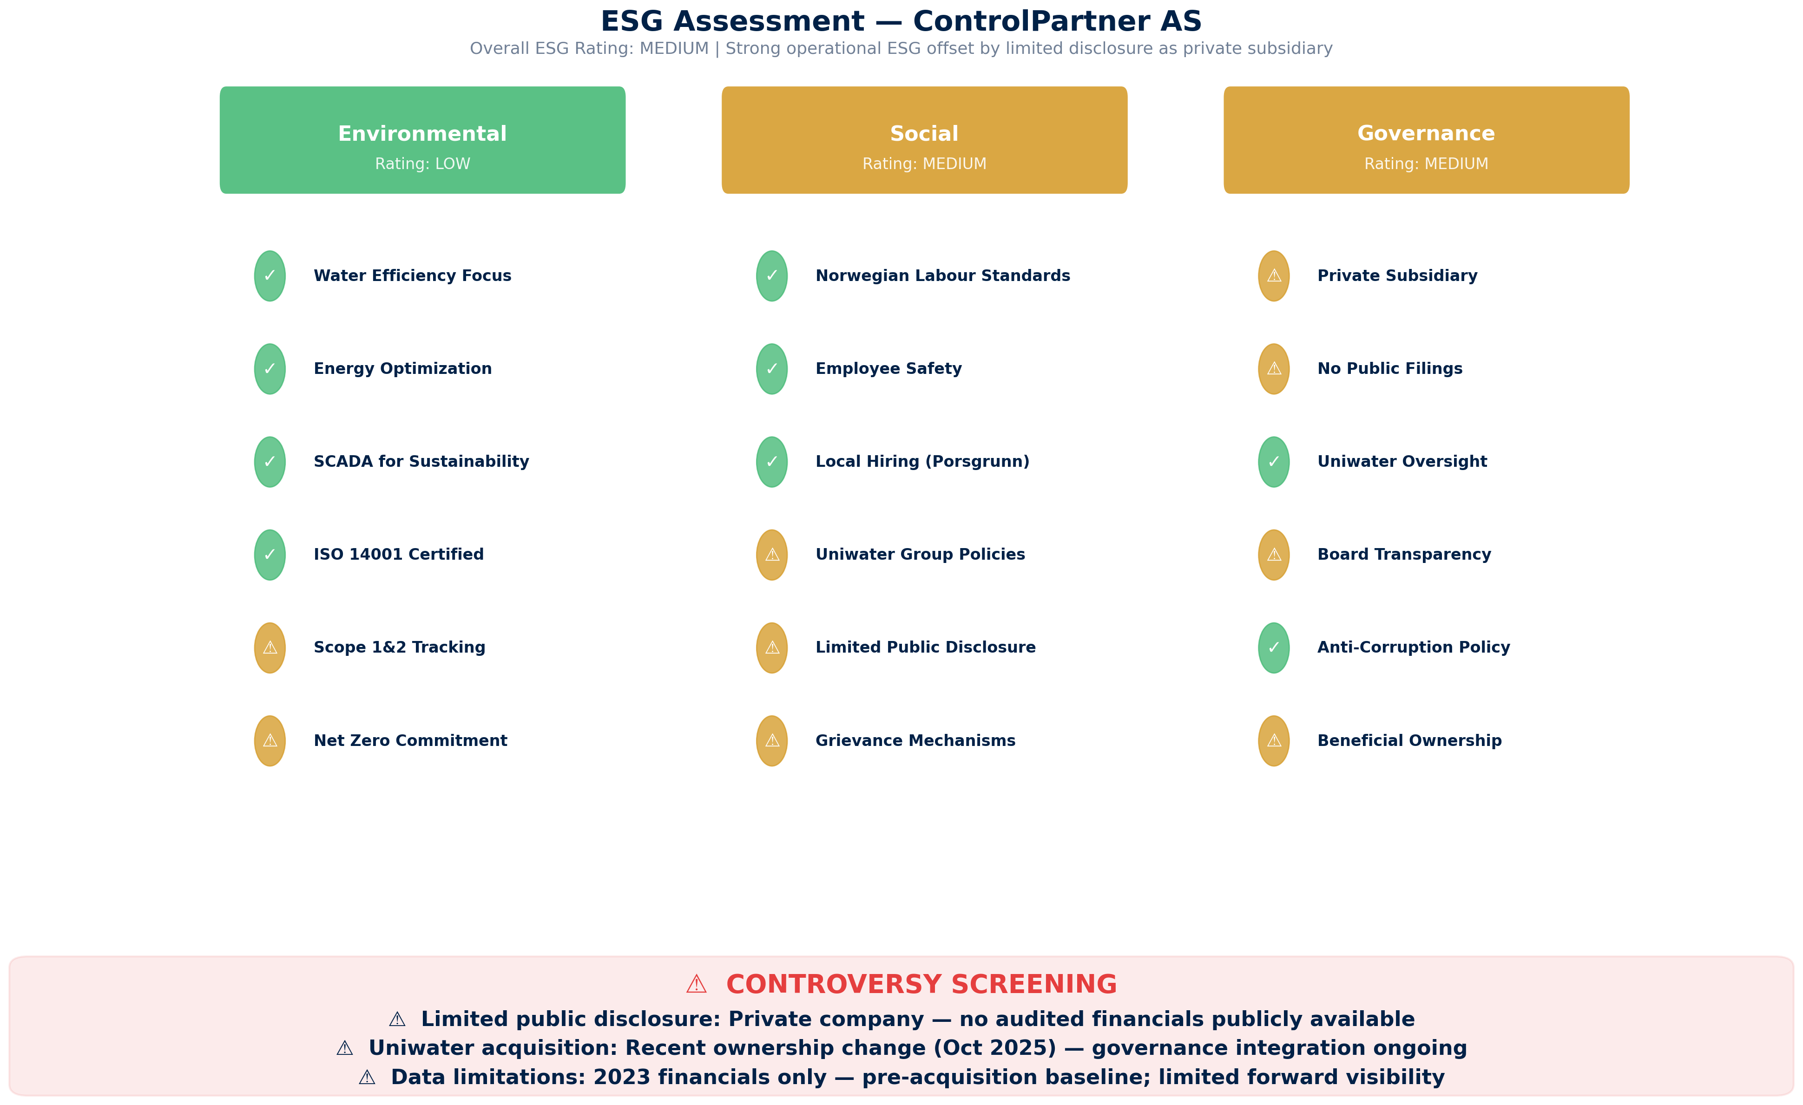
ESG ASSESSMENT
Environmental, Social & Governance Screening | Overall Rating: MEDIUM
Source: Manu Forti Intelligence | Confidential | March 2026

