Slide 1
Form Energy
Form Energy Inc.
Supplier Evaluation Report
Long-Duration Energy Storage / Iron-Air Battery Technology
$1.52B Funding Raised | 100+ Hour Storage | Pre-Revenue | ~400 Employees
Source: Manu Forti Intelligence | Confidential | March 2026
⚡ Manu Forti

Slide 2
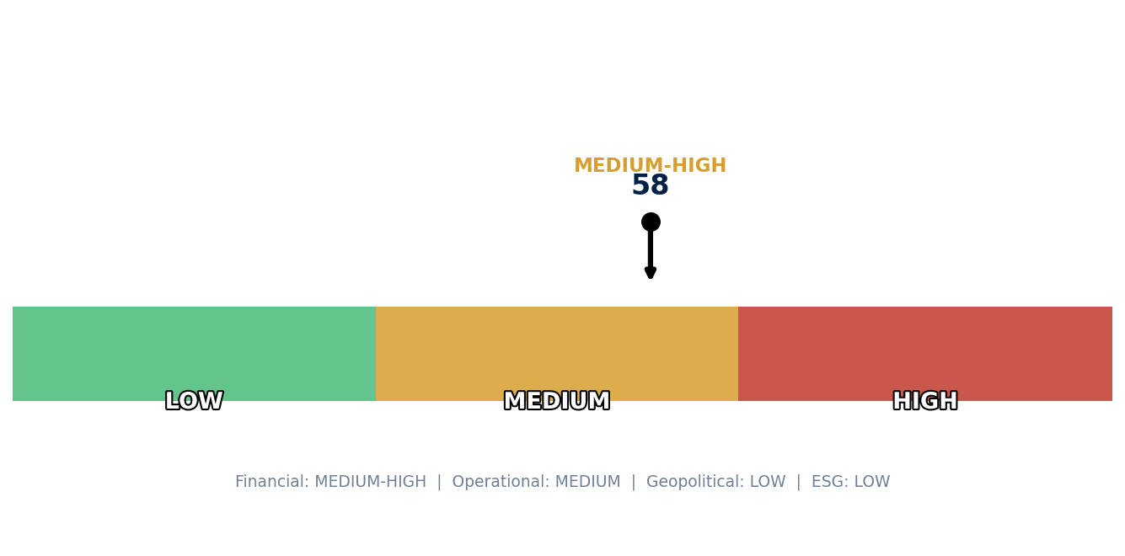
Form Energy
EXECUTIVE SUMMARY
Key Insight
Form Energy is the leading iron-air battery developer with breakthrough 100-hour storage technology. Strong investor backing ($1.52B) and major utility contracts position it well, but pre-revenue status and manufacturing scale-up risks are significant. First-mover advantage in multi-day storage is substantial.
Risk Summary: Financial MEDIUM-HIGH | Operational MEDIUM | Geopolitical LOW | ESG LOW
Source: Manu Forti Intelligence | Confidential | March 2026
⚡ Manu Forti

Slide 3
Form Energy
RECOMMENDATION
APPROVE with CONDITIONS
Conditions for Approval:
1. Verify manufacturing facility construction timeline (Weirton, WV)
2. Confirm Google contract execution milestones (2025-2027)
3. Require performance guarantees on first commercial deployments
4. Obtain financial covenant for contracts >$50M
5. Establish technical escrow for IP continuity
6. Monitor Series D funding progress (if required for scale-up)
Risk Summary: Financial MEDIUM-HIGH | Operational MEDIUM | Geopolitical LOW | ESG LOW
Source: Manu Forti Intelligence | Confidential | March 2026
⚡ Manu Forti

Slide 4
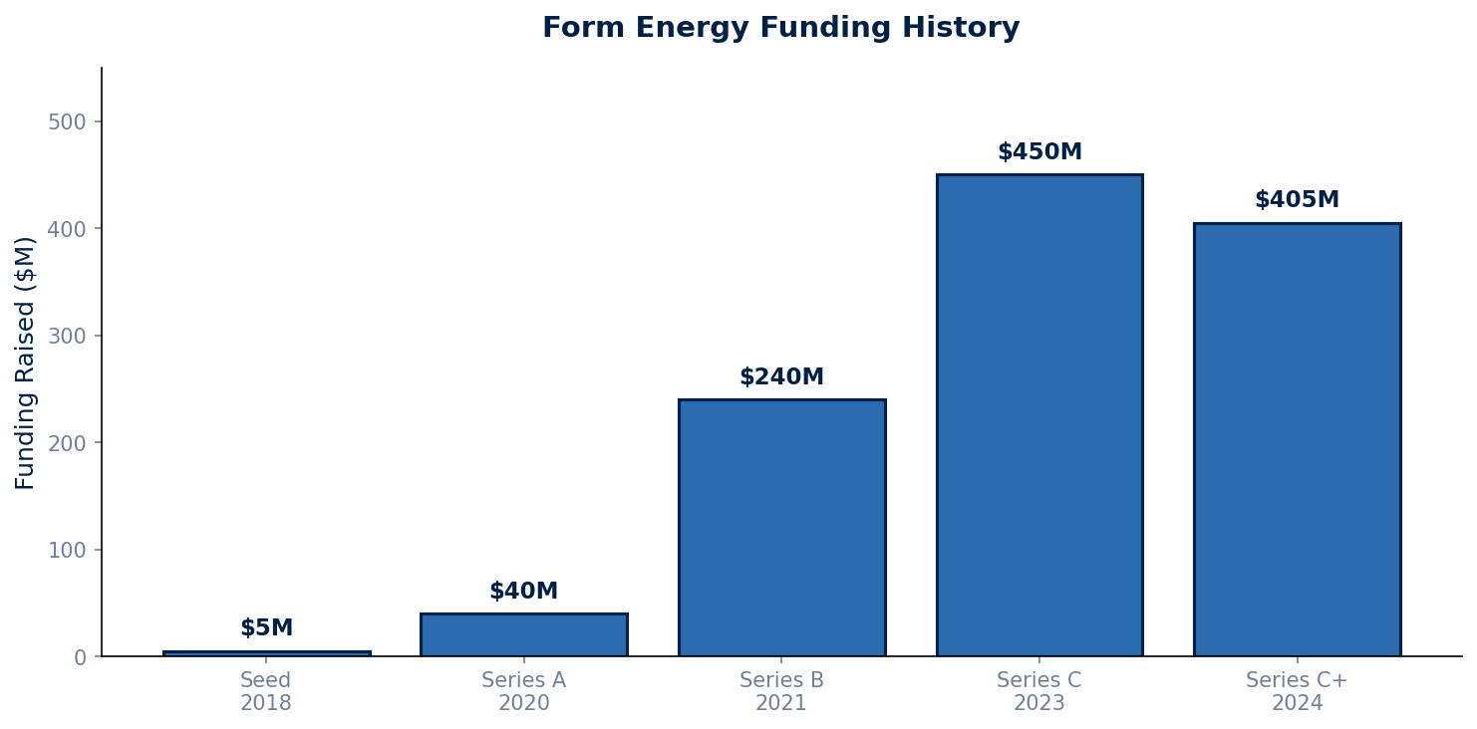
Form Energy
FINANCIAL HEALTH
Key Financial Metrics
Status: Pre-revenue
Funding Raised: $1.52B
Latest Valuation: $2.5B+
Investors: 35+ institutions
Order Book: $2.5B+
(Google: 300MW/30GWh)
Cash Position: Strong
($1.5B+ estimated)
Debt: Minimal
(Well-funded)
Source: Manu Forti Intelligence | Confidential | March 2026
⚡ Manu Forti

Slide 5
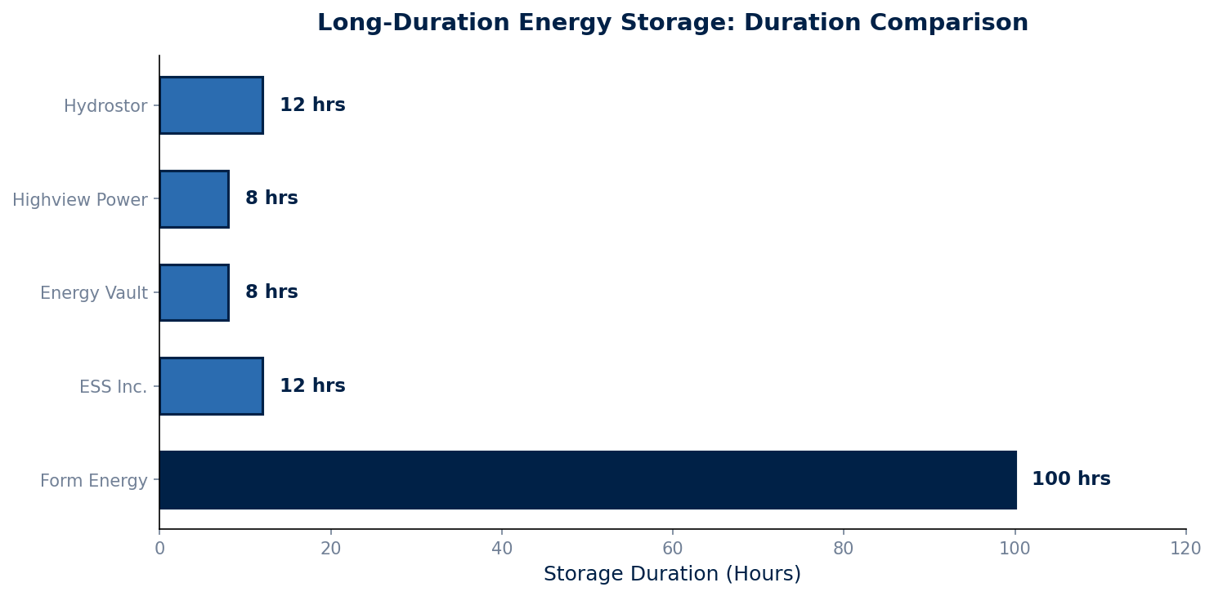
Form Energy
MARKET POSITION
Competitive Position
Market: Long-Duration
Energy Storage (LDES)
Market Size: $30B+ by 2030
Form Energy Rank: #1
in iron-air technology
Key Differentiators:
• Only 100+ hour battery
• Lowest cost ($20/kWh)
• Safest chemistry
• US manufacturing
Major Competitors:
• ESS Inc. (iron flow)
• Energy Vault (gravity)
• Highview Power (LAES)
• Hydrostor (compressed air)
Source: Manu Forti Intelligence | Confidential | March 2026
⚡ Manu Forti

Slide 6
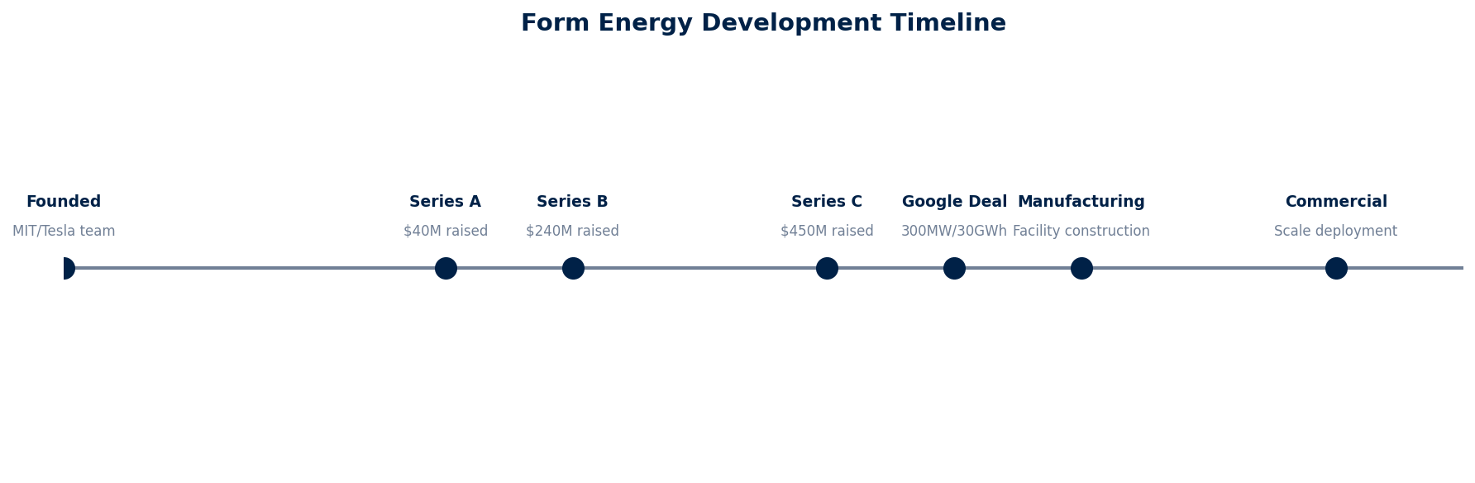
Form Energy
OPERATIONAL CAPABILITY & RISK
Risk Assessment
HIGH IMPACT:
• Manufacturing scale-up
• Technology performance
• Funding requirements
MEDIUM IMPACT:
• Competition
• Sales cycle length
• Customer concentration
MITIGATION:
• Strong investor backing
• Phased manufacturing ramp
• Diversified customer base
• IP protection
Source: Manu Forti Intelligence | Confidential | March 2026
⚡ Manu Forti

Slide 7
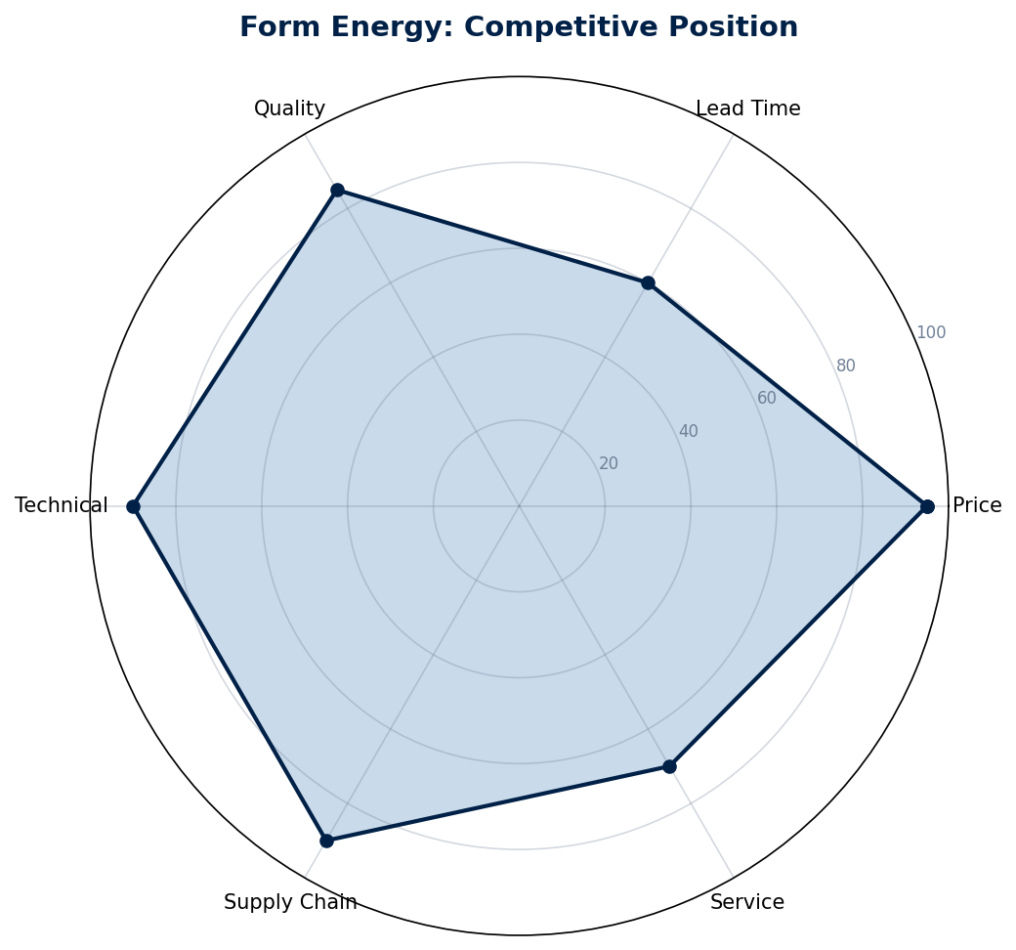
Form Energy
COMMERCIAL INTELLIGENCE
Commercial Terms
Pricing Model:
Capital sale + 20-year service
Target: $20/kWh at scale
Contract Structure:
• Long-term service agreements
• Performance guarantees
• Modular deployment
• Turnkey or equipment-only
Key Customers:
• Google (300MW/30GWh)
• Xcel Energy
• Great River Energy
Negotiation Notes:
• Early customer pricing available
• IRA tax credits (30%+ effective discount)
• Performance guarantees critical
• Strategic partnerships secure supply chain
Source: Manu Forti Intelligence | Confidential | March 2026
⚡ Manu Forti

Slide 8
Form Energy
ESG ASSESSMENT
ENVIRONMENTAL
LOW RISK
✓ 100% renewable grid enablement
✓ Abundant iron (no conflict)
✓ Non-toxic, recyclable
✓ US manufacturing
✓ IRA clean energy beneficiary
SOCIAL
LOW RISK
✓ 400+ employees, growing
✓ 750+ jobs in Weirton, WV
✓ STEM education partnerships
✓ Diversity initiatives
✓ Former steel town revitalization
GOVERNANCE
MEDIUM RISK
✓ Strong board (energy experts)
✓ Transparent technology
✓ Regular safety certifications
⚠ Private company disclosure
⚠ Rapid growth governance
Source: Manu Forti Intelligence | Confidential | March 2026
⚡ Manu Forti

Slide 9
Form Energy
SUPPLIER PROFILE
Organization Structure
Form Energy Inc.
├── CEO & Co-Founder
│ └── Mateo Jaramillo
│ (Former Tesla VP)
├── Chief Scientist
│ └── Yet-Ming Chiang
│ (MIT Professor)
├── President
│ └── Ted Wiley
│ (Harvard/HBS)
├── CFO
│ └── Charlotte Beard
└── ~400 Employees
(R&D, Engineering,
Manufacturing)
Company Overview
Founded: 2017
Headquarters: Somerville, MA
Employees: ~400
Ownership: Private (VC-backed)
Technology: Iron-air batteries
Duration: 100+ hours
Cost Target: $20/kWh
Key Investors:
• Breakthrough Energy Ventures
• T. Rowe Price
• GE Vernova
• ArcelorMittal
• Temasek
• Macquarie Capital
Total Raised: $1.52B
Source: Manu Forti Intelligence | Confidential | March 2026
⚡ Manu Forti

