Slide 1

SUPPLIER EVALUATION REPORT
Form Energy Inc
Iron-Air Batteries | Long-Duration Storage | 100+ Hours
$1.52B Funding | ~400 Employees | USA | Pre-Revenue
Confidential | March 2026 | Manu Forti Intelligence

Slide 2
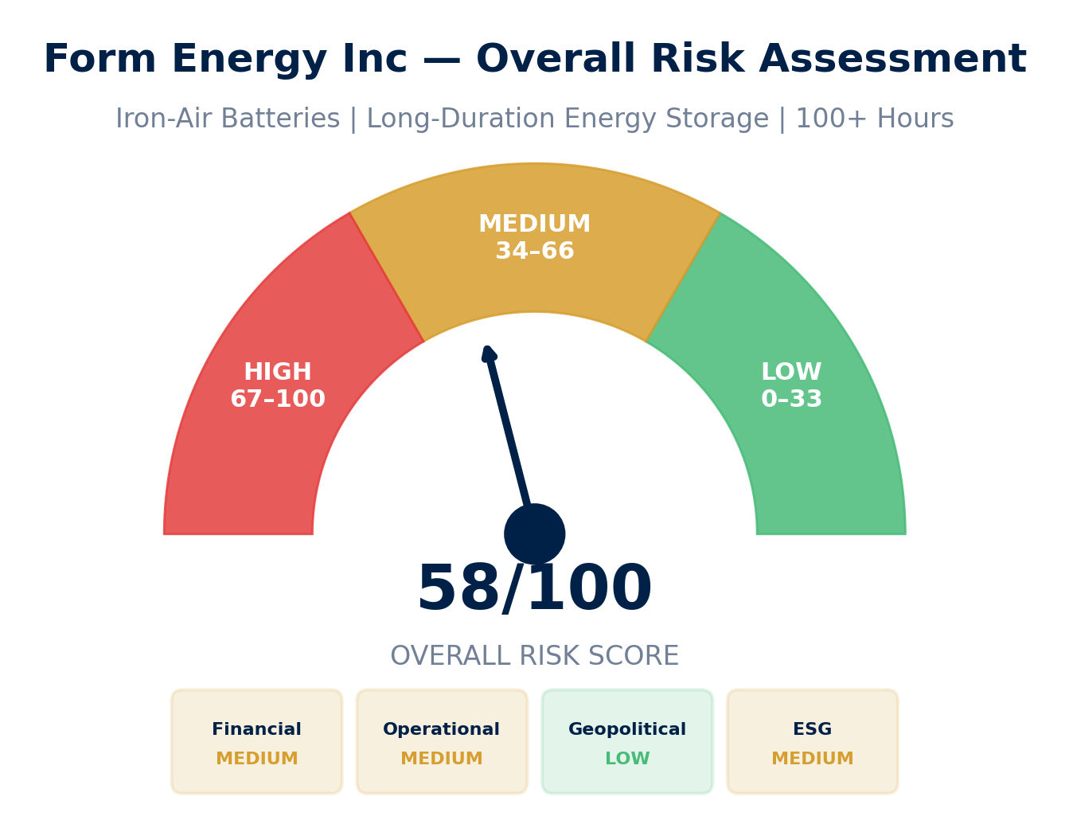
EXECUTIVE SUMMARY
Form Energy Inc — Risk & Suitability Overview
SUPPLIER SNAPSHOT
Supplier:
Form Energy Inc
Type:
Private (venture-backed)
Sector:
Iron-Air Battery Storage
HQ:
Somerville, MA, USA
Founded:
2017 by MIT researchers
Valuation:
$2.5B (2024)
Funding:
$1.52B total raised
Employees:
~400
Revenue:
Pre-revenue (2027 target)
Key Contract:
Google 300MW/30GWh
Key Findings
• Iron-air battery technology: 100+ hour duration at $20/kWh target cost
• $1.52B funding from Breakthrough Energy, T. Rowe Price, GE Vernova, Temasek
• Google contract: 300MW/30GWh (2026-2028) — first major commercial validation
• Pre-revenue status: Manufacturing facility under construction in Weirton, WV
Source: Manu Forti Intelligence | Confidential | March 2026

Slide 3
RECOMMENDATION
Decision Summary & Commercial Conditions
⚠ RECOMMENDATION: CONDITIONAL APPROVAL — ENHANCED DUE DILIGENCE REQUIRED
Form Energy represents a breakthrough in long-duration energy storage with iron-air technology. However, pre-revenue status and manufacturing scale-up risks require milestone-based engagement with performance guarantees before full commercial commitment.
Commercial Conditions
• Payment: Milestone-based (no advance payment)
• Performance bonds: Parent guarantee from Form Energy
• Liquidated damages: For delivery delays post-2027
• Technology escrow: Source code / manufacturing IP
• Termination: Exit rights if milestones missed
Enhanced Due Diligence (Mandatory)
• Verify Google contract milestones and performance guarantees
• Site visit: Weirton, WV manufacturing facility
• Technology audit: Independent validation of 100-hr duration claims
• Financial audit: Review runway and Series E terms
• Insurance: Verify product liability coverage
• Reference checks: Early pilot customers (if any)
Overall Risk Summary — MEDIUM-HIGH (58/100)
Financial: MEDIUM
Operational: MEDIUM
Geopolitical: LOW
ESG: MEDIUM
$1.52B funding; pre-revenue; 2027 target
Unproven manufacturing at scale
US-based; stable jurisdiction
Strong environmental; governance gaps
Source: Manu Forti Intelligence | Confidential | March 2026

Slide 4
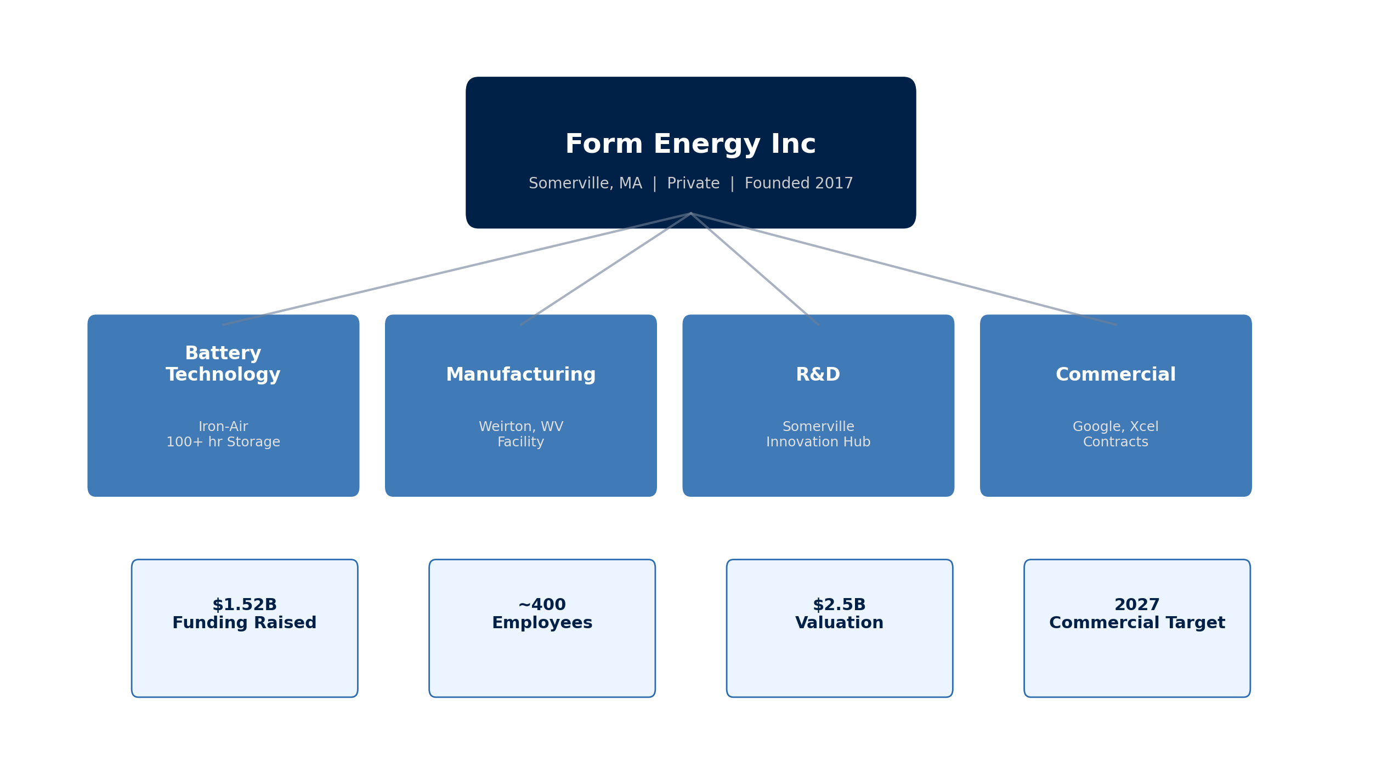
SUPPLIER PROFILE
Corporate Structure & Global Footprint
Company Overview
• Form Energy Inc is a US-based energy
• storage company founded in 2017 by
• MIT researchers. Developing iron-air
• batteries capable of 100+ hour duration
• storage at projected $20/kWh cost.
•
• Breakthrough technology addresses
• long-duration storage gap in renewable
• energy grid integration.
Leadership
• Mateo Jaramillo — CEO
• Former Tesla Energy (Powerwall)
•
• MIT pedigree: Co-founders from
• Yet-Ming Chiang research group
•
• HQ: Somerville, MA | Founded: 2017
Source: Manu Forti Intelligence | Confidential | March 2026

Slide 5
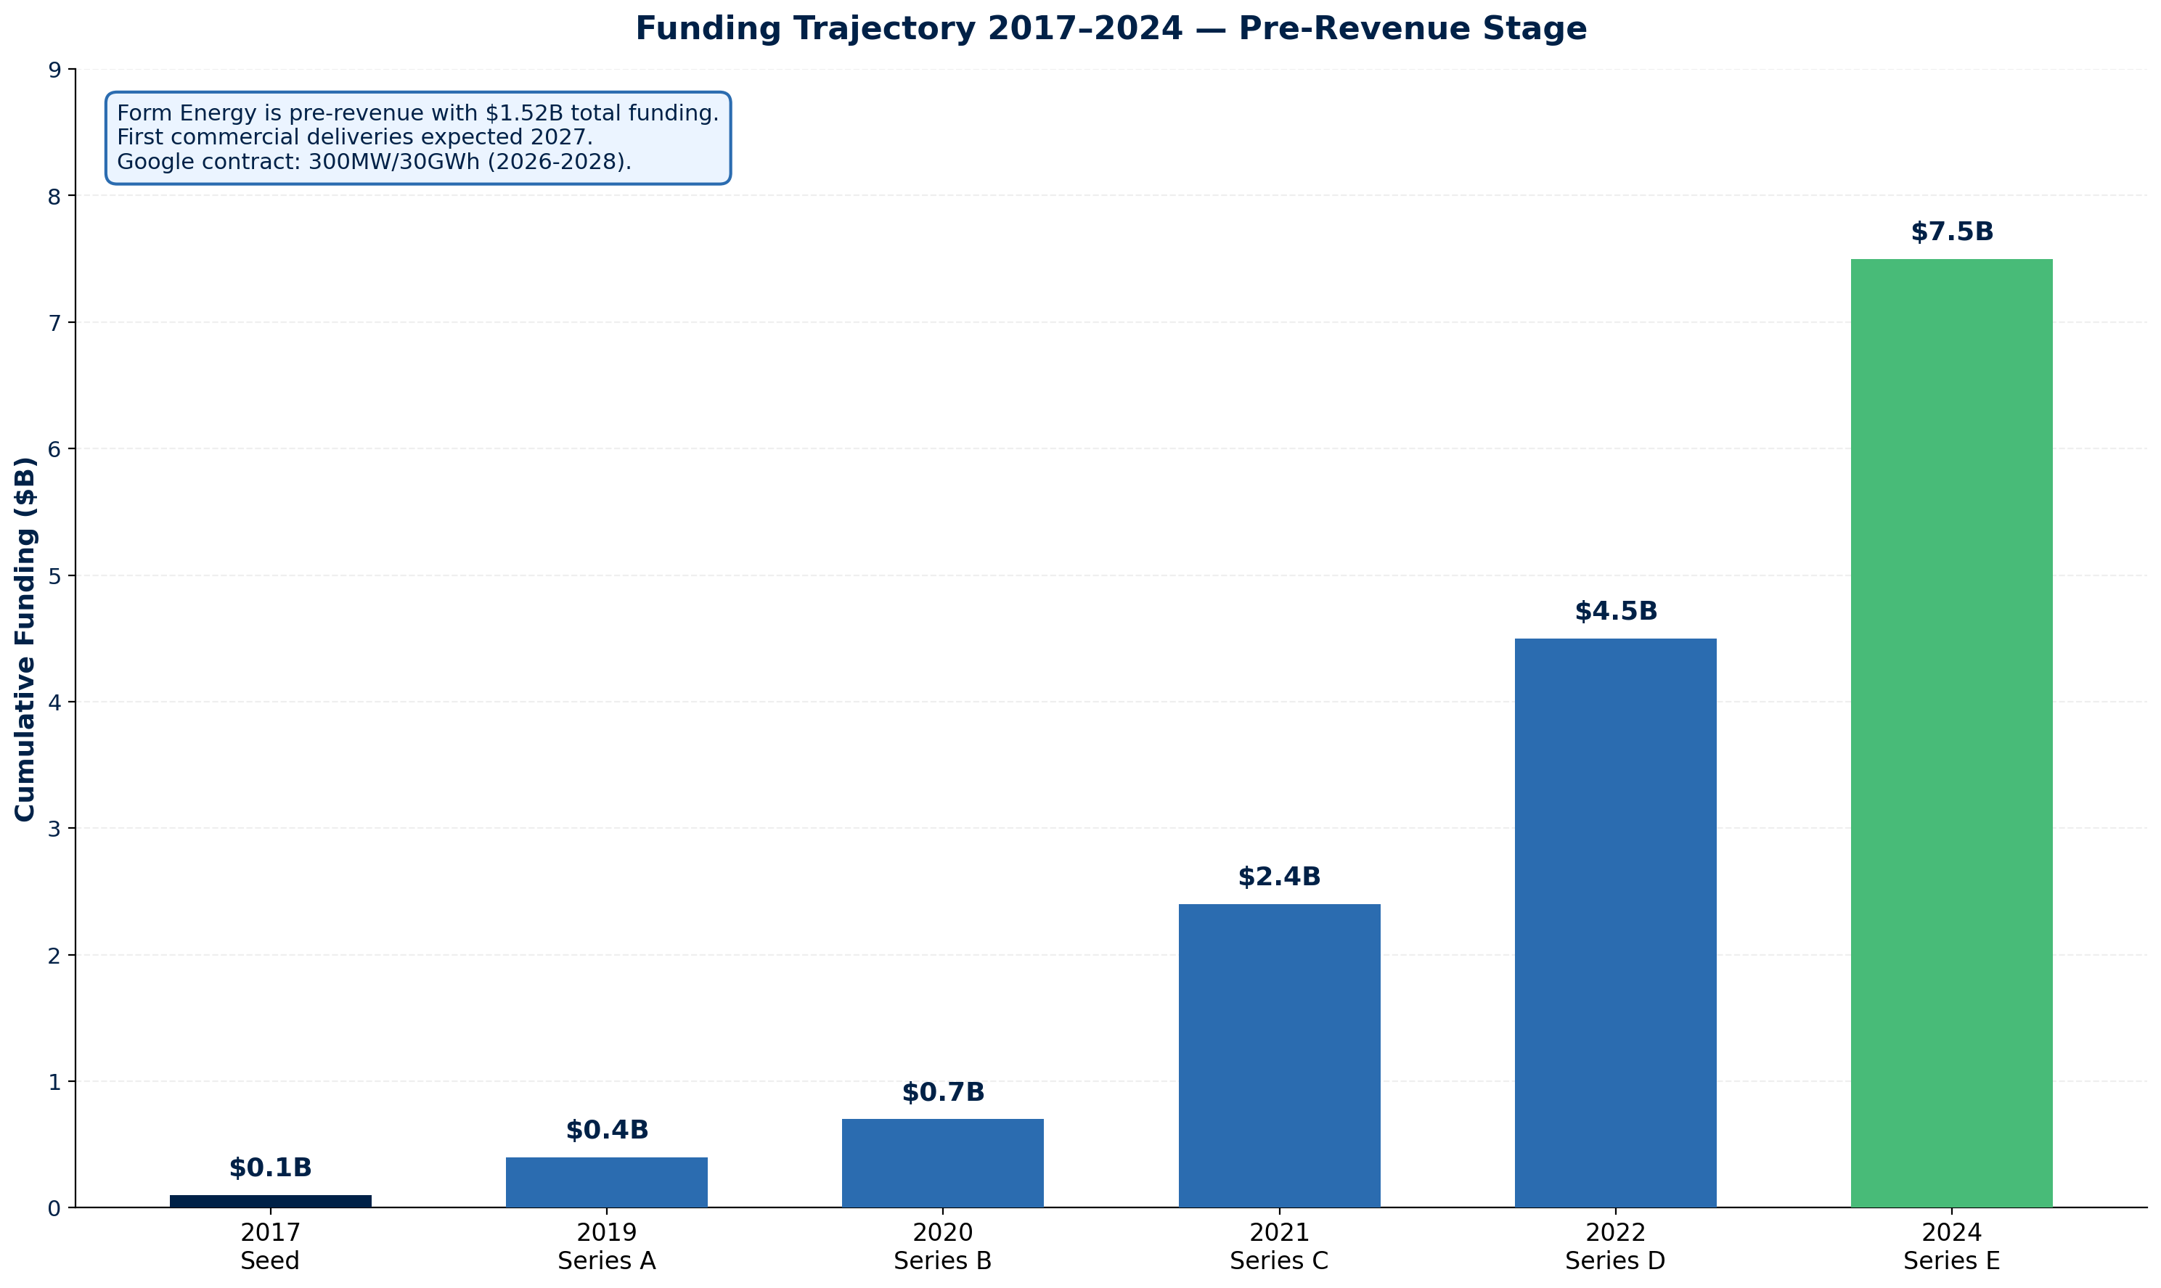
FINANCIAL HEALTH
Funding Trajectory 2017–2024 | Pre-Revenue Stage | $1.52B Total Funding
Financial Highlights
Latest Valuation:
$2.5B (2024)
Total Funding:
$1.52B (Series E)
Latest Round:
$450M Series E
Key Investors:
Breakthrough Energy Ventures
Revenue 2024:
$0 (pre-revenue)
Revenue 2027E:
First commercial deliveries
Cash Runway:
Estimated 3-4 years
Burn Rate:
High (manufacturing build-out)
Financial Risk: MEDIUM ⚠
Exposure Guidance
• Pre-revenue: No revenue track record
• Milestone-based payments mandatory
• Verify runway through 2027 commercialization
• Request investor letters of support
Source: Manu Forti Intelligence | Confidential | March 2026

Slide 6
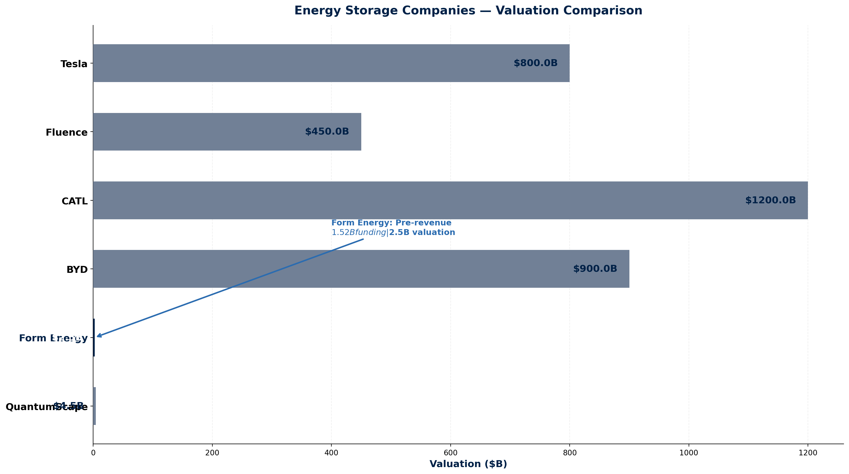
MARKET POSITION
Energy Storage Companies — Valuation Comparison
Competitive Landscape
• Form Energy occupies unique position
• in long-duration storage (100+ hours).
• Competes with lithium-ion for shorter
• durations; unique for multi-day storage.
• Target: $20/kWh vs Li-ion $130/kWh.
Form Energy Competitive Advantages
• 100+ hour duration (Li-ion: 4-8 hrs)
• Iron-air chemistry: abundant materials
• No rare earths or lithium supply risk
• Target cost: $20/kWh (1/6th of Li-ion)
• Google contract validation (300MW)
• US manufacturing: Weirton, WV facility
Key Competitors
• Tesla Energy — USA — $800B mkt cap — Powerwall/Powerpack/Megapack leader
• Fluence — USA/Australia — $450M revenue — Grid-scale storage integrator
• CATL — China — $120B mkt cap — World’s largest battery manufacturer
• BYD — China — $90B mkt cap — Integrated EV + energy storage
Source: Manu Forti Intelligence | Confidential | March 2026

Slide 7
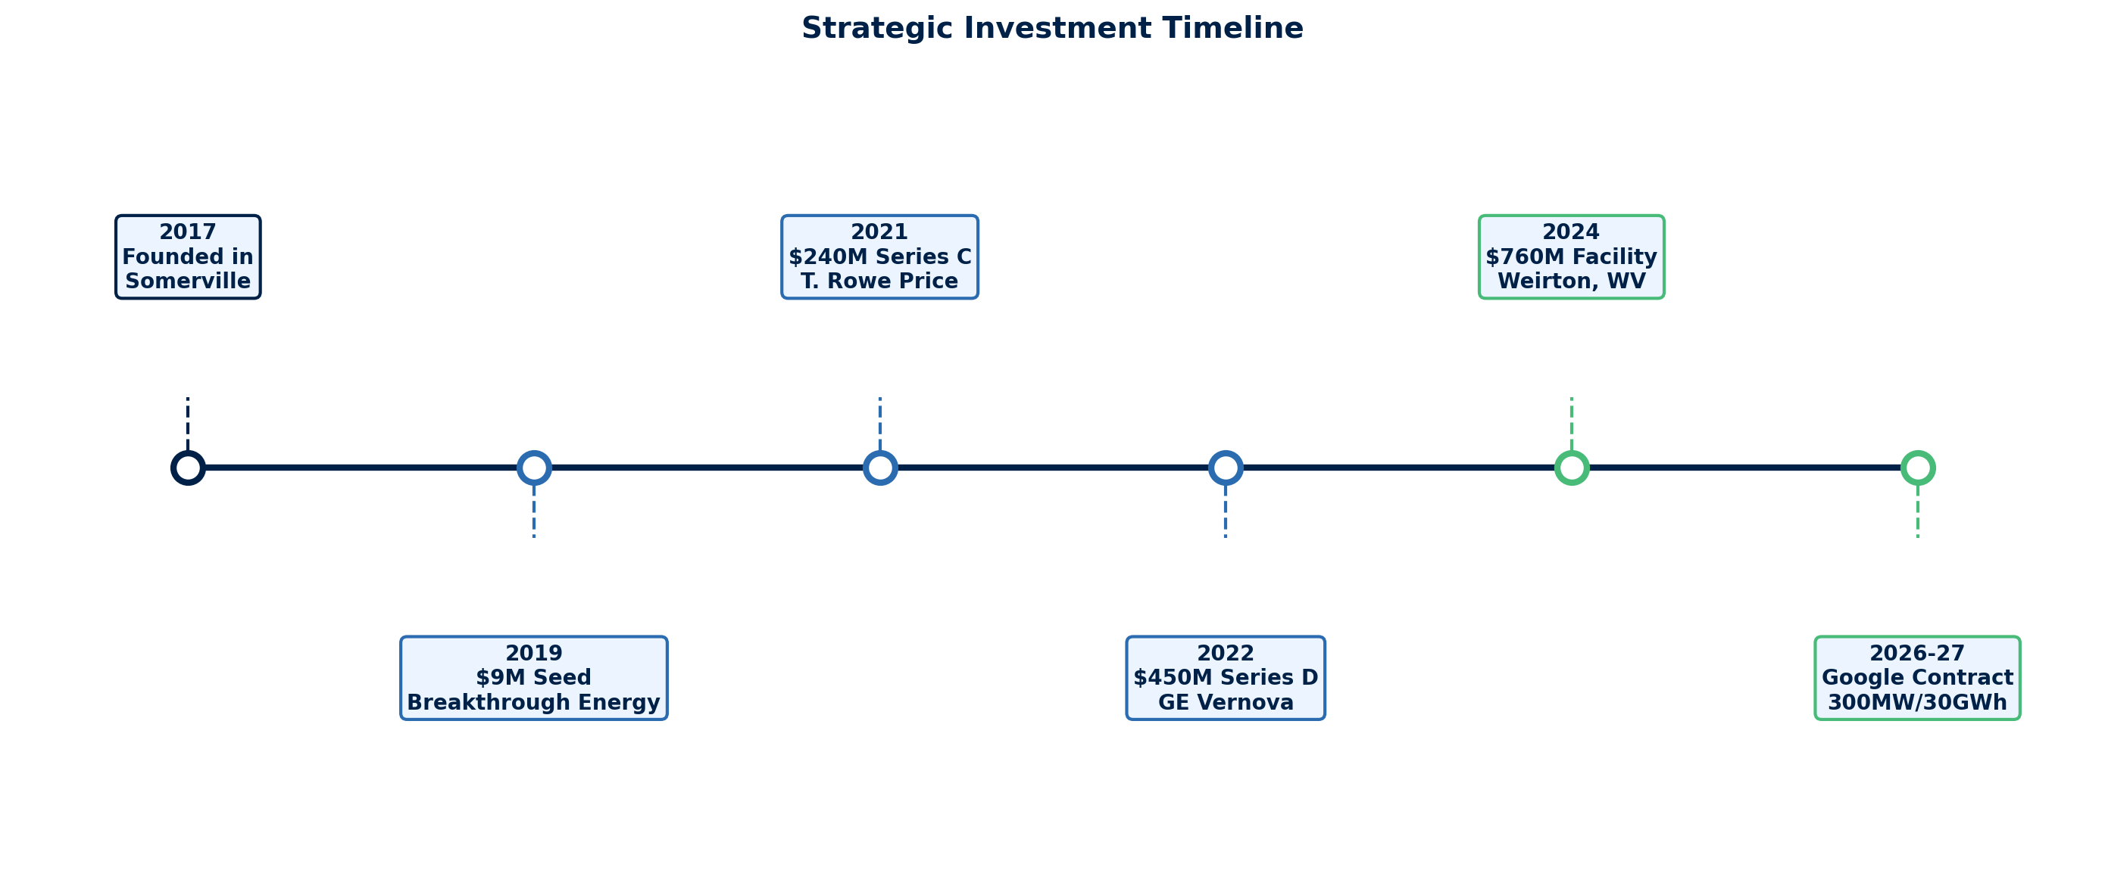
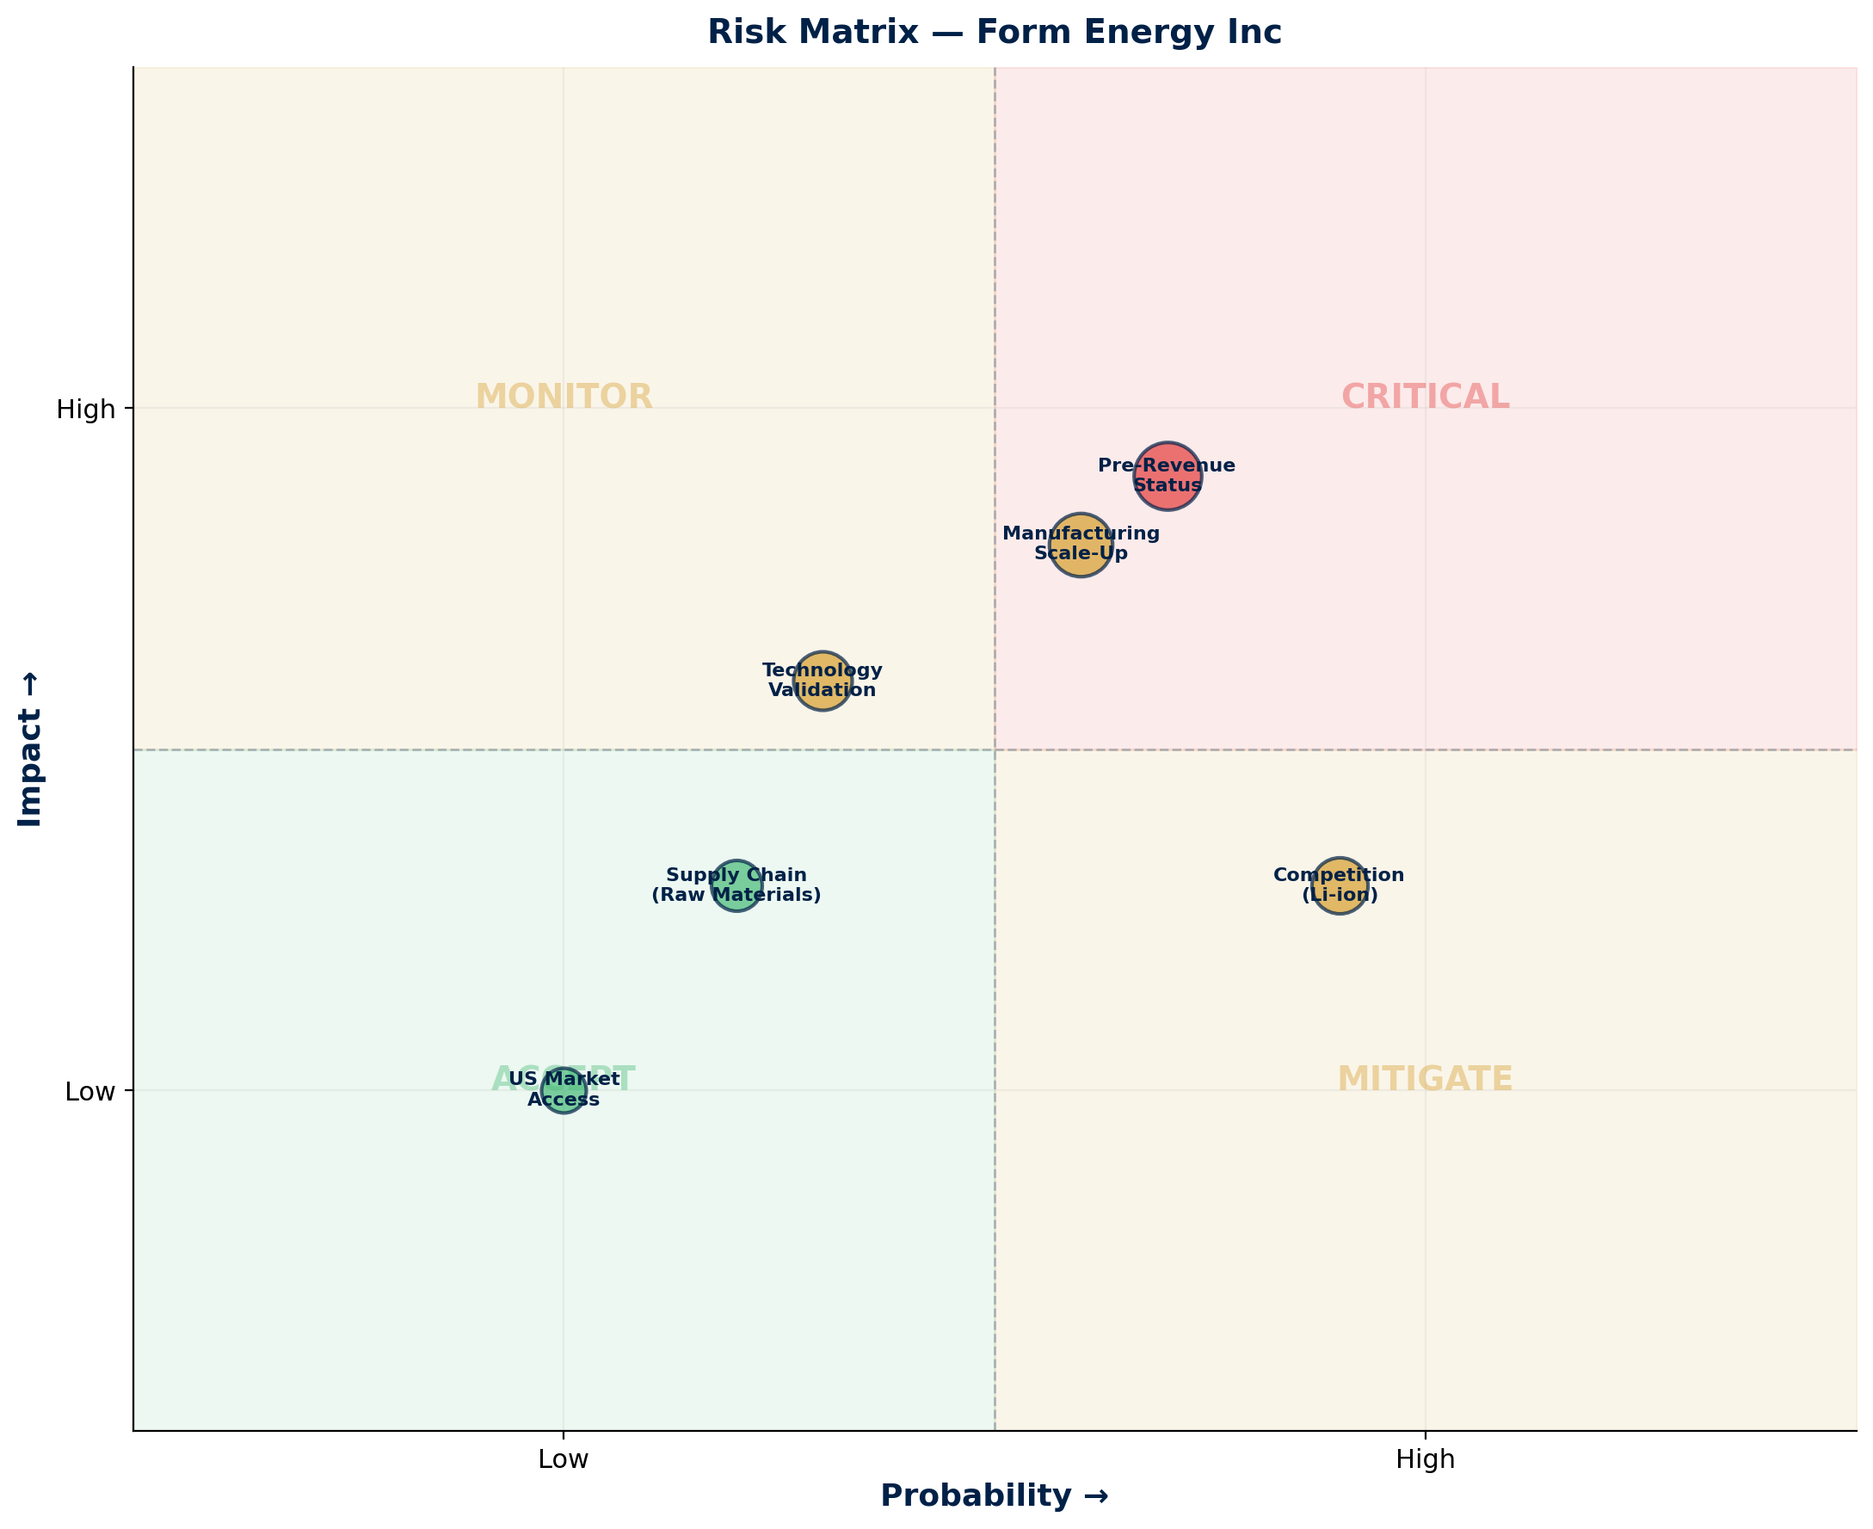
OPERATIONAL CAPABILITY & RISK ASSESSMENT
Milestones & Strategic Investment | Risk Matrix | Capability Summary
Risk Summary
Key Capabilities
• Iron-air battery R&D and engineering
• 100+ hour duration storage technology
• US-based manufacturing (Weirton, WV)
• Strategic partnerships: Google, Xcel
Financial:
🟡 MEDIUM
$1.52B funding; pre-revenue; runway TBD
Technology:
🟡 MEDIUM
Iron-air validated; manufacturing scale unproven
Operational:
🟡 MEDIUM
First facility under construction; 2027 target
Competition:
🟢 LOW
Unique 100+ hr position vs Li-ion
Supply Chain:
🟢 LOW
Iron, air, water — abundant inputs
Source: Manu Forti Intelligence | Confidential | March 2026

Slide 8
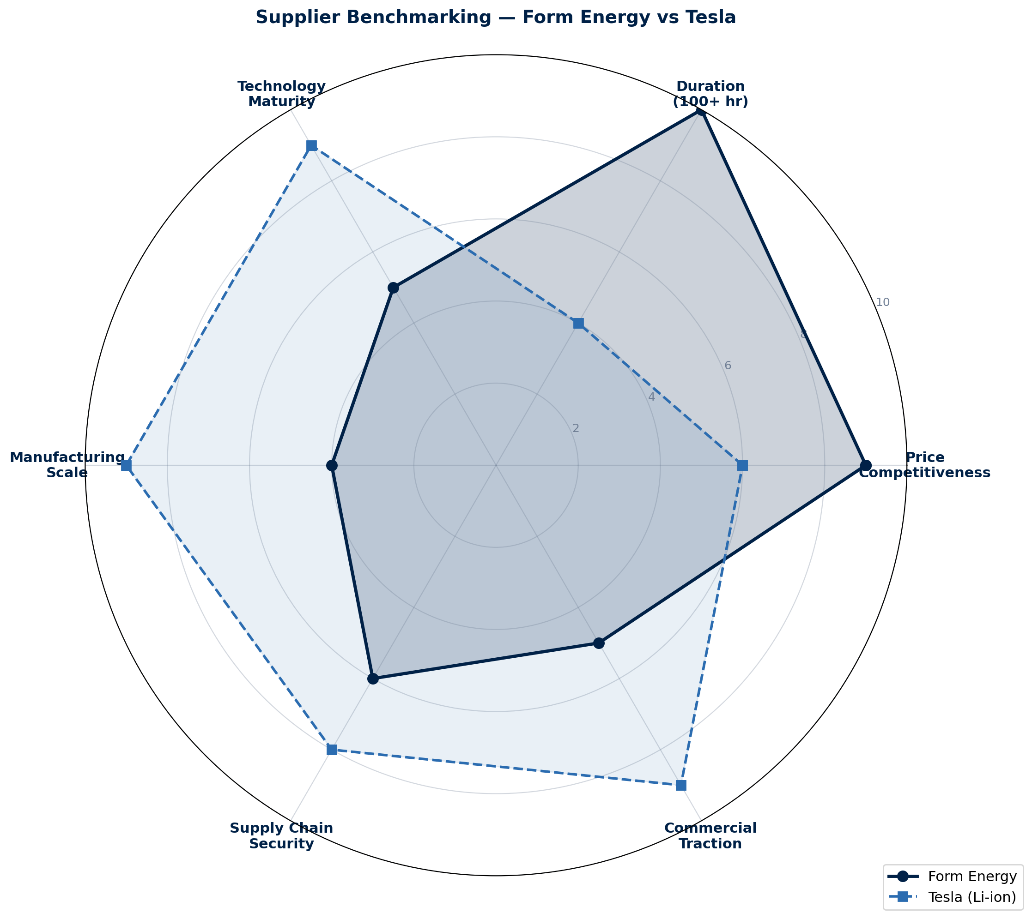
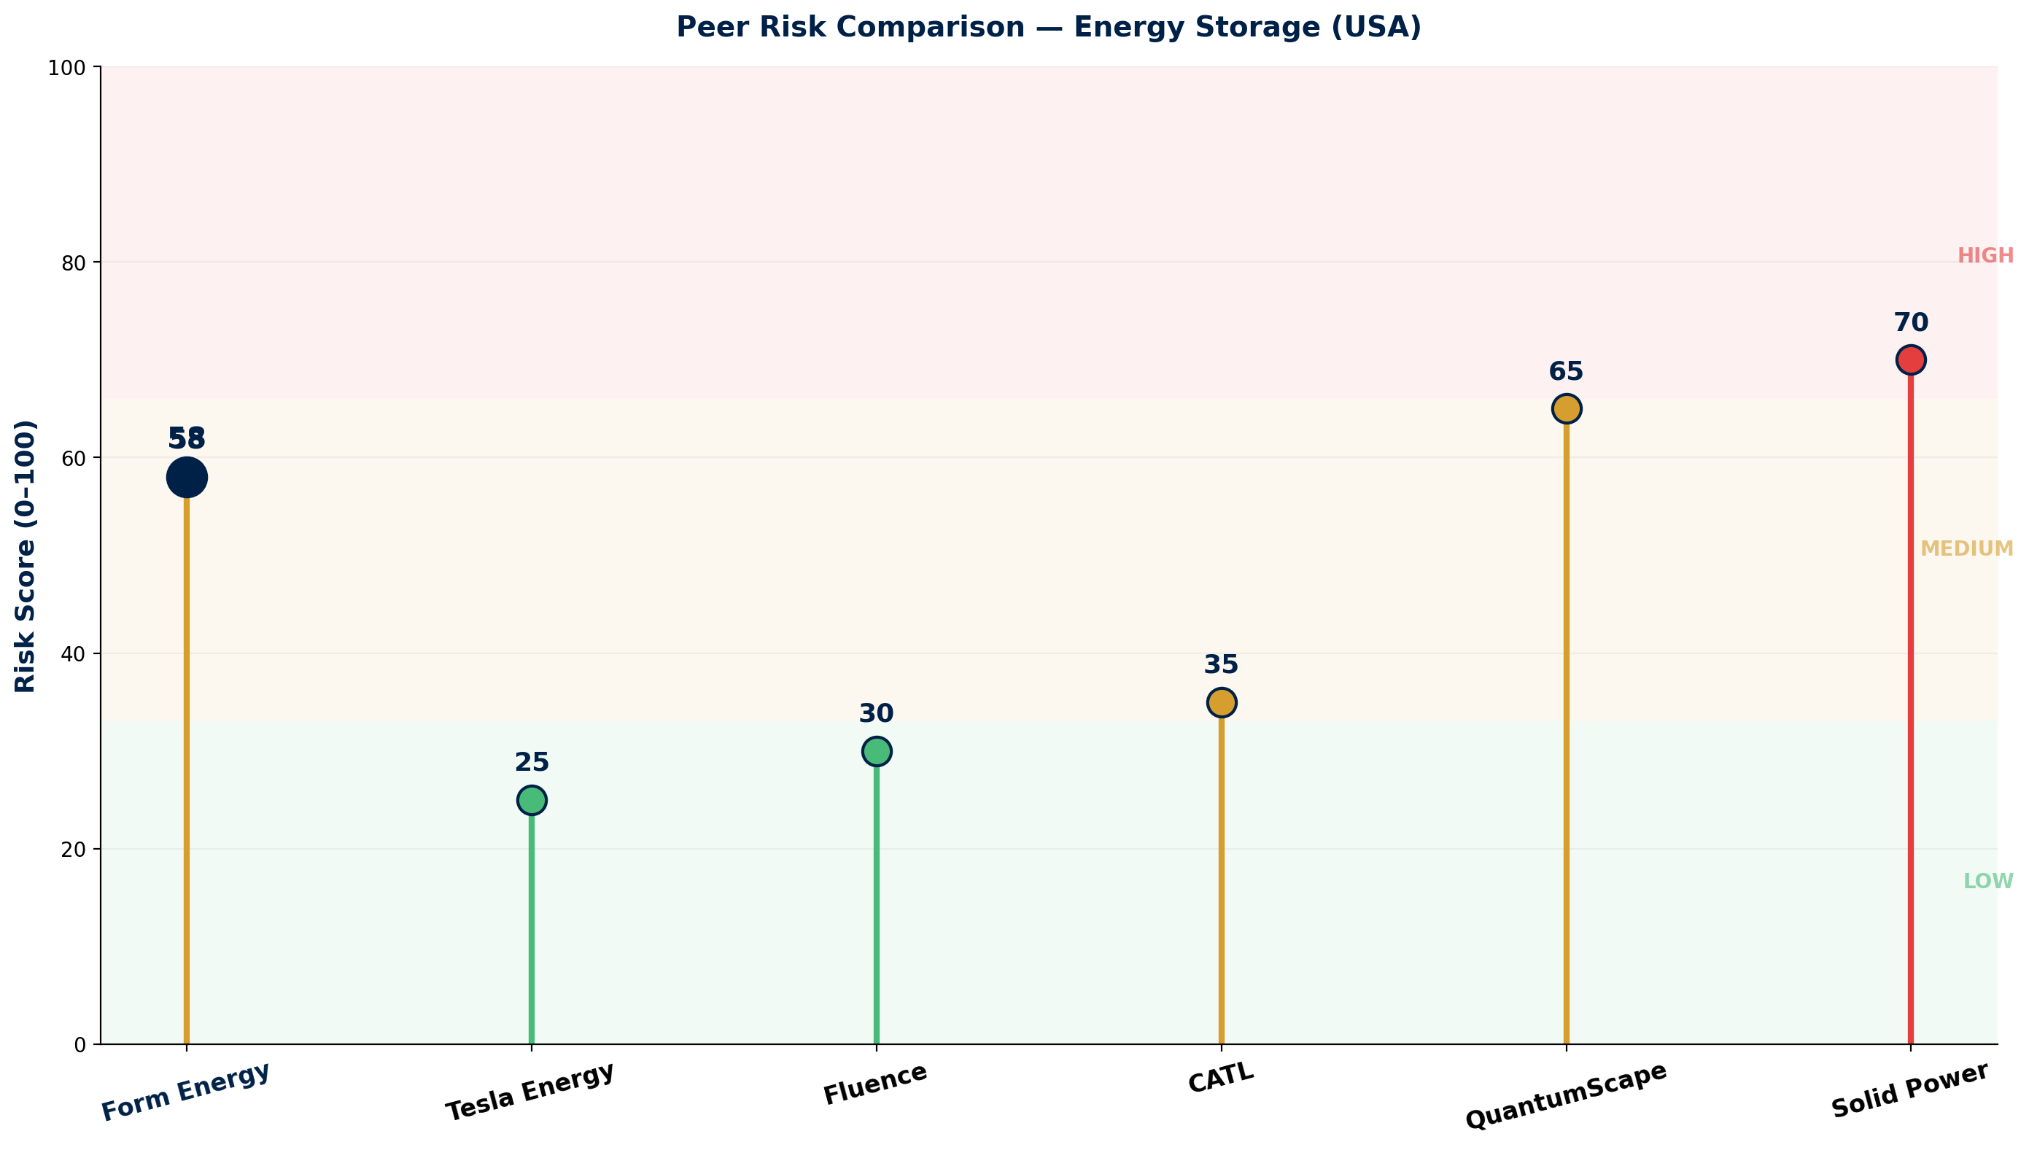
COMMERCIAL INTELLIGENCE & PEER RISK COMPARISON
Benchmarking Radar | Peer Risk Profile | Commercial Terms
Commercial Terms & Negotiation
• Pricing: Target $20/kWh (vs Li-ion $130/kWh)
• Lead time: 2027+ for commercial volumes
• Contract: Google 300MW/30GWh reference pricing
• Leverage: Early adopter positioning for LDES
Key Watch Points
• ⚠ Verify Google contract performance milestones
• ⚠ Monitor Weirton facility construction progress
• ⚠ Track 2027 commercial delivery readiness
• ⚠ Assess technology field validation data
Source: Manu Forti Intelligence | Confidential | March 2026

Slide 9
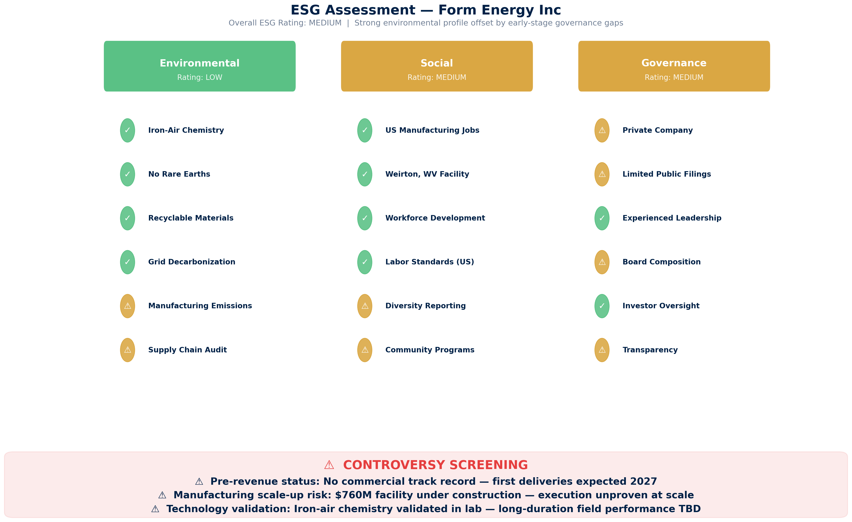
ESG ASSESSMENT
Environmental, Social & Governance Screening | Overall Rating: MEDIUM
Source: Manu Forti Intelligence | Confidential | March 2026

