Slide 1

SUPPLIER EVALUATION REPORT
JA Solar
Solar Cell & Module Manufacturing | 100+ GW Capacity | Global Leader
RMB 81.6B Revenue | 50,000+ Employees | SZSE: 002459 | Founded 2005
Confidential | March 2026 | Manu Forti Intelligence

Slide 2
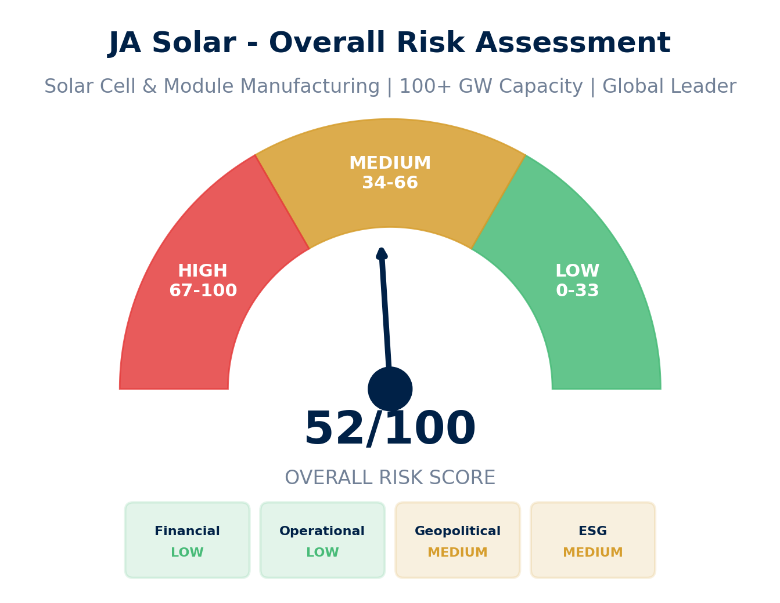
EXECUTIVE SUMMARY
JA Solar - Risk & Suitability Overview
SUPPLIER SNAPSHOT
Supplier:
JA Solar Technology Co., Ltd.
Type:
Public Company
Sector:
Solar Manufacturing
HQ:
Beijing, China
Founded:
2005
Employees:
50,000+
Revenue:
RMB 81.6B (2023)
Net Profit:
RMB 7.0B
Shipments:
79 GW (2024)
Exchange:
Shenzhen 002459
Key Findings
• Tier-1 solar manufacturer with 79 GW shipments in 2024 (#3 globally)
• Strong financials: RMB 81.6B revenue, 40.5% 3-year CAGR
• Global manufacturing: China + Southeast Asia facilities
• V16: What This Means for Buyers: Reliable supplier with trade risk exposure
Source: Manu Forti Intelligence | Confidential | March 2026

Slide 3
RECOMMENDATION
Decision Summary & Commercial Conditions
✓ RECOMMENDATION: APPROVE
JA Solar is a Tier-1 solar manufacturer with strong financials, proven scale, and competitive positioning. Primary risk is geopolitical (China-based, trade restrictions). Recommended with standard monitoring.
Commercial Conditions
• Payment: Standard terms (30-60 days)
• Performance warranty: 25-year module warranty
• Supply agreement: Annual volume commitment
• Price protection: Quarterly price adjustments
• Quality assurance: IEC certified products
Due Diligence (Recommended)
• Verify supply chain transparency (no forced labor)
• Review tariff exposure for destination market
• Confirm manufacturing capacity allocation
• Validate 25-year warranty backing
• Check ESG compliance certifications
Escalation Triggers - Change Recommendation If:
• New sanctions imposed on JA Solar or parent entities
• Forced labor allegations substantiated in supply chain
• Financial distress (debt/EBITDA > 4x, negative cash flow)
• Loss of Tier-1 Bloomberg NEF ranking
Source: Manu Forti Intelligence | Confidential | March 2026

Slide 4
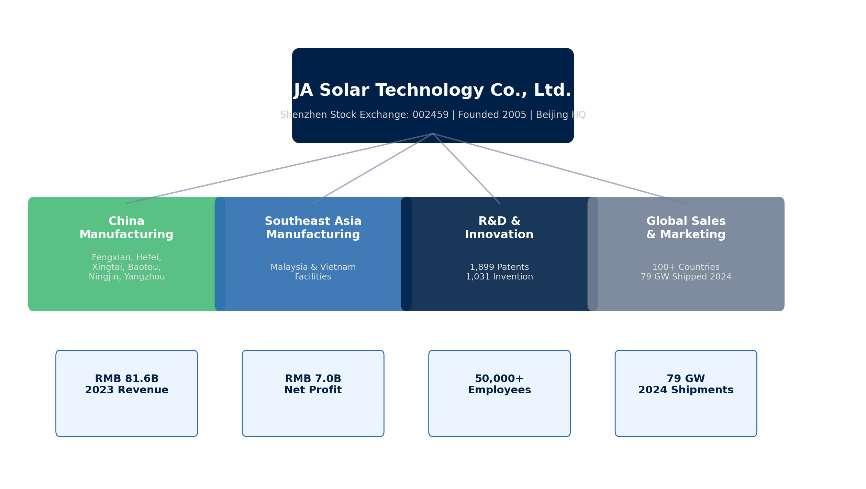
SUPPLIER PROFILE
Corporate Structure & Global Footprint
Company Overview
• JA Solar is a leading global manufacturer
• of high-performance solar cells and modules.
• Founded 2005, listed on Shenzhen Stock
• Exchange (002459) since 2018.
•
• Vertically integrated from wafer to module
• with R&D focus on cell efficiency.
Leadership & Operations
• CEO: Jin Baofang
• (industry veteran)
•
• HQ: Beijing, China
• Manufacturing: China,
• Malaysia, Vietnam
•
• R&D: 1,899 patents
Source: Manu Forti Intelligence | Confidential | March 2026

Slide 5
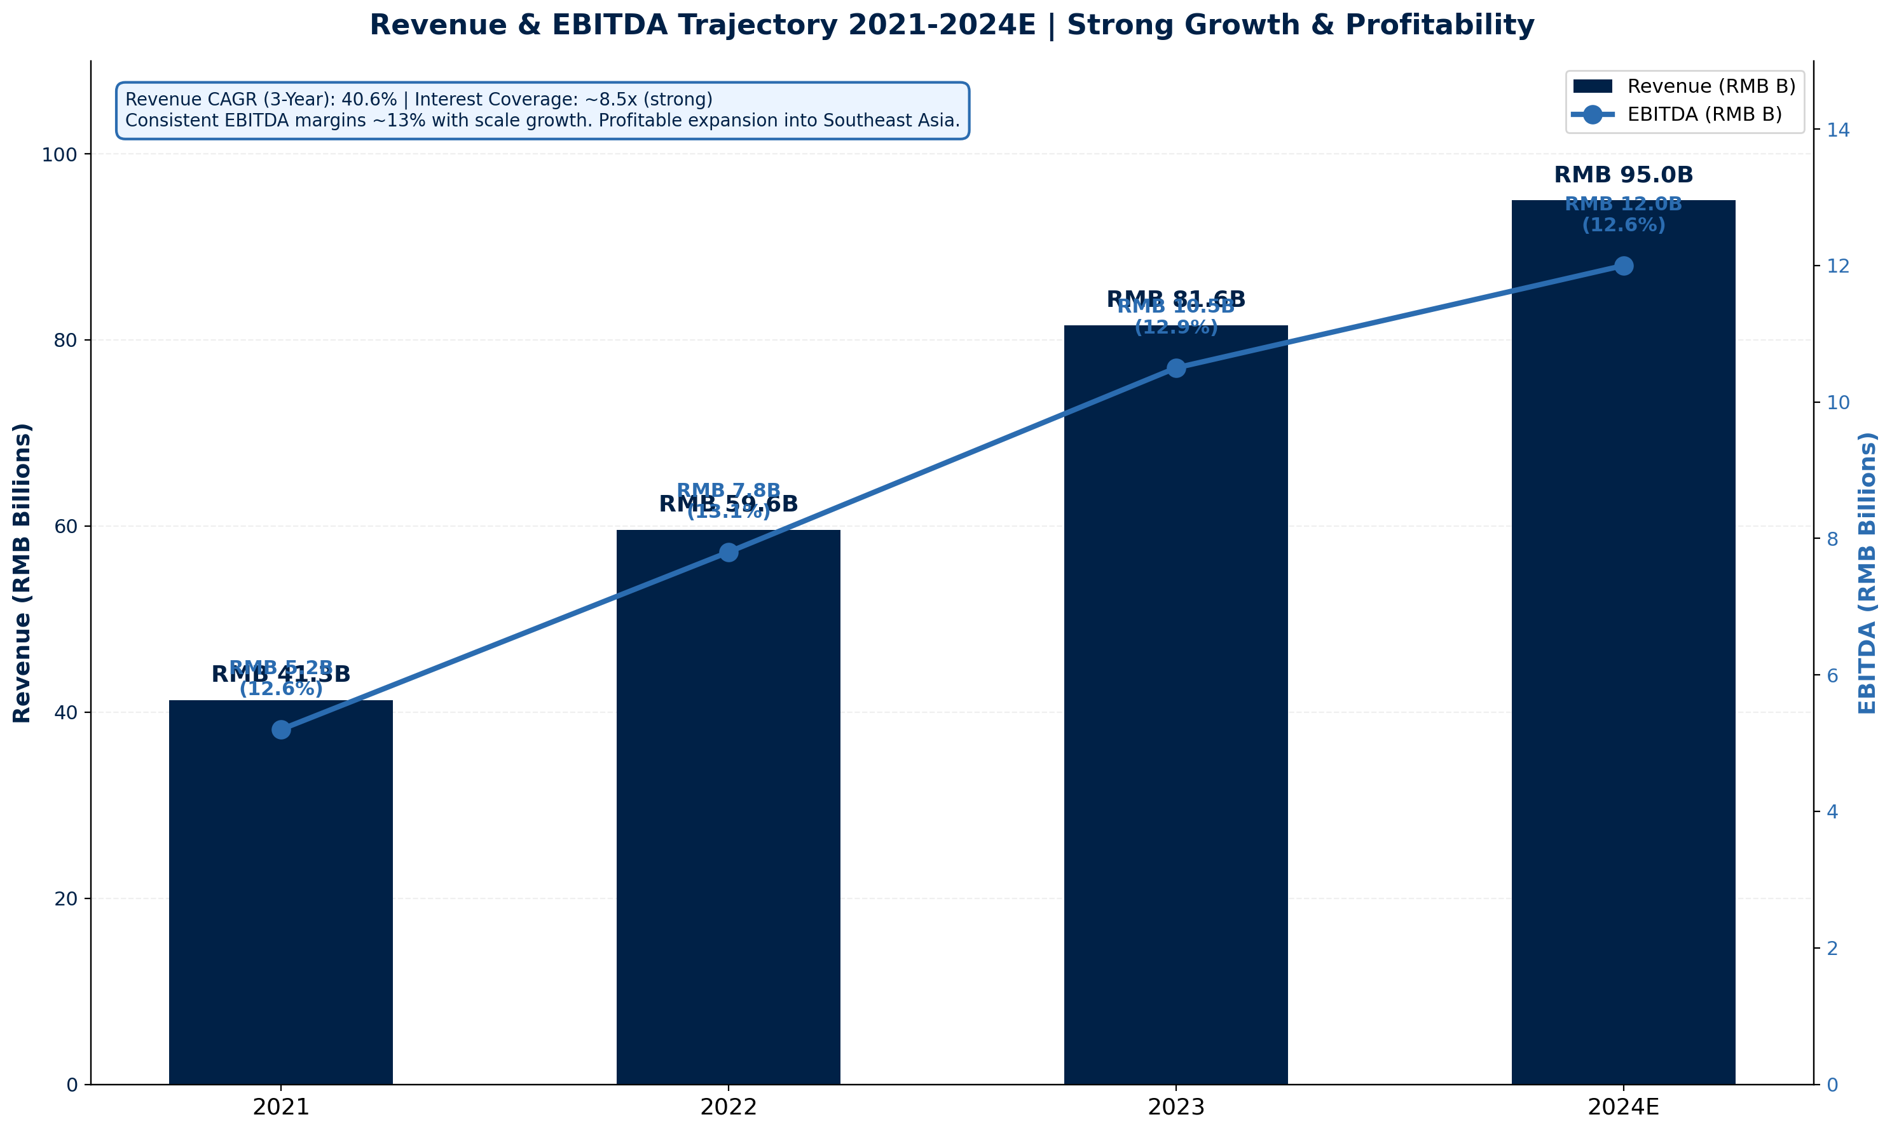
FINANCIAL HEALTH
Revenue & EBITDA Trajectory 2021-2024E | Shenzhen Stock Exchange
KEY METRICS
Revenue (2023):
RMB 81.6B
Revenue YoY:
+11.7%
EBITDA:
RMB 10.5B
EBITDA Margin:
12.9%
Net Profit:
RMB 7.0B
3-Year CAGR:
40.5%
Interest Coverage:
~8.5x
Debt/EBITDA:
~1.2x
2024 Shipments:
79 GW
R&D Spend:
RMB 3.7B
Source: Manu Forti Intelligence | Confidential | March 2026

Slide 6
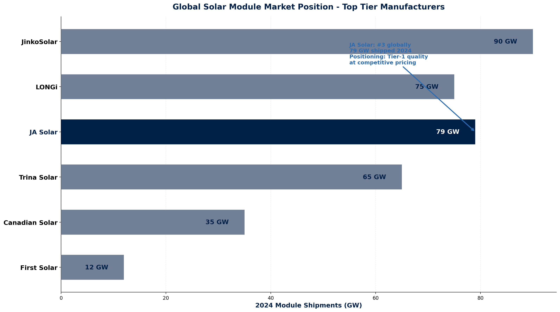
MARKET POSITION
Global Solar Module Rankings & Competitive Landscape
COMPETITIVE CONTEXT
JA Solar ranks #3 globally in
module shipments (79 GW 2024).
Tier-1 manufacturer per Bloomberg
NEF - bankable for utility-scale
projects.
Competes on price-performance
with JinkoSolar and LONGi.
Key differentiator: Vertically
integrated manufacturing with
strong R&D investment (5.3% of
revenue).
Source: Manu Forti Intelligence | Confidential | March 2026

Slide 7
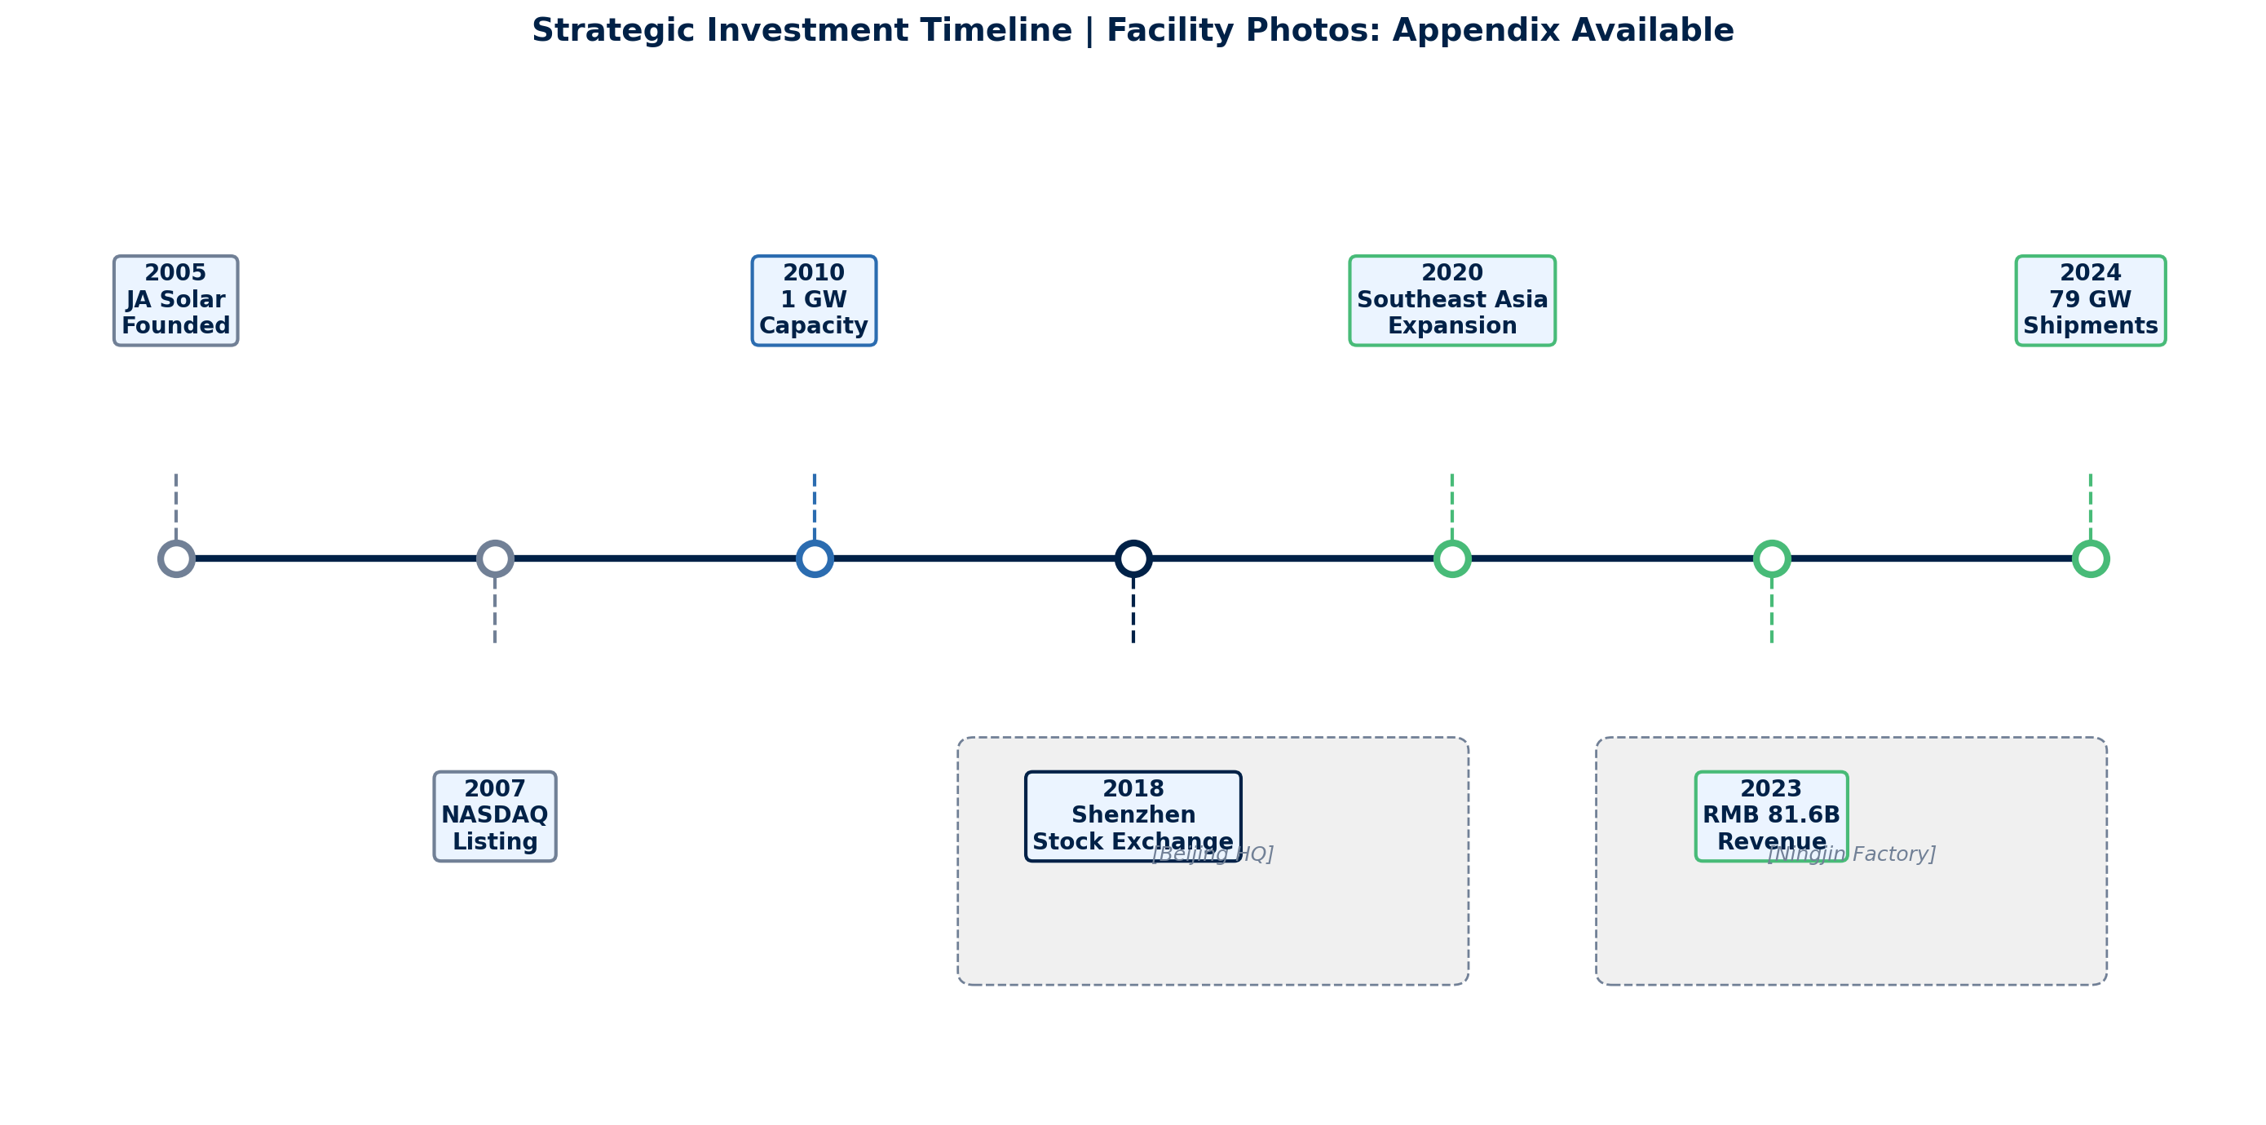
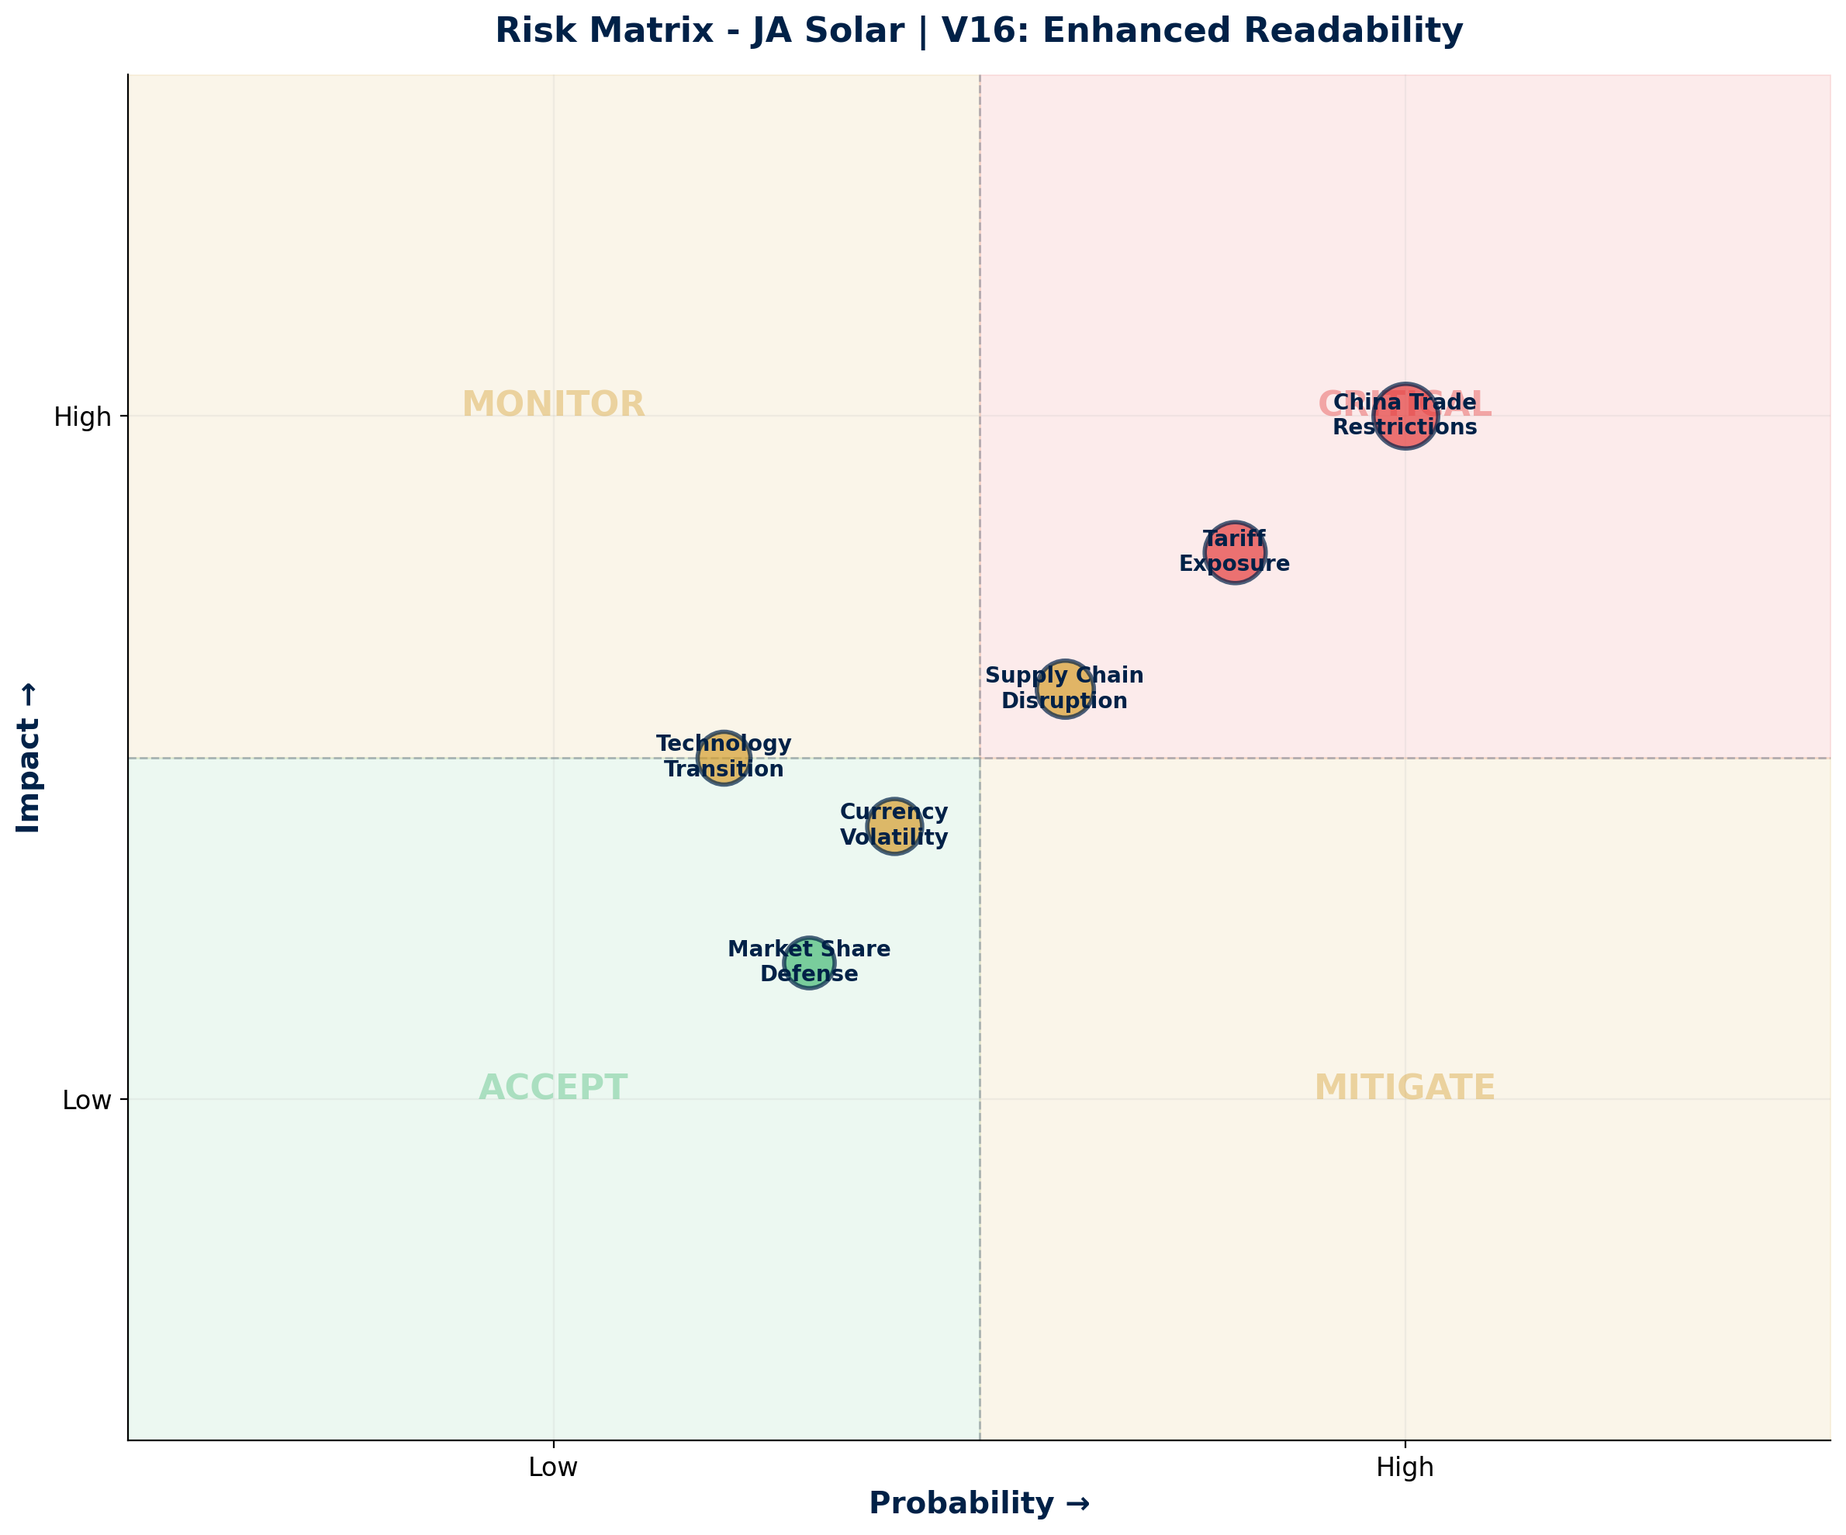
OPERATIONAL CAPABILITY + RISK ASSESSMENT
Manufacturing Timeline & Risk Matrix
Risk Summary Table
China Trade Restrictions
Geopolitical
HIGH
US tariffs, sanctions risk
Tariff Exposure
Geopolitical
HIGH
Import duties affect pricing
Supply Chain Disruption
Operational
MEDIUM
Component availability
Technology Transition
Operational
MEDIUM
N-type cell migration
Market Share Defense
Commercial
LOW
Competition from Tier-1
Source: Manu Forti Intelligence | Confidential | March 2026

Slide 8
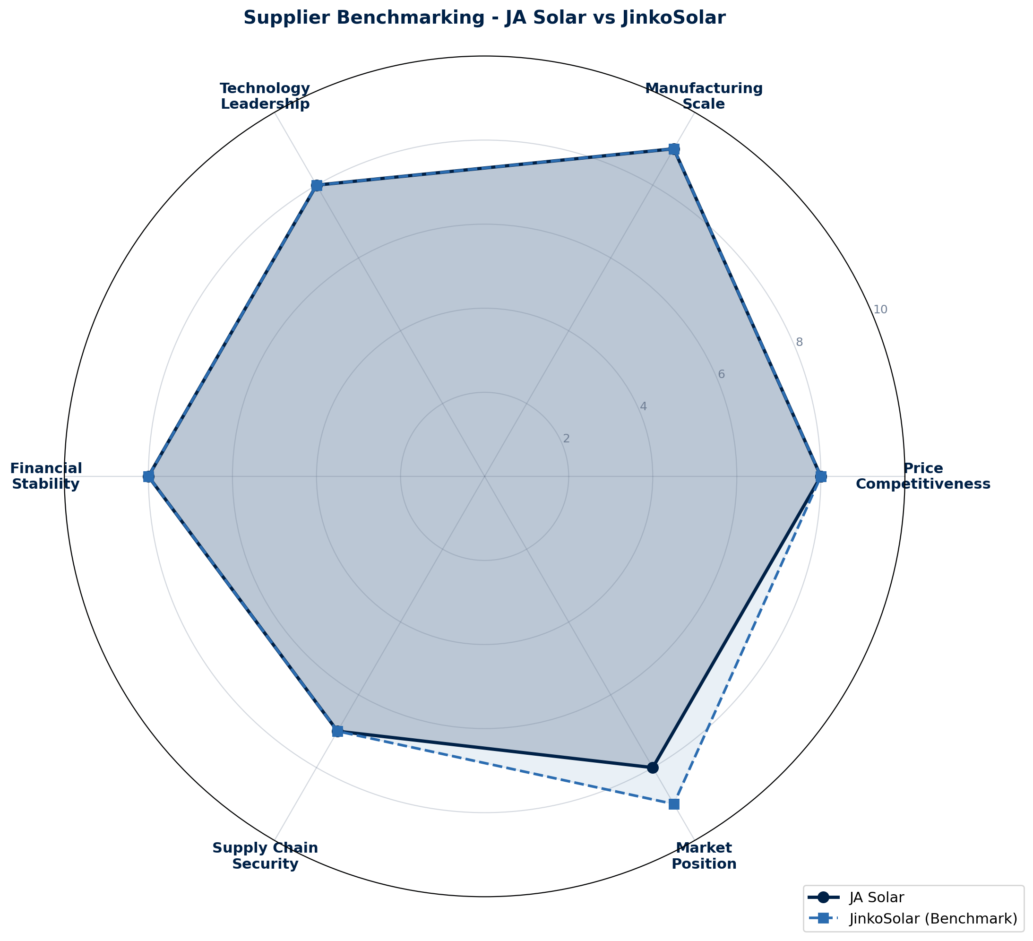
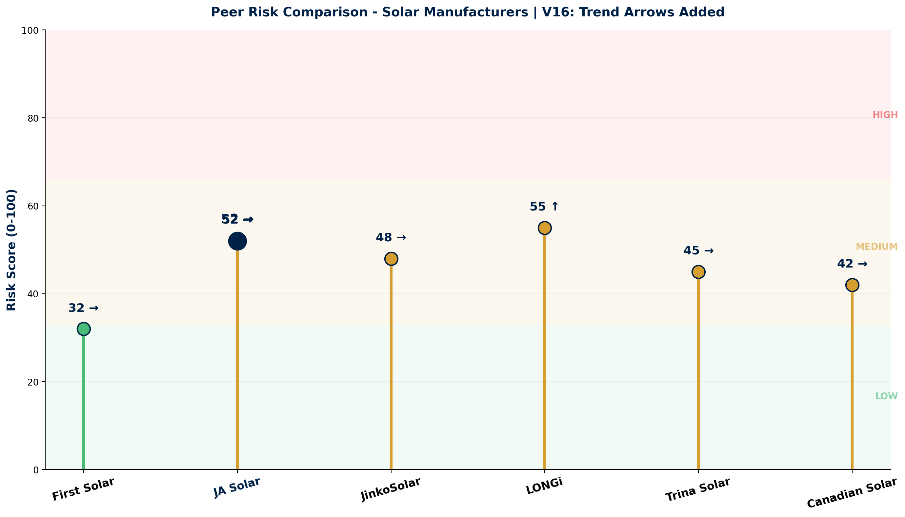
COMMERCIAL INTELLIGENCE + PEER RISK
Benchmarking & Negotiation Insights
Negotiation Leverage Assessment (V16)
Commercial Terms
• Buyer power: MODERATE (multiple Tier-1 options)
• Pricing: $0.15-0.20/W (module)
• Volume commitment increases leverage
• Payment: 30-60 days standard
• Long-term contracts favor buyer
• Warranty: 25-year performance
• Tariff exposure is key negotiation point
• Delivery: 8-12 weeks lead time
Source: Manu Forti Intelligence | Confidential | March 2026

Slide 9
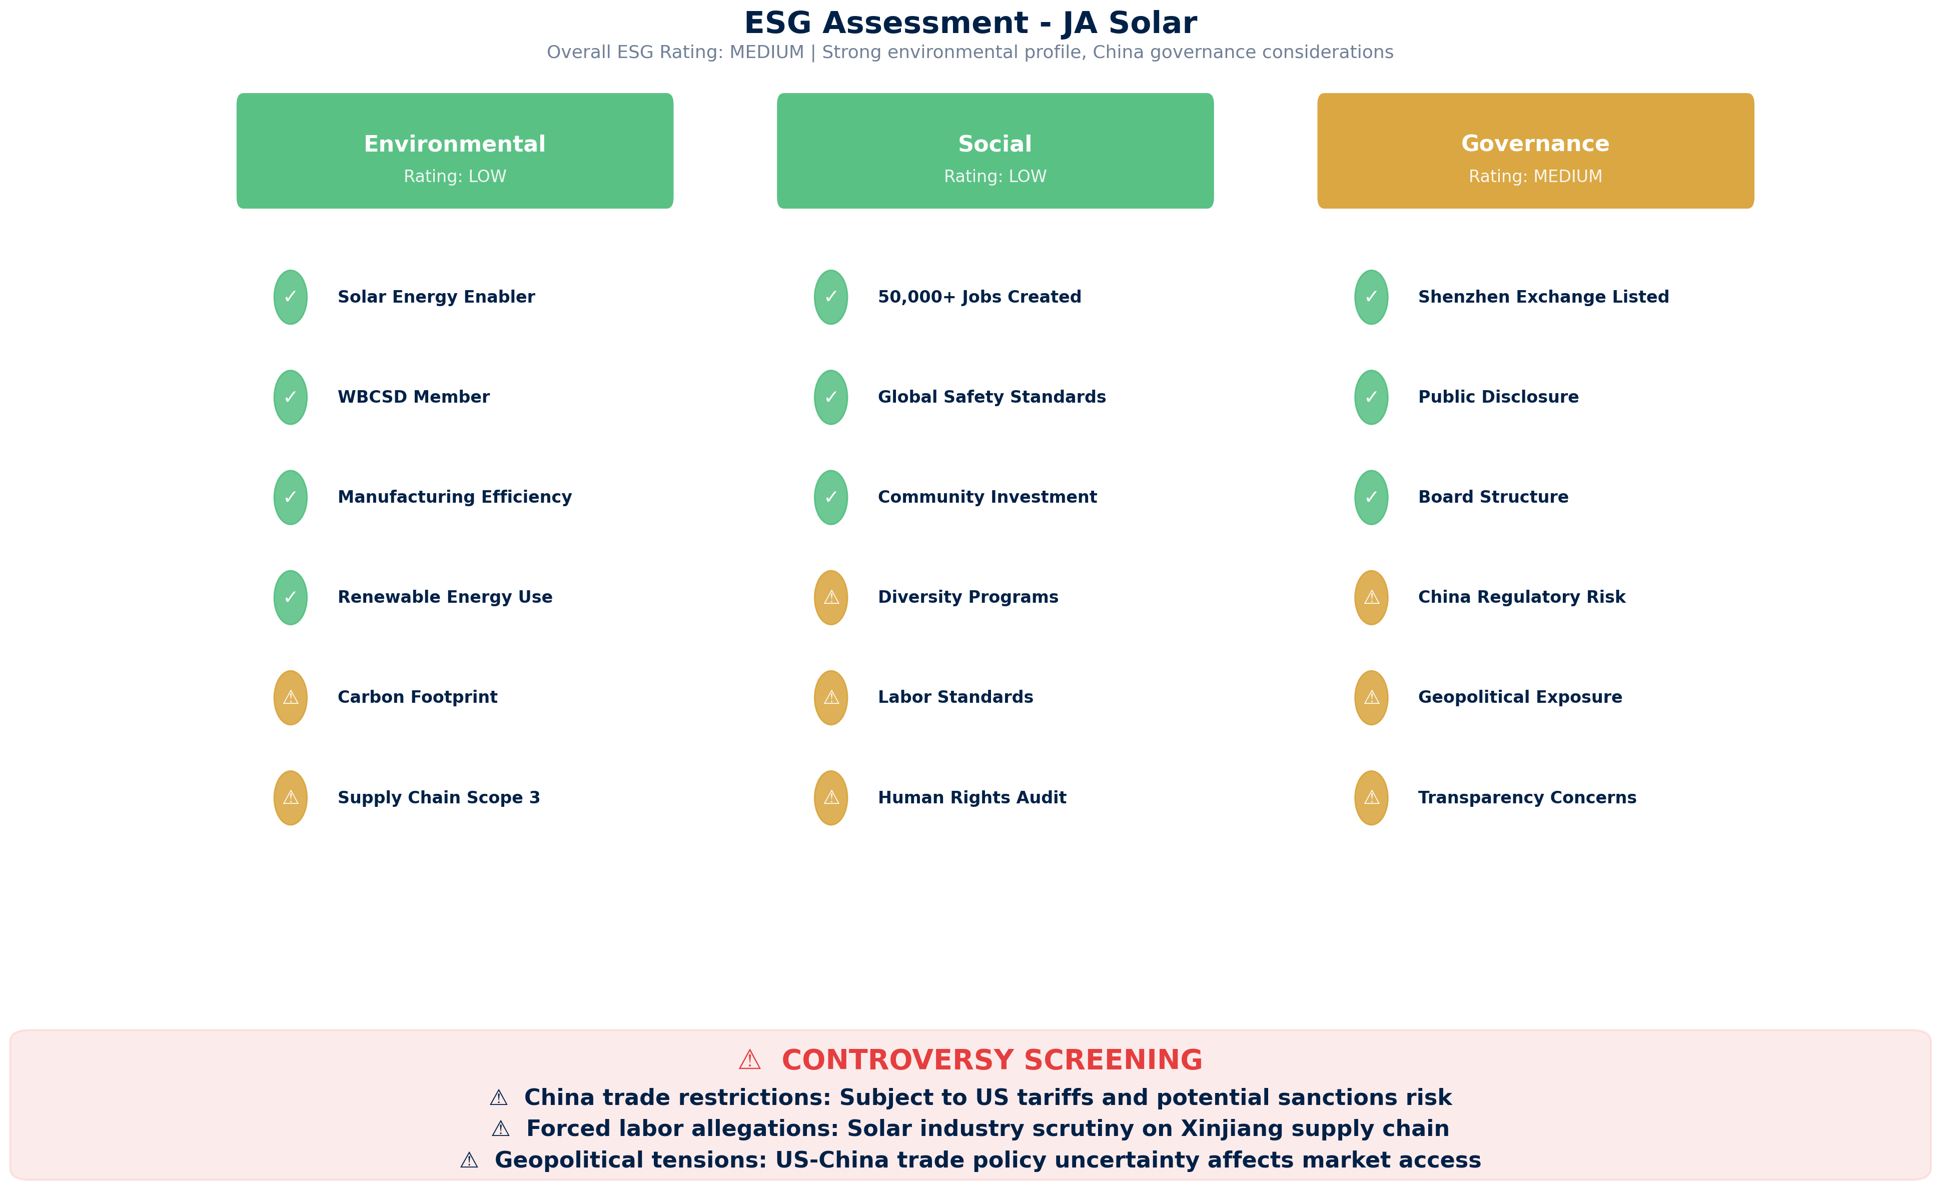
ESG ASSESSMENT
Environmental, Social & Governance Review
Source: Manu Forti Intelligence | Confidential | March 2026

