Slide 1
SUPPLIER EVALUATION REPORT
JiangSu HuaPeng Transformer Co., Ltd.
Power Transformers | Medium Power Transformers | Global Export
US$1.0B Revenue | 2,500 Employees | 57 Years | 200,000 MVA Capacity
Confidential | March 2026 | Manu Forti Intelligence

Slide 2
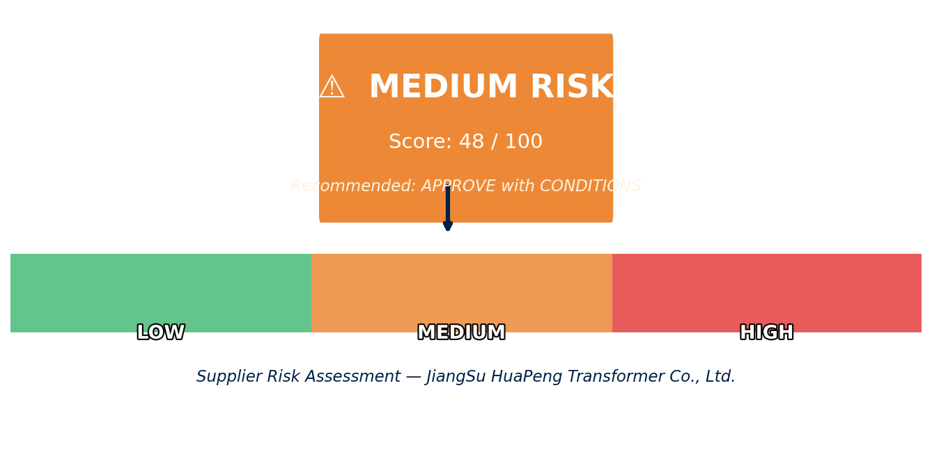
EXECUTIVE SUMMARY
JiangSu HuaPeng Transformer Co., Ltd. — Risk & Suitability Overview
SUPPLIER SNAPSHOT
Supplier:
JiangSu HuaPeng Transformer Co., Ltd.
Type:
Family-Owned (Private)
Sector:
Power Transformer Manufacturing
HQ:
Liyang, Jiangsu, China
Founded:
1967 (57 years)
Revenue:
US$1.0B (2022)
Employees:
2,500 globally
Capacity:
200,000 MVA, up to 850kV
Key Findings
• World's largest Medium Power Transformer producer — market leader position
• 57-year track record with zero catastrophic failures — exceptional quality record
• Only Chinese company in top 10 North American transformer brands — unique position
• 100% China-based manufacturing creates geopolitical exposure — conditions required
Source: Manu Forti Intelligence | Confidential | March 2026

Slide 3
RECOMMENDATION
Decision Summary & Commercial Conditions
⚠ RECOMMENDATION: APPROVE WITH CONDITIONS
JSHP is recommended for Medium Power Transformer supply and select High Power projects. World's largest MPT capacity and zero failure record support approval. Conditions apply due to 100% China manufacturing and geopolitical exposure.
Commercial Conditions
• Fixed pricing or hedging for multi-year contracts
• Parent company guarantee for orders >US$5M
• Performance bonds: 10% for large projects
• Payment terms: Letter of Credit for initial orders
• Confirm US sales office support for NA projects
Approval Conditions (Mandatory)
• Quality inspection rights at Liyang facility
• Quarterly production capacity confirmation
• Geopolitical risk monitoring and mitigation plan
• Alternative sourcing plan for critical projects
• Currency hedging for CNY/USD/EUR exposure
Overall Risk Summary — MEDIUM (48/100)
Financial: LOW
Operational: LOW
Geopolitical: HIGH
ESG: MEDIUM
US$1.0B revenue, debt-free family ownership
200k MVA capacity, zero failure record
100% China manufacturing, trade policy risk
Family governance, limited transparency
Source: Manu Forti Intelligence | Confidential | March 2026

Slide 4
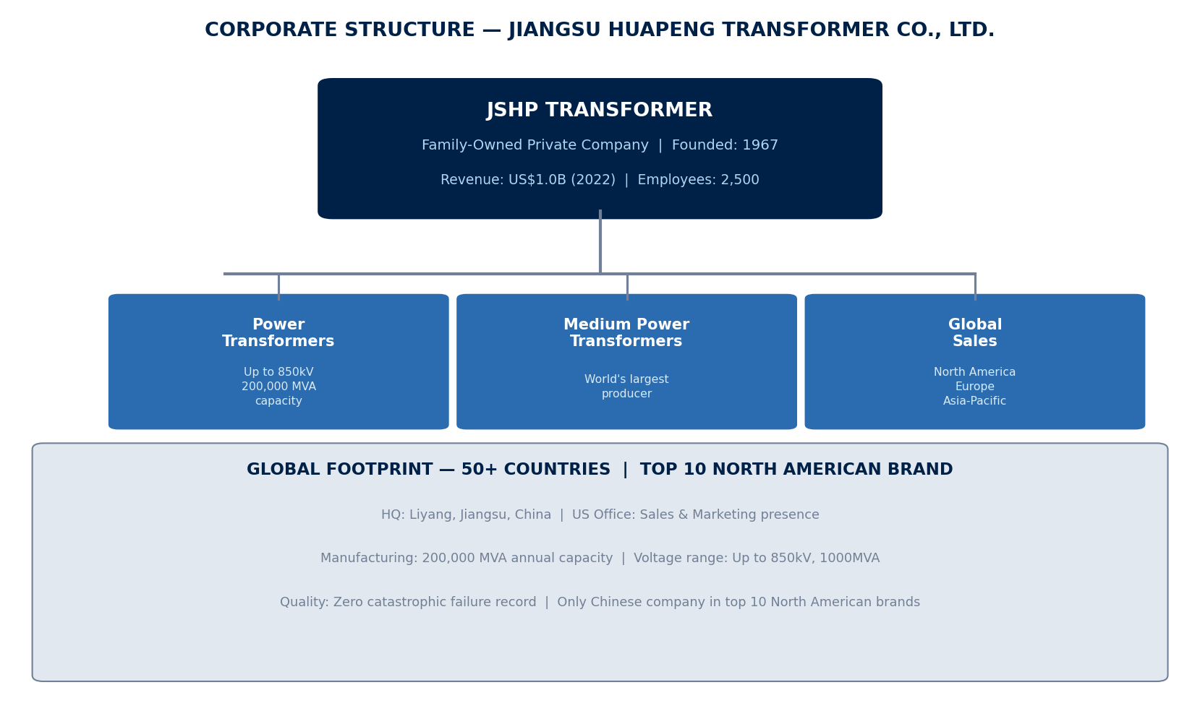
SUPPLIER PROFILE
Corporate Structure & Global Footprint
Company Overview
JiangSu HuaPeng Transformer Co., Ltd. (JSHP)
is a leading Chinese manufacturer of power
transformers, specializing in Medium Power
Transformers where it holds the position of
world's largest producer.
Founded in 1967, the family-owned company
has built a 57-year track record with zero
catastrophic failures across thousands of
installed units globally.
Manufacturing Excellence
• Annual capacity: 200,000 MVA
• Voltage range: Up to 850kV, 1000MVA
• 50-day avg fabrication (110kV-500kV)
• 2022 production: 628 units (110-500kV)
• 8,764 units (69kV and below)
• ISO 9001 certified
Source: Manu Forti Intelligence | Confidential | March 2026

Slide 5
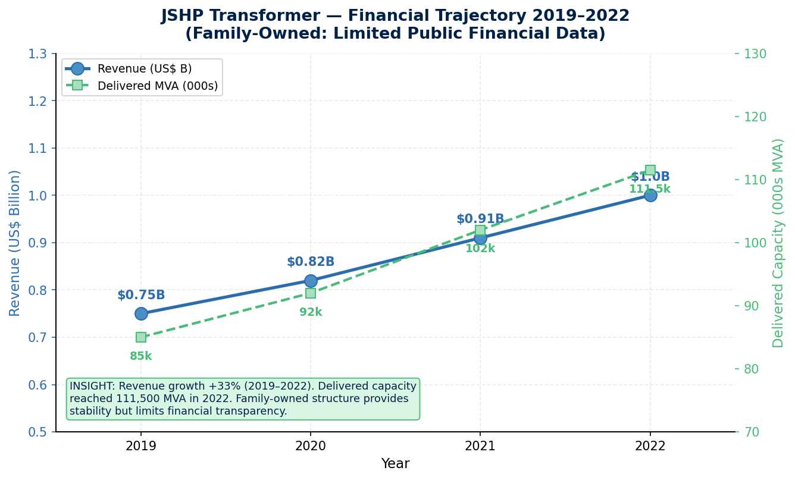
FINANCIAL HEALTH
Revenue Trajectory 2019–2022 | Family-Owned: Limited Public Financial Data
Financial Highlights
2022 Revenue:
US$1.0B (est.)
Revenue Growth:
+33% (2019–2022)
Ownership:
Family-owned, private
Debt Status:
Minimal / Debt-free
Delivered 2022:
111,500 MVA
Liquidity:
Strong (private reserves)
Transparency:
Limited (private co.)
Credit Risk:
LOW — stable ownership
Financial Risk: LOW ✓
Exposure Guidance
• Debt-free family ownership — low credit risk
• Parent guarantee recommended for large orders
• Limited financial transparency — private company
• Payment: LC recommended for initial orders
Source: Manu Forti Intelligence | Confidential | March 2026

Slide 6
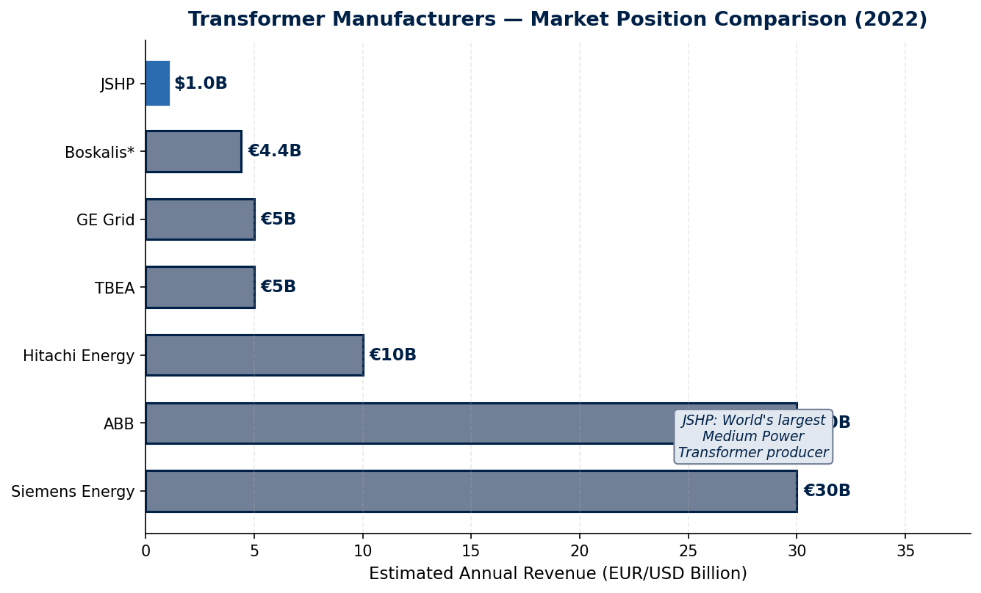
MARKET POSITION
Transformer Manufacturing — Revenue Comparison
Competitive Landscape
JSHP occupies a unique position as the only
Chinese manufacturer in the top 10 North
American transformer brands. While smaller
than global giants like Siemens and ABB,
JSHP dominates the Medium Power Transformer
segment with unmatched specialization.
JSHP Competitive Advantages
• World's largest MPT producer by volume
• Only Chinese company in top 10 NA brands
• Zero catastrophic failure record
• 50-day fabrication time (competitive)
• Strong value proposition vs. European peers
• 200,000 MVA manufacturing capacity
Key Competitors
• Siemens Energy — Germany — €30B+ — Global leader, premium pricing
• ABB — Switzerland — €30B+ — Broad portfolio, strong service network
• Hitachi Energy — Japan — €10B+ — Technology leader, high reliability
• TBEA — China — €5B+ — Domestic China leader, expanding globally
Source: Manu Forti Intelligence | Confidential | March 2026

Slide 7
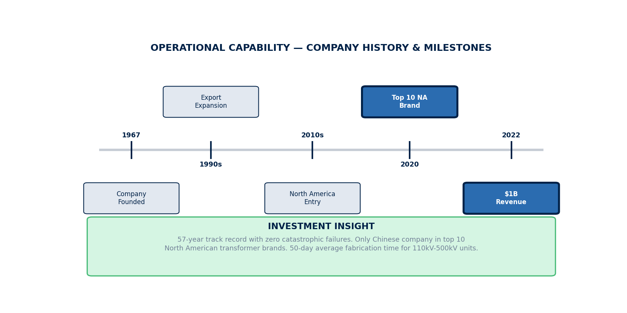
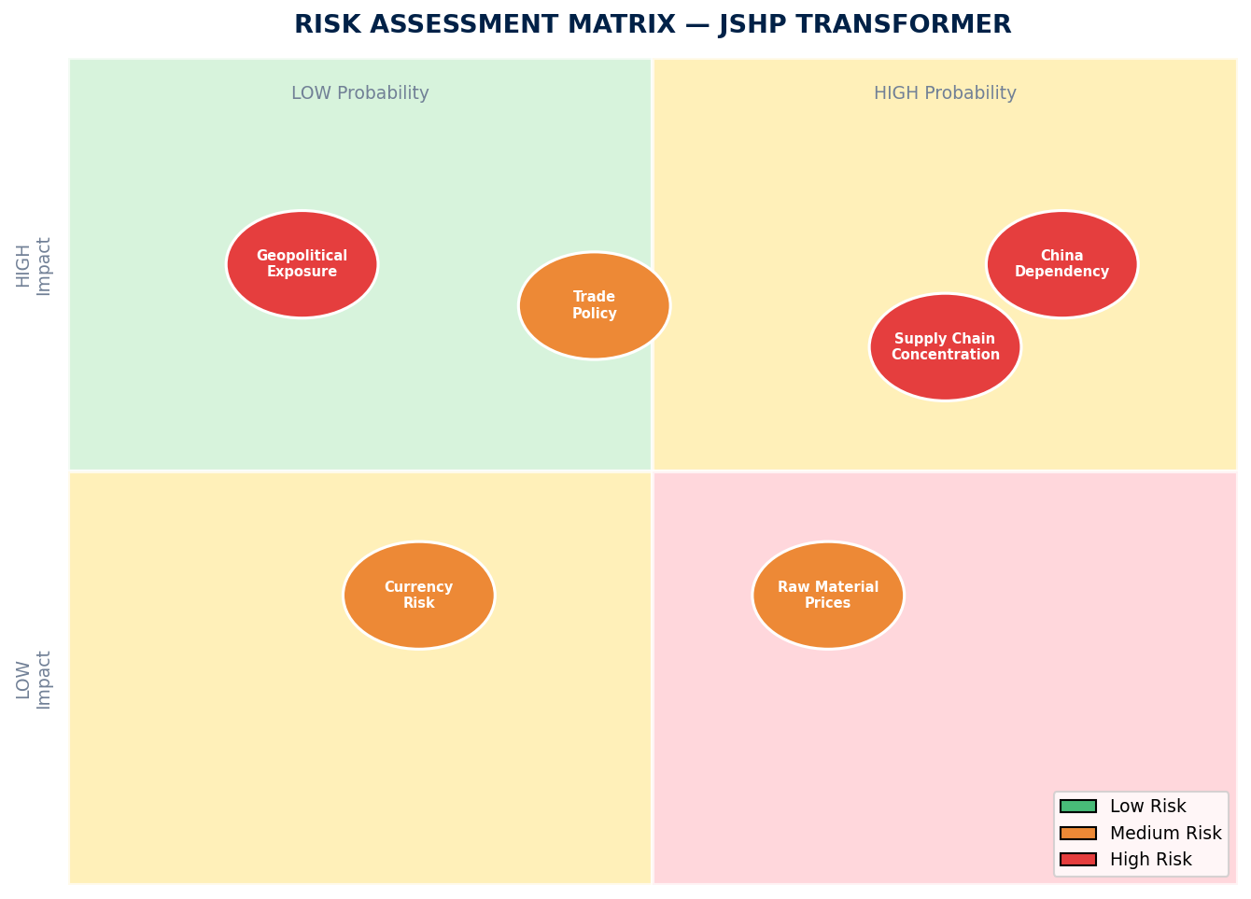
OPERATIONAL CAPABILITY & RISK ASSESSMENT
Milestones & Strategic Investment | Risk Matrix | Capability Summary
Risk Summary
Key Capabilities
• ISO 9001 certified quality management
• 57 years continuous operation
• 50+ countries served globally
• US sales office for NA support
Geopolitical:
🔴 HIGH
100% China manufacturing — tariff/trade exposure
Trade Policy:
🟡 MEDIUM
US/EU tariffs on Chinese electrical equipment
Supply Chain:
🔴 HIGH
Concentrated China supply base
Operational:
🟢 LOW
Zero failures, ISO 9001 certified
Financial:
🟢 LOW
Debt-free family ownership
Source: Manu Forti Intelligence | Confidential | March 2026

Slide 8
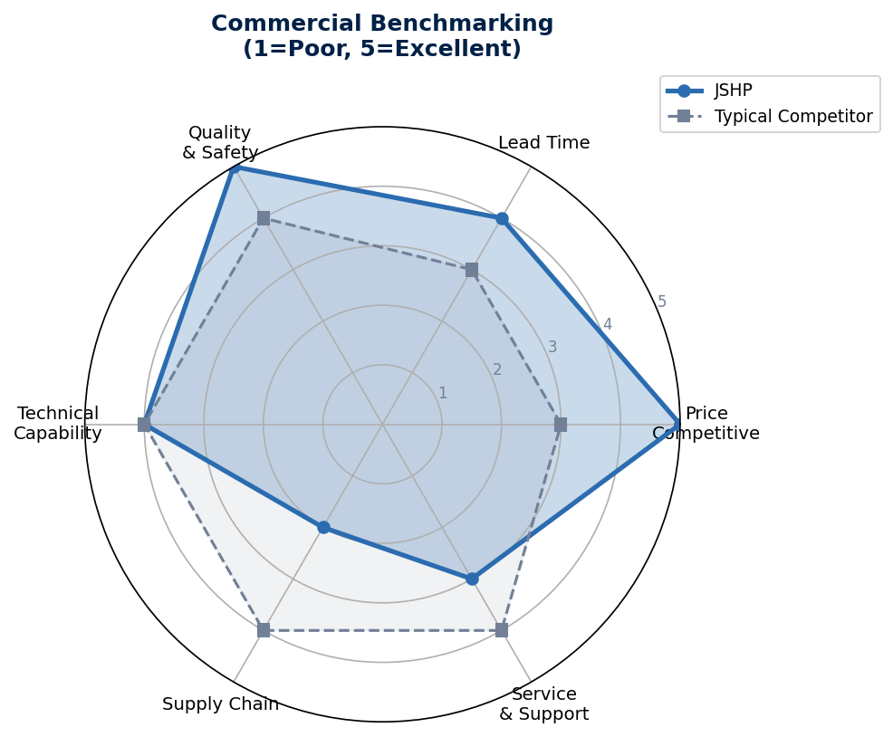
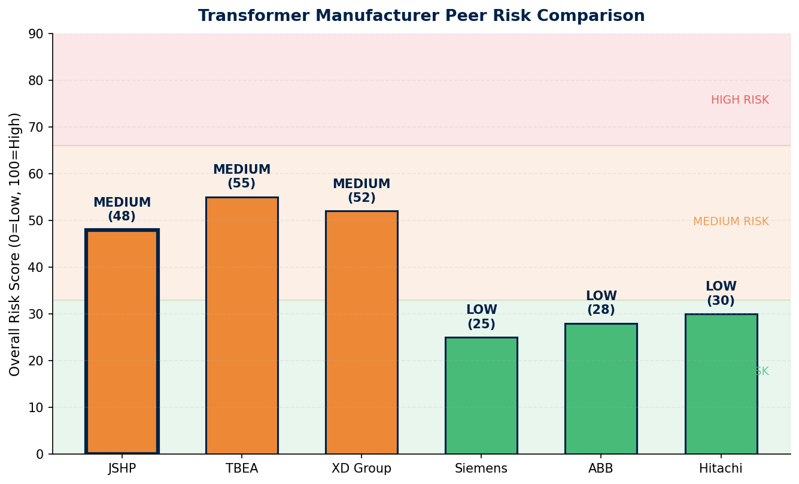
COMMERCIAL INTELLIGENCE & PEER RISK COMPARISON
Benchmarking Radar | Peer Risk Profile | Commercial Terms
Commercial Terms & Negotiation
• Pricing: 20-30% below European competitors
• Lead time: 50 days average (110kV-500kV)
• MOQ: Flexible for established relationships
• Warranty: Standard 2-year, extended available
Key Watch Points
⚠ Geopolitical: Monitor US-China trade policy developments
⚠ Supply chain: Confirm raw material sourcing stability
⚠ Currency: Hedge CNY/USD exposure on long-term contracts
Source: Manu Forti Intelligence | Confidential | March 2026

Slide 9
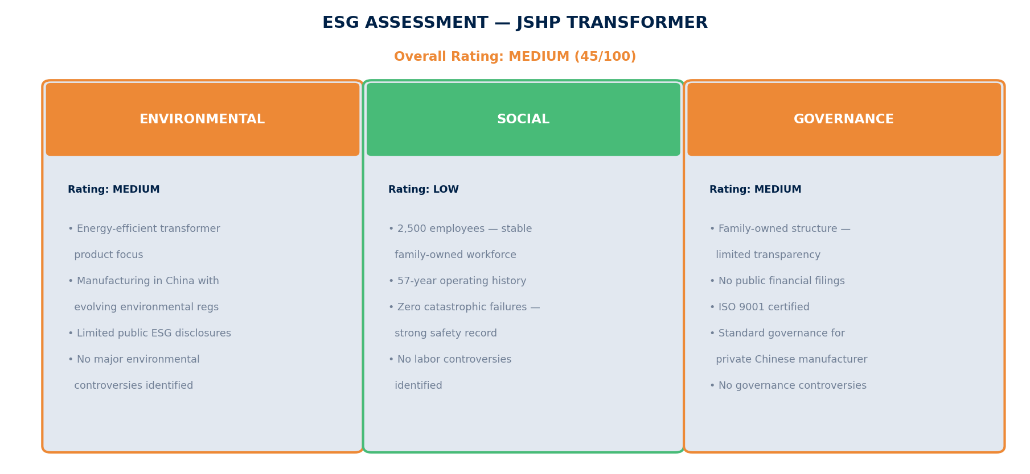
ESG ASSESSMENT
Environmental, Social & Governance Screening | Overall Rating: MEDIUM
Source: Manu Forti Intelligence | Confidential | March 2026

