Slide 1

SUPPLIER EVALUATION REPORT
Nel ASA
Hydrogen Electrolysers | Alkaline & PEM | 1 GW+ Manufacturing
NOK 1.6B Order Backlog | ~550 Employees | Oslo Bors Listed | Founded 1927
Confidential | March 2026 | Manu Forti Intelligence

Slide 2
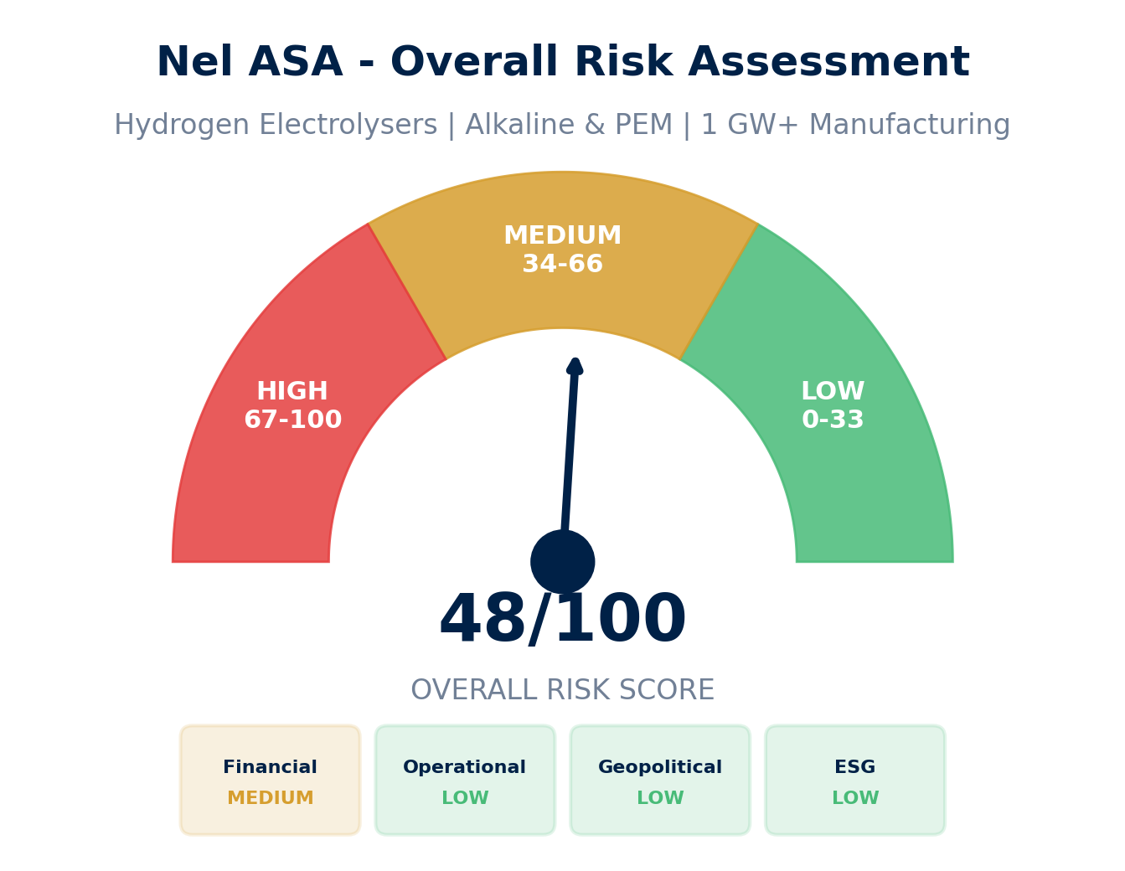
EXECUTIVE SUMMARY
Nel ASA - Risk & Suitability Overview
SUPPLIER SNAPSHOT
Supplier:
Nel ASA (OSE: NEL)
Type:
Public Company
Sector:
Hydrogen Electrolysers
HQ:
Oslo, Norway
Founded:
1927
Employees:
~550
Revenue:
NOK 1.3B (2023)
Order Backlog:
NOK 1.6B
Cash:
NOK 1.9B
Manufacturing:
1.5 GW Capacity
Key Findings
• Leading Nordic hydrogen electrolyser manufacturer with 1+ GW capacity
• Dual technology: Alkaline (Heroya, Norway) and PEM (Wallingford, US)
• Negative EBITDA but strong cash position (NOK 1.9B) and order backlog
• ESG leader: Enabling green hydrogen economy; strong environmental profile
Source: Manu Forti Intelligence | Confidential | March 2026

Slide 3
RECOMMENDATION
Decision Summary & Commercial Conditions
⚠ RECOMMENDATION: CONDITIONAL APPROVAL
Nel is a technically capable, established electrolyser manufacturer with strong ESG credentials and manufacturing scale. However, negative EBITDA and order backlog decline require enhanced due diligence and milestone-based engagement.
Commercial Conditions
• Payment: Milestone-based (no advance payment)
• Performance bonds: 10-15% of contract value
• Liquidated damages: For delivery delays
• Parent guarantee: Not applicable (public company)
• Local entity: Norwegian contract preferred
Enhanced Due Diligence (Mandatory)
• Review latest quarterly financials (Q4 2024)
• Verify order backlog quality and customer creditworthiness
• Site visit: Heroya manufacturing facility
• Technology validation: Independent electrolyser efficiency test
• Reference checks: Existing utility customers
Overall Risk Summary - MEDIUM (48/100)
Financial: MEDIUM
Operational: LOW
Geopolitical: LOW
ESG: LOW
Negative EBITDA; strong cash position
Proven manufacturing; 1+ GW capacity
Norwegian-based; stable jurisdiction
Green hydrogen enabler; strong profile
Source: Manu Forti Intelligence | Confidential | March 2026

Slide 4
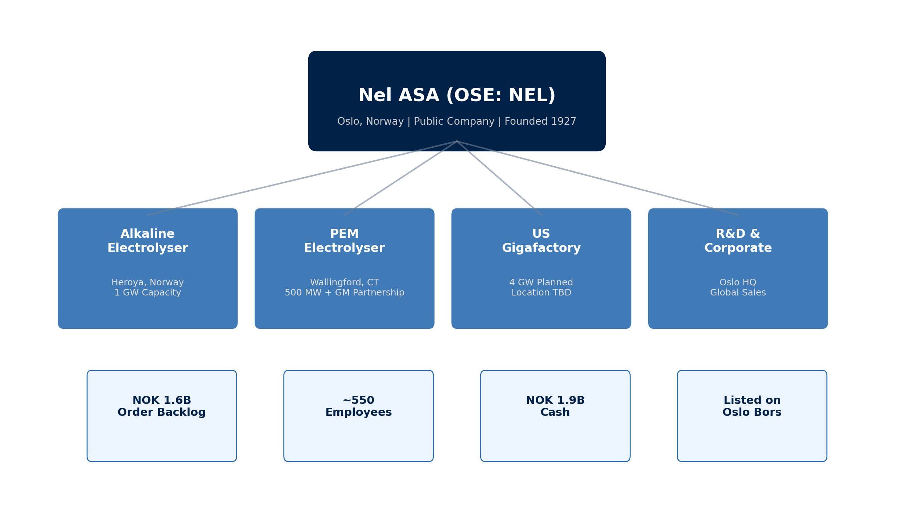
SUPPLIER PROFILE
Corporate Structure & Global Footprint
Company Overview
• Nel ASA is a leading global hydrogen
• company specializing in electrolyser
• technology for production of green
• hydrogen from renewable energy.
•
• Founded 1927; spun out as dedicated
• hydrogen company in 2015. Listed on
• Oslo Bors (OSE: NEL).
Leadership & Operations
• CEO: Hakon Volldal
• (appointed 2020)
•
• HQ: Oslo, Norway
• Manufacturing: Heroya (NO),
• Wallingford (US)
•
• R&D: GM partnership (PEM)
Source: Manu Forti Intelligence | Confidential | March 2026

Slide 5
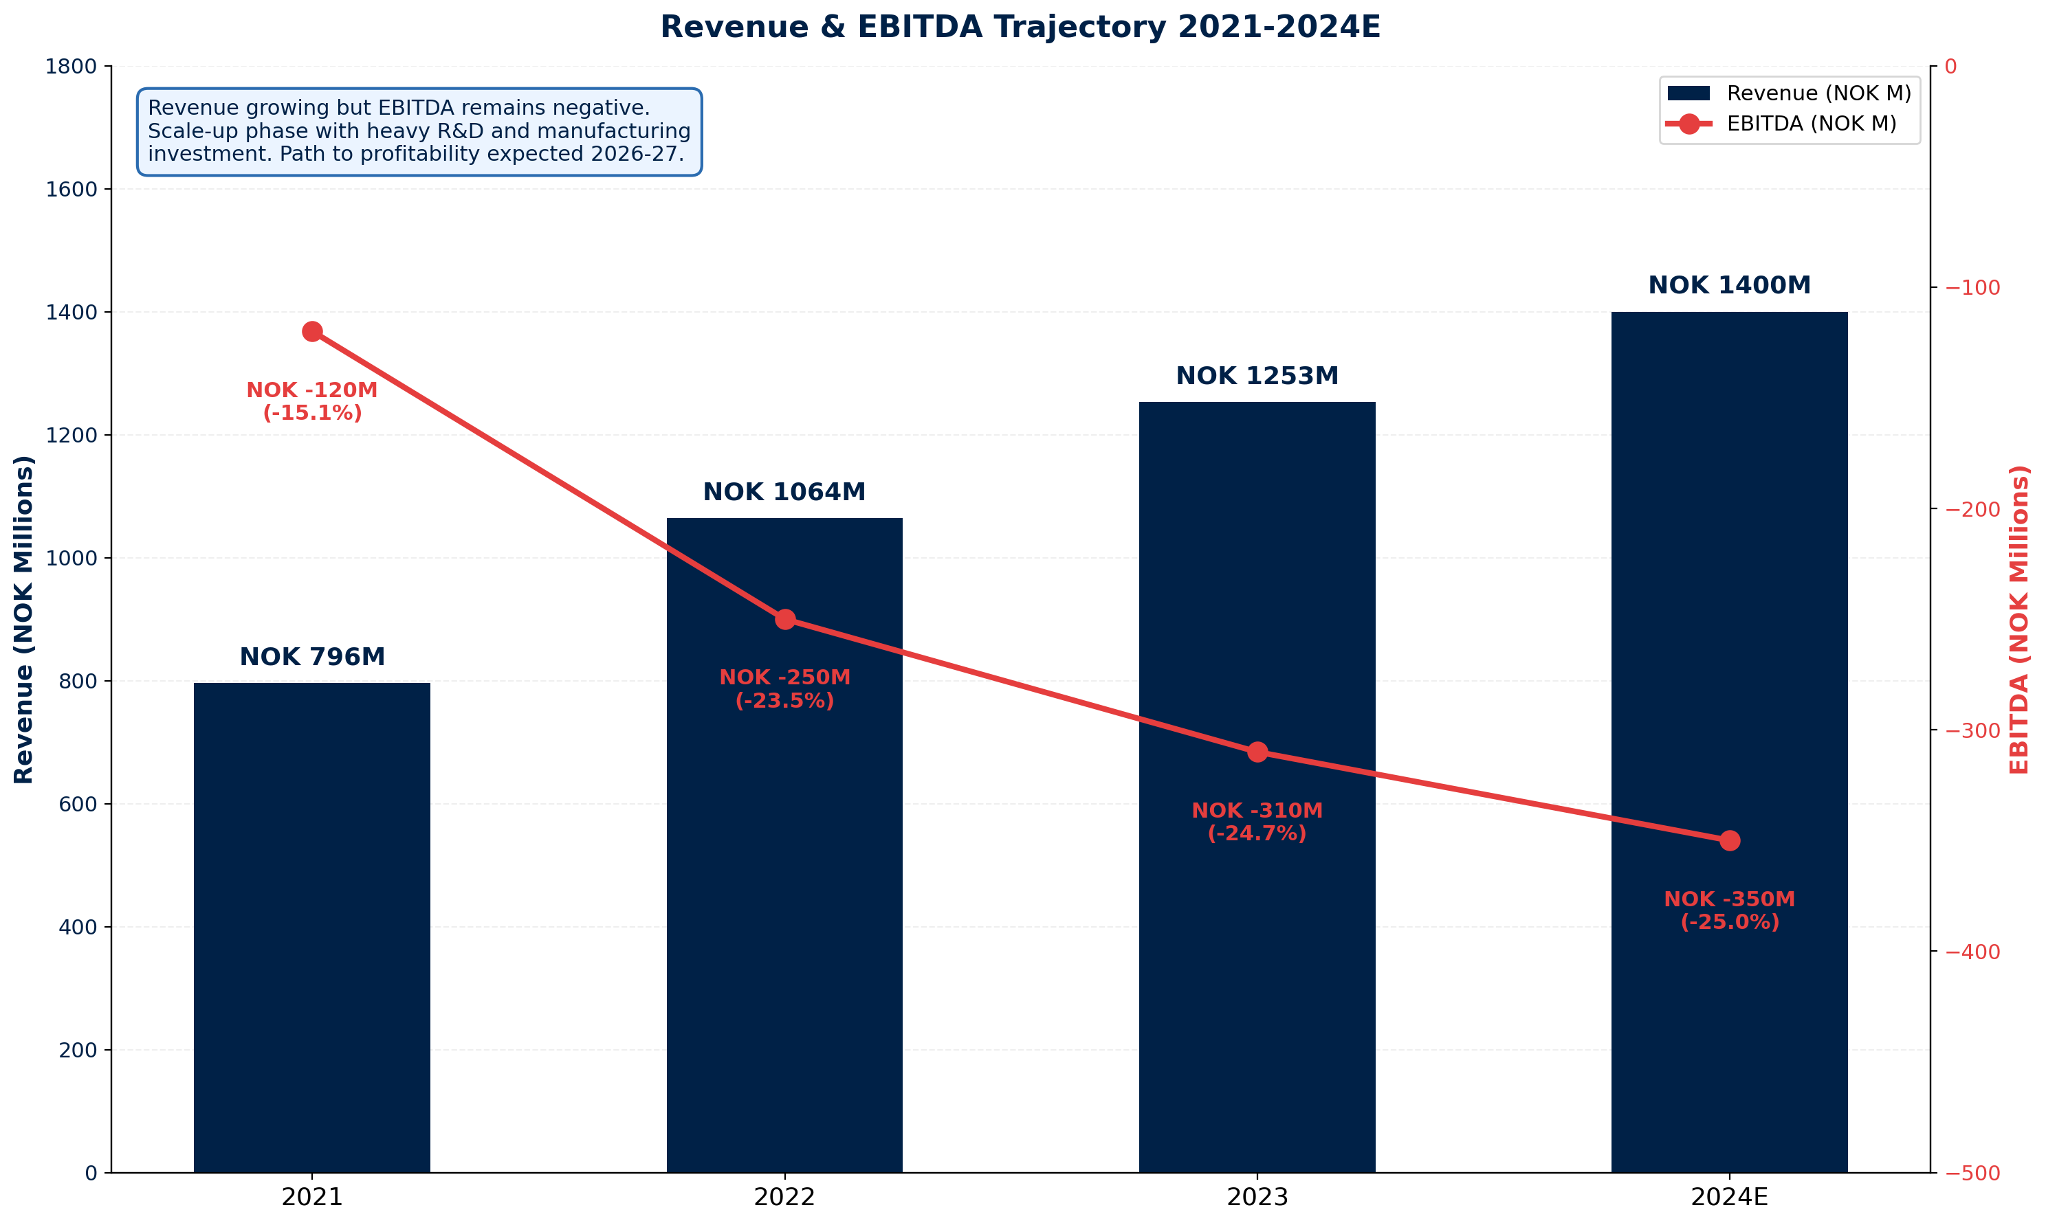
FINANCIAL HEALTH
Revenue & EBITDA Trajectory 2021-2024E | Listed on Oslo Bors
Financial Highlights
2023 Revenue:
NOK 1,253M
2024E Revenue:
NOK ~1,400M
Revenue Growth:
+21% YoY (Q3 2024)
EBITDA:
NOK -90M (Q3 2024)
Order Backlog:
NOK 1,614M (Q4 2024)
Cash Balance:
NOK 1,876M
Employees:
~550
Market Cap:
NOK ~15B (varies)
Financial Risk: MEDIUM ⚠
Exposure Guidance
• Negative EBITDA but strong cash buffer
• Public company - full financial disclosure
• Milestone-based payments recommended
• Monitor quarterly results for improvement
Source: Manu Forti Intelligence | Confidential | March 2026

Slide 6
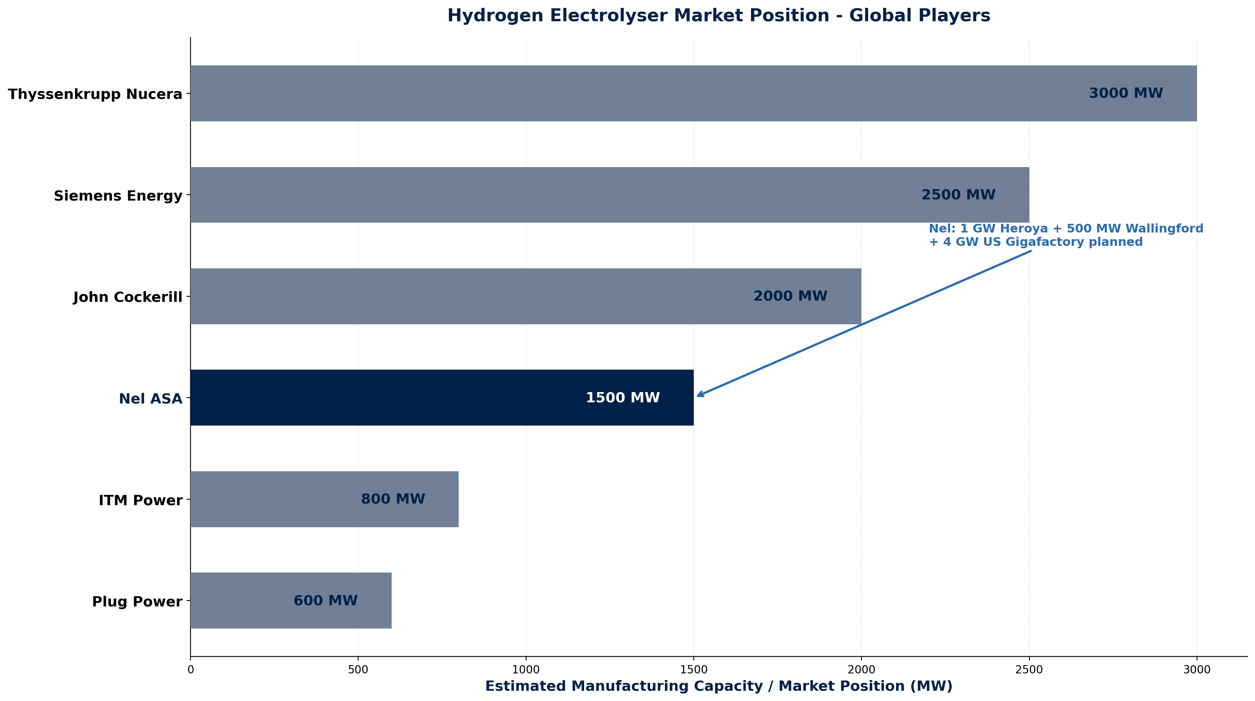
MARKET POSITION
Hydrogen Electrolyser Market Position - Global Players
Competitive Landscape
• Nel is a top-4 global electrolyser
• manufacturer with established
• technology and manufacturing scale.
• Competes with German industrial
• giants and emerging players.
Nel Competitive Advantages
• 1+ GW manufacturing capacity
• Dual technology (Alkaline + PEM)
• Norwegian/Nordic green energy access
• US expansion (4 GW Gigafactory planned)
• GM partnership for PEM technology
• Public company transparency
Key Competitors
• Thyssenkrupp Nucera - Germany - 3 GW capacity - Industrial giant
• Siemens Energy - Germany - 2.5 GW - Energy infrastructure leader
• John Cockerill - Belgium - 2 GW - Industrial equipment focus
• ITM Power - UK - 800 MW - PEM specialist
• Plug Power - USA - 600 MW - Integrated hydrogen solutions
Source: Manu Forti Intelligence | Confidential | March 2026

Slide 7
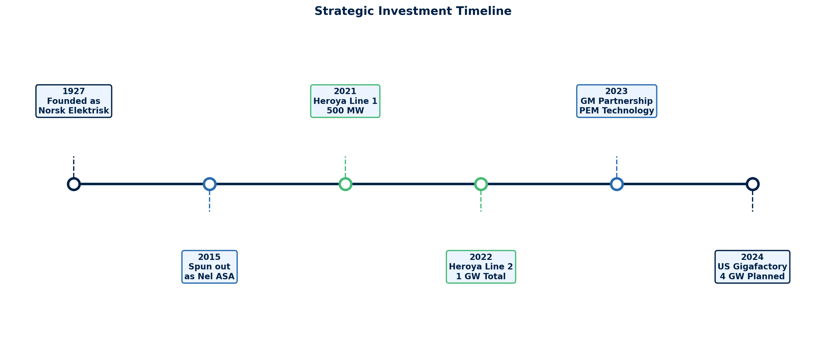
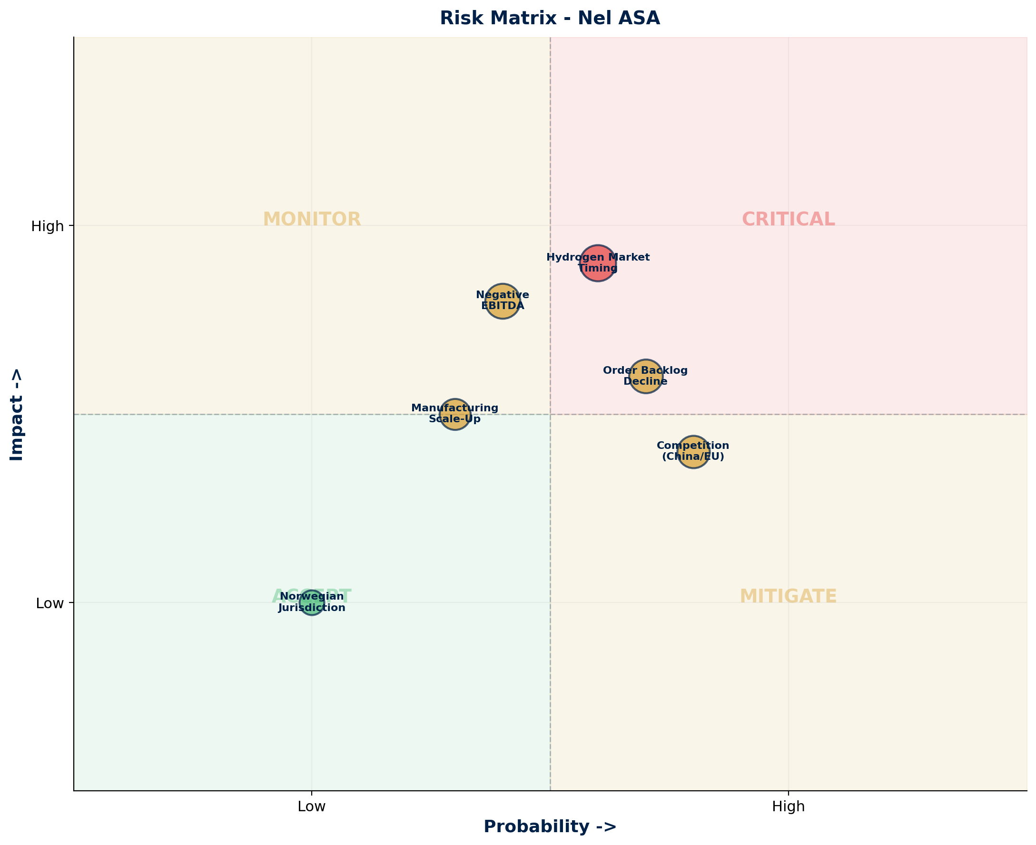
OPERATIONAL CAPABILITY & RISK ASSESSMENT
Milestones & Strategic Investment | Risk Matrix | Capability Summary
Risk Summary
Key Capabilities
• Alkaline electrolyser manufacturing (1 GW)
• PEM electrolyser technology (GM partnership)
• Modular, scalable system design
• Global service and support network
Financial:
🟡 MEDIUM
Negative EBITDA; strong cash position
Operational:
🟢 LOW
Proven manufacturing; 1+ GW capacity
Technology:
🟢 LOW
Mature alkaline + GM PEM partnership
Competition:
🟡 MEDIUM
Strong German/Chinese competition
Market Timing:
🟡 MEDIUM
Green hydrogen adoption slower than expected
Source: Manu Forti Intelligence | Confidential | March 2026

Slide 8
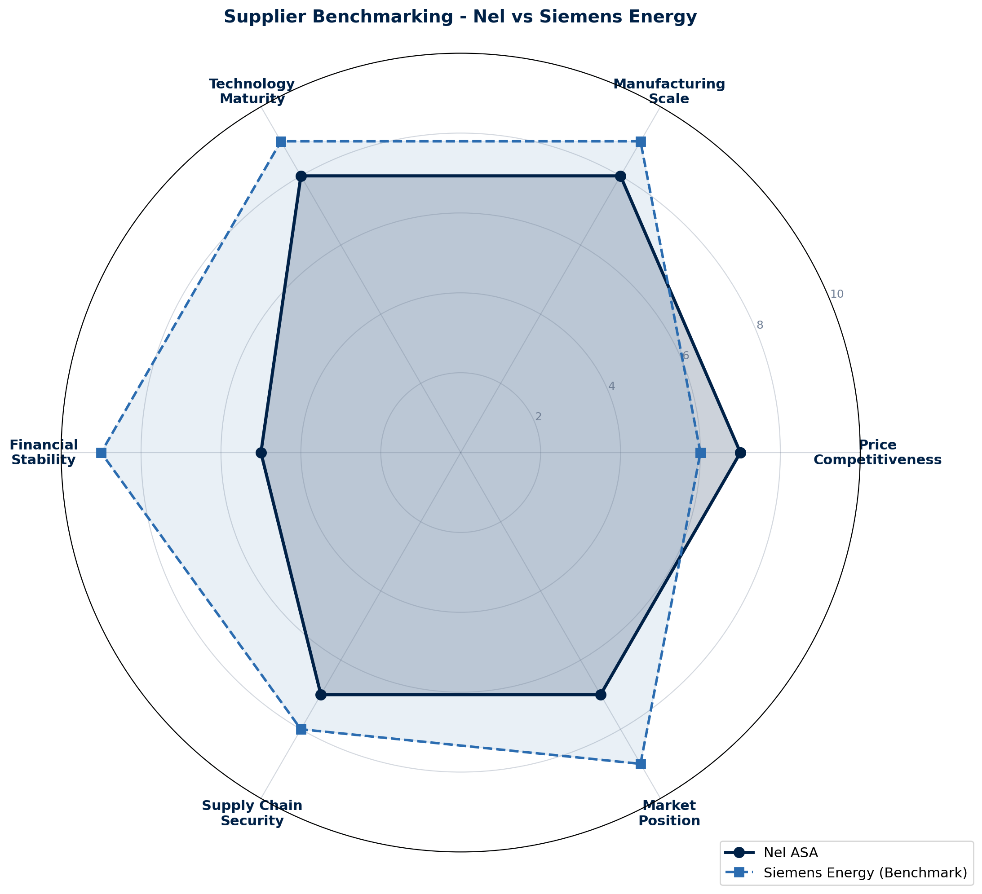
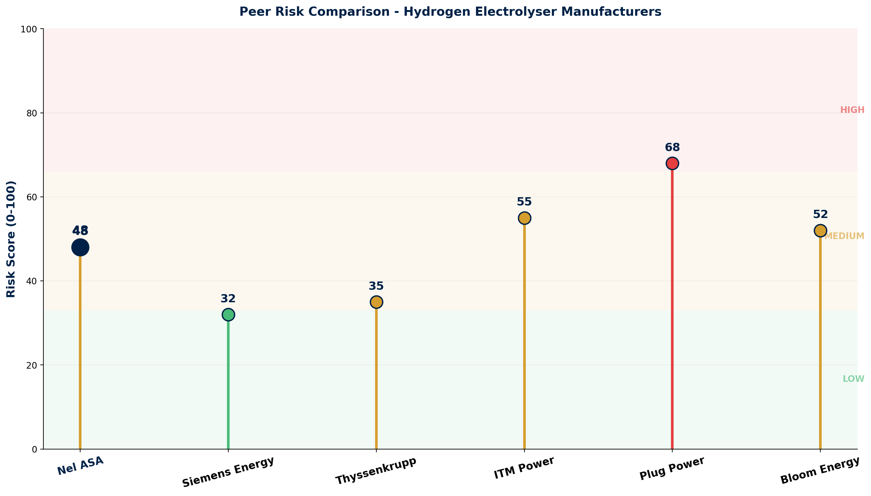
COMMERCIAL INTELLIGENCE & PEER RISK COMPARISON
Benchmarking Radar | Peer Risk Profile | Commercial Terms
Commercial Terms & Negotiation
• Pricing: Competitive vs Siemens/Thyssenkrupp
• Lead time: 12-18 months for large-scale projects
• Payment: Milestone-based recommended
• Warranty: Standard 2-year equipment warranty
Key Watch Points
• ⚠ Monitor quarterly financial results for EBITDA improvement
• ⚠ Track order backlog trend (declined from NOK 2.4B to 1.6B)
• ⚠ Verify US Gigafactory construction timeline
• ⚠ Assess competition from Chinese electrolyser manufacturers
Source: Manu Forti Intelligence | Confidential | March 2026

Slide 9
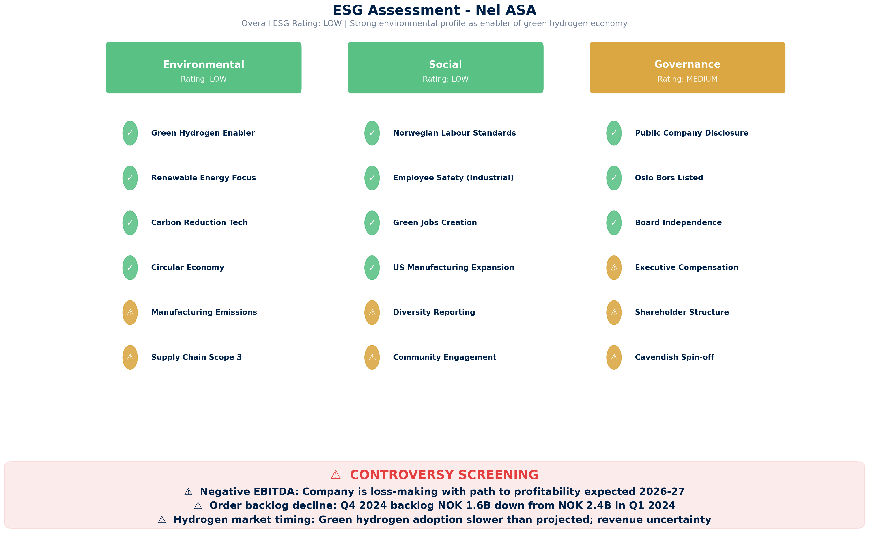
ESG ASSESSMENT
Environmental, Social & Governance Screening | Overall Rating: LOW
Source: Manu Forti Intelligence | Confidential | March 2026

