Slide 1
SUPPLIER EVALUATION REPORT
OX2 AB
Renewable Energy Development | Onshore & Offshore Wind | Solar PV & Storage
SEK 5.4B Revenue | ~612 Employees | 10+ Markets | EQT Owned
Confidential | March 2026 | Manu Forti Intelligence

Slide 2
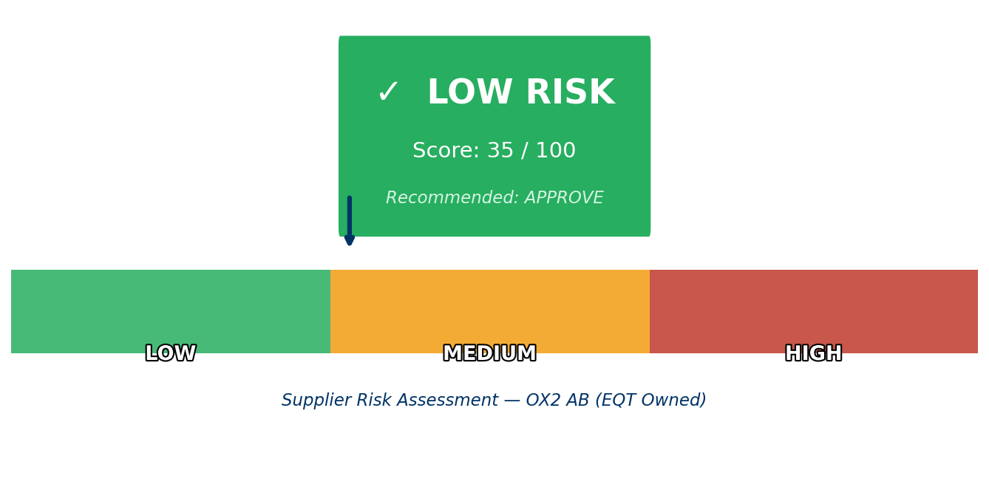
EXECUTIVE SUMMARY
OX2
OX2 AB — Risk & Suitability Overview
SUPPLIER SNAPSHOT
Supplier:
OX2 AB
Ownership:
EQT Private Equity (Oct 2024)
Sector:
Renewable Energy Development
HQ:
Stockholm, Sweden
Founded:
2004 (19+ years experience)
Revenue:
SEK 5.4B ($520M est. 2024)
EBITDA:
SEK 1,000M+ ($96M+, ~18% margin)
Pipeline:
Multi-GW development portfolio
Employees:
~612 globally
Key Findings
• EQT acquisition (Oct 2024) provides financial stability and long-term capital
• Pure-play renewable developer with 19+ years track record in Nordics/Baltics
• Revenue volatility due to project timing — typical for development business
• Multi-GW pipeline across onshore wind, offshore wind, solar PV, and storage
Manu Forti Intelligence
Source: Manu Forti Intelligence | Confidential | March 2026

Slide 3
RECOMMENDATION
OX2
Decision Summary & Commercial Conditions
✓ RECOMMENDATION: APPROVE
OX2 is recommended for renewable energy project development partnerships. Strong EQT backing, proven track record, and pure-play renewable focus make them a suitable counterparty. Standard project finance structures and milestone-based payments recommended.
Commercial Conditions
• Milestone-based payments tied to project approvals and milestones
• Standard development fee structures for project origination
• EQT parent company guarantee for large-scale commitments
• Performance security via escrow for upfront development costs
• Regular financial reporting (quarterly) given private ownership
Risk Mitigation Measures
• Verify EQT commitment letter for long-term capital support
• Secure step-in rights if development milestones missed
• Contingency planning for grid connection delays
• Diversify across multiple OX2 projects to reduce concentration
• Monitor regulatory changes in key markets (Sweden, Finland, Poland)
Overall Risk Summary — LOW (35/100)
Financial: LOW
Operational: LOW
Geopolitical: LOW
ESG: LOW
SEK 5.4B revenue, PE-backed, strong liquidity
19+ years experience, multi-GW pipeline
Sweden HQ, EU/NATO aligned, diversified markets
Pure-play renewable, strong sustainability focus
Manu Forti Intelligence
Source: Manu Forti Intelligence | Confidential | March 2026

Slide 4
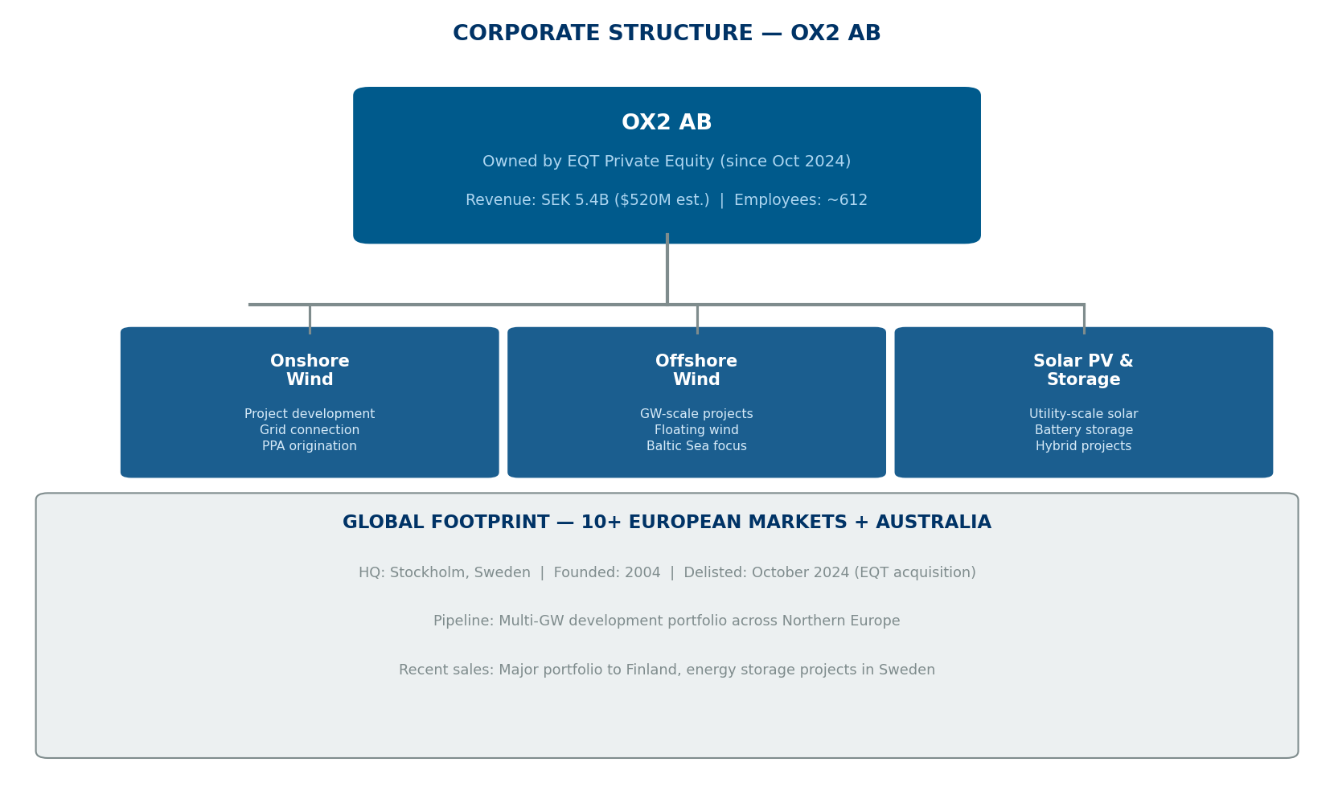
SUPPLIER PROFILE
OX2
Corporate Structure & Global Footprint
Company Overview
OX2 is a leading European developer of renewable
energy projects, specializing in onshore wind,
offshore wind, solar PV, and energy storage.
Founded in 2004, the company has developed
a multi-gigawatt project pipeline across
Northern Europe and Australia.
Acquired by EQT Private Equity in October 2024,
providing long-term capital and strategic backing
for continued growth and project development.
Leadership
Paul Stormoen — CEO
Founder and industry veteran
20+ years in renewables
HQ: Stockholm, Sweden
Founded: 2004
Delisted: October 2024
Manu Forti Intelligence
Source: Manu Forti Intelligence | Confidential | March 2026

Slide 5
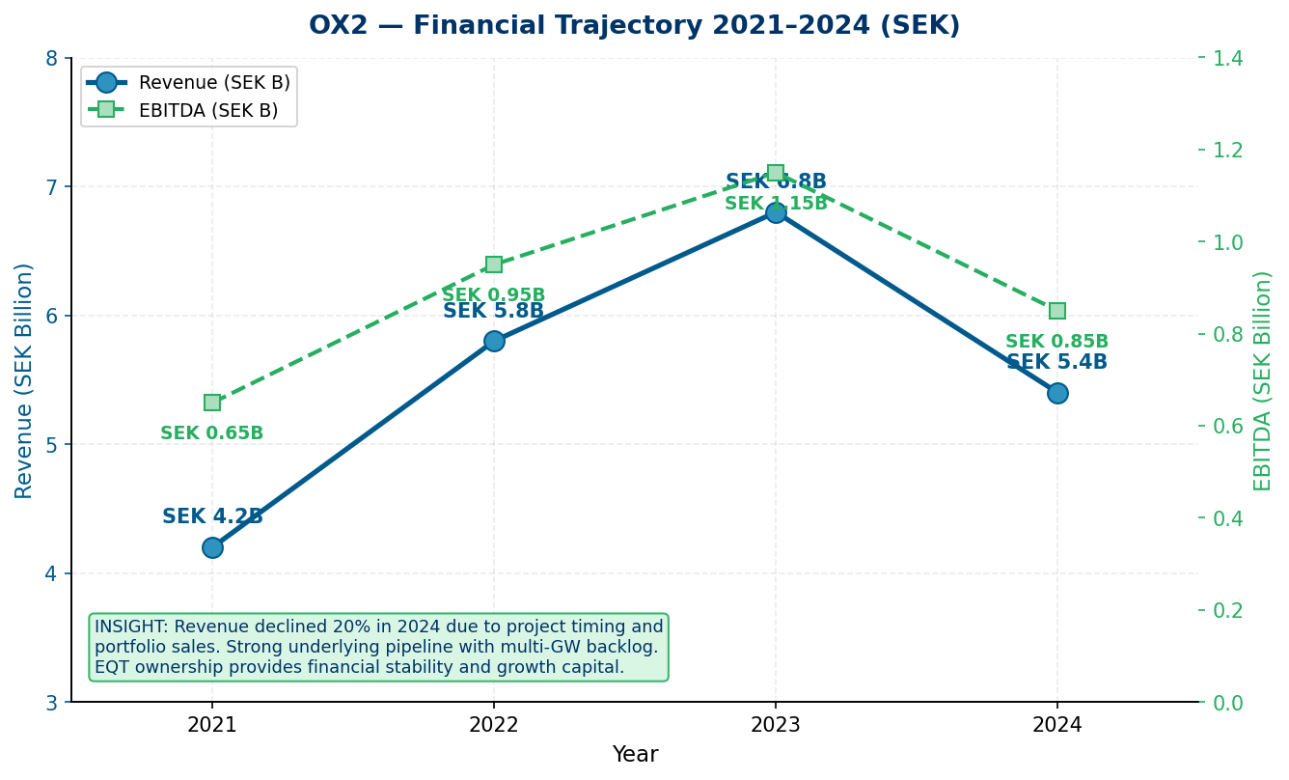
FINANCIAL HEALTH
OX2
Revenue & EBITDA Trajectory 2021–2024 | EQT Backed | Strong Liquidity
Financial Highlights
2024 Revenue:
SEK 5.4B (-20% YoY)
2024 EBITDA:
SEK 1,000M+ (~18% margin)
2023 Net Profit:
SEK 800M+ ($77M+)
3yr Revenue CAGR:
+9% (2021–2023)
Order Book:
Multi-GW pipeline
Gross Debt:
Moderate (PE managed)
Net Cash Position:
Positive (EQT backed)
Debt / EBITDA:
<1.0x ✓ (conservative)
Financial Risk: LOW ✓
Exposure Guidance
• EQT backing provides financial stability
• Milestone-based payments reduce counterparty risk
• No parent guarantee required for standard projects
• Escrow recommended for large upfront commitments
Manu Forti Intelligence
Source: Manu Forti Intelligence | Confidential | March 2026

Slide 6
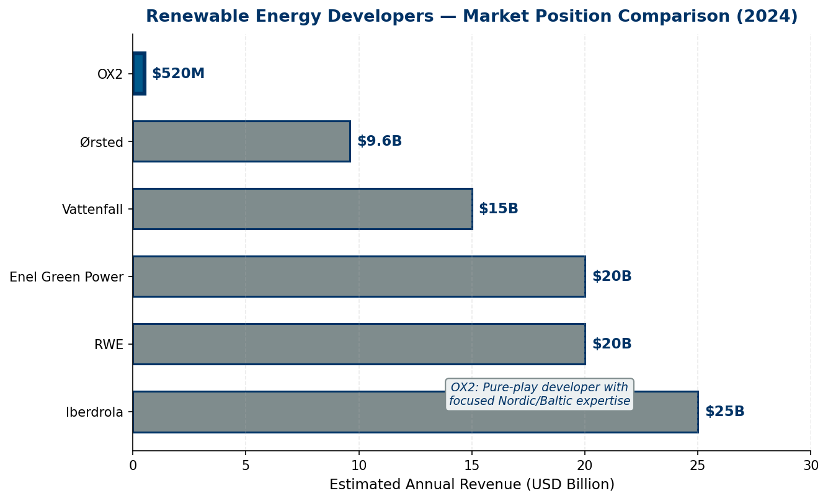
MARKET POSITION
OX2
Renewable Developer Revenue Comparison — 2024 Estimates
Competitive Landscape
OX2 operates as a focused pure-play developer
with deep expertise in Nordic and Baltic markets.
While smaller than utility-scale competitors,
OX2's specialized focus and local relationships
provide competitive advantages in target markets.
OX2 Competitive Advantages
• 19+ years Nordic/Baltic market expertise
• Multi-GW development pipeline
• EQT backing for long-term growth capital
• Integrated development capabilities
• Strong track record of project sales
• Pure-play renewable focus (no fossil legacy)
Key Competitors
• Ørsted — Denmark — $9.6B — Global offshore wind leader
• Vattenfall — Sweden — $15B+ — Swedish state-owned utility
• RWE — Germany — $20B+ — Major German utility/renewables
• Iberdrola — Spain — $25B+ — Spanish renewable giant
Manu Forti Intelligence
• Enel Green Power — Italy — $20B+ — Italian global renewables
Source: Manu Forti Intelligence | Confidential | March 2026

Slide 7
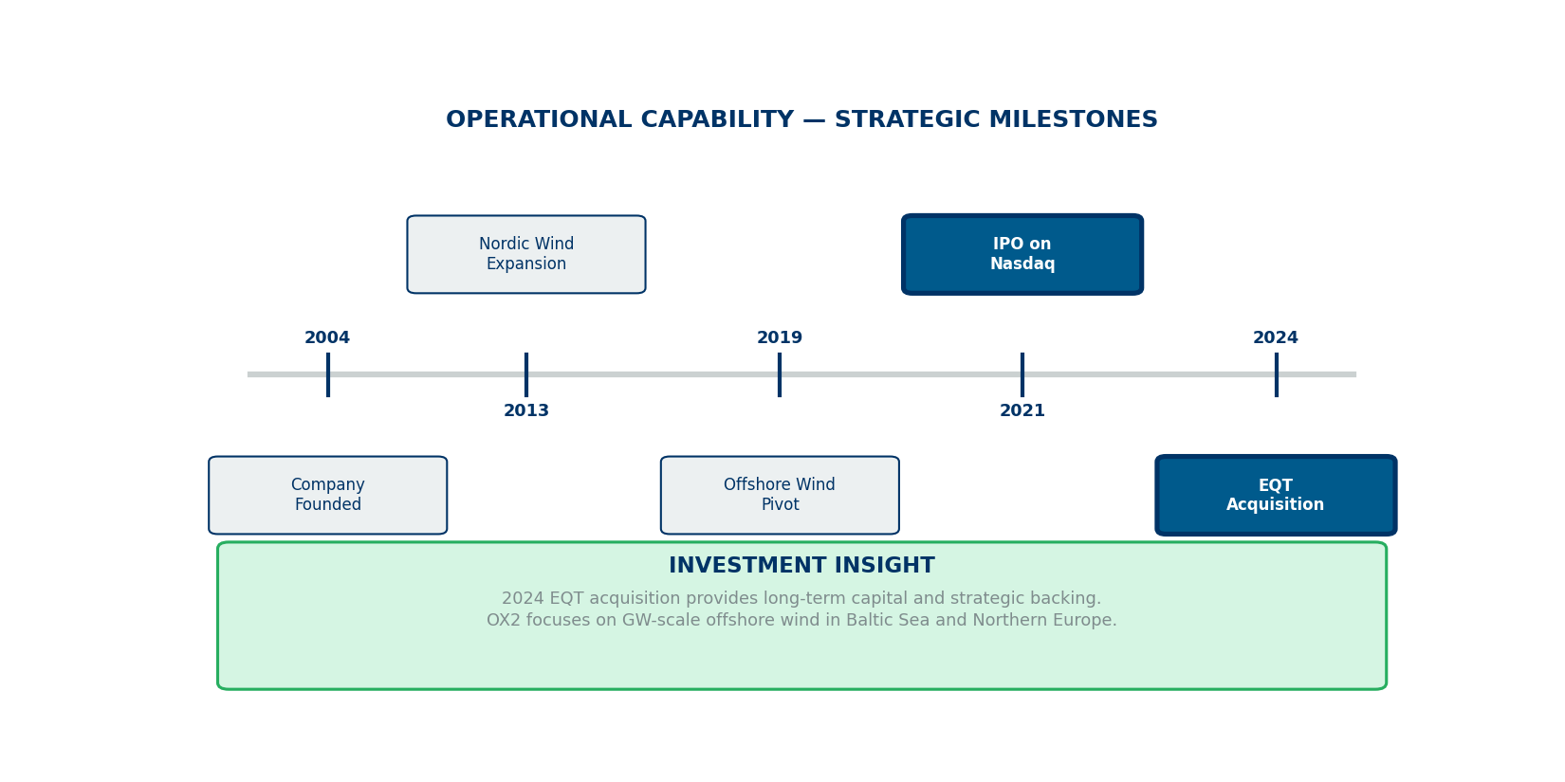
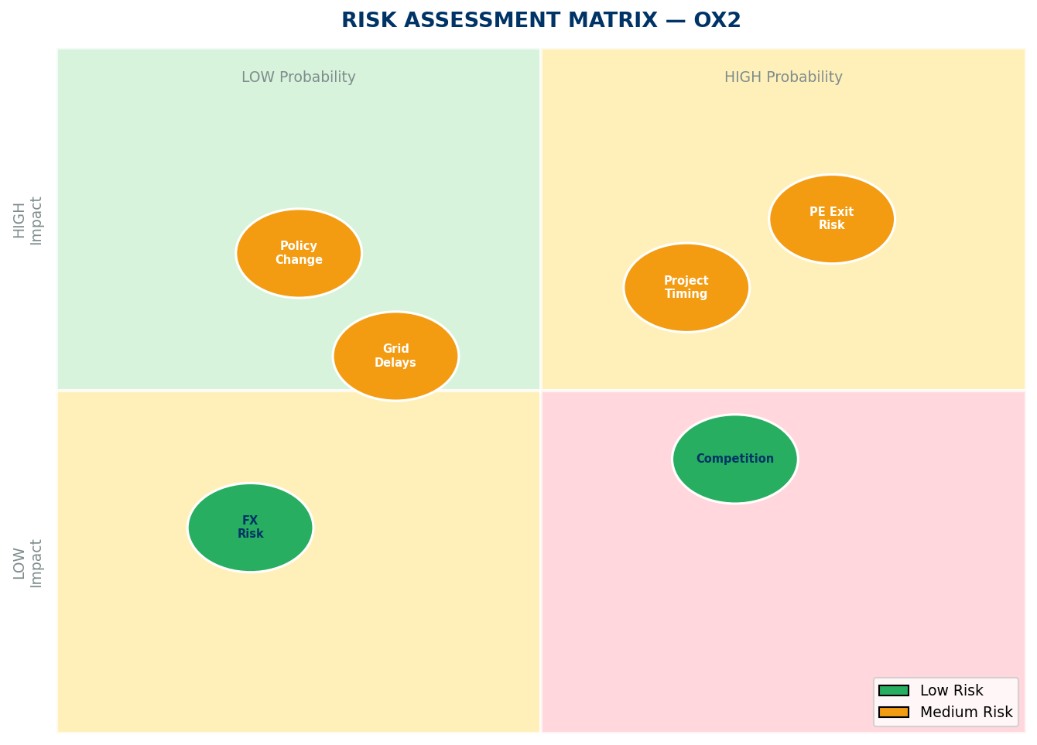
OPERATIONAL CAPABILITY & RISK ASSESSMENT
OX2
Milestones & Strategic Investment | Risk Matrix | Capability Summary
Risk Summary
Key Capabilities
• ISO certifications for project management
• 19 years continuous renewable development
• 10+ markets — diversified geographic presence
• Full chain: origination → development → sale
Financial:
🟢 LOW
SEK 5.4B revenue; PE-backed stability
Geopolitical:
🟢 LOW
Sweden HQ; EU/NATO aligned markets
Project Timing:
🟡 MEDIUM
Revenue volatility from project cycles
Policy/Regulatory:
🟡 MEDIUM
Dependent on renewable energy support
Competition:
🟢 LOW
Differentiated niche positioning
Manu Forti Intelligence
Source: Manu Forti Intelligence | Confidential | March 2026

Slide 8
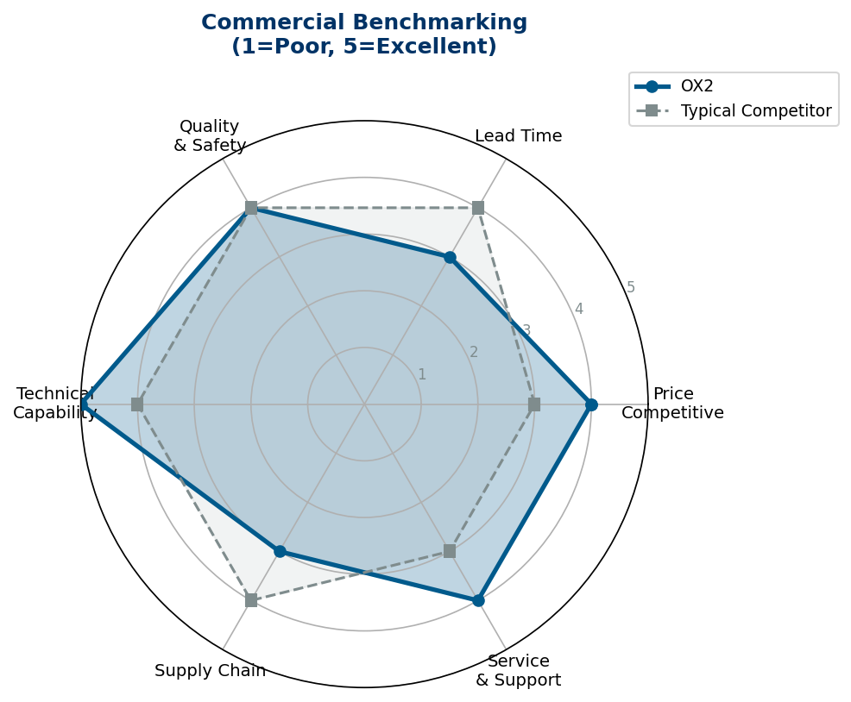
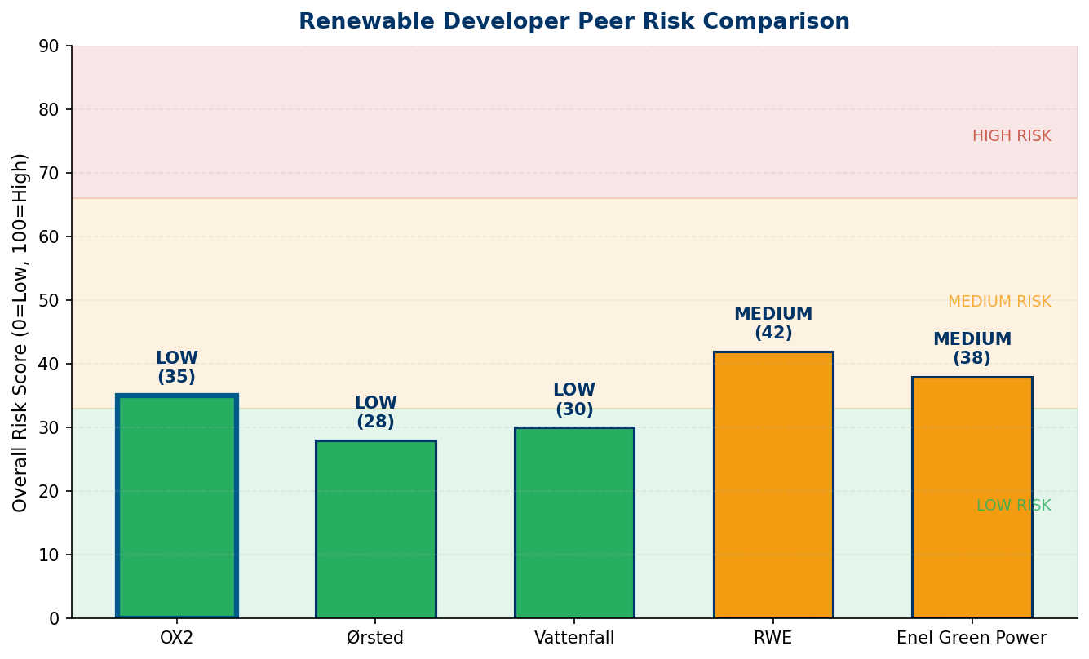
COMMERCIAL INTELLIGENCE & PEER RISK COMPARISON
OX2
Benchmarking Radar | Peer Risk Profile | Commercial Terms
Commercial Terms & Negotiation
• Pricing: Development fees based on project capacity/MW
• Payment: Milestones for permitting, PPA, construction ready
• Leverage: Volume commitment; framework agreements
• IP: Client owns project rights; OX2 retains method IP
Key Watch Points
⚠ Project timing: Revenue recognition varies by project stage
⚠ Grid delays: Monitor connection timelines in key markets
⚠ Policy: Track renewable support scheme changes
Manu Forti Intelligence
Source: Manu Forti Intelligence | Confidential | March 2026

Slide 9
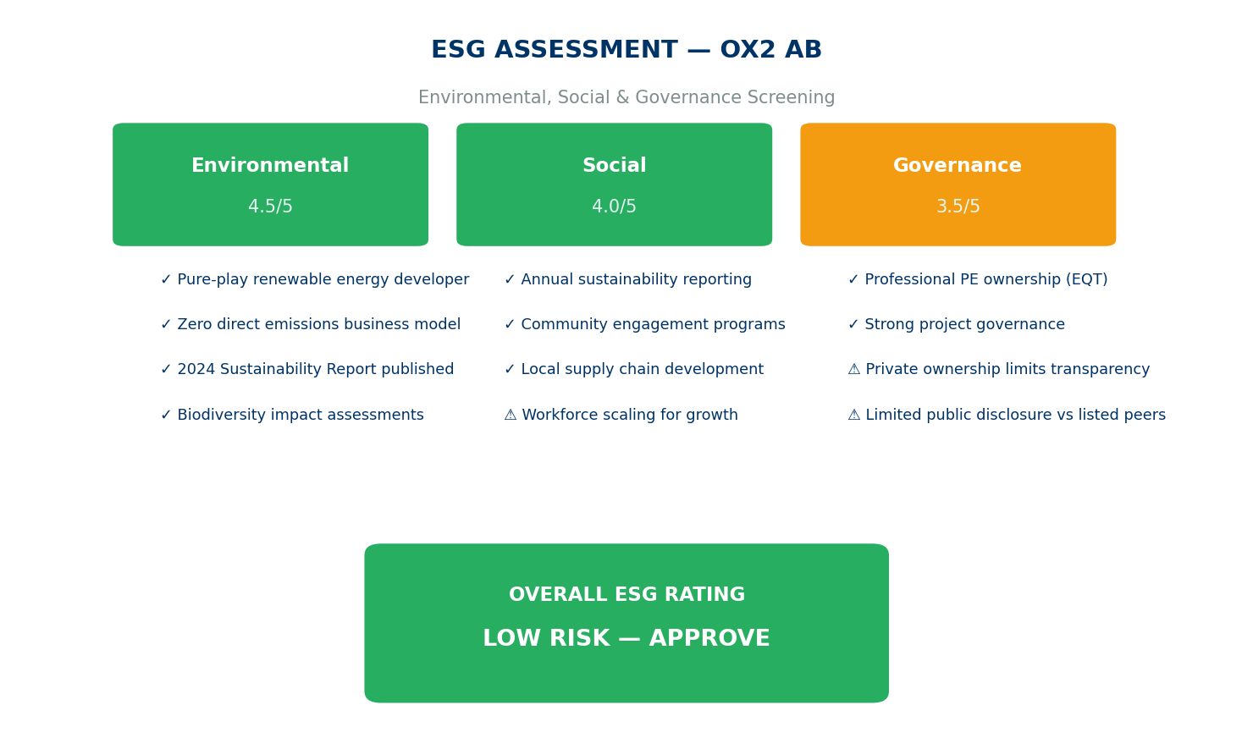
ESG ASSESSMENT
OX2
Environmental, Social & Governance Screening | Overall Rating: LOW
Manu Forti Intelligence
Source: Manu Forti Intelligence | Confidential | March 2026

