Slide 1

SUPPLIER EVALUATION REPORT
WEG S.A.
Electric Motors, Transformers & Industrial Automation | Bovespa: WEGE3
R$ 38.0B Revenue | 40,000 Employees | Founded 1961 | Jaraguá do Sul, Brazil
Confidential | March 2026 | Manu Forti Intelligence

Slide 2
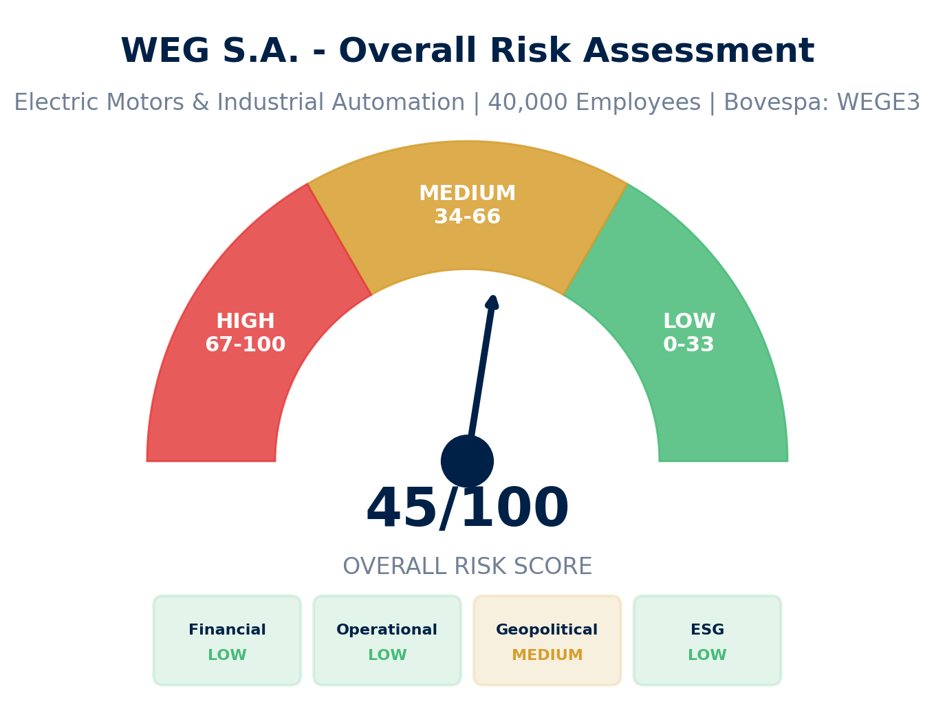
EXECUTIVE SUMMARY
WEG S.A. — Risk & Suitability Overview
SUPPLIER SNAPSHOT
Supplier:
WEG S.A.
Type:
Public Company
Sector:
Electric Motors & Automation
HQ:
Jaraguá do Sul, Brazil
Founded:
1961
Employees:
40,000+
Revenue:
R$ 38.0B (2024)
EBITDA Margin:
22.4%
Debt/EBITDA:
0.6x
Exchange:
Bovespa: WEGE3
Key Findings
• Global #4 in electric motors with 12% market share
• Strong financials: 16.9% revenue CAGR, conservative 0.6x Debt/EBITDA
• 73% revenue from sustainable products — strong ESG profile
• Risk: BRL currency volatility requires hedge for international buyers
Source: Manu Forti Intelligence | Confidential | March 2026

Slide 3
RECOMMENDATION
Decision Summary & Commercial Conditions
✓ RECOMMENDATION: APPROVE with CURRENCY HEDGE
WEG S.A. is a financially strong, globally diversified electric motor manufacturer with conservative leverage and proven execution. Primary risk is BRL currency exposure.
Commercial Conditions
• Payment: Standard terms (30-60 days)
• Performance warranty: Standard manufacturer terms
• Supply agreement: Annual volume commitment
• Price protection: Quarterly adjustments
• Quality assurance: IEC certified products
Due Diligence
• Verify currency hedge for contract duration
• Review recent Regal Rexnord integration
• Confirm capacity allocation for your volume
• Validate warranty terms for your application
• Check local service support availability
Overall Risk Summary - MEDIUM (45/100)
Financial:
LOW
Strong profitability, low leverage
Operational:
LOW
Proven scale, global footprint
Escalation Triggers - Change Recommendation If:
Geopolitical:
MEDIUM
BRL currency exposure
• BRL depreciation >25% against contract currency
ESG:
LOW
73% sustainable revenue
• Loss of investment-grade credit rating
• Major acquisition integration failure
• Significant market share loss to competitors
Source: Manu Forti Intelligence | Confidential | March 2026

Slide 4
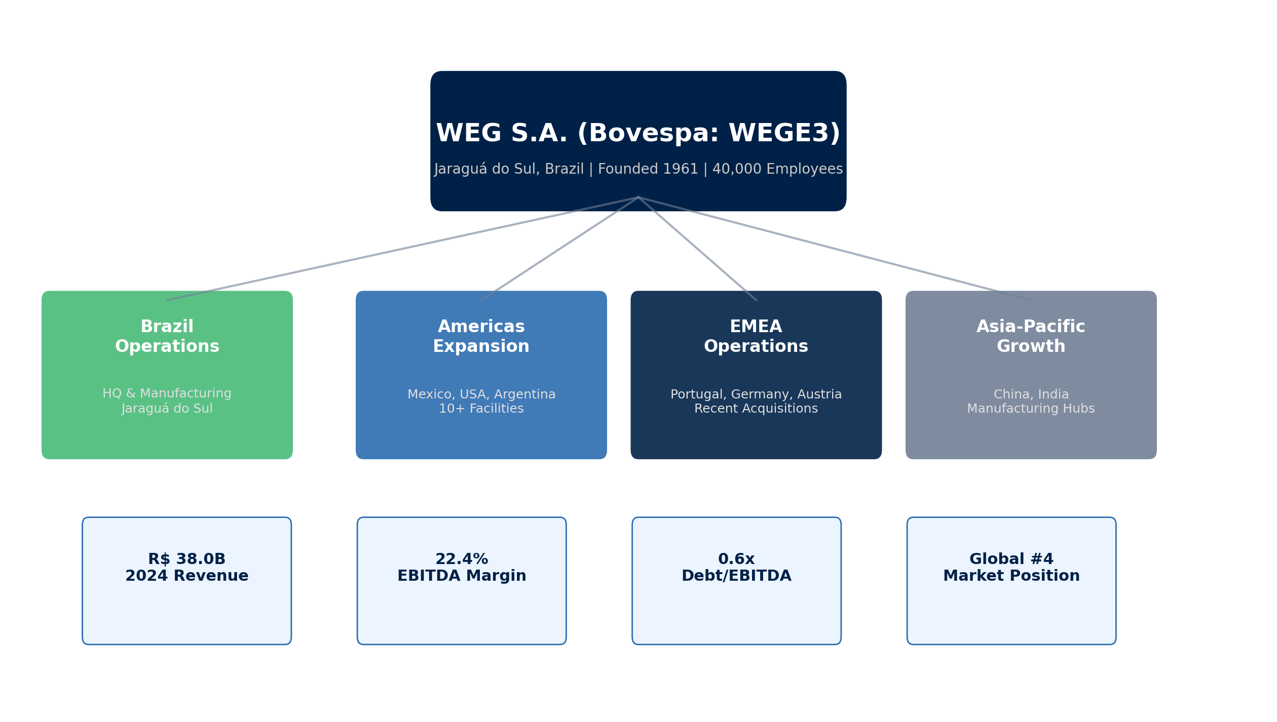
SUPPLIER PROFILE
Corporate Structure & Global Footprint
Company Overview
Leadership & Operations
• WEG S.A. is a leading global manufacturer of electric motors,
• CEO: Alberto Kuba (appointed April 2024)
transformers, and industrial automation equipment.
Internal promotion after 25+ years at WEG
• Founded in 1961 in Jaraguá do Sul, Brazil by Werner, Eggon,
• HQ: Jaraguá do Sul, Santa Catarina, Brazil
and Geraldo (W-E-G).
• Stock: Bovespa: WEGE3 | Market Cap: ~$15B
• Serves 135+ countries with 40,000+ employees worldwide.
Source: Manu Forti Intelligence | Confidential | March 2026

Slide 5
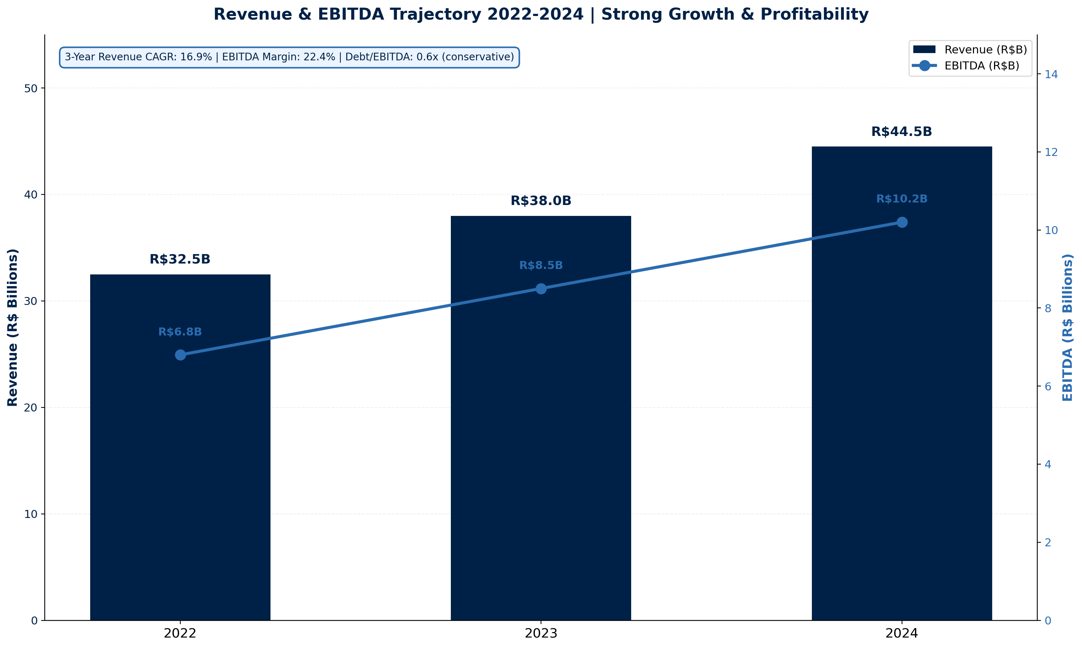
FINANCIAL HEALTH
Revenue & EBITDA Trajectory 2022-2024 | Bovespa: WEGE3
KEY METRICS
Revenue (2024):
R$ 38.0B
Revenue YoY:
+16.9%
EBITDA:
R$ 8.5B
EBITDA Margin:
22.4%
Net Profit:
R$ 4.2B
3-Year CAGR:
16.9%
Debt/EBITDA:
0.6x
Cash Position:
R$ 7.3B
Market Cap:
~$15B
Employees:
40,000+
Financial Risk: LOW ✓
Exposure Guidance
• Conservative leverage at 0.6x Debt/EBITDA
• Strong cash generation supports growth
• Currency hedge recommended for non-BRL contracts
• Investment-grade credit profile
Source: Manu Forti Intelligence | Confidential | March 2026

Slide 6
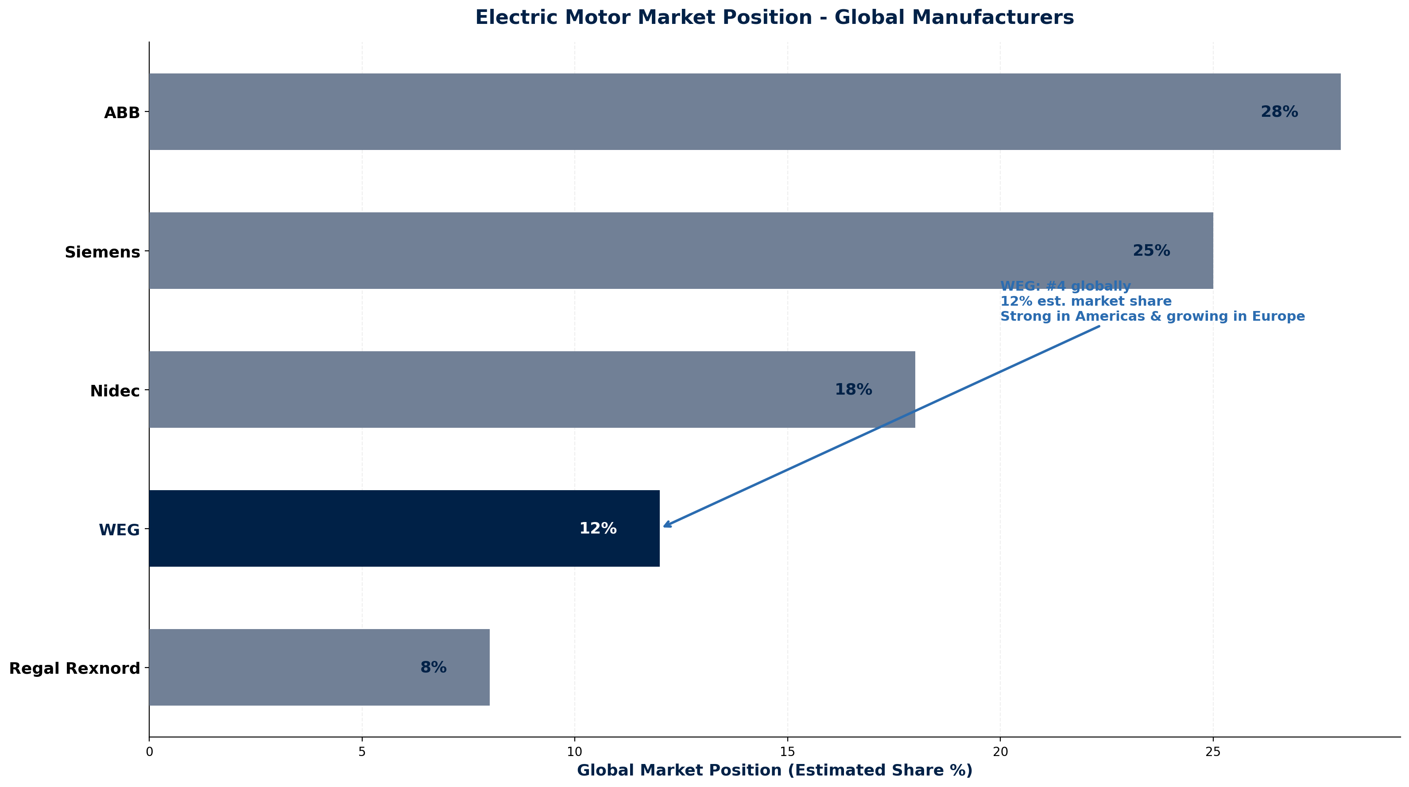
MARKET POSITION
Global Electric Motor Market Comparison
Source: Manu Forti Intelligence | Confidential | March 2026

Slide 7
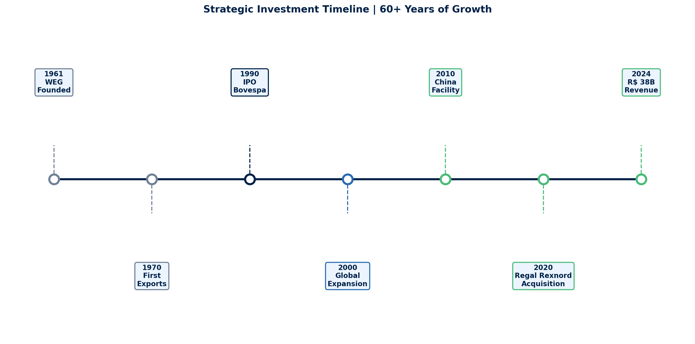
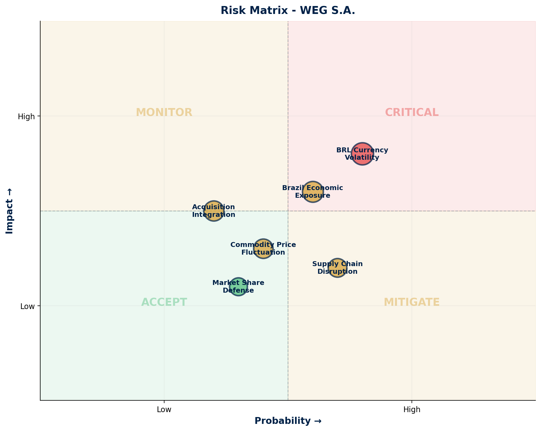
OPERATIONAL CAPABILITY + RISK ASSESSMENT
Strategic Timeline & Risk Matrix
Risk Summary Table
BRL Currency Volatility
Geopolitical
HIGH
15-25% annual volatility affects pricing
Brazil Economic Exposure
Geopolitical
MEDIUM
43% revenue from Brazil market
Commodity Price Fluctuation
Operational
MEDIUM
Copper, steel price impacts margins
Acquisition Integration
Operational
MEDIUM
Regal Rexnord integration ongoing
Supply Chain Disruption
Operational
LOW
Diversified global manufacturing
Market Share Defense
Commercial
LOW
Strong competitive position
Source: Manu Forti Intelligence | Confidential | March 2026

Slide 8
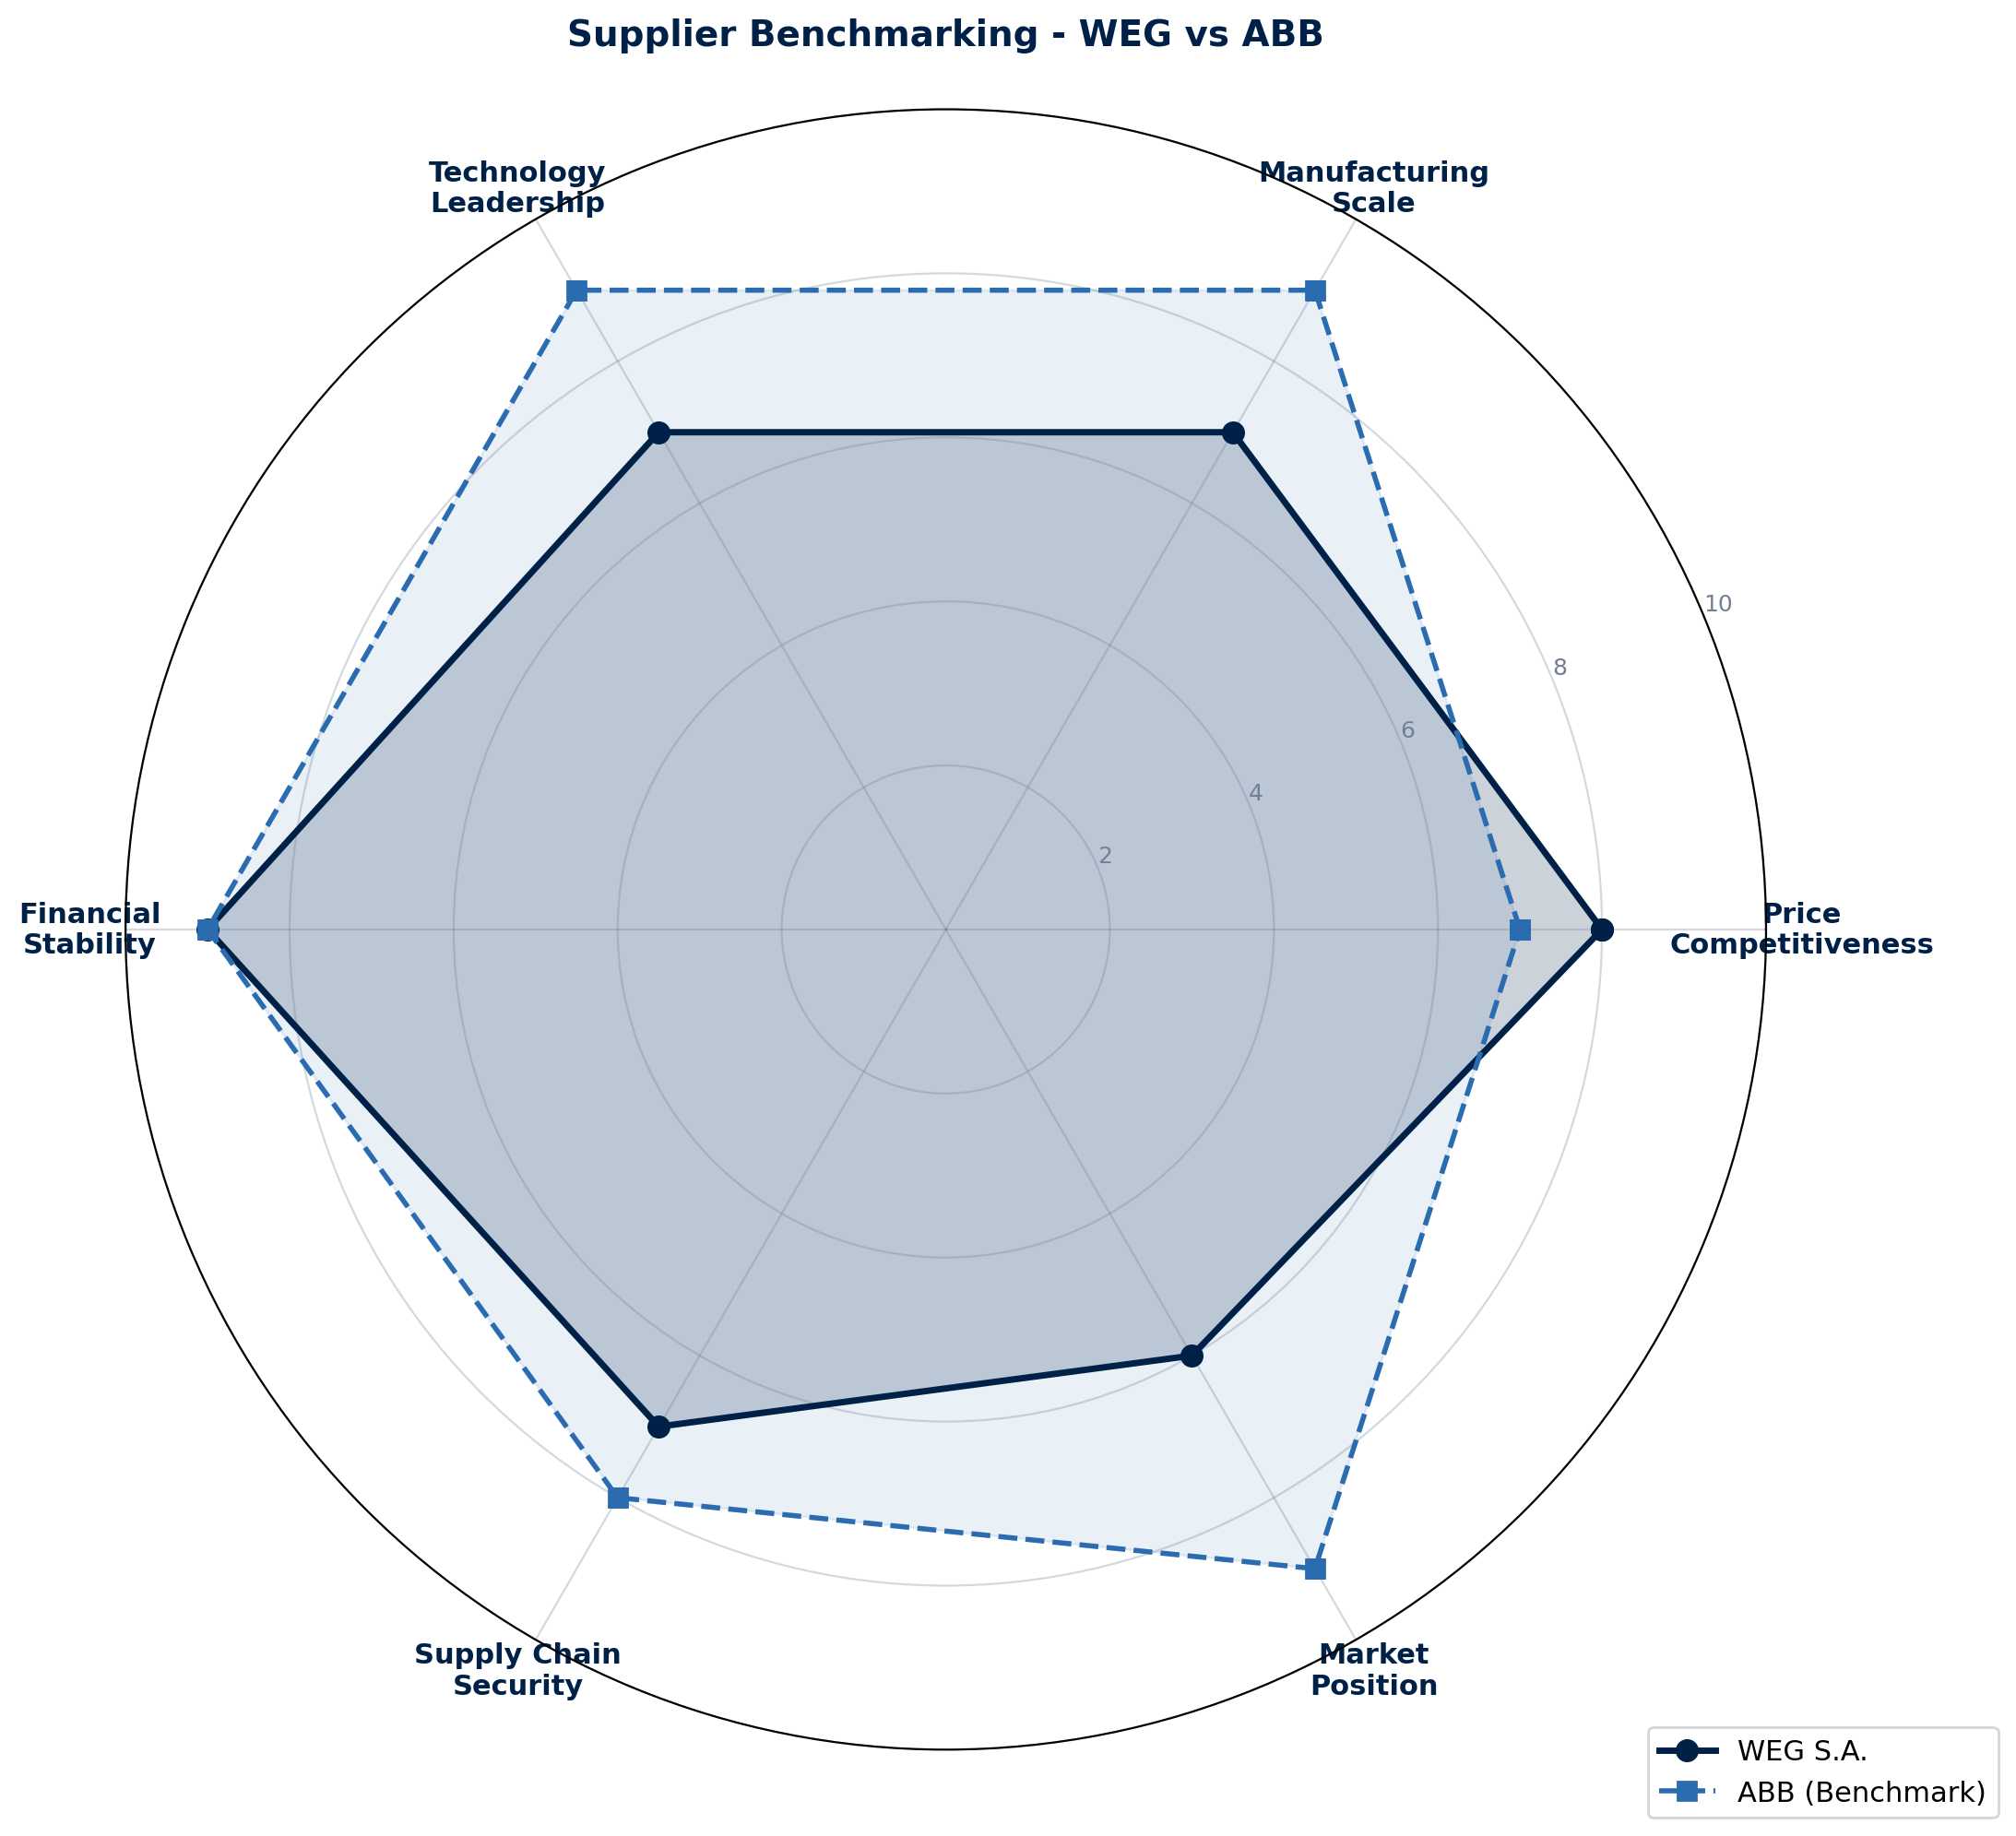
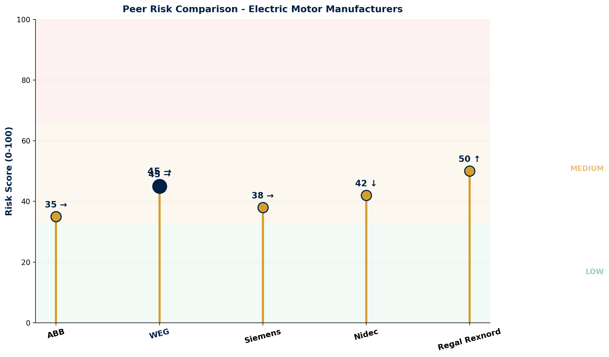
COMMERCIAL INTELLIGENCE + PEER RISK
Benchmarking & Competitive Analysis
Negotiation Leverage Assessment
Commercial Terms
• Buyer power: MODERATE (multiple Tier-1 options)
• Pricing: Competitive vs ABB/Siemens
• Volume commitment increases leverage
• Payment: 30-60 days standard
• Long-term contracts favor buyer
• Warranty: Standard manufacturer terms
• Currency hedge is key negotiation point
• Delivery: 8-12 weeks for custom orders
Source: Manu Forti Intelligence | Confidential | March 2026

Slide 9
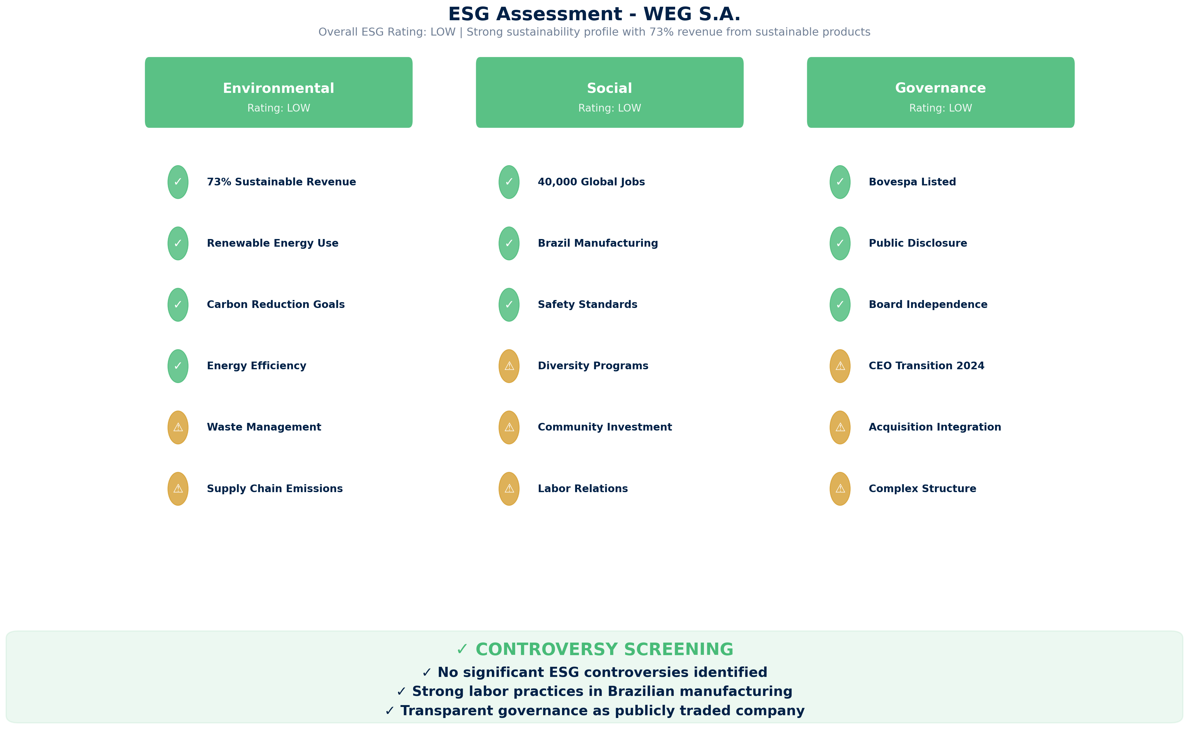
ESG ASSESSMENT
Environmental, Social & Governance Review
Source: Manu Forti Intelligence | Confidential | March 2026

