Slide 1
9800 MDT using Docker & TIG
Byung Wook Cho
Technical Leader, TTG
April 2022

Slide 2
Today’s conversation
01
9800 Streaming Telemetry
02
Exploring Yang data model Using Yangsuite
03
Containers Using Docker
04
TIG Stack
05
Python Integration
06
Bringing It All Together
07
Demo

Slide 3
9800 Streaming Telemetry
Devices are traditionally configured and managed using CLI and GUI
Alternatively, can use programmatic interfaces (NETCONF, RESTCONF, gNMI and gRPC)
NETCONF supports dial-in mode where a remote device initiates a connection request to the 9800
gRPC supports dial-out mode where the 9800 initiate a connection request to a remote device
YANG data models define what type of operational data is accessible through the programmatic interfaces
There are 215 YANG data models of which 42 is specifically for wireless

Slide 4
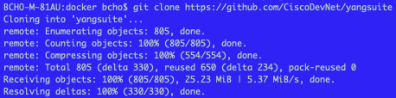
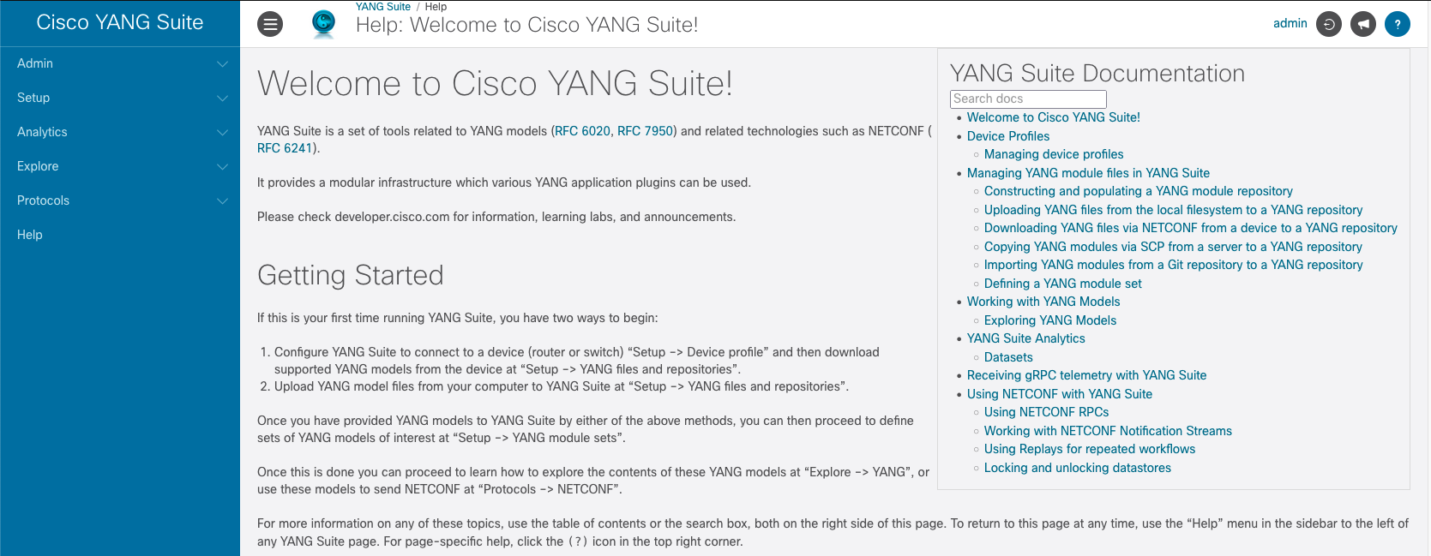
Exploring YANG Using Yangsuite
A containerized app that helps you explore what data models are available
You can download from https://github.com/CiscoDevNet/yangsuite
To launch
cd yangsuite/docker/
./start_yang_suite.sh
Follow prompts to set the username, password, certificates, etc.
Access the tool using browser GUI at http://localhost or https://localhost:8443

Slide 5
Exploring YANG Using Yangsuite
You can either manually load the YANG models OR connect to a device and pull the YANG models
You can download the YANG data models manually from Github https://github.com/YangModels/yang/tree/main/vendor/cisco/xe
Steps on how to load the YANG models from a device can be found in the reference section of this preso.
YANG model names containing ‘Cisco-IOS-XE-wireless-xxx-oper’ provides the operational data
You will need this to build the telemetry config in the 9800

Slide 6
9800 Telemetry Configuration
Enable NETCONF globally on the 9800
Subscribe to the yang data model of interest using xpath filter discovered through yangsuite tool
Define the source and destination IP address that will be used for streaming telemetry
Configure the periodic update interval (100th of a second)
Verify subscription status
Ensure Valid state and Msgs Sent is incrementing

Slide 7
TIG Stack
Telegraf – Open source plugin-driven server agent written solely in GO capable of collecting metrics and sending it to a variety of external datastores.
Influxdb – Open source time series datastore written solely in GO that ingests metrics and logs received from Telegraf
Grafana – Open source monitoring app that periodically polls the data from a data source such as Influxdb to provide user defined visualization

Slide 8
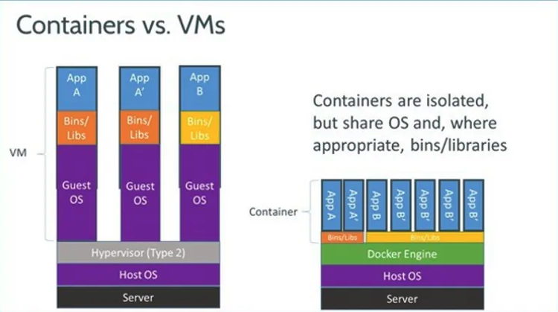
Containers Using Docker
So many ready to deploy apps already available in docker hub (https://hub.docker.com)
Apps are run in an isolated environment
Doesn’t require a lot of server resource (you can even use your work PC)
Easy to manage release versions
Easy to launch multiple containers using docker-compose

Slide 9
Python Integration
What if I wanted to monitor something that doesn’t seem to be available anywhere in Telemetry subscription?
Building blocks of your script should consist of
Periodic polling mechanism
Extraction of Data of interest from device
Packaging of data into a format that Telegraf understands
You’ll need to manually create a “bucket” on the Telegraf container to store the new data into
You can run the script directly from guestshell service of 9800 (hardware appliance version only) or from an external PC on the network
Data_Dictionary = {
“measurement”: string, “tags”: {
”tag1”: string,
“tag2”: string
},
”fields”: {
“field1”: integer
}
}

Slide 10

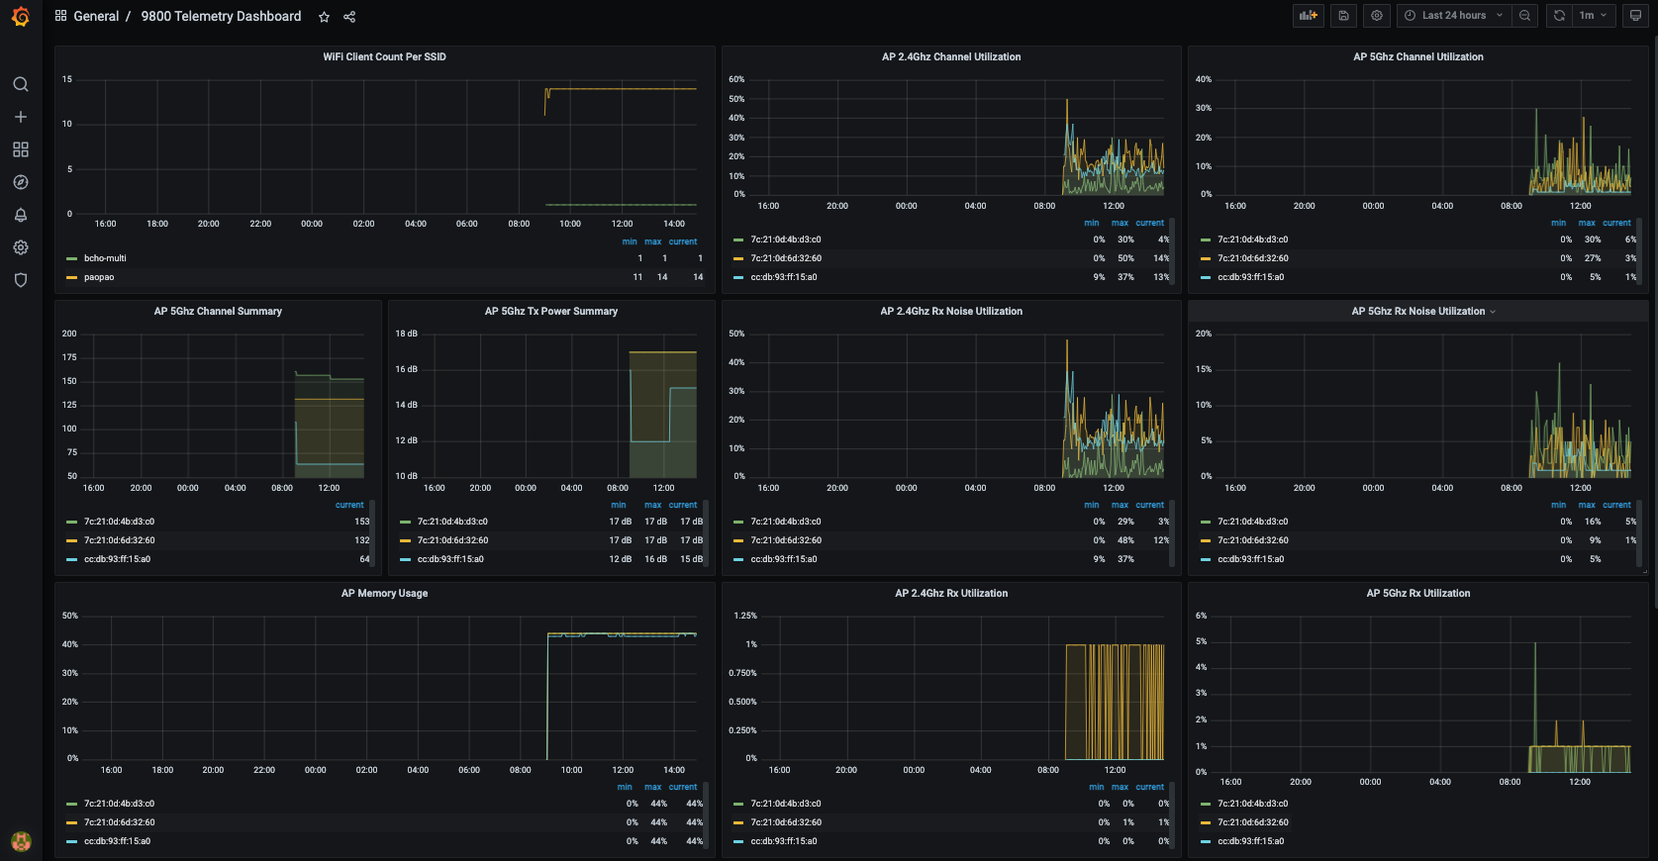
Bringing It All Together
9800 sends telemetry data to Telegraf periodically or on-change using gRPC
Telegraf ingests this data and forwards it to influxdb
Influxdb will then itemize this data into a time series database
Grafana periodically polls this time series database to provide user defined visualization which can be viewed using HTTP on port 3000
Syslog-Ng translates RFC3164 to RFC5424 syslog standard as Influxdb only supports the latter
Syslog-Ng
Telegraf
Influxdb

Slide 11
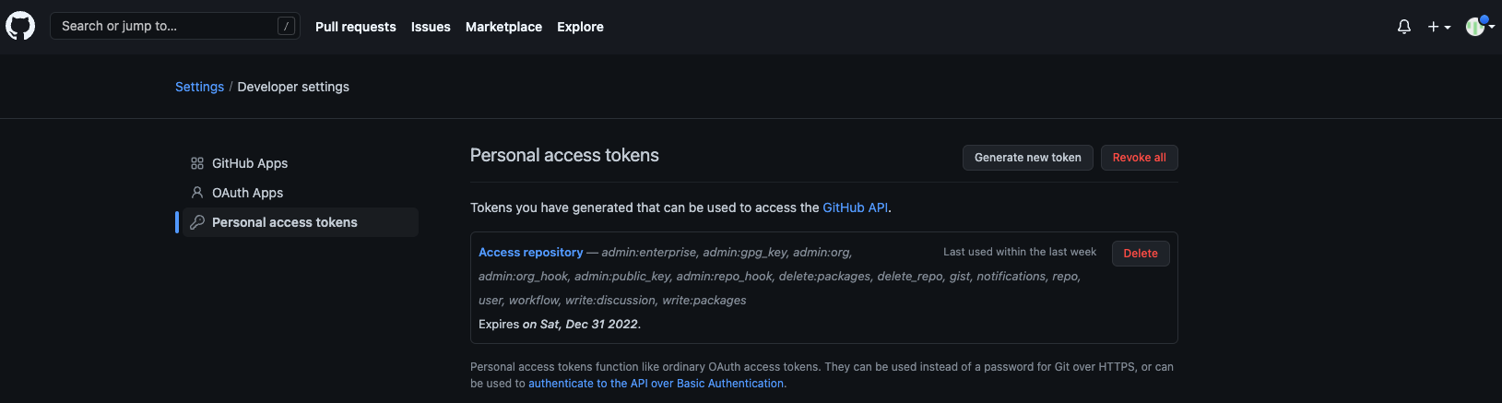
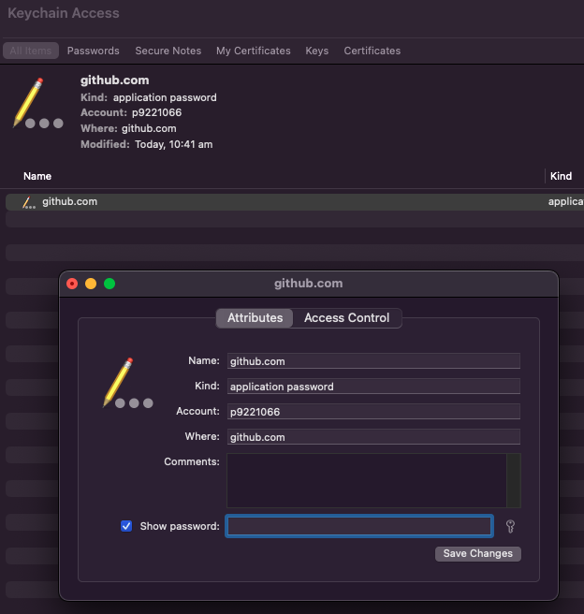
Github
Starting Aug 13, 2021, GitHub no longer accepts your github account password for git operations
You’ll need to create a personal access token at Setttings > Developer Settings > Personal Access Token > Generate New Token
You can then either use this token instead of your account password to perform git operations OR map this token on your system
For Windows, goto Control Panel > Credential Manager > Windows Credentials > find git:https://github.com > Edit > Replace password with personal access token.
For macOS, find the Keychain access app and search for github.com. Under internet password entry, add the new personal access token.

Slide 12
Jonglim Notes
Install git and docker
Clone repo - git clone https://github.com/p9221066/ios-xe-mdt.git
Check if docker is installed – docker ps
Follow the instructinon https://github.com/p9221066/ios-xe-mdt - move files to folders, rename path in docker-compose.ym, push config to 9800, etc.
Run the container - sudo docker-compose up –d
Access Grafana GUI using the default 'admin/admin' credential. You will be asked to change the password – https://localhost:3000
In Grafana, Add a data store. Follow step 7 of read me guide
Import dashboard.
Influxdb can be access thru http://localhost:8086

Slide 13
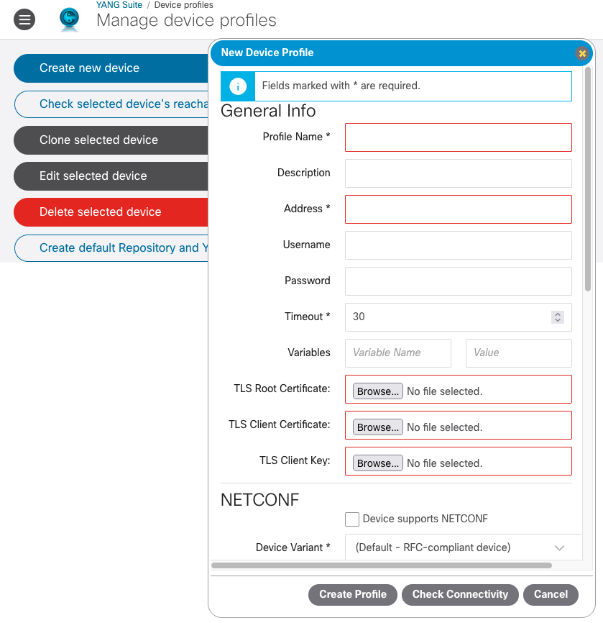
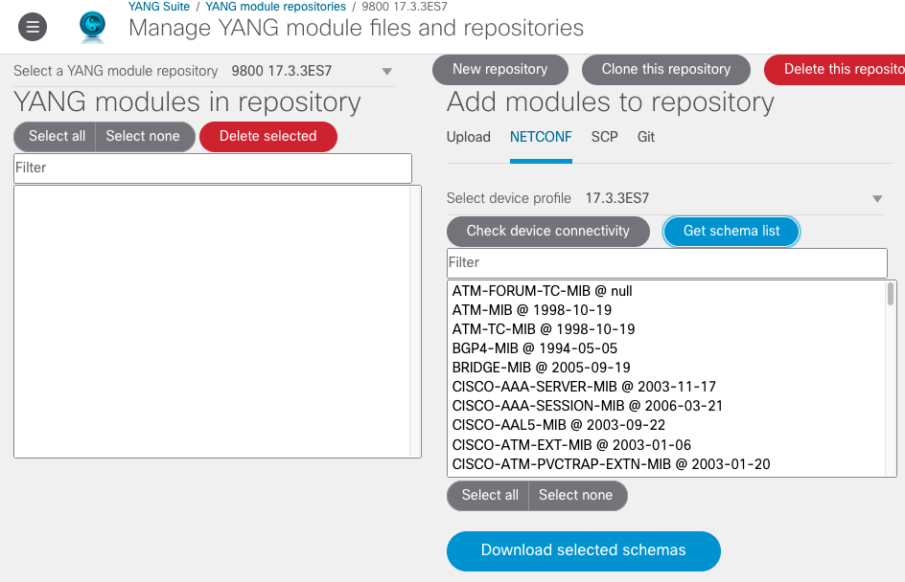
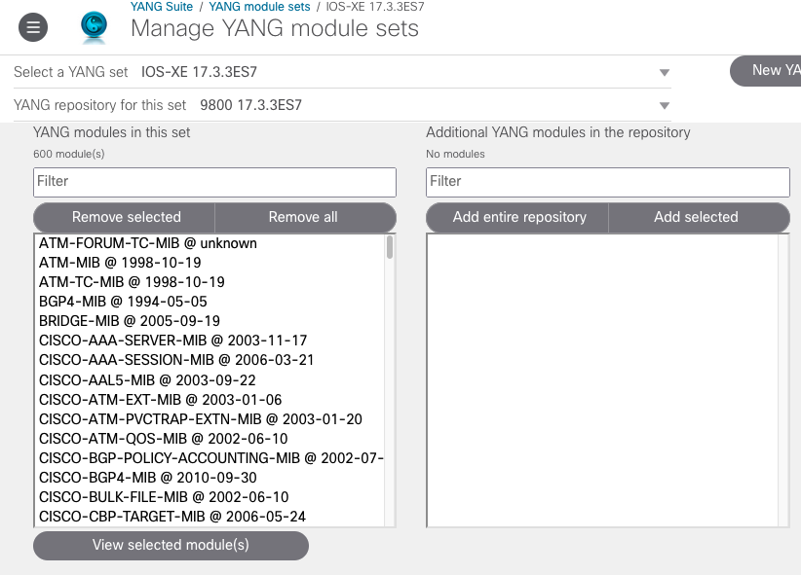
YANG Data Models
You can download a YANG Data Model from a device on your network by creating a device profile (Setup > Device profiles)
Device profile contains the necessary NETCONF and SSH settings required to log into the device and download the YANG Data Model
Create a new repository (Setup > YANG files and repositories).
Click on NETCONF option and select the device profile you created. Click Get schema list.
Select the YANG Data Models of interest and click on Download selected schemas.
Add the YANG data models downloaded to the repository into the YANG module sets.
You are now ready to explore the YANG models.

Slide 14
Telegraf Initial Config
Before you create the Telegraf container, you will need to modify the ‘telegraf.conf’ config file with some initial settings
This file basically contains an input plugin that handles the streaming telemetry data from the 9800 and an output plugin that sends the data to the influxdb container
I have already prepared this file for you to download at https://github.com/p9221066/ios-xe-mdt.git. You can either clone it using ‘git’ or manually download it and place it in your local directory.
Create a directory called ‘telegraf’ in your local directory and store this file there
[[inputs.cisco_telemetry_mdt]]
transport = “”grpc””
service_address = “:57000”
[inputs.cisco_telemetry_mdt.aliases]
ifstats = ”ietf-interfaces:interfaces-state/interface/statistics”
[[outputs.influxdb_v2]]
urls = [http://influxdb:8086]
token = “cisco123”
organization = “cisco.com”
bucket = “9800”

Slide 15
Syslog-Ng Initial Config
Before you can run the Syslog-Ng container, you will need to modify the ‘syslog.conf’ config file
This file basically defines an input filter and an output filter
I have already prepared this file for you to download https://github.com/p9221066/ios-xe-mdt.git. You can either clone it using ‘git’ or manually download it and place it in your local directory.
Create a directory called ‘syslog-ng’ in your local directory and store this file in there
source s_9800 {
network(
ip(“0.0.0.0”)
port(514)
transport(”udp”)
flags(no-parse)
);
};
…
destination d_telegraf {
syslog (
“10.0.0.97”
transport(“tcp”)
port(7514)
)
}

Slide 16
Influxdb Initial Config
There is no initial config required for influxdb container as the ‘docker-compose.yml’ file already has the environmental setting required
You can modify the names of these settings
Create a directory called ‘influxdb2’ in your local directory.

