Slide 1
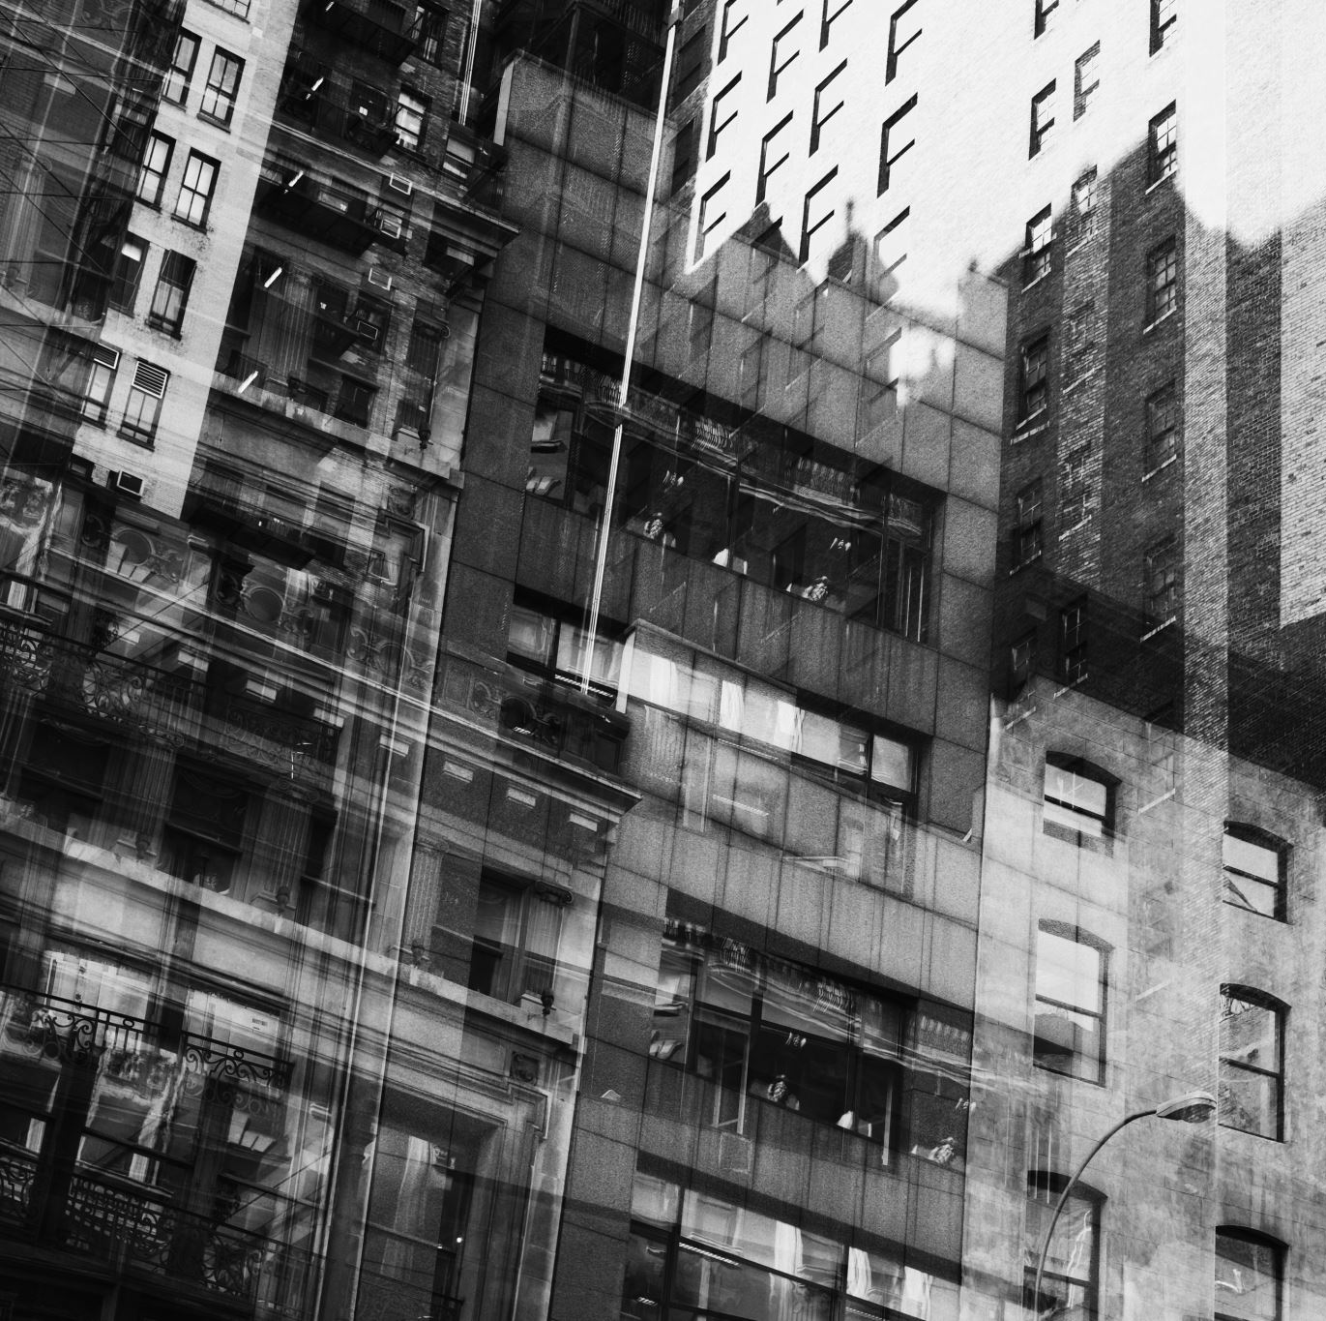
Urban Climate
Name : Khatun e Jannat Mimia
Roll No :

Slide 2
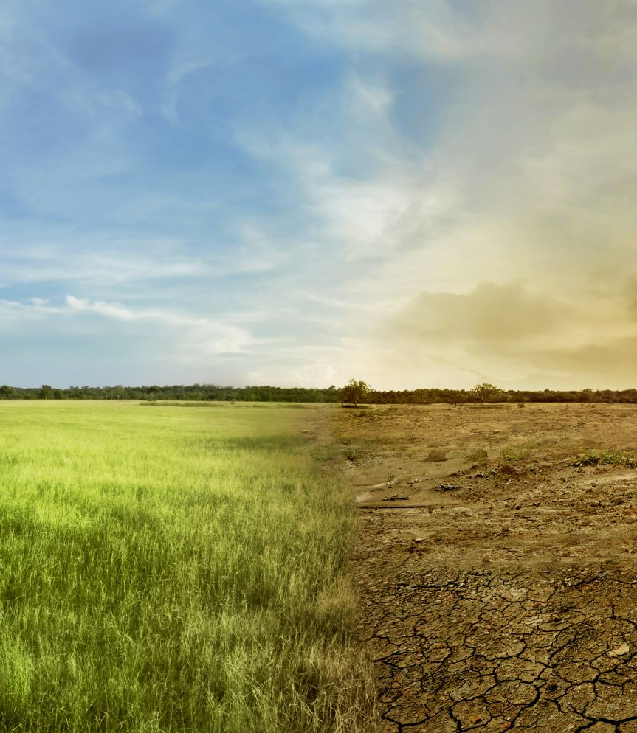
“Examining The Nexus Between Land Surface Temperature And Urban Growth In Chattogram Metropolitan Area Of Bangladesh Using Long Term Landsat Series Data”

Slide 3
Abstract
This study examines the impact of Land-Use/Land-Cover changes on Land Surface Temperature (LST) in Chattogram, Bangladesh, revealing a significant increase in urban areas and LST over 28 years, with the Urban Heat Island effect intensifying.
It also highlights the relationship between biophysical indices and LST, offering solutions to mitigate the UHI effect by altering urban patch characteristics.

Slide 4
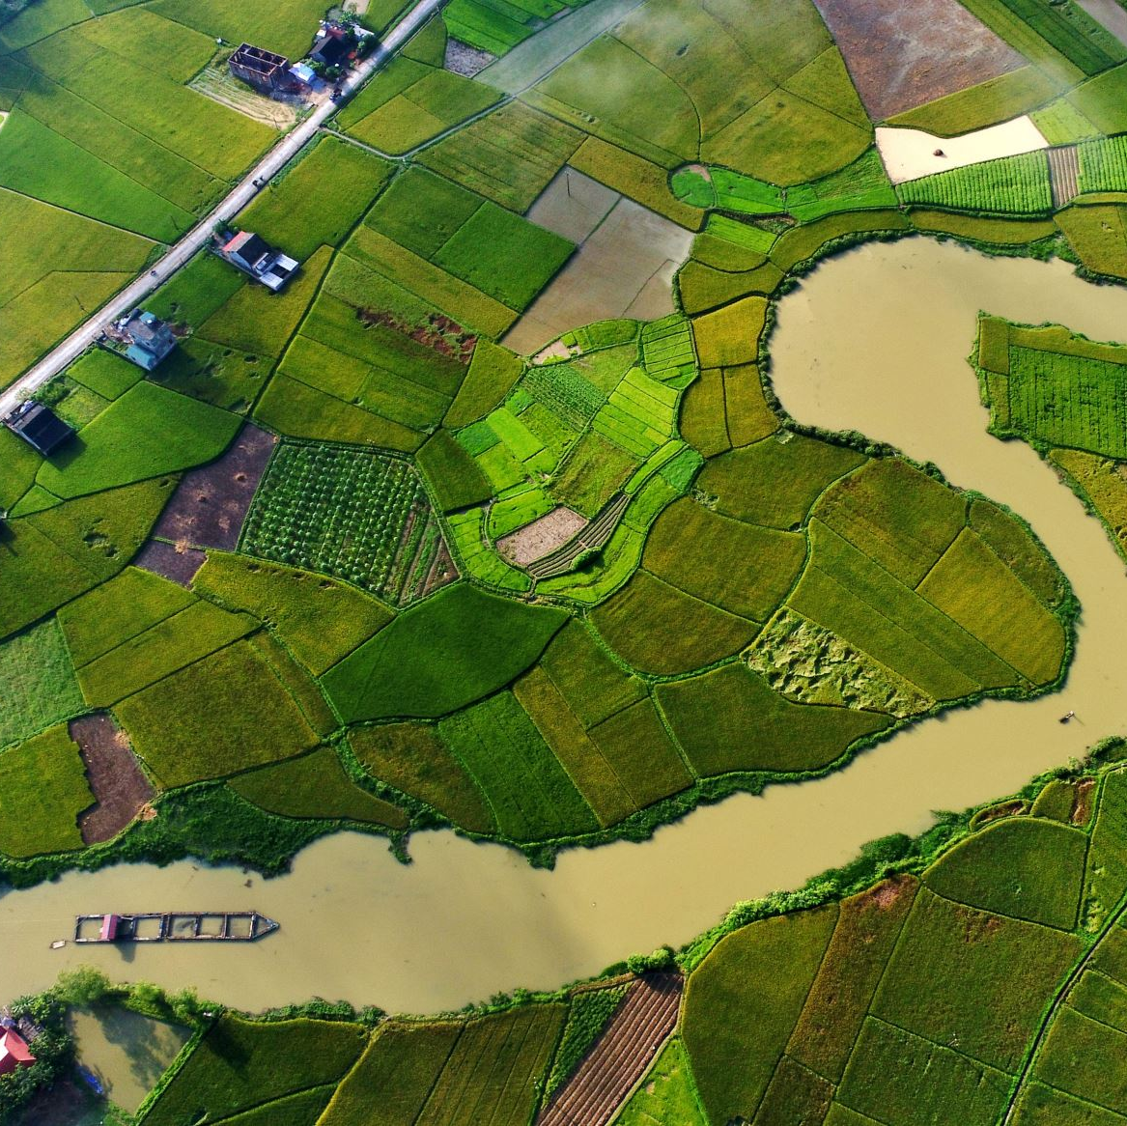
Introduction
Urbanization in developing countries, particularly in South Asia, is rapidly increasing, leading to significant Land-Use/Land-Cover (LULC) changes and Urban Heat Island (UHI) effects. This study focuses on Chattogram, Bangladesh, examining how LULC changes from 1990 to the present have impacted Land Surface Temperature (LST) and UHI, using satellite imagery and biophysical indices. The findings aim to inform urban planning and contribute to sustainable development goals, particularly in mitigating UHI effects in growing cities.

Slide 5
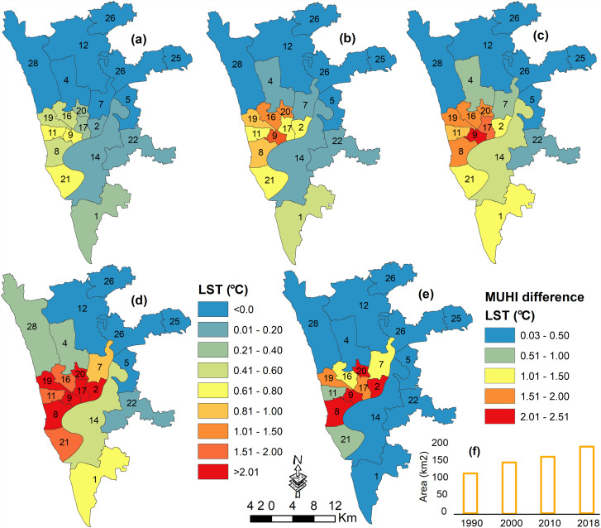
Materials and methods
The study focuses on the 729.85 km² Chattogram Metropolitan Area, with Chattogram City as its core.
Located between 90°41′E and 92°2′E longitude, CMA is bordered by the Bay of Bengal and major rivers.
It experiences a tropical monsoon climate with annual rainfall between 2400 mm and 3000 mm.

Slide 6
Table 1
Accuracy assessment statistics of the image-based LULC classification.
Study Year | Overall Accuracy | Khat(%)
1900 | 96.00 | 95.20
2000 | 97.00 | 96.40
2010 | 92.62 | 91.00
2020 | 93.98 | 92.78

Slide 7
Results and Discussions

Slide 9
Total Areas
WaterBody
Urban Areas
Agriculture Land
Rural Settlement

Slide 10
Shape
WaterBody
Urban Areas
Total Areas
Agriculture Land
Rural Settlement

Slide 11
Hyperlink
Khatune E Jannat Mimia_Batch65.pptx

Slide 12
Conclusions
Landsat images were used to analyze LULC, LST spatial patterns, and their relationship with biophysical indices in Chattogram Metropolitan Area. Urban land use metrics, vegetation, and waterbody proportions were assessed at 500 m grids to study their impact on LST.

