Slide 1
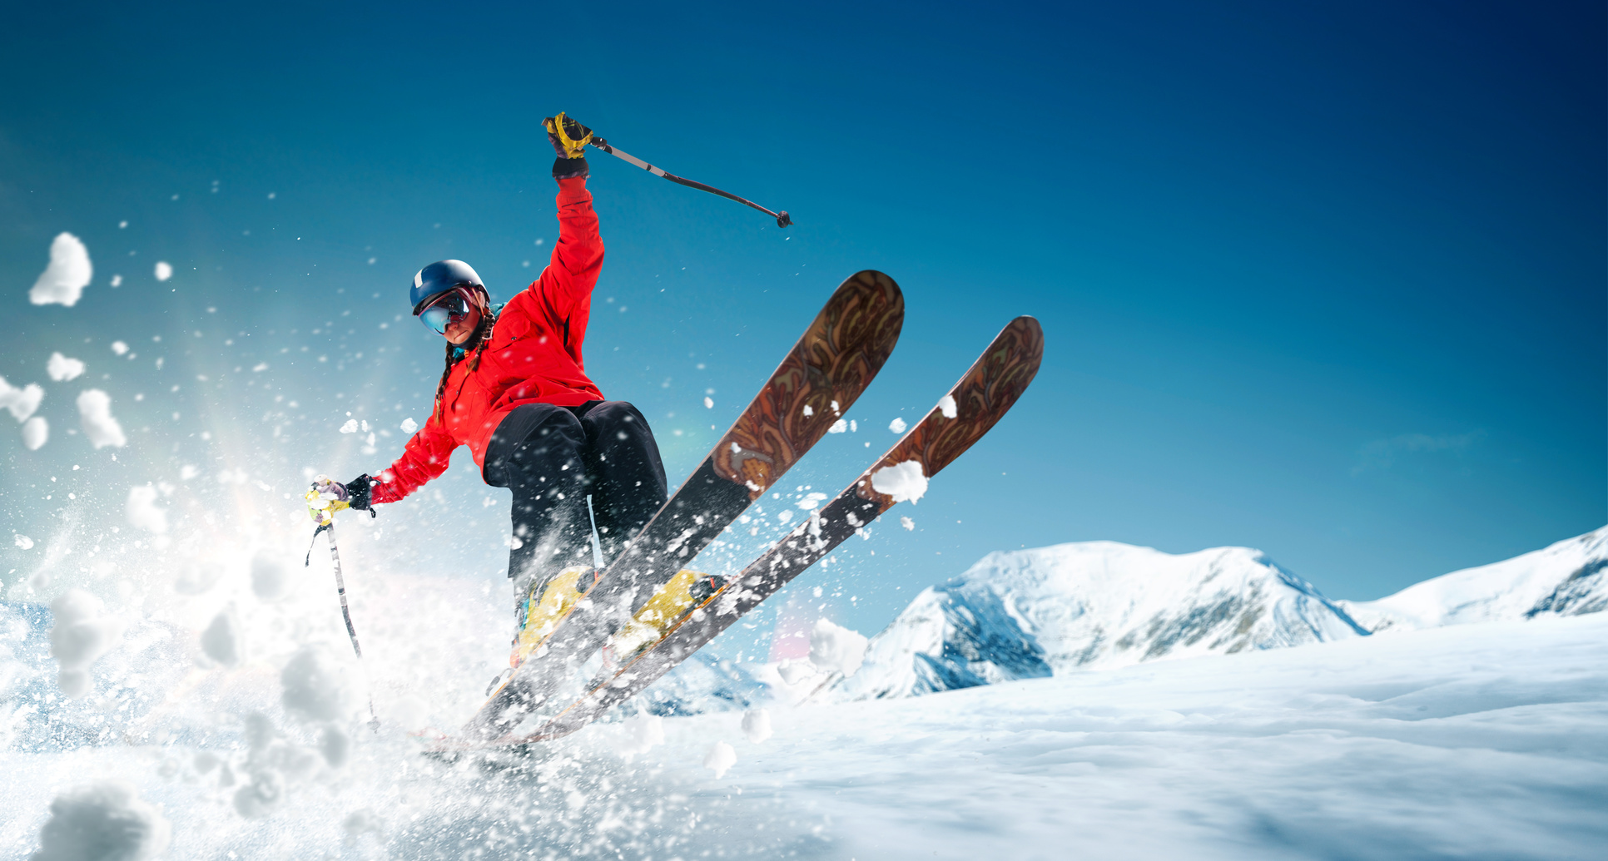
Big Mountain Resorts
It’s time to think BIGGER!

Slide 2

Challenges at Big Mountain Resorts
  Current ticket price: $81.00 Highest in Montana
  Need to offset recent capital investment of $1.54 million in equipment costs
  Goal: Increase profitability while maintaining customer satisfaction
  Strategic focus: Enhancing features, increasing usage, and rebranding

Slide 3
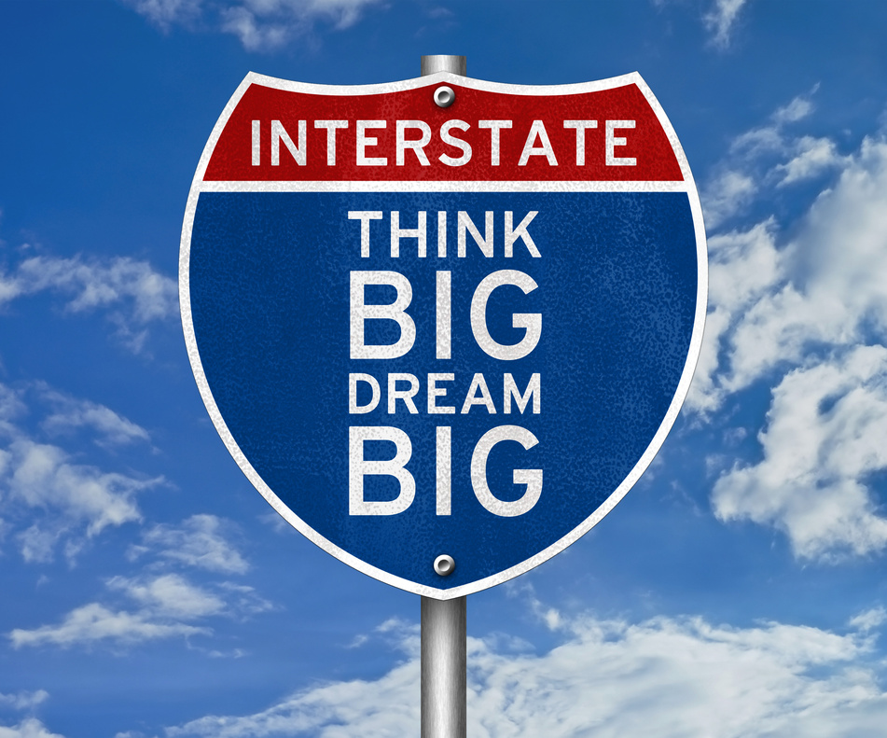
Why Action is Needed
What we offer is BIG!
  Top notch skiing and snowboarding experience for all ability levels
  350,000 annual visitors expected
Where we are going is BIGGER!
Growth targets:
  15% increase in customer usage
  10% boost in brand recognition
  Revenue increase to sustain improvements and investments

Slide 4

Strategic Recommendation
  Provide a BIG experience
-Exceptional features
-Exceptional service
  Focused marketing efforts
-100 ski runs
-Most skiable terrain
-Longest ski run in the state
  Optimize offerings for cost-effectiveness
-100 runs down from 105
  Raise ticket price modestly: $82.99
-Use ticket pricing model to
design “membership packages”
-Earn customer loyalty and
reward it

Slide 5
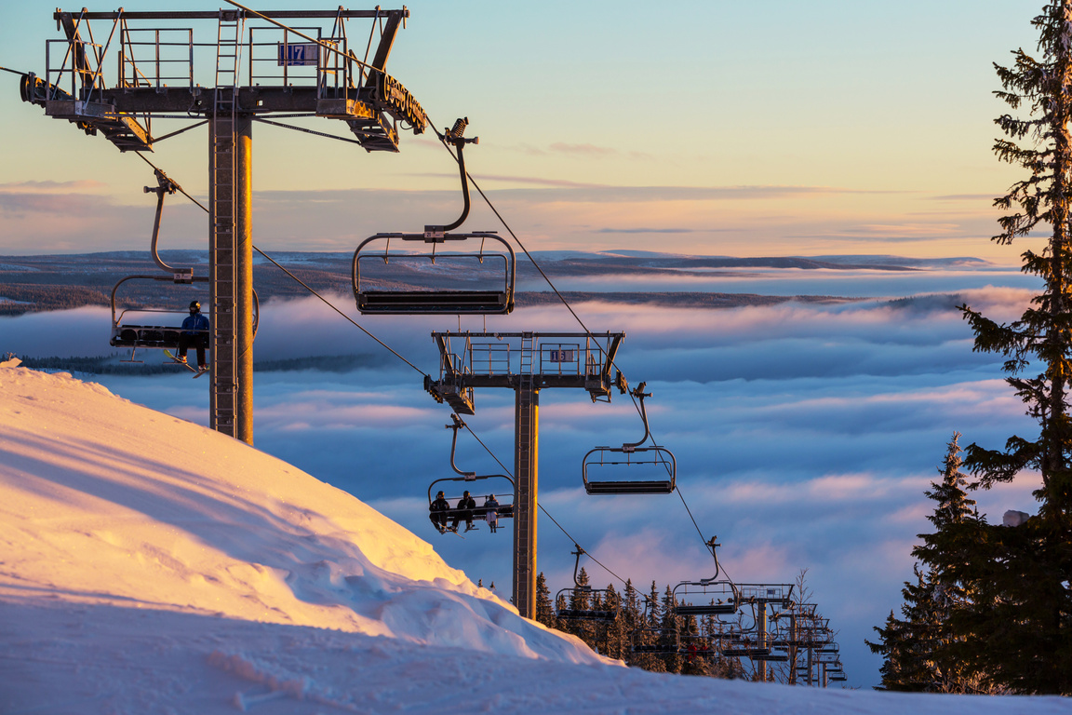
Key Drivers of Ticket Pricing
  Features positively correlated to ticket pricing
  Vertical drop
-BMR is Top 5 in state
  Snow-making acreage
-BMR is #1 in state
  Chair lifts
-BMR is #1 in total chairs
-BMR is #1 in fastQuads
  Number of runs
-BMR is Top 3 in state
  Skiable terrain acreage
-BMR is #1 in state
-BMR has the longest run
in the state (3.3 miles)

Slide 6

Predicted Ticket Price and Revenue
  Ticket price increase is modest.
  Machine learning model predicts: $95.87 (± $9.64) for a resort with the features of BMR.
  Recommended price: $82.99 (conservative, accounts for competition)
  Expected revenue: $3.47 million from 350,000 visitors

Slide 7

Strategic Adjustments
  Recent investment: new chair lift aligns with key features in demand
  Continue to use machine learning model to monitor trends in the market
  Proposal: maintain 100 trails (cost-effective vs. adding features)

Slide 8
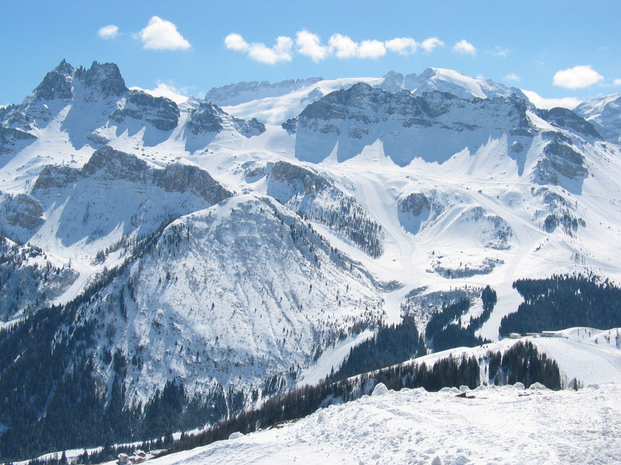
THINK BIGGER at
Big Mountain Resorts
Key competitive advantages:
  Most chairs and fastQuads in Montana
  Longest ski run (3.3 miles)
  Highest snow-covered acreage
Action plan:
  Modest price increase
  Strong marketing on unique features
  Achieve targeted growth in usage and revenue

