Slide 1


Remember Turn on Default Principal To Role Mapping in order to avoid mappings
Remember Turn on Default Principal To Role Mapping in order to avoid mappings
Threads
Runnable
Executors
Futures and Callables
(Making remote HTTP-requests)
Literature:

Slide 2
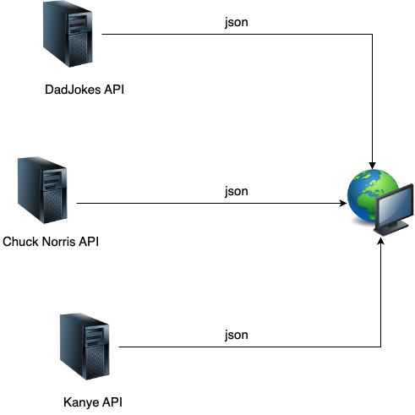
WHY Todays Topic's

Slide 3
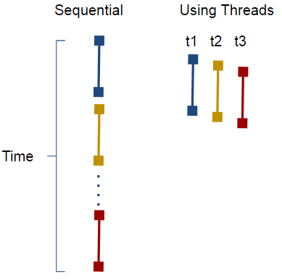
WHY

Slide 4
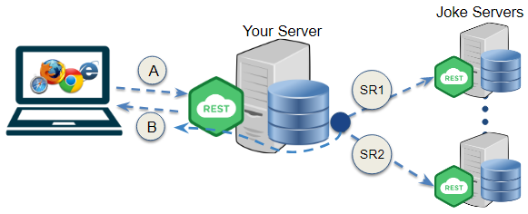
The Goal: our own broker api

Slide 5


Short recap on threads

Slide 6
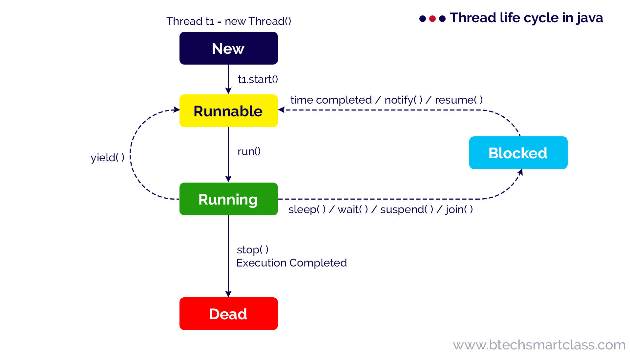
Super Simplified Diagram of a Threads Life Cycle
Link

Slide 7
Immutability
(Shared) Memory
Immutable = cannot be mutated Same as final keyword in Java
Shared memory leads to race-conditions and starvation. And Possibly deadlocking Solution: Don’t change values! New problem: How do get data back from threads?
?
Proces 1
Proces 2

Slide 8
Runnable interface
Runnable interface to normal Threads as well as executors
Has one abstract method run() that takes no arguments and returns void:
public class MyTask implements Runnable{ @Override public void run() { // Your method here } }
Thread t = new Thread(new MyTask());
t.run();
t.start();
"Never" create your threads like this. Use one of the thread-pools supplied by the Executors class

Slide 9
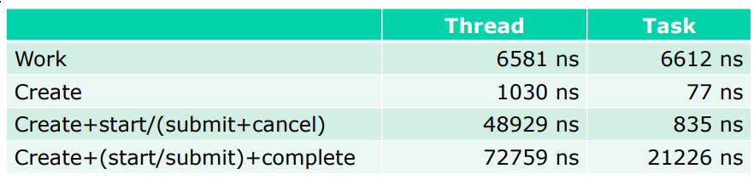
ExecutorService's
Threads have overhead (time and memory)
Better to divide your work into tasks, and let reusable threads run them.
"Tasks" is what we call Runnables (and Callables) in Java, when we call them through executors

Slide 10
ExecutorService
ExecutorService’s are usually created via one of the factory methods in the Executors class as outlined below:
Executors with Runnables
ExecutorService es = Executors.newXXXThreadPool();
es.execute(task1); //task1 must be a Runnable-instance
es.execute(task2);
…
es.shutdown();
es.awaitTermination();

Slide 11
ExecutorService: Pool types
NewCachedThreadPool() Creates a thread pool that creates new threads as needed, but will reuse previously constructed threads when they are available. If threads are idle for 60 seconds, they are terminated. Suitable for many short-lived tasks.
newFixedThreadPool(int nThreads) Creates a thread pool that reuses a fixed number of threads operating off a shared unbounded queue.
NewSingleThreadExecutor() Creates an Executor that uses a single worker thread operating off an unbounded queue. Ideal for scenarios where only one task should run at a time.
newScheduledThreadPool() Executes periodically (eg. For database clean up) Useful for tasks that need to be executed on a timed schedule.
WorkStealingPool() From Java8
Creates a thread pool that maintains enough threads to support the given parallelism level, and may use multiple queues to reduce contention.

Slide 12
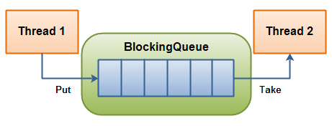
A Producer/Consumer Solution
En “task” køres via run() metoden i en Runnable

Slide 13
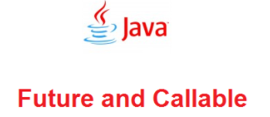
Getting results back from Threads
Shared memory leads to race-conditions and starvation. And Possibly deadlocking Solution: Don’t change values! New problem: How do get data back from threads?

Slide 14
Callable interface
Callable interface has one abstract method call() that takes no arguments Generic type: Object of <T> where T can be any Class
Below is an example with T as String:
import java.util.concurrent.Callable; public class MyTask implements Callable<String> { @Override public String call() throws Exception { // Your method that returns a String here return "hello"; } }
-------------------
MyTask t = () -> "Hello!";

Slide 15
Future interface
Threads are asynchronous, so we generally do not know when we will get the result back. So, how do we extract the value from a Callable?
Future<T> comes to the rescue
Future<String> future = executor.submit( new Callable<String>(){ @Override public String call(){ //do stuff } } );

Slide 16
Working with futures
A Future represents work that will be done at some point in the “future”, hence the name. A bit like javascript promises!
There are several ways to get the result from a Future:
//Get the result when it's ready. Blocks the thread until then. future.get(); //If you want to escape from the blocking method //no later than a given time, you can set that. future.get(10, TimeUnit.MINUTES); //Or you can ask if the task is done (returns a boolean). future.isDone();

Slide 17
ExecutorService
ExecutorService’s are usually created via one of the factory methods in the Executors class as outlined below:
Executors with Callables (and Futures)
ExecutorService es = Executors.newXXXThreadPool();
//call1 must be a Callable object of type String. Observe how //submit(..) returns a Future
Future<String> f1 = es.submit(call1)
...
//Get the result (when ready) from the future
System.out.println(f1.get());
...

Slide 18
Let’s create an example
Jokes

