Slide 1
Plotly & Powerpoint
Automatically generating charts and adding them to PowerPoint slides
Slide template found on SlidesGo

Slide 2
Basic template
Text will go here

Slide 4
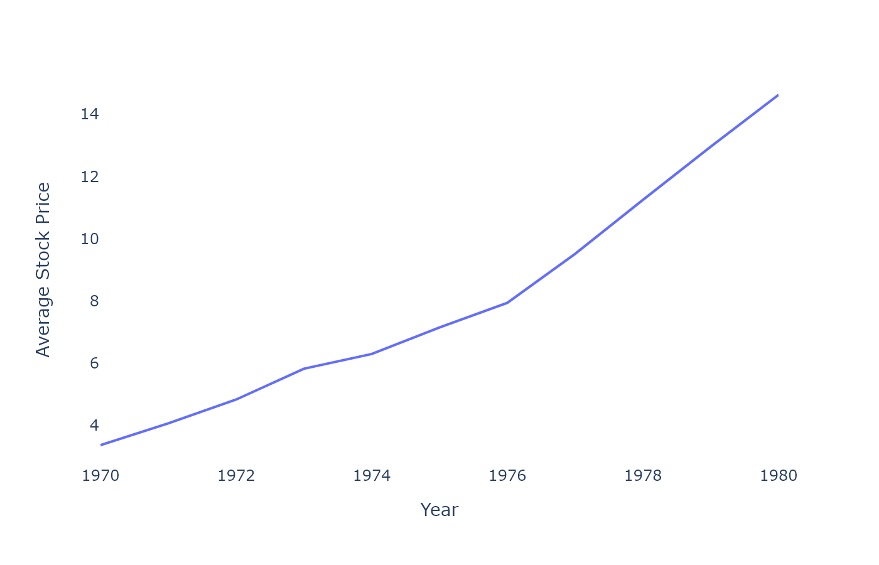
Stock Prices by Company
Grouping by additional variables is easy

Slide 5
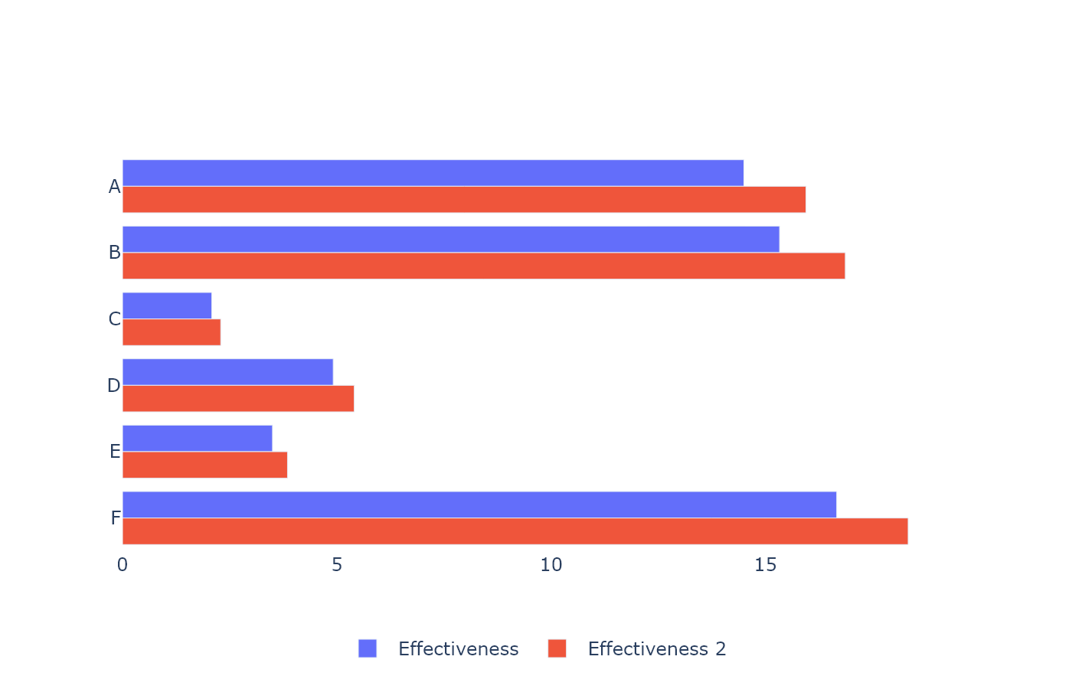
Avg Spray Effictiveness by Type
this slide has data on it!

Slide 6
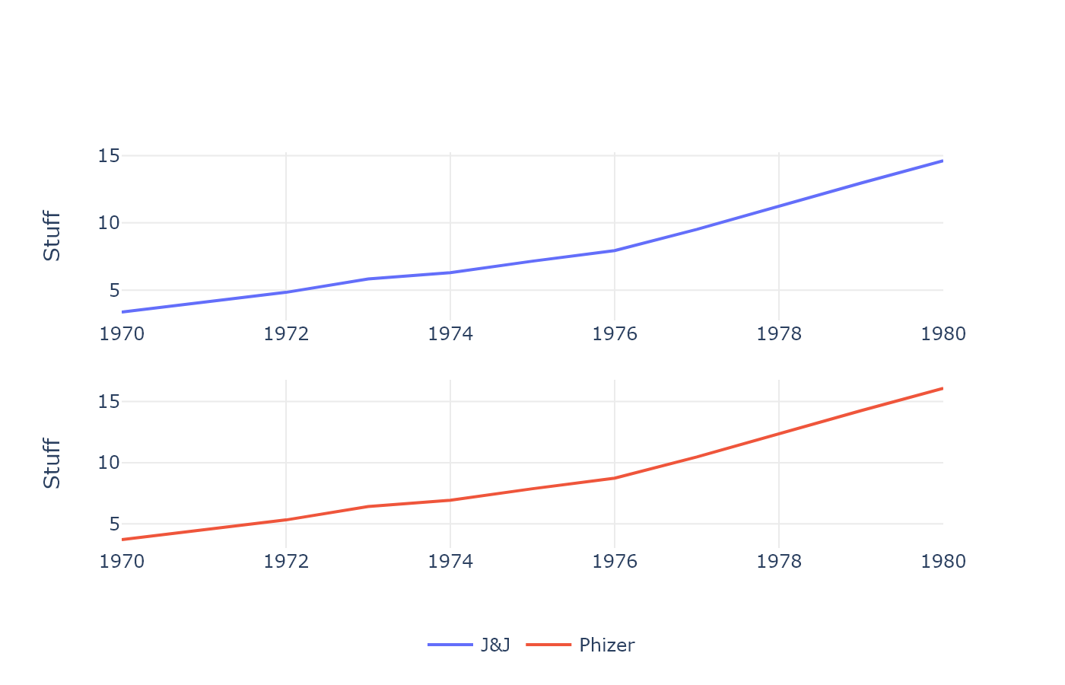
Multiple Comanpy Stock Prices
Faceting can be fun

Slide 7
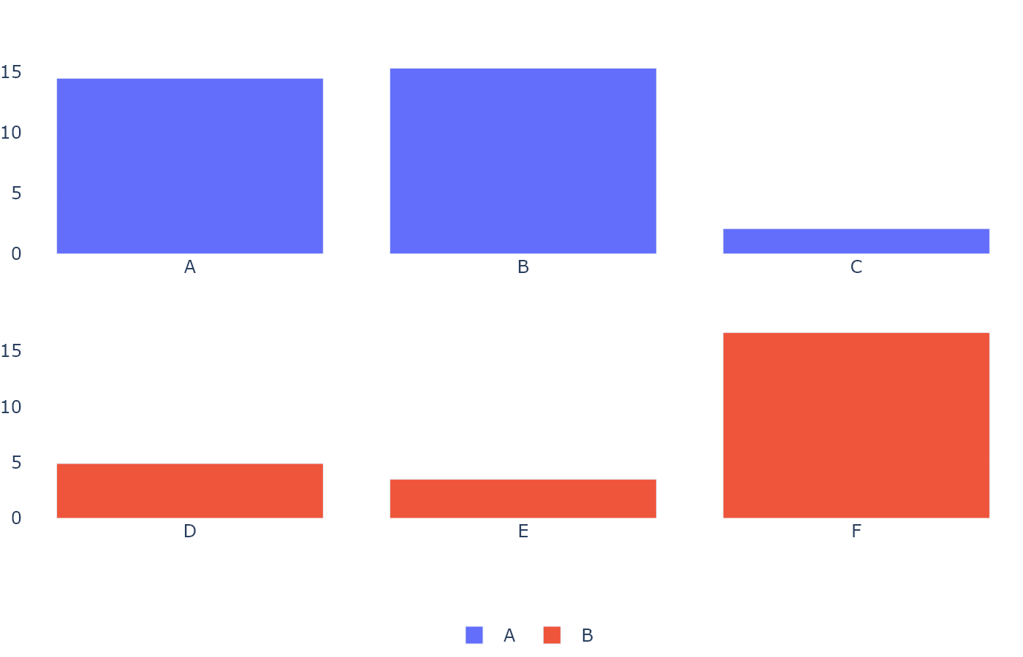
Avg Spray Effictiveness by Type
this slide has data on it!

Slide 8
Stock Prices by Company
Grouping by additional variables is easy

Slide 9
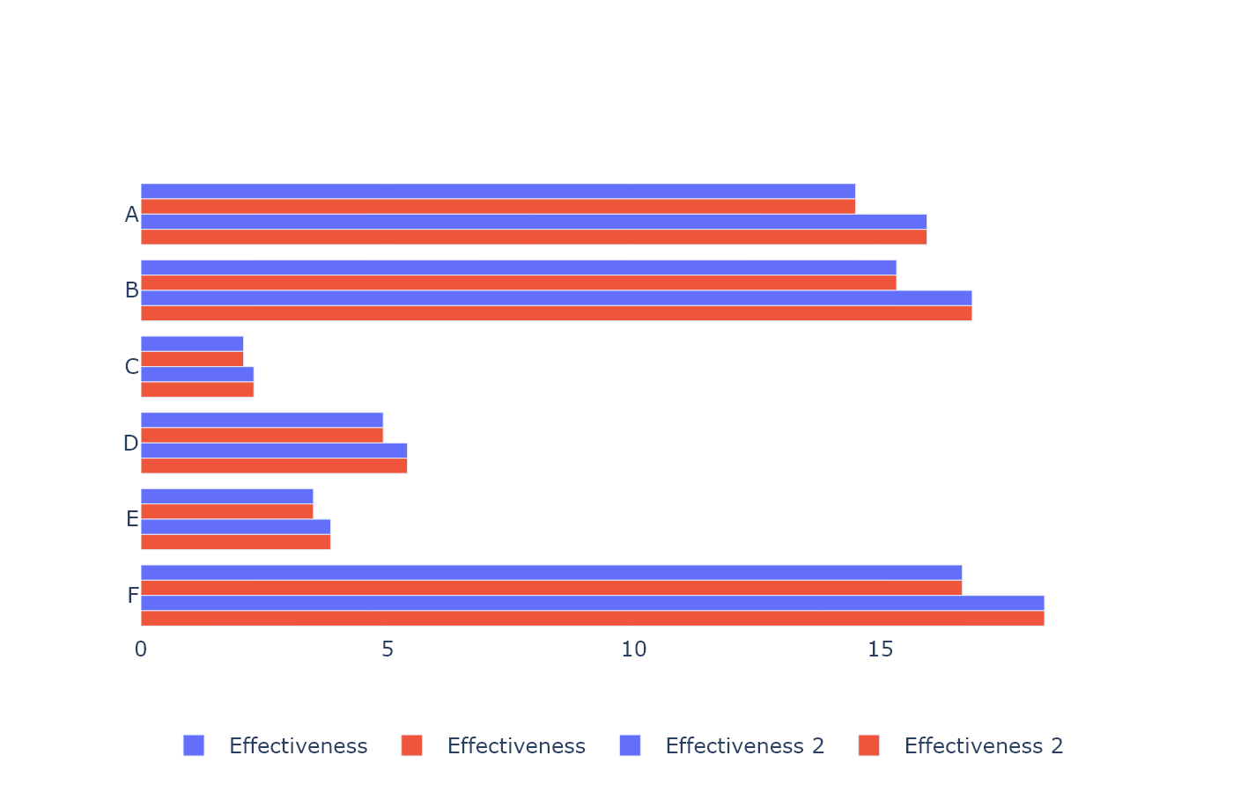
Avg Spray Effictiveness by Type
this slide has data on it!

Slide 10
Multiple Comanpy Stock Prices
Faceting can be fun

Slide 11
Avg Spray Effictiveness by Type
this slide has data on it!

