Slide 1
Plotly & Powerpoint
Automatically generating charts and adding them to PowerPoint slides
Slide template found on SlidesGo

Slide 2
Basic template
Text will go here

Slide 3
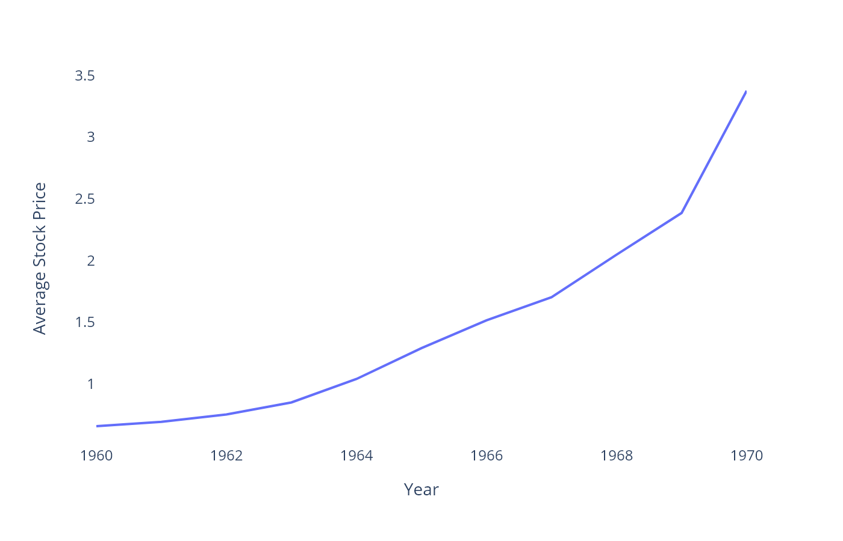
Stock Prices by Company
Grouping by additional variables is easy

Slide 4
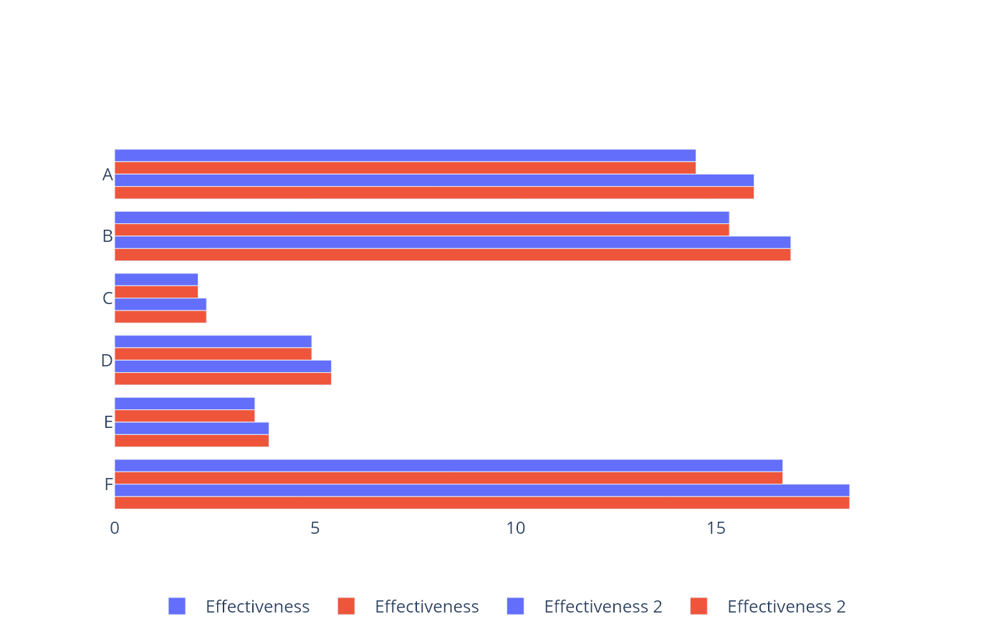
Avg Spray Effictiveness by Type
this slide has data on it!

Slide 5
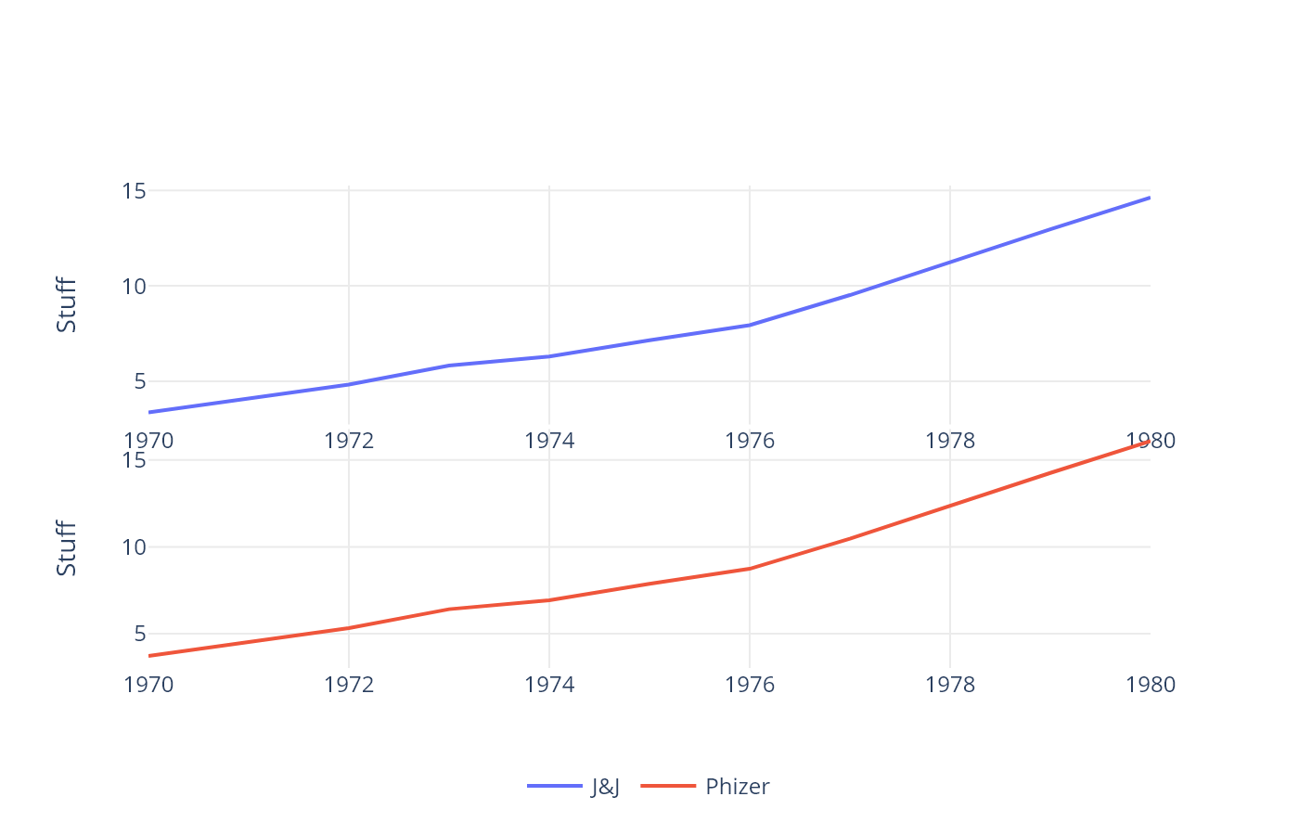
Multiple Comanpy Stock Prices
Faceting can be fun

Slide 6
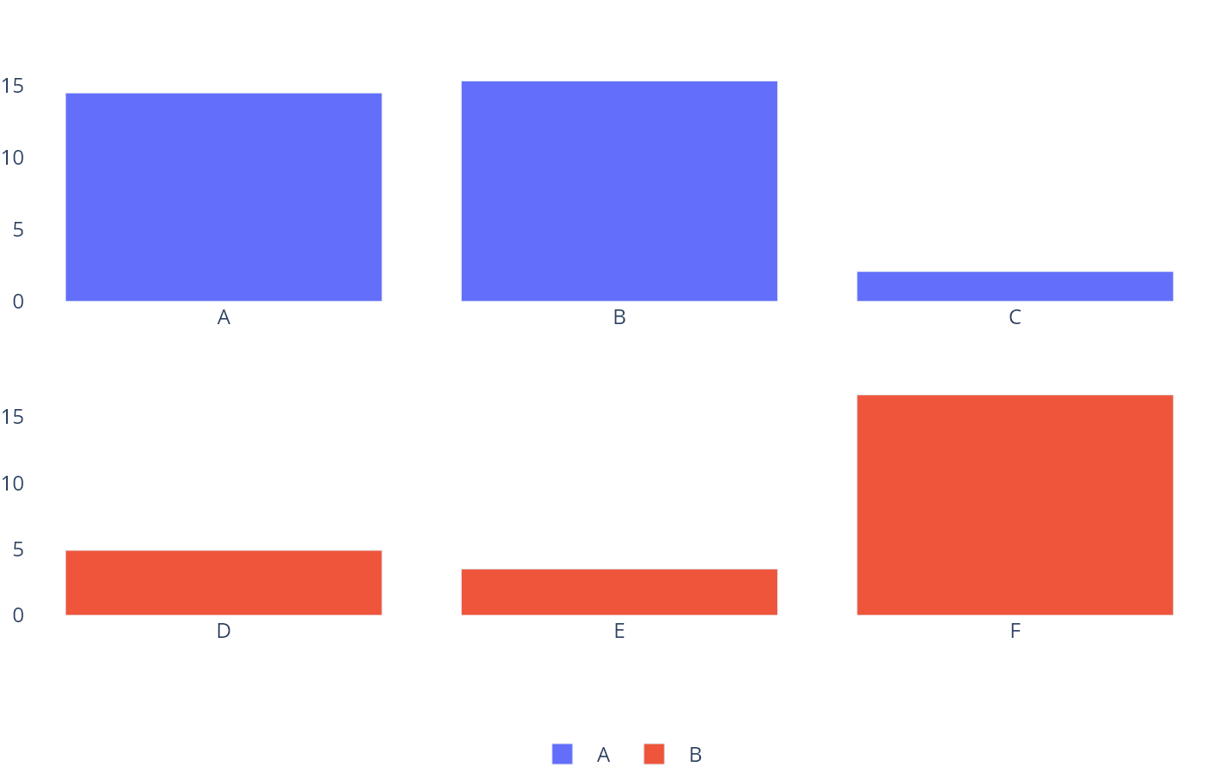
Avg Spray Effictiveness by Type
this slide has data on it!

Slide 7
count | spray | m2
10 | A | $11
7 | A | $3
20 | A | $22
14 | A | $15
14 | A | $15
12 | A | $13
10 | A | $11
23 | A | $25

Slide 8
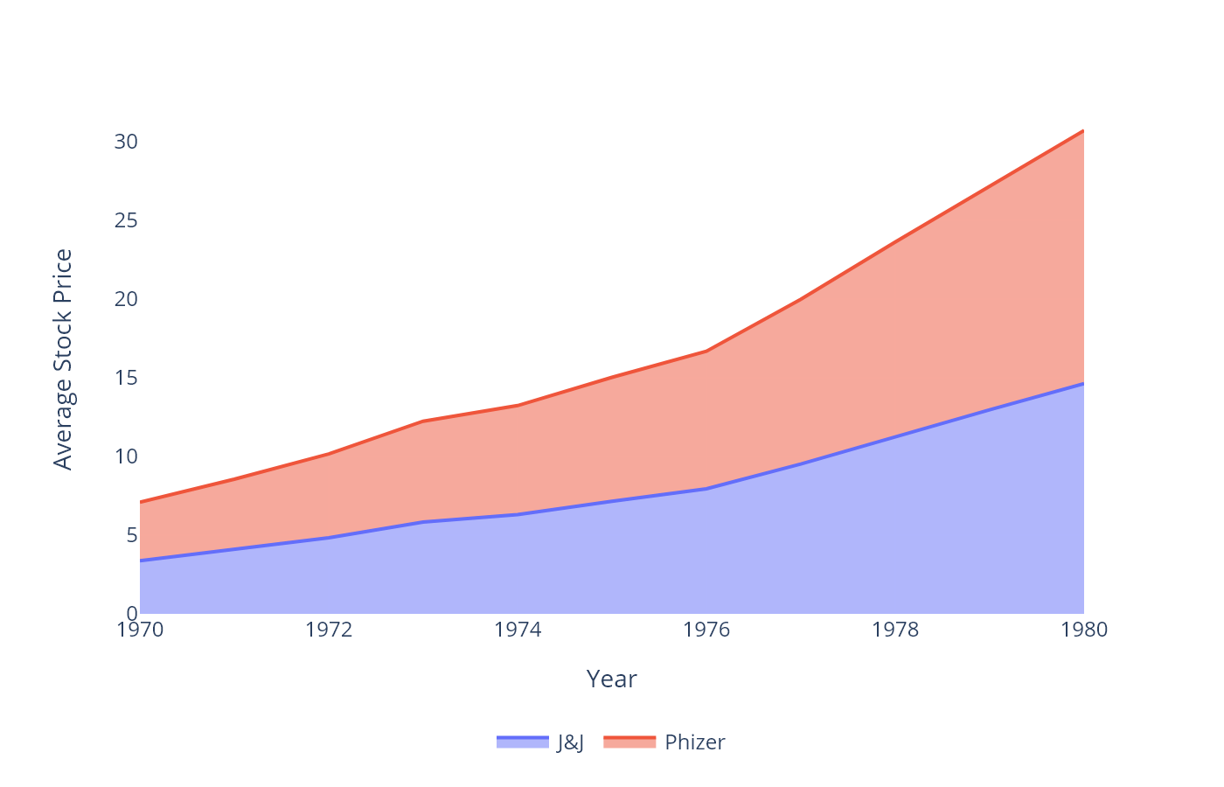
Stock Prices by Company - Filled Line Chart
Grouping by additional variables is easy

Slide 9
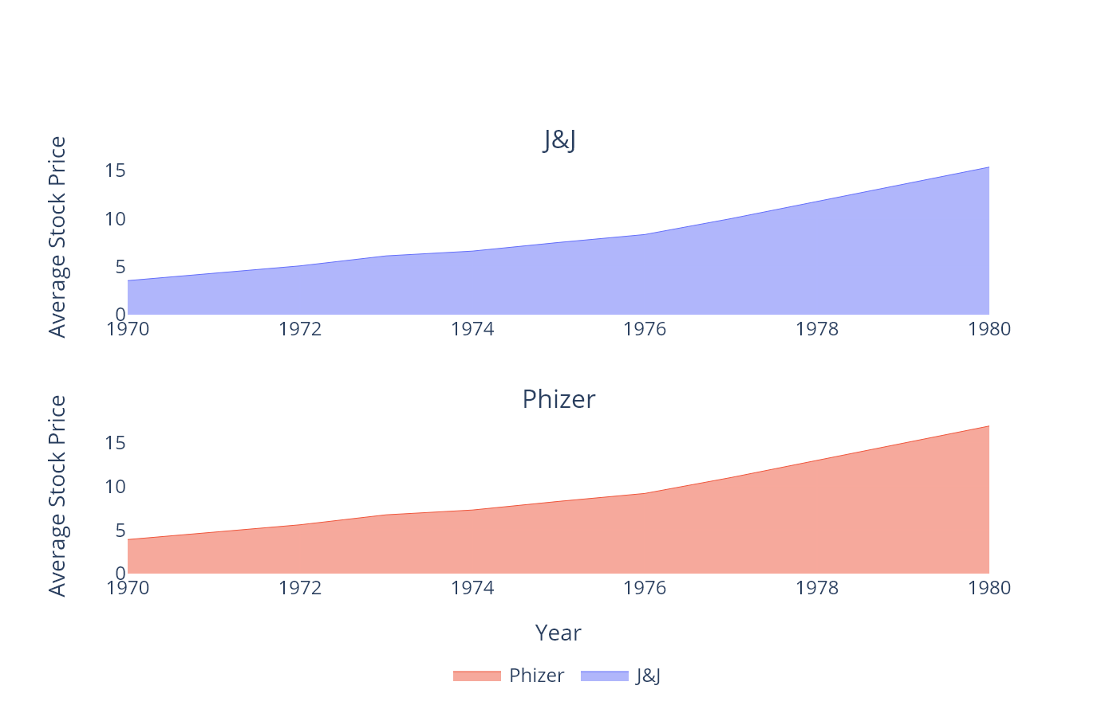
Facet Filled Line
Grouping by additional variables is easy

Slide 10
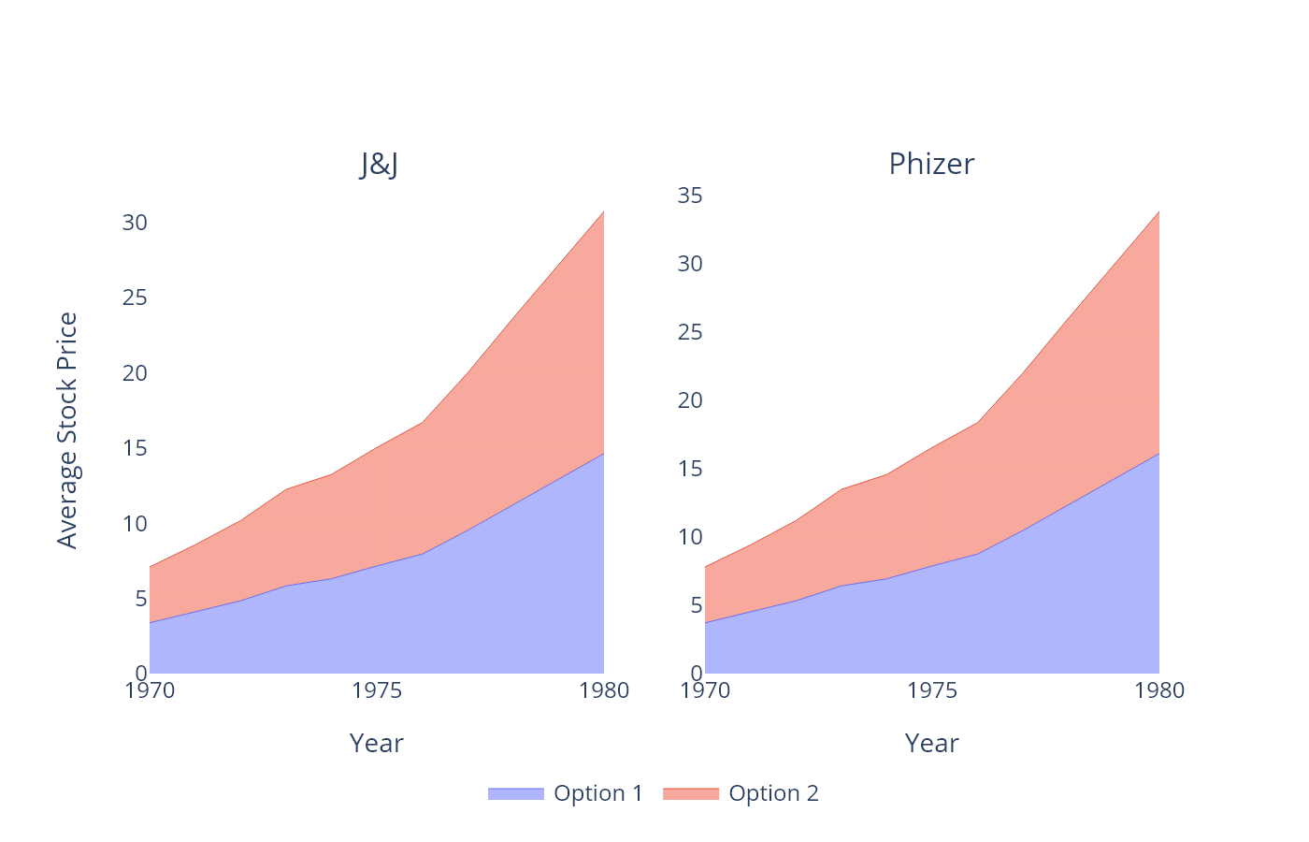
Facet Filled Line with Color Grouping
Grouping by additional variables is easy

