Slide 1
Plotly & Powerpoint
Automatically generating charts and adding them to PowerPoint slides
Slide template found on SlidesGo

Slide 2
Basic template
Text will go here

Slide 3
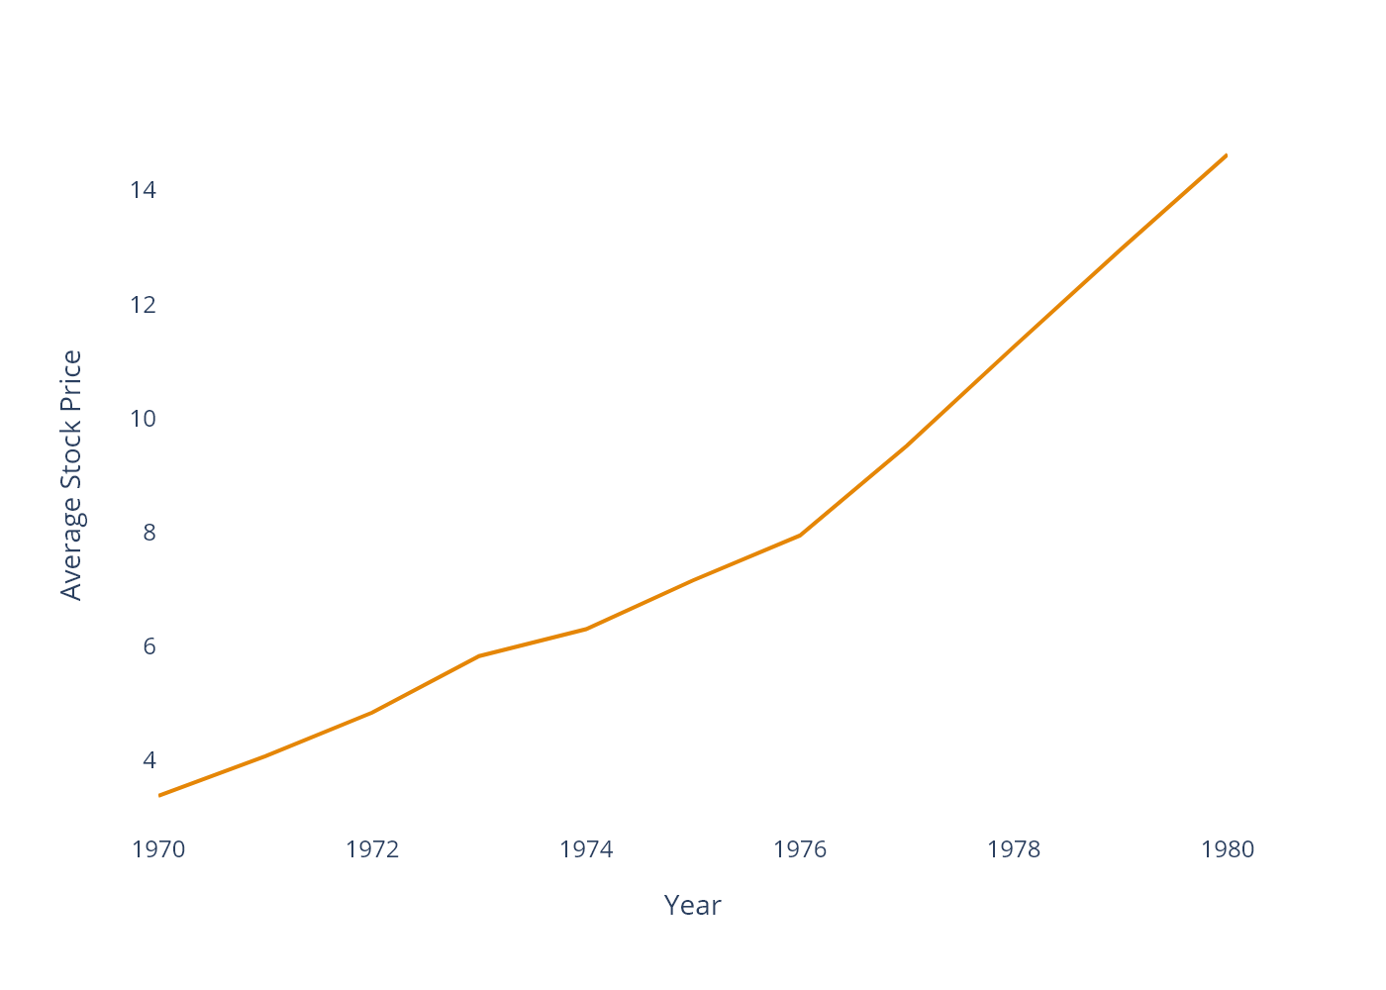
Stock Prices by Company
Grouping by additional variables is easy

Slide 4
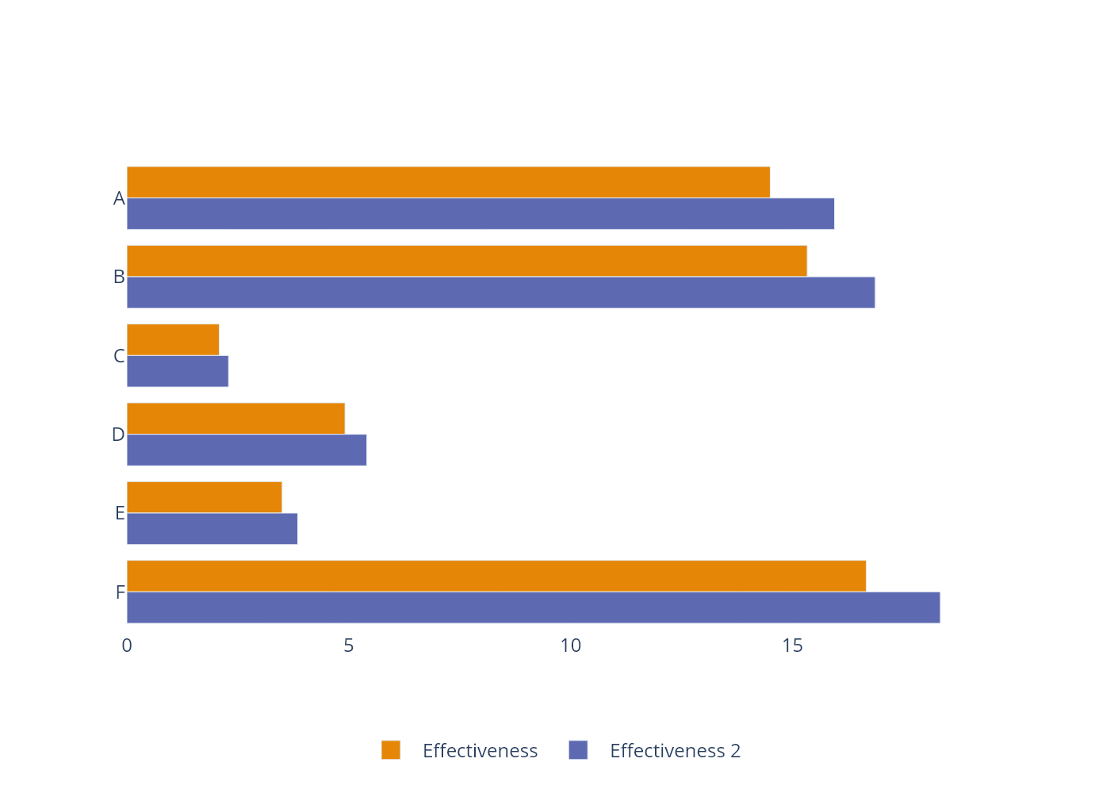
Avg Spray Effictiveness by Type
this slide has data on it!

Slide 5
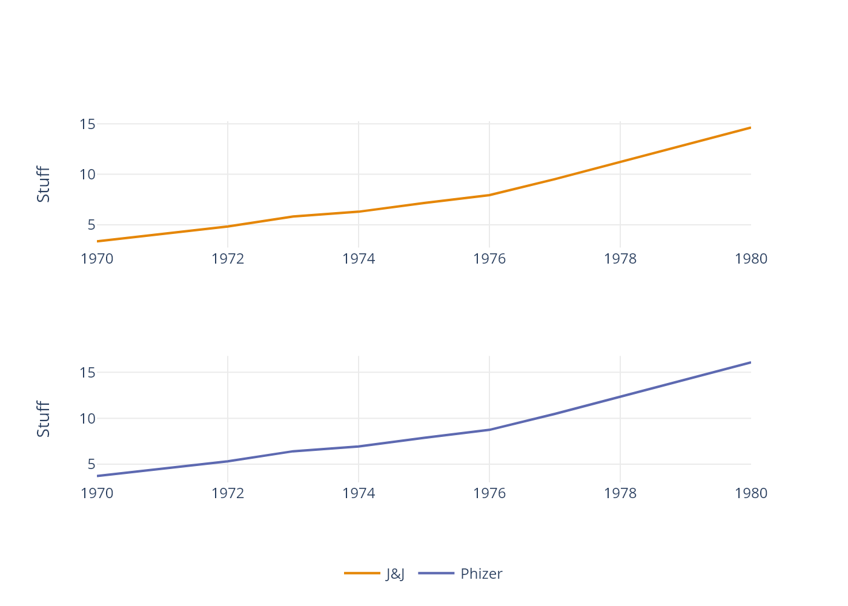
Multiple Comanpy Stock Prices
Faceting can be fun

Slide 6
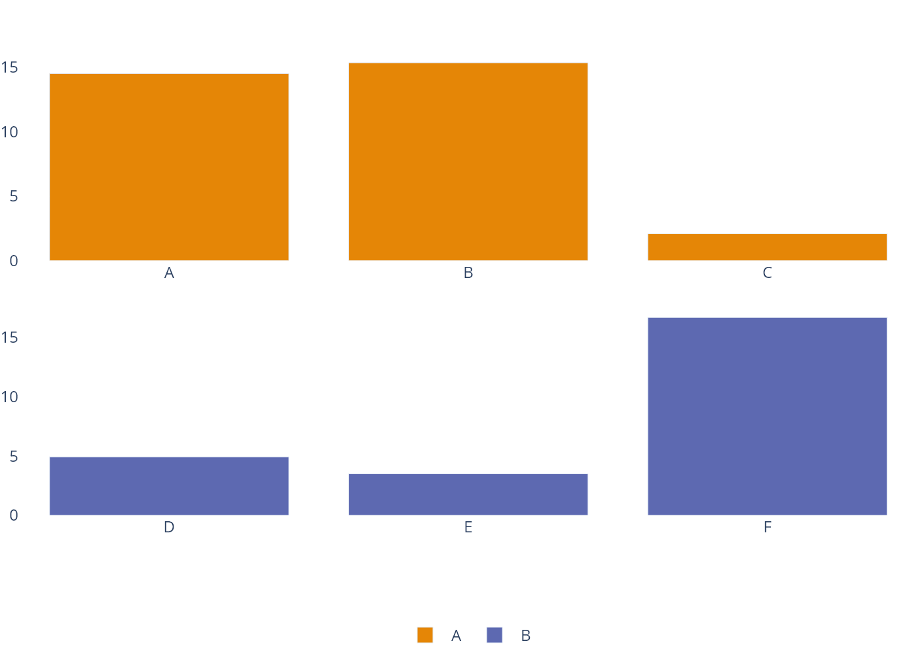
Avg Spray Effictiveness by Type
this slide has data on it!

Slide 7
Example of a Table
count | spray | m2 | m3 | m4
10 | A | $11 | 11% | 11.0
7 | A | $3 | 3% | 3.85
20 | A | $22 | 22% | 22.0
14 | A | $15 | 15% | 15.4
14 | A | $15 | 15% | 15.4

