Slide 1
Sympl PM
Product Manager Training
Projects · the product catalog · Category Requests · Excel export · PSIR
October 2026 release

Slide 2
Agenda
1
Getting around
2
Projects
Sign in, dashboard, navigation
Create a project and use the product grid
3
The product catalog
4
Category Requests
One record per part number; link, don't duplicate
Ask for a new category the right way
5
Excel export & import
6
PSIR Generator & wrap-up
Dropdowns and the Valid Values sheet
Build a PSIR; quick reference
Sympl PM · Product Manager Training

Slide 3
What's new in this release
Product catalog
Category Requests
Export dropdowns
Branding
Every product exists once. Projects link to products instead of holding copies.
Request a new category with its required attributes; reviewers approve and build it.
Project exports now have dropdown lists and a Valid Values sheet.
Company name and logo across the app, sign-in pages and email.
Sympl PM · Product Manager Training

Slide 4
01
Getting around
Sign in, dashboard and navigation

Slide 5
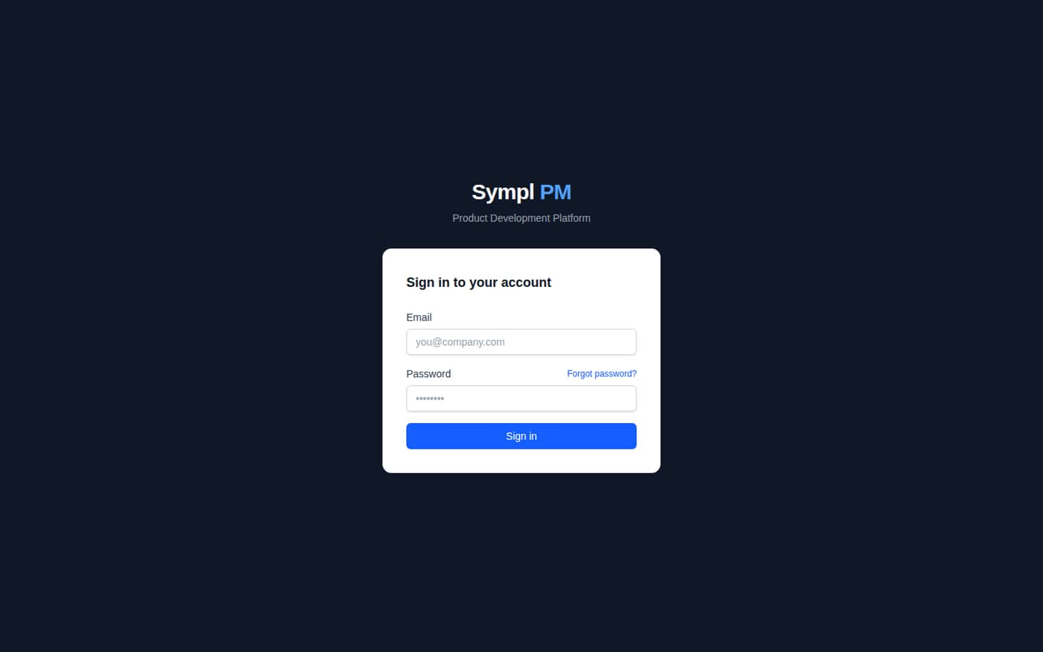
GETTING AROUND
Signing in
​Open the Sympl PM address your team uses.
​Sign in with your work email and password.
​Forgot password? emails a reset link (valid 1 hour).
​New users: use the Set Your Password invitation (valid 7 days).
Sympl PM · Product Manager Training

Slide 6
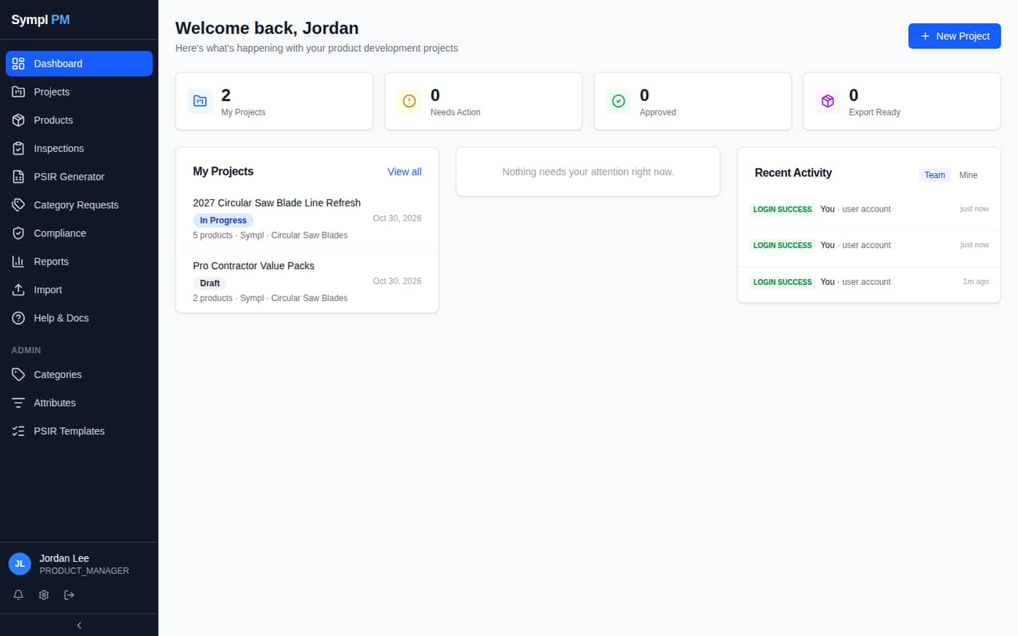
GETTING AROUND
Your dashboard
​Counts: My Projects, Needs Action, Approved, Export Ready.
​My Projects lists your active work.
​Items needing your attention appear in the middle.
​Recent Activity for your team or just you.
​Sidebar: Projects, Products, Inspections, PSIR Generator, Category Requests, Compliance, Reports, Import, Help.
Sympl PM · Product Manager Training

Slide 7
02
Projects
Create a project and work in the product grid

Slide 8
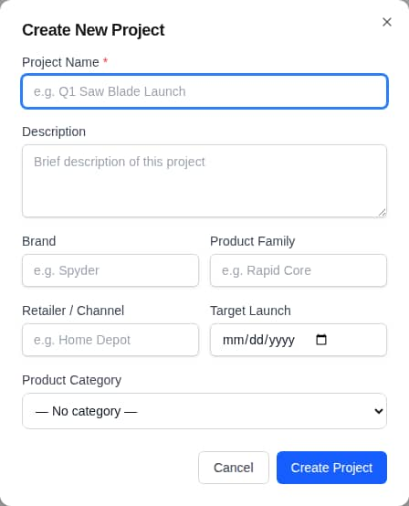
PROJECTS
Creating a project
​Projects → New Project.
​Only Project Name is required.
​Add Brand, Product Family, Retailer / Channel, Target Launch and Product Category.
​Create Project — you're the owner.
​Add teammates on the Members tab.
Sympl PM · Product Manager Training

Slide 9
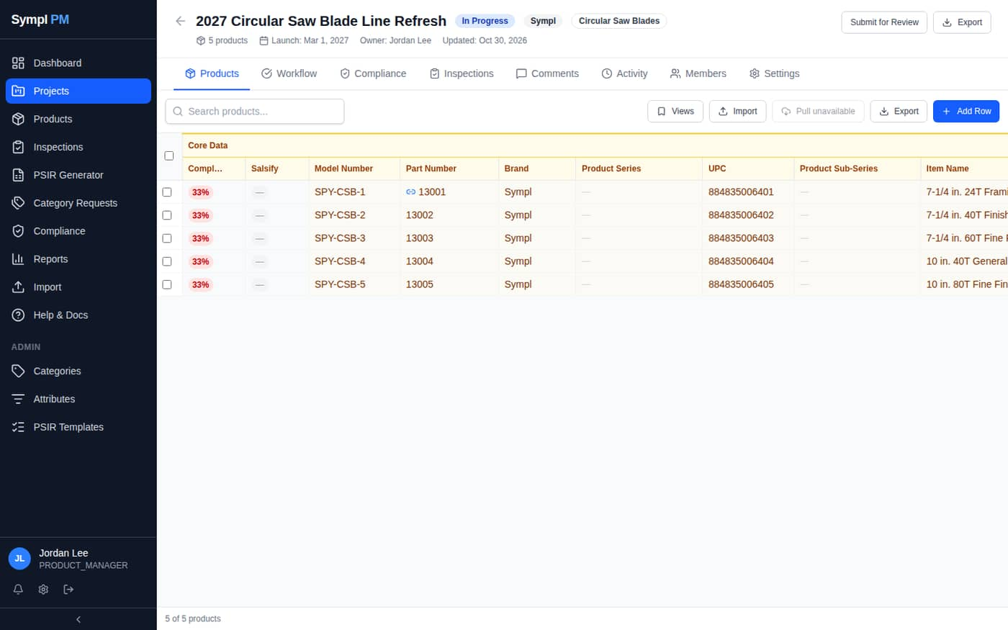
PROJECTS
The product grid
​Click a cell to edit; changes save automatically.
​Tab across, Enter down, Esc cancels.
​Compl… = % of required fields filled.
​Views saves sort, columns and search.
​Tabs: Workflow, Compliance, Inspections, Comments, Activity, Members, Settings.
Sympl PM · Product Manager Training

Slide 10
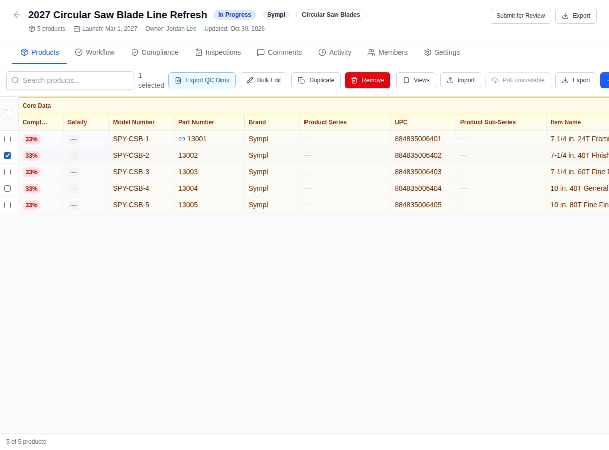
PROJECTS
Selecting rows
​Tick rows to show the toolbar.
​Bulk Edit one field across many products.
​Duplicate a row as a starting point.
​Remove takes products off this project only.
​Export QC Dims for the inspection vendor.
Sympl PM · Product Manager Training

Slide 11
03
The product catalog
One record per part number

Slide 12
THE PRODUCT CATALOG
How the catalog works
Product 13001
one record in the catalog
link
link
2027 Circular Saw Blade Line Refresh
Pro Contractor Value Packs
​Part numbers are unique across the platform.
​An edit in either project changes the same record.
​A blue link icon by the Part Number = also used in another project.
​Remove unlinks from one project; the product stays in the catalog.
Sympl PM · Product Manager Training

Slide 13
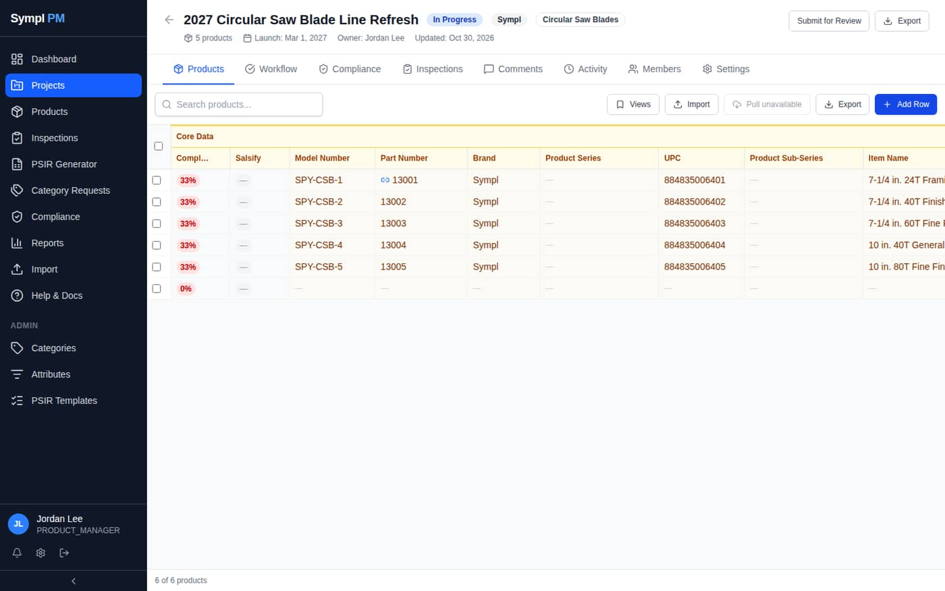
THE PRODUCT CATALOG
Adding products: new or existing
​Add Row creates a blank row.
​Type a new part number → a new product.
​Type an existing part number → Sympl asks to add that existing product instead. Click OK.
​Duplicates are refused — no more copies.
Sympl PM · Product Manager Training

Slide 14
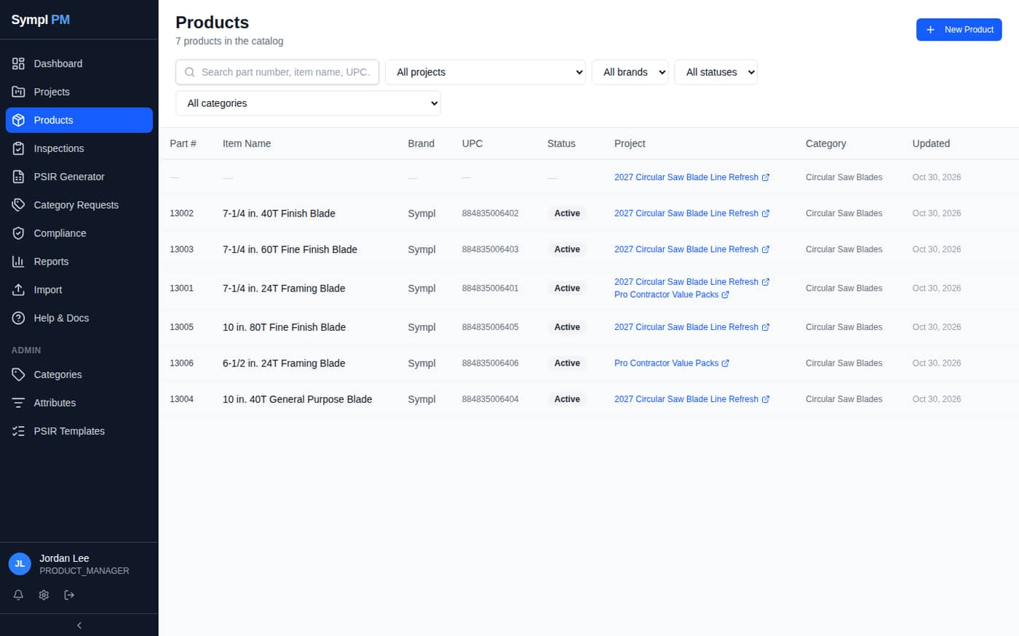
THE PRODUCT CATALOG
The Products page
​The whole catalog, 50 per page.
​Filter by search, project, brand, status, category.
​Project column shows every project a product is in.
​New Product creates a product with no project yet.
Sympl PM · Product Manager Training

Slide 15
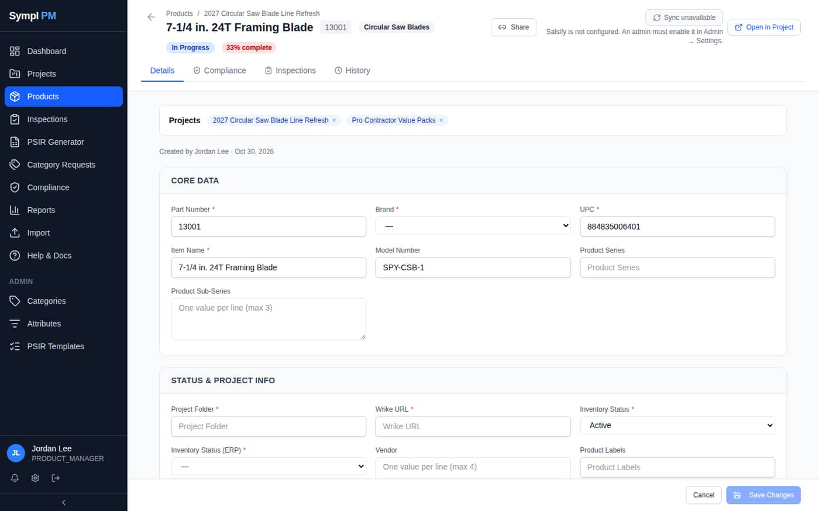
THE PRODUCT CATALOG
The product page
​Projects panel: every project using this product; × removes it from one.
​All fields by section; Save Changes.
​History tab: who changed what, old → new.
​Open in Project jumps to the grid row.
​Share makes an expiring read-only link.
Sympl PM · Product Manager Training

Slide 16
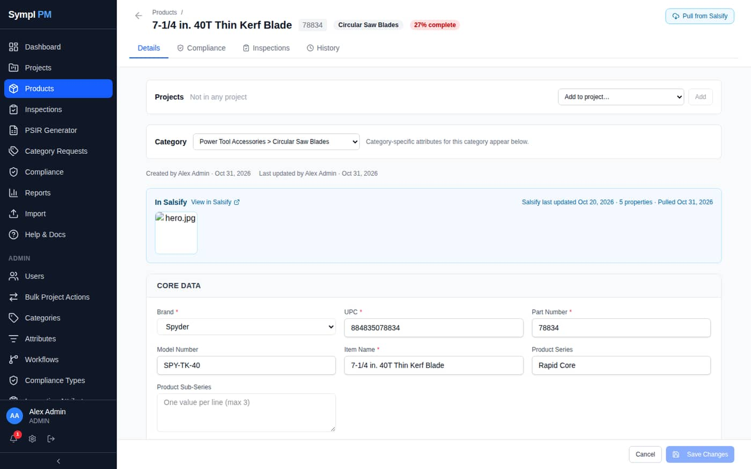
THE PRODUCT CATALOG
Setting the category
​Product page → Category picker, under Projects.
​The category decides which category-specific attributes appear.
​Required for products not in a project.
​In a project? Use project category inherits it.
​Changes are logged in History.
Sympl PM · Product Manager Training

Slide 17
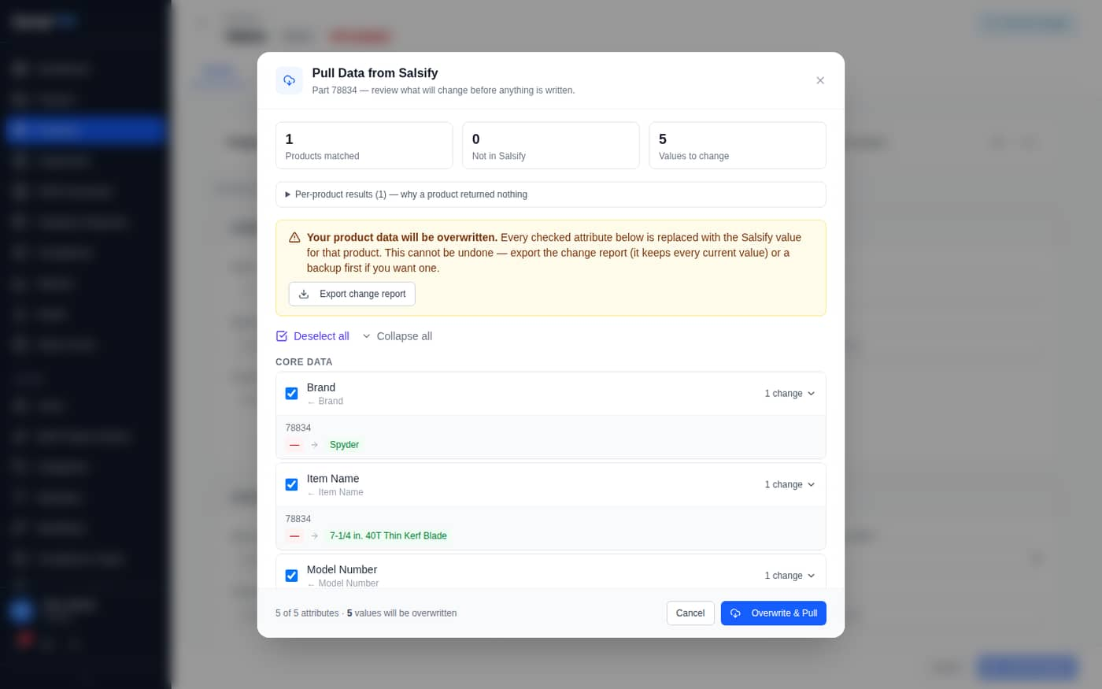
THE PRODUCT CATALOG
Pull from Salsify
​Product page → Pull from Salsify — works even if the product isn't in a project.
​Needs a saved Part Number.
​Review the change report: current → Salsify value; untick fields to skip.
​Export change report to Excel (also a backup).
​Overwrite & Pull — each field is logged in History.
Sympl PM · Product Manager Training

Slide 18
04
Category Requests
Ask for the category you need

Slide 19
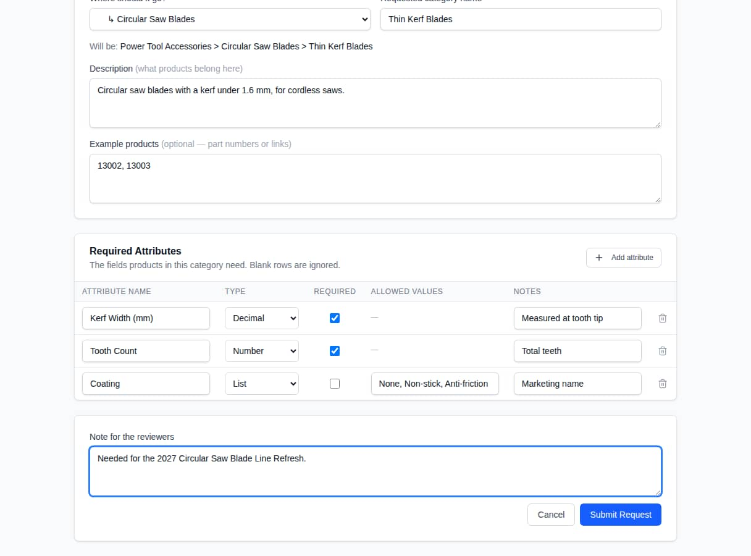
CATEGORY REQUESTS
Submitting a request
​Category Requests → New Request.
​Pick where it goes (or a new parent) and the name.
​Describe it; add example part numbers.
​List Required Attributes: name, type, required, allowed values, notes.
​Add a note for reviewers → Submit Request.
Sympl PM · Product Manager Training

Slide 20
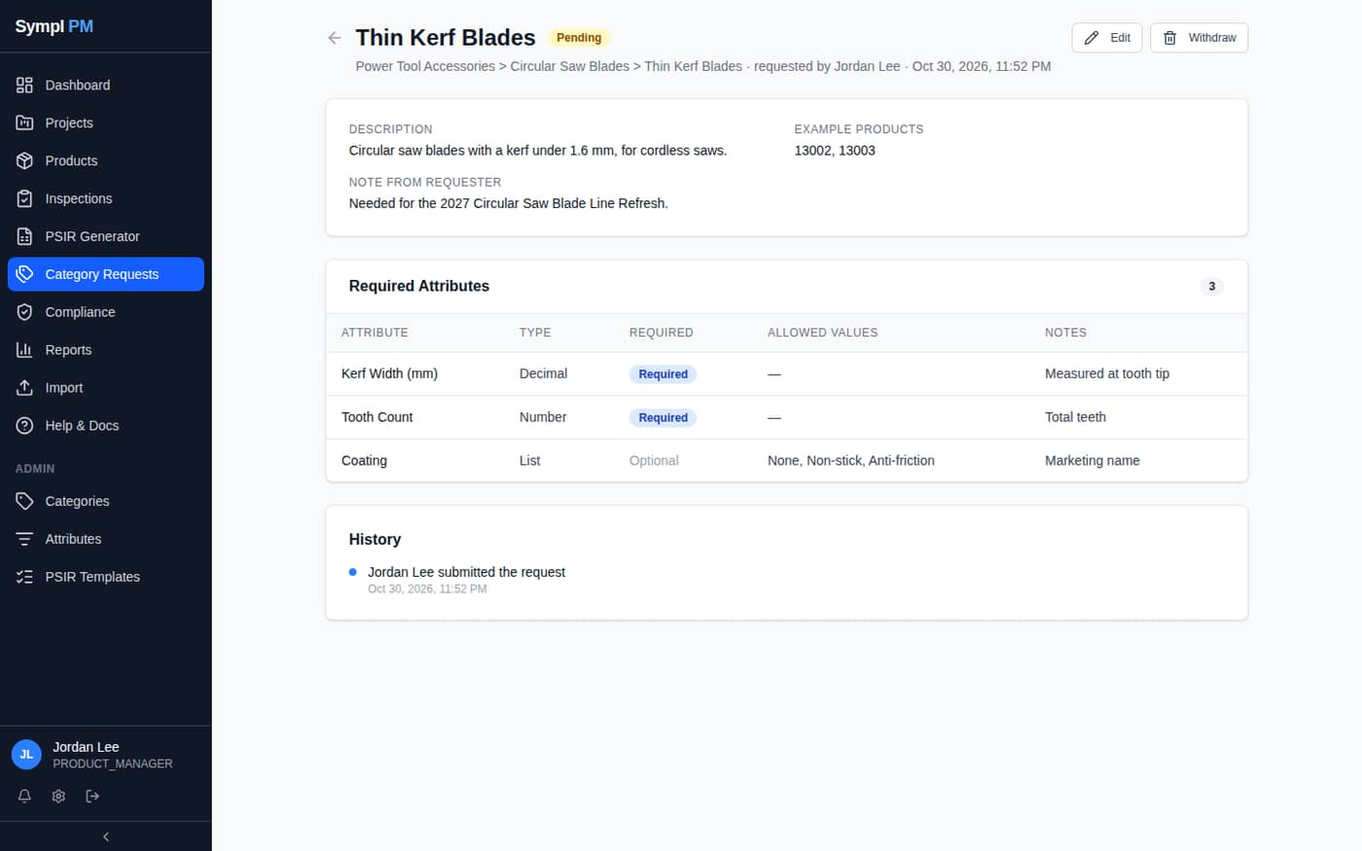
CATEGORY REQUESTS
Tracking your request
​Pending — you can Edit or Withdraw.
​Needs Info — answer and resubmit.
​Approved — being built by an Admin.
​Completed — ready to use.
​Rejected — see the reviewer's note.
​You're notified at every step.
Sympl PM · Product Manager Training

Slide 21
05
Excel export & import
Dropdowns and valid values

Slide 22
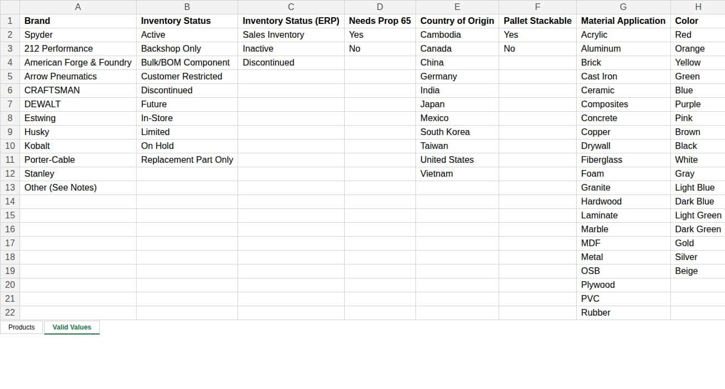
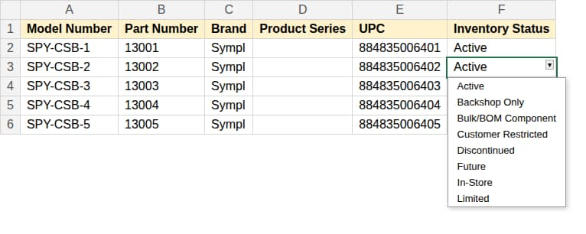
EXCEL EXPORT & IMPORT
Export: dropdowns and Valid Values
​Project → Export downloads the workbook.
​Columns with defined values have a dropdown — pick, don't type.
​The Valid Values sheet lists every allowed value.
​Header notes describe each column; header row is frozen.
​Off-list values show a warning (not a block).
Sympl PM · Product Manager Training

Slide 23
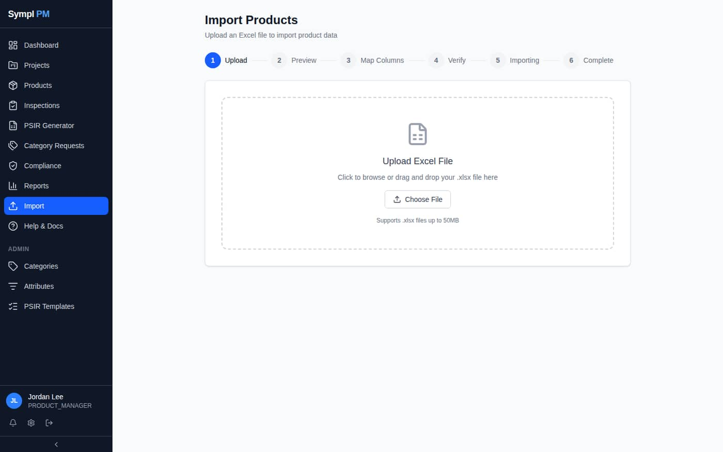
EXCEL EXPORT & IMPORT
Import (unchanged)
​Import → upload .xlsx.
​Preview → Map Columns → Verify.
​Verify shows rows created vs. updated, old → new.
​Matched by Part Number — an existing part updates that one catalog record everywhere.
Sympl PM · Product Manager Training

Slide 24
06
PSIR Generator & wrap-up
Build a PSIR; where to get help

Slide 25
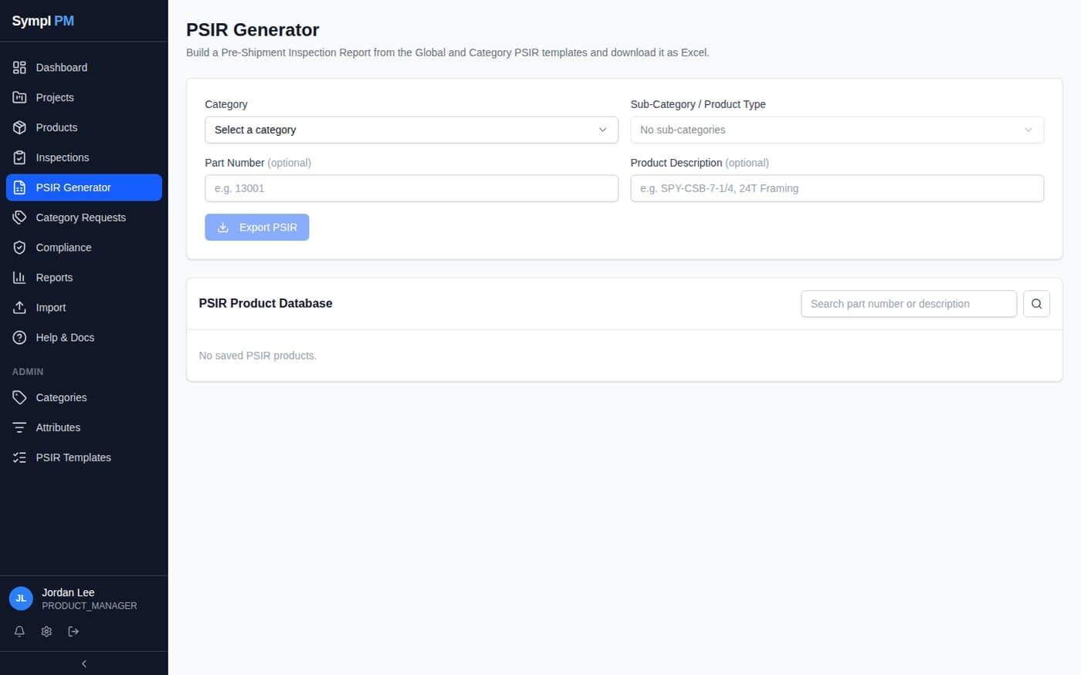
PSIR GENERATOR
PSIR Generator
​Choose Category → Sub-Category / Product Type.
​Enter Part Number and Description.
​Fill in the fields; blanks export as {Field Name}.
​Export PSIR downloads the workbook.
​Save to PSIR Product Database to reuse later.
Sympl PM · Product Manager Training

Slide 26
Quick reference
I want to… | Do this
Start a project | Projects → New Project
Add a new product | Project → Add Row
Add an existing product | Add Row → type part number → OK
Take a product off a project | Tick row → Remove
See where a product is used | Product page → Projects panel
Create a product with no project | Products → New Product
Set a product's category | Product page → Category
Fill a product from Salsify | Product page → Pull from Salsify
Request a category | Category Requests → New Request
Excel with dropdowns | Project → Export
Bulk update | Import → map → verify
Build a PSIR | PSIR Generator → Export PSIR
Sympl PM · Product Manager Training

Slide 27
Questions & help
​Help & Docs in the sidebar — reference for every module.
​Product Manager SOP — step-by-step procedures with screenshots.
​Notifications: bell icon; email preferences in My Profile.
​Problems or access requests: contact your Sympl PM administrator.
Sympl PM · Product Manager Training

