Slide 1
Predicting Political Stance Using Factors of Education, Income, and Religion.
An analysis of survey responses indicating political preferences, religious beliefs, educational background, and family income, using data from the General Social Survey.
Jonathan Bunch
March 7, 2021
Bellevue University-DSC530

Slide 2
Hypotheses:
There is a correlation between certain political views (liberal vs. conservative) and certain religious beliefs.
There is a correlation between certain political views and some aspects of household employment (income, hours typically worked, perceived “prestige” of occupation).
There is a correlation between certain political views and the respondent’s level of commitment to education.
Political views can be predicted using regression analysis on these correlated variables.

Slide 3
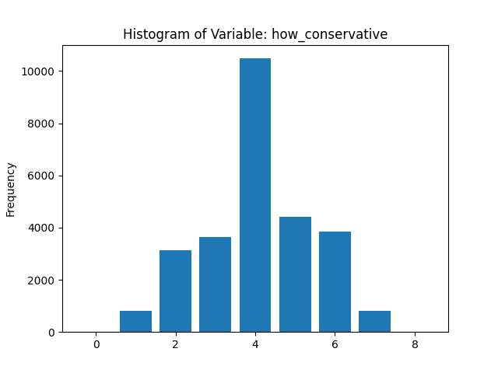
“how_conservative” This variable represents the respondent’s self-reported identification on a scale of liberal to conservative. This is a categorical variable with values from 1-7 (“extremely liberal” to “extremely conservative”).
Summary Statistics:
count 27161
unique 7
top 4
freq 10485
Name: how_conservative, dtype: int64
64797 4
64799 4
64804 4
64808 4
64810 5
Name: how_conservative, dtype: category
Categories (7, int64): [1 < 2 < 3 < 4 < 5 < 6 < 7]

Slide 4
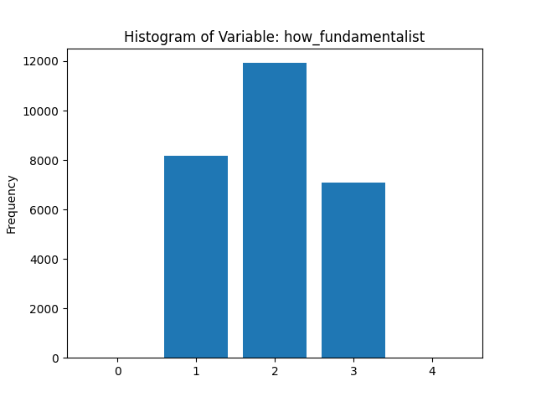
“how_fundamentalist” Similar to “how_conservative”, this variable represents the respondent’s self-reported identification on a scale of liberal to fundamentalist. This is a categorical variable with values from 1-3 (“liberal”, “moderate”, and “fundamentalist”).
Summary Statistics:
count 27161
unique 3
top 2
freq 11925
Name: how_fundamentalist, dtype: int64
64797 3
64799 3
64804 2
64808 3
64810 1
Name: how_fundamentalist, dtype: category
Categories (3, int64): [3 < 2 < 1]

Slide 5
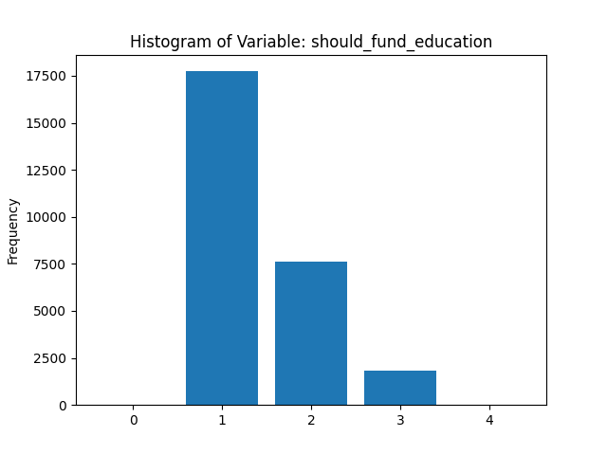
“should_fund_education” This variable represents the respondent’s opinion on the amount of funding currently being committed to the education system. This is a categorical variable with values from 1-3 (“should spend less”, “maintain current”, and “should spend more”).
Summary Statistics:
count 27161
unique 3
top 1
freq 17737
Name: should_fund_education, dtype: int64
64797 1
64799 1
64804 3
64808 1
64810 1
Name: should_fund_education, dtype: category
Categories (3, int64): [3 < 2 < 1]

Slide 6
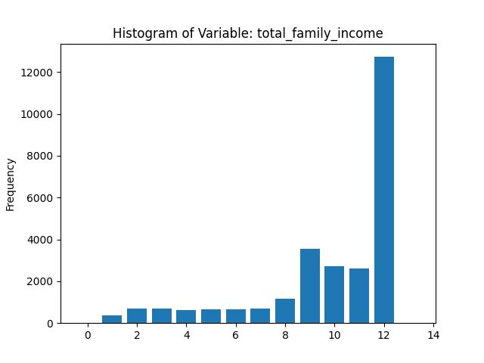
“total_family_income” This variable represents the respondent’s total annual family income. This is a categorical variable with values from 1-12 that represent income ranges (”less than $1000” to “over $25000”). The low upper limit on categories probably explains the high frequency of the value 12.
Summary Statistics:
count 27161
unique 12
top 12
freq 12727
Name: total_family_income, dtype: int64
64797 11
64799 12
64804 10
64808 10
64810 12
Name: total_family_income, dtype: category
Categories (12, int64): [1 < 2 < 3 < 4 ... 9 < 10 < 11 < 12]

Slide 7
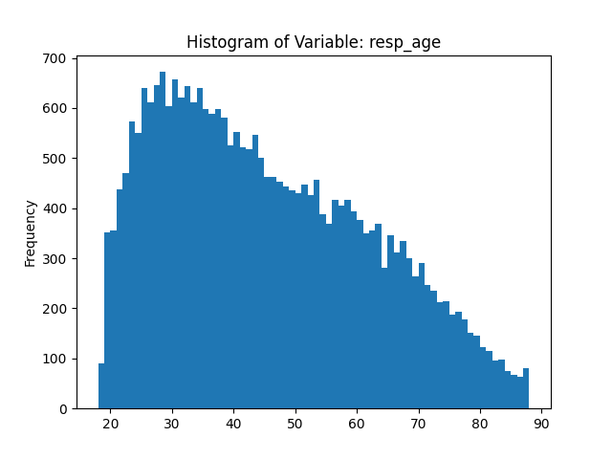
“resp_age” This variable simply represents the respondent’s age at the time of the survey; it is not coded or categorized.
Summary Statistics:
count 27161.000000
mean 44.918523
std 16.930920
min 18.000000
25% 31.000000
50% 42.000000
75% 58.000000
max 88.000000
Name: resp_age, dtype: float64
64797 74
64799 76
64804 46
64808 19
64810 75
Name: resp_age, dtype: int64

Slide 8
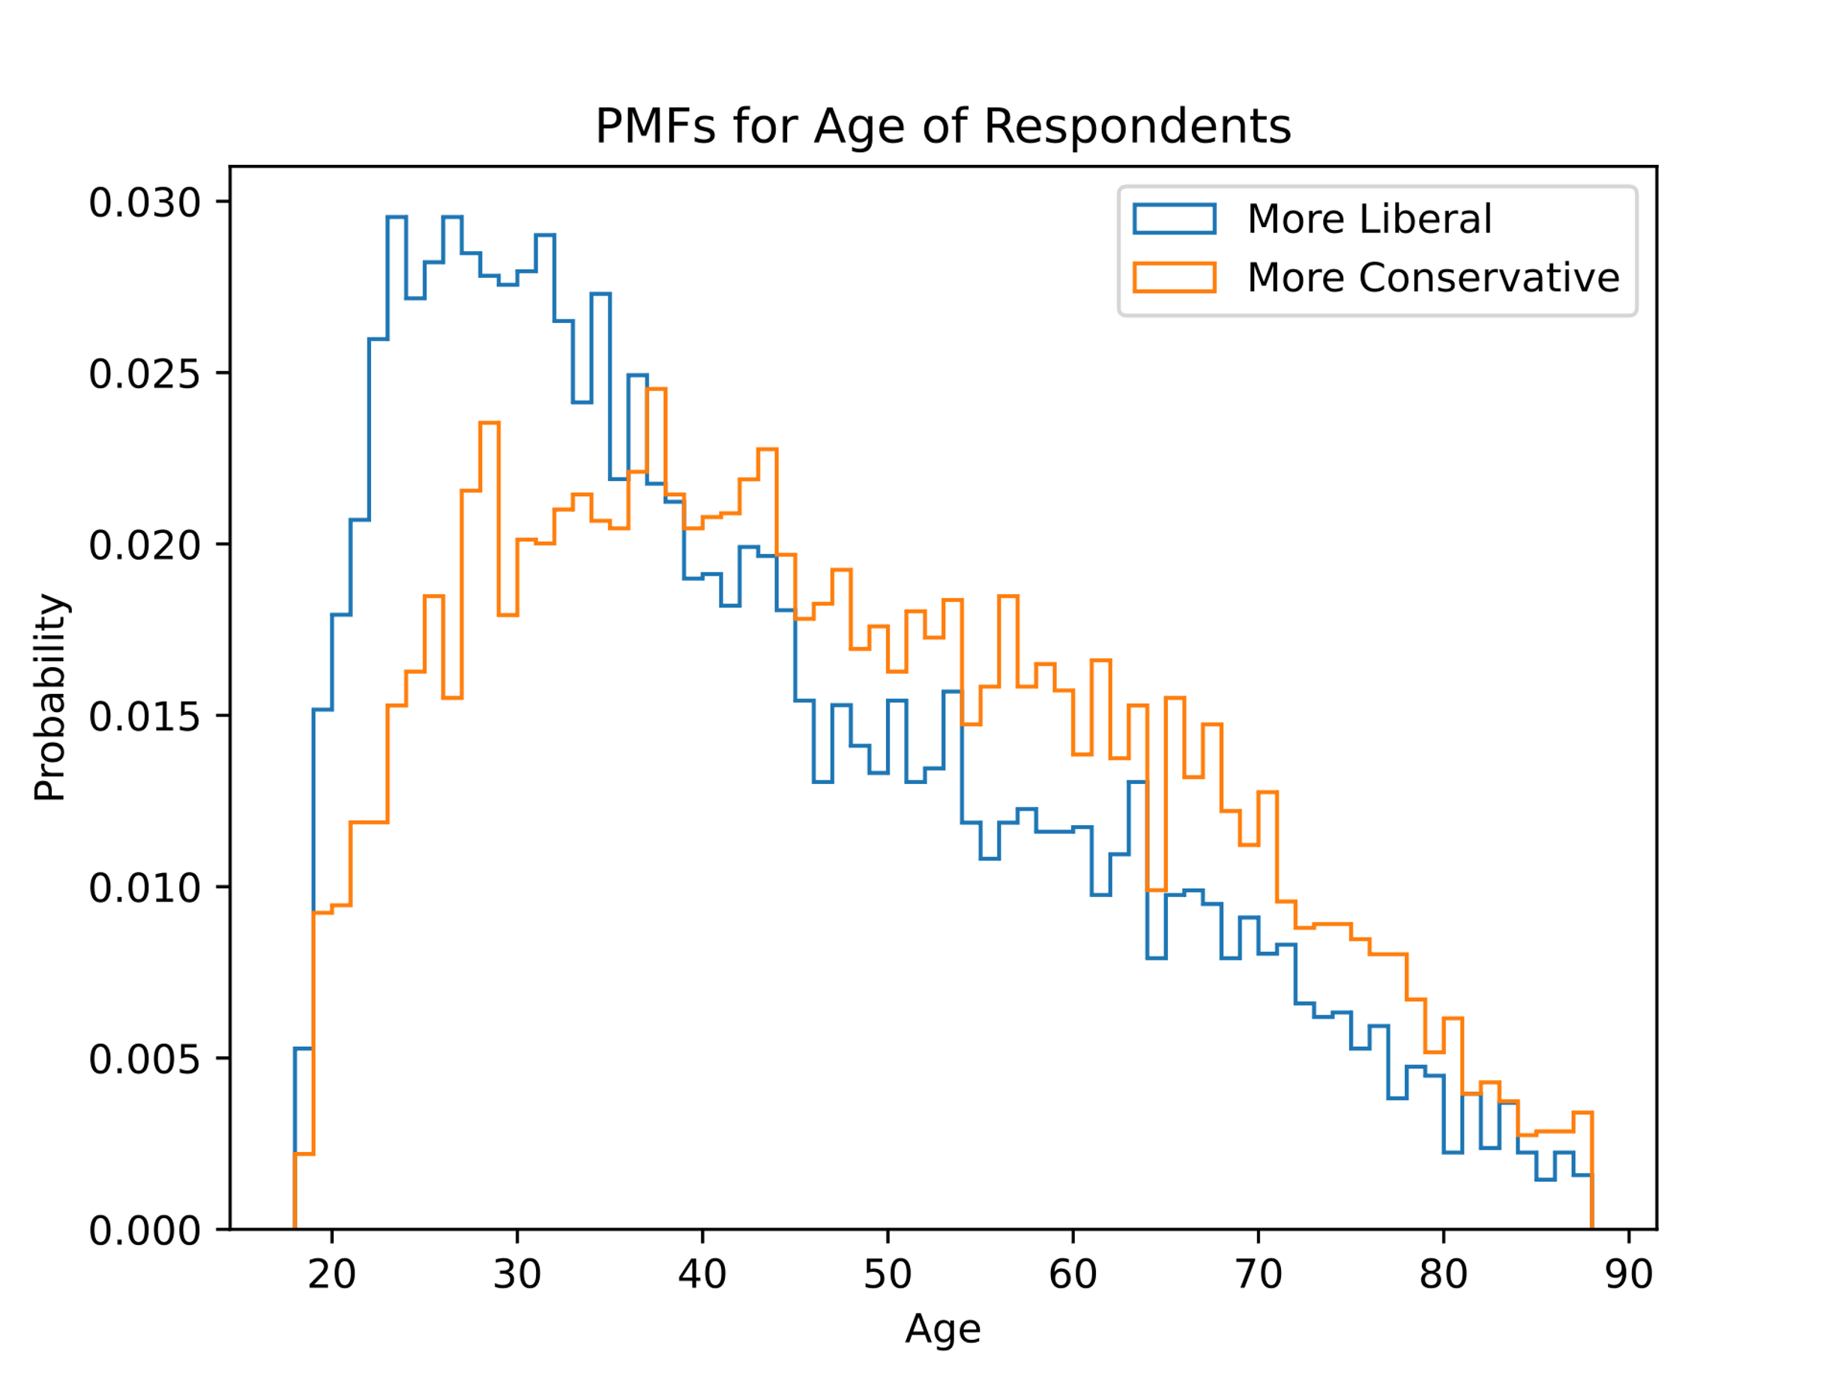
Compare two scenarios in the data: For this exercise, I divided the “resp_age” variable into two groups based on the respondent’s response to the “how_conservative” variable.

Slide 9
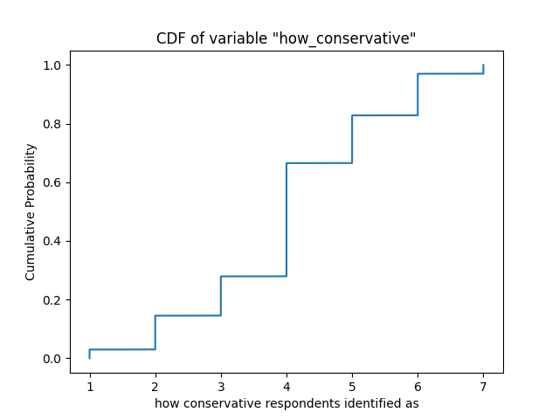
Create a CDF of one variable: This plot indicates that “how_conservative” has a fairly normal distribution, as we can also see from the histogram.

Slide 10
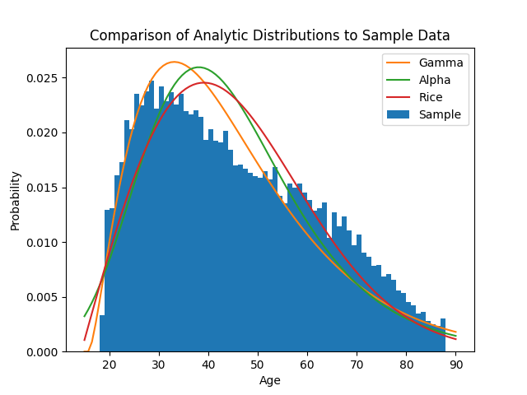
Plot an analytical distribution: I tried to fit several different analytical distributions to the ”resp_age” variable. The fit was not perfect with any of these models, but there were a few that fit fairly well.

Slide 11
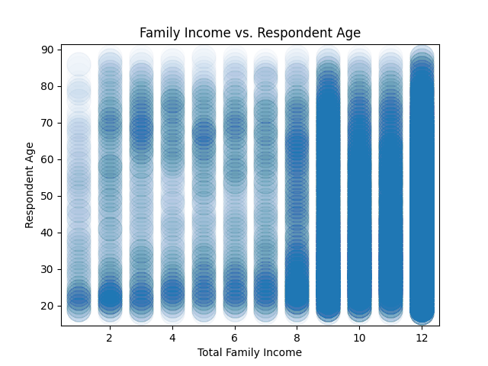
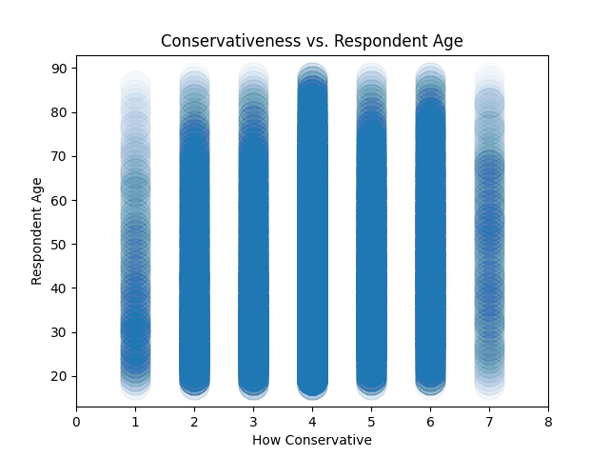
Create two scatter plots: Scatter plots are not the ideal visualization for categorical variables, so the usefulness of these plots is limited. However, adjusting the alpha and marker size did make for some interesting plots.

Slide 12
Conduct a hypothesis test: I tested the hypothesis that there would be a significant correlation between “how_conservative” and “should_fund_education” by performing a permutation test.
xs = df.how_conservative.copy() ys = df.should_fund_education.copy() orig_corr = scipy.stats.spearmanr(a=xs, b=ys) rng = np.random.default_rng() perm_x = rng.permutation(xs) perm_corr = scipy.stats.spearmanr(a=perm_x, b=ys)
The correlation was not very strong to begin with, and this test failed completely.

Slide 13
Perform a regression analysis: I decided to try each of the potential predictive variables, even those with low correlations. I used Poisson regression since the dependent variable is categorical.
# Looping through all potential predictive variables.
formulas = ['how_conservative ~ how_fundamentalist', 'how_conservative ~ resp_age', 'how_conservative ~ total_family_income', 'how_conservative ~ should_fund_education'] for form in formulas: model = smf.poisson(form, data=df.astype('int64')) results = model.fit() print(results.summary())
# Multiple regression with all predictive variables.
form_multi = 'how_conservative ~ how_fundamentalist + resp_age + total_family_income + should_fund_education' model = smf.poisson(form_multi, data=df.astype('int64')) results = model.fit() print(results.summary())
The individual pseudo-R-squared values were very low, but the p-values were well below the threshold to indicate significance. The multiple regression model was slightly better, but, overall, these variables failed to deliver any practical amount of predictive power.

