Slide 1
AKKA
A multi-processing library based on the Actor model for Java and Scala
Jon Burgin
Rackspace Hosting

Slide 2
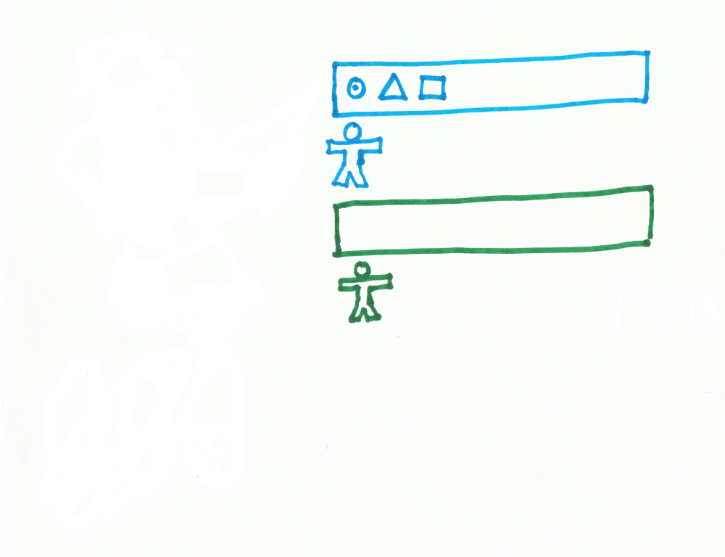

Slide 3
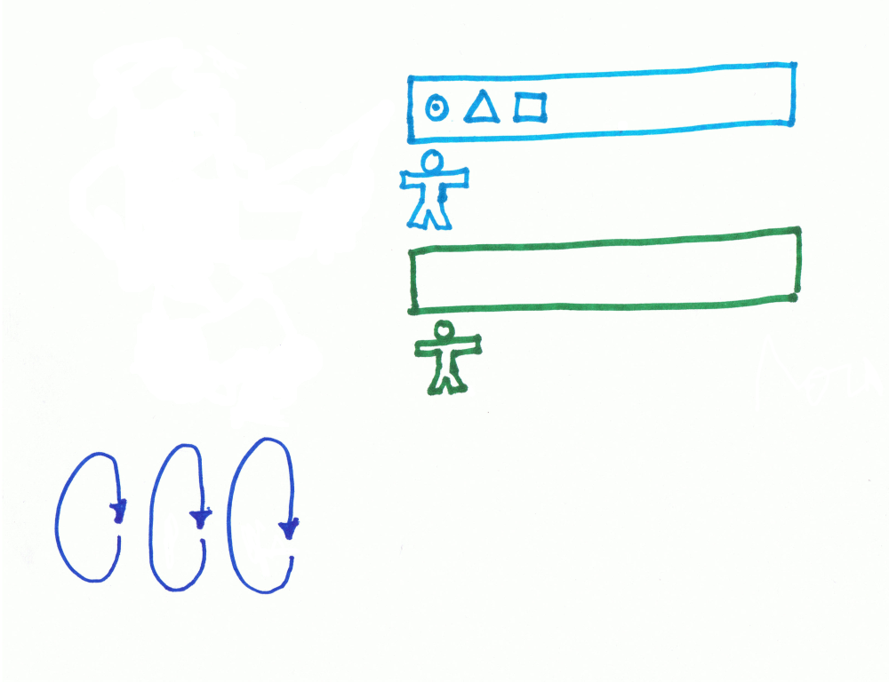

Slide 4
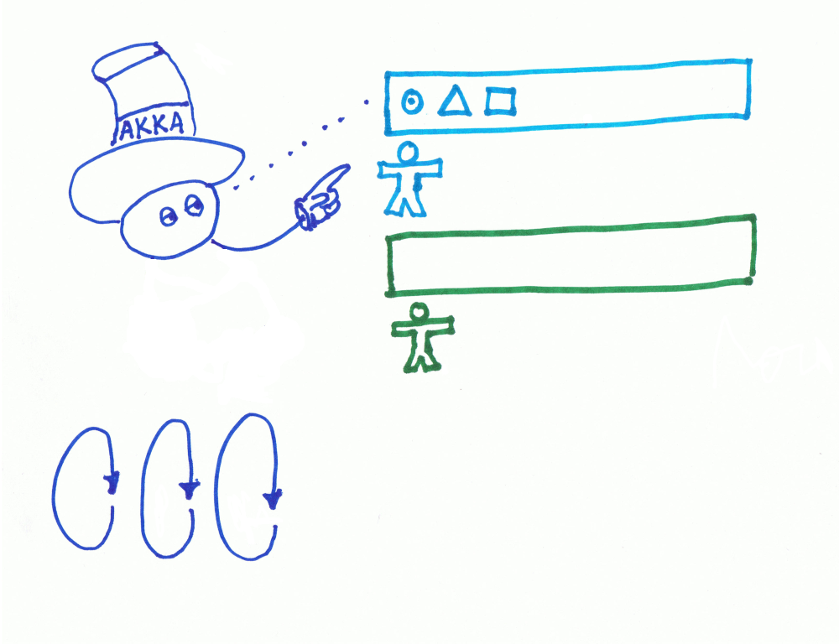

Slide 5
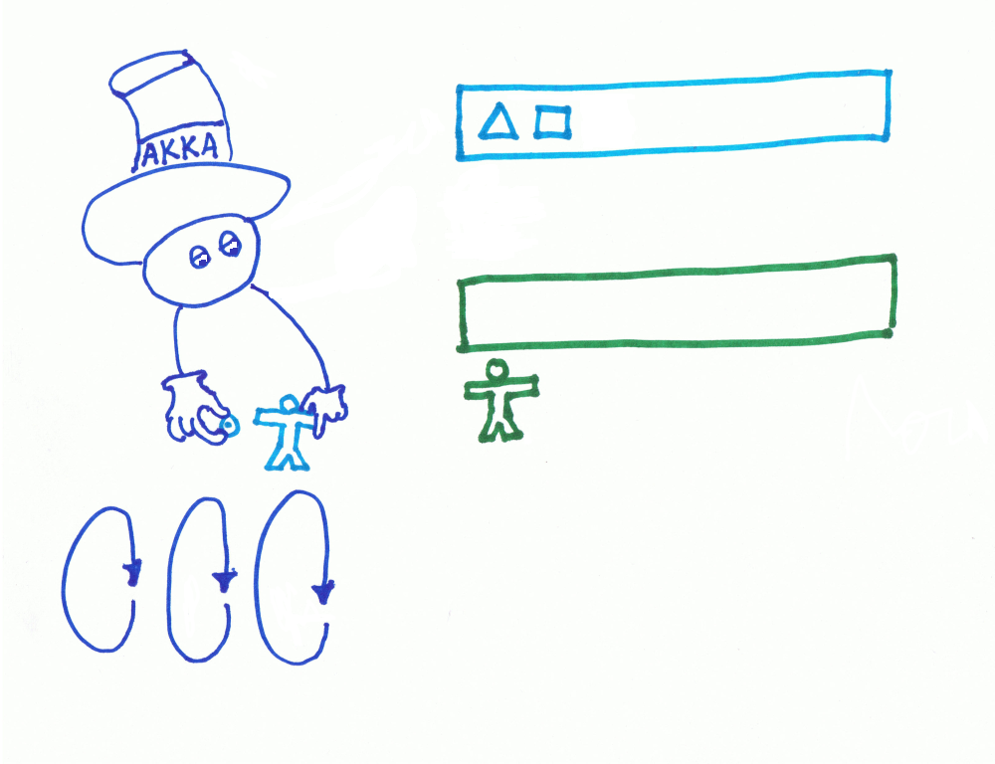

Slide 6
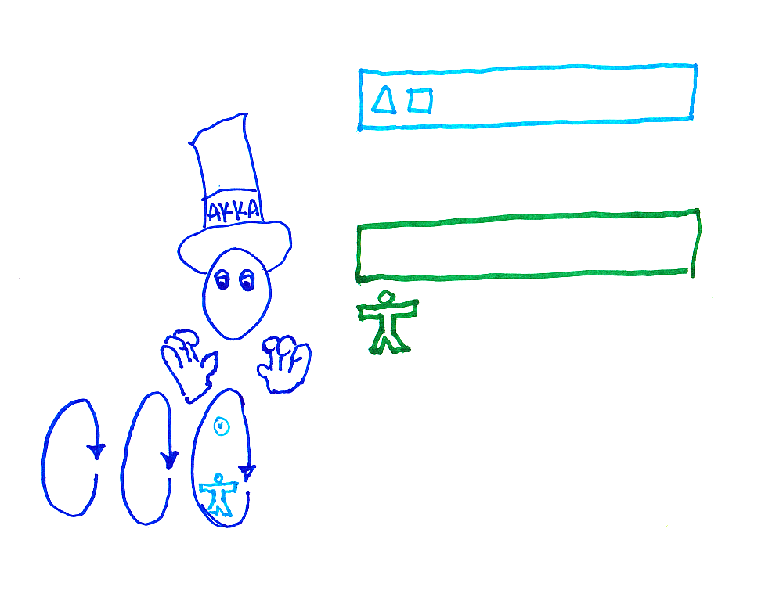

Slide 7
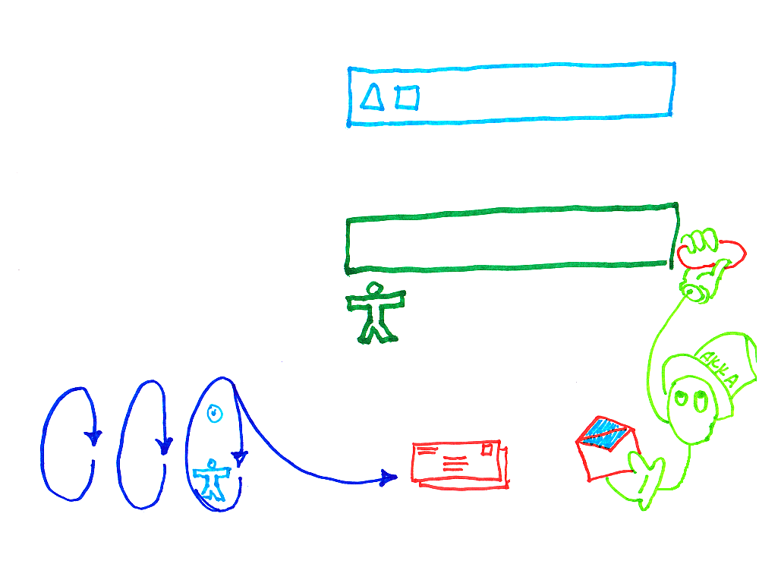

Slide 8
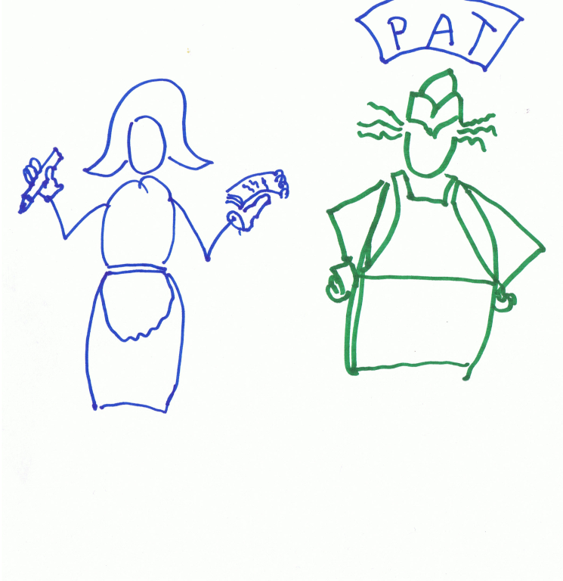

Pizza
Request
Pizza
Pizza
Request
Pizza
Dinner
Result
Message
Dinner
Request
Message
Pizza
Request
Pizza

Slide 9
Links
git://github.com/jonburgin/JavaAkkaDemo.git
http://akka.io
Jon.burgin@{gmail.com,rackspace.com}

