Slide 1

XML:
A Revolution Unfolds
Adam Bosworth
General Manager
Microsoft Corporation

Slide 2
Agenda
XML today
Realizing the Web’s full potential
  Implications for XML
Next Steps

Slide 3
XML Today

Slide 4
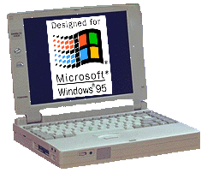

XML & Web-Based, 3-Tier Applications
Client
Presentation &
Interaction
Delivery &
Manipulation
Middle-Tier
Data
Integration
Storage

Slide 5
What’s shipping today
XML support in Internet Explorer 4.0
    XML Parser
    XML Data Source Object (DSO)
Dynamic HTML (DHTML) for Presentation
Download from http://www.microsoft.com/xml
Notes:
Sources to this entire demo are available on http://www.microsoft.com/xml

Slide 6

Demonstration
Built by Junglee
Searching for used books on the Web
Runs on Internet Explorer 4

Slide 7
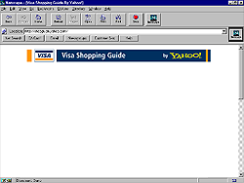
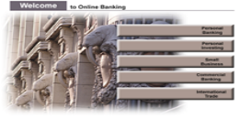

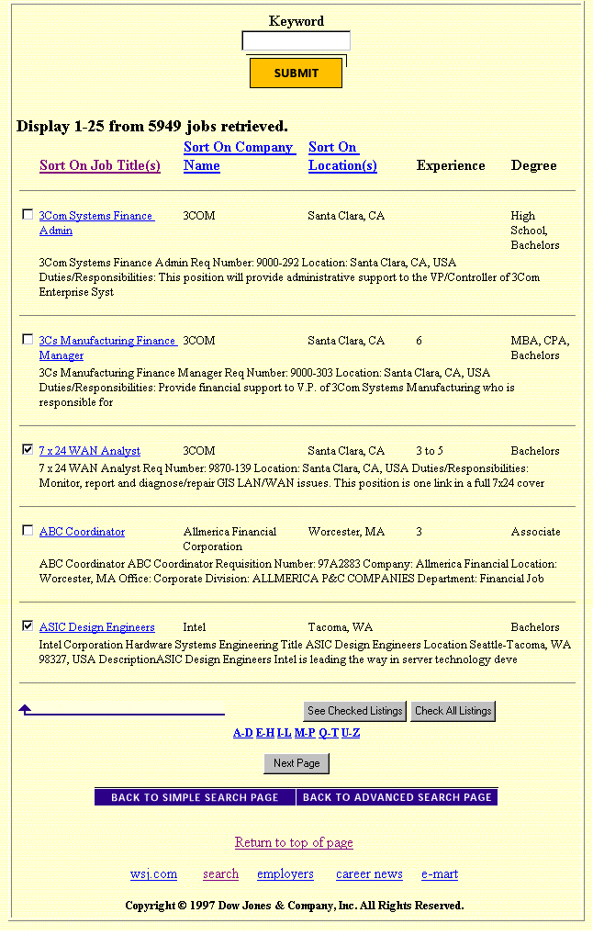
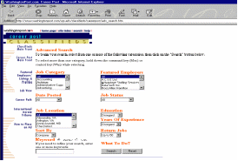
Junglee:
Virtual Database Technology
Web sites
Internet and
Enterprise
Applications
ODBC
XML
HTTPHTML
Virtual Database
Internet
Access the Web
As a Database
Notes:
Junglee Virtual Database Technology
Is a Java based Web integration platform
That enables enterprise applications to access the Web
As a database

Slide 8
Online Recruitment
Job Listings
(Corporations)
Online
Job Sites
Wall Street
Journal
Andersen
Consulting
Junglee
Job
Canopy
Washington
Post
Dell
Bank of
America
Internet
CareerPath
AT&T
CareerMosaic
Motorola
600+ companies
in the VDB
AOL

Slide 9
Web Commerce
Product Catalogs
Web Portals
Yahoo!
Amazon.com
Junglee
Shopping
Guide
Go2Net
Barnes&Noble
Wal-Mart
.
.
.
.
.
.
Internet
The Gap
Motorola
100+ merchants
in the VDB

Slide 10
Junglee Architecture
Steve Sklepowich:
This is too complex for
Paris keynote
Virtual
Database
Server
Wrappers
Web Sites
SELECT *
FROM books
WHERE
author = ‘Grisham’
Amazon.com
Query
Decomposition
BarnesandNoble.com
Powell’s Books
Data
Transformation
and Validation
XML
Document
Processing
Unstructured
Data
Extractor

Slide 11
XML in the Browser
Steve Sklepowich:
Again too complex
Graphical Elements
Search
Form
Book Window
Deal Window
Query
Web
Server
DHTML & JScript
XML DSO
for
Deals
XML DSO
for
Books
Results
XML
Document
Processing Elements
Browser

Slide 12
Realizing the Web’s Full Potential

Slide 13
The Web’s Full Potential
Search for:
  Goods (e.g. Used Books)
  Services (e.g. Lawn-mowing)
  Information (e.g. Portfolios)
Applications
  Sites are applications that help analyze and manage this data

Slide 14
Challenges to Realize the Web’s Full Potential...
Find information intelligently
Interact with applications on servers easily and efficiently
But: physical implementations will vary from site to site
Notes:
Find information intelligently and interact with applications on servers easily and efficiently
Historically, this was hard
SQL. RPC.
These talk to physical implementations which will vary from site to site
Agreement on physical implementations is impossible

Slide 15
Web Sites Requirements
Standardize on logical views, not physical implementations
Standard description of logical views available
  More than databases actually did
Sites can interact with each other and with clients!
Notes:
Sites must expose their services in a standard way, something ironically that even databases never really did
Sites must be truly interoperable
Windows 95 client, or my Apache server can both walk up to any site and:
discover its shape
discover which services it supports, for which data
easily interact with these services

Slide 16
Lessons from the Web
Simplicity wins
  Open, Easy, Flexible
Efficiency loses
  Complex, Binary formats, Fixed vocabularies
Notes:
Simplicity wins
Open
Easy
Flexible
Efficiency loses
Binary formats (lock user in)
Complex (Add in every widget)
Fixed vocabulary (You have to get it right)

Slide 17
Lessons from Servers
Servers are like grocery stores
Good performance requires
    Coarse-grained communication
    Limited ability to multitask
    Queues
    Interruptible models
    Standards
Notes:
For good performance
Coarse grained communication (shopping bags)
Limited ability to multitask (checkout counters)
Queues (lines of customers)
Interruptible models (looking up prices)
Standards (Visa, ATM, bar codes)
Implications
An architecture for applications on the Web must take these factors into account

Slide 18
We have learned
We need an architecture that lets us interact in a coarse-grained way through logical views
As a Web architecture, it must be easy, open, and flexible to build and interact with these logical views

Slide 19
XML
XML is the most fundamental building block
  It is the Meta-grammar that allows us to describe any data or state for any logical view
  It is simple, easy, and open
  It can describe any package of information moved to or from the middle-tier

Slide 20
Application architecture
Client
View, Edit &
Manage XML
XML &
Components
Middle-Tier
Transform Data into
XML Logical View
Storage

Slide 21
XML is already evolving to the next level
Currently Emerging
  Namespaces
  XML-Data
  XML Stores
  XML Converters
  Tools galore
Notes:
Namespaces
Allows agreement on vocabulary while still letting each application augment or extend this vocabulary as they see fit
Critical to agreement on the Web
XML Data
Allows two fundamental extensions to XML:
Data-Types
Extensible Document-Type Definitions (Schemas)

Slide 22
Still to come...

Slide 23
Presentation
Data isn’t presentation
Today — Dynamic HTML
Tomorrow:
  XML inside DHTML: CSS & Script
  Extensible Style Language (XSL) which will allow the swift transformation of XML to HTML, or XML on client or server

Slide 24
Remember the book store
Describe the store’s services
Describe the books
Request specific books
Act as my shopping cart
Allow me to buy books

Slide 25
New XML grammars
Schema
  Logical view shape itself
Site Information
  Site/Object/Server shape itself
Filters and Updates
  Any request for subsets of data
  Any desired set of changes to data

Slide 26
New XML grammars
Object Persistence
  Describe how to save or reload the state of any object to/from XML

Slide 27
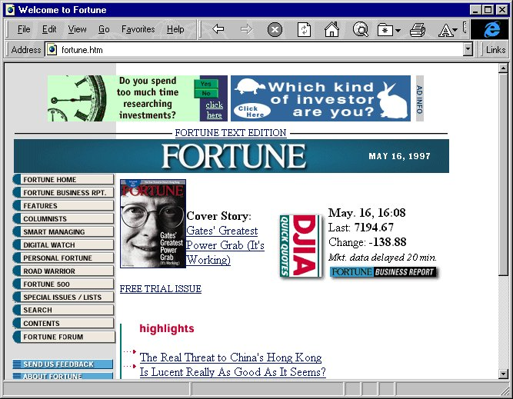
Web Applications Architecture
DHTML
Objects
Applications:
Excel, Word
Client
XML
Middle-tier
Application
Middle-Tier
Custom
Code
XML
Database
to XML
Storage
XML
Mainframe
Database
Notes:
Big Blue Triangles
Converters from relational databases to XML logical views
Converters from one XML schema to another
Converters from XML to DHTML
Simple component model for converters
Yellow Tanks
API’s so any component can use the store to manage XML in a standard manner
Support for the new XML grammars for updating and filtering
Needed is swift Document Object Model (DOM) convergence on an API that is lean, easy to implement, appropriate for programmers, and a reasonable basis for script-writers
Server components will emerge to become:
temporary stores and queues for XML
converters between XML and relational databases
converters between multiple XML schema
Objects will:
Load directly from XML messages
Interact easily with machines talking XML

Slide 28
What’s missing
Dashed Pink Lines
Dashed Red Lines
Yellow Tanks
Blue Triangles

Slide 29
RPC
Dashed Pink Lines
XML provides a basis for an extremely simple and open RPC
Can be implemented by anyone wanting to interact on the Web

Slide 30
New XML Grammars Dashed Red Lines
Querying, Updating XML logical views
Same need as SQL for Query and Update

Slide 31
Stores/Queues
Yellow Tanks
Need to temporarily cache it, index it, update the cached copy, transact it
Also requires a store for managing it

Slide 32
Converters
Blue Triangles
Between physical implementations and XML-based logical views
Special cases required for relational databases

Slide 33
What can be built?
Line-of-business applications
  Planning
  Notification
  Data Capture
  Information searching
  Collaboration

Slide 34
Next Steps

Slide 35
Step I
Learn XML
  View, edit, & manage XML
  Map XML logical views & databases
  http://www.microsoft.com/xml
Define grammars
  General e.g. Schema
  Industry-specific

Slide 36
Step II
Build sites that are open applications
  As standard XML grammars emerge to describe site services, support them
Make them interoperable. For each site
  Publish its shape, its services, and most importantly its data

Slide 37
Step III
As XML grammars emerge for filtering and updating:
  Implement and support them
Engineer your client side objects to talk XML to servers.

Slide 38
Summary
We’re only at the very start of the Web revolution. The most exciting part is still to come
With XML, interacting with data and applications on the Web will be as easy as viewing shared content
Get started!

Slide 39

http://www.microsoft.com/xml
™

