Slide 1

XML:
A Revolution Unfolds
Adam Bosworth
General Manager
Microsoft Corporation

Slide 2
Agenda
XML Basics
XML today
Why XML
Ongoing XML Work
Next Steps

Slide 3
XML Basics
What is XML

Slide 4
So What Is XML
A standard for encoding data
3 Key differences from HTML
  1) The set of Tags is unlimited but all container tags must have end tags.
Example of legal XML
  <Person>
  <Name>Adam Bosworth</Name> <Title>General Manager</Title> <Age>42</Age>
  </Person>

Slide 5
What is XML
Like HTML, XML can intermix tags and text
More legal XML
  <Person>Adam Bosworth is an <role>advocate</role> for <technology>XML</technology>
  </Person>

Slide 6
What is XML
2nd Key difference. Tags may not overlap each other.
Example of illegal XML
  <Person><Name>Adam</Name>
  <Key Point><Heading>XML provides a data bus</Heading> </Person><More>…</More> </KeyPoint>

Slide 7
What is XML
But XML tags don’t describe user interface. There is no default presentation for each tag. They describe information.
  XML has no special tags for titles or lists or paragraphs or images.
  It isn’t a presentation grammar. It is a way to encode any information.

Slide 8
What is XML
XML And Character Sets
Defaults to Unicode/UTF8.
  If not Unicode, then add
    <?XML Encoding=“…”?>
    is of seven-bit ASCII
    <?XML Encoding=“Windows-1250”?> would support Eastern Europe

Slide 9
What is XML
Namespaces provide ways to mix XML tags without chaos
<?XML::Namespace href = “http://ofs/PO.dtd” as = “po”?> <po::Order><ShipTo>Adam</ShipTo> <Amount>100</Amount>
<Items> <Item><Qty>6</Qty><Prod>E13</Prod></> <Item><Qty>9</Qty><Prod>J14</Prod></> </Items>
</po::Order>

Slide 10
What is XML
XML And Validation
You can enforce rules about these tags.Two kinds of ways to define rules for the document.
  DTD’s.
  XML Schema’s.

Slide 11
What is XML
DTD’s (Definition Type Documents)
  DTDs. This is used to define a grammar for the tags and attributes. This syntax is supported, but deprecated by us. It uses a special non-XML-based grammar

Slide 12
Document Type Definition
Or DTD
  <!doctype RootElement System “URL”[]> or if an internal DTD then
  <!doctype RootElement [
    <!ELEMENT author (#PCDATA)>
    <!ELEMENT title (#PCDATA)>
    <!ELEMENT book (title?, author+)>
    ]>

Slide 13
What is XML
XML Schemas (XML-DATA)
  Schema. This is a much richer and more extensible way to describe the rules for the content of a document and uses XML itself as a grammar. It was submitted to the W3C as the XML-DATA submission.

Slide 14
Schema
A schema is defined using
a particular XML syntax
  <elementType id="author"> <String/>
  </elementType>
  <elementType id="title"> <String/>
  </elementType>
  <elementType id="book">
  <elt href="#title" occurs="OPTIONAL"/>
  <elt href="#author" occurs="ONEORMORE"/>
  </elementType>

Slide 15
XML Today

Slide 16
What’s shipping today
XML support in Internet Explorer 4.0
    XML Parser
    XML Data Source Object (DSO)
Dynamic HTML (DHTML) for Presentation
Toy demo you can download from http://www.microsoft.com/xml
Notes:
Sources to this entire demo are available on http://www.microsoft.com/xml

Slide 17
Merrill Lynch
Partner
  Full Service Brokerage
  Rebuilding all systems for intra, inter, and extranets
  Demo of ongoing work runs on IE 4.0.
  Infrastructure for Streaming
  UI & Data Tuned to Context

Slide 18
From Chaos to Structure
Problem:
  Chaos: Increasing Size & Complexity of Applications, Data Sets & Distribution Points
  Need More Contextual Information, Less Data
Solution:
  Use XML, XSL, DHTML to Standardize Encoding, Delivery, Presentation and Analysis

Slide 19
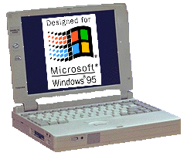

XML & Web-Based
3-Tier Applications
Client
IE4
XML, XSL, DHTML
Java Script
Link Mgr. COM
Custom
Service
Navigation
Data
Aggregation
Modules
Middle-Tier
DHTML
Java Script
Storage
DB2
DB2
DB2
ODBC
DB2

Slide 20
Why XML

Slide 21
The Web’s Full Potential
Search for:
  Goods (e.g. Used Books)
  Services (e.g. Lawn-mowing)
  Information (e.g. Portfolios)
Applications
  Sites are applications that help analyze and manage this data

Slide 22
Challenges to Realize the Web’s Full Potential...
Find information intelligently
Interact with applications on servers easily and efficiently
But: physical implementations will vary from site to site
Notes:
Find information intelligently and interact with applications on servers easily and efficiently
Historically, this was hard
SQL. RPC.
These talk to physical implementations which will vary from site to site
Agreement on physical implementations is impossible

Slide 23
XML & Web-Based, 3-Tier Applications
Client
Presentation &
Interaction
Delivery &
Manipulation
Middle-Tier
Data
Integration
Storage

Slide 24
Web Sites Requirements
Standardize on logical views, not physical implementations
Standard description of logical views available
  More than databases actually did
Sites can interact with each other and with clients!
Notes:
Sites must expose their services in a standard way, something ironically that even databases never really did
Sites must be truly interoperable
Windows 95 client, or my Apache server can both walk up to any site and:
discover its shape
discover which services it supports, for which data
easily interact with these services

Slide 25
Lessons from the Web
Simplicity wins
  Open, Easy, Flexible
Efficiency loses
  Complex, Binary formats, Fixed vocabularies
Notes:
Simplicity wins
Open
Easy
Flexible
Efficiency loses
Binary formats (lock user in)
Complex (Add in every widget)
Fixed vocabulary (You have to get it right)

Slide 26
Lessons from Servers
Servers are like grocery stores
Good performance requires
    Coarse-grained communication
    Limited ability to multitask
    Queues
    Interruptible models
    Standards
Notes:
For good performance
Coarse grained communication (shopping bags)
Limited ability to multitask (checkout counters)
Queues (lines of customers)
Interruptible models (looking up prices)
Standards (Visa, ATM, bar codes)
Implications
An architecture for applications on the Web must take these factors into account

Slide 27
We have learned
We need an architecture that lets us interact in a coarse-grained way through logical views
As a Web architecture, it must be easy, open, and flexible to build and interact with these logical views

Slide 28
XML
XML is the most fundamental building block
  It is the Meta-grammar that allows us to describe any data or state for any logical view
  It is simple, easy, and open
  It can describe any package of information moved to or from the middle-tier

Slide 29
Application architecture
Client
View, Edit &
Manage XML
XML &
Components
Middle-Tier
Transform Data into
XML Logical View
Storage

Slide 30
Ongoing XML Work

Slide 31
XML is already evolving to the next level
Currently Emerging
  Namespaces
  XML-Data (“XML Schemas”)
  XSL
  XML Stores
  Tools galore
Notes:
Namespaces
Allows agreement on vocabulary while still letting each application augment or extend this vocabulary as they see fit
Critical to agreement on the Web
XML Data
Allows two fundamental extensions to XML:
Data-Types
Extensible Document-Type Definitions (Schemas)

Slide 32
Presentation
Data isn’t presentation
Today — Dynamic HTML
Tomorrow:
  XML inside DHTML: CSS & Script
  Extensible Style Language (XSL) which will allow the swift transformation of XML to HTML, or XML on client or server

Slide 33
Remember the book store
Describe the store’s services
Describe the books
Request specific books
Act as my shopping cart
Allow me to buy books

Slide 34
New XML grammars
Schema
  Logical view shape itself
Site Information
  Site/Object/Server shape itself
Filters and Updates
  Any request for subsets of data
  Any desired set of changes to data

Slide 35
New XML grammars
Object Persistence
  Describe how to save or reload the state of any object to/from XML
Object Method Invocation
  XML grammar for marshalling arguments to any method of any remote object include XML arg’s.

Slide 36
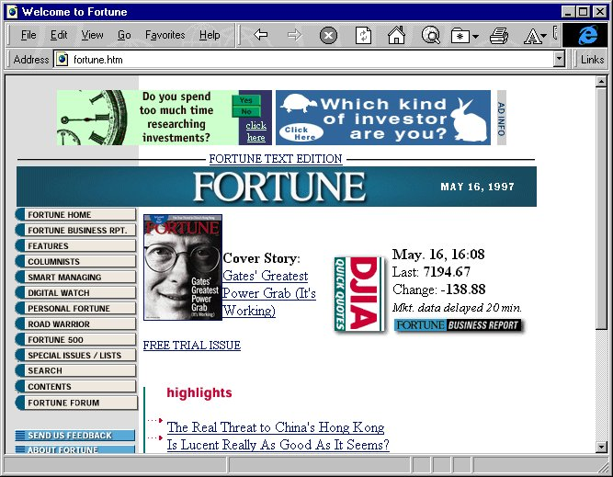
Web Applications Architecture
DHTML
Objects
Applications:
Excel, Word
Client
XML
Middle-tier
Application
Middle-Tier
Custom
Code
XML
Database
to XML
Storage
XML
Mainframe
Database
Notes:
Big Blue Triangles
Converters from relational databases to XML logical views
Converters from one XML schema to another
Converters from XML to DHTML
Simple component model for converters
Yellow Tanks
API’s so any component can use the store to manage XML in a standard manner
Support for the new XML grammars for updating and filtering
Needed is swift Document Object Model (DOM) convergence on an API that is lean, easy to implement, appropriate for programmers, and a reasonable basis for script-writers
Server components will emerge to become:
temporary stores and queues for XML
converters between XML and relational databases
converters between multiple XML schema
Objects will:
Load directly from XML messages
Interact easily with machines talking XML

Slide 37
What’s missing
Dashed Pink Lines
Dashed Red Lines
Yellow Tanks
Blue Triangles

Slide 38
RPC
Dashed Pink Lines
XML provides a basis for an extremely simple and open RPC
Can be implemented by anyone wanting to interact on the Web

Slide 39
New XML Grammars Dashed Red Lines
Querying, Updating XML logical views
Same need as SQL for Query and Update

Slide 40
Stores/Queues
Yellow Tanks
Need to temporarily cache it, index it, update the cached copy, transact it
Also requires a store for managing it

Slide 41
Converters
Blue Triangles
Between physical implementations and XML-based logical views
Special cases required for relational databases

Slide 42
What can be built?
Line-of-business applications
  Planning
  Notification
  Data Capture
  Information searching
  Collaboration

Slide 43
Next Steps

Slide 44
Step I
Learn XML
  View, edit, & manage XML
  Map XML logical views & databases
  http://www.microsoft.com/xml
Define grammars
  General e.g. Schema
  Industry-specific

Slide 45
Step II
Build sites that are open applications
  As standard XML grammars emerge to describe site services, support them
Make them interoperable. For each site
  Publish its shape, its services, and most importantly its data

Slide 46
Step III
As XML grammars emerge for filtering and updating:
  Implement and support them
Engineer your client side objects to talk XML to servers.

Slide 47
Summary
We’re only at the very start of the Web revolution. The most exciting part is still to come
With XML, interacting with data and applications on the Web will be as easy as viewing shared content
Get started!

Slide 48

http://www.microsoft.com/xml
™

