Slide 1
NESI NanoRacks Embedded System Integration Board
HARDWARE
Functional Design

Slide 2
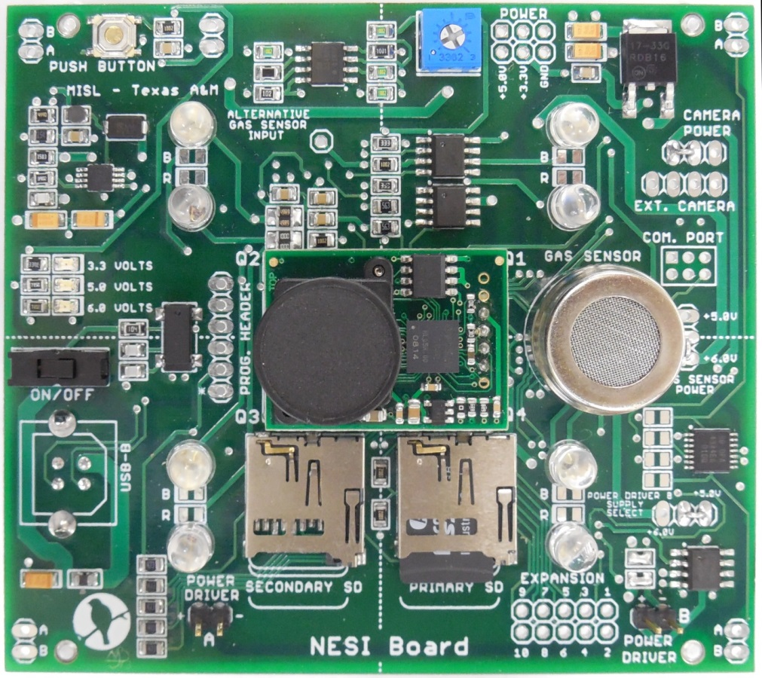
NESI Board
Functional Block Diagram

Slide 3
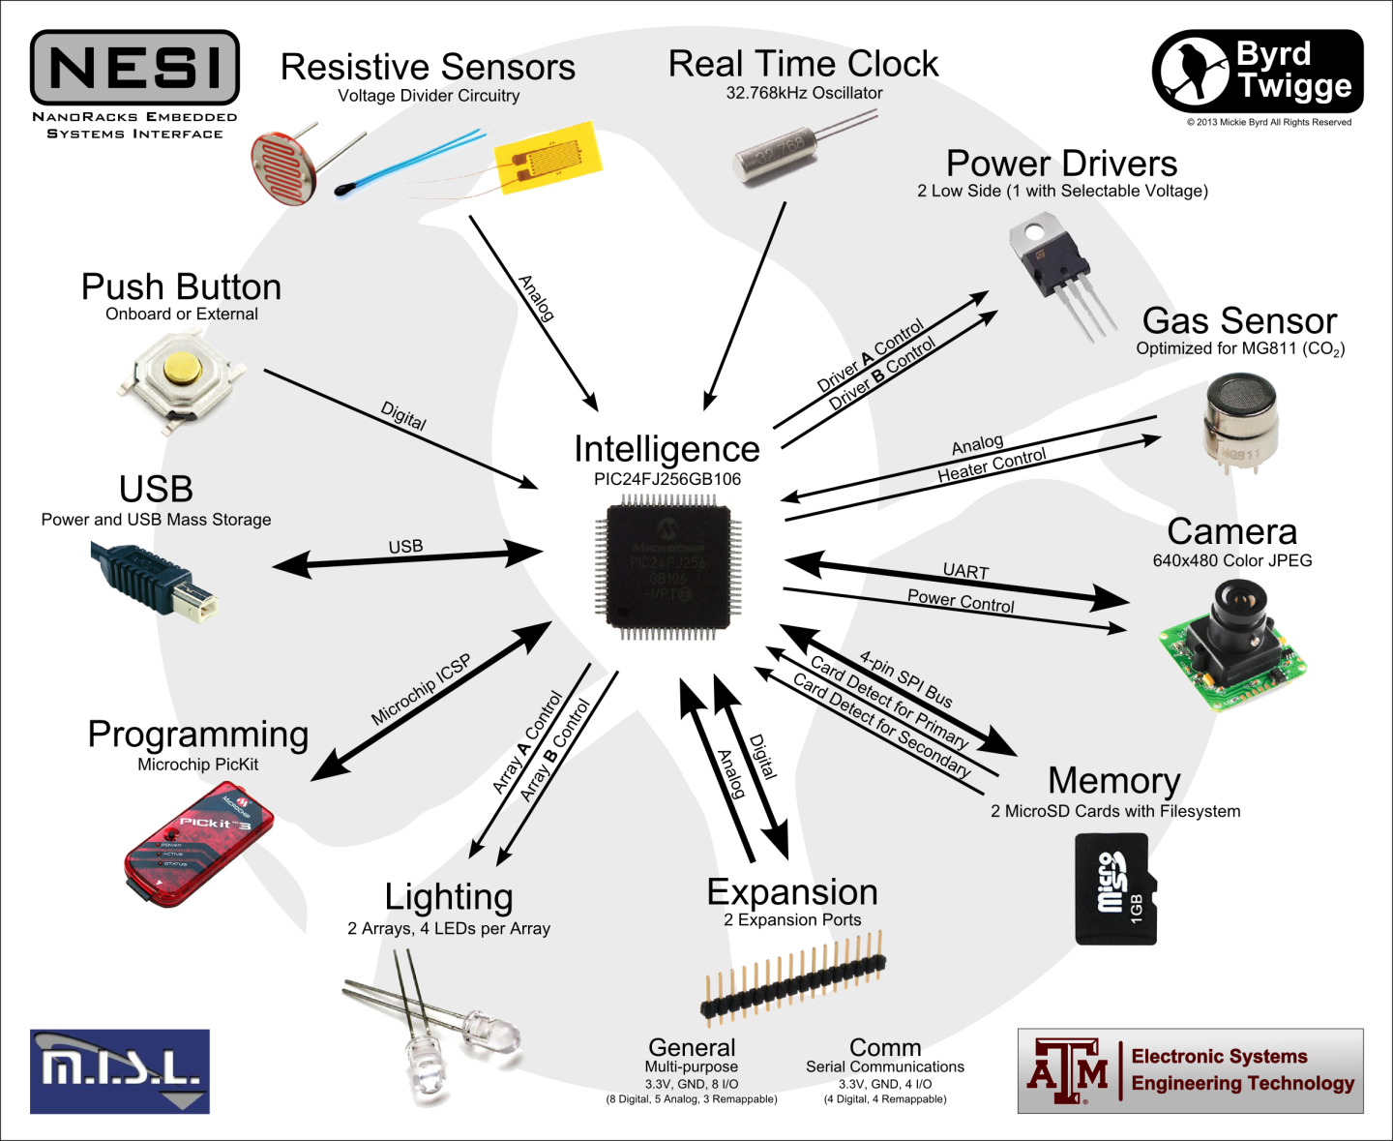
Overview

Slide 4
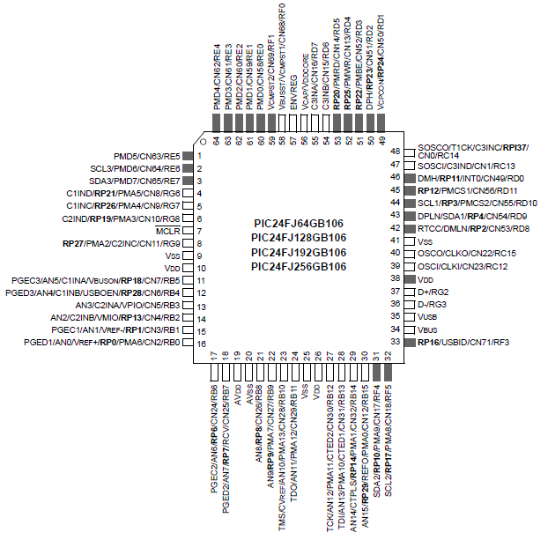
PIC24FJ256GB106
Legend:
AN – Analog Input
DI – Digital Input
DO – Digital Output
RP – Remappable Peripherals
SOSC – Secondary Oscillator I/O
U - Unity Gain Buffer

Slide 5
Power
5V
Switch
3.3 V
3.3 V
USB
PIC24
10
VDD
ENVREG
57
5V
3.3V
19
AVDD
VSS
8
Voltage
Regulator
26
VDD
AVSS
19
35
VUSB
VSS
27
5V
6V
38
VDD
VSS
19
DC-DC
Booster

Slide 6
USB Mass Storage Interface
USB Slave
USB Type B Jack
PIC24
PIC24
D+
37
D+
D-
D+
D-
36
USB
D-
5V
VBUS
GND
Switch

Slide 7
Push Button
3.3V
PIC24
Pull up
Resistor
Button
DI E4
64
JP14
1
2
External button access

Slide 8
Resistive Sensors
3.3V
3.3V
PIC24
Resistor
Resistor
JP3
U
16
AN0
AN1
15
U
JP4
A
A
B
B
3.3V
3.3V
Resistor
Resistor
JP5
U
14
AN2
AN3
13
U
JP6
A
A
B
B
Resistors selected based on sensor's nominal value

Slide 9
Power Output Header
5V
JP10
5V
1
2
3.3V
3.3V
3
4
5
6

Slide 10
Real Time Clock
PIC24
SOSCI
47
1
32.768 K
Oscillator
SOSCO
48
4

Slide 11
Power Drivers
Attach load here
Power Driver A
IC4
JP2
5V
PIC24
Enable
Low
Side
Power
Driver
1
DO E7
3
2
7/8
2
1
Resistor
DI G6
4
Status
Resistors divide voltage down to 3.3V range for status to microcontroller
Attach load here
JP16
6V
Resistor
IC1
JP11
1
Enable
1
2
5V
60
Low
Side
Power
Driver
DO E0
2
7/8
2
3
1
Voltage
Selection port
Power Driver B

Slide 12
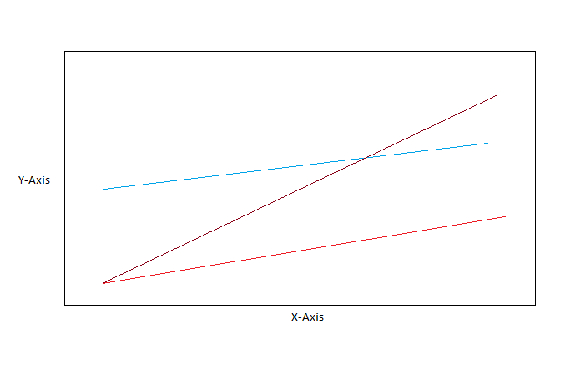
Gas Sensor
JP9
5V
1
PIC24
IC4
2
6V
Heater
Enable
Low
Side
Power
Driver
H2
B1
B2
H1
A1
A2
3
DO G6
4
2
5/6
CO₂
Voltage
Selection port
4
AN4
12
Gain
Offset

Slide 13
Camera
On Board Camera Mount
Secondary Header
3.3V
JP7
JP13
PIC24
1
1
TX
RP26
5
2
2
RX
RP19
6
3
3
4
4
PIC24
IC1
Camera
Enable
Low
Side
Power
Driver
JP15
DO E1
61
4
5/6
1
3
2
3
Camera Power Control Header

Slide 14
Gas Sensor
JP9
5V
1
PIC24
IC4
2
6V
Heater
Enable
Low
Side
Power
Driver
H2
B1
B2
H1
A1
A2
3
DO G6
4
2
5/6
CO₂
Voltage
Selection port
4
AN4
12
Gain
Offset

Slide 15
Memory
PIC24
DI D7
55
Chip Detect Primary
Primary
SD Card
DO D2
50
Chip Select Primary
SPI
46
MOSI
3
SPI
45
MISO
SPI
44
SCLK
Secondary
SD Card
DO D9
43
Chip Select Secondary
DI D8
42
Chip Detect Secondary

Slide 16
Expansion Header
3.3V
JP8
1
2
PIC24
PIC24
DIO G9/ RP27
8
3
4
AN5/ DIO B5 /RP18
11
AN10/ DIO B10
23
5
6
24
AN11/ DIO B11
AN12/ DIO B12
27
7
8
28
AN13/ DIO B13
DIO F3 /RP16
33
9
10
54
DIO D6

Slide 17
Communication Header
3.3V
JP12
1
2
PIC24
PIC24
DIO D5 /RP20
53
3
4
52
DIO D4 /RP25
DIO D3 /RP22
51
5
6
50
DIO D2 /RP23

Slide 18
Comm. Header Example
UART Application
SPI Application
3.3V
3.3V
JP12
JP12
1
2
1
2
PIC24
PIC24
PIC24
PIC24
TX
RTS
MOSI
SCLK
RP20
53
3
4
52
RP25
RP20
53
3
4
52
RP25
RX
CTS
MISO
CS
RP22
51
5
6
50
RP23
RP22
51
5
6
50
RP23
TX - transmit
RX - receive
RTS – request to send
CTS - clear to send
MOSI – master out slave in
MISO – master in slave out
SCLK – slave clock
CS – chip select

Slide 19
LEDs
5V
PIC24
IC2
LED Enable
Low
Side
Power
Driver
DO B8
21
4
LED
5/6
Current Limiting
Resistor
3
1
2
Resistor chosen based on LED current requirements
IC2
LED Enable
Low
Side
Power
Driver
LED
DO B9
22
2
7/8
Current Limiting
Resistor
1
1
2
External ports used for through hole LEDs

Slide 20
Programming Interface
PIC24
JP1
MCLR
7
1
PICkit
PGD
Data
18
4
PGC
Clock
17
5
Power must be applied through USB to program

