Slide 1
Querying 100TB w/BigQuery and Spark
Jon Chase
jon@cedexis.com
@jonchase

Slide 2
Agenda
Overview
BigQuery
Spark

Slide 3
Overview

Slide 4

Closed-loop automatic optimization at web scale
Radar
measurement
Openmix
optimization
Fully automated
“Hands Free”
operation
Fusion
3rd party
Impact
results
Notes:
Cedexis is the only solution to offer an automated solution to dynamically leverage real-time performance data to make load balancing and routing decisions to continuously improve the user experience.

Slide 5
Our Volume
7.3 billion transactions/day
84.7K/sec (average)
peak TPS is higher

Slide 6
Retention
Logs: 1 month
Minute aggregates: 1 month*
Hour aggregates: 2 months*
Day aggregates: 13 months*
120TB in BigQuery and growing
* Aggregations are loss-less

Slide 7
Our use cases
User facing charts in our portal (interactive)
Heavy use of percentiles/histograms
Ad hoc analysis by our engineers and SEs (and more!) – “data driven”
Complex “show me the value” jobs

Slide 8
What we wanted
Unlimited storage
Lossless (or not very lossy)
Fast
Low maintenance
Easy to use
Monitor-able
Cost effective
Horizontally scalable

Slide 9
BigQuery

Slide 10
BigQuery overview
“A fast, economical and fully managed data warehouse for large-scale data analytics.”

Slide 11
BigQuery overview
SQL access for “big data”
SaaS
Pay as you go
Excellent docs
Columnar
Horizontally scales
Much faster than Hive/Pig/Spark SQL, etc.
Cheaper/easier/more powerful than Impala

Slide 12
Our BQ use cases
Querying raw logs
Typically done by engineers when debugging
Querying aggregations
Preaggregate data for interactive web charts

Slide 13
Loading data into BQ
Formats: JSON, CSV
Batch (cheaper, slower, 1-2 min load delay)
Stream ($, faster, instantly query-able)

Slide 14
Organizing data
Partitions
By day, by customer, preferably both
Querying partitions
table_query(my_dataset, ‘table_id contains “20160201”’)
…or…
from table1, table2, table3

Slide 15
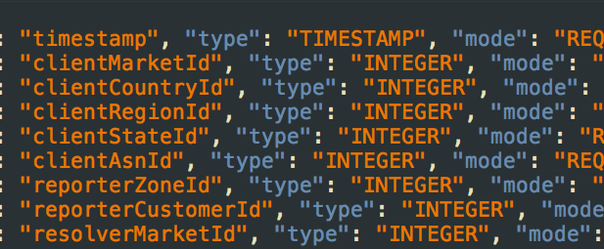
Schemas

Slide 16
Data types
Integer
Float
String
Timestamp
Boolean
Nested
Repeated

Slide 17
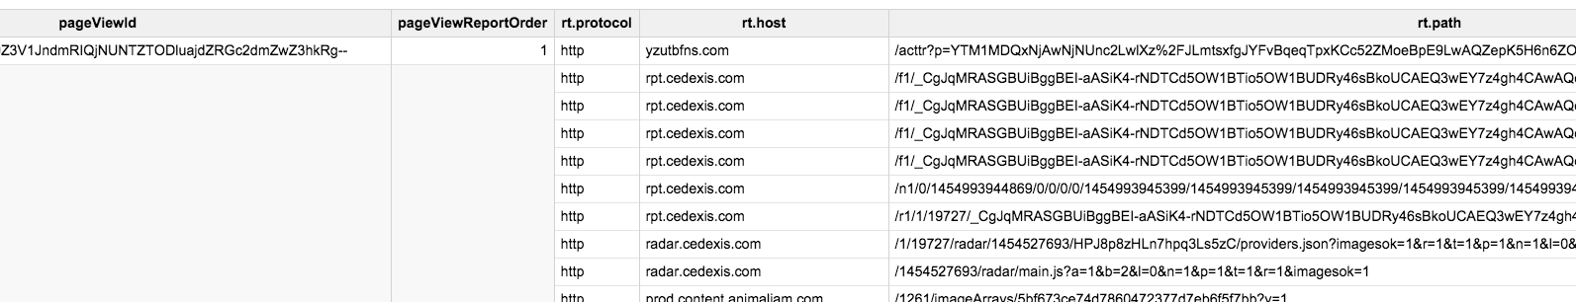
Nested/repeated example

Slide 18
Querying
Mostly just ‘regular’ SQL
Full complement of SQL is available
Plus BQ specific additions

Slide 19
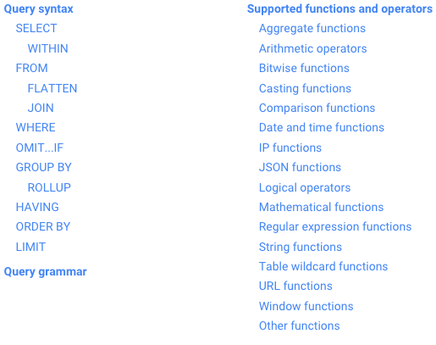

Slide 20
SELECT
group_0_dimension,
group_1_dimension,
STRFTIME_UTC_USEC(group_2_dimension, "%FT%TZ") group_2_dimension,
group_2_fact_0
FROM (
SELECT
group_0_dimension,
group_1_dimension,
group_2_dimension,
group_2_fact_0,
DENSE_RANK() OVER (ORDER BY group_0_sort DESC) group_0_rank,
DENSE_RANK() OVER (PARTITION BY group_0_dimension ORDER BY group_1_sort DESC) group_1_rank
FROM (
SELECT
group_0_dimension,
group_1_dimension,
group_2_dimension,
SUM(total) OVER (PARTITION BY group_0_dimension, group_1_dimension, group_2_dimension) group_2_fact_0,
SUM(total) OVER (PARTITION BY group_0_dimension) group_0_sort,
SUM(total) OVER (PARTITION BY group_0_dimension, group_1_dimension) group_1_sort,
group_2_dimension group_2_sort
FROM (
SELECT
appId group_0_dimension,
effectiveCountryId group_1_dimension,
[timestamp] group_2_dimension,

Slide 21
SUM(total) total
FROM
[openmix_minute_zid_cid.1_13949_20160221_19],
[openmix_minute_zid_cid.1_13949_20160222_14],
[openmix_minute_zid_cid.1_13949_20160222_16]
WHERE
[timestamp] BETWEEN TIMESTAMP("2016-02-21 16:00:00 UTC")
AND TIMESTAMP("2016-02-22 16:00:00 UTC")
AND appId IN (11)
GROUP BY
group_0_dimension,
group_1_dimension,
group_2_dimension ) )
ORDER BY
group_0_sort DESC,
group_1_sort DESC,
group_2_sort ASC )
WHERE
group_0_rank <= 1
AND group_1_rank <= 5

Slide 22
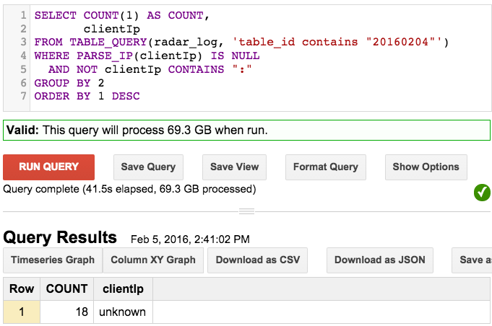

Slide 23
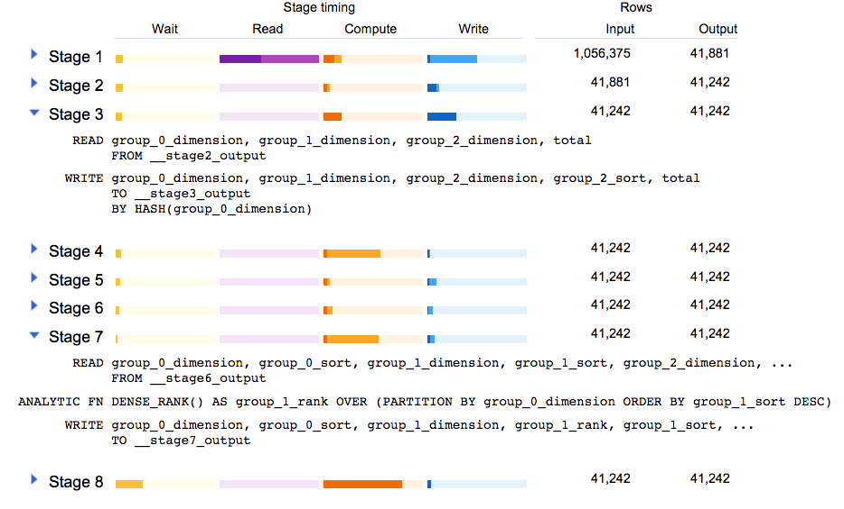
Execution plans

Slide 24
Query performance
Quite good in general, though…
Best case is never as good as RDBMS, but…
Worst case is much better, however…
Shared resources, so performance will vary

Slide 25
Storage space and retention
Unlimited (in practice)
Simply a function of how much you want to spend

Slide 26
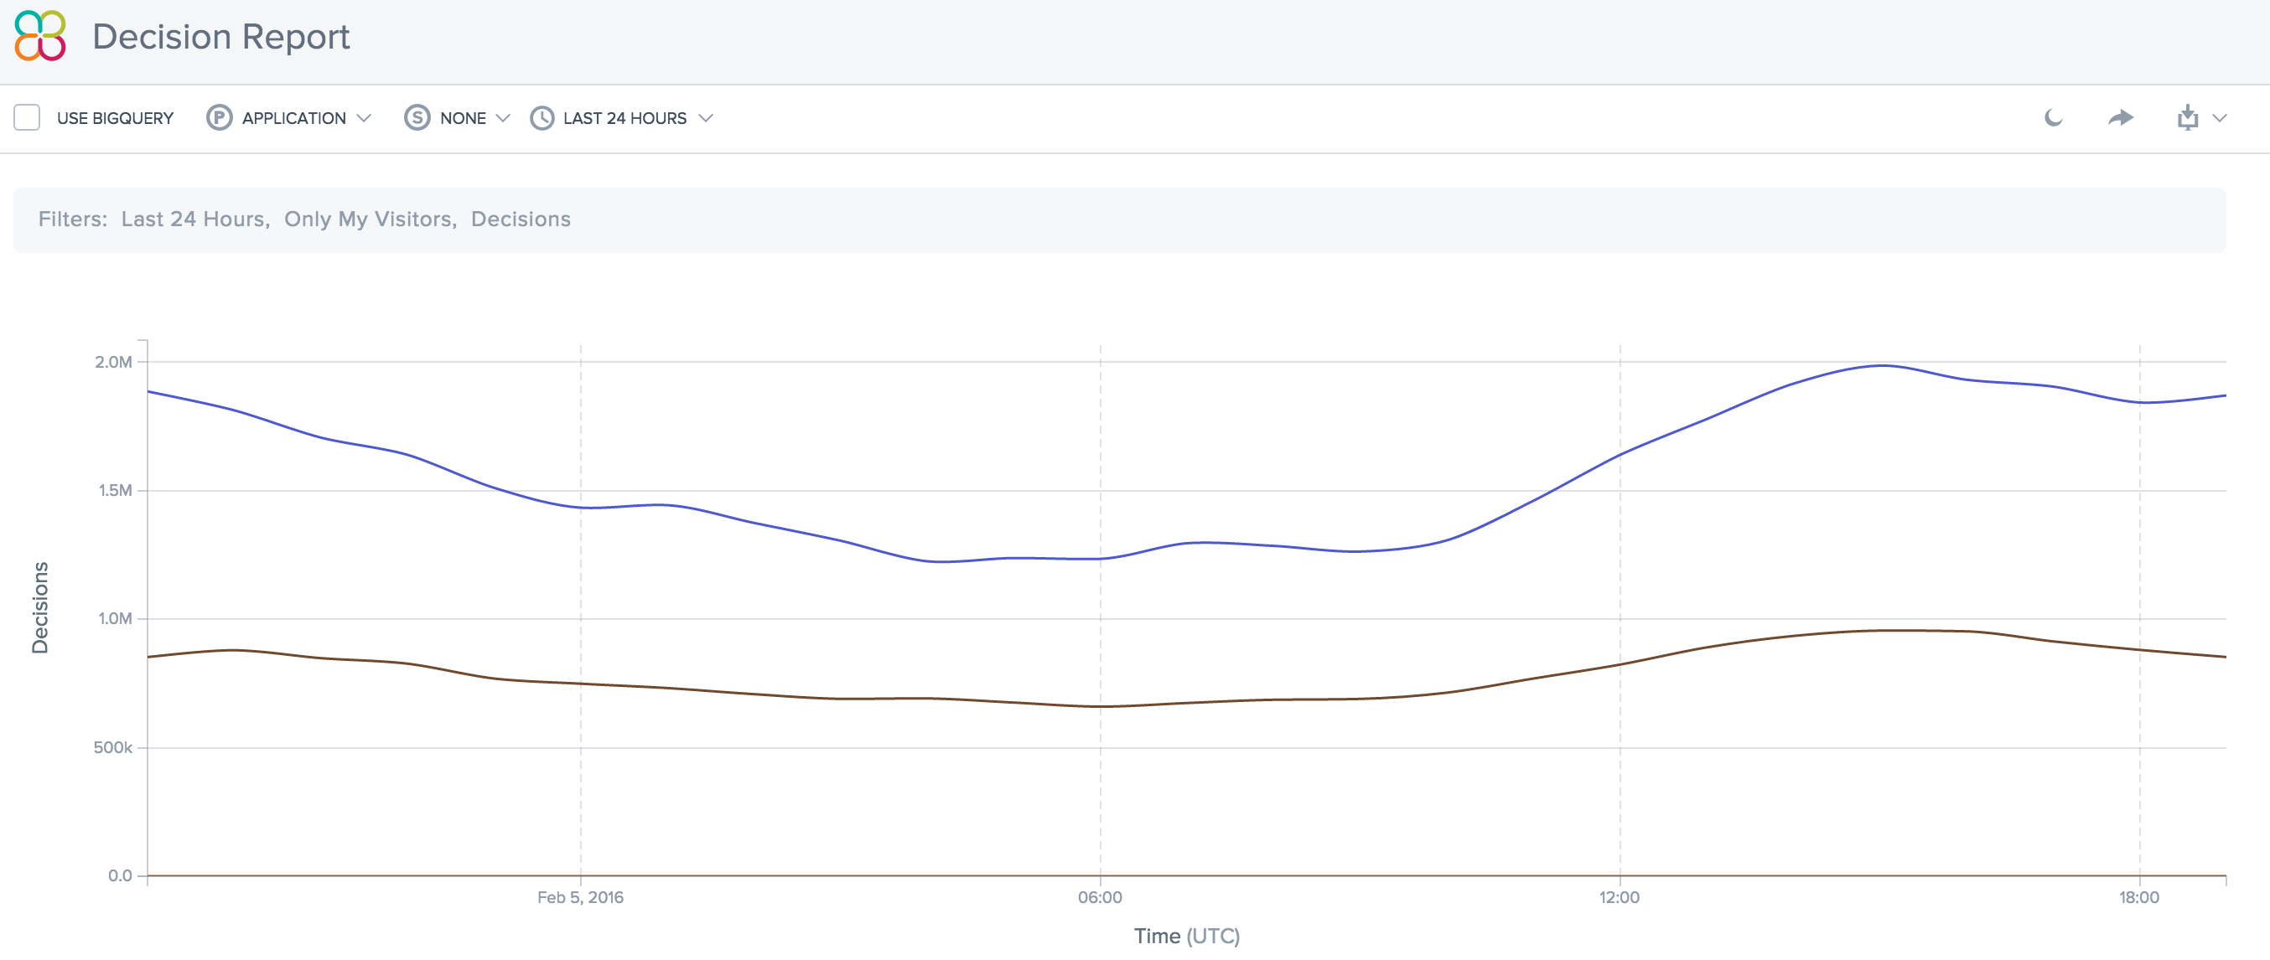

Slide 27
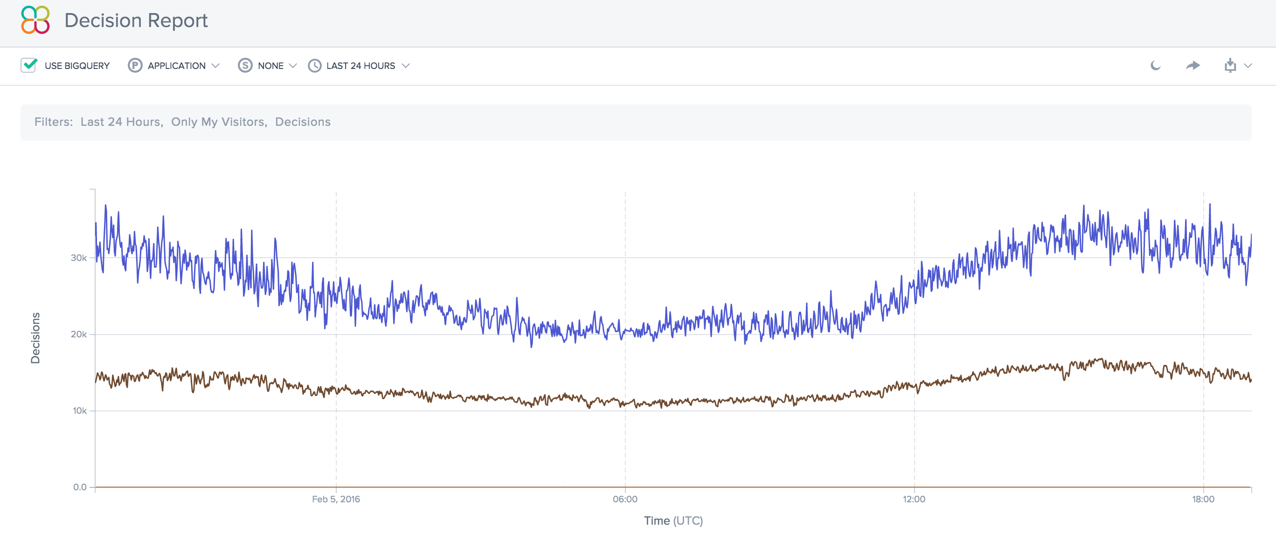

Slide 28
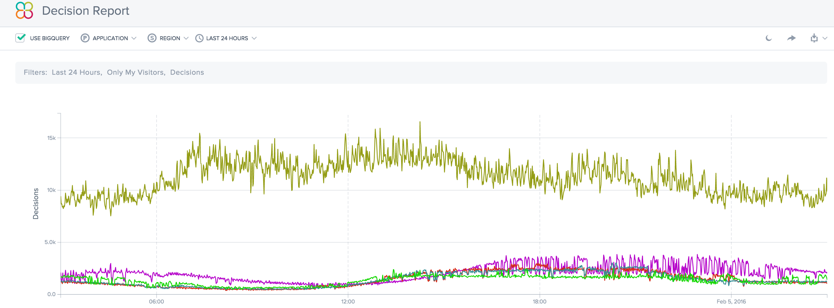

Slide 29
Aging out old data
Set expiration time on table when you create it
Set default expiration time per dataset, e.g.
Minute: 1 month
Hour: 2 months
Day: 13 months
BQ cleans up after you

Slide 30
Tuning (hardware/settings/etc.)
<this slide intentionally left blank>

Slide 31
BigQuery API
All major languages
Quite nice to work with

Slide 32
Monitoring
API is helpful to monitor load jobs and queries
Table metadata (size, row count, creation time, etc.) available via SQL

Slide 33
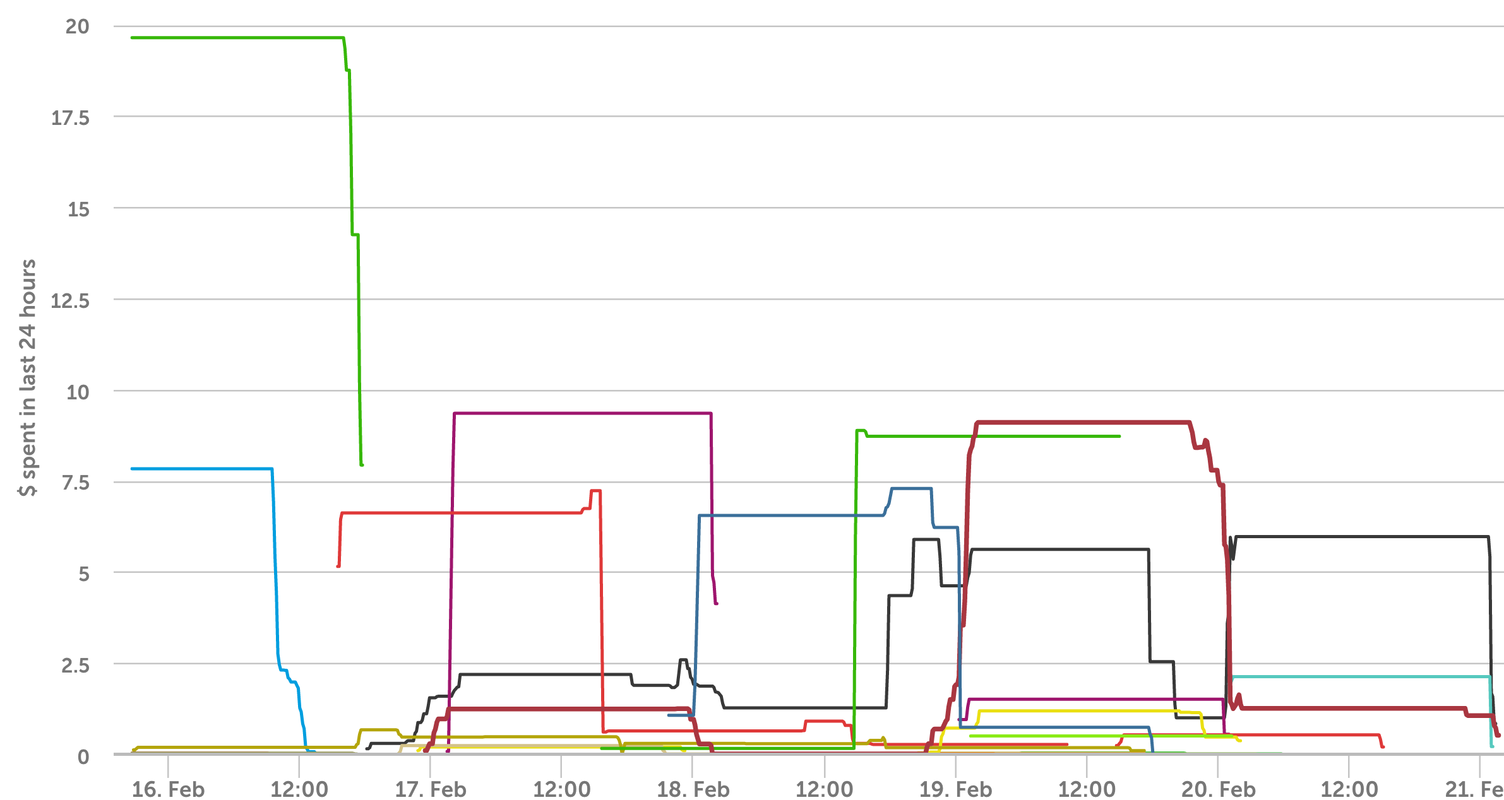

Slide 34
Cost
Store: $0.02/GB/mo.
(100TB = $2,048/mo.)
Query: $5.00/TB
Streaming inserts: $0.01/200MB
Batch inserts: $0

Slide 35
When not to use BQ
…if all you want is the absolute fastest query performance…it might not be for you
…if you can pre-aggregate everything
…if you can fit it into an RDBMS or KV store

Slide 36
When to use BigQuery
However, if you want to empower anyone in your organization to dig into the data, it may be worth it
You can always mix and match BQ (data exploration/debugging) with another backend solution (snappy charts)

Slide 37
Evolution of data access @ Cedexis
Shell scripts
Hadoop jobs
Spark SQL
BigQuery
Slow, difficult, few users
Fast, easy, many users

Slide 38
BigQuery - conclusion
BigQuery = good

Slide 39
Spark

Slide 40
Spark
Distributed processing framework on the JVM
Like Hadoop, but not
Execute arbitrary code in distributed fashion
Horizontally scalable

Slide 41
Spark Streaming
Runs in batches
24/7
ETLs logs into BigQuery
Reuse code between raw logs and aggregates

Slide 42
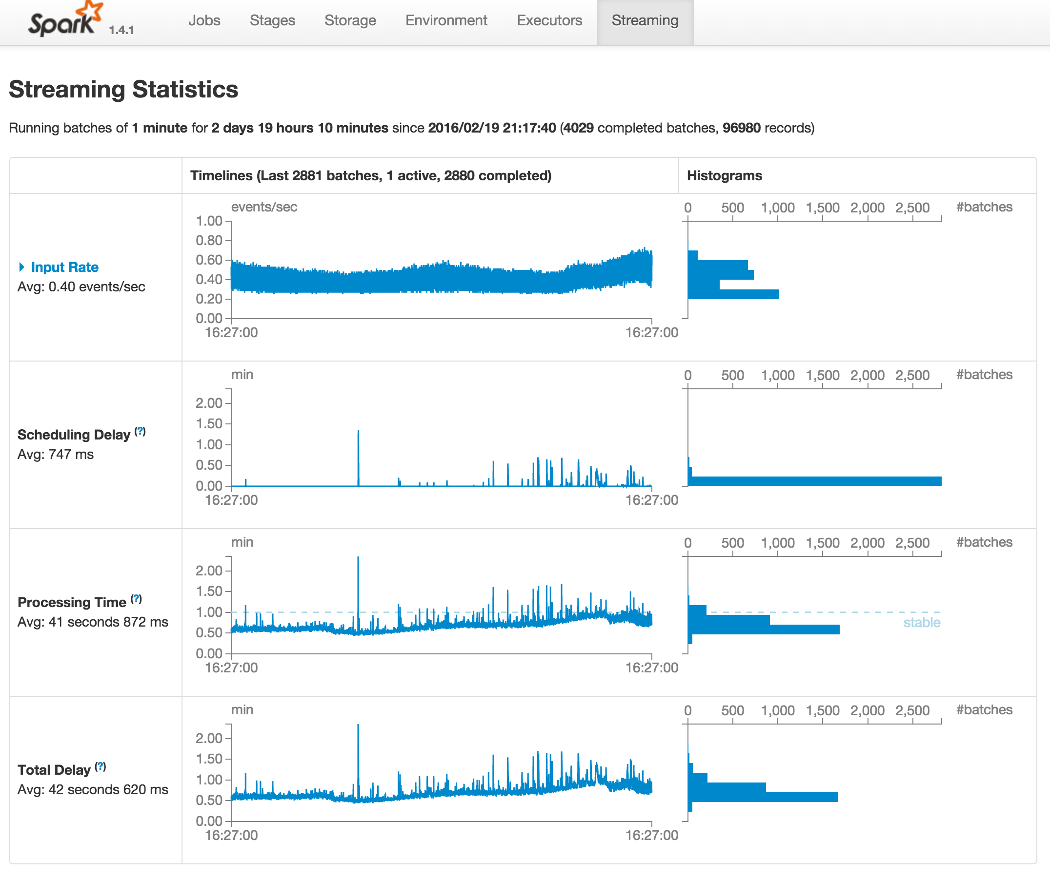

Slide 43
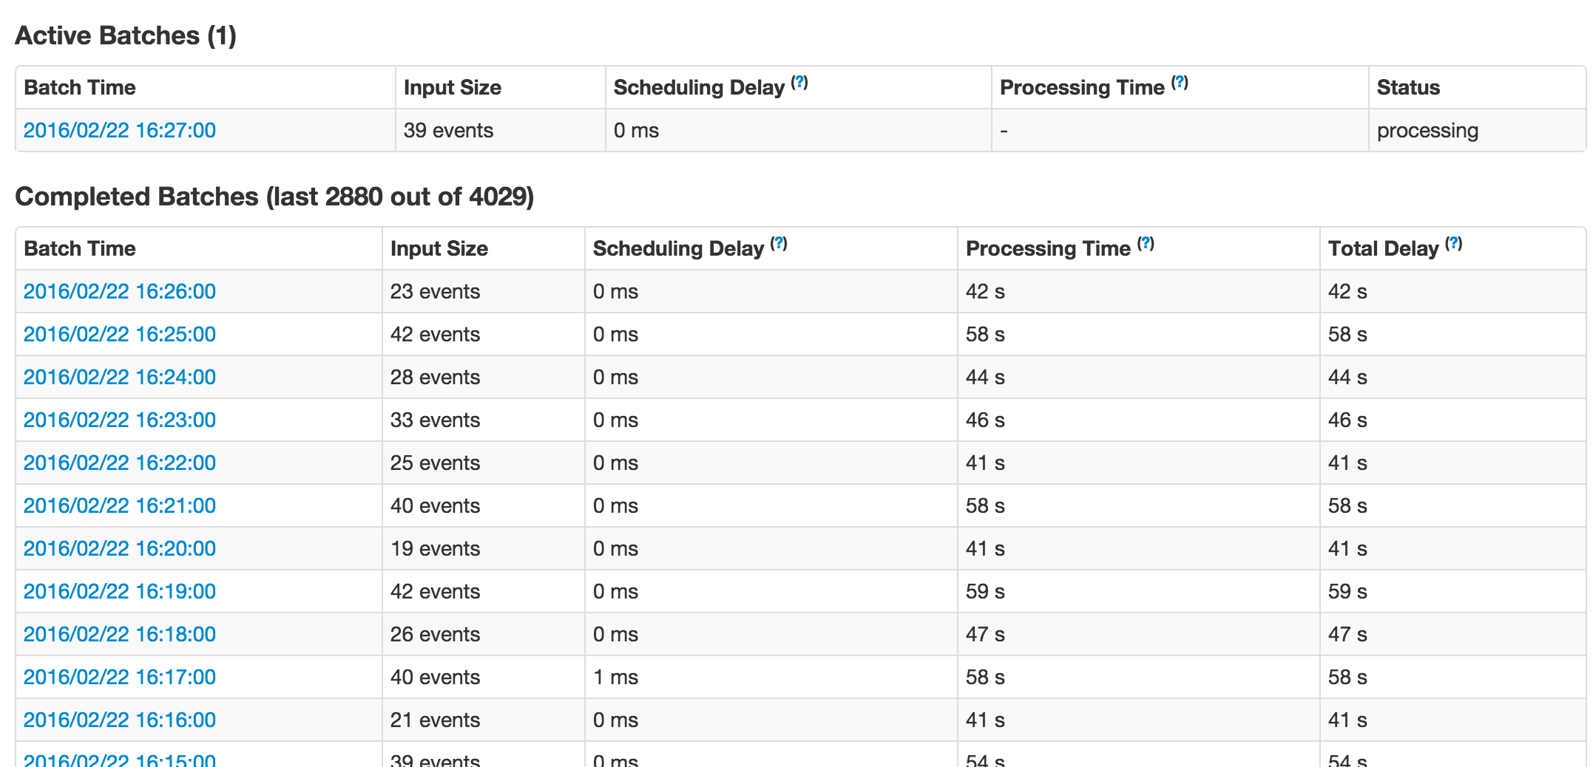

Slide 44
Data flow
Logs -> S3 -> SQS -> Spark Streaming -> BigQuery
Happens once per minute

Slide 45
Spark - conclusion
Spark = good

Slide 46
Q/A

