Slide 1

Task 1 – Exploratory Data Analysis
Prepared by Jonathan Chia
17 February 2021

Slide 2
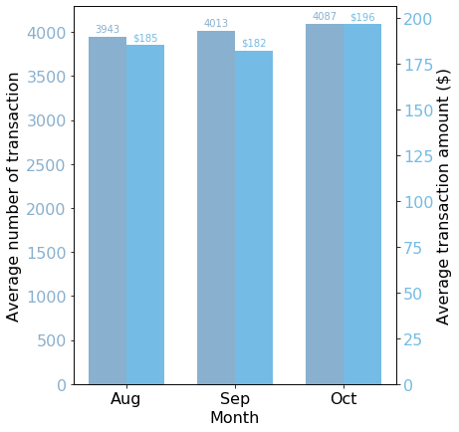
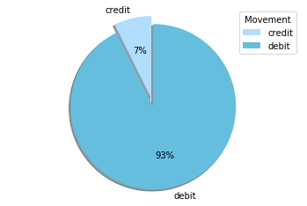
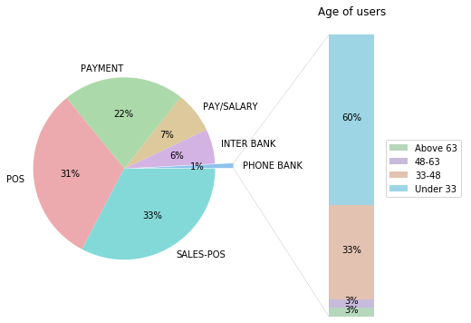
Transaction Insights
Average transaction
number and amount
Movement type
Transaction Type
$1898.73
Average Credit Amount
$52.57
Average Debit Amount
Almost 93% of transactions are debit transactions. This makes sense as the average debit transaction amount is only $52.57 while the average credit transaction amount is much higher at $1898.73.
12,043
Total Transactions
$187.93
Average Transaction Amount
ANZ should terminate phone bank operations as only 1% of its customer uses it. Moreover, almost 60% of this customer group are below the age of 33. They will be able to adapt to other type of services quickly.

Slide 3
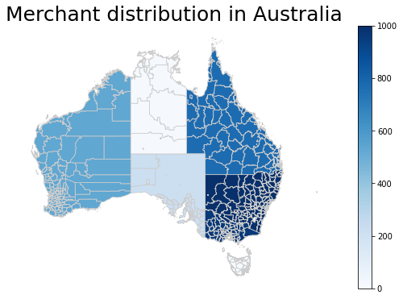
Merchant Demographics
2,703
Total Unique Merchants
The merchant density is higher in states such as New South Wales and Victoria as the number of merchant is high despite being smaller than other larger states such as Western Australia and Queensland.
It is surprising to see how little merchants are distributed in the Northern Territory.
ANZ should try to gain more customers in the Northern Territory and South Australia as these state are fairly large and could possibly have a large number of customer.

