Slide 1
Connect Bot

Slide 2
What does an algorithm need to play a game?

Slide 3
What does an algorithm need to play a game?
A data structure to represent game states

Slide 4
What does an algorithm need to play a game?
A data structure to represent game states
A function to discover possible moves for a given player

Slide 5
What does an algorithm need to play a game?
A data structure to represent game states
A function to discover possible moves for a given player
A function to transform the game state into a new one given a move

Slide 6
What does an algorithm need to play a game?
A data structure to represent game states
A function to discover possible moves for a given player
A function to transform the game state into a new one given a move
A function to determine if a game state is won by a player, drawn or still playing

Slide 7
What does it look like for an algorithm to play?
A game state data structure can be a node in a tree

Slide 8
What does it look like for an algorithm to play?
A game state data structure can be a node in a tree
Each possible move can be a branch to new nodes or game states

Slide 9
What does it look like for an algorithm to play?
A game state data structure can be a node in a tree
Each possible move can be a branch to new nodes or game states
Expand the tree and then drill down to find a winning move

Slide 10
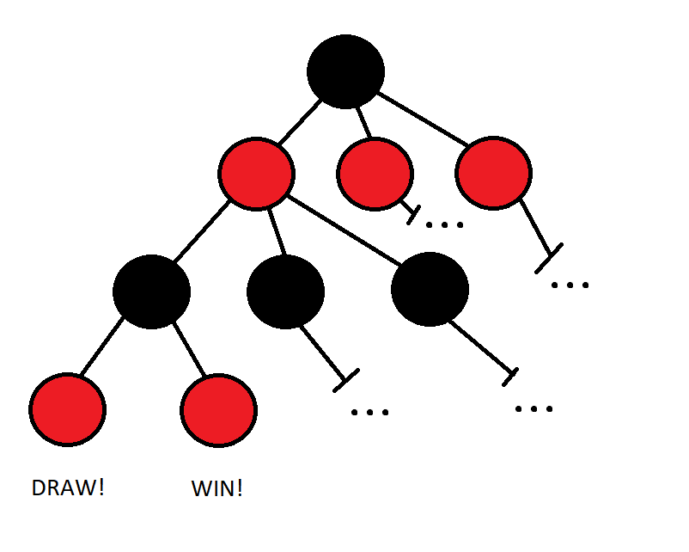
Visual Representation of Game Tree

Slide 11
But we can’t fill out the entire tree
In total there are more than 4.5 trillion possible positions!

Slide 12
But we can’t fill out the entire tree
In total there are more than 4.5 trillion possible positions!
What’s an algorithm to do?

Slide 13
But we can’t fill out the entire tree
In total there are more than 4.5 trillion possible positions!
What’s an algorithm to do?
We’ll use a heuristic function and stop searching before hitting the bottom

Slide 14
Heuristic Function
“A heuristic function, also called simply a heuristic, is a function that ranks alternatives in search algorithms at each branching step based on available information to decide which branch to follow. For example, it may approximate the exact solution.” - Judea Pearl

Slide 15
Scoring our Heuristic
Positions favorable to Black (first player) will be positive
Positions favorable to Red (second player) will be negative

Slide 16
Scoring our Heuristic
Positions favorable to Black (first player) will be positive
Positions favorable to Red (second player) will be negative
More points for more promising positional aspects
Two discs together with open sides
Three discs together
A disc with lots of potential scoring participations

Slide 17
Scoring our Heuristic
Positions favorable to Black (first player) will be positive
Positions favorable to Red (second player) will be negative
More points for more promising positional aspects
Two discs together with open sides
Three discs together
A disc with lots of potential scoring participations
Search to a given depth and then return heuristic value if we didn’t find an end state

Slide 18
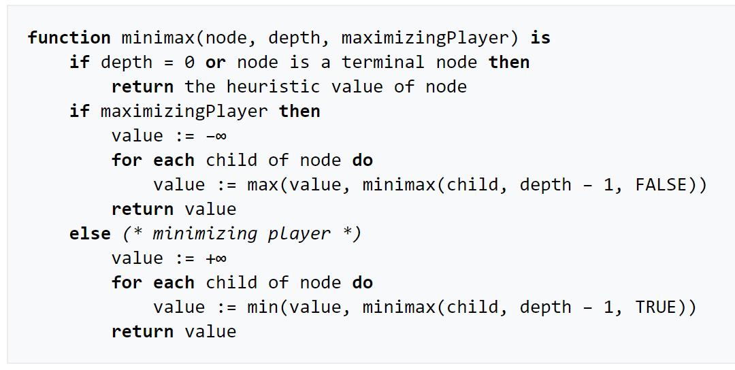
We’re going to use the MinMax Algorithm

Slide 19
Alpha-Beta Pruning
“It stops evaluating a move when at least one possibility has been found that proves the move to be worse than a previously examined move. Such moves need not be evaluated further. When applied to a standard minimax tree, it returns the same move as minimax would, but prunes away branches that cannot possibly influence the final decision.” – Peter Norvig

Slide 20
Alpha-Beta Pruning
“It stops evaluating a move when at least one possibility has been found that proves the move to be worse than a previously examined move. Such moves need not be evaluated further. When applied to a standard minimax tree, it returns the same move as minimax would, but prunes away branches that cannot possibly influence the final decision.” – Peter Norvig
While searching save the min and max players best moves along that path to leave early if we have already found a better move

Slide 21
Let’s try it out!

Slide 22
Citations
https://oeis.org/A212693
https://en.wikipedia.org/wiki/Connect_Four
https://en.wikipedia.org/wiki/Heuristic_(computer_science)
https://en.wikipedia.org/wiki/Minimax
https://en.wikipedia.org/wiki/Alpha%E2%80%93beta_pruning
Russell, S. J., Davis, E., & Norvig, P. (2015). Artificial intelligence: A modern approach.

