Slide 1

BEACHCAR / BUILD WEEK
01
REAL-WORLD OUTCOME
It found
the one.
Beachcar surfaced a 1960 Willys DJ-3A Surrey.
Its user bought it.
FOUND BY BEACHCAR • BOUGHT BY ITS USER
Not a hypothetical recommendation.

Slide 2
BEACHCAR / BUILD WEEK
02
THE PROBLEM
Filters match specs.
Taste is harder.
The car you love is usually hiding between the checkboxes.
WHAT FILTERS SEE
WHAT BEACHCAR LEARNS
1970–1995
4×4
UNDER $40K
open-air charm
tiny footprint
memorable color
Specifications narrow the market. Taste explains the choice.

Slide 3
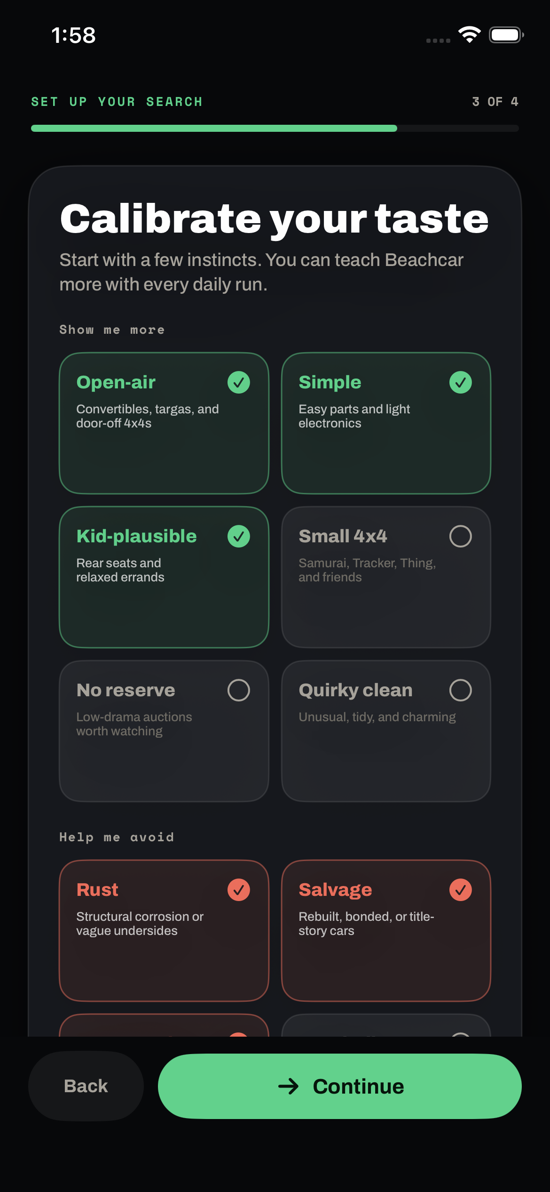
BEACHCAR / BUILD WEEK
03
TEACH IT ONCE
Two minutes turns
instinct into memory.
Start with feelings, not makes and models. Beachcar saves the result as a durable research brief.
OPEN-AIR
SIMPLE
KID-PLAUSIBLE
AVOID
rust • salvage • anonymous luxury

Slide 4
BEACHCAR / BUILD WEEK
04
LOCAL, AUTHENTICATED RESEARCH
Your Codex does the legwork.
The user keeps the login. Beachcar keeps the memory.
01
02
03
04
Local Codex
→
Signed-in browser
→
Beachcar MCP
→
iPhone
GPT-5.6 plans + judges
User logs in; Codex reads
Memory in; shortlist out
Private review + feedback
$0
Research runs on the user’s machine—with their access, judgment, and schedule.
BEACHCAR AI COST

Slide 5
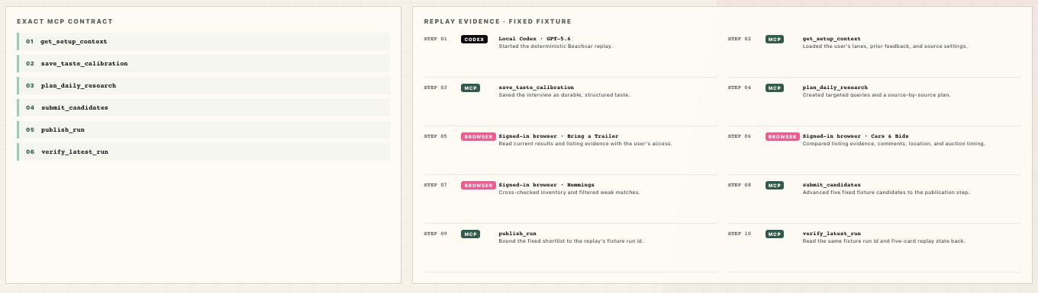
BEACHCAR / BUILD WEEK
05
DETERMINISTIC REPLAY
One fixture binds the replay state.
RUN ID
5
$0 BEACHCAR AI
demo_replay_surrey_path
FIXTURE CANDIDATES
load fixture → replay tools → materialize state → verify fixture

Slide 6
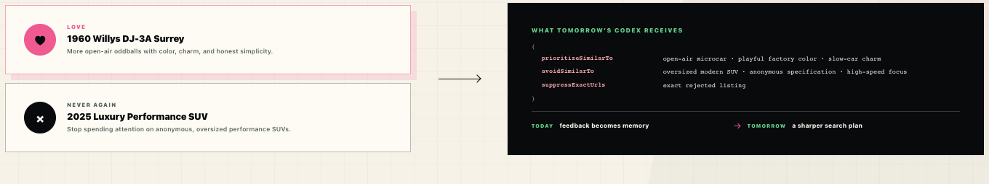
BEACHCAR / BUILD WEEK
06
TOMORROW GETS BETTER
Every reaction changes tomorrow.
Love it. Or: never again. Beachcar turns both into explicit memory—not hidden vibes.
TODAY
feedback becomes memory
→
TOMORROW
a sharper research plan

Slide 7
BEACHCAR
Your Codex.
Your taste.
The one.
A private auction scout that learns what only you would choose.
OPENAI BUILD WEEK
APPS FOR YOUR LIFE
FOUND • VERIFIED • LEARNED
BEACHCAR

