Slide 1
BEACHCAR
Your Codex.
Your taste.
Your car.
What if you know the feeling—but not the make or model?
OPENAI BUILD WEEK
APPS FOR YOUR LIFE
START WITH THE FEELING
BEACHCAR

Slide 2
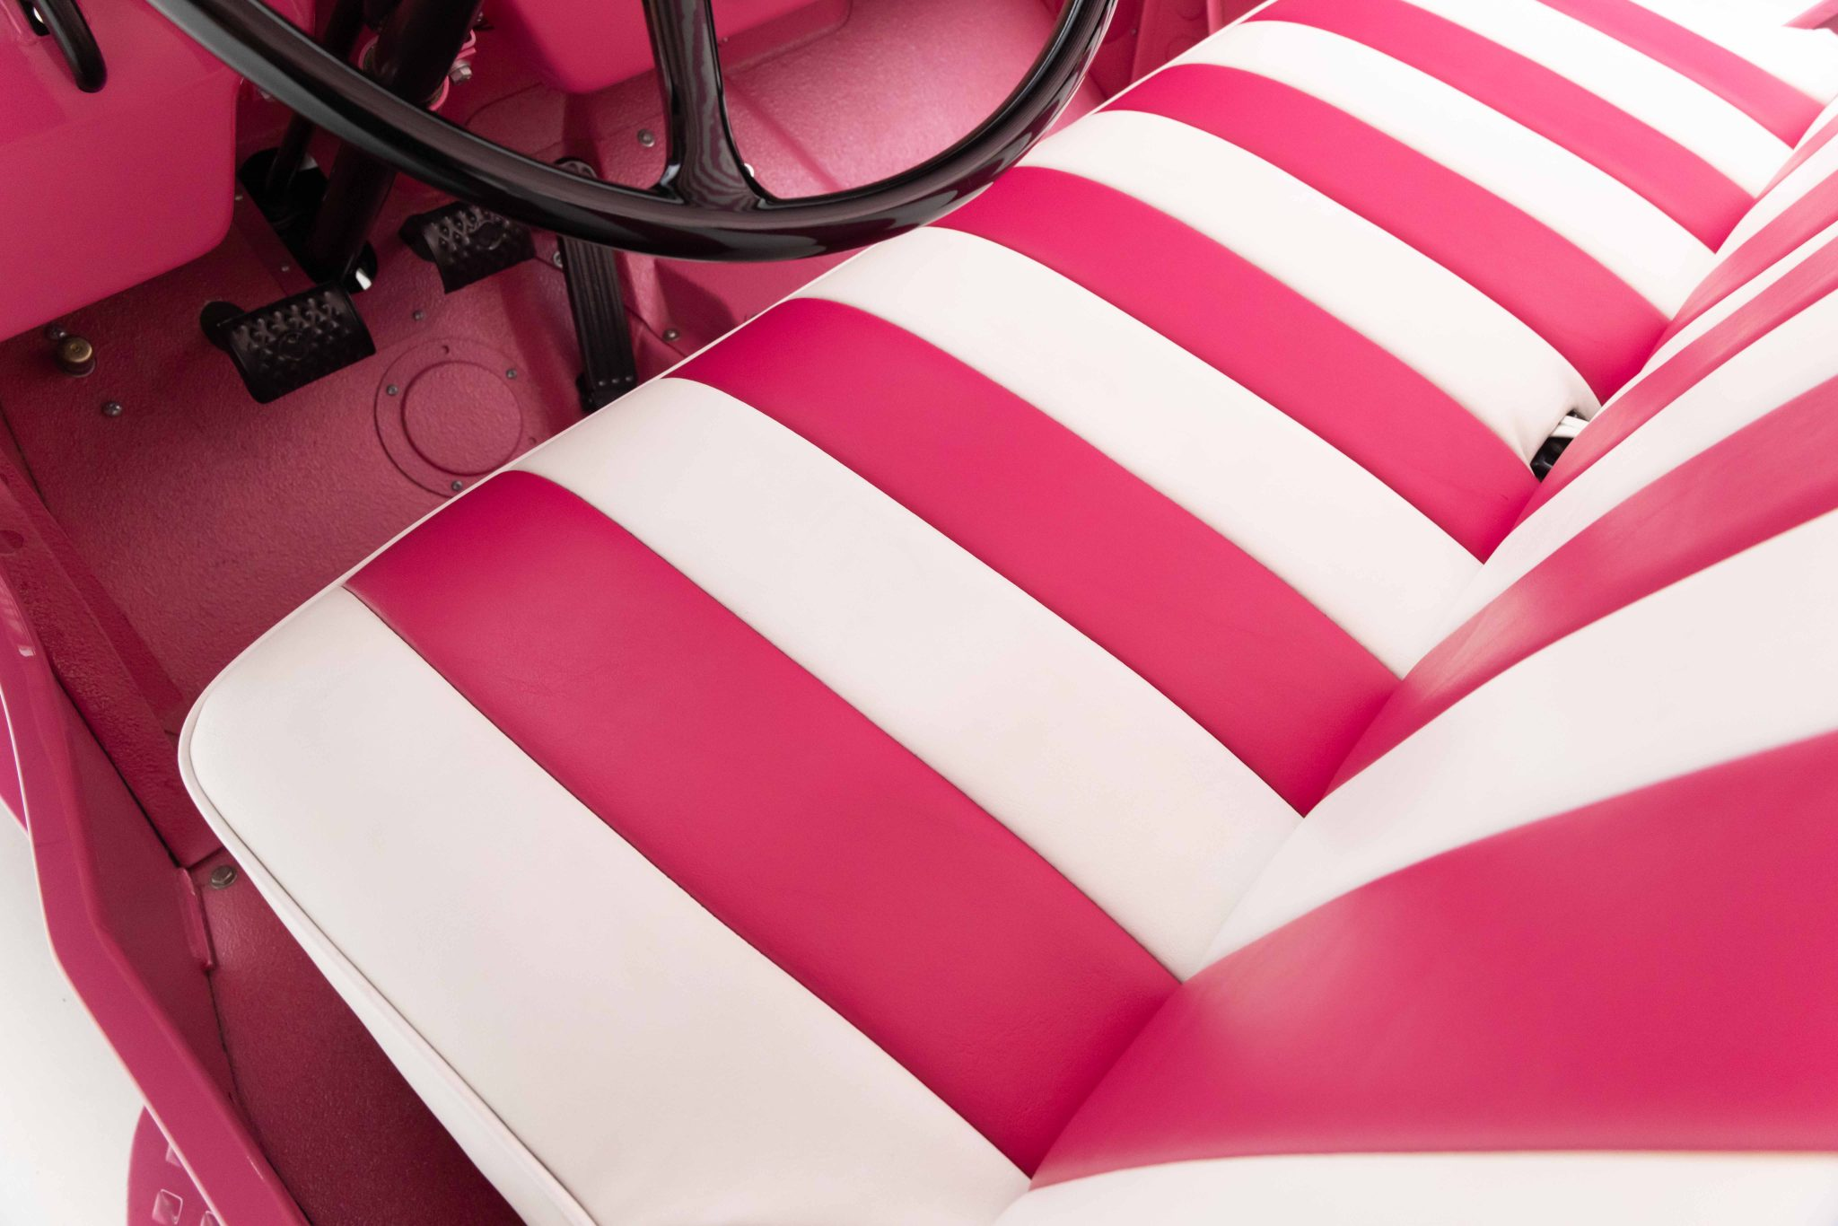
BEACHCAR / BUILD WEEK
02
THE REAL NEED
Two-mile
summers.
In our tiny beach town, summer means one- or two-mile kid runs—to camp, friends, the beach, ice cream.
QUIRKY • KID-PLAUSIBLE • BEACH-DAY READY
I couldn't name it—or search for it.

Slide 3
BEACHCAR / BUILD WEEK
03
START WITH THE FEELING
I knew the feeling.
Not the make or model.
Most sites make you name the answer before they help you search.
WHAT FILTERS ASK
WHAT BEACHCAR LEARNS
YEAR
MAKE + MODEL
PRICE
open-air charm
kid-plausible
weird in the right way
Start with taste. Use specifications to narrow the hunt.

Slide 4
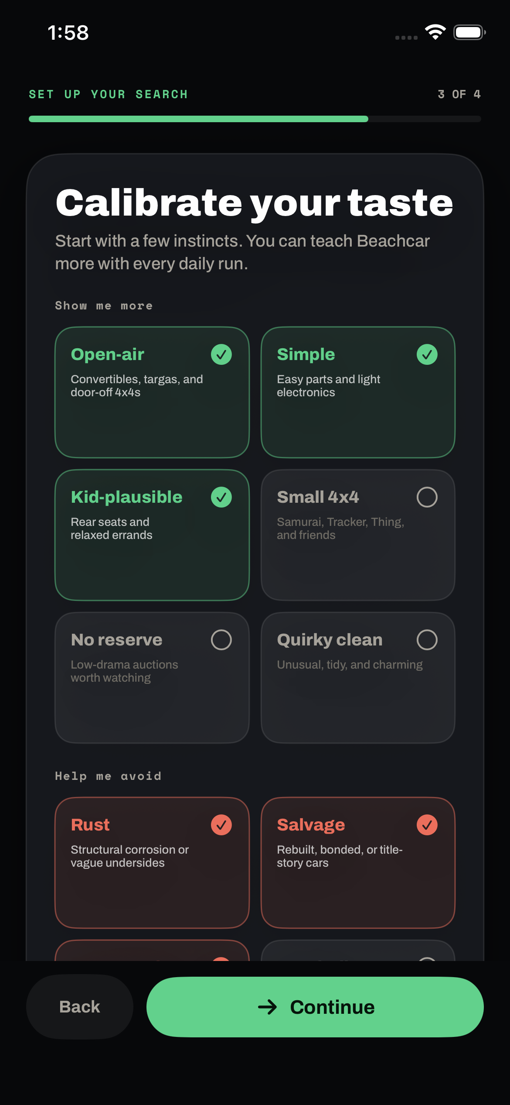
BEACHCAR / BUILD WEEK
04
TEACH IT ONCE
A few minutes turn
instinct into memory.
Start with feelings, not makes and models. Beachcar saves a durable brief that your Codex can use again.
OPEN-AIR
SIMPLE
KID-PLAUSIBLE
AVOID
rust • salvage • precious

Slide 5
BEACHCAR / BUILD WEEK
05
LOCAL, AUTHENTICATED RESEARCH
Your Codex goes hunting.
Signed-in browser for access. Beachcar MCP for memory.
01
02
03
04
Local Codex
→
Signed-in browser
→
Beachcar MCP
→
iPhone
GPT-5.6 plans + evaluates
User logs in; Codex reads
Taste in; shortlist out
Private review + feedback
USER
Model use belongs to the user's Codex plan. Research runs on their computer, with their login and schedule.
CODEX PLAN + COMPUTER

Slide 6
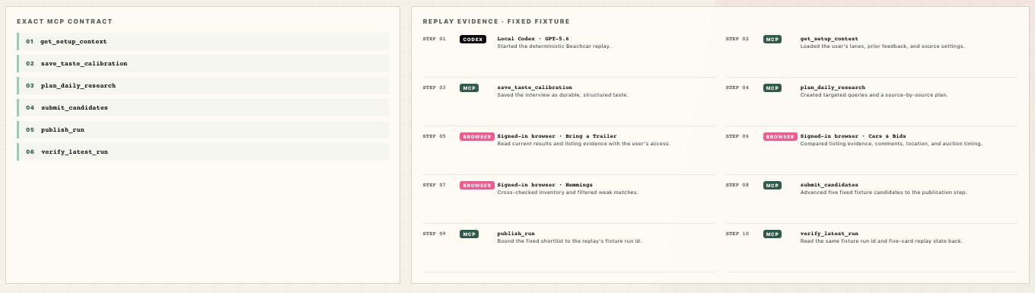
BEACHCAR / BUILD WEEK
06
TESTED REPLAY CONTRACT
One fixture tests the Beachcar contract.
FIXTURE ID
1
REPLAY ONLY
demo_replay_surrey_path
DETERMINISTIC FIXTURE
load fixture → replay tools → materialize fixture state → verify fixture

Slide 7
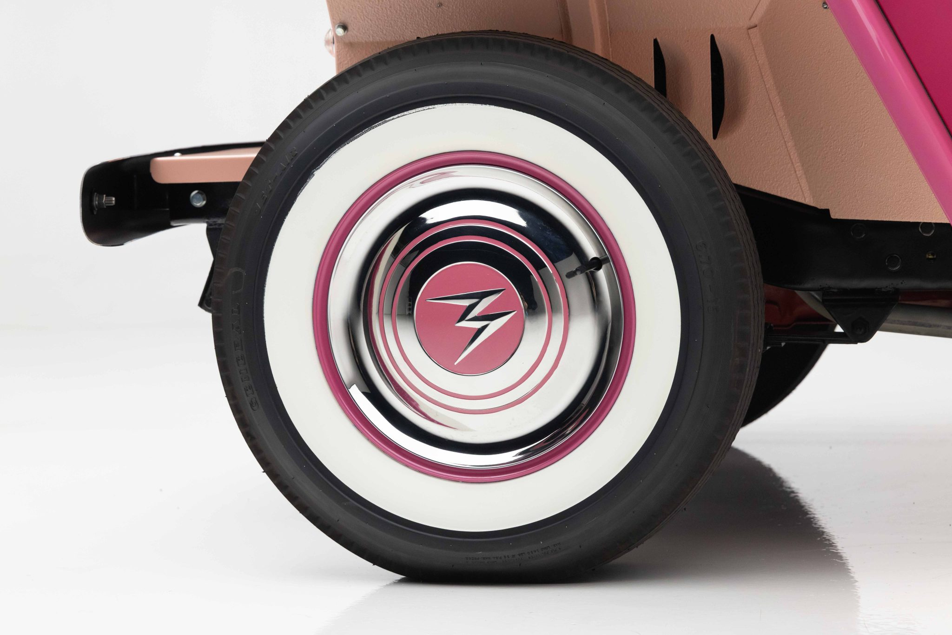
BEACHCAR / BUILD WEEK
07
TASTE, REFINED
More beach.
Less car show.
For two weeks, every reaction sharpened the hunt: more charm, less precious.
LOVE IT • NEVER AGAIN • TRY AGAIN
Then something impossible appeared.

Slide 8
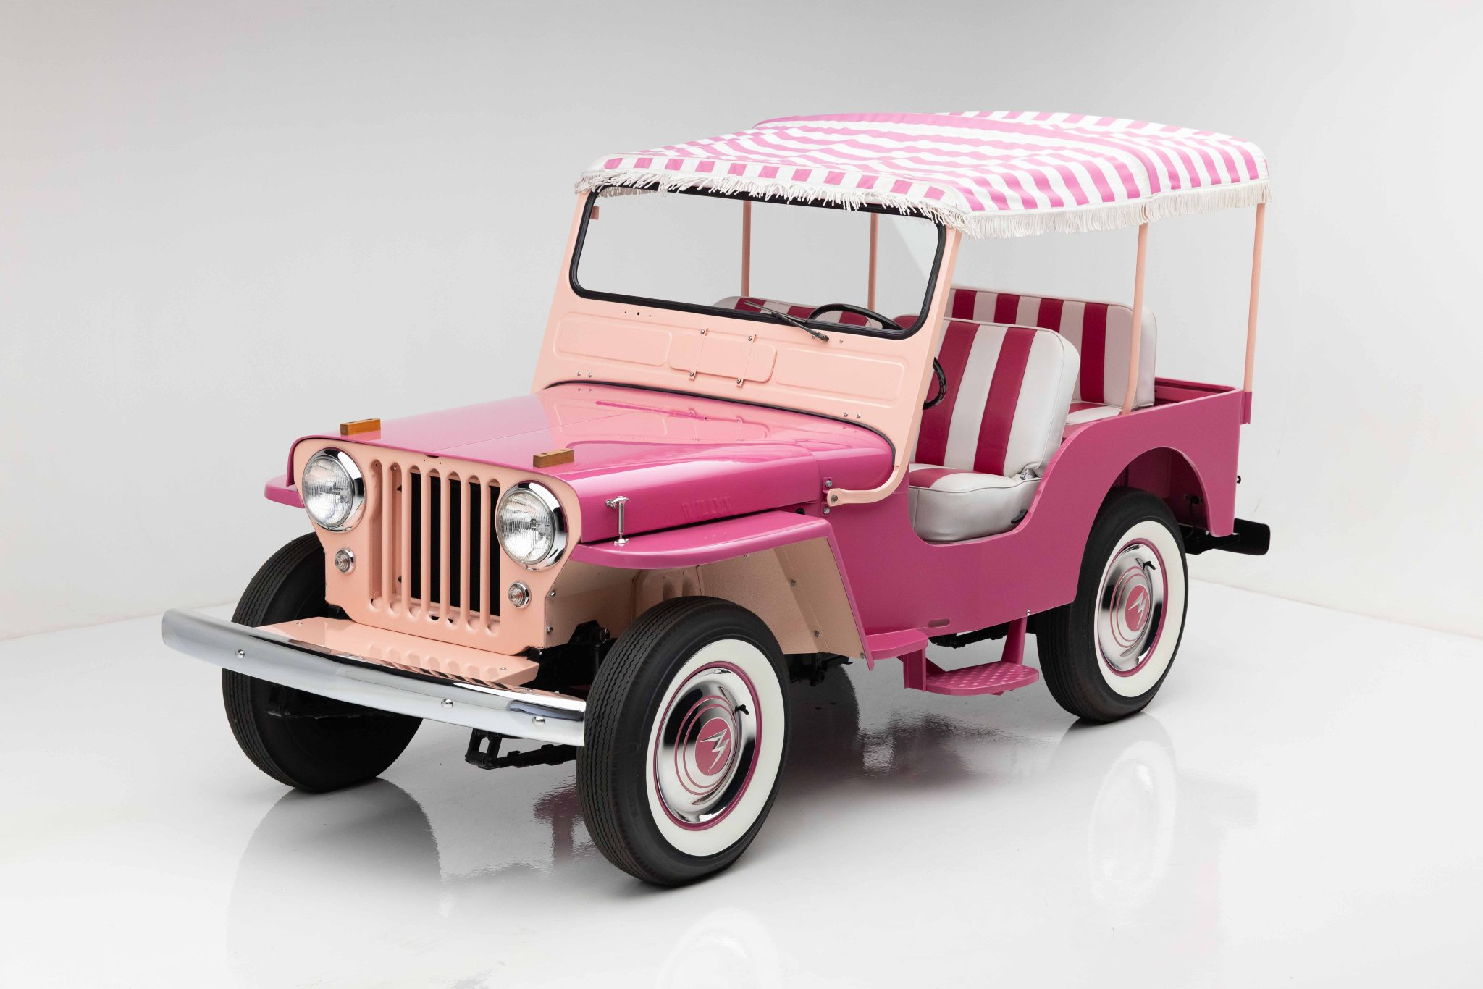
BEACHCAR / BUILD WEEK
08
THE REAL OUTCOME
I BOUGHT
IT.
A 1960 Willys Surrey—part Jeep, part golf cart, part beach umbrella. This is actually my car now.
FOUND BY BEACHCAR • BOUGHT BY ME
Purchase predates Build Week. Productization does not.

Slide 9
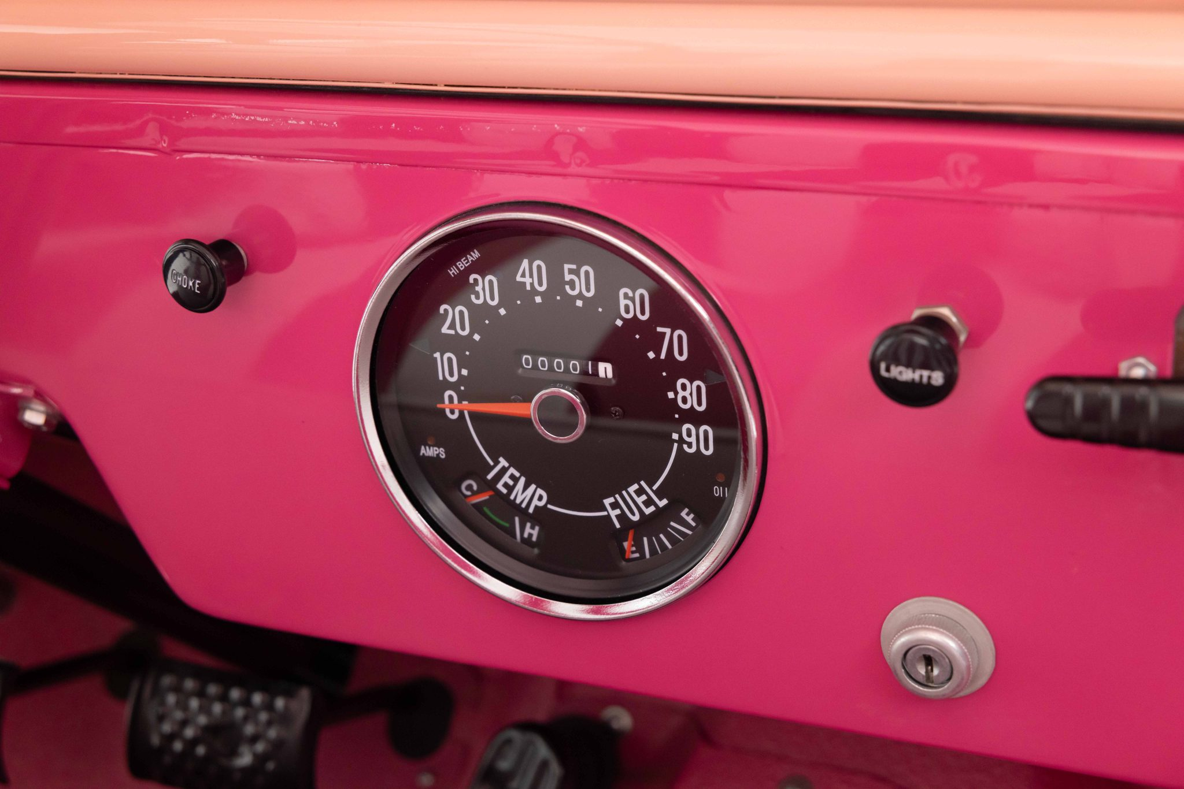
BEACHCAR / BUILD WEEK
09
THE SHARED UPSIDE
Your Codex can improve Beachcar too.
Opt in to a weekly Garage Session. You review every change before anything is shared.
OPT IN
one weekly Garage Session
→
YOU REVIEW
before any issue or PR

Slide 10
BEACHCAR
Your Codex.
Your taste.
Your car.
I built it to find one weird little car. Now your Codex can go looking for yours.
OPENAI BUILD WEEK
APPS FOR YOUR LIFE
REAL TASTE • REAL WEB • REAL RESULT
BEACHCAR

